Slide 1











Link 1
Link 0
lane group 1
:
1
lane group 2
:
2
Link 2
lane groups 3
:

Slide 3
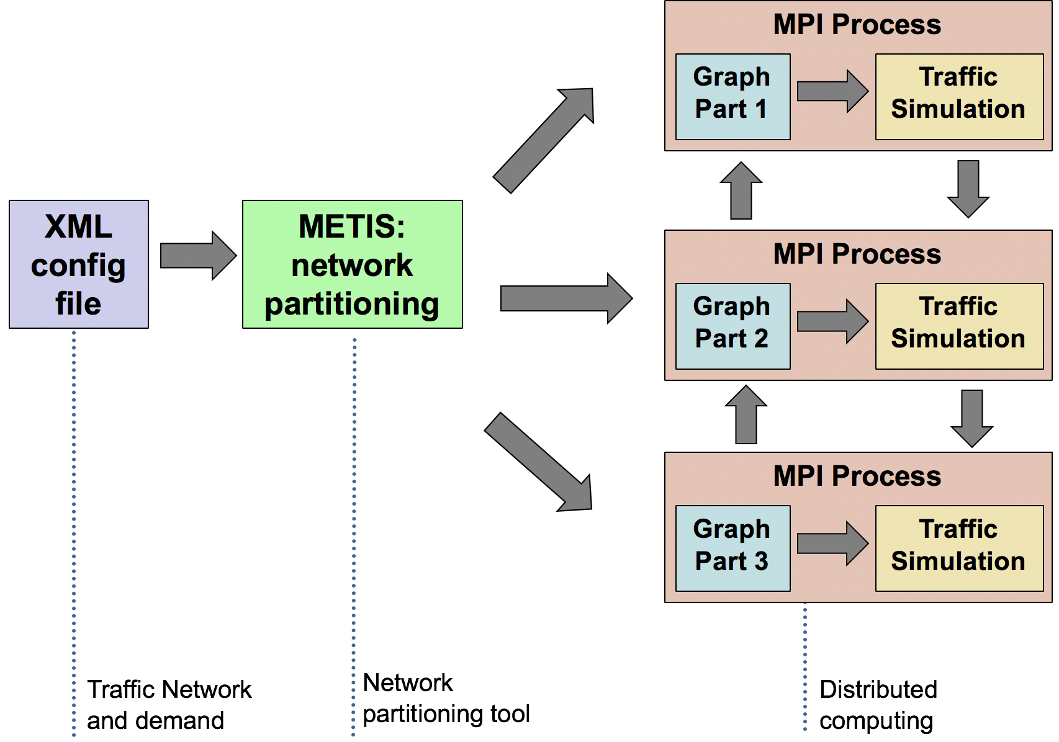
Parallelization Strategy: Network Partitioning

Slide 4
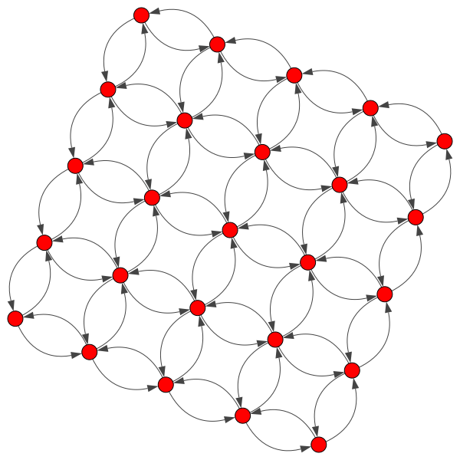
Results: Parallel simulation attains considerable speed up
Run on a synthetic grid-like network with 62500 nodes, 170000 Links, and 12500 origin-destination pairs.
Parallel simulation on 1024 cores:
475 speed up compared to serial simulation
Time reduction from 8245 seconds to 17 seconds

Slide 5
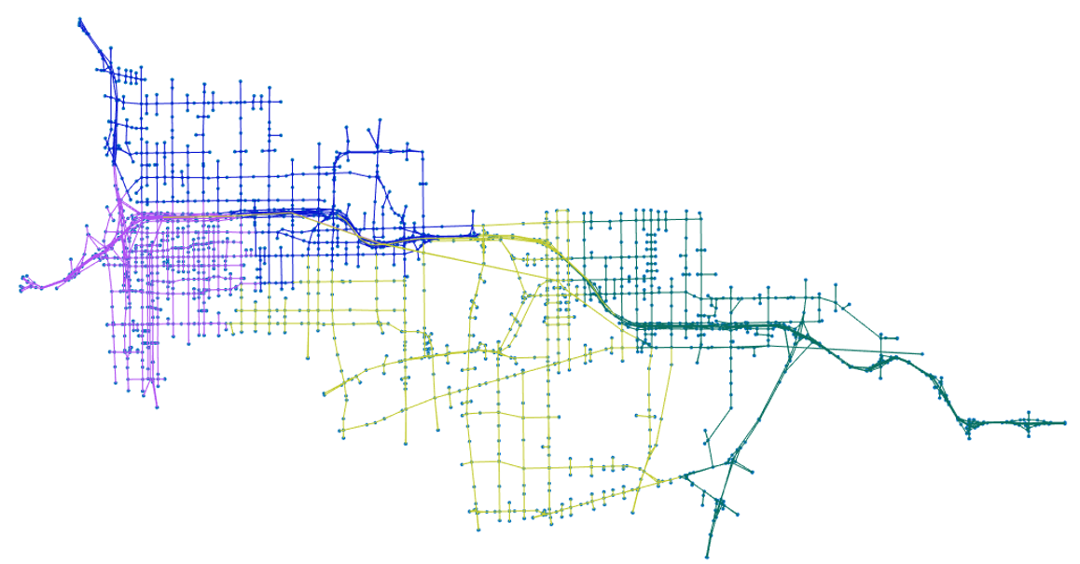
M1
M4
M2
M3
M1
M4
M2
M3

