Slide 1
Coupledline Compiled Data

Slide 2
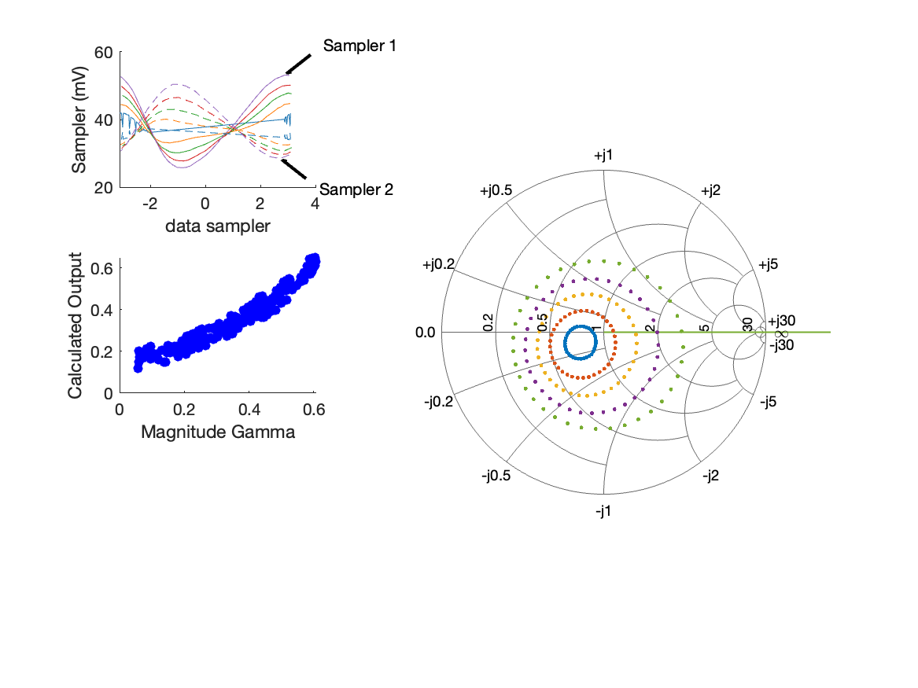
Coupled Line Performance At 10.40 GHz, 16.000000 dBm Output Power 1.70 V mean sampler bias
Sampler Av
  Sampler 1: 37.231
  Sampler 2: 37.231
Sampler Offset (rather than -1)
  -3.1788284378201692
Goodness Of fit
  0.12166907202065433
Sampler 1 Range
  0.027417510100000004
Sampler 2 Range
  0.0218747223
DUT output dBm Mean
  16.114601790934213
DUT input dBm Mean
  4.332699205150254
RMS Error
  0.045621461802833829
Max Error
  0.084723703189411748

Slide 3
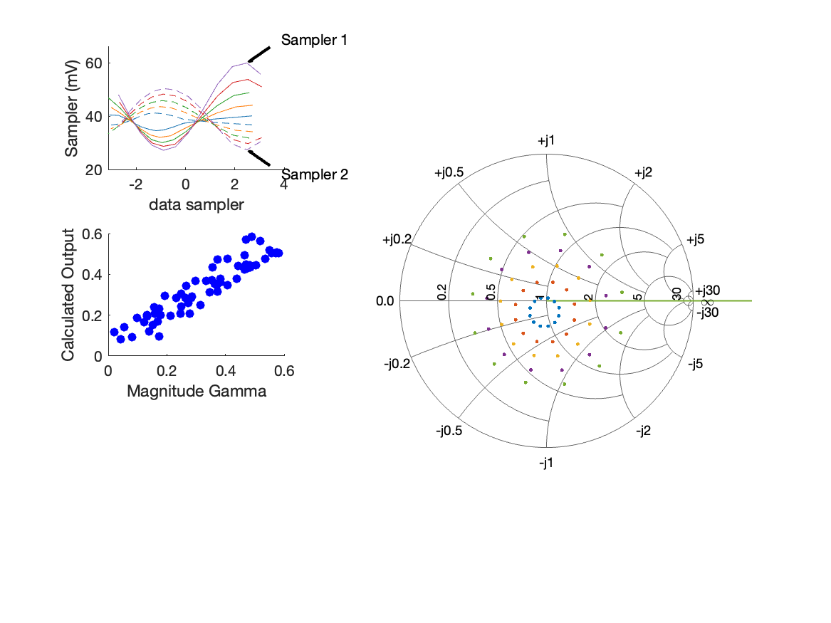
Coupled Line Performance At 10.70 GHz, 16.000000 dBm Output Power 1.70 V mean sampler bias
Sampler Av
  Sampler 1: 31.670
  Sampler 2: 31.670
Sampler Offset (rather than -1)
  -3.0357092819182823
Goodness Of fit
  0.098059182482942708
Sampler 1 Range
  0.032770451300000003
Sampler 2 Range
  0.022969365299999999
DUT output dBm Mean
  16.666860184490751
DUT input dBm Mean
  5.1823639109238213
RMS Error
  0.055514560496422602
Max Error
  0.079508735041993878

Slide 4
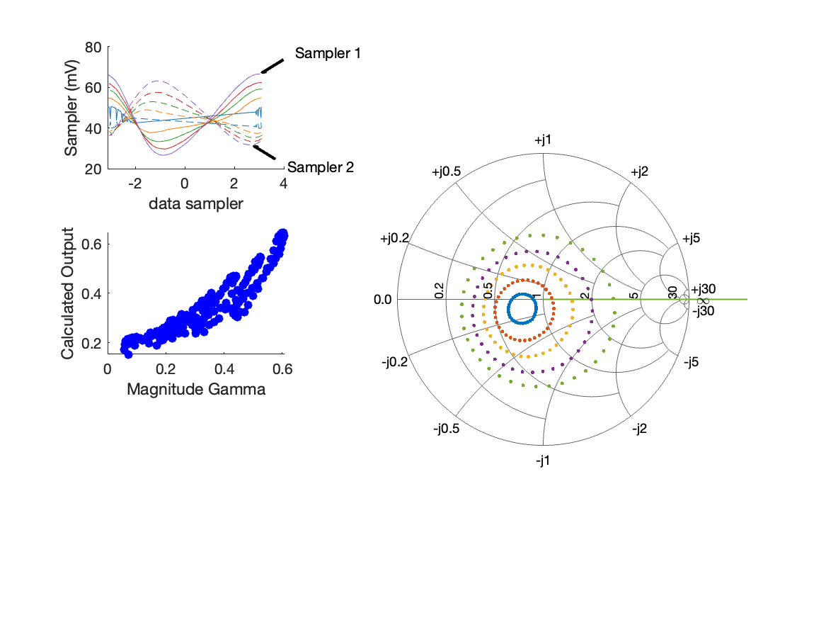
Coupled Line Performance At 10.40 GHz, 18.000000 dBm Output Power 1.70 V mean sampler bias
Sampler Av
  Sampler 1: 23.584
  Sampler 2: 23.584
Sampler Offset (rather than -1)
  -2.3928734794920006
Goodness Of fit
  0.27473500064506962
Sampler 1 Range
  0.040079704699999996
Sampler 2 Range
  0.031522902899999997
DUT output dBm Mean
  18.017481518711993
DUT input dBm Mean
  6.2666640940391414
RMS Error
  0.063969776525187344
Max Error
  0.14503028164862153

Slide 5
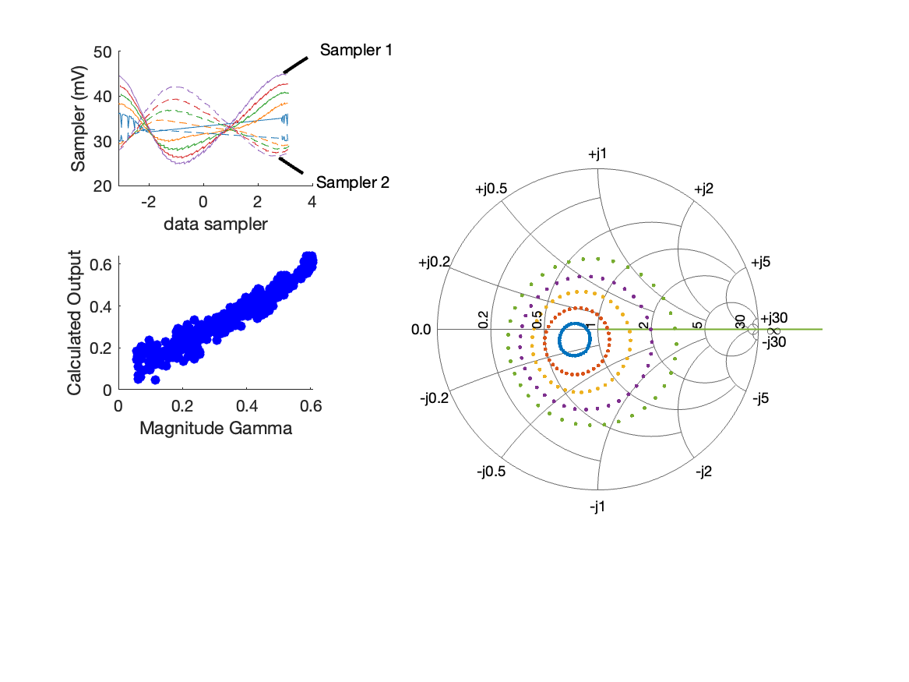
Coupled Line Performance At 10.40 GHz, 14.000000 dBm Output Power 1.77 V mean sampler bias
Sampler Av
  Sampler 1: 46.838
  Sampler 2: 46.838
Sampler Offset (rather than -1)
  -3.5531356580609259
Goodness Of fit
  0.22892641562124227
Sampler 1 Range
  0.020136884099999995
Sampler 2 Range
  0.015745912000000001
DUT output dBm Mean
  14.529609796489771
DUT input dBm Mean
  2.9089016773724761
RMS Error
  0.044177016263585292
Max Error
  0.093374293202553471

Slide 6
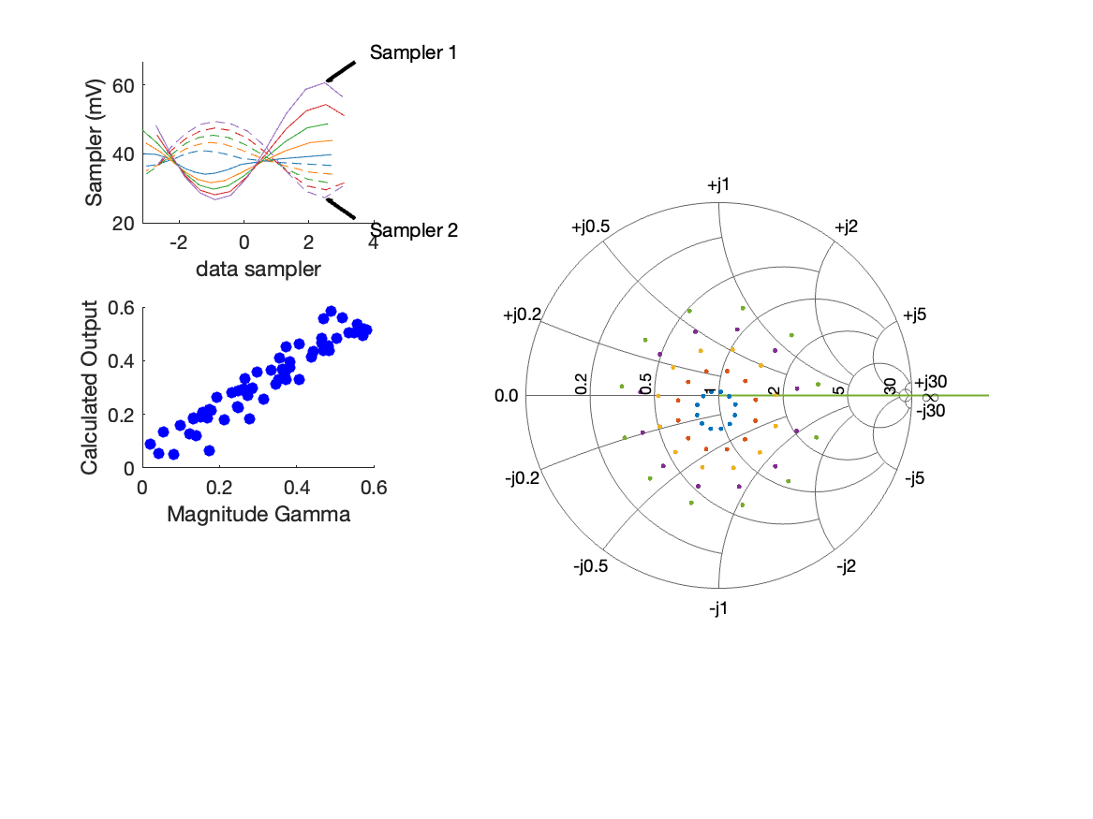
Coupled Line Performance At 10.70 GHz, 16.000000 dBm Output Power 1.80 V mean sampler bias
Sampler Av
  Sampler 1: 32.802
  Sampler 2: 32.802
Sampler Offset (rather than -1)
  -3.2308358327858318
Goodness Of fit
  0.070913582150695958
Sampler 1 Range
  0.034000380999999996
Sampler 2 Range
  0.0221460856
DUT output dBm Mean
  16.684218101157416
DUT input dBm Mean
  5.599995410923821
RMS Error
  0.049602722376044753
Max Error
  0.11057648873565054

Slide 7

Coupled Line Performance At 10.40 GHz, 14.000000 dBm Output Power 1.85 V mean sampler bias
Sampler Av
  Sampler 1: 41.745
  Sampler 2: 41.745
Sampler Offset (rather than -1)
  -3.2439945173441593
Goodness Of fit
  0.16504619273299637
Sampler 1 Range
  0.020744503600000002
Sampler 2 Range
  0.015378494700000002
DUT output dBm Mean
  14.649872457600878
DUT input dBm Mean
  3.4157580940391421
RMS Error
  0.049994673399330933
Max Error
  0.11034997514692524

Slide 8
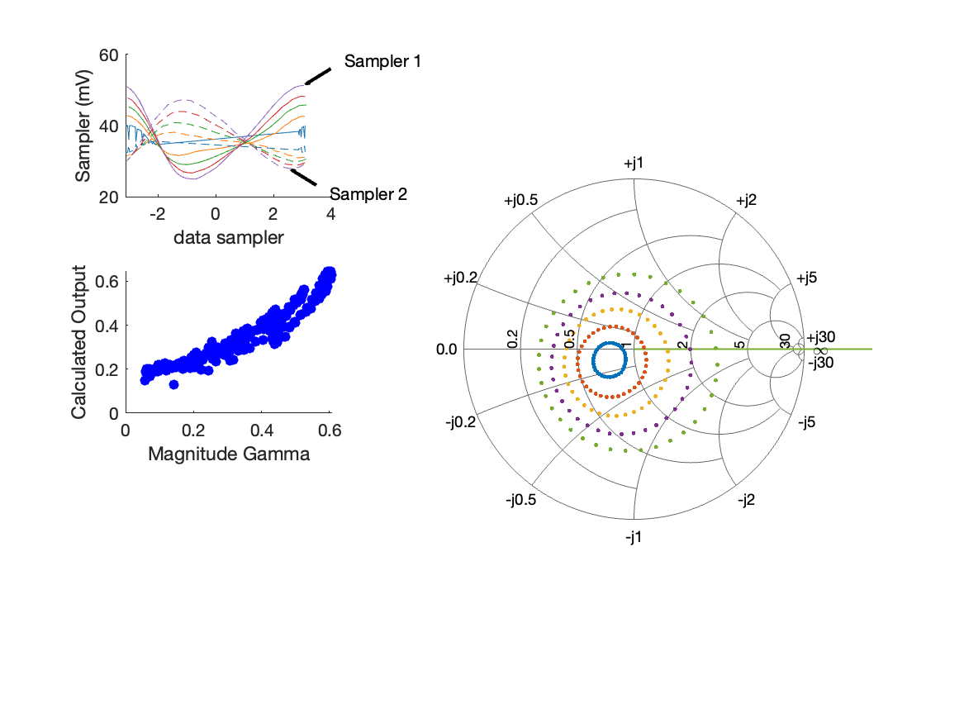
Coupled Line Performance At 10.40 GHz, 16.000000 dBm Output Power 1.85 V mean sampler bias
Sampler Av
  Sampler 1: 31.332
  Sampler 2: 31.332
Sampler Offset (rather than -1)
  -2.6533049355799472
Goodness Of fit
  0.21816855086265707
Sampler 1 Range
  0.0263670667
Sampler 2 Range
  0.019313220499999999
DUT output dBm Mean
  15.772175618711991
DUT input dBm Mean
  4.6558474273724757
RMS Error
  0.057381216563449168
Max Error
  0.12610904294383152

Slide 9
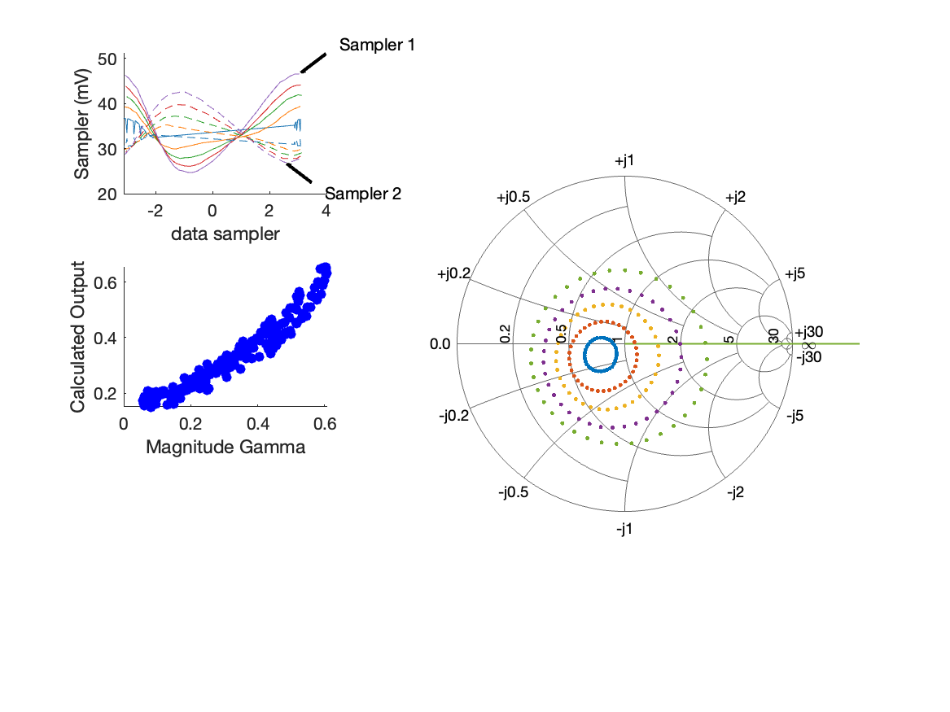
Coupled Line Performance At 10.40 GHz, 14.000000 dBm Output Power 1.90 V mean sampler bias
Sampler Av
  Sampler 1: 35.896
  Sampler 2: 35.896
Sampler Offset (rather than -1)
  -2.9094700410891789
Goodness Of fit
  0.15880688763425119
Sampler 1 Range
  0.021863913499999998
Sampler 2 Range
  0.015776935499999999
DUT output dBm Mean
  14.771196613156434
DUT input dBm Mean
  4.1084757051502541
RMS Error
  0.048338080601732385
Max Error
  0.097169983164696438

Slide 10
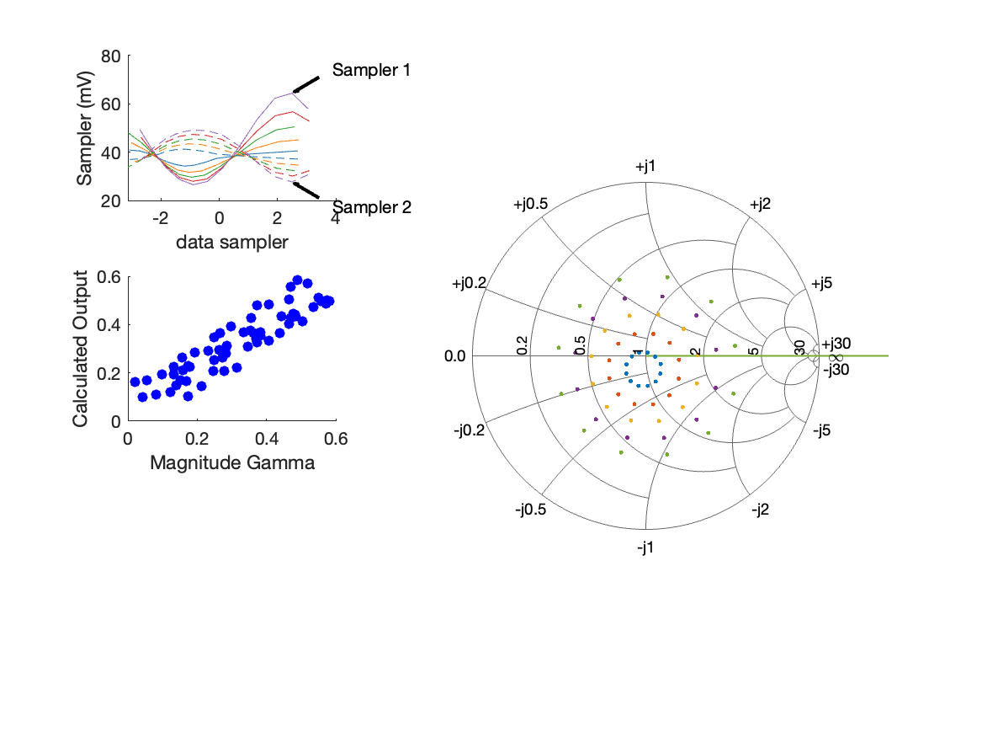
Coupled Line Performance At 10.70 GHz, 16.000000 dBm Output Power 2.00 V mean sampler bias
Sampler Av
  Sampler 1: 28.631
  Sampler 2: 28.631
Sampler Offset (rather than -1)
  -3.0906726450794464
Goodness Of fit
  0.12387708155638631
Sampler 1 Range
  0.037890231099999998
Sampler 2 Range
  0.021460514099999998
DUT output dBm Mean
  16.900318334490752
DUT input dBm Mean
  7.7327795775904882
RMS Error
  0.064963244685192351
Max Error
  0.090442606133943504

