Slide 1
Coupledline Compiled Data

Slide 2
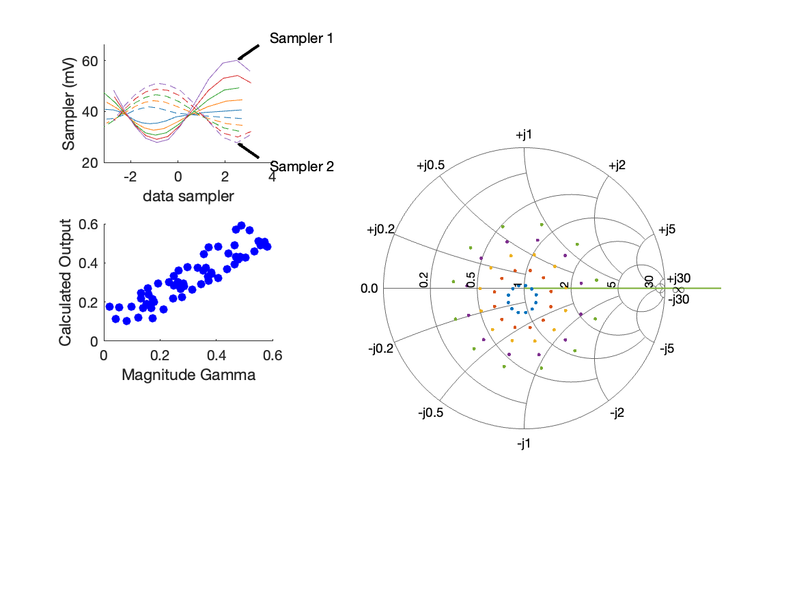
Coupled Line Performance At 10.70 GHz, 16.000000 dBm Output Power 1.60 V mean sampler bias
Sampler Av
  Sampler 1: 30.244
  Sampler 2: 30.244
Sampler Offset (rather than -1)
  -2.8982236290740651
Goodness Of fit
  0.13726480564411167
Sampler 1 Range
  0.0322563778
Sampler 2 Range
  0.023383050400000001
DUT output dBm Mean
  16.680004934490753
DUT input dBm Mean
  5.1249169109238206
RMS Error
  0.06775670072449283
Max Error
  0.096008164762975579

Slide 3
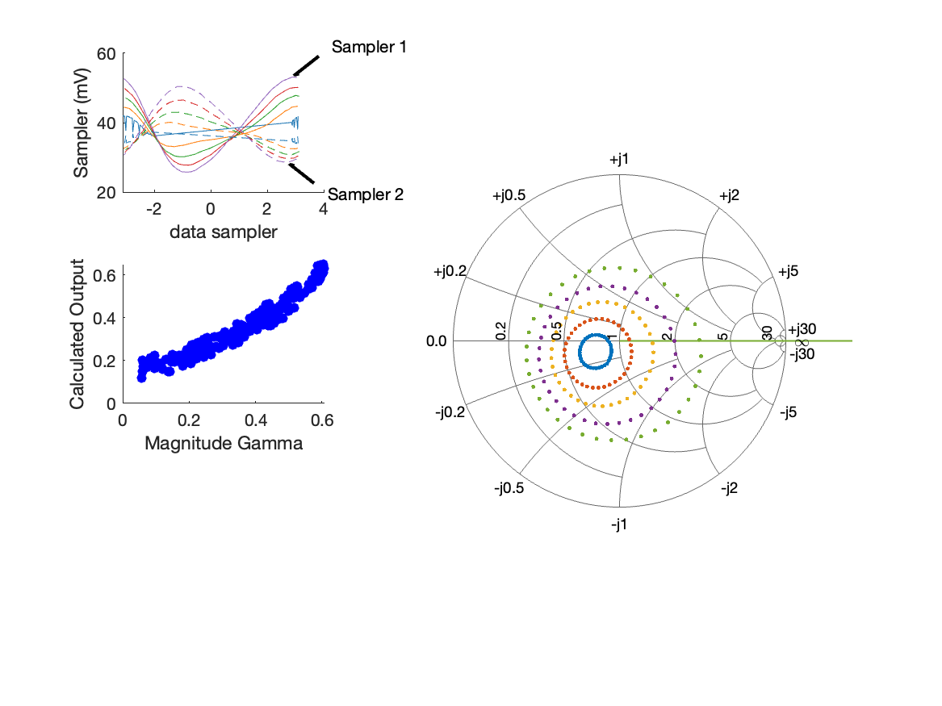
Coupled Line Performance At 10.40 GHz, 16.000000 dBm Output Power 1.70 V mean sampler bias
Sampler Av
  Sampler 1: 37.231
  Sampler 2: 37.231
Sampler Offset (rather than -1)
  -3.1788284378201692
Goodness Of fit
  0.12166907202065433
Sampler 1 Range
  0.027417510100000004
Sampler 2 Range
  0.0218747223
DUT output dBm Mean
  16.114601790934213
DUT input dBm Mean
  4.332699205150254
RMS Error
  0.045621461802833829
Max Error
  0.084723703189411748

Slide 4
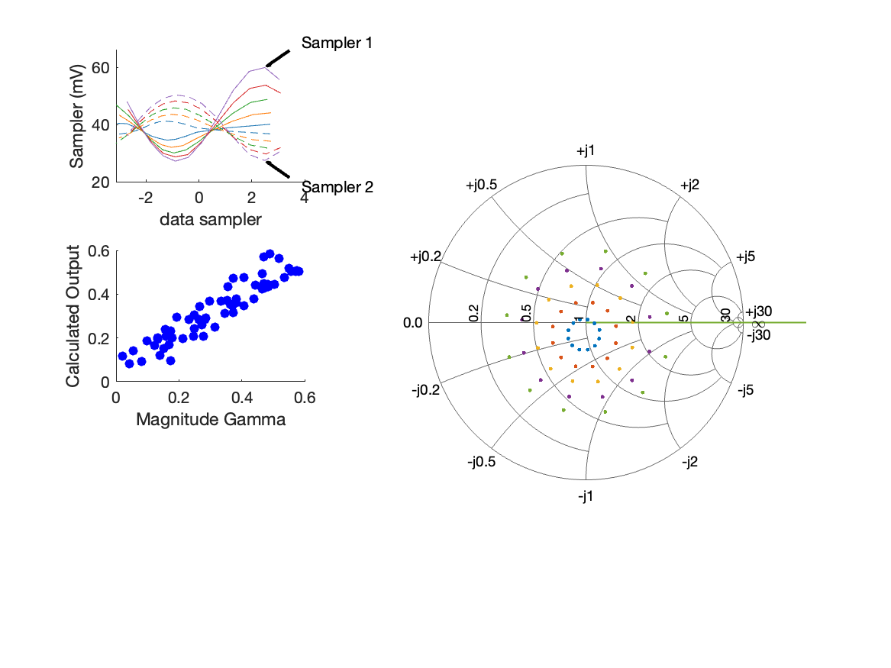
Coupled Line Performance At 10.70 GHz, 16.000000 dBm Output Power 1.70 V mean sampler bias
Sampler Av
  Sampler 1: 31.670
  Sampler 2: 31.670
Sampler Offset (rather than -1)
  -3.0357092819182823
Goodness Of fit
  0.098059182482942708
Sampler 1 Range
  0.032770451300000003
Sampler 2 Range
  0.022969365299999999
DUT output dBm Mean
  16.666860184490751
DUT input dBm Mean
  5.1823639109238213
RMS Error
  0.055514560496422602
Max Error
  0.079508735041993878

Slide 5
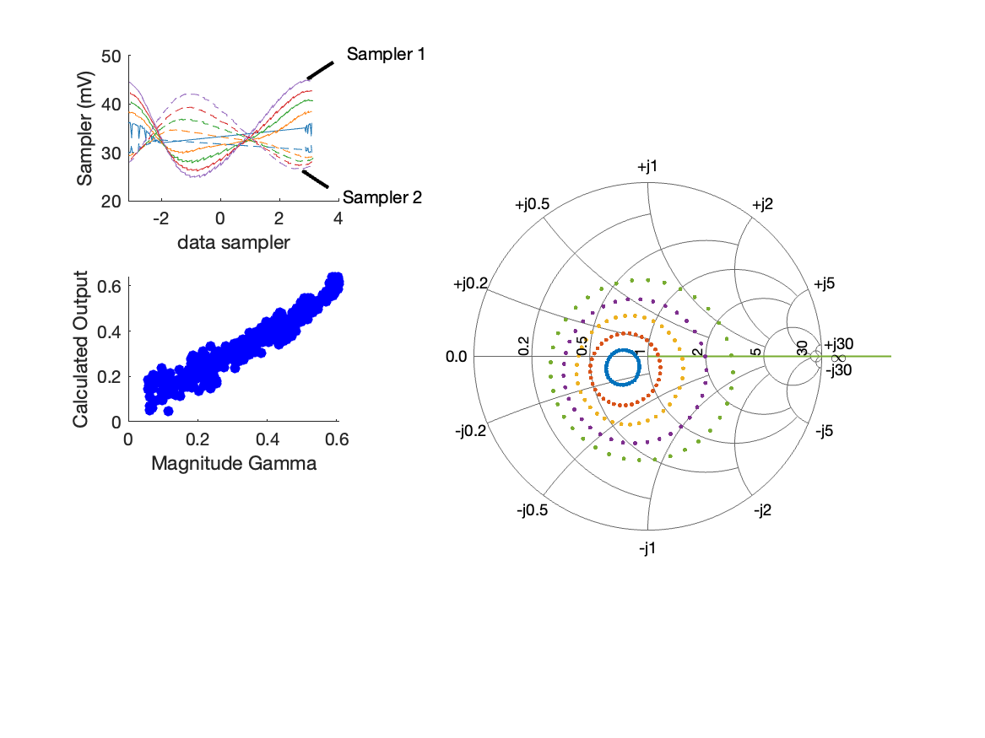
Coupled Line Performance At 10.40 GHz, 14.000000 dBm Output Power 1.77 V mean sampler bias
Sampler Av
  Sampler 1: 46.838
  Sampler 2: 46.838
Sampler Offset (rather than -1)
  -3.5531356580609259
Goodness Of fit
  0.22892641562124227
Sampler 1 Range
  0.020136884099999995
Sampler 2 Range
  0.015745912000000001
DUT output dBm Mean
  14.529609796489771
DUT input dBm Mean
  2.9089016773724761
RMS Error
  0.044177016263585292
Max Error
  0.093374293202553471

Slide 6
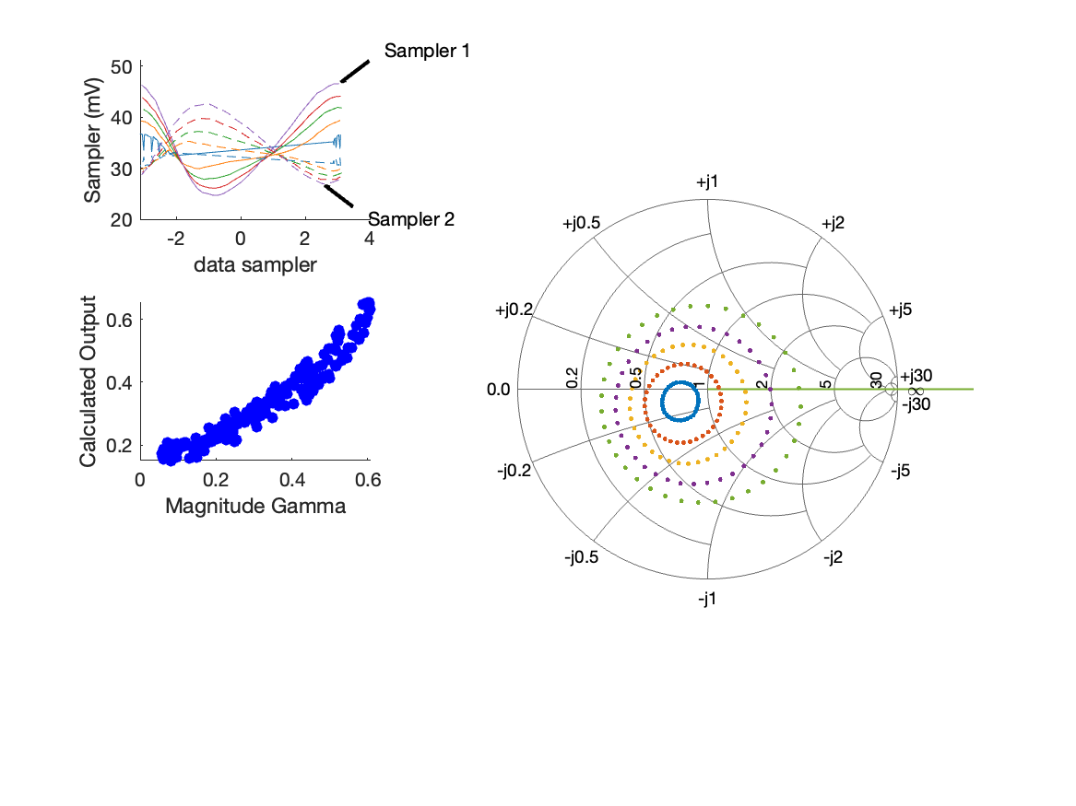
Coupled Line Performance At 10.40 GHz, 14.000000 dBm Output Power 1.90 V mean sampler bias
Sampler Av
  Sampler 1: 35.896
  Sampler 2: 35.896
Sampler Offset (rather than -1)
  -2.9094700410891789
Goodness Of fit
  0.15880688763425119
Sampler 1 Range
  0.021863913499999998
Sampler 2 Range
  0.015776935499999999
DUT output dBm Mean
  14.771196613156434
DUT input dBm Mean
  4.1084757051502541
RMS Error
  0.048338080601732385
Max Error
  0.097169983164696438

Slide 7
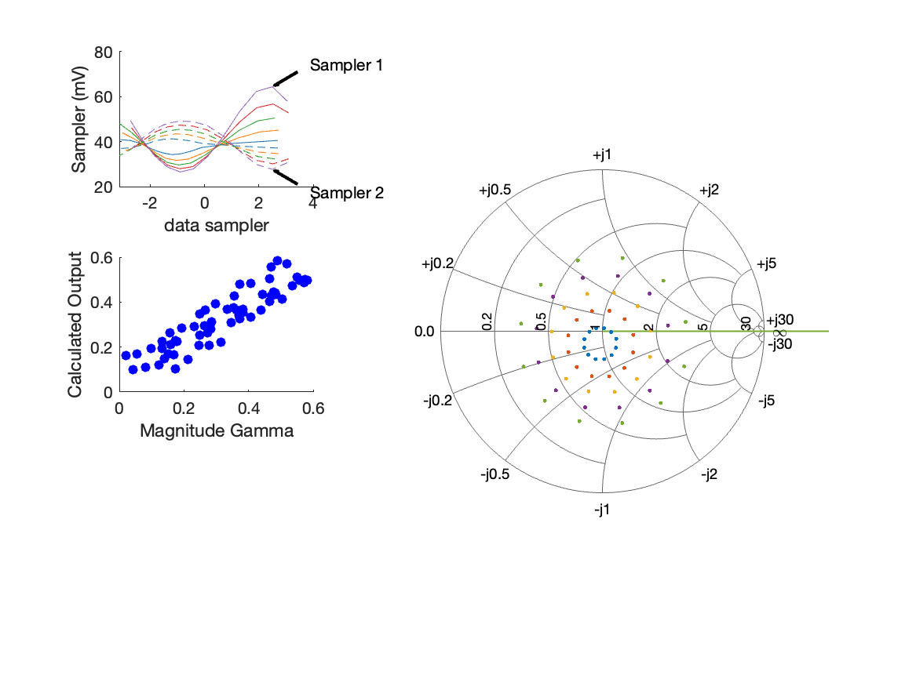
Coupled Line Performance At 10.70 GHz, 16.000000 dBm Output Power 2.00 V mean sampler bias
Sampler Av
  Sampler 1: 28.631
  Sampler 2: 28.631
Sampler Offset (rather than -1)
  -3.0906726450794464
Goodness Of fit
  0.12387708155638631
Sampler 1 Range
  0.037890231099999998
Sampler 2 Range
  0.021460514099999998
DUT output dBm Mean
  16.900318334490752
DUT input dBm Mean
  7.7327795775904882
RMS Error
  0.064963244685192351
Max Error
  0.090442606133943504

