Slide 1
Coupledline Compiled Data

Slide 2
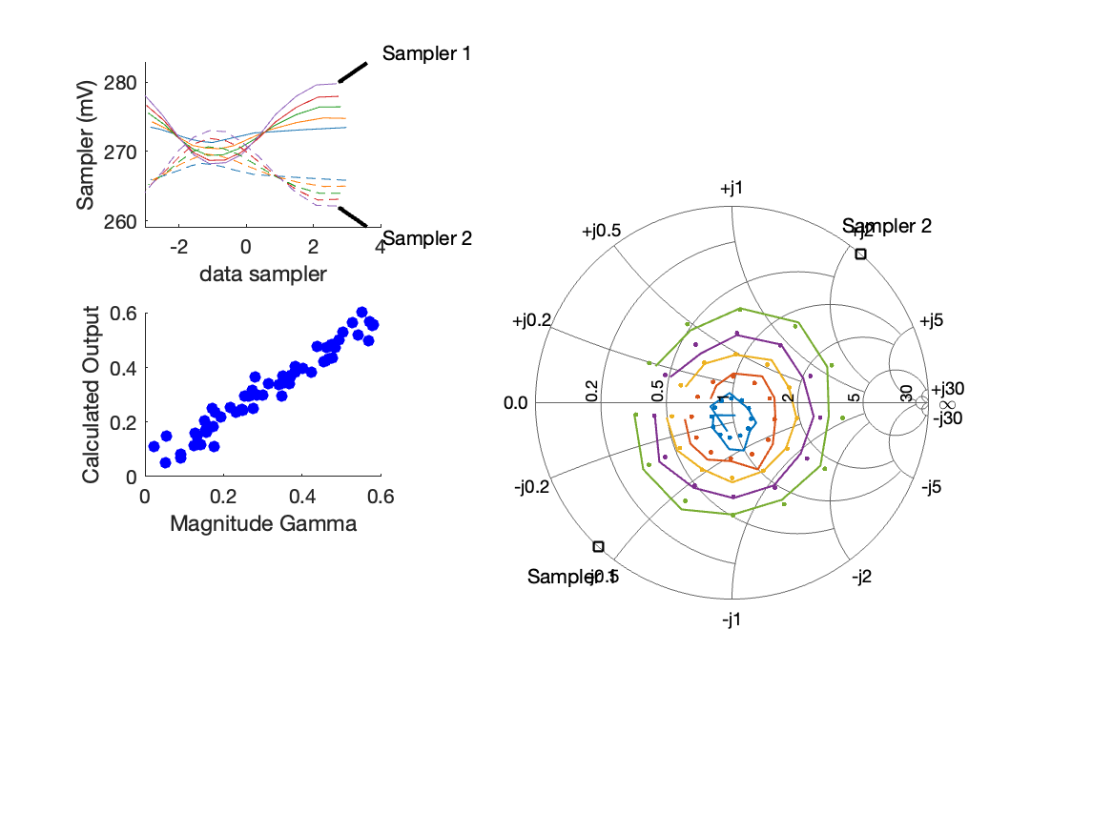
Coupled Line Performance At 10.90 GHz, 10.000000 dBm Output Power 1.75 V mean sampler bias
Sampler Av
  Sampler 1: 105.123
  Sampler 2: 105.123
Sampler Offset (rather than -1)
  -61.396445523007642
Goodness Of fit
  0.031863705692589894
Sampler 1 Range
  0.011522366000000006
Sampler 2 Range
  0.010869391000000006
DUT output dBm Mean
  9.9890529080691799
DUT input dBm Mean
  10.507417188090209
RMS Error
  0.043966866559922296
Max Error
  0.071225878491407546

Slide 3

Coupled Line Performance At 10.90 GHz, 8.000000 dBm Output Power 2.00 V mean sampler bias
Sampler Av
  Sampler 1: 161.753
  Sampler 2: 161.753
Sampler Offset (rather than -1)
  -144.21601413985104
Goodness Of fit
  0.025366009392946611
Sampler 1 Range
  0.006488076999999981
Sampler 2 Range
  0.00617542900000001
DUT output dBm Mean
  7.9854290747358467
DUT input dBm Mean
  8.5018435214235435
RMS Error
  0.048706539466378963
Max Error
  0.070424497062771999

