Slide 1
Simple Load Pull Report
Initial Bias sweep for single power

Slide 2
Test Configuration
Frequencies: (GHz)
9.9, 10.4, 10.9, 11.4, 11.9
Input Powers: (dBm)
20
Load Impedances:
Gamma Magnitude:
0.1, 0.2, 0.3, 0.4, 0.5, 0.6, 0.7
Gamma Phase
-175, -165, -155, -145, -135, -125, -115, -105, -95, -85, -75, -65, -55, -45, -35, -25, -15, -5, 5, 15, 25, 35, 45, 55, 65, 75, 85, 95, 105, 115, 125, 135, 145, 155, 165, 175

Slide 3
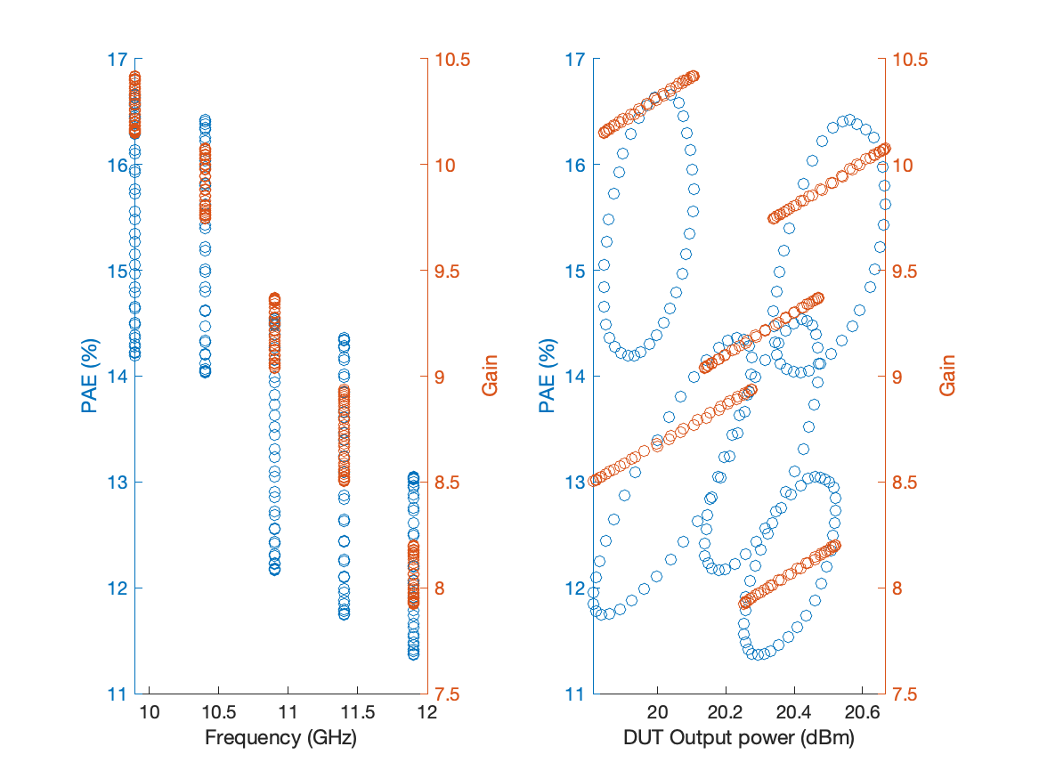
Large Signal Performance

Slide 4
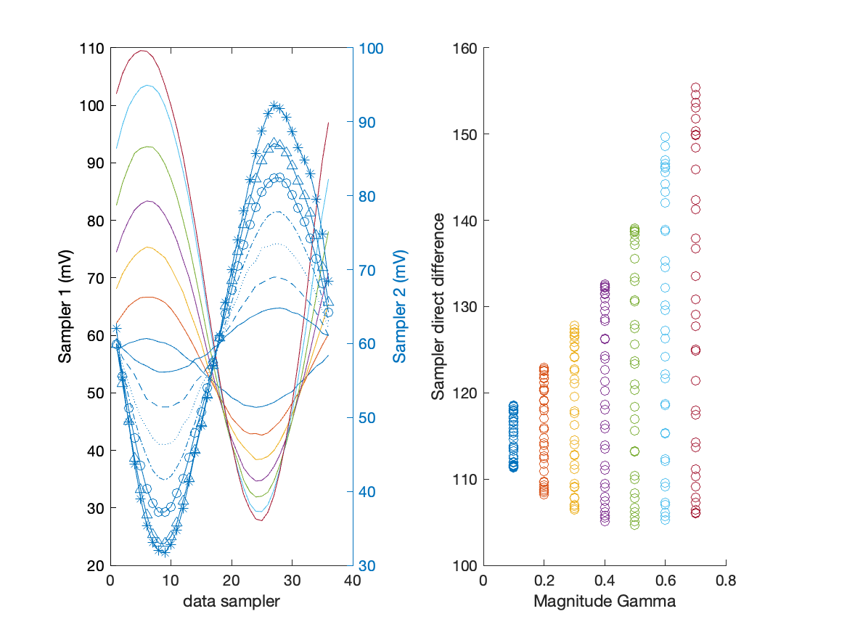
Raw Sampler Performance at9.9 GHz

Slide 5
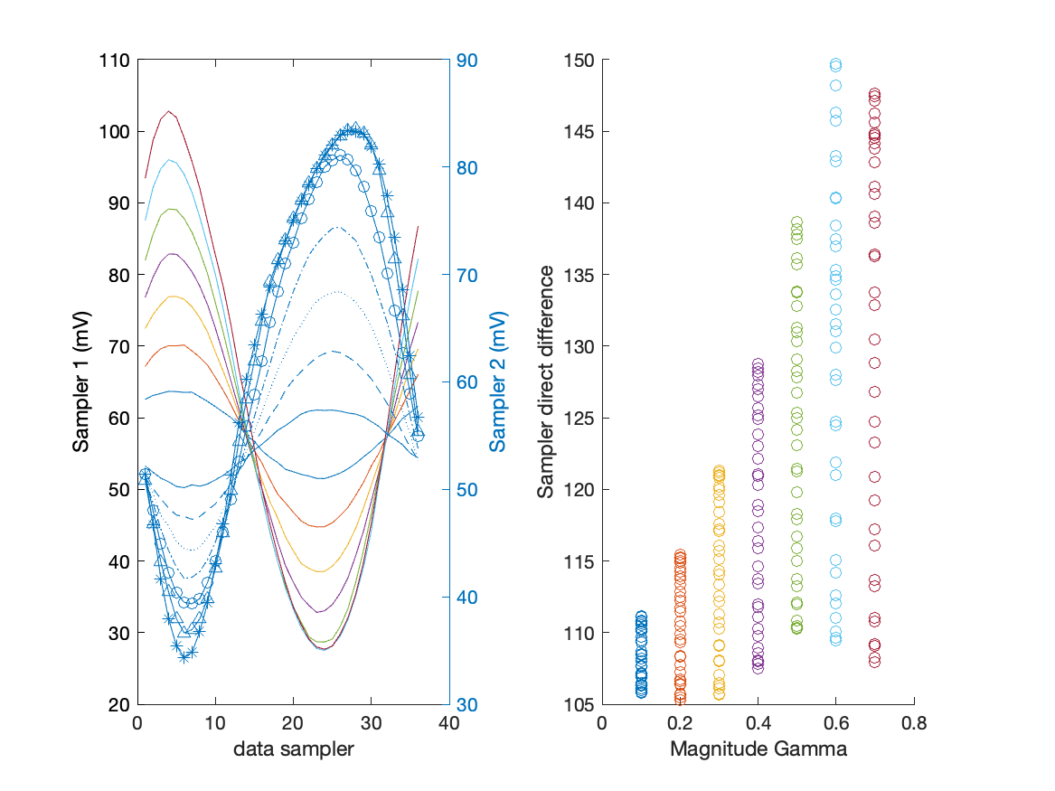
Raw Sampler Performance at10.4 GHz

Slide 6
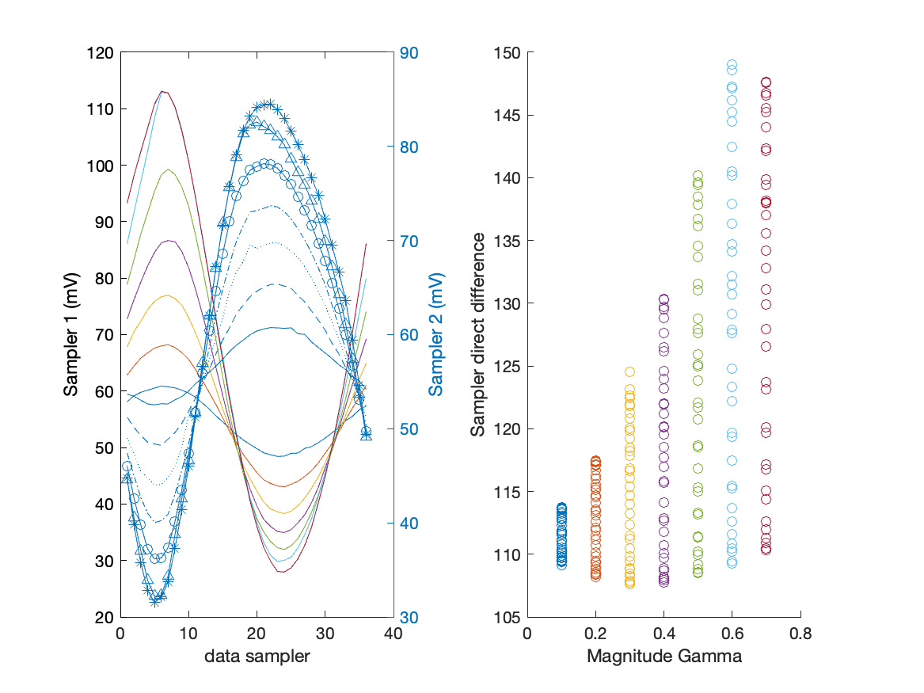
Raw Sampler Performance at10.9 GHz

Slide 7
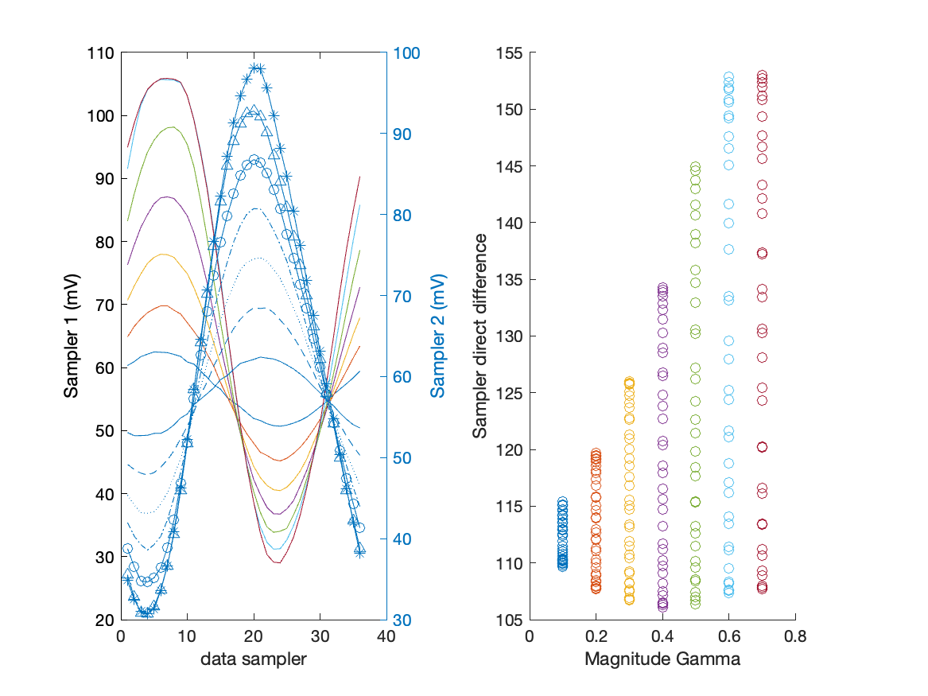
Raw Sampler Performance at11.4 GHz

Slide 8
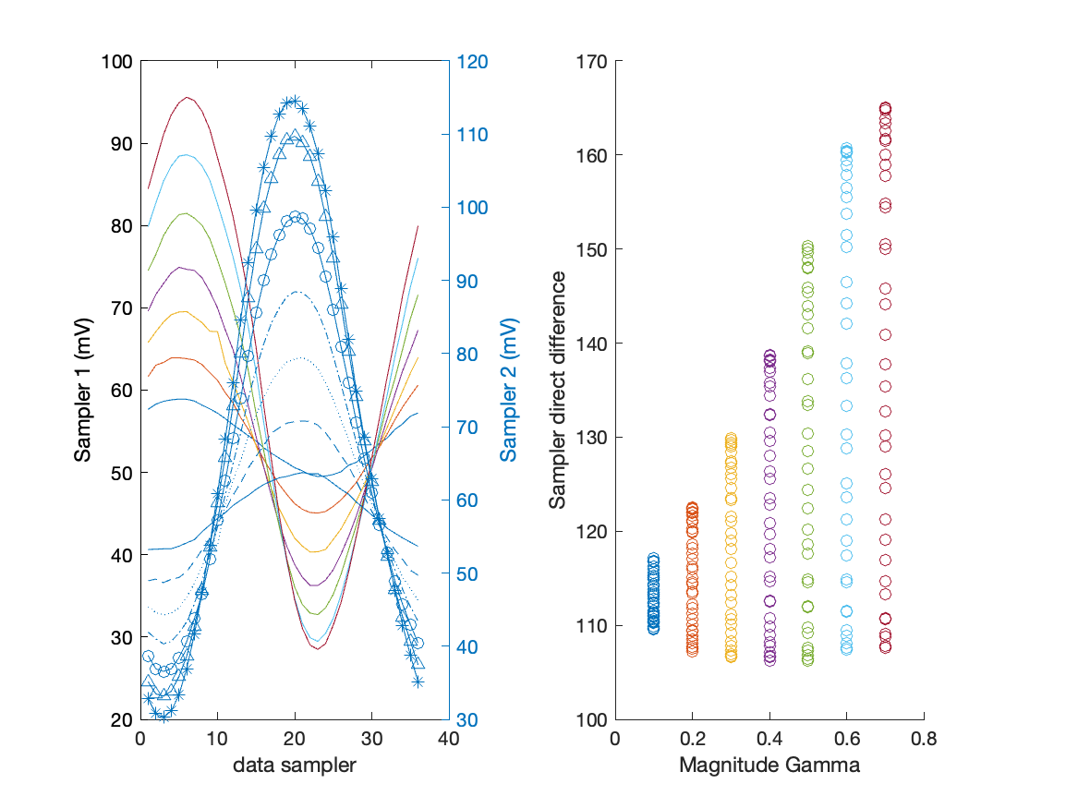
Raw Sampler Performance at11.9 GHz

