Slide 1
Simple Drive Up Report
19mA biasing while RF off. Corse frequency but full drive up. No code for stopping after peak PAE.

Slide 2
Test Configuration
Frequencies: (GHz)
8, 8.5, 9, 9.5, 10, 10.5, 11, 11.5, 12
Input Powers: (dBm)
2, 3, 4, 5, 6, 7, 8, 9, 10, 11, 12, 13, 14, 15, 16, 17, 18, 19, 20, 21, 22
Load Impedances:
Gamma Magnitude:
0
Gamma Phase
0

Slide 3
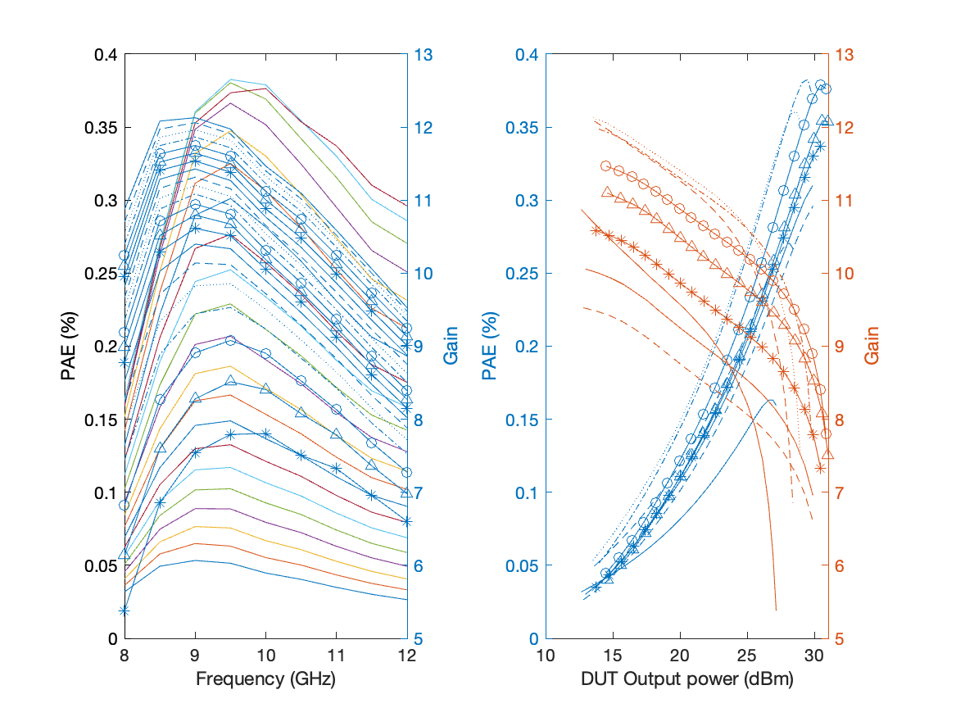
Large Signal Performance

