Slide 1
Simple Load Pull Report
None

Slide 2
Test Configuration
Frequencies: (GHz)
8, 8.5, 9, 9.5, 10, 10.5, 11, 11.5, 12
Input Powers: (dBm)
10, 11, 12, 13, 14, 15, 16, 17, 18, 19, 20, 21, 22, 23, 24
Load Impedances:
Gamma Magnitude:
0
Gamma Phase
0

Slide 3
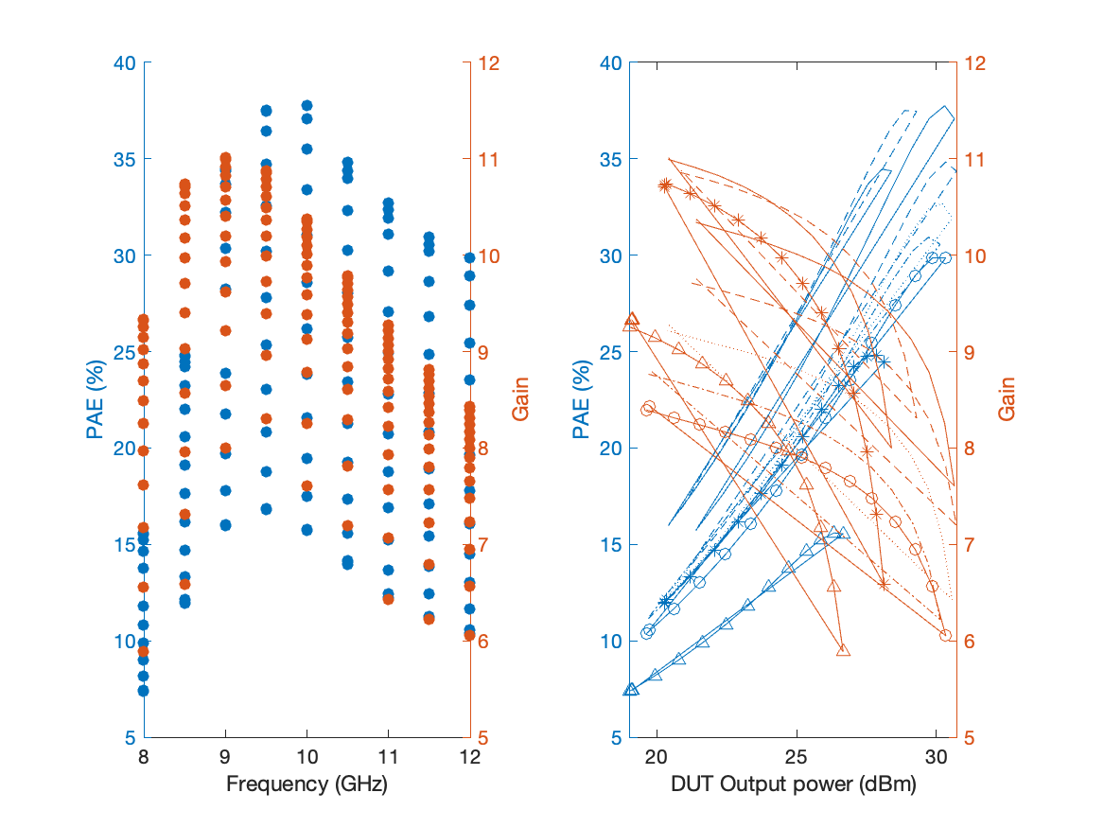
Large Signal Performance ->drain current 10.797mA

Slide 4
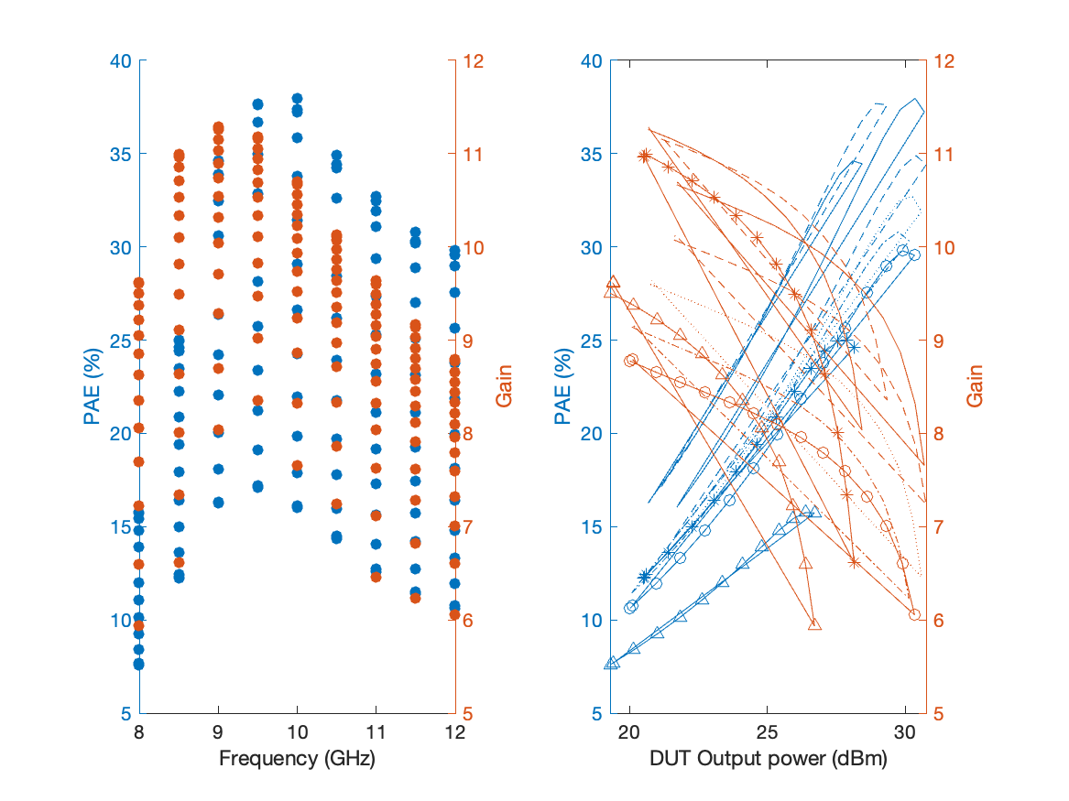
Large Signal Performance ->drain current 14.792mA

Slide 5
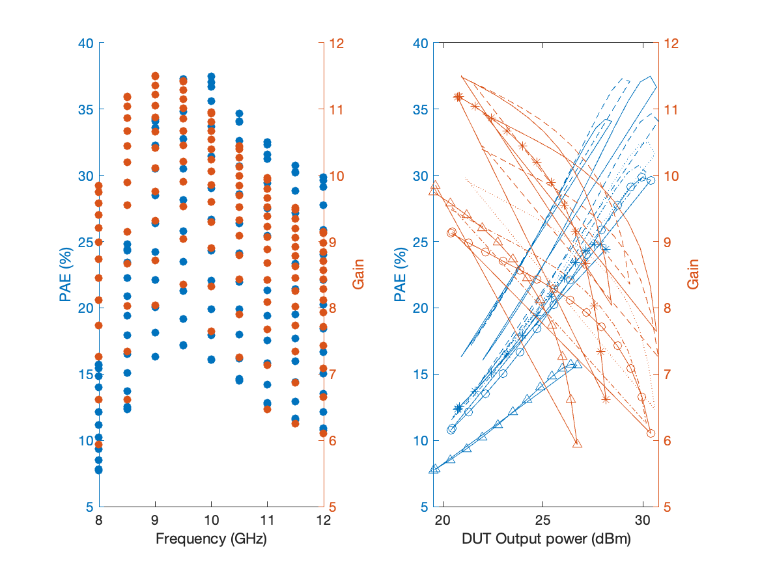
Large Signal Performance ->drain current 19.666mA

Slide 6
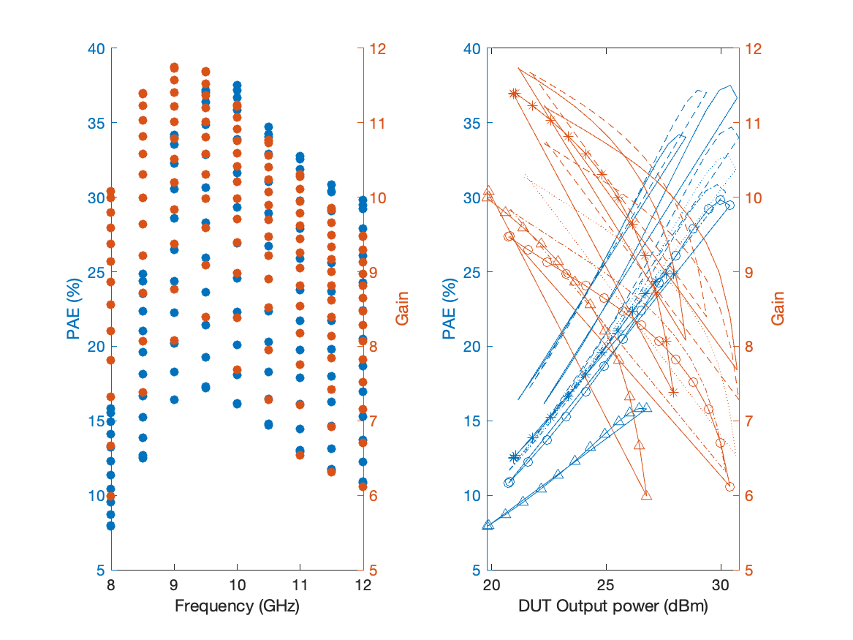
Large Signal Performance ->drain current 24.846mA

Slide 7
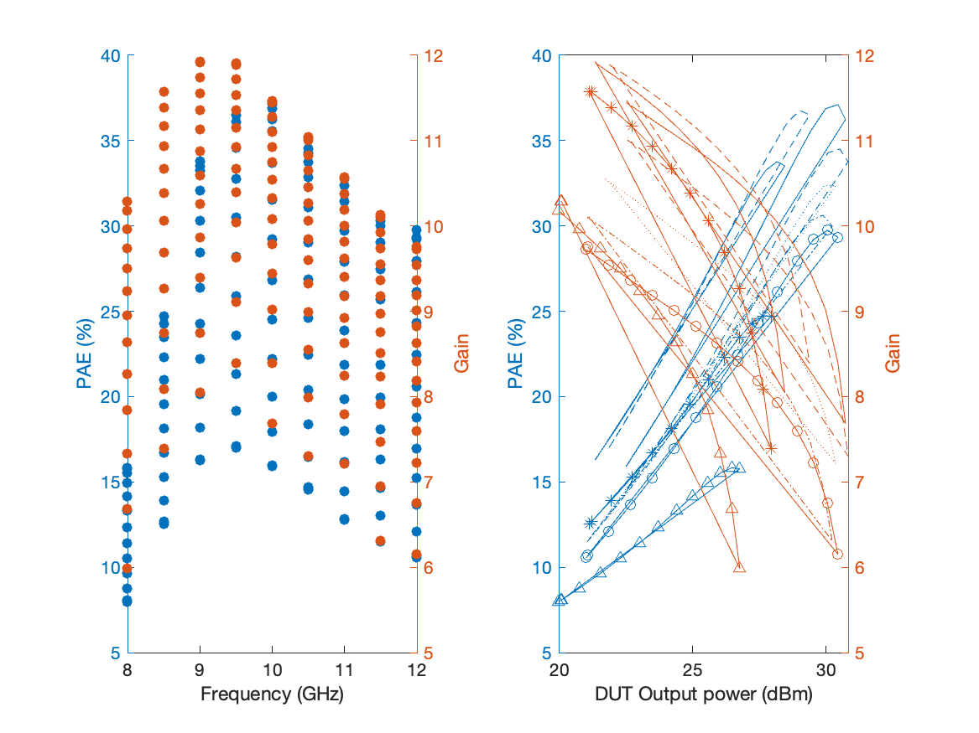
Large Signal Performance ->drain current 30.155mA

