Slide 1
Simple Load Pull Report
None

Slide 2
Test Configuration
Frequencies: (GHz)
8.9, 9.4, 9.9, 10.4, 10.9, 11.4, 11.9
Input Powers: (dBm)
14, 16, 18, 22
Load Impedances:
Gamma Magnitude:
0.1, 0.2, 0.3, 0.4, 0.5
Gamma Phase
-175, -165, -155, -145, -135, -125, -115, -105, -95, -85, -75, -65, -55, -45, -35, -25, -15, -5, 5, 15, 25, 35, 45, 55, 65, 75, 85, 95, 105, 115, 125, 135, 145, 155, 165, 175

Slide 3
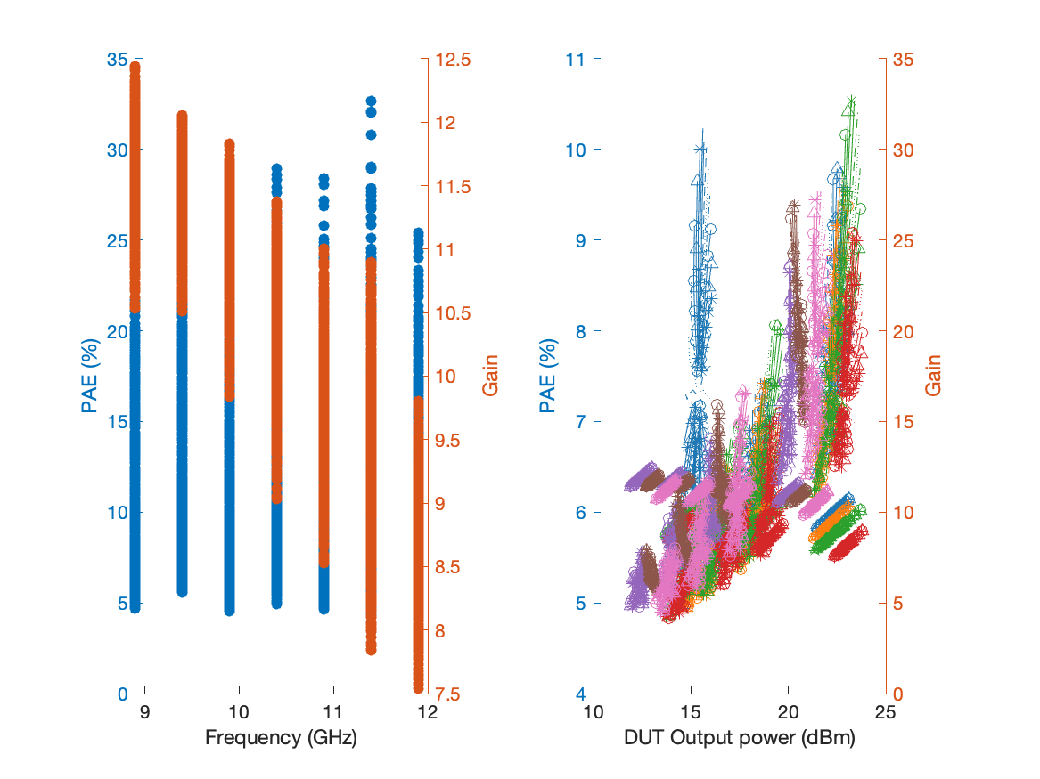
Large Signal Performance ->drain current 12.364mA

Slide 4
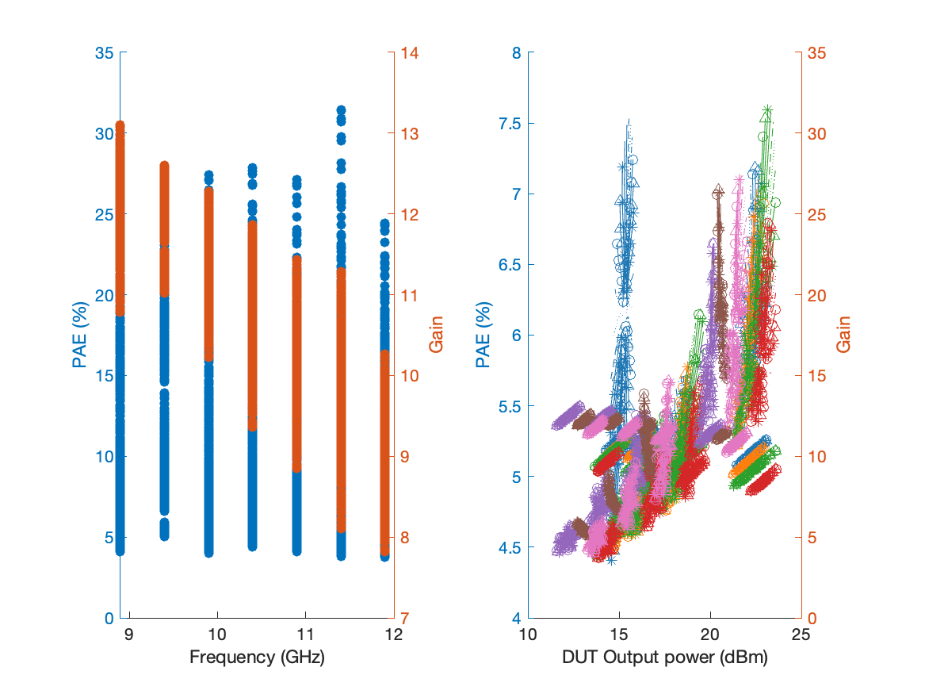
Large Signal Performance ->drain current 17.448mA

Slide 5
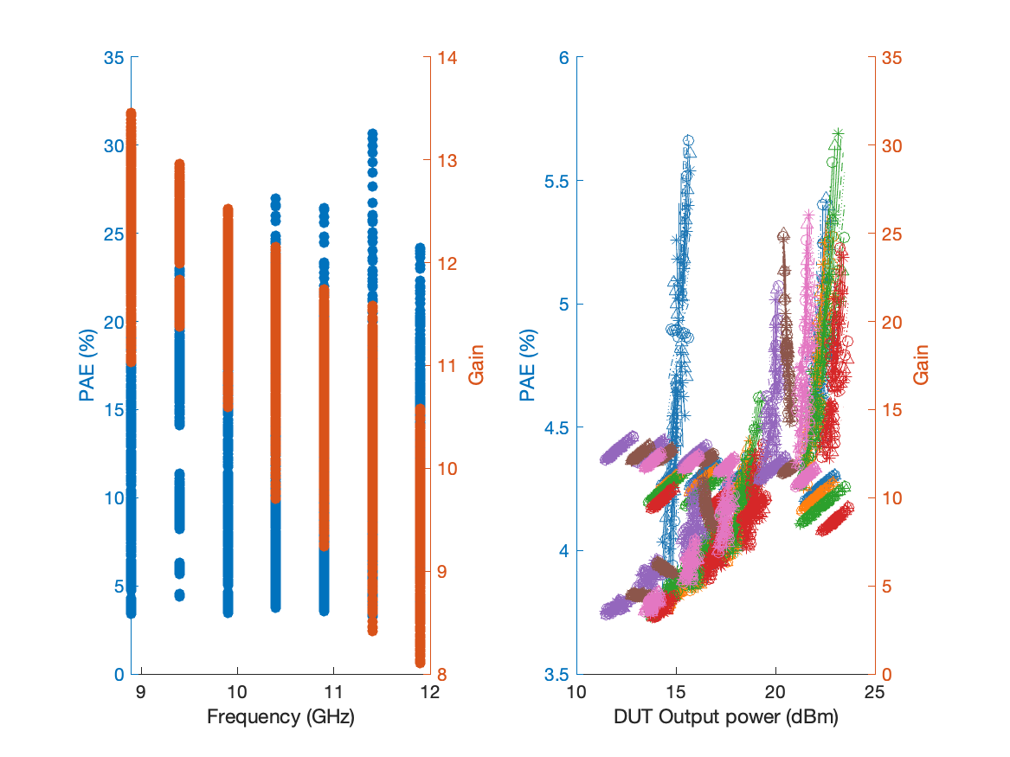
Large Signal Performance ->drain current 22.736mA

Slide 6
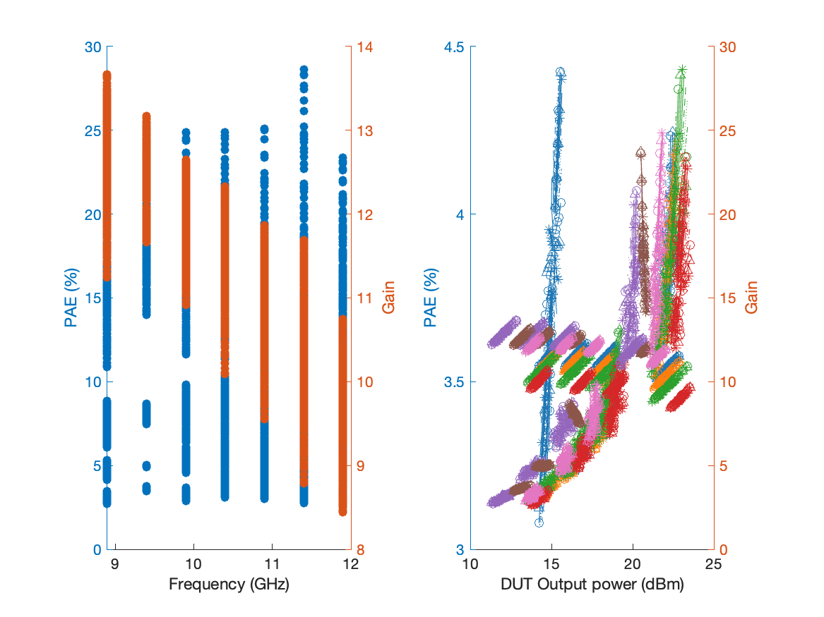
Large Signal Performance ->drain current 28.154mA

Slide 7
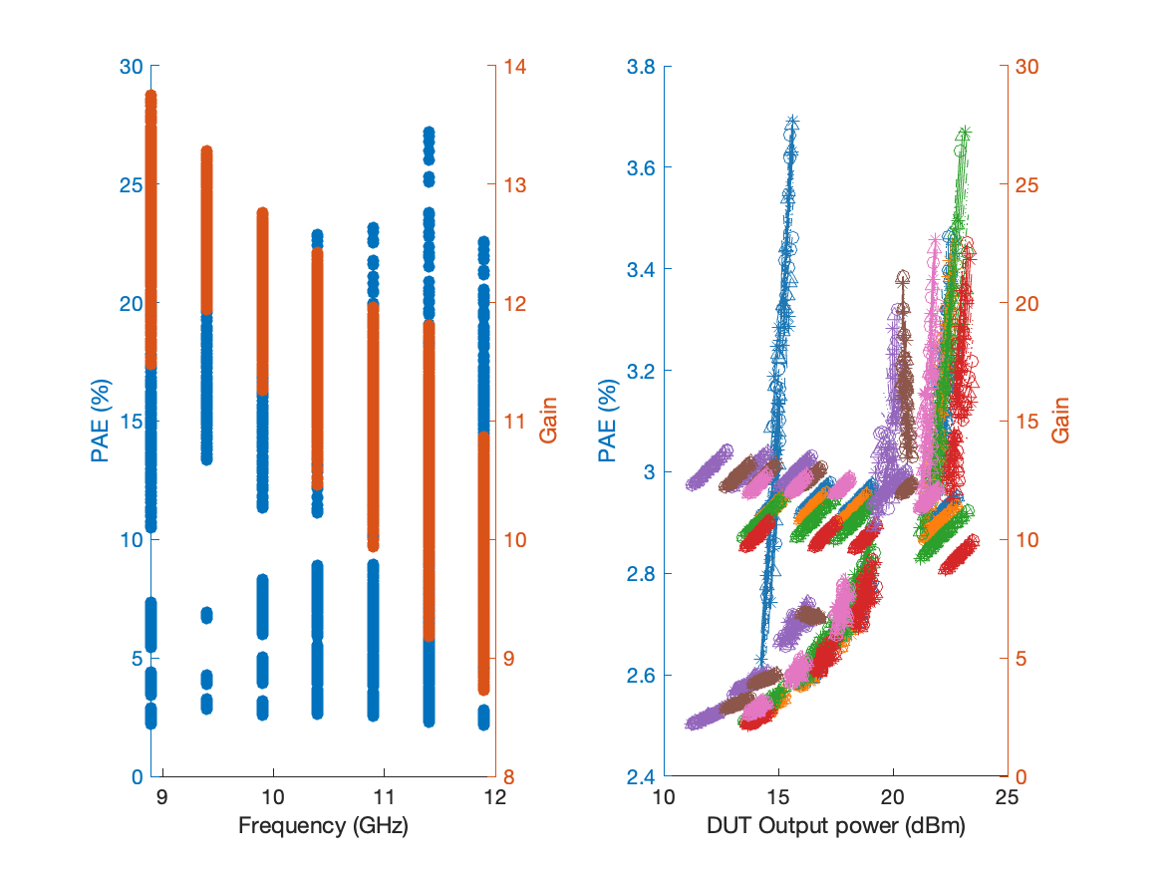
Large Signal Performance ->drain current 33.693mA

