Slide 1
Load Termination Report

Slide 2
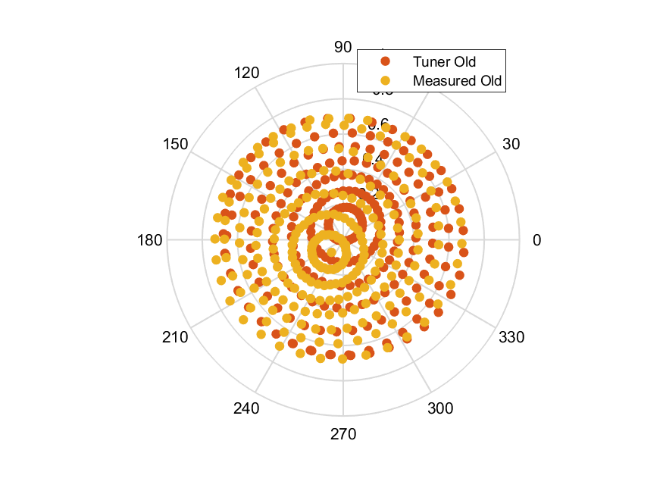
Load termination plot at8GHz

Slide 3
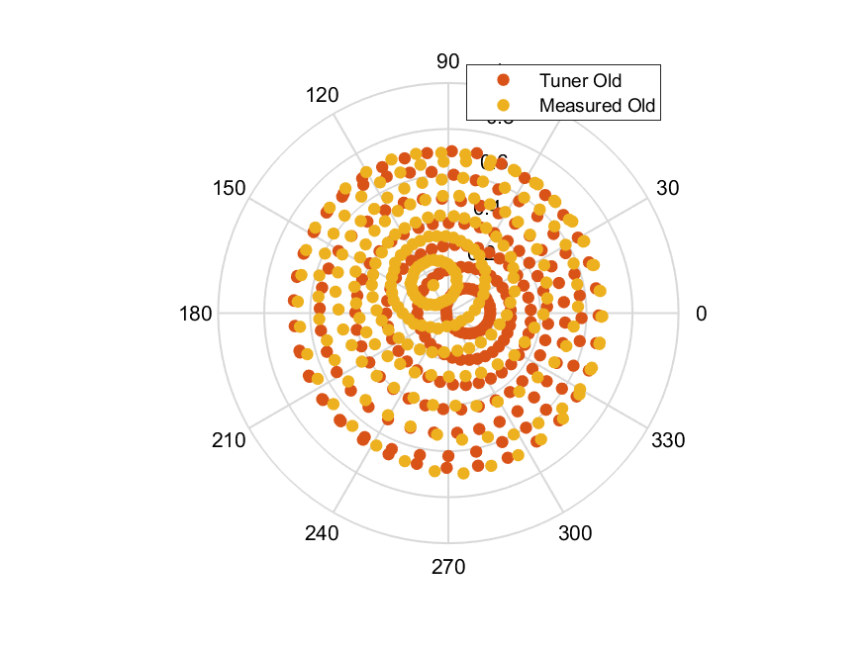
Load termination plot at8.1GHz

Slide 4
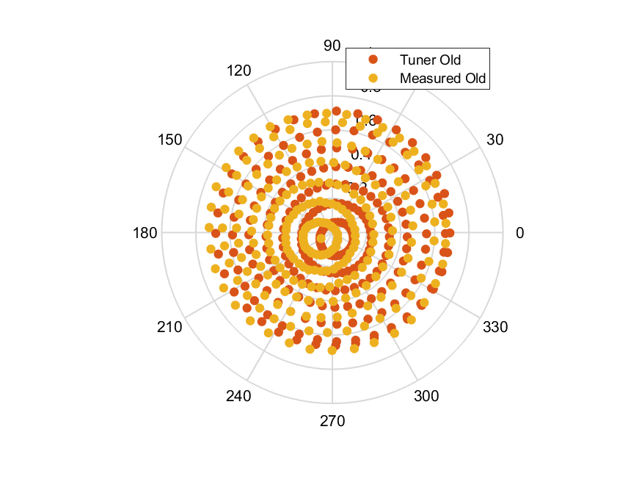
Load termination plot at8.2GHz

Slide 5
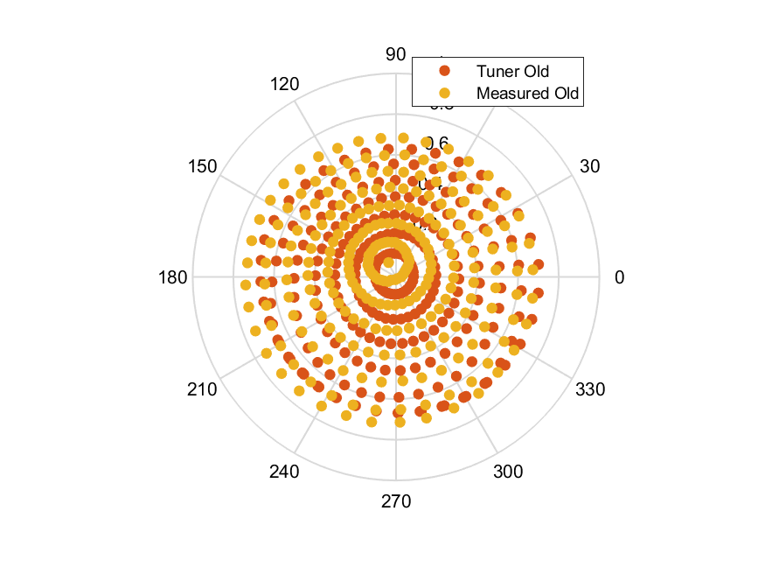
Load termination plot at8.3GHz

Slide 6
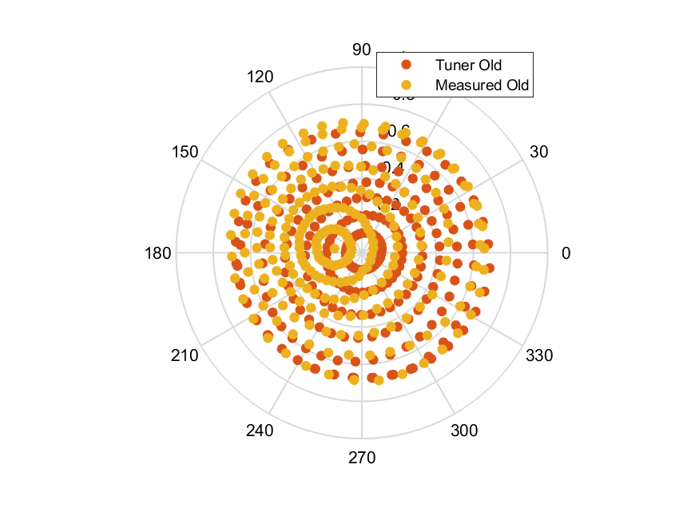
Load termination plot at8.4GHz

Slide 7
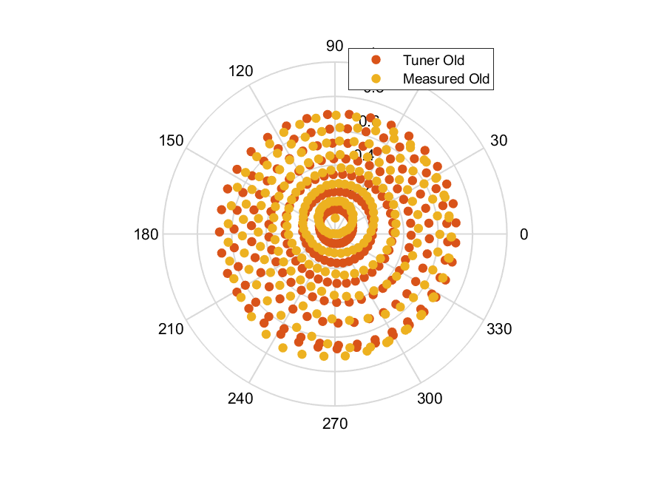
Load termination plot at8.5GHz

Slide 8
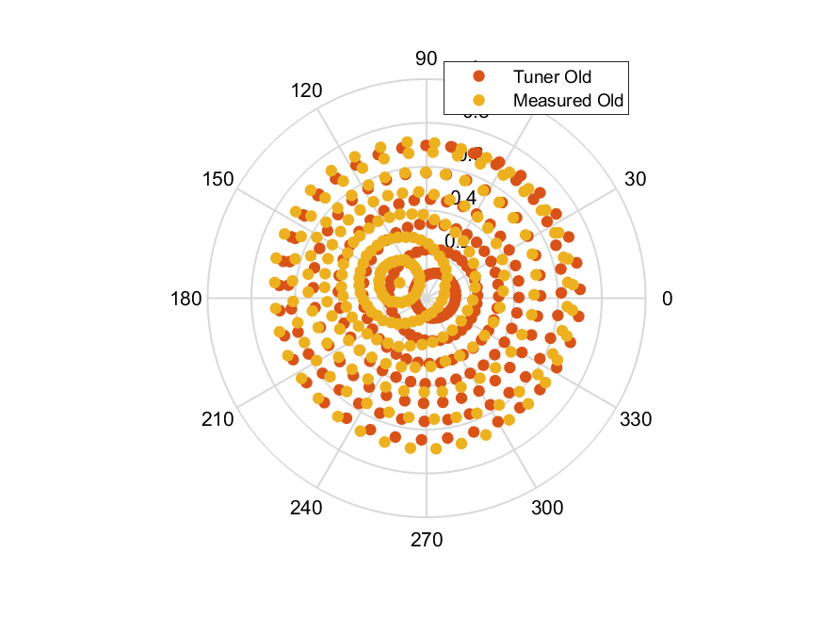
Load termination plot at8.6GHz

Slide 9
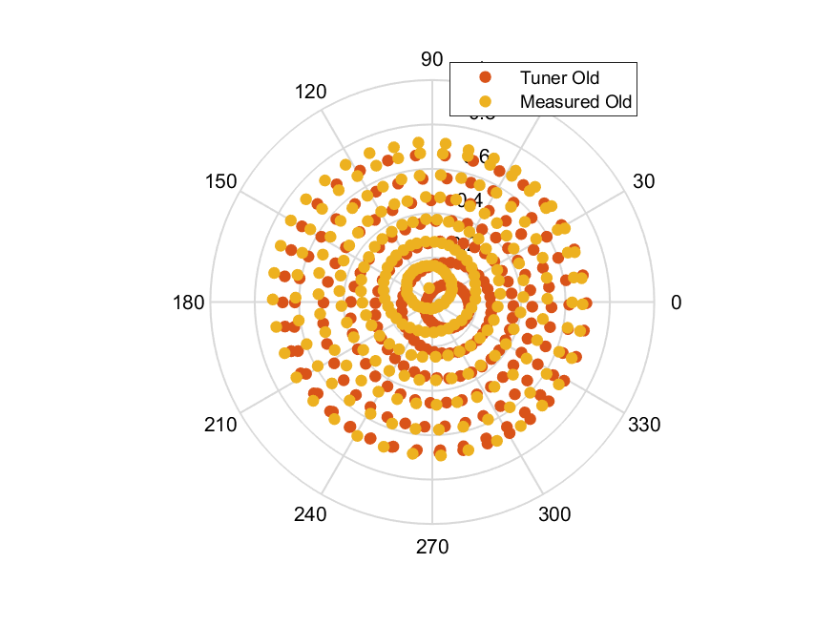
Load termination plot at8.7GHz

Slide 10
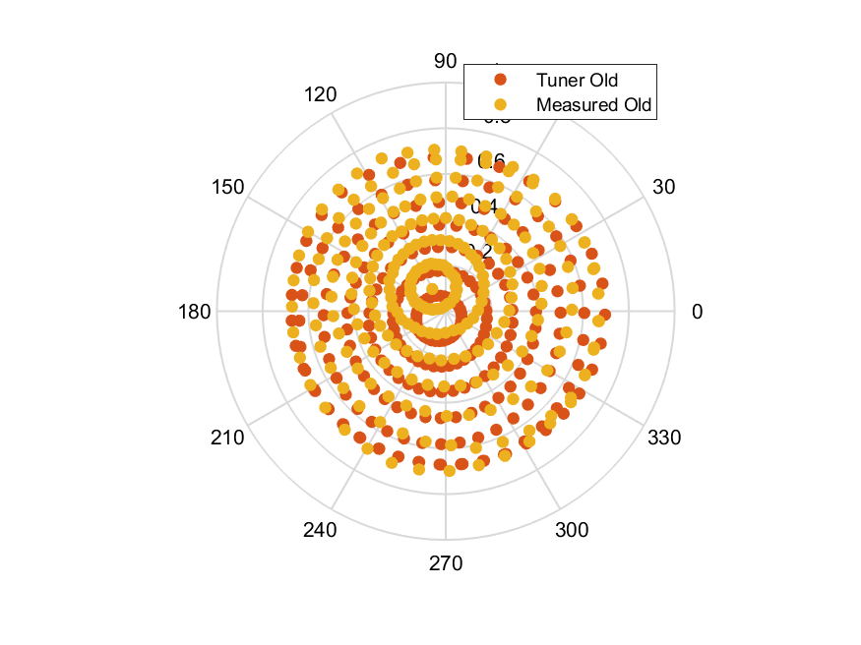
Load termination plot at8.8GHz

Slide 11
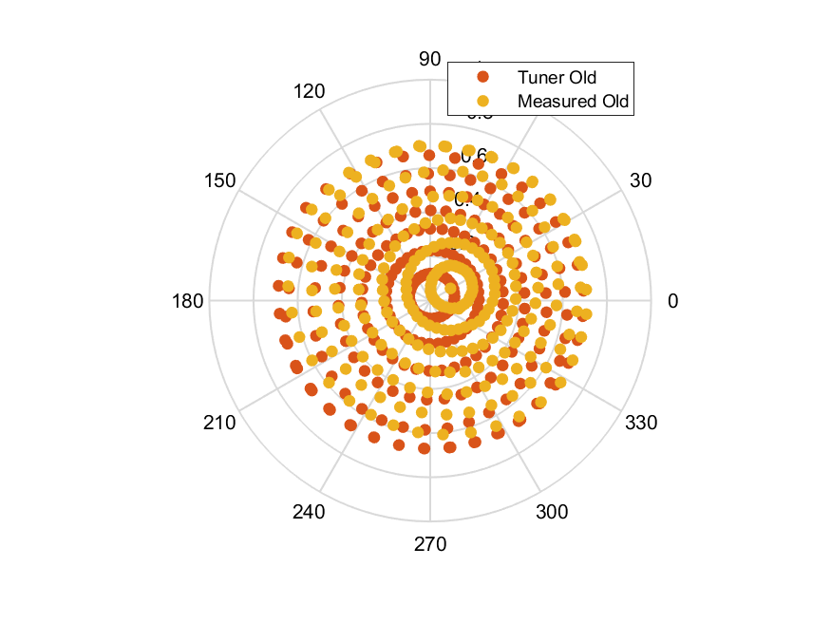
Load termination plot at8.9GHz

Slide 12
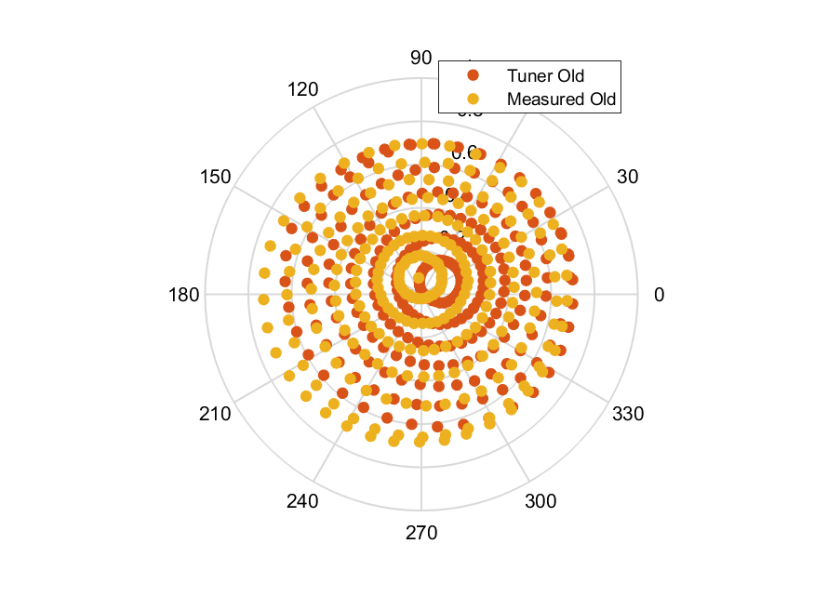
Load termination plot at9GHz

Slide 13
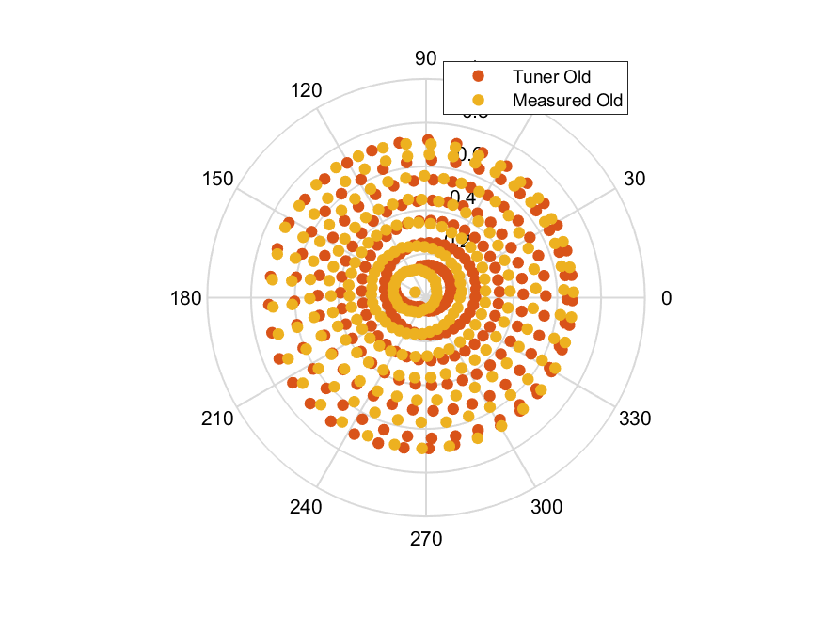
Load termination plot at9.1GHz

Slide 14
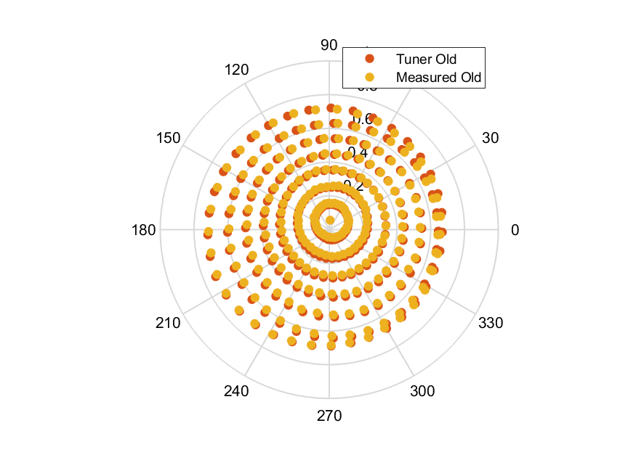
Load termination plot at9.2GHz

Slide 15
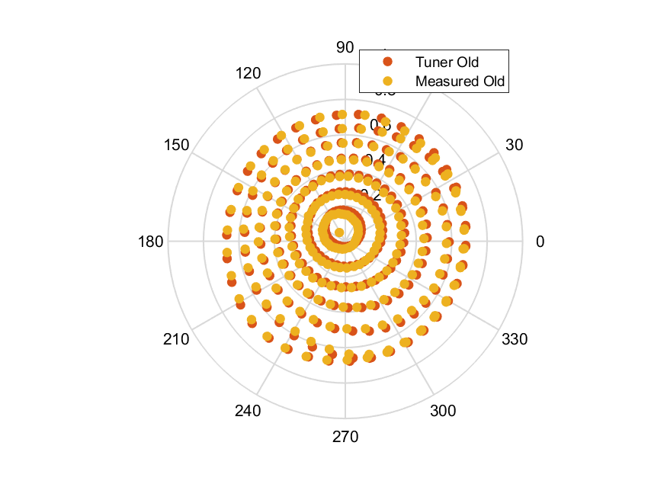
Load termination plot at9.3GHz

Slide 16
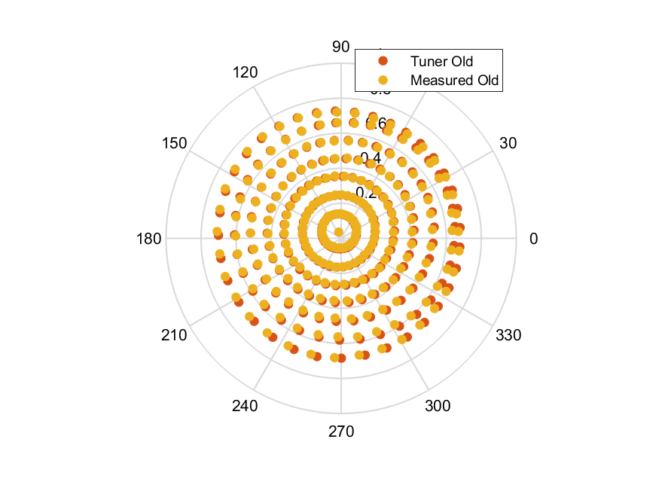
Load termination plot at9.4GHz

Slide 17
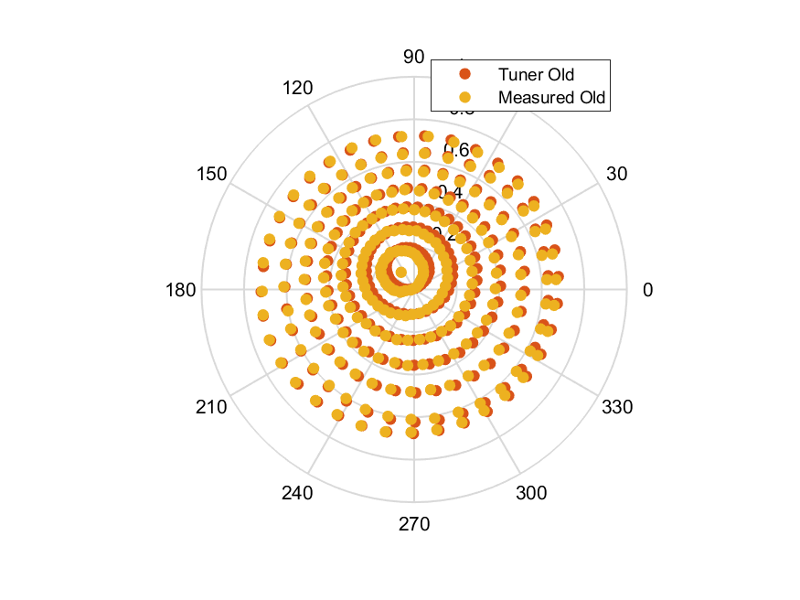
Load termination plot at9.5GHz

Slide 18
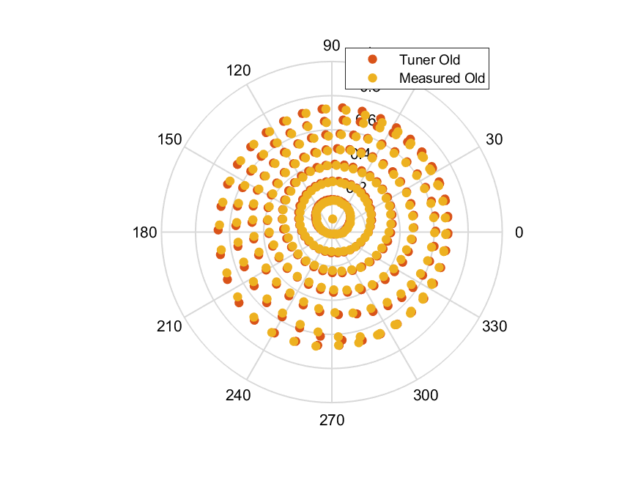
Load termination plot at9.6GHz

Slide 19
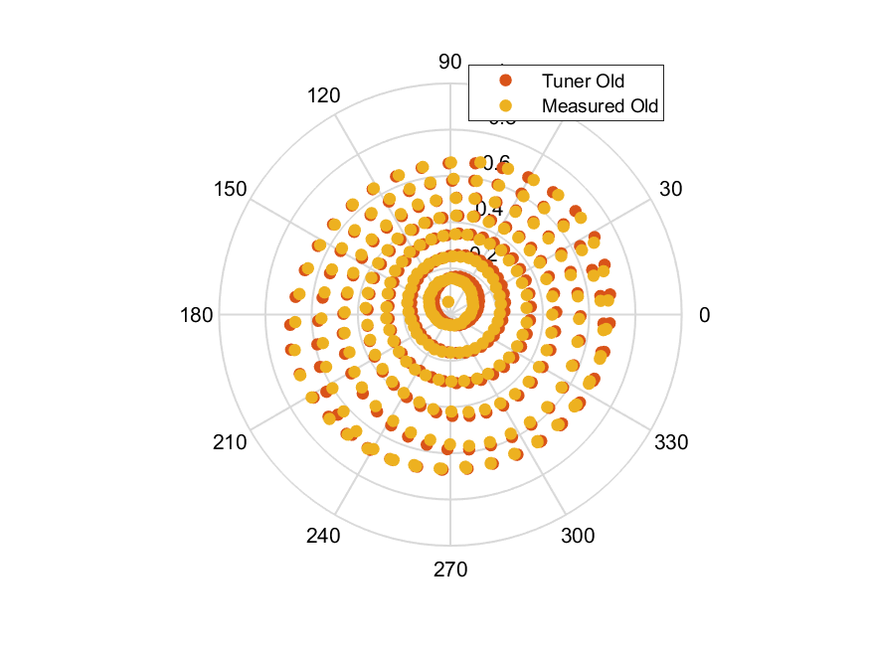
Load termination plot at9.7GHz

Slide 20
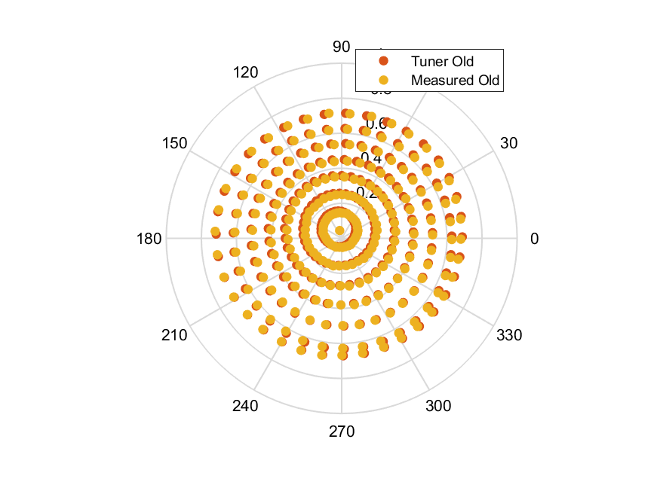
Load termination plot at9.8GHz

Slide 21
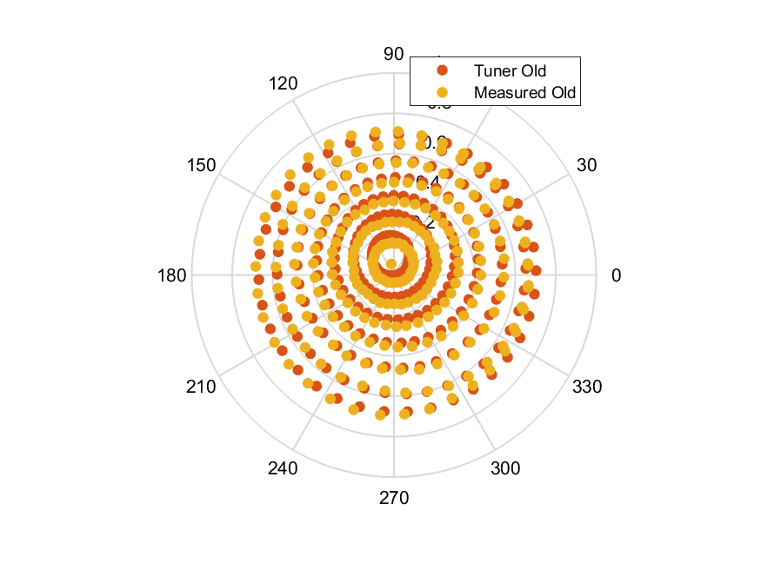
Load termination plot at9.9GHz

Slide 22
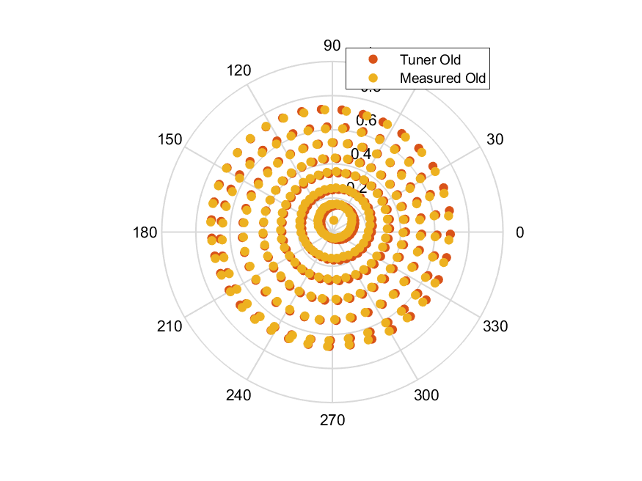
Load termination plot at10GHz

Slide 23
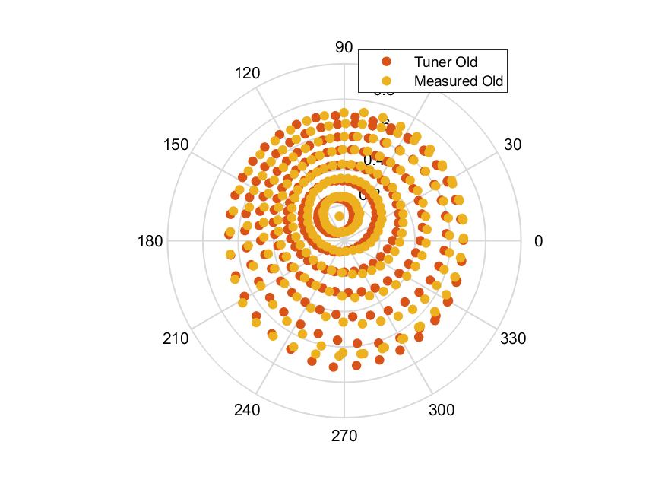
Load termination plot at10.1GHz

Slide 24
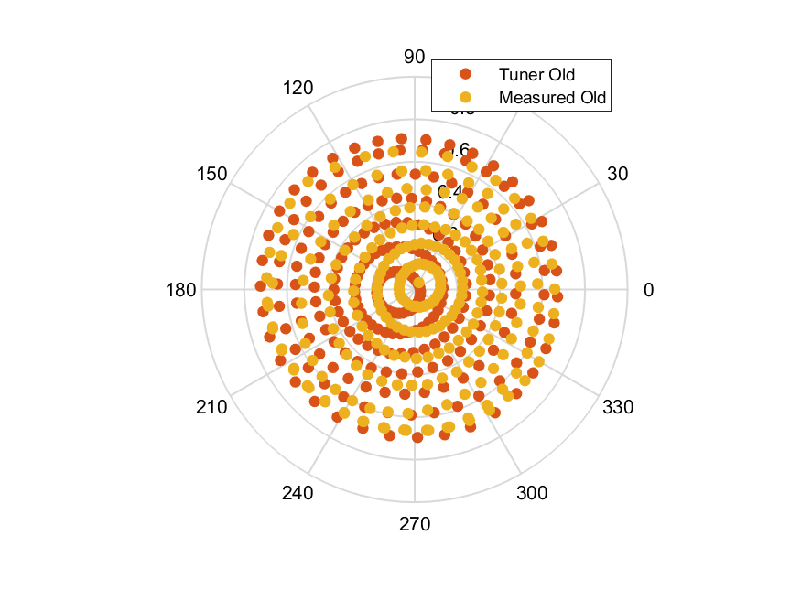
Load termination plot at10.2GHz

Slide 25
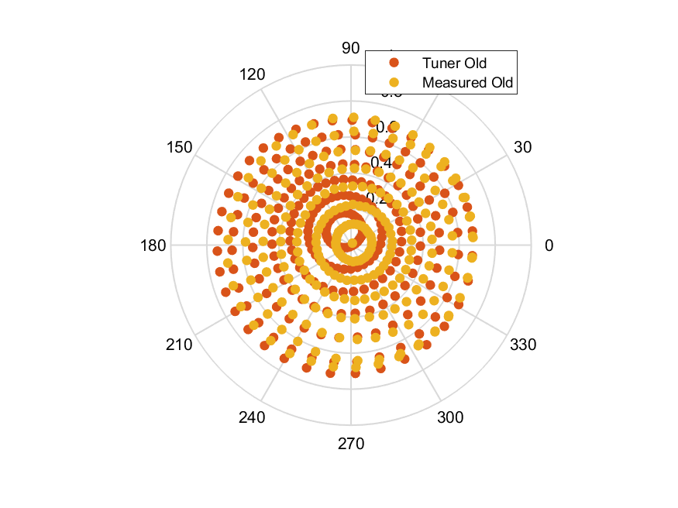
Load termination plot at10.3GHz

Slide 26
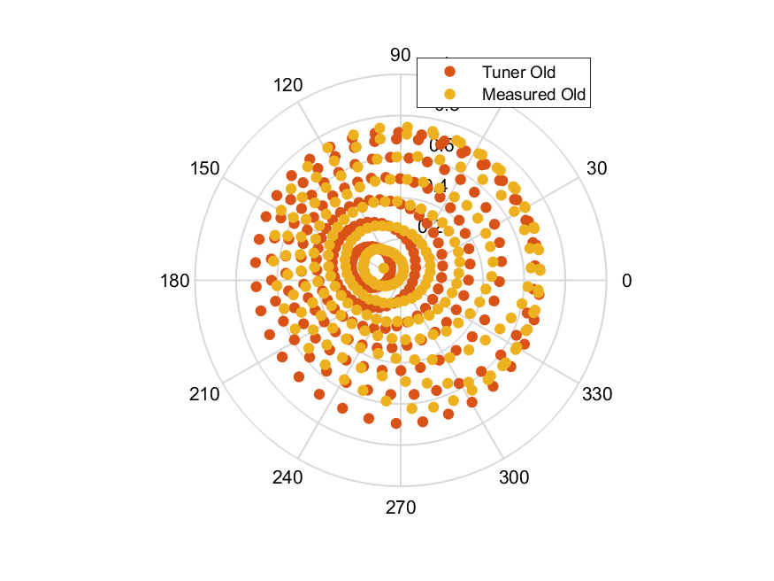
Load termination plot at10.4GHz

Slide 27
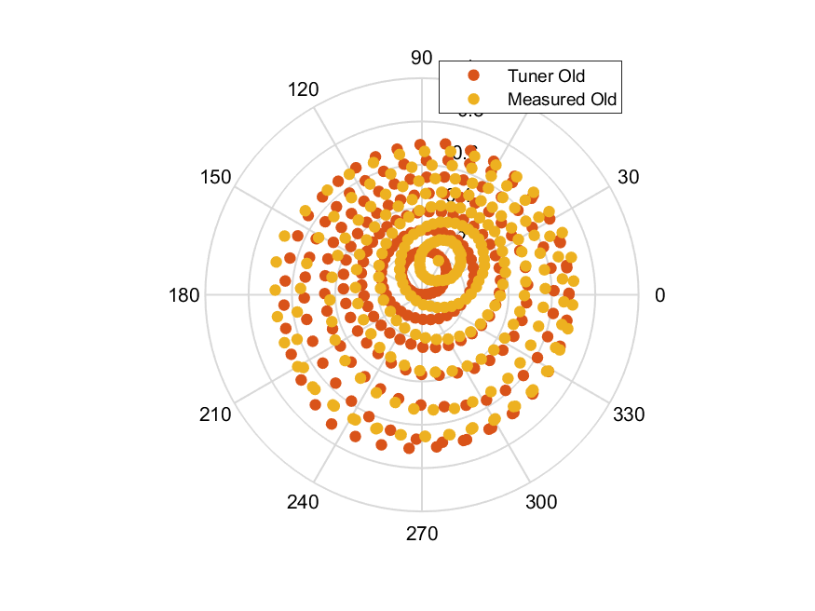
Load termination plot at10.5GHz

Slide 28
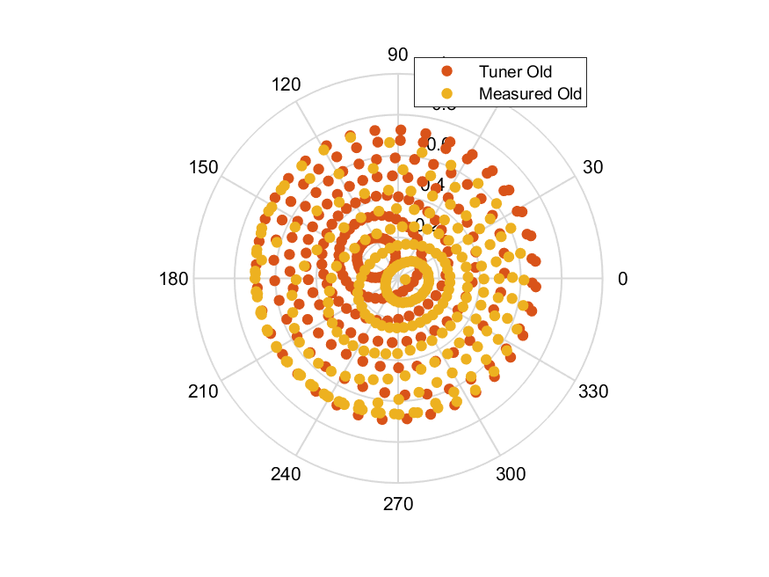
Load termination plot at10.6GHz

Slide 29
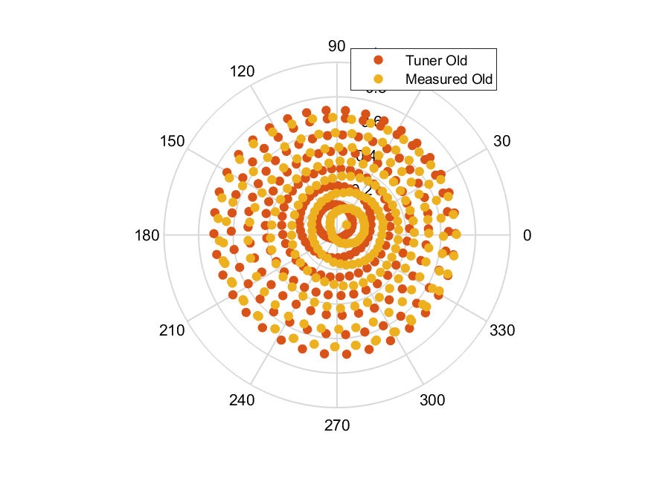
Load termination plot at10.7GHz

Slide 30
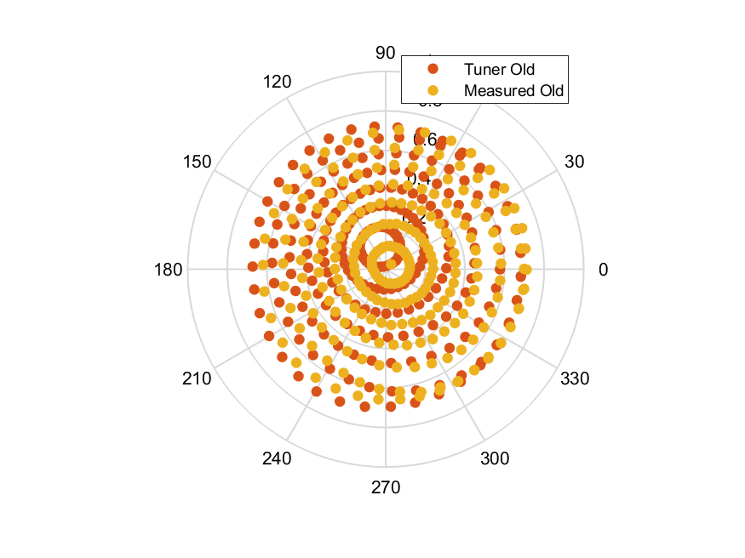
Load termination plot at10.8GHz

Slide 31
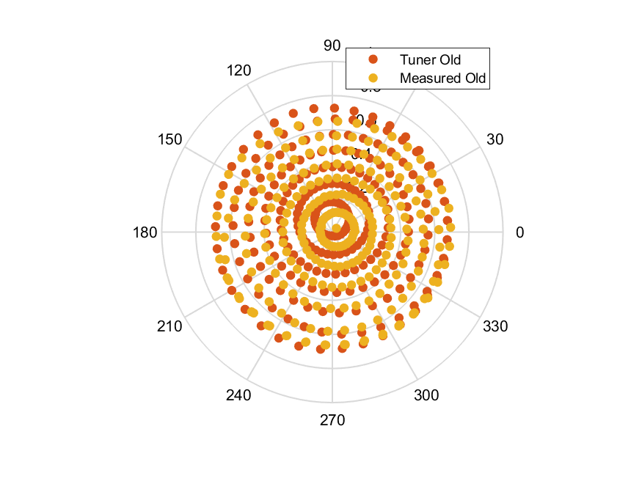
Load termination plot at10.9GHz

Slide 32
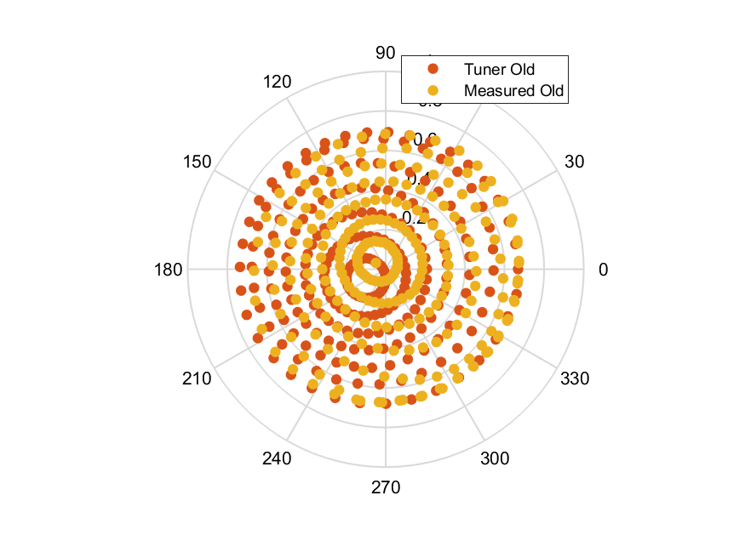
Load termination plot at11GHz

Slide 33
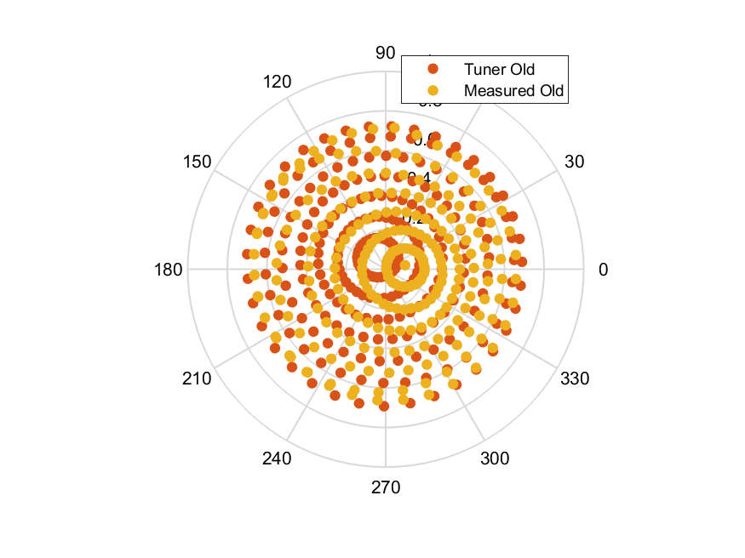
Load termination plot at11.1GHz

Slide 34
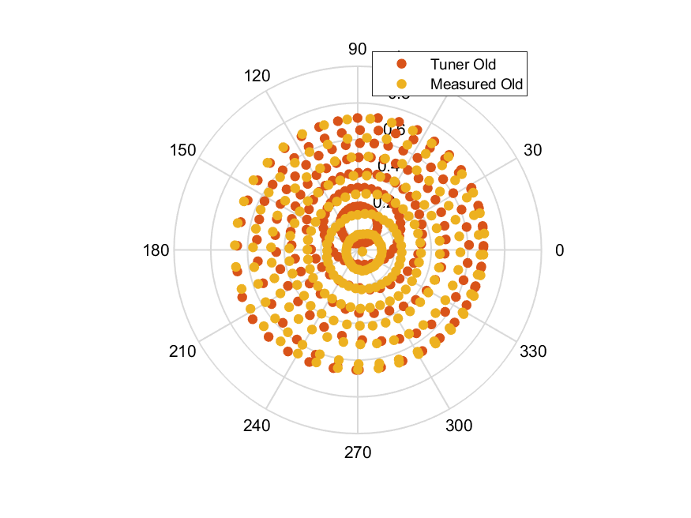
Load termination plot at11.2GHz

Slide 35
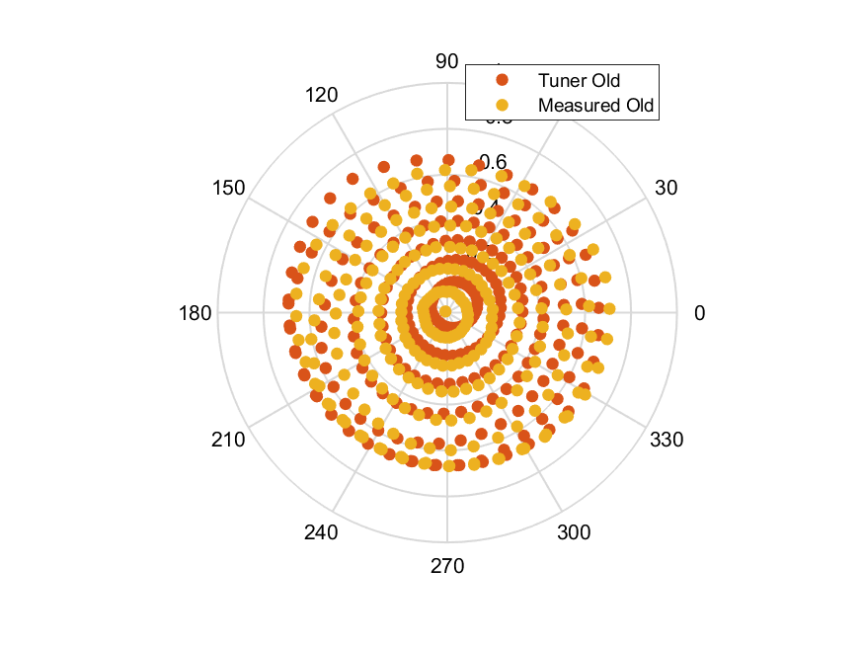
Load termination plot at11.3GHz

Slide 36
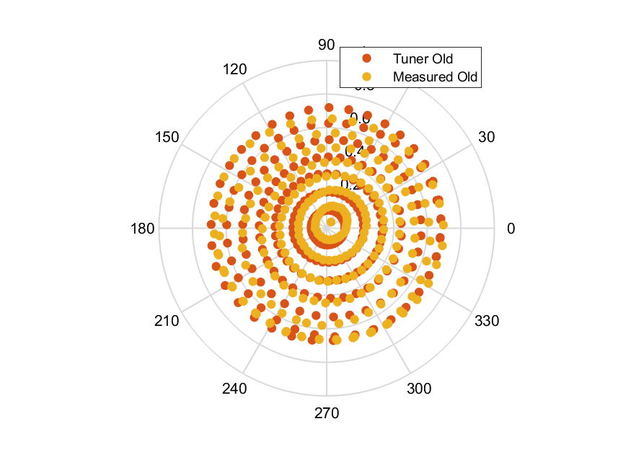
Load termination plot at11.4GHz

Slide 37
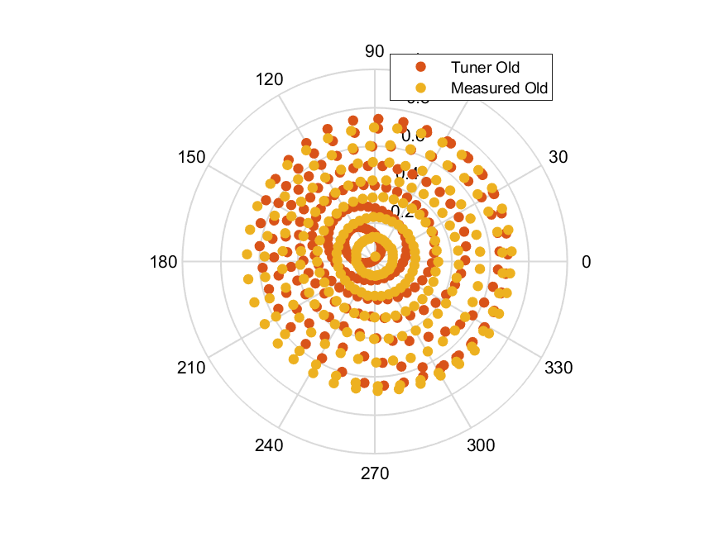
Load termination plot at11.5GHz

Slide 38
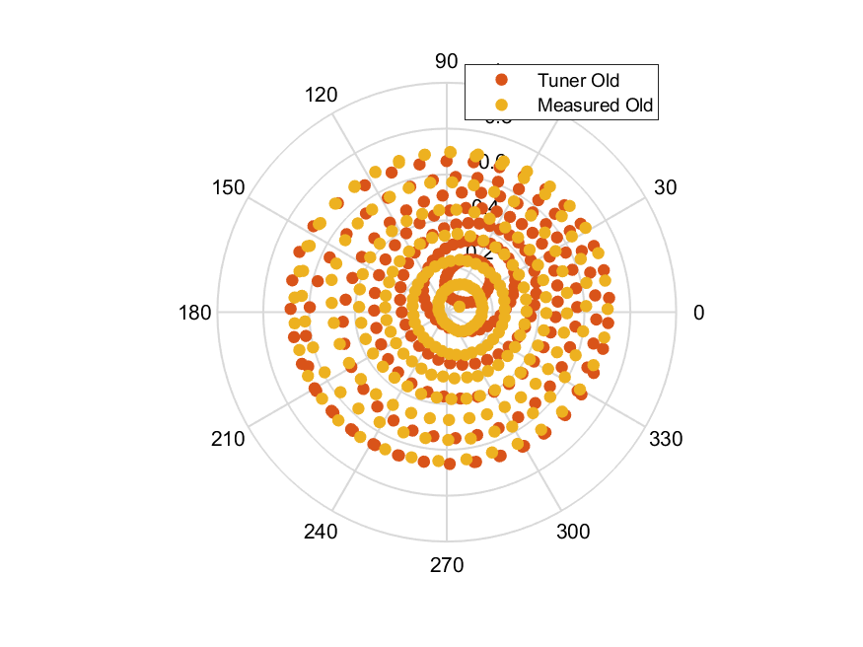
Load termination plot at11.6GHz

Slide 39
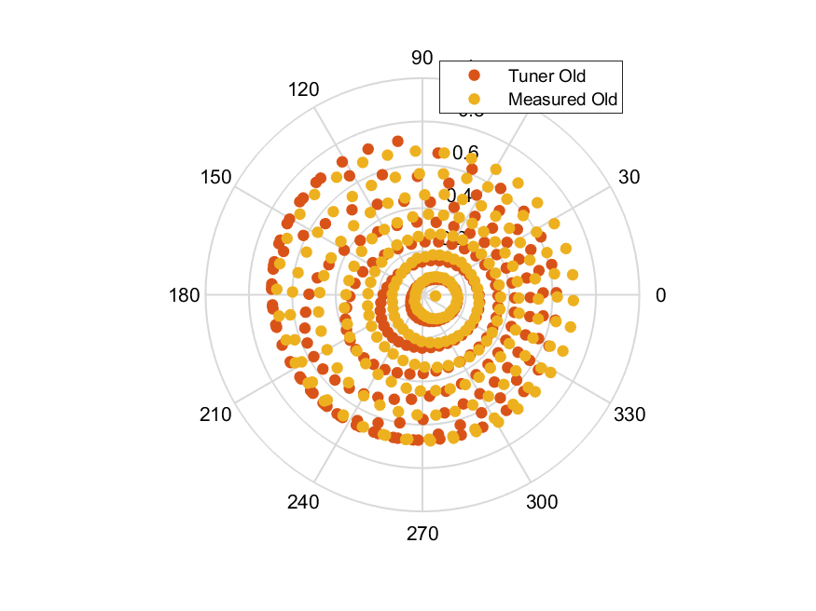
Load termination plot at11.7GHz

Slide 40
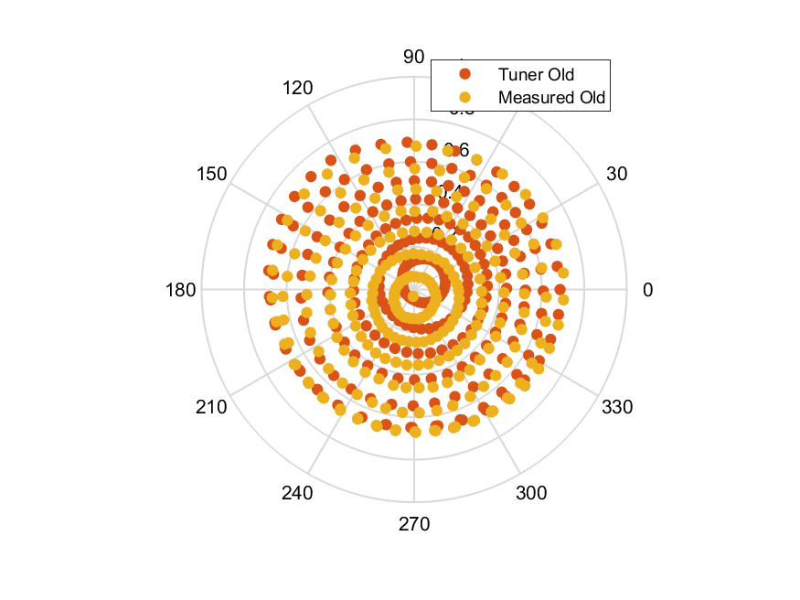
Load termination plot at11.8GHz

Slide 41
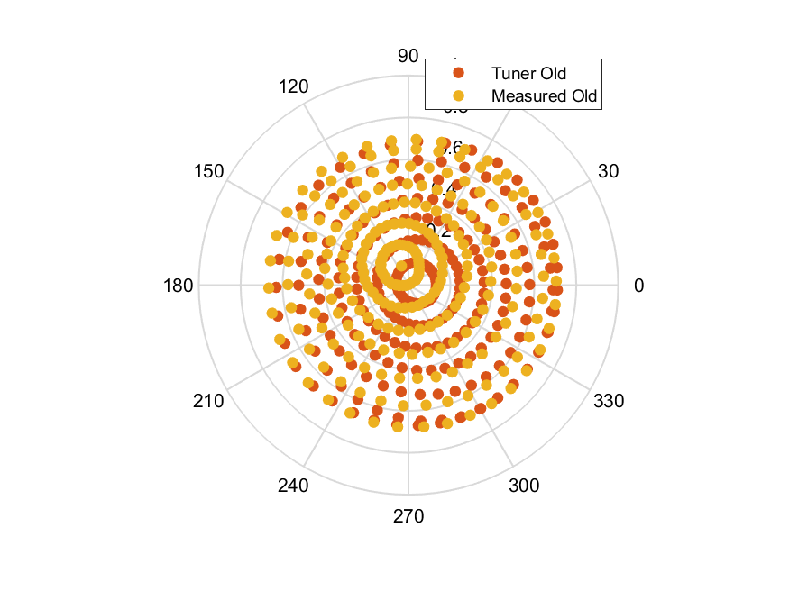
Load termination plot at11.9GHz

Slide 42
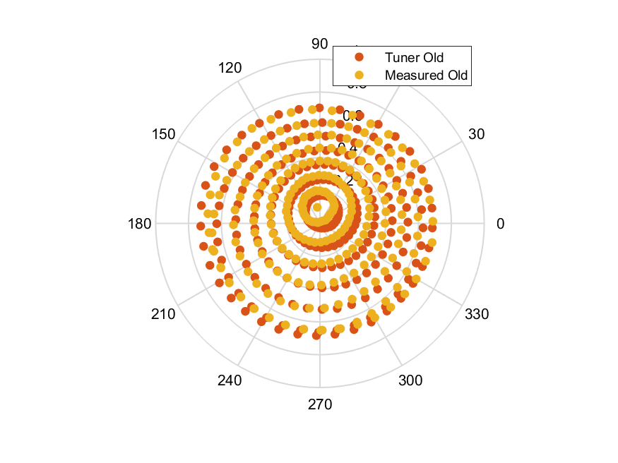
Load termination plot at12GHz

