Slide 1
Coupledline Compiled Data

Slide 2
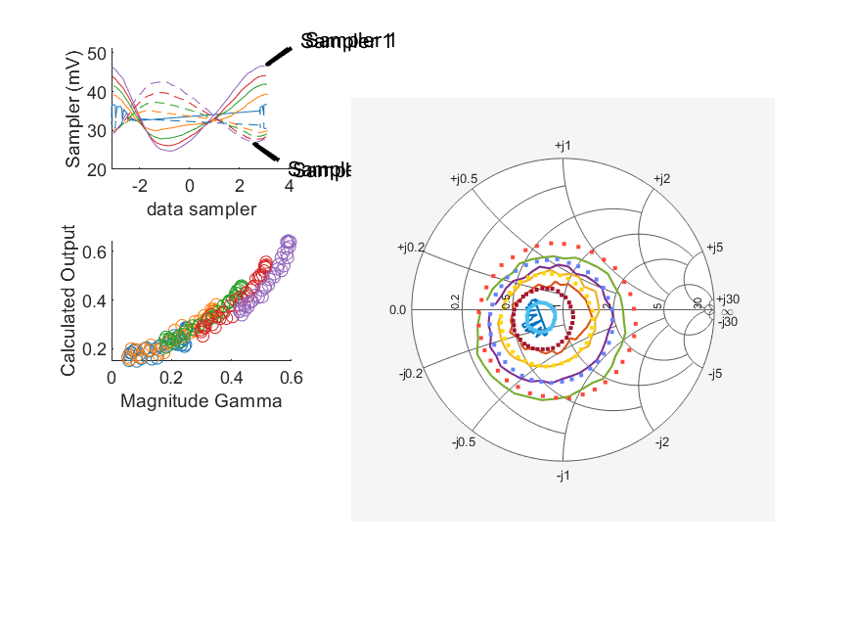
Coupled Line Performance At 10.40 GHz, 14.000000 dBm Output Power 1.90 V mean sampler bias
Sampler Av
  Sampler 1: 0.4
  Sampler 2: 0.271
Kappa
  Sampler 1: 0.0209
  Sampler 2: 0.0208
Goodness Of fit
  0.15258487600197301
Range
  Sampler 1: 0.0219
  Sampler 2: 0.0158
dBm Mean
  DUT output 14.7712
  DUT input 4.10848
RMS Error
  0.0476442
Max Error
  0.0960514

