Slide 1
Coupledline Compiled Data

Slide 2
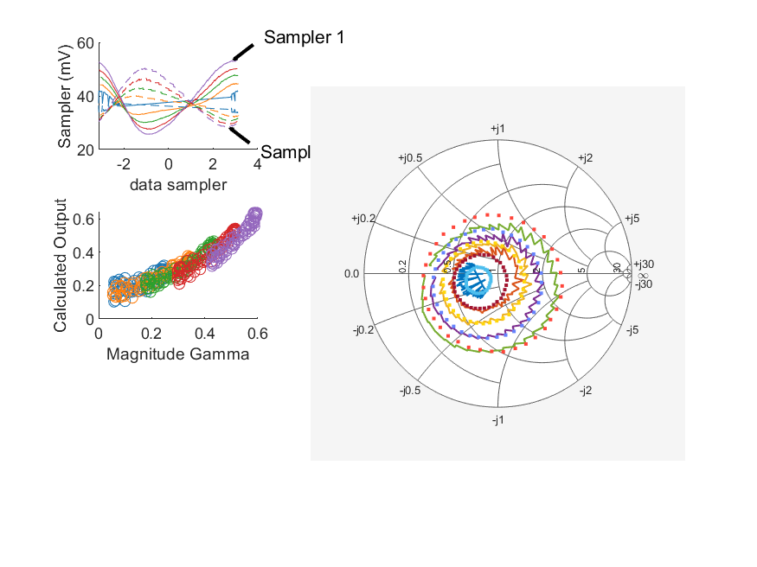
Coupled Line Performance At 10.40 GHz, 16.000000 dBm Output Power 1.72 V mean sampler bias
Sampler Av
  Sampler 1: 0.3
  Sampler 2: 0.226
Kappa
  Sampler 1: 0.0227
  Sampler 2: 0.0253
Goodness Of fit
  0.30560928325761405
Range
  Sampler 1: 0.0274
  Sampler 2: 0.022
dBm Mean
  DUT output 16.0742
  DUT input 4.34667
RMS Error
  0.0504821
Max Error
  0.110064

Slide 3
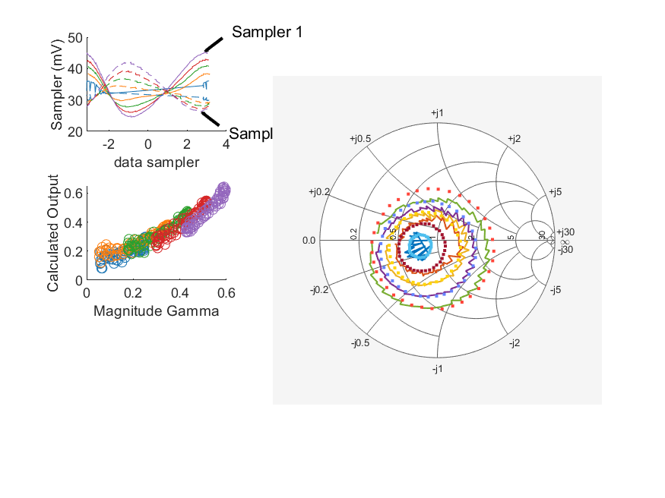
Coupled Line Performance At 10.40 GHz, 14.000000 dBm Output Power 1.82 V mean sampler bias
Sampler Av
  Sampler 1: 0.348
  Sampler 2: 0.251
Kappa
  Sampler 1: 0.0222
  Sampler 2: 0.0222
Goodness Of fit
  0.28714784958015938
Range
  Sampler 1: 0.0207
  Sampler 2: 0.0158
dBm Mean
  DUT output 14.6082
  DUT input 3.22322
RMS Error
  0.0471981
Max Error
  0.110505

Slide 4
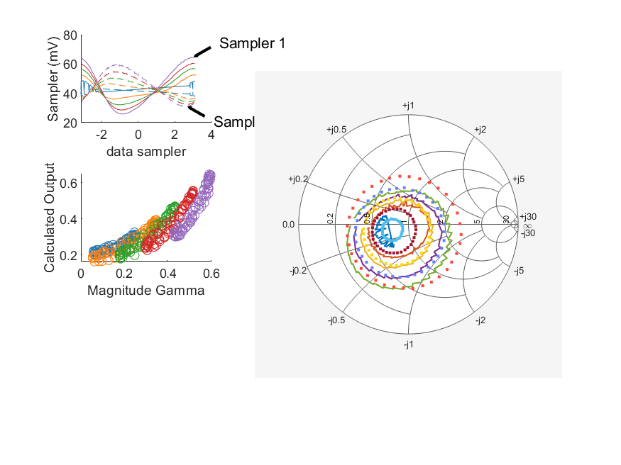
Coupled Line Performance At 10.40 GHz, 18.000000 dBm Output Power 1.82 V mean sampler bias
Sampler Av
  Sampler 1: 0.35
  Sampler 2: 0.244
Kappa
  Sampler 1: 0.0212
  Sampler 2: 0.0212
Goodness Of fit
  0.63415120496592603
Range
  Sampler 1: 0.039
  Sampler 2: 0.0289
dBm Mean
  DUT output 17.7074
  DUT input 6.64951
RMS Error
  0.0691645
Max Error
  0.147745

Slide 5
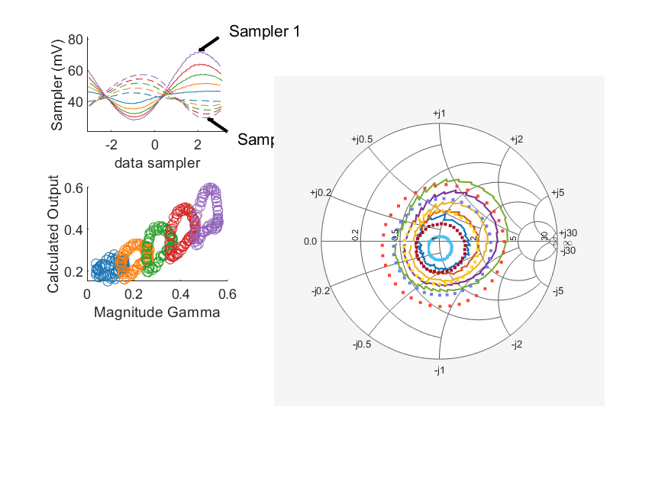
Coupled Line Performance At 10.90 GHz, 18.000000 dBm Output Power 1.82 V mean sampler bias
Sampler Av
  Sampler 1: 0.394
  Sampler 2: 0.227
Kappa
  Sampler 1: 0.019
  Sampler 2: 0.0213
Goodness Of fit
  1.116549269740603
Range
  Sampler 1: 0.0441
  Sampler 2: 0.0279
dBm Mean
  DUT output 17.8175
  DUT input 7.35988
RMS Error
  0.0859946
Max Error
  0.147816

Slide 6
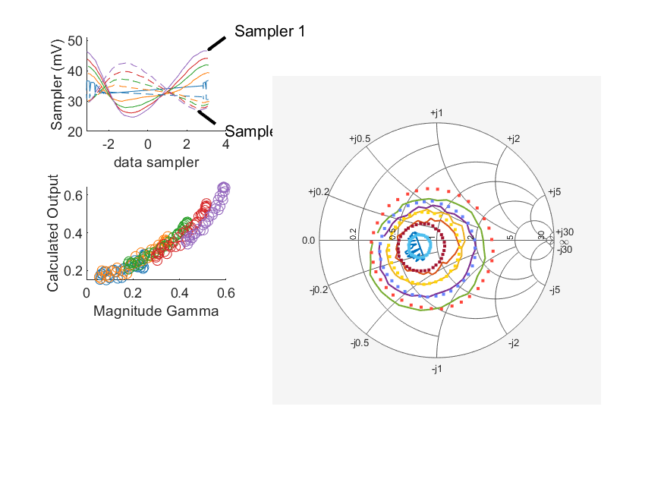
Coupled Line Performance At 10.40 GHz, 14.000000 dBm Output Power 1.90 V mean sampler bias
Sampler Av
  Sampler 1: 0.4
  Sampler 2: 0.271
Kappa
  Sampler 1: 0.0209
  Sampler 2: 0.0208
Goodness Of fit
  0.15258487600197301
Range
  Sampler 1: 0.0219
  Sampler 2: 0.0158
dBm Mean
  DUT output 14.7712
  DUT input 4.10848
RMS Error
  0.0476442
Max Error
  0.0960514

Slide 7
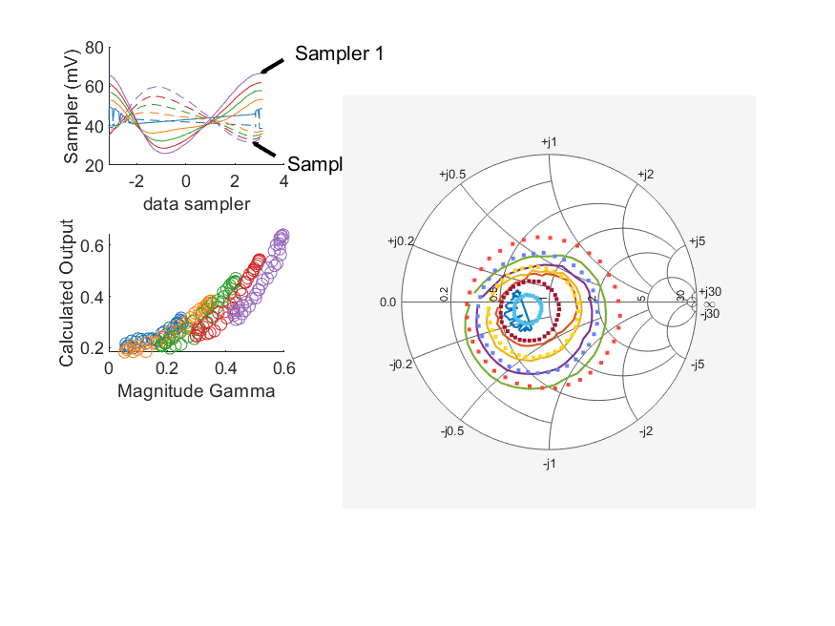
Coupled Line Performance At 10.40 GHz, 18.000000 dBm Output Power 1.90 V mean sampler bias
Sampler Av
  Sampler 1: 0.358
  Sampler 2: 0.237
Kappa
  Sampler 1: 0.0207
  Sampler 2: 0.0209
Goodness Of fit
  0.27217757203108861
Range
  Sampler 1: 0.0406
  Sampler 2: 0.0283
dBm Mean
  DUT output 17.7751
  DUT input 7.41609
RMS Error
  0.0651304
Max Error
  0.131651

