Slide 1
Coupledline Compiled Data

Slide 2
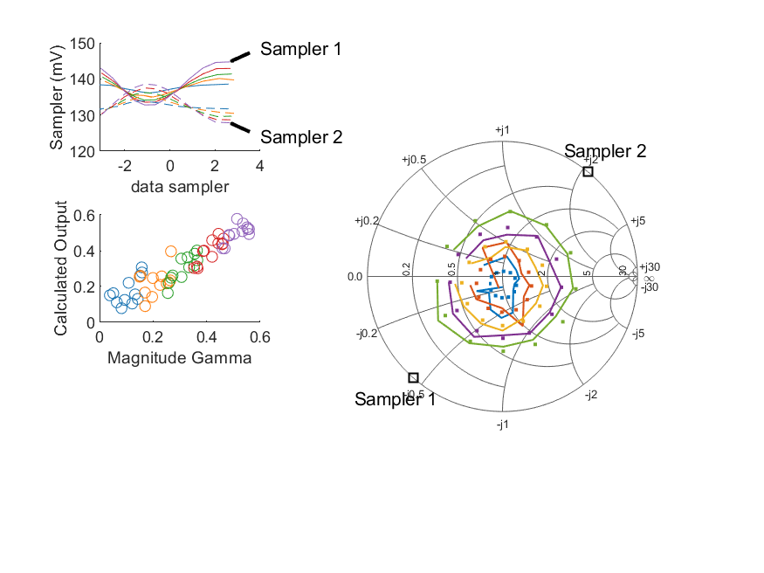
Coupled Line Performance At 10.90 GHz, 10.000000 dBm Output Power 1.50 V mean sampler bias
Sampler Av
  Sampler 1: 0.449
  Sampler 2: 0.366
Kappa
  Sampler 1: 0.13
  Sampler 2: 0.13
Goodness Of fit
  0.062071463746388195
Range
dBm Mean
  DUT output 9.98551
  DUT input 10.5002
RMS Error
  0.0646817
Max Error
  0.0969043

Slide 3
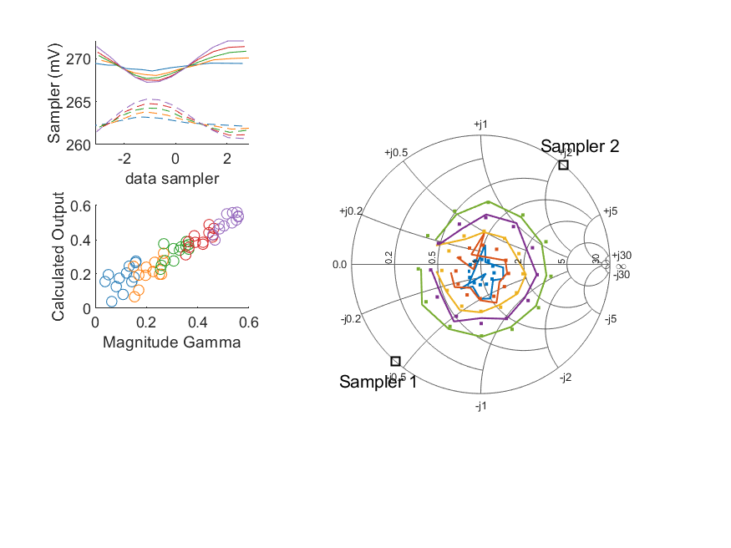
Coupled Line Performance At 10.90 GHz, 6.000000 dBm Output Power 1.75 V mean sampler bias
Sampler Av
  Sampler 1: 0.509
  Sampler 2: 0.423
Kappa
  Sampler 1: 0.268
  Sampler 2: 0.259
Goodness Of fit
  0.046643622884976255
Range
dBm Mean
  DUT output 5.93986
  DUT input 6.45489
RMS Error
  0.0691828
Max Error
  0.0713563

Slide 4
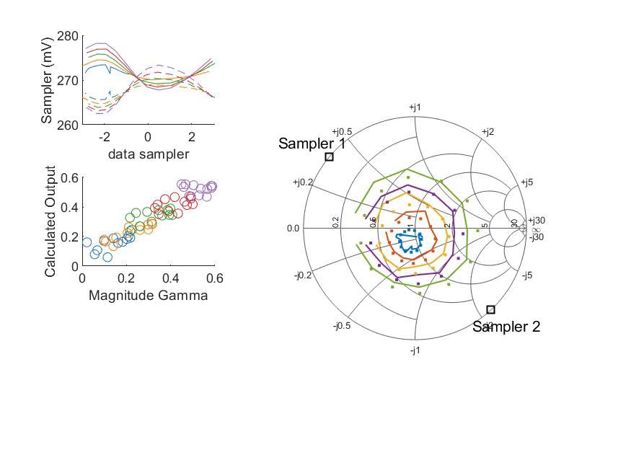
Coupled Line Performance At 10.80 GHz, 10.000000 dBm Output Power 1.75 V mean sampler bias
Sampler Av
  Sampler 1: 0.385
  Sampler 2: 0.409
Kappa
  Sampler 1: 0.266
  Sampler 2: 0.265
Goodness Of fit
  0.10644441446538641
Range
dBm Mean
  DUT output 9.98928
  DUT input 10.4341
RMS Error
  0.0575422
Max Error
  0.0946929

Slide 5
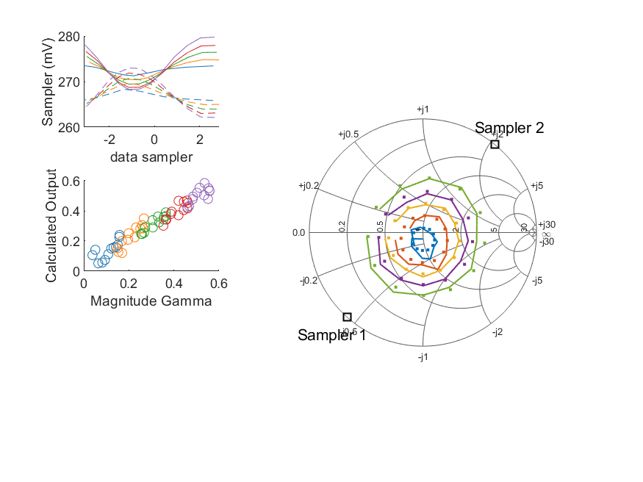
Coupled Line Performance At 10.90 GHz, 10.000000 dBm Output Power 1.75 V mean sampler bias
Sampler Av
  Sampler 1: 0.426
  Sampler 2: 0.365
Kappa
  Sampler 1: 0.265
  Sampler 2: 0.265
Goodness Of fit
  0.031863705692576717
Range
dBm Mean
  DUT output 9.98905
  DUT input 10.5074
RMS Error
  0.0439668
Max Error
  0.0712259

Slide 6
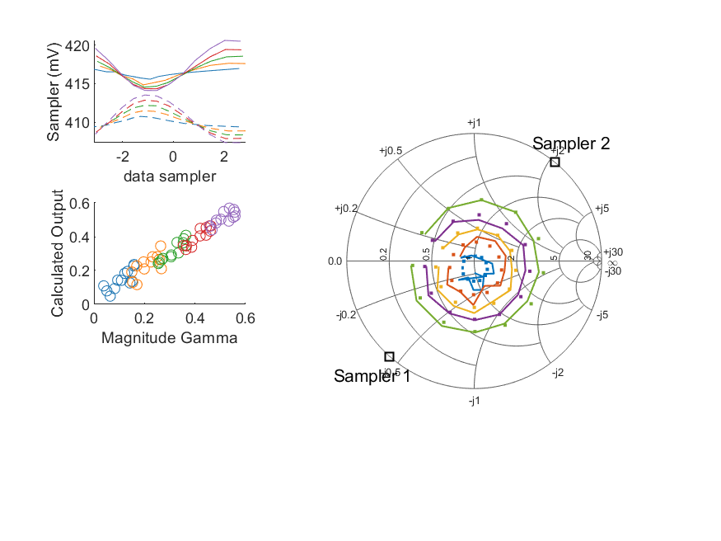
Coupled Line Performance At 10.90 GHz, 8.000000 dBm Output Power 2.00 V mean sampler bias
Sampler Av
  Sampler 1: 0.439
  Sampler 2: 0.378
Kappa
  Sampler 1: 0.412
  Sampler 2: 0.409
Goodness Of fit
  0.025366009392892481
Range
dBm Mean
  DUT output 7.98543
  DUT input 8.50184
RMS Error
  0.0487065
Max Error
  0.0704244

Slide 7
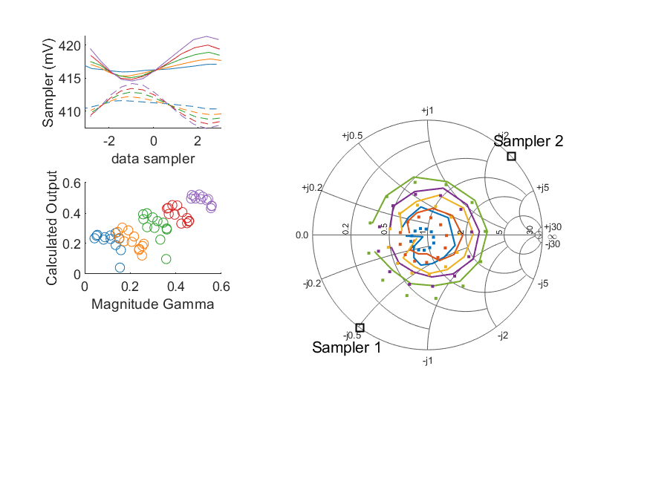
Coupled Line Performance At 11.20 GHz, 8.000000 dBm Output Power 2.00 V mean sampler bias
Sampler Av
  Sampler 1: 0.378
  Sampler 2: 0.336
Kappa
  Sampler 1: 0.411
  Sampler 2: 0.411
Goodness Of fit
  0.067979902529492292
Range
dBm Mean
  DUT output 8.00985
  DUT input 8.52097
RMS Error
  0.0640061
Max Error
  0.0879221

Slide 8
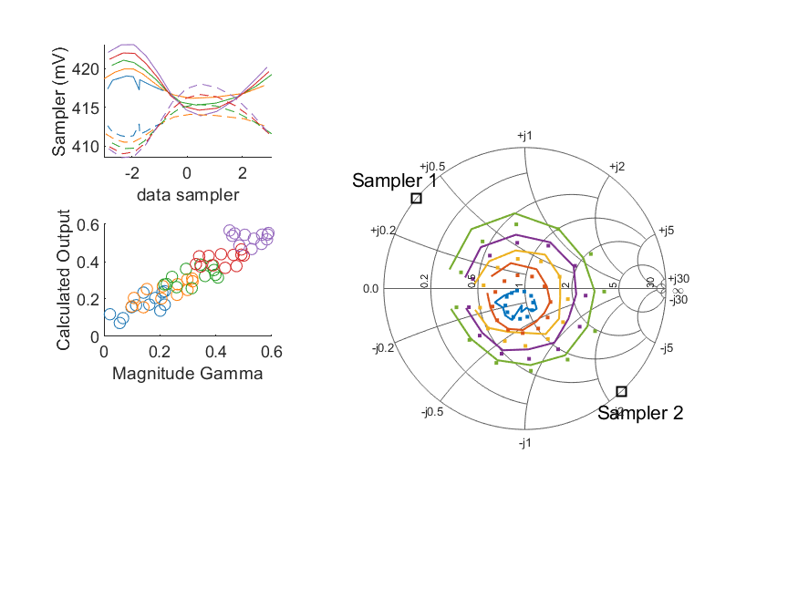
Coupled Line Performance At 10.80 GHz, 10.000000 dBm Output Power 2.00 V mean sampler bias
Sampler Av
  Sampler 1: 0.32
  Sampler 2: 0.343
Kappa
  Sampler 1: 0.412
  Sampler 2: 0.411
Goodness Of fit
  0.10935600373483753
Range
dBm Mean
  DUT output 9.97368
  DUT input 10.4174
RMS Error
  0.0580391
Max Error
  0.0999925

Slide 9
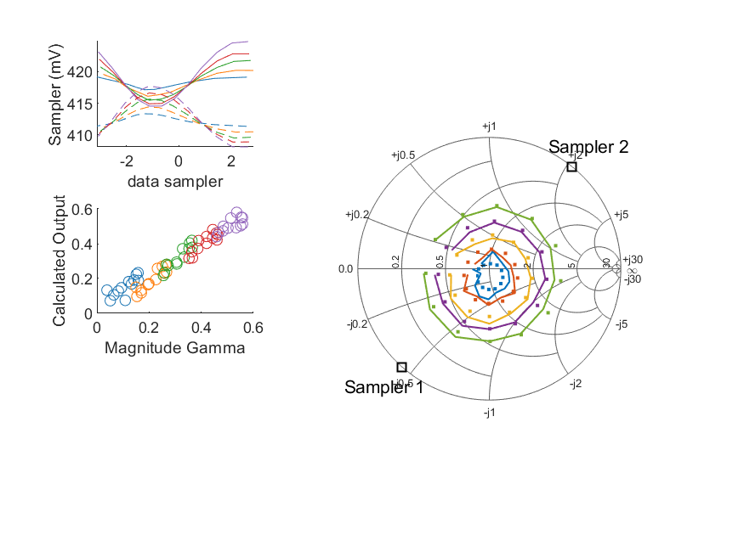
Coupled Line Performance At 10.90 GHz, 10.000000 dBm Output Power 2.00 V mean sampler bias
Sampler Av
  Sampler 1: 0.393
  Sampler 2: 0.339
Kappa
  Sampler 1: 0.411
  Sampler 2: 0.411
Goodness Of fit
  0.024656456459019312
Range
dBm Mean
  DUT output 9.97417
  DUT input 10.4914
RMS Error
  0.0361116
Max Error
  0.0697982

Slide 10
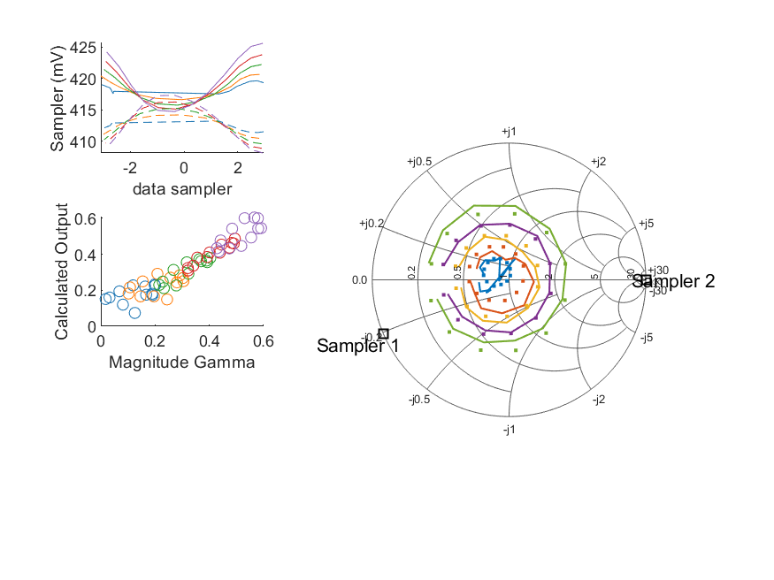
Coupled Line Performance At 11.00 GHz, 10.000000 dBm Output Power 2.00 V mean sampler bias
Sampler Av
  Sampler 1: 0.415
  Sampler 2: 0.416
Kappa
  Sampler 1: 0.411
  Sampler 2: 0.411
Goodness Of fit
  0.051220588194671859
Range
dBm Mean
  DUT output 10.0123
  DUT input 10.4481
RMS Error
  0.0532743
Max Error
  0.0845864

