Slide 1
Coupledline Compiled Data

Slide 2
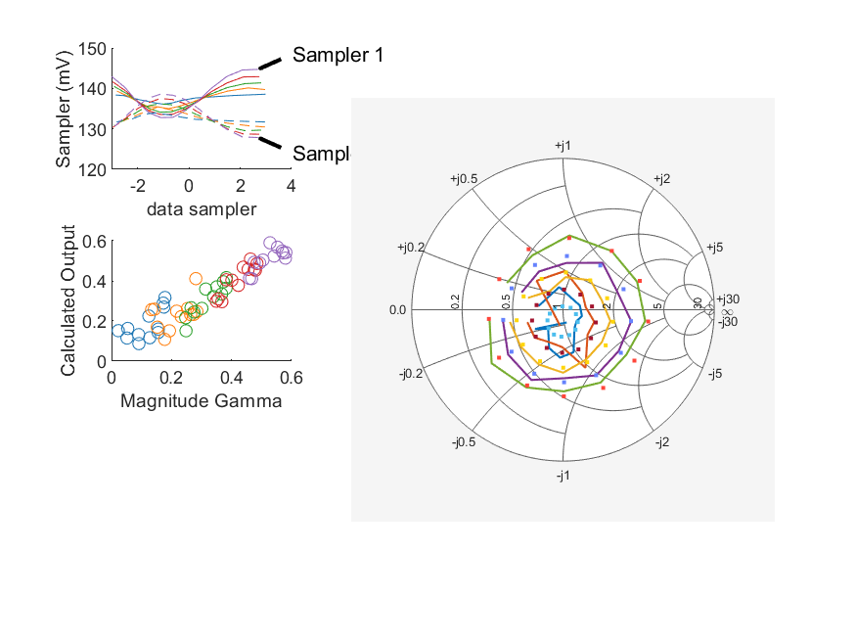
Coupled Line Performance At 10.90 GHz, 10.000000 dBm Output Power 1.50 V mean sampler bias
Sampler Av
  Sampler 1: 0.449
  Sampler 2: 0.366
Kappa
  Sampler 1: 0.13
  Sampler 2: 0.13
Goodness Of fit
  0.062071463746388195
Range
  Sampler 1: 0.0119
  Sampler 2: 0.0107
dBm Mean
  DUT output 9.98551
  DUT input 10.5002
RMS Error
  0.0646817
Max Error
  0.0969043

Slide 3
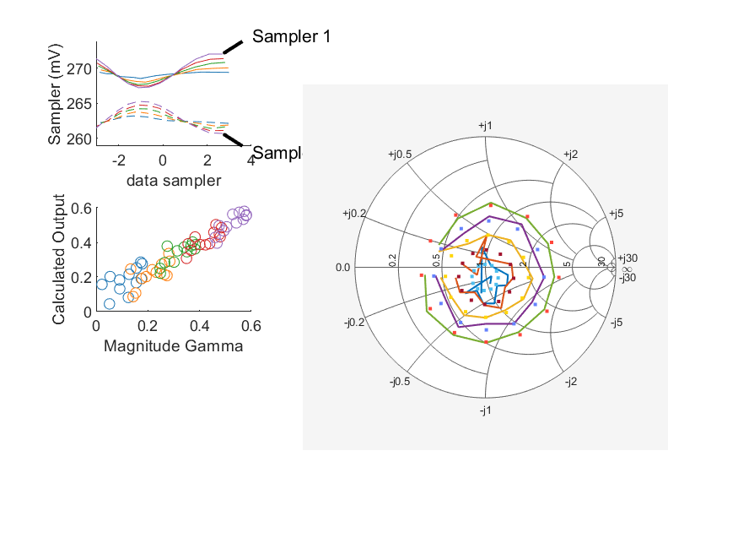
Coupled Line Performance At 10.90 GHz, 6.000000 dBm Output Power 1.75 V mean sampler bias
Sampler Av
  Sampler 1: 0.509
  Sampler 2: 0.423
Kappa
  Sampler 1: 0.268
  Sampler 2: 0.259
Goodness Of fit
  0.046643622884976255
Range
  Sampler 1: 0.00481
  Sampler 2: 0.00458
dBm Mean
  DUT output 5.93986
  DUT input 6.45489
RMS Error
  0.0691828
Max Error
  0.0713563

Slide 4
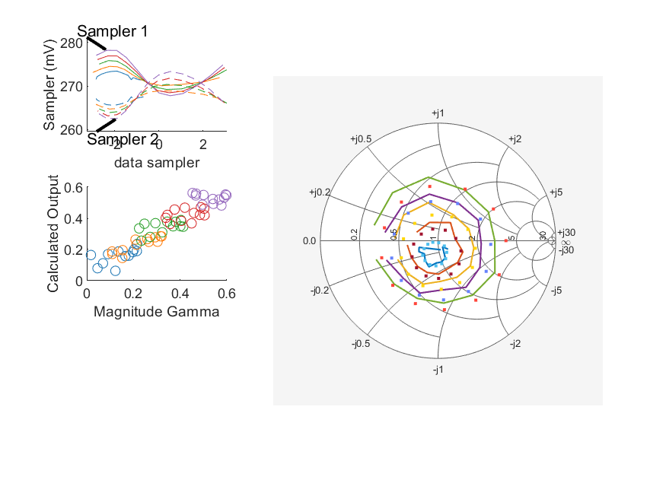
Coupled Line Performance At 10.80 GHz, 10.000000 dBm Output Power 1.75 V mean sampler bias
Sampler Av
  Sampler 1: 0.385
  Sampler 2: 0.409
Kappa
  Sampler 1: 0.266
  Sampler 2: 0.265
Goodness Of fit
  0.10644441446538641
Range
  Sampler 1: 0.0104
  Sampler 2: 0.0108
dBm Mean
  DUT output 9.98928
  DUT input 10.4341
RMS Error
  0.0575422
Max Error
  0.0946929

Slide 5
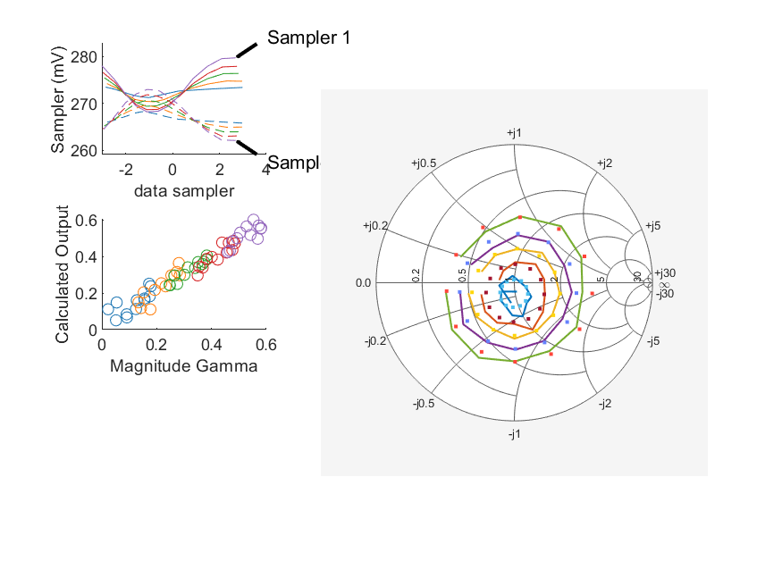
Coupled Line Performance At 10.90 GHz, 10.000000 dBm Output Power 1.75 V mean sampler bias
Sampler Av
  Sampler 1: 0.426
  Sampler 2: 0.365
Kappa
  Sampler 1: 0.265
  Sampler 2: 0.265
Goodness Of fit
  0.031863705692576717
Range
  Sampler 1: 0.0115
  Sampler 2: 0.0109
dBm Mean
  DUT output 9.98905
  DUT input 10.5074
RMS Error
  0.0439668
Max Error
  0.0712259

Slide 6
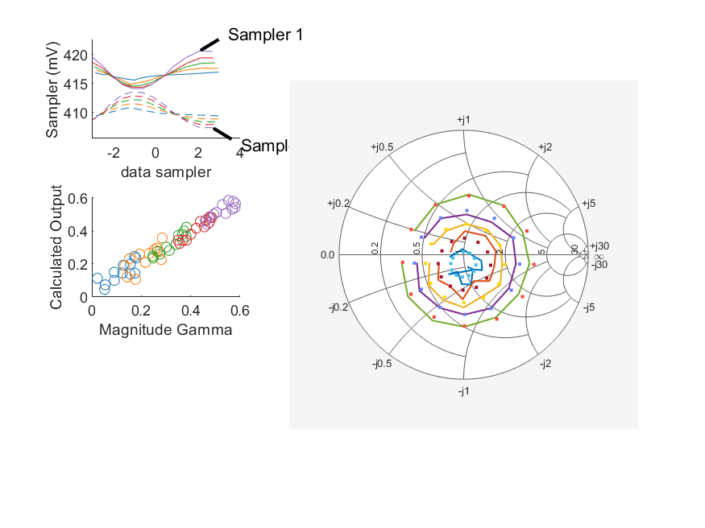
Coupled Line Performance At 10.90 GHz, 8.000000 dBm Output Power 2.00 V mean sampler bias
Sampler Av
  Sampler 1: 0.439
  Sampler 2: 0.378
Kappa
  Sampler 1: 0.412
  Sampler 2: 0.409
Goodness Of fit
  0.025366009392892481
Range
  Sampler 1: 0.00649
  Sampler 2: 0.00618
dBm Mean
  DUT output 7.98543
  DUT input 8.50184
RMS Error
  0.0487065
Max Error
  0.0704244

Slide 7
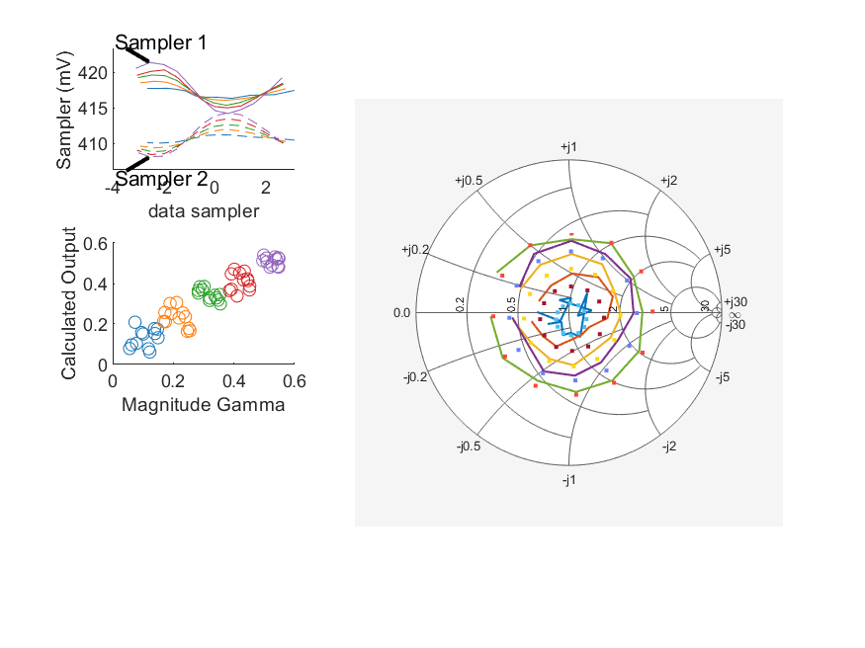
Coupled Line Performance At 11.20 GHz, 8.000000 dBm Output Power 2.00 V mean sampler bias
Sampler Av
  Sampler 1: 0.378
  Sampler 2: 0.336
Kappa
  Sampler 1: 0.411
  Sampler 2: 0.411
Goodness Of fit
  0.067979902529492292
Range
  Sampler 1: 0.00716
  Sampler 2: 0.00616
dBm Mean
  DUT output 8.00985
  DUT input 8.52097
RMS Error
  0.0640061
Max Error
  0.0879221

Slide 8
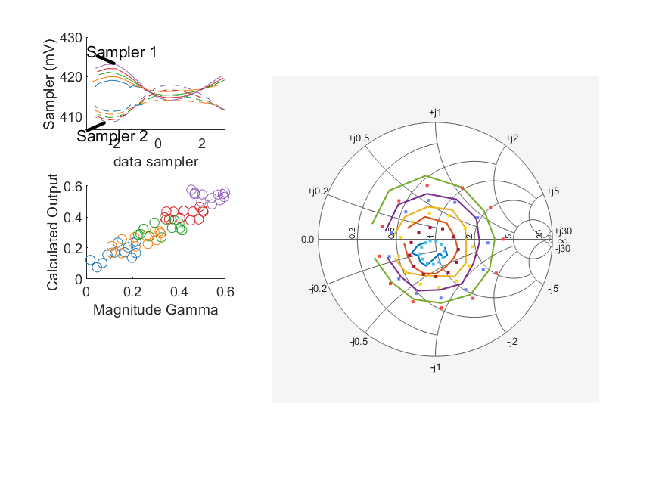
Coupled Line Performance At 10.80 GHz, 10.000000 dBm Output Power 2.00 V mean sampler bias
Sampler Av
  Sampler 1: 0.32
  Sampler 2: 0.343
Kappa
  Sampler 1: 0.412
  Sampler 2: 0.411
Goodness Of fit
  0.10935600373483753
Range
  Sampler 1: 0.00919
  Sampler 2: 0.00953
dBm Mean
  DUT output 9.97368
  DUT input 10.4174
RMS Error
  0.0580391
Max Error
  0.0999925

Slide 9
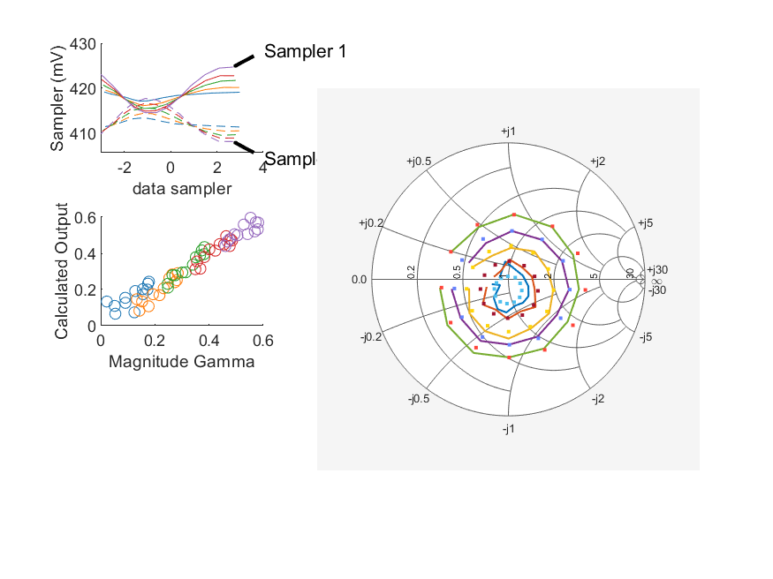
Coupled Line Performance At 10.90 GHz, 10.000000 dBm Output Power 2.00 V mean sampler bias
Sampler Av
  Sampler 1: 0.393
  Sampler 2: 0.339
Kappa
  Sampler 1: 0.411
  Sampler 2: 0.411
Goodness Of fit
  0.024656456459019312
Range
  Sampler 1: 0.0101
  Sampler 2: 0.00959
dBm Mean
  DUT output 9.97417
  DUT input 10.4914
RMS Error
  0.0361116
Max Error
  0.0697982

Slide 10
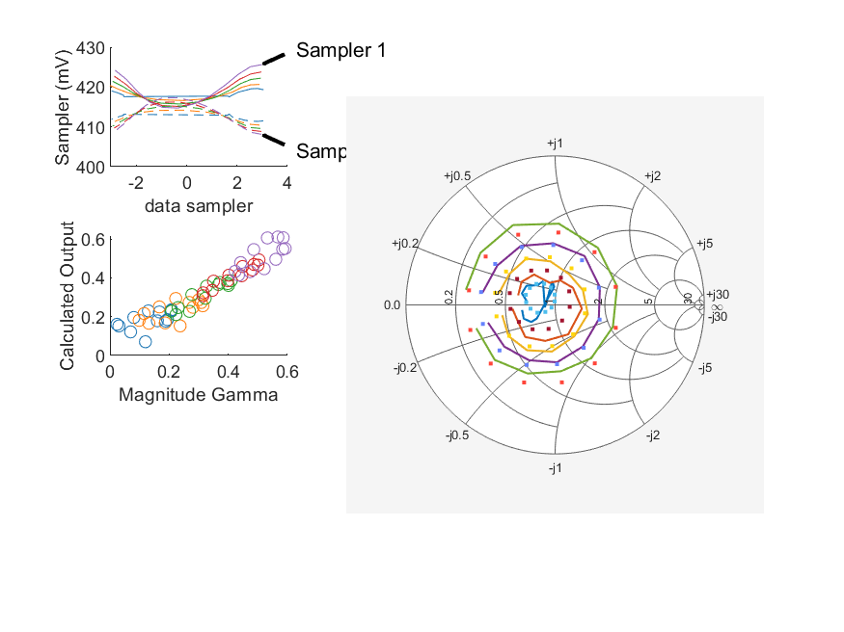
Coupled Line Performance At 11.00 GHz, 10.000000 dBm Output Power 2.00 V mean sampler bias
Sampler Av
  Sampler 1: 0.415
  Sampler 2: 0.416
Kappa
  Sampler 1: 0.411
  Sampler 2: 0.411
Goodness Of fit
  0.051220588194671859
Range
  Sampler 1: 0.0109
  Sampler 2: 0.0092
dBm Mean
  DUT output 10.0123
  DUT input 10.4481
RMS Error
  0.0532743
Max Error
  0.0845864

