Slide 1
Simple Drive Up Report
None

Slide 2
Test Configuration
Frequencies: (GHz)
8.9, 9.4, 9.9, 10.4, 10.9, 11.4, 11.9
Input Powers: (dBm)
14, 16, 18, 22
Load Impedances:
Gamma Magnitude:
0.1, 0.2, 0.3, 0.4, 0.5
Gamma Phase
0.1, 0.2, 0.3, 0.4, 0.5

Slide 3
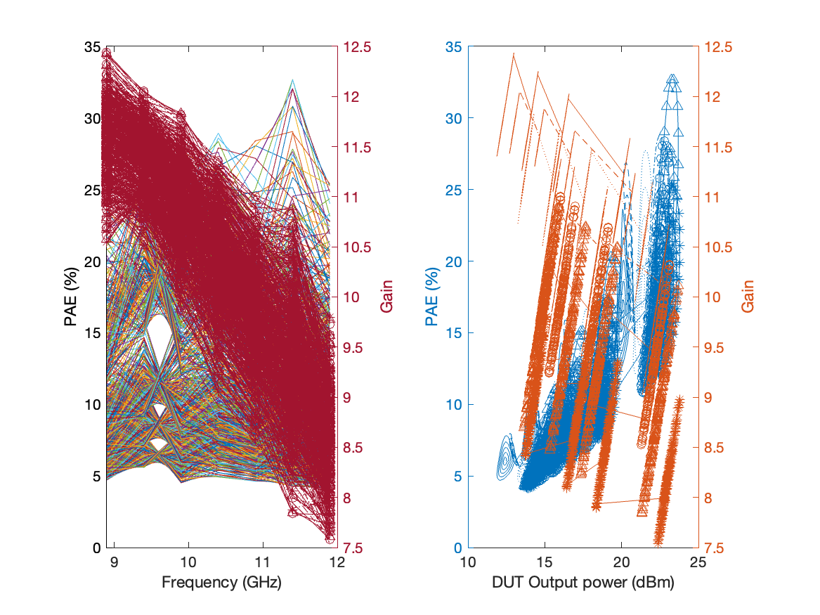
Large Signal Performance

