Slide 1
Simple Load Pull Report
None

Slide 2
Test Configuration
Frequencies: (GHz)
8.9, 9.4, 9.9, 10.4, 10.9, 11.4, 11.9
Input Powers: (dBm)
14, 16, 18, 22
Load Impedances:
Gamma Magnitude:
0.1, 0.2, 0.3, 0.4, 0.5
Gamma Phase
-175, -165, -155, -145, -135, -125, -115, -105, -95, -85, -75, -65, -55, -45, -35, -25, -15, -5, 5, 15, 25, 35, 45, 55, 65, 75, 85, 95, 105, 115, 125, 135, 145, 155, 165, 175

Slide 3
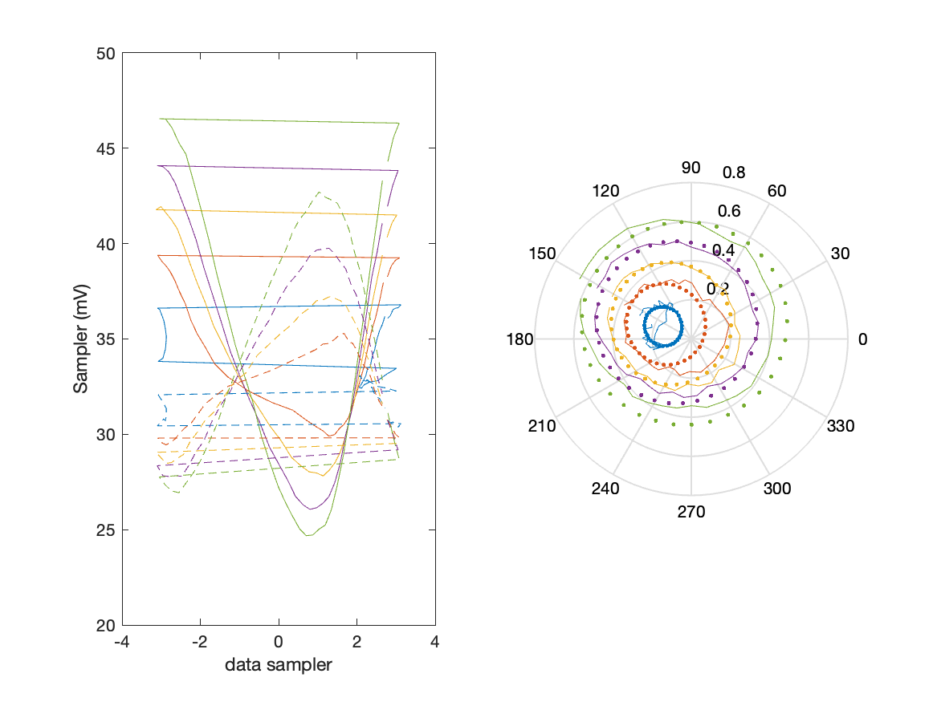
Sampler Performance Frequency 10.40 GHz, Power 14 dBm
Sampler Av
Sampler 1: 35.896
Sampler 2: 54.013
Sampler Offset (rather than -1)
-2.9095
Goodness Of fit
0.15881

Slide 4
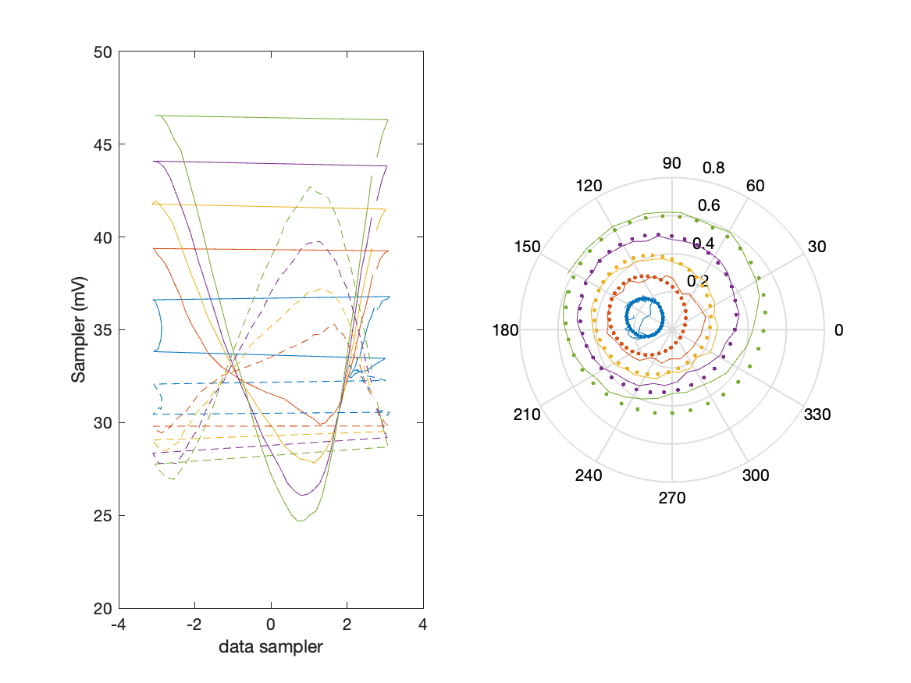
Sampler Performance x^3 Frequency 10.40 GHz, Power 14 dBm
Sampler Av
Sampler 1: 2.302255e+01
Sampler 2: 16.254
Sampler Av3
Sampler 1: 13.482
Sampler 2: 20.902
Sampler Offset (rather than -1)
-1.665
Goodness Of fit
0.089532

Slide 5
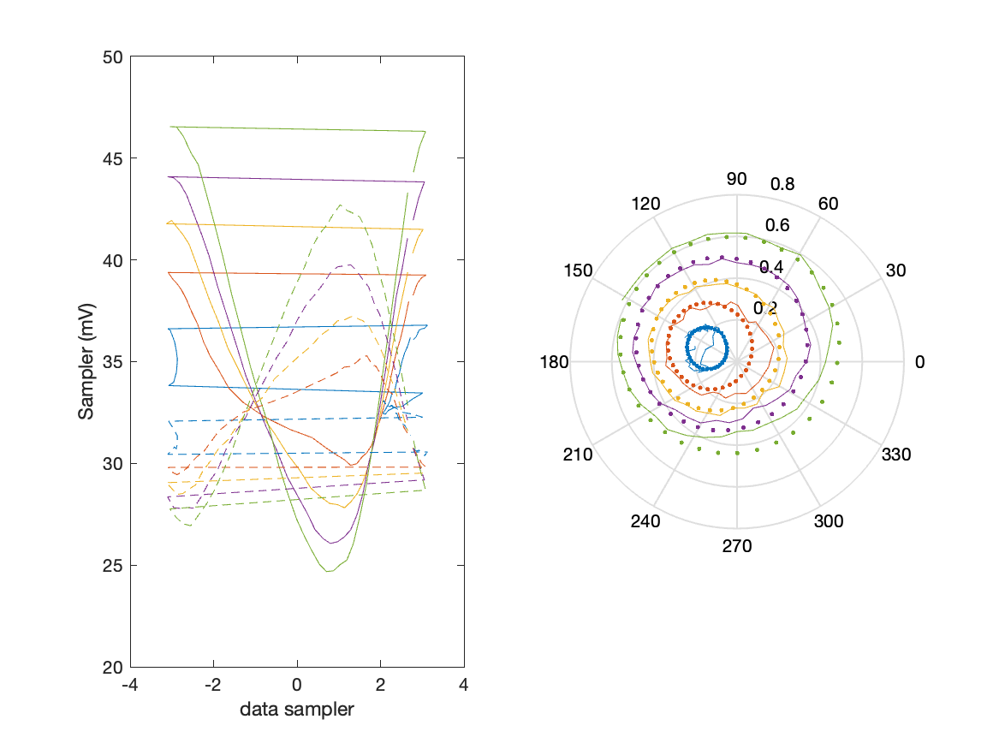
Sampler Performance x^2 x^3 Frequency 10.40 GHz, Power 14 dBm
Sampler Av
Sampler 1: 21.233
Sampler 2: 17.715
Sampler Av3
Sampler 1: 12.846
Sampler 2: 20.613
Sampler Av2
Sampler 1: 6.692
Sampler 2: 0.194
Sampler Offset (rather than -1)
-1.6777
Goodness Of fit
0.089557

Slide 6
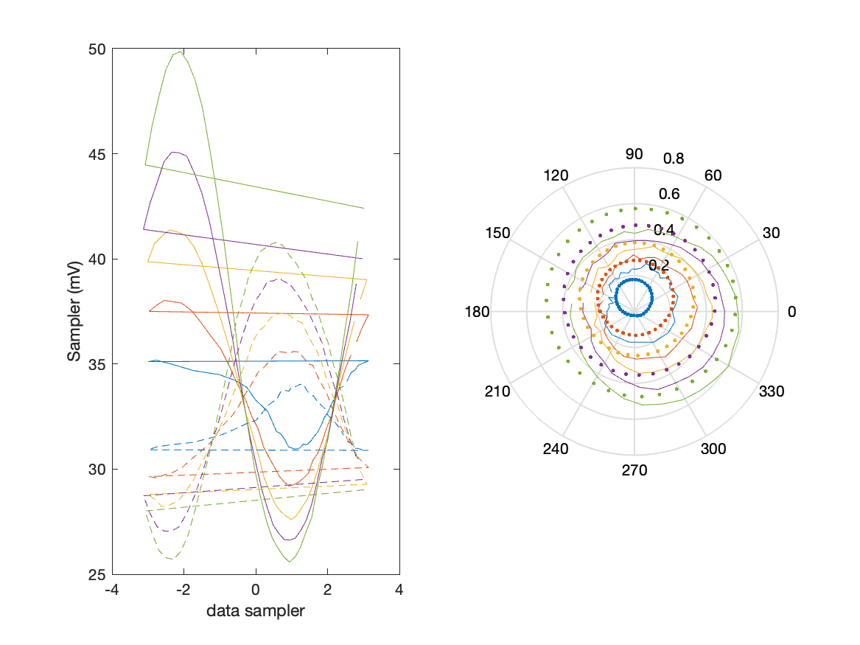
Sampler Performance Frequency 10.90 GHz, Power 14 dBm
Sampler Av
Sampler 1: 26.876
Sampler 2: 50.354
Sampler Offset (rather than -1)
-2.4769
Goodness Of fit
0.61029

Slide 7
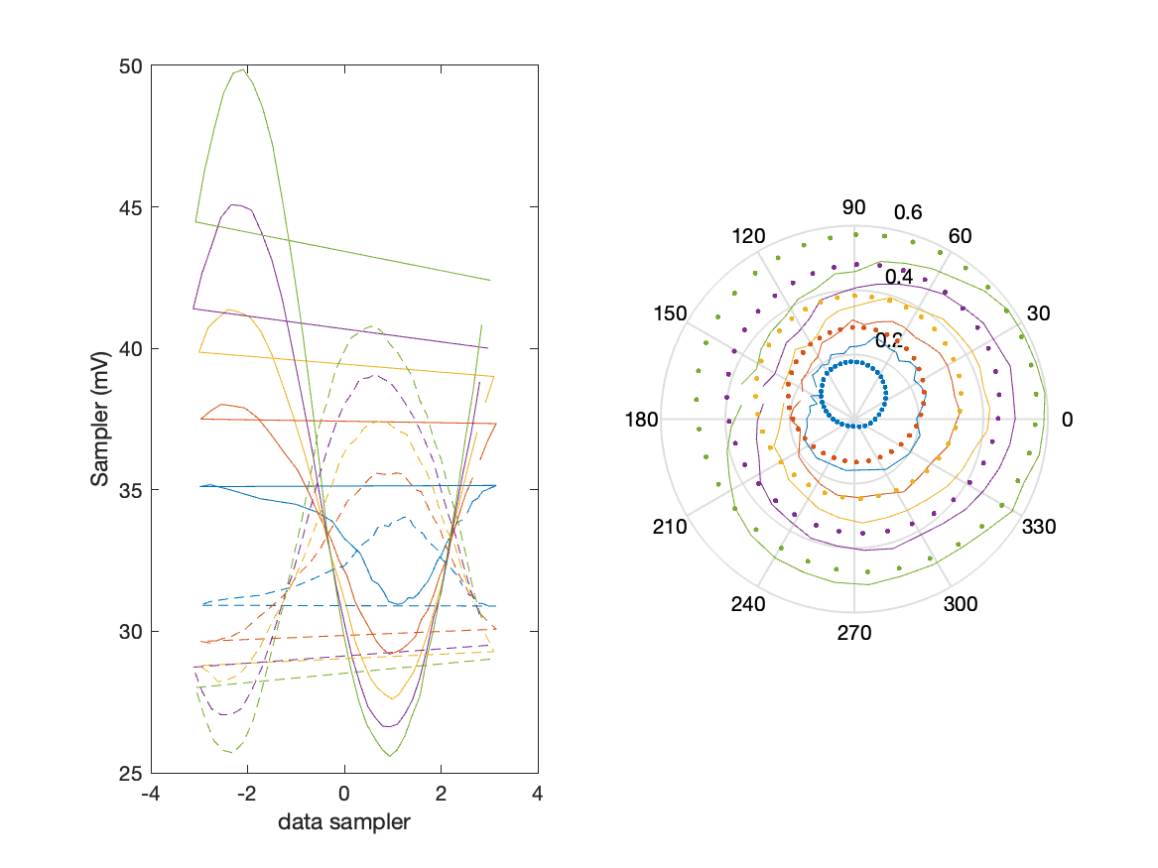
Sampler Performance x^3 Frequency 10.90 GHz, Power 14 dBm
Sampler Av
Sampler 1: 1.160409e+01
Sampler 2: 0.001
Sampler Av3
Sampler 1: 13.592
Sampler 2: 23.304
Sampler Offset (rather than -1)
-0.86841
Goodness Of fit
0.48299

Slide 8
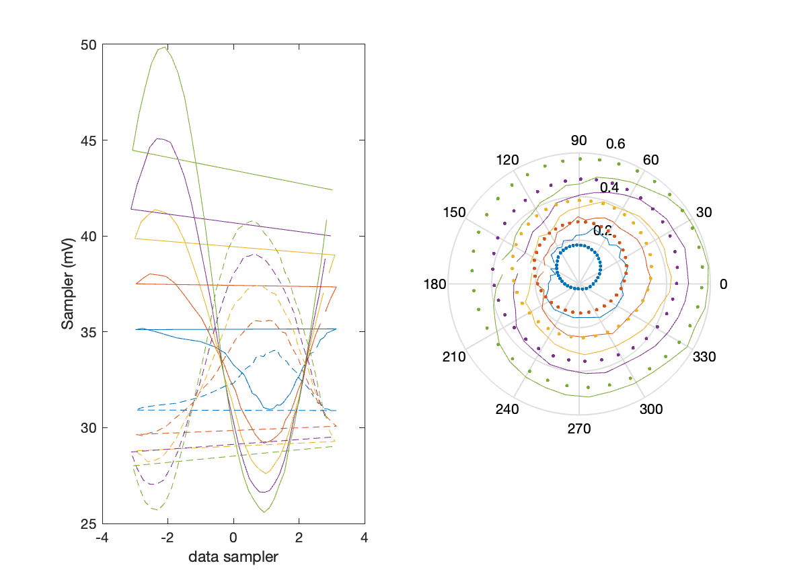
Sampler Performance x^2 x^3 Frequency 10.90 GHz, Power 14 dBm
Sampler Av
Sampler 1: 6.278
Sampler 2: 5.471
Sampler Av3
Sampler 1: 9.847
Sampler 2: 22.517
Sampler Av2
Sampler 1: 13.066
Sampler 2: 0.321
Sampler Offset (rather than -1)
-0.95891
Goodness Of fit
0.48504

Slide 9
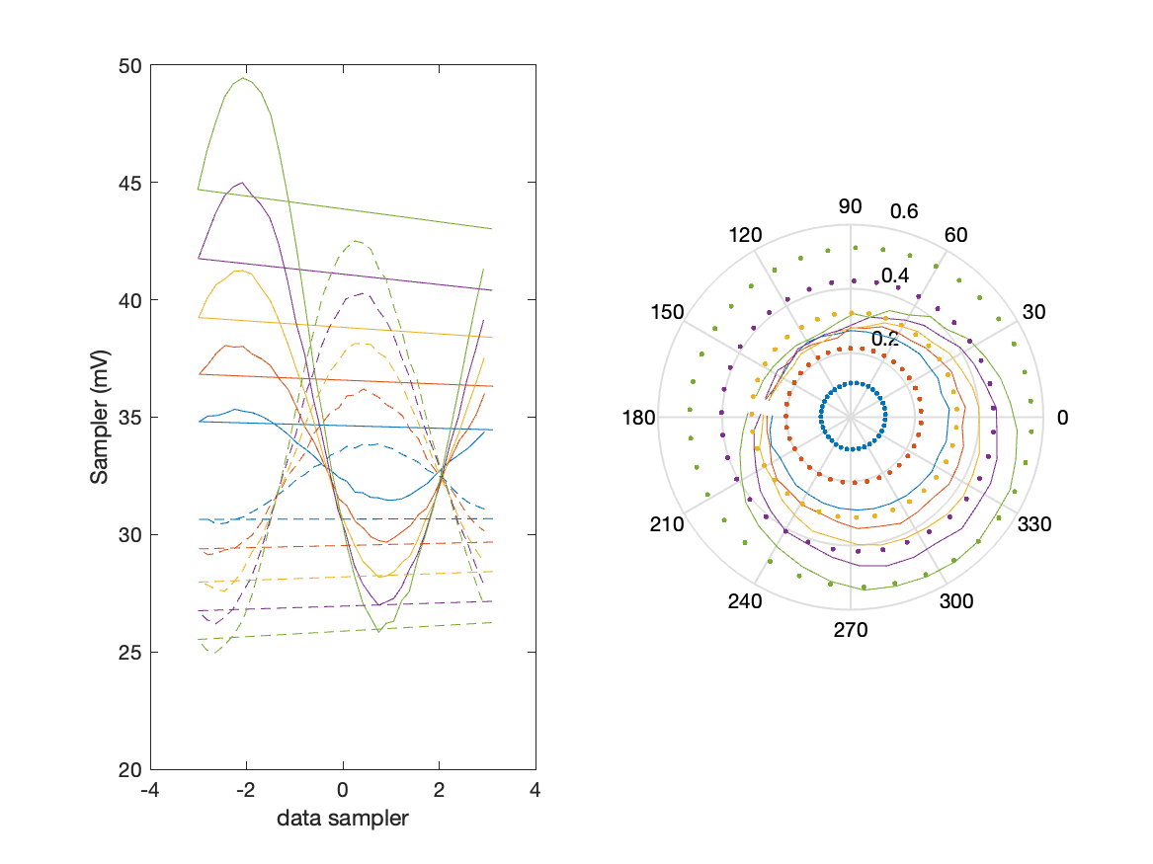
Sampler Performance Frequency 11.40 GHz, Power 14 dBm
Sampler Av
Sampler 1: 17.400
Sampler 2: 23.932
Sampler Offset (rather than -1)
-1.2744
Goodness Of fit
1.0257

Slide 10
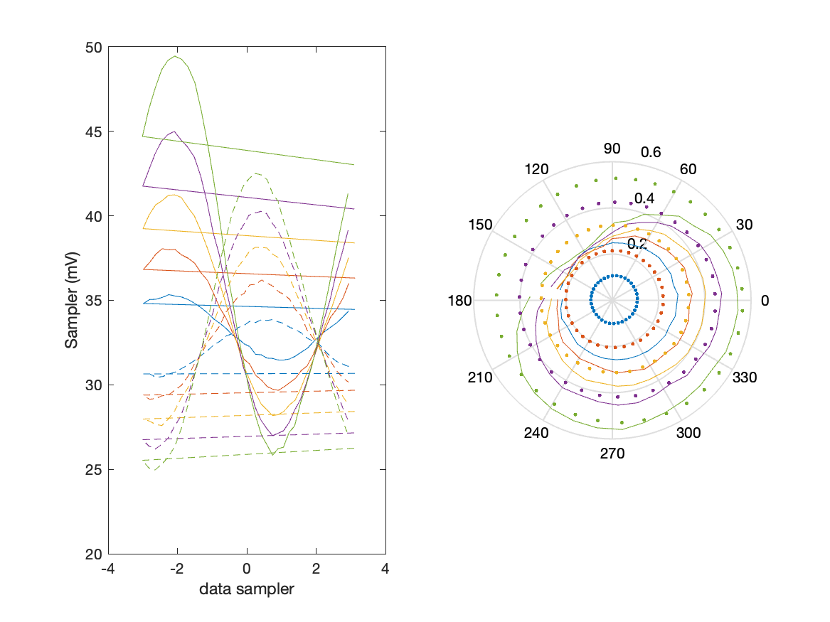
Sampler Performance x^3 Frequency 11.40 GHz, Power 14 dBm
Sampler Av
Sampler 1: 2.929934e-07
Sampler 2: 0.000
Sampler Av3
Sampler 1: 15.741
Sampler 2: 18.721
Sampler Offset (rather than -1)
-0.30238
Goodness Of fit
0.78067

Slide 11
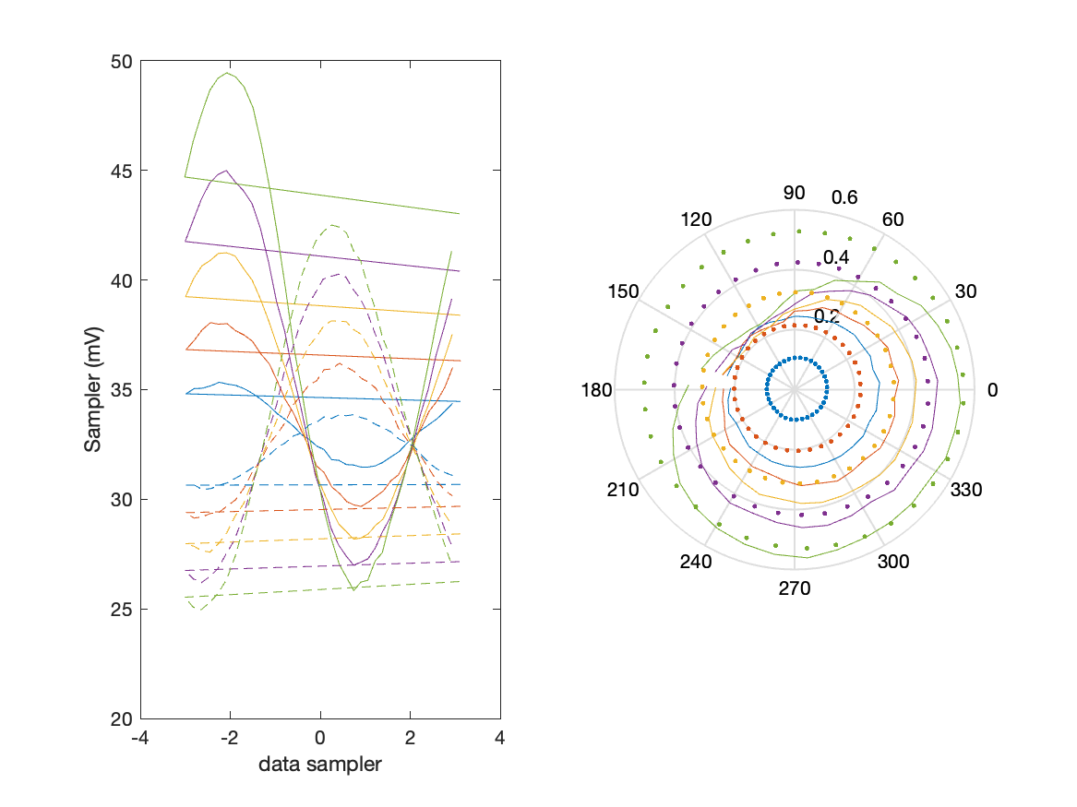
Sampler Performance x^2 x^3 Frequency 11.40 GHz, Power 14 dBm
Sampler Av
Sampler 1: 5.397
Sampler 2: 2.415
Sampler Av3
Sampler 1: 14.258
Sampler 2: 18.518
Sampler Av2
Sampler 1: 0.114
Sampler 2: 0.462
Sampler Offset (rather than -1)
-0.51659
Goodness Of fit
0.81076

Slide 12
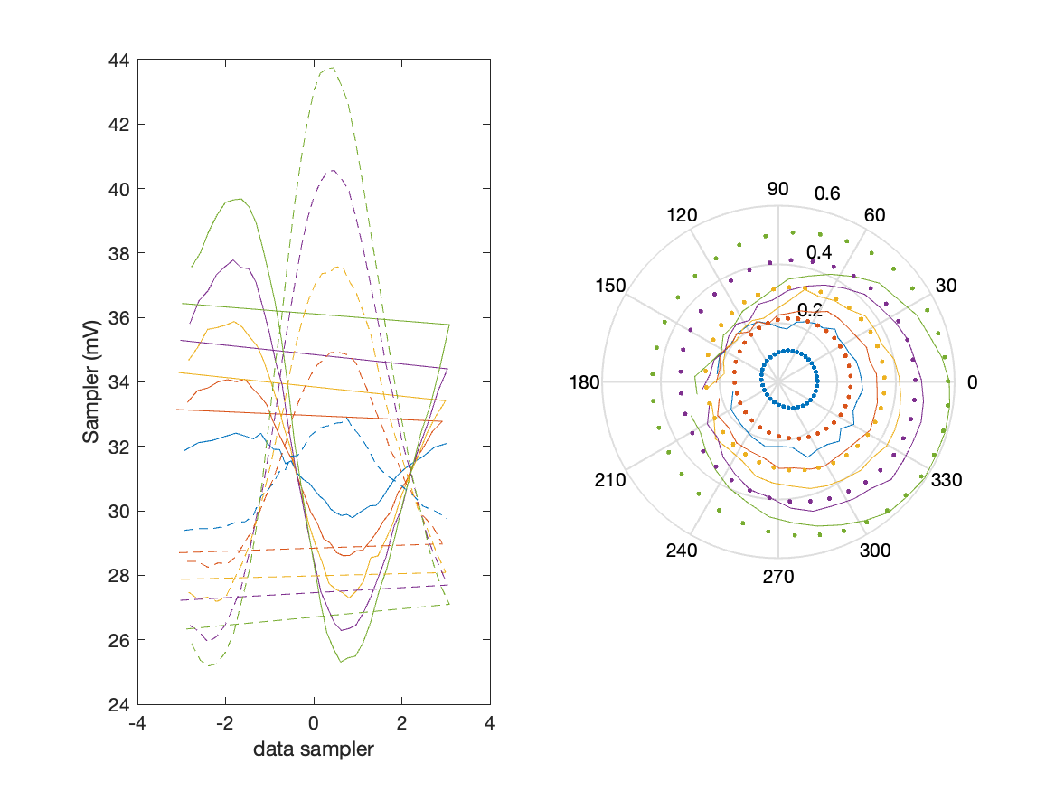
Sampler Performance Frequency 11.90 GHz, Power 14 dBm
Sampler Av
Sampler 1: 32.812
Sampler 2: 31.382
Sampler Offset (rather than -1)
-1.9431
Goodness Of fit
0.55428

Slide 13
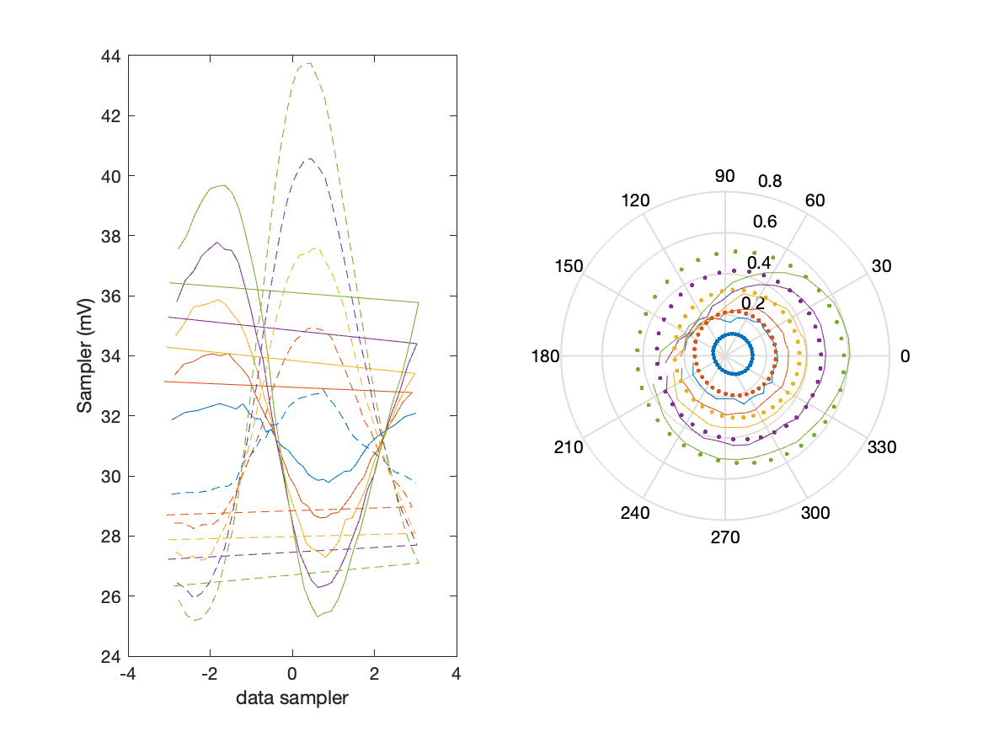
Sampler Performance x^3 Frequency 11.90 GHz, Power 14 dBm
Sampler Av
Sampler 1: 1.104440e-07
Sampler 2: 2.325
Sampler Av3
Sampler 1: 20.769
Sampler 2: 19.419
Sampler Offset (rather than -1)
-0.51897
Goodness Of fit
0.4172

Slide 14

Sampler Performance x^2 x^3 Frequency 11.90 GHz, Power 14 dBm
Sampler Av
Sampler 1: 6.829
Sampler 2: 9.975
Sampler Av3
Sampler 1: 19.643
Sampler 2: 17.816
Sampler Av2
Sampler 1: -0.057
Sampler 2: -0.037
Sampler Offset (rather than -1)
-0.87823
Goodness Of fit
0.43124

Slide 15
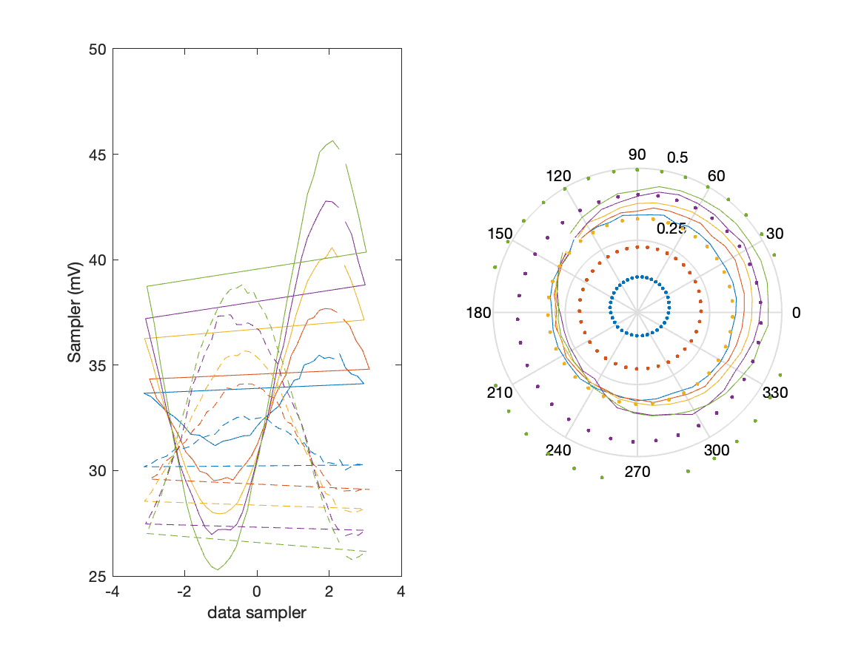
Sampler Performance Frequency 8.90 GHz, Power 14 dBm
Sampler Av
Sampler 1: 9.424
Sampler 2: 18.846
Sampler Offset (rather than -1)
-0.79821
Goodness Of fit
1.5497

Slide 16
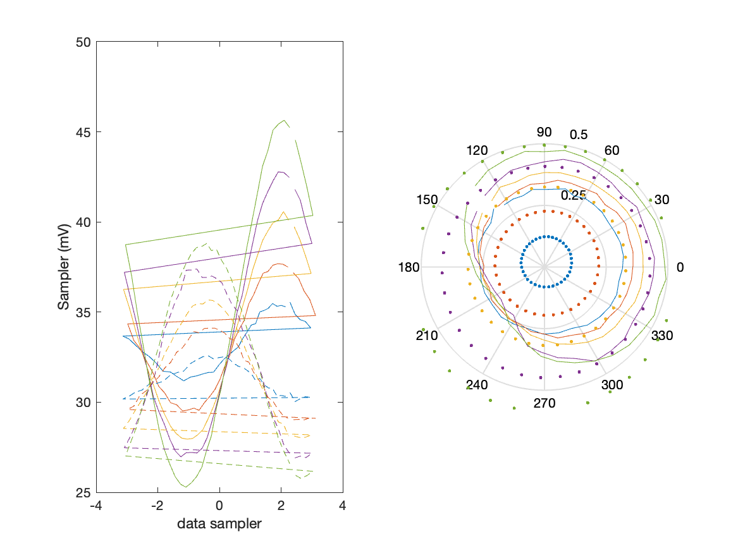
Sampler Performance x^3 Frequency 8.90 GHz, Power 14 dBm
Sampler Av
Sampler 1: 3.766403e-14
Sampler 2: 0.000
Sampler Av3
Sampler 1: 15.003
Sampler 2: 19.478
Sampler Offset (rather than -1)
-0.26427
Goodness Of fit
1.3026

Slide 17
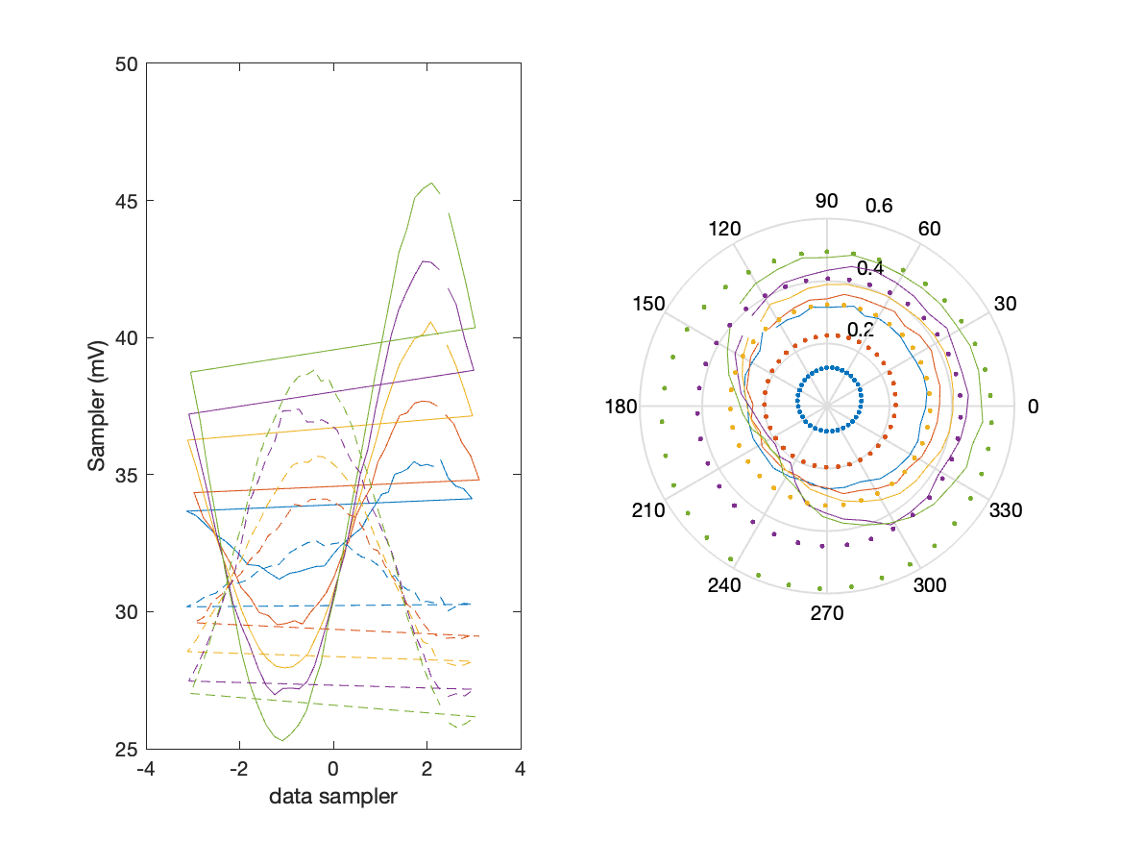
Sampler Performance x^2 x^3 Frequency 8.90 GHz, Power 14 dBm
Sampler Av
Sampler 1: 3.669
Sampler 2: 4.281
Sampler Av3
Sampler 1: 14.095
Sampler 2: 18.899
Sampler Av2
Sampler 1: 0.307
Sampler 2: -0.091
Sampler Offset (rather than -1)
-0.48066
Goodness Of fit
1.3602

Slide 18
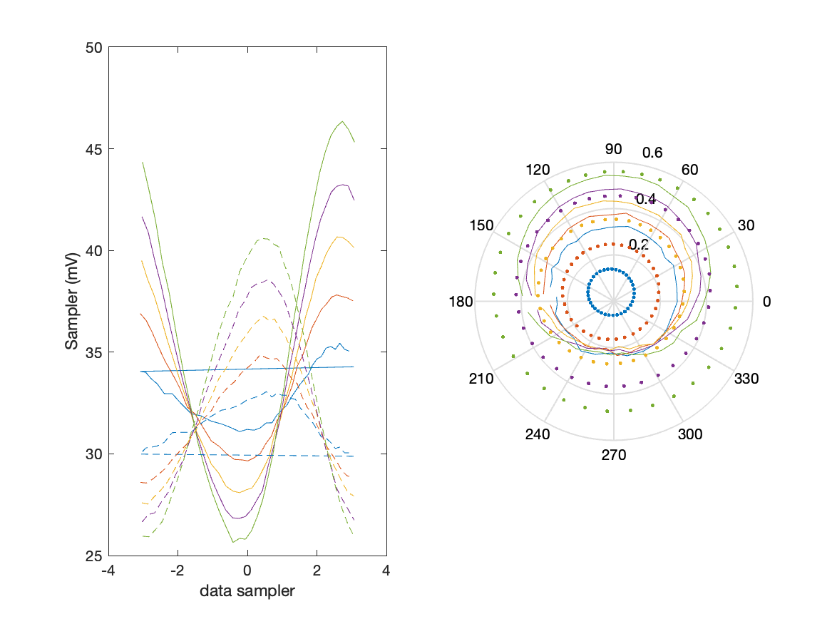
Sampler Performance Frequency 9.40 GHz, Power 14 dBm
Sampler Av
Sampler 1: 17.212
Sampler 2: 24.054
Sampler Offset (rather than -1)
-1.2475
Goodness Of fit
0.92154

Slide 19
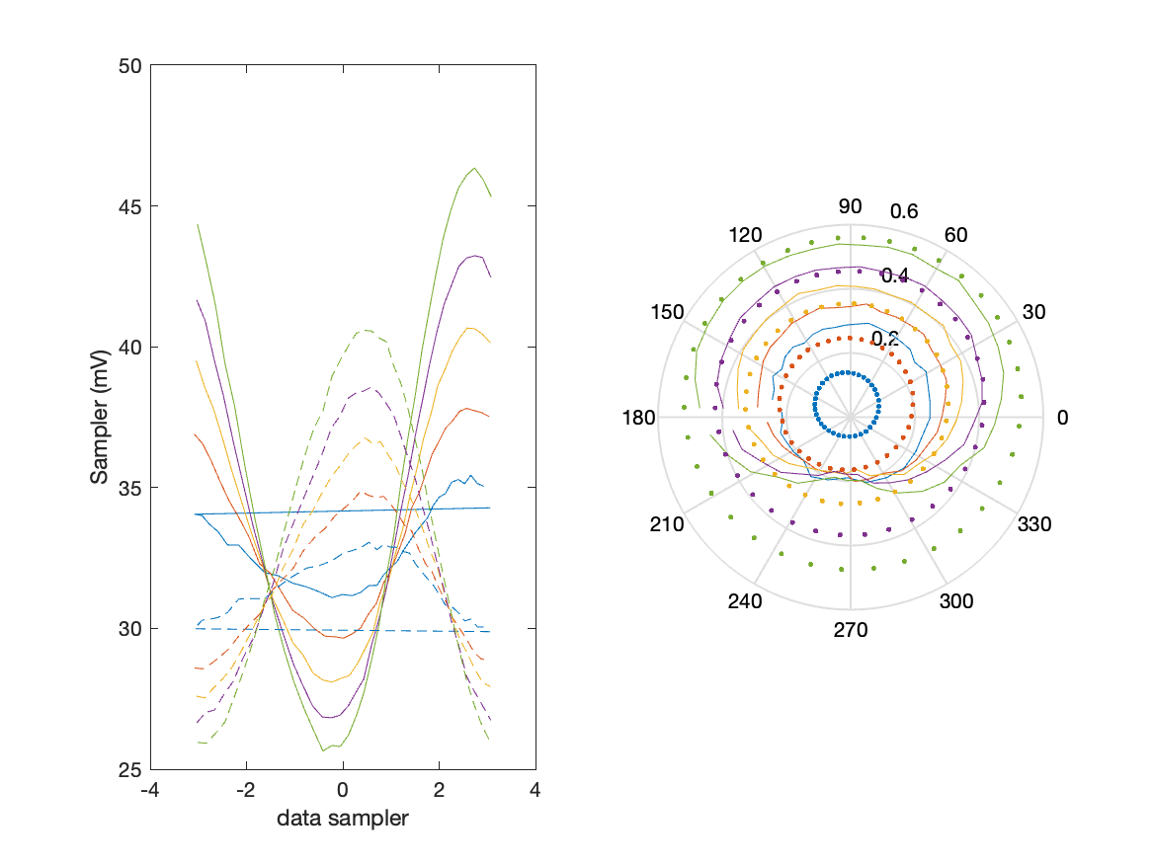
Sampler Performance x^3 Frequency 9.40 GHz, Power 14 dBm
Sampler Av
Sampler 1: 2.819183e-10
Sampler 2: 0.000
Sampler Av3
Sampler 1: 16.661
Sampler 2: 19.539
Sampler Offset (rather than -1)
-0.33903
Goodness Of fit
0.65757

Slide 20

Sampler Performance x^2 x^3 Frequency 9.40 GHz, Power 14 dBm
Sampler Av
Sampler 1: 4.594
Sampler 2: 2.665
Sampler Av3
Sampler 1: 15.433
Sampler 2: 19.171
Sampler Av2
Sampler 1: 0.158
Sampler 2: 0.176
Sampler Offset (rather than -1)
-0.52767
Goodness Of fit
0.69591

Slide 21
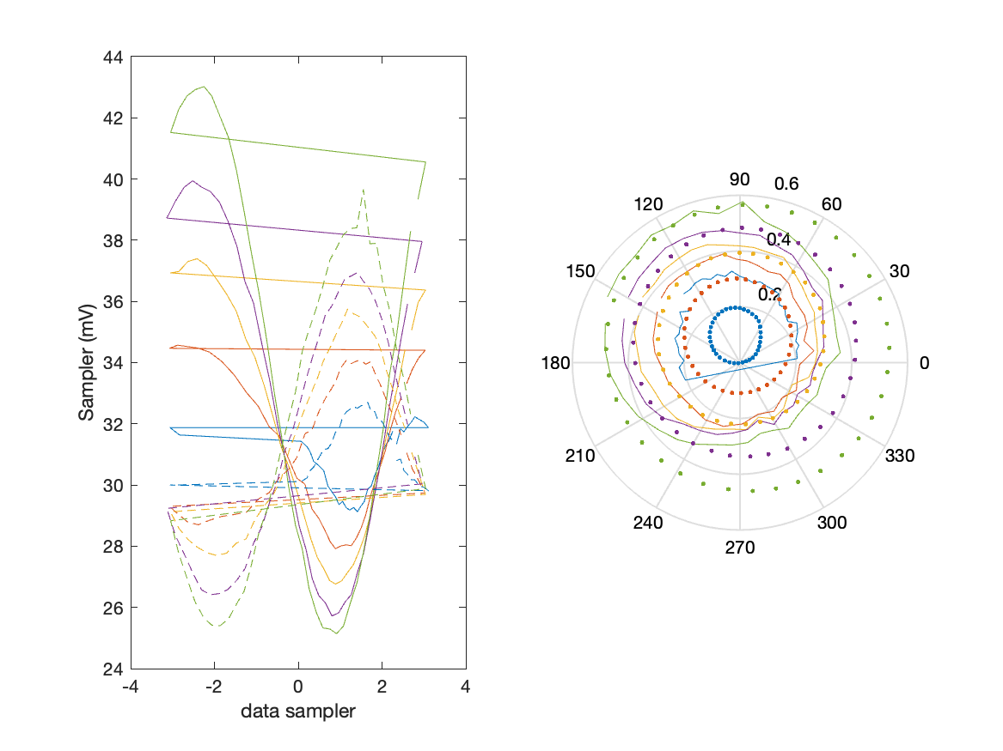
Sampler Performance Frequency 9.90 GHz, Power 14 dBm
Sampler Av
Sampler 1: 22.262
Sampler 2: 39.000
Sampler Offset (rather than -1)
-1.832
Goodness Of fit
0.77952

Slide 22
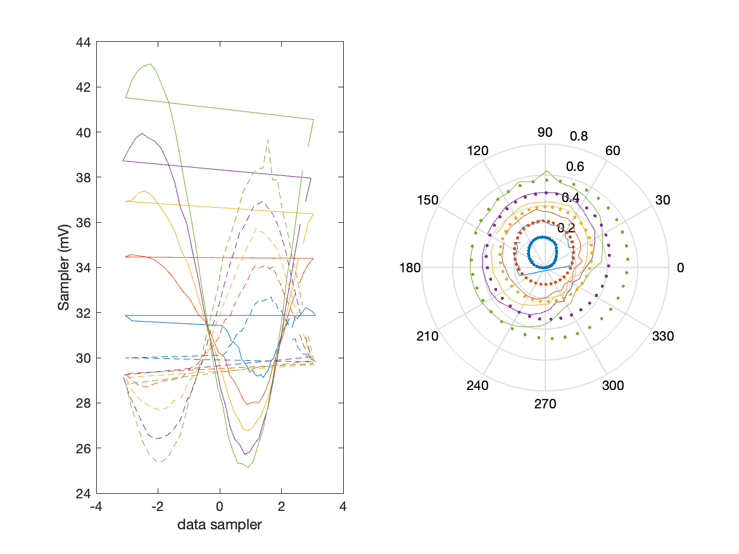
Sampler Performance x^3 Frequency 9.90 GHz, Power 14 dBm
Sampler Av
Sampler 1: 2.220502e-14
Sampler 2: 0.000
Sampler Av3
Sampler 1: 18.241
Sampler 2: 22.896
Sampler Offset (rather than -1)
-0.48609
Goodness Of fit
0.57406

Slide 23

Sampler Performance x^2 x^3 Frequency 9.90 GHz, Power 14 dBm
Sampler Av
Sampler 1: 3.749
Sampler 2: 7.244
Sampler Av3
Sampler 1: 17.554
Sampler 2: 21.745
Sampler Av2
Sampler 1: -0.109
Sampler 2: -0.155
Sampler Offset (rather than -1)
-0.75668
Goodness Of fit
0.59697

