Slide 1
Coupledline Compiled Data

Slide 2
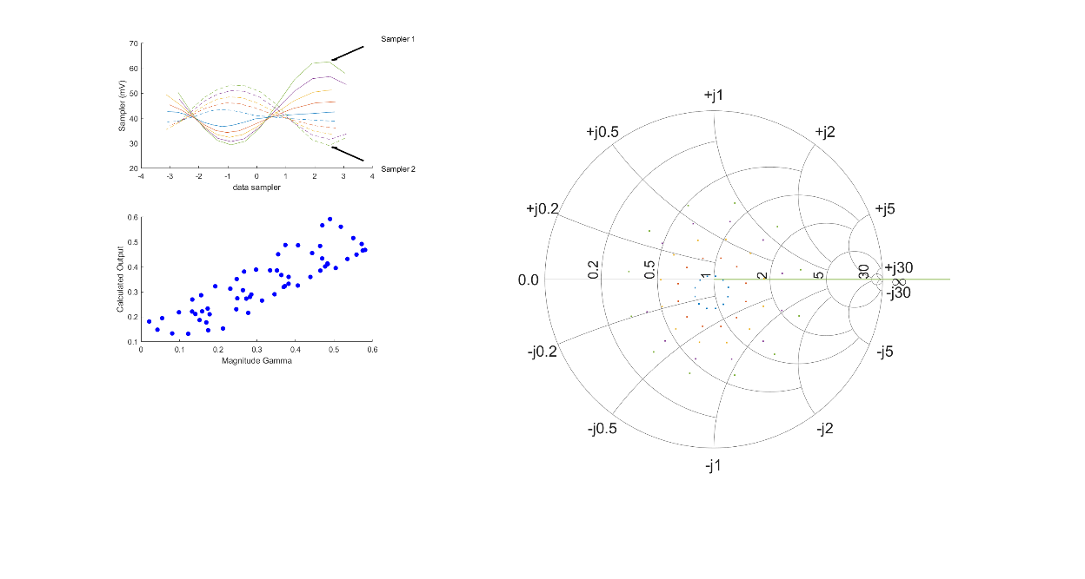
Coupled Line Performance At 10.70 GHz, 16.000000 dBm Output Power 1.40 V mean sampler bias
Sampler Av
  Sampler 1: 25.592
  Sampler 2: 25.592
Sampler Offset (rather than -1)
  -2.5624305998448818
Goodness Of fit
  0.18192528890927073
Sampler 1 Range
  0.0332663661
Sampler 2 Range
  0.024208674899999998
DUT output dBm Mean
  16.80374998449075
DUT input dBm Mean
  5.4533120775904873
RMS Error
  0.078415354498218653
Max Error
  0.11268328162014984

Slide 3
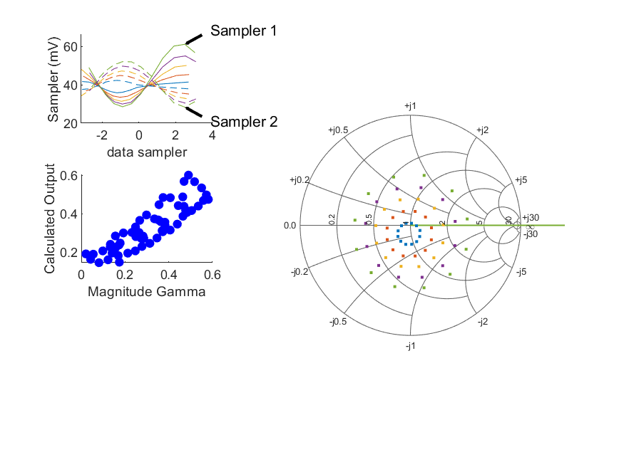
Coupled Line Performance At 10.70 GHz, 16.000000 dBm Output Power 1.50 V mean sampler bias
Sampler Av
  Sampler 1: 27.090
  Sampler 2: 27.090
Sampler Offset (rather than -1)
  -2.6223795361832725
Goodness Of fit
  0.1661299016570143
Sampler 1 Range
  0.0325594102
Sampler 2 Range
  0.023717400199999999
DUT output dBm Mean
  16.723610267824082
DUT input dBm Mean
  5.2528030775904879
RMS Error
  0.076233262771743179
Max Error
  0.10661689334502084

Slide 4
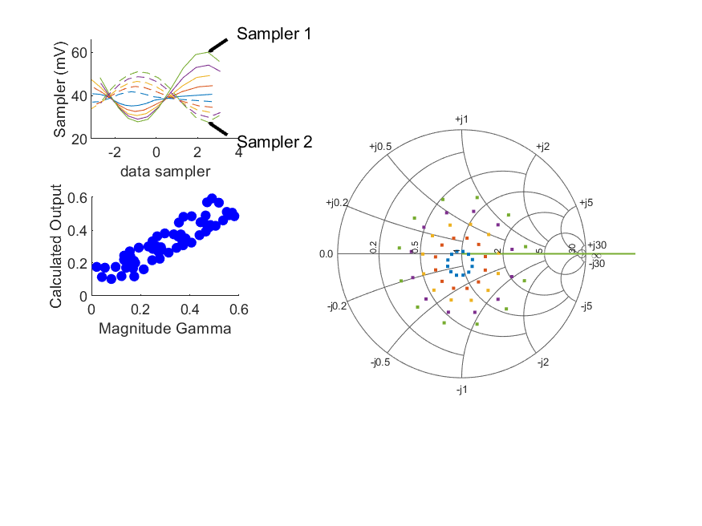
Coupled Line Performance At 10.70 GHz, 16.000000 dBm Output Power 1.60 V mean sampler bias
Sampler Av
  Sampler 1: 30.244
  Sampler 2: 30.244
Sampler Offset (rather than -1)
  -2.8982236460560373
Goodness Of fit
  0.13726480564411181
Sampler 1 Range
  0.0322563778
Sampler 2 Range
  0.023383050400000001
DUT output dBm Mean
  16.680004934490753
DUT input dBm Mean
  5.1249169109238206
RMS Error
  0.067756700687662458
Max Error
  0.096008162829435251

Slide 5
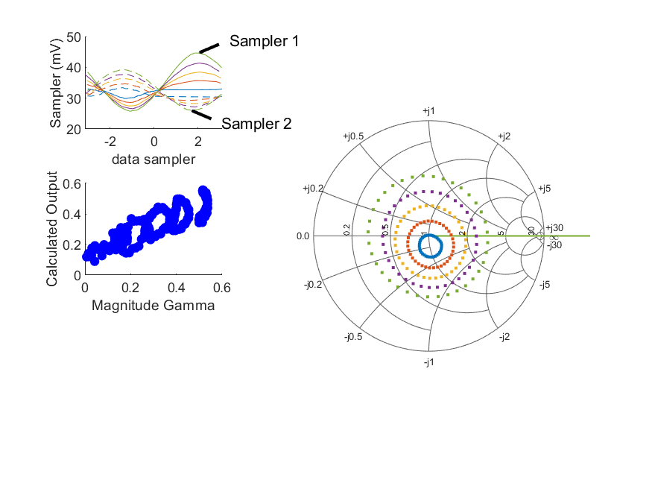
Coupled Line Performance At 9.90 GHz, 14.000000 dBm Output Power 1.70 V mean sampler bias
Sampler Av
  Sampler 1: 32.440
  Sampler 2: 32.440
Sampler Offset (rather than -1)
  -2.5181876647965993
Goodness Of fit
  0.56336908431535804
Sampler 1 Range
  0.0189030634
Sampler 2 Range
  0.013155521399999998
DUT output dBm Mean
  14.071986289548843
DUT input dBm Mean
  1.764670593329023
RMS Error
  0.083871124606482397
Max Error
  0.1693560343569947

Slide 6
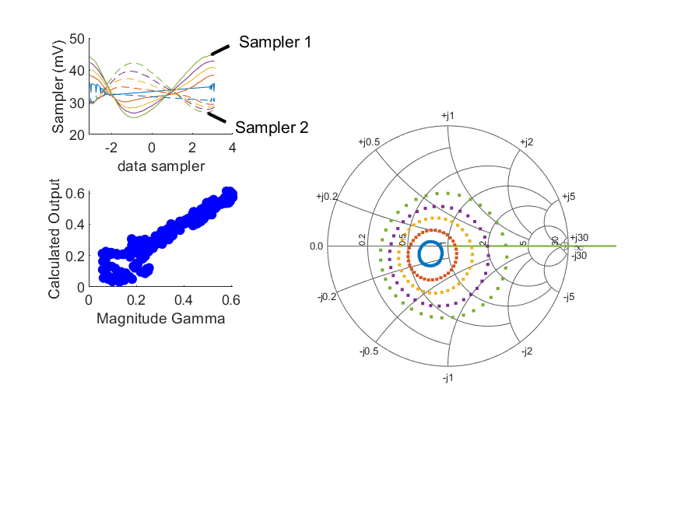
Coupled Line Performance At 10.40 GHz, 14.000000 dBm Output Power 1.70 V mean sampler bias
Sampler Av
  Sampler 1: 47.832
  Sampler 2: 47.832
Sampler Offset (rather than -1)
  -3.6033429554213043
Goodness Of fit
  0.11418217253419516
Sampler 1 Range
  0.019440630099999998
Sampler 2 Range
  0.015446096199999999
DUT output dBm Mean
  14.529755013156434
DUT input dBm Mean
  2.7267958718169205
RMS Error
  0.059800960740399839
Max Error
  0.15080638537014482

Slide 7
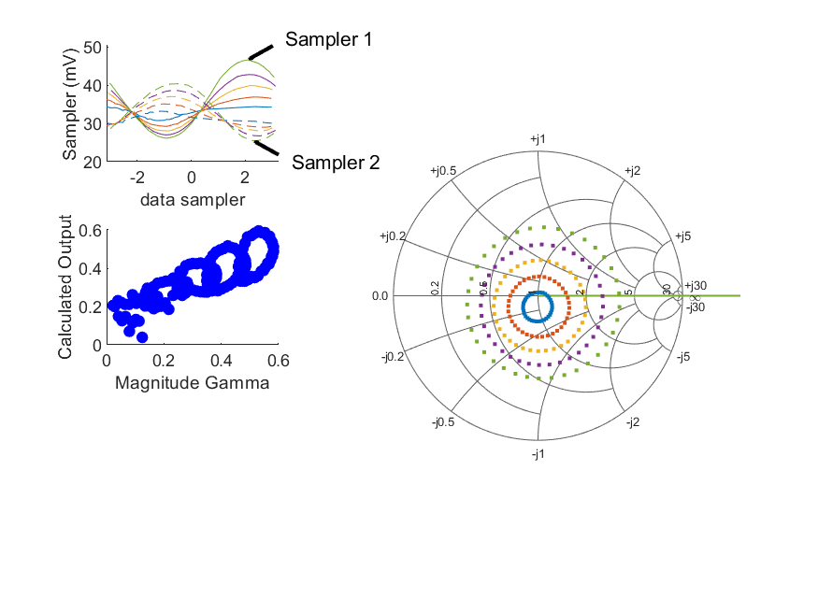
Coupled Line Performance At 10.90 GHz, 14.000000 dBm Output Power 1.70 V mean sampler bias
Sampler Av
  Sampler 1: 27.096
  Sampler 2: 27.096
Sampler Offset (rather than -1)
  -2.2622707280294803
Goodness Of fit
  0.66603035783970743
Sampler 1 Range
  0.020461110299999998
Sampler 2 Range
  0.014894121499999996
DUT output dBm Mean
  14.360573502513626
DUT input dBm Mean
  3.0357804103124315
RMS Error
  0.08882993722522442
Max Error
  0.16749059378353048

Slide 8
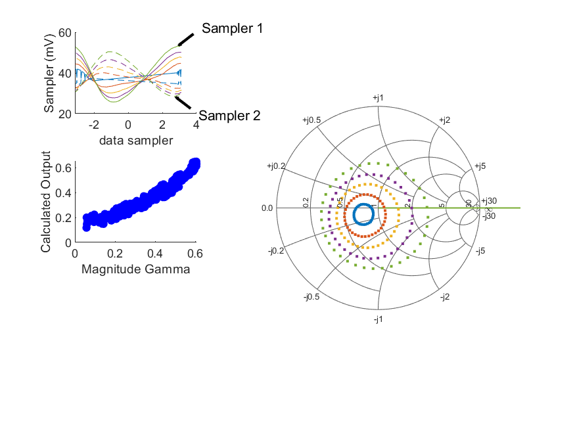
Coupled Line Performance At 10.40 GHz, 16.000000 dBm Output Power 1.70 V mean sampler bias
Sampler Av
  Sampler 1: 37.231
  Sampler 2: 37.231
Sampler Offset (rather than -1)
  -3.1788284586407385
Goodness Of fit
  0.12166907202065408
Sampler 1 Range
  0.027417510100000004
Sampler 2 Range
  0.0218747223
DUT output dBm Mean
  16.114601790934213
DUT input dBm Mean
  4.332699205150254
RMS Error
  0.04562146133207174
Max Error
  0.08472370318792688

Slide 9
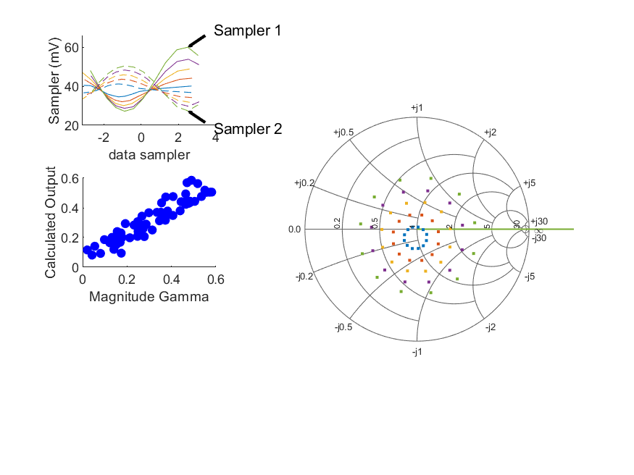
Coupled Line Performance At 10.70 GHz, 16.000000 dBm Output Power 1.70 V mean sampler bias
Sampler Av
  Sampler 1: 31.670
  Sampler 2: 31.670
Sampler Offset (rather than -1)
  -3.0357092716362288
Goodness Of fit
  0.098059182482942764
Sampler 1 Range
  0.032770451300000003
Sampler 2 Range
  0.022969365299999999
DUT output dBm Mean
  16.666860184490751
DUT input dBm Mean
  5.1823639109238213
RMS Error
  0.055514560987310252
Max Error
  0.07950873743701628

Slide 10
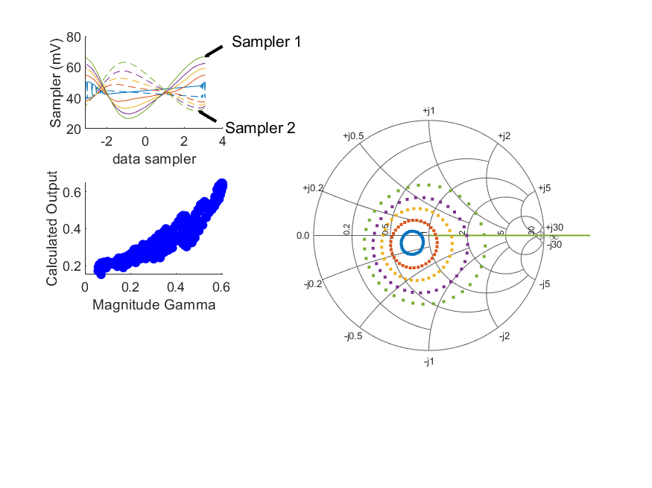
Coupled Line Performance At 10.40 GHz, 18.000000 dBm Output Power 1.70 V mean sampler bias
Sampler Av
  Sampler 1: 23.584
  Sampler 2: 23.584
Sampler Offset (rather than -1)
  -2.3928734489291998
Goodness Of fit
  0.27473500064506945
Sampler 1 Range
  0.040079704699999996
Sampler 2 Range
  0.031522902899999997
DUT output dBm Mean
  18.017481518711993
DUT input dBm Mean
  6.2666640940391414
RMS Error
  0.063969777234923697
Max Error
  0.1450302817480455

Slide 11
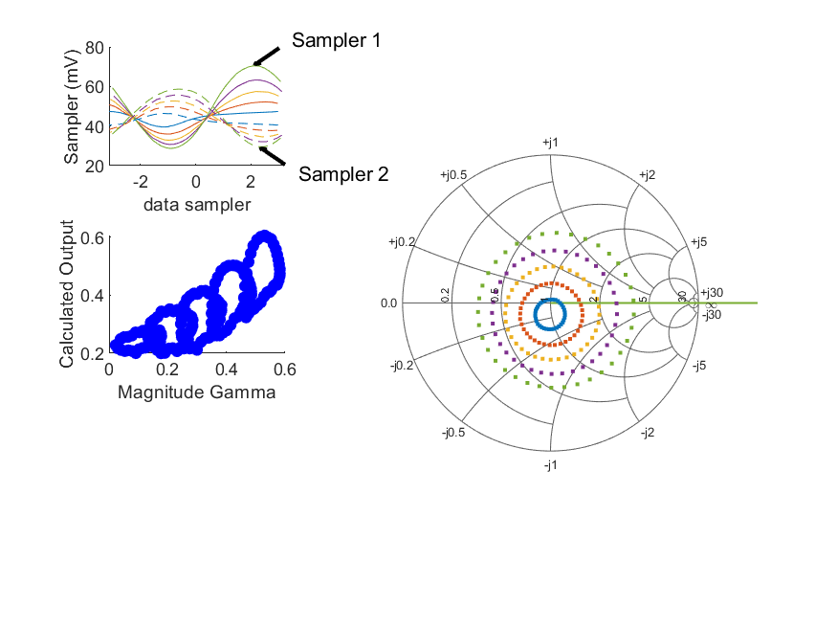
Coupled Line Performance At 10.90 GHz, 18.000000 dBm Output Power 1.70 V mean sampler bias
Sampler Av
  Sampler 1: 17.811
  Sampler 2: 17.811
Sampler Offset (rather than -1)
  -1.9842835306295978
Goodness Of fit
  0.73279500086414773
Sampler 1 Range
  0.041768086199999999
Sampler 2 Range
  0.029136850300000003
DUT output dBm Mean
  17.874309613624735
DUT input dBm Mean
  6.6308082992013198
RMS Error
  0.099492834475408395
Max Error
  0.14426949148880719

Slide 12
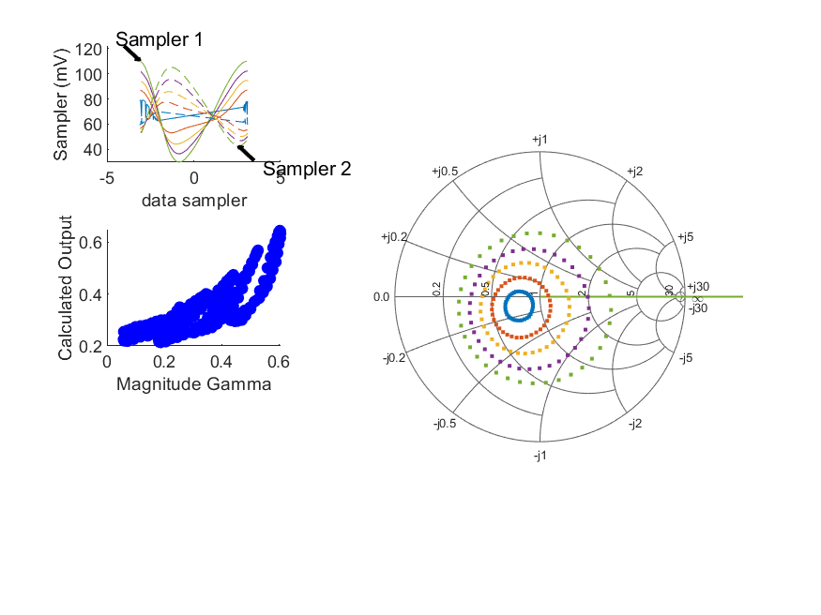
Coupled Line Performance At 10.40 GHz, 22.000000 dBm Output Power 1.70 V mean sampler bias
Sampler Av
  Sampler 1: 8.376
  Sampler 2: 8.376
Sampler Offset (rather than -1)
  -1.2680035125117011
Goodness Of fit
  0.54897923894509704
Sampler 1 Range
  0.08021814960000001
Sampler 2 Range
  0.0619753392
DUT output dBm Mean
  21.694345398939767
DUT input dBm Mean
  10.430307594039142
RMS Error
  0.089871870506923746
Max Error
  0.17044481053776478

Slide 13
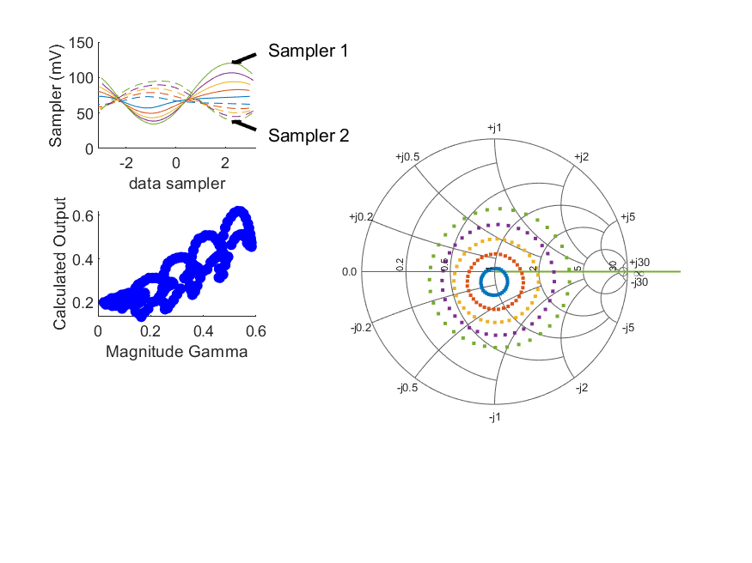
Coupled Line Performance At 10.90 GHz, 22.000000 dBm Output Power 1.70 V mean sampler bias
Sampler Av
  Sampler 1: 10.403
  Sampler 2: 10.403
Sampler Offset (rather than -1)
  -1.8591334679395171
Goodness Of fit
  0.50108040282059907
Sampler 1 Range
  0.085715351999999995
Sampler 2 Range
  0.056027664300000002
DUT output dBm Mean
  21.617961743735847
DUT input dBm Mean
  10.944901632534654
RMS Error
  0.080629067169095764
Max Error
  0.14921010803848994

Slide 14
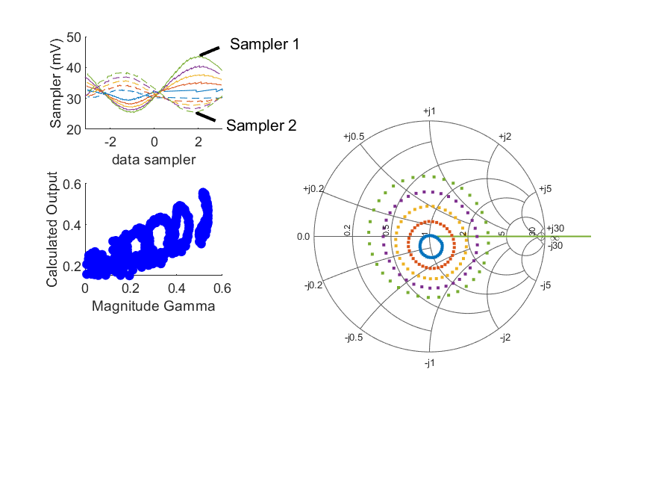
Coupled Line Performance At 9.90 GHz, 14.000000 dBm Output Power 1.77 V mean sampler bias
Sampler Av
  Sampler 1: 31.548
  Sampler 2: 31.548
Sampler Offset (rather than -1)
  -2.3773416481826053
Goodness Of fit
  1.4229547043112198
Sampler 1 Range
  0.018372291299999999
Sampler 2 Range
  0.013032205799999998
DUT output dBm Mean
  13.84012695621551
DUT input dBm Mean
  1.6906239266623559
RMS Error
  0.099852683451528618
Max Error
  0.20019581798084563

Slide 15
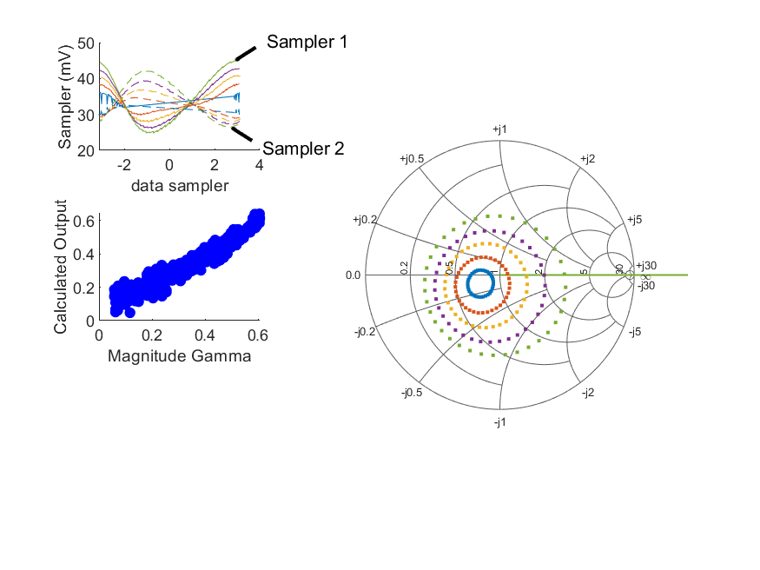
Coupled Line Performance At 10.40 GHz, 14.000000 dBm Output Power 1.77 V mean sampler bias
Sampler Av
  Sampler 1: 46.838
  Sampler 2: 46.838
Sampler Offset (rather than -1)
  -3.5531356503016904
Goodness Of fit
  0.22892641562124239
Sampler 1 Range
  0.020136884099999995
Sampler 2 Range
  0.015745912000000001
DUT output dBm Mean
  14.529609796489771
DUT input dBm Mean
  2.9089016773724761
RMS Error
  0.044177016387781563
Max Error
  0.093374293485552429

Slide 16

Coupled Line Performance At 10.40 GHz, 16.000000 dBm Output Power 1.77 V mean sampler bias
Sampler Av
  Sampler 1: 31.518
  Sampler 2: 31.518
Sampler Offset (rather than -1)
  -2.6762271256329648
Goodness Of fit
  0.58480866554855782
Sampler 1 Range
  0.027675748700000002
Sampler 2 Range
  0.021501774100000003
DUT output dBm Mean
  15.989574165934217
DUT input dBm Mean
  4.4244458440391421
RMS Error
  0.071234203917795419
Max Error
  0.14593820159188597

Slide 17
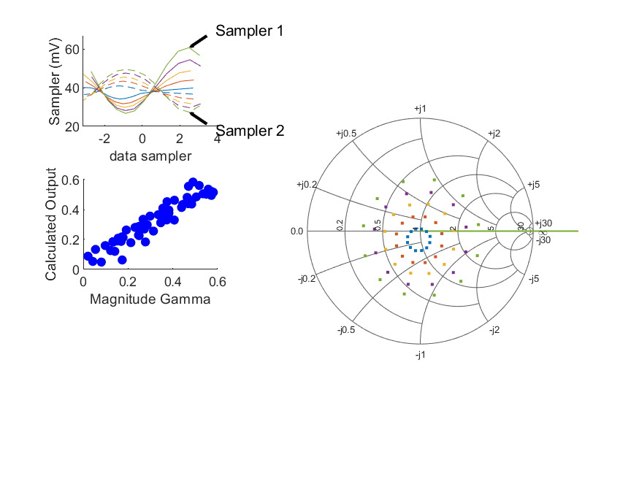
Coupled Line Performance At 10.70 GHz, 16.000000 dBm Output Power 1.80 V mean sampler bias
Sampler Av
  Sampler 1: 32.802
  Sampler 2: 32.802
Sampler Offset (rather than -1)
  -3.2308358406267006
Goodness Of fit
  0.070913582150696139
Sampler 1 Range
  0.034000380999999996
Sampler 2 Range
  0.0221460856
DUT output dBm Mean
  16.684218101157416
DUT input dBm Mean
  5.599995410923821
RMS Error
  0.049602722406662907
Max Error
  0.1105764902014033

Slide 18
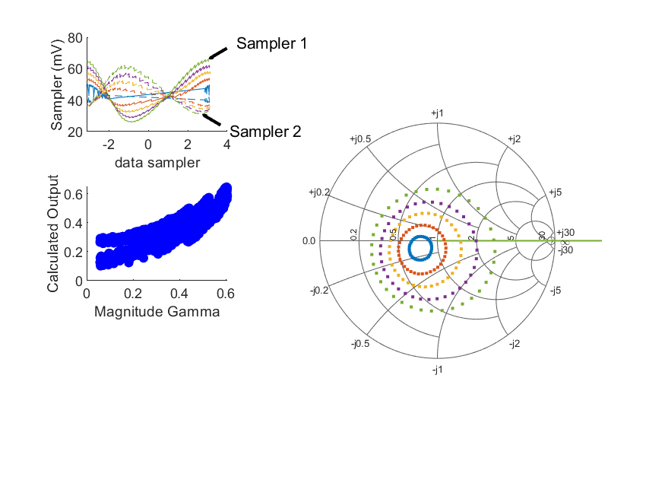
Coupled Line Performance At 10.40 GHz, 18.000000 dBm Output Power 1.77 V mean sampler bias
Sampler Av
  Sampler 1: 19.096
  Sampler 2: 19.096
Sampler Offset (rather than -1)
  -1.8964122598364916
Goodness Of fit
  0.9162571254149996
Sampler 1 Range
  0.040225075100000007
Sampler 2 Range
  0.031197561400000001
DUT output dBm Mean
  17.792676329823102
DUT input dBm Mean
  6.375689094039144
RMS Error
  0.083354211210125914
Max Error
  0.17080198481914682

Slide 19
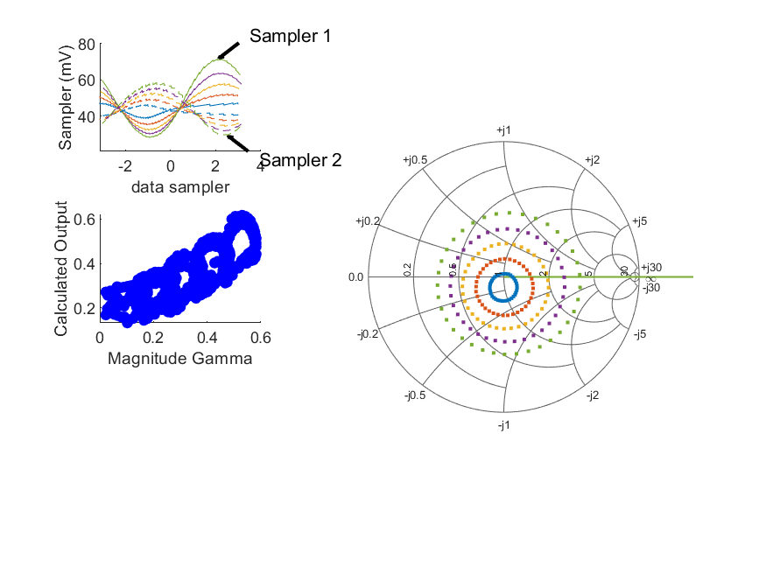
Coupled Line Performance At 10.90 GHz, 18.000000 dBm Output Power 1.77 V mean sampler bias
Sampler Av
  Sampler 1: 16.611
  Sampler 2: 16.611
Sampler Offset (rather than -1)
  -1.9022255546420104
Goodness Of fit
  1.4060601205559262
Sampler 1 Range
  0.043444404800000003
Sampler 2 Range
  0.0290479607
DUT output dBm Mean
  17.837158780291404
DUT input dBm Mean
  6.9965804380902101
RMS Error
  0.096648832179898073
Max Error
  0.15872556218161787

Slide 20
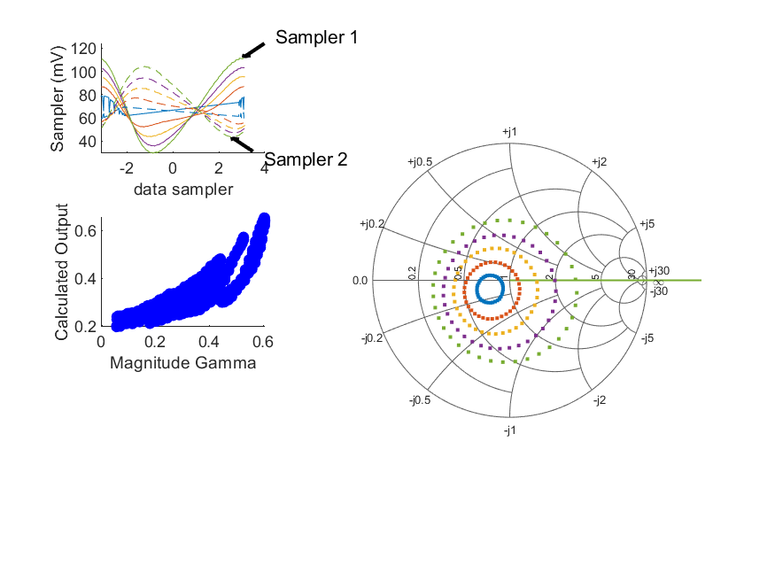
Coupled Line Performance At 10.40 GHz, 22.000000 dBm Output Power 1.77 V mean sampler bias
Sampler Av
  Sampler 1: 8.791
  Sampler 2: 8.791
Sampler Offset (rather than -1)
  -1.3697072820338472
Goodness Of fit
  0.89214488438766881
Sampler 1 Range
  0.082151210100000011
Sampler 2 Range
  0.060814083200000008
DUT output dBm Mean
  21.697564827073109
DUT input dBm Mean
  10.928830788483587
RMS Error
  0.079682673737740184
Max Error
  0.16100738308771245

Slide 21
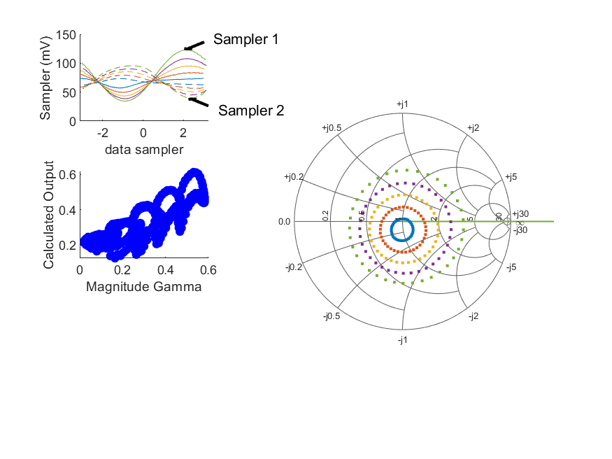
Coupled Line Performance At 10.90 GHz, 22.000000 dBm Output Power 1.77 V mean sampler bias
Sampler Av
  Sampler 1: 9.137
  Sampler 2: 9.137
Sampler Offset (rather than -1)
  -1.6619697393726161
Goodness Of fit
  1.2543279474508462
Sampler 1 Range
  0.088955911500000012
Sampler 2 Range
  0.056268748700000003
DUT output dBm Mean
  21.673568762193621
DUT input dBm Mean
  11.503896771423541
RMS Error
  0.091969431220868245
Max Error
  0.19139914177291756

Slide 22
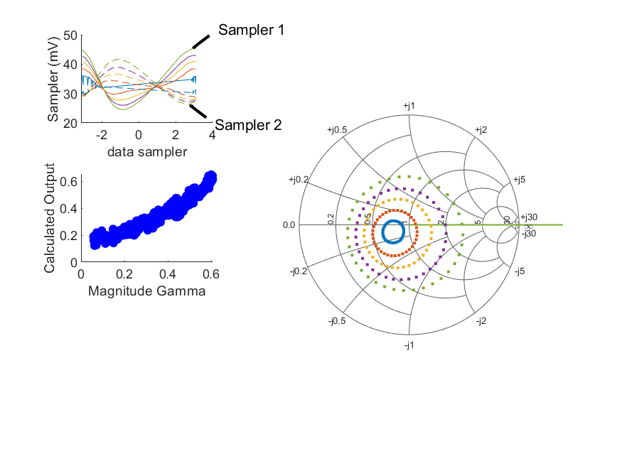
Coupled Line Performance At 10.40 GHz, 14.000000 dBm Output Power 1.85 V mean sampler bias
Sampler Av
  Sampler 1: 41.745
  Sampler 2: 41.745
Sampler Offset (rather than -1)
  -3.2439945134707293
Goodness Of fit
  0.1650461927329967
Sampler 1 Range
  0.020744503600000002
Sampler 2 Range
  0.015378494700000002
DUT output dBm Mean
  14.649872457600878
DUT input dBm Mean
  3.4157580940391421
RMS Error
  0.049994672621389666
Max Error
  0.11034997430660559

Slide 23
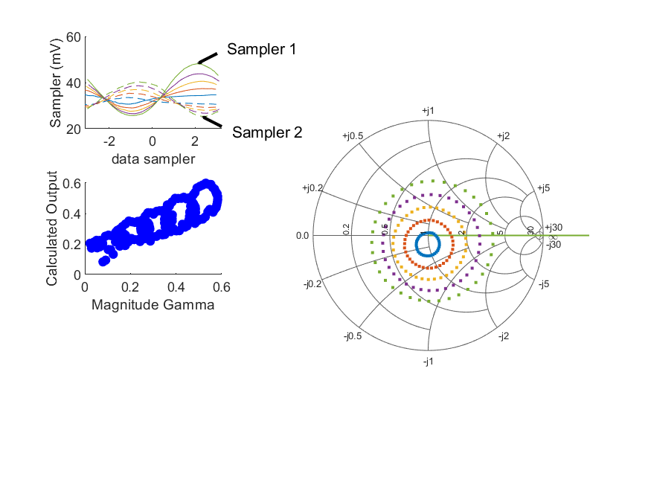
Coupled Line Performance At 10.90 GHz, 14.000000 dBm Output Power 1.85 V mean sampler bias
Sampler Av
  Sampler 1: 28.228
  Sampler 2: 28.228
Sampler Offset (rather than -1)
  -2.4891315255996798
Goodness Of fit
  0.660003025688364
Sampler 1 Range
  0.0224571771
Sampler 2 Range
  0.014915483700000003
DUT output dBm Mean
  14.586091335846959
DUT input dBm Mean
  3.9344367436457643
RMS Error
  0.090198365164912753
Max Error
  0.15376111990997798

Slide 24
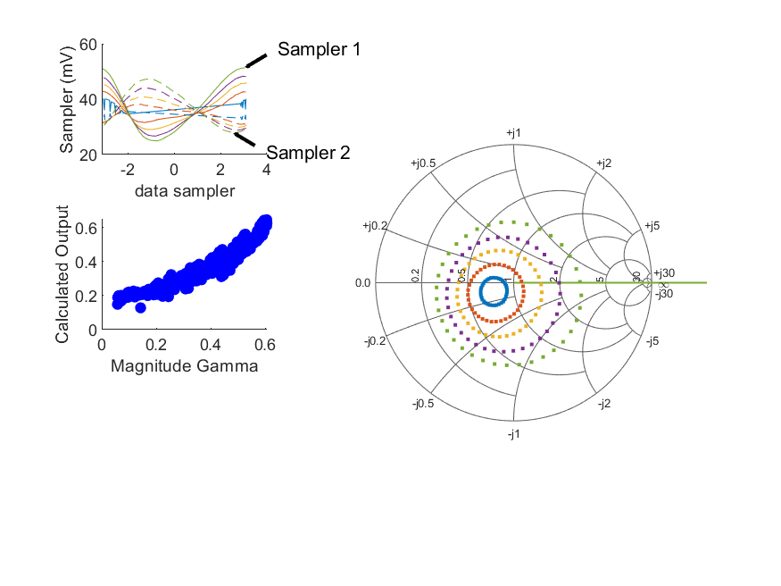
Coupled Line Performance At 10.40 GHz, 16.000000 dBm Output Power 1.85 V mean sampler bias
Sampler Av
  Sampler 1: 31.332
  Sampler 2: 31.332
Sampler Offset (rather than -1)
  -2.6533049644836337
Goodness Of fit
  0.21816855086265718
Sampler 1 Range
  0.0263670667
Sampler 2 Range
  0.019313220499999999
DUT output dBm Mean
  15.772175618711991
DUT input dBm Mean
  4.6558474273724757
RMS Error
  0.057381215923757146
Max Error
  0.12610904364769893

Slide 25
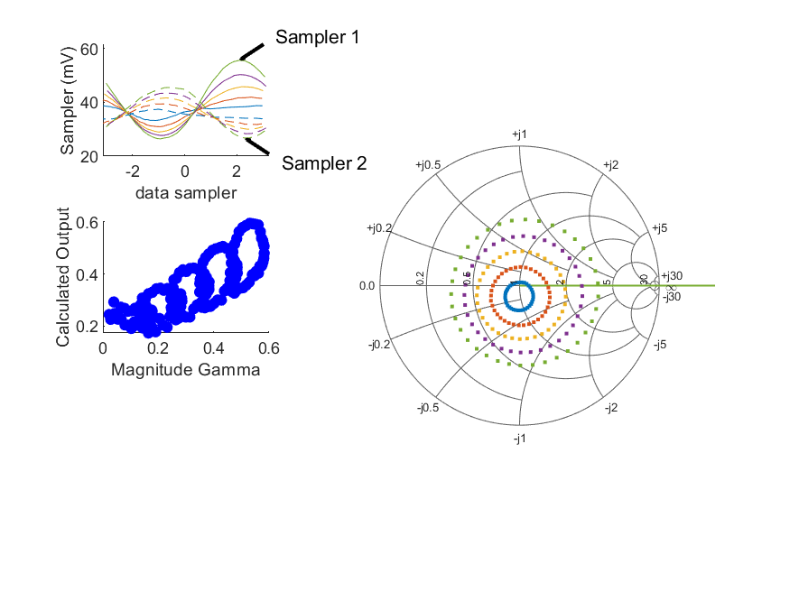
Coupled Line Performance At 10.90 GHz, 16.000000 dBm Output Power 1.85 V mean sampler bias
Sampler Av
  Sampler 1: 22.944
  Sampler 2: 22.944
Sampler Offset (rather than -1)
  -2.2414442629070046
Goodness Of fit
  0.74008212756218494
Sampler 1 Range
  0.029173036999999999
Sampler 2 Range
  0.018748617100000003
DUT output dBm Mean
  15.782175280291401
DUT input dBm Mean
  5.2662730214235429
RMS Error
  0.099686636955398686
Max Error
  0.16068290396976298

Slide 26
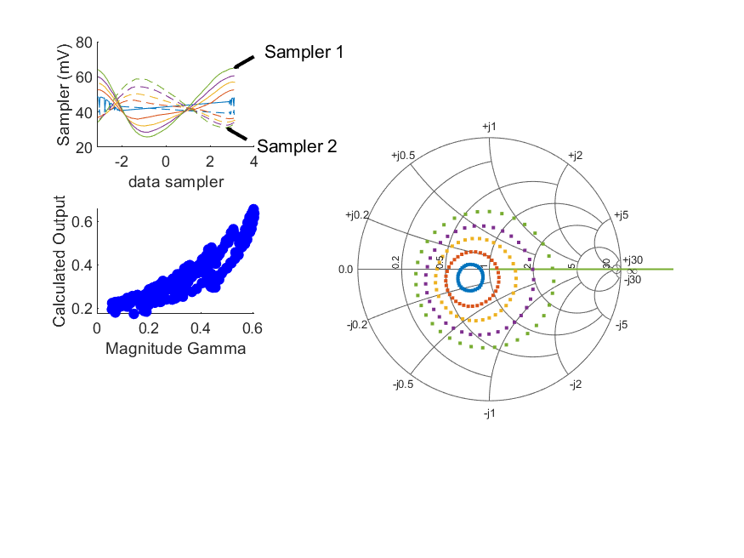
Coupled Line Performance At 10.40 GHz, 18.000000 dBm Output Power 1.85 V mean sampler bias
Sampler Av
  Sampler 1: 21.670
  Sampler 2: 21.670
Sampler Offset (rather than -1)
  -2.2089483741555527
Goodness Of fit
  0.35168132176325029
Sampler 1 Range
  0.039000323800000007
Sampler 2 Range
  0.027792688200000002
DUT output dBm Mean
  17.717106835378658
DUT input dBm Mean
  6.8657102051502532
RMS Error
  0.071798753916765962
Max Error
  0.16002195885775322

Slide 27
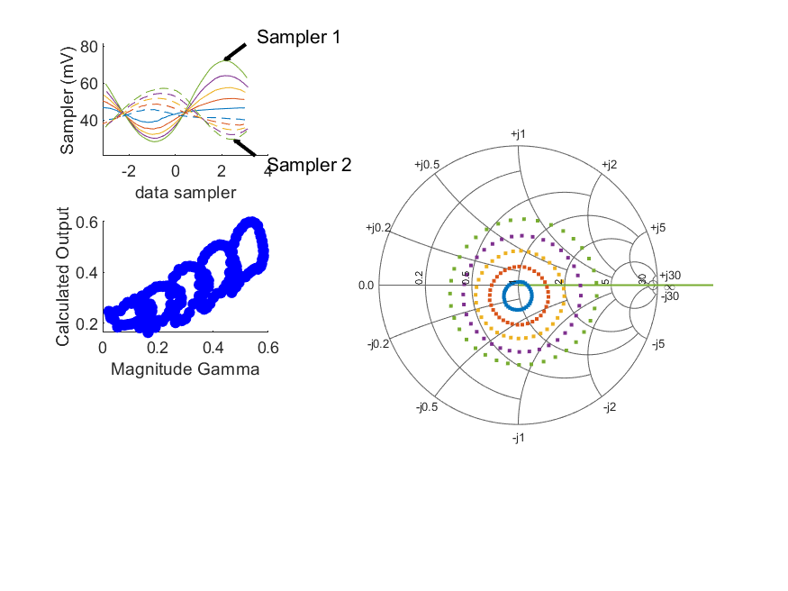
Coupled Line Performance At 10.90 GHz, 18.000000 dBm Output Power 1.85 V mean sampler bias
Sampler Av
  Sampler 1: 16.046
  Sampler 2: 16.046
Sampler Offset (rather than -1)
  -1.8846810382069021
Goodness Of fit
  0.73033615881238001
Sampler 1 Range
  0.044067799399999996
Sampler 2 Range
  0.027712650200000001
DUT output dBm Mean
  17.824123163624733
DUT input dBm Mean
  7.594010854756875
RMS Error
  0.09791593960472314
Max Error
  0.14955162159740387

Slide 28
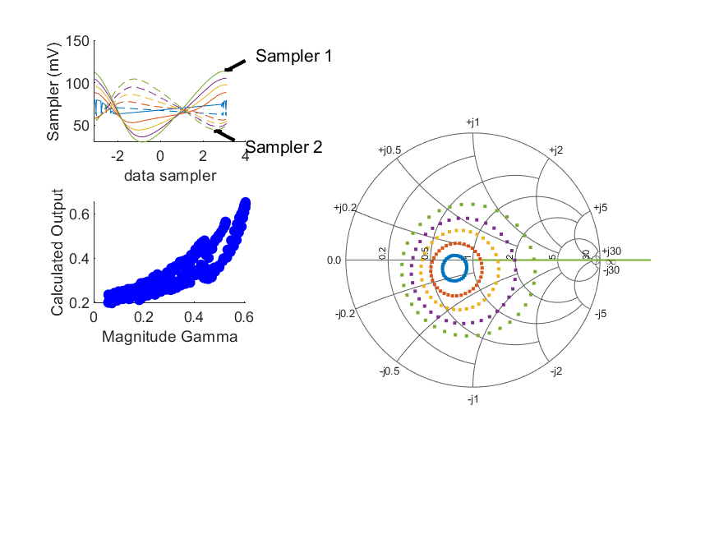
Coupled Line Performance At 10.40 GHz, 22.000000 dBm Output Power 1.85 V mean sampler bias
Sampler Av
  Sampler 1: 9.355
  Sampler 2: 9.355
Sampler Offset (rather than -1)
  -1.5138471754142522
Goodness Of fit
  0.40637547512273331
Sampler 1 Range
  0.0837033851
Sampler 2 Range
  0.060186917899999991
DUT output dBm Mean
  21.788013264112546
DUT input dBm Mean
  11.513137427372476
RMS Error
  0.076782595966454772
Max Error
  0.15720024946117445

Slide 29
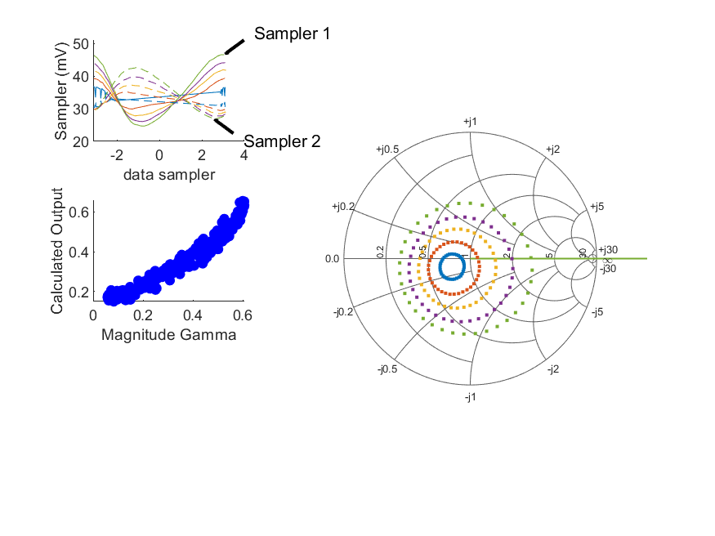
Coupled Line Performance At 10.40 GHz, 14.000000 dBm Output Power 1.90 V mean sampler bias
Sampler Av
  Sampler 1: 35.896
  Sampler 2: 35.896
Sampler Offset (rather than -1)
  -2.9094699907103245
Goodness Of fit
  0.15880688763425099
Sampler 1 Range
  0.021863913499999998
Sampler 2 Range
  0.015776935499999999
DUT output dBm Mean
  14.771196613156434
DUT input dBm Mean
  4.1084757051502541
RMS Error
  0.048338081983303034
Max Error
  0.09716998316763803

Slide 30
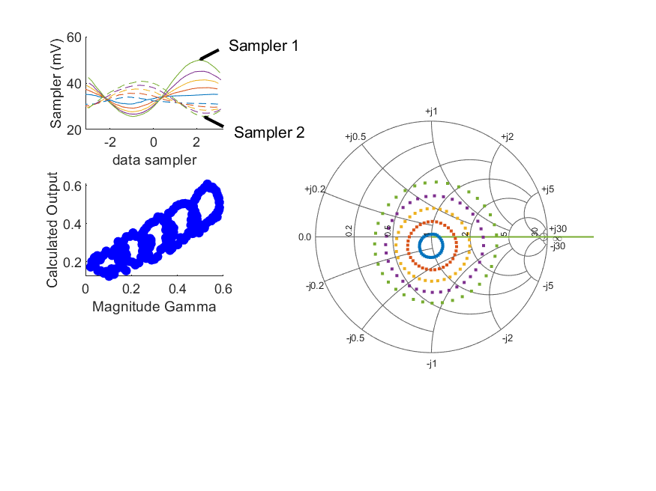
Coupled Line Performance At 10.90 GHz, 14.000000 dBm Output Power 1.90 V mean sampler bias
Sampler Av
  Sampler 1: 26.876
  Sampler 2: 26.876
Sampler Offset (rather than -1)
  -2.4768995681267052
Goodness Of fit
  0.61029368336531964
Sampler 1 Range
  0.024277514099999998
Sampler 2 Range
  0.015108071599999998
DUT output dBm Mean
  14.748669285846956
DUT input dBm Mean
  4.6357511325346525
RMS Error
  0.087500309605436172
Max Error
  0.14164384149109444

Slide 31
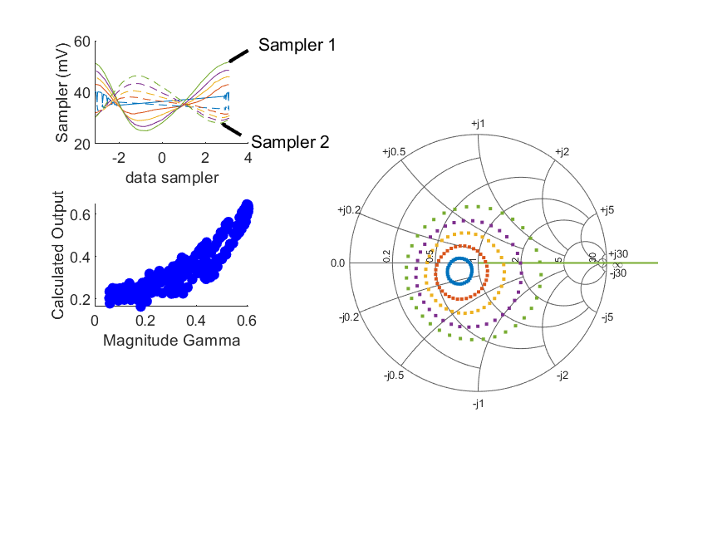
Coupled Line Performance At 10.40 GHz, 16.000000 dBm Output Power 1.90 V mean sampler bias
Sampler Av
  Sampler 1: 31.175
  Sampler 2: 31.175
Sampler Offset (rather than -1)
  -2.7602276966766683
Goodness Of fit
  0.33808380198157195
Sampler 1 Range
  0.026476227300000002
Sampler 2 Range
  0.018385177500000002
DUT output dBm Mean
  15.695813179823103
DUT input dBm Mean
  5.0972915384835868
RMS Error
  0.073855924833440265
Max Error
  0.15537382429425006

Slide 32
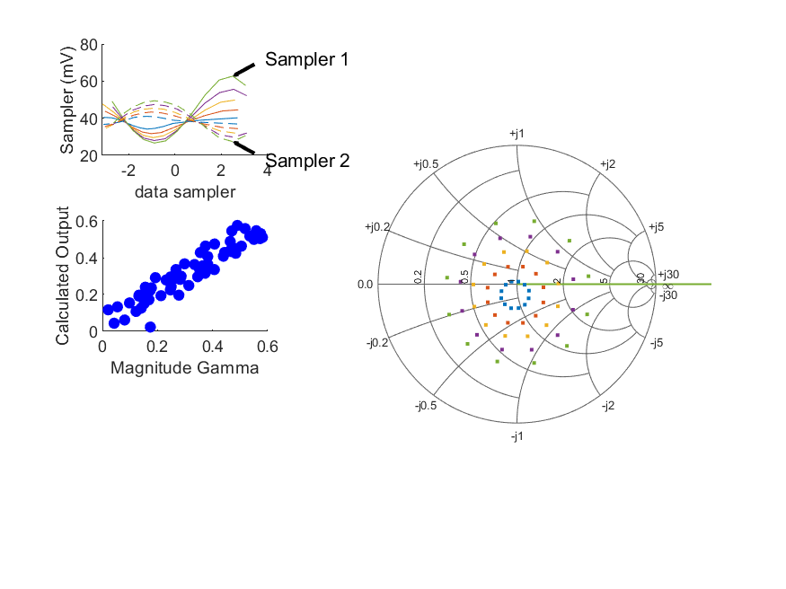
Coupled Line Performance At 10.70 GHz, 16.000000 dBm Output Power 1.90 V mean sampler bias
Sampler Av
  Sampler 1: 31.518
  Sampler 2: 31.518
Sampler Offset (rather than -1)
  -3.2680880237715626
Goodness Of fit
  0.076702740656612214
Sampler 1 Range
  0.03604442590000001
Sampler 2 Range
  0.0220128661
DUT output dBm Mean
  16.802804901157415
DUT input dBm Mean
  6.6249169109238197
RMS Error
  0.054864025552742078
Max Error
  0.15078573243229676

Slide 33

Coupled Line Performance At 10.40 GHz, 18.000000 dBm Output Power 1.90 V mean sampler bias
Sampler Av
  Sampler 1: 19.970
  Sampler 2: 19.970
Sampler Offset (rather than -1)
  -2.0920640295048467
Goodness Of fit
  0.2807083957794162
Sampler 1 Range
  0.040594893199999996
Sampler 2 Range
  0.028321377000000002
DUT output dBm Mean
  17.775126429823104
DUT input dBm Mean
  7.4160910940391433
RMS Error
  0.065589389749488344
Max Error
  0.13207903243587571

Slide 34

Coupled Line Performance At 10.40 GHz, 22.000000 dBm Output Power 1.90 V mean sampler bias
Sampler Av
  Sampler 1: 9.504
  Sampler 2: 9.504
Sampler Offset (rather than -1)
  -1.5625424968608237
Goodness Of fit
  0.42435361395466975
Sampler 1 Range
  0.084210197799999997
Sampler 2 Range
  0.059378589000000002
DUT output dBm Mean
  21.794909676964103
DUT input dBm Mean
  11.831456094039142
RMS Error
  0.079393166812337837
Max Error
  0.16969521703153267

Slide 35
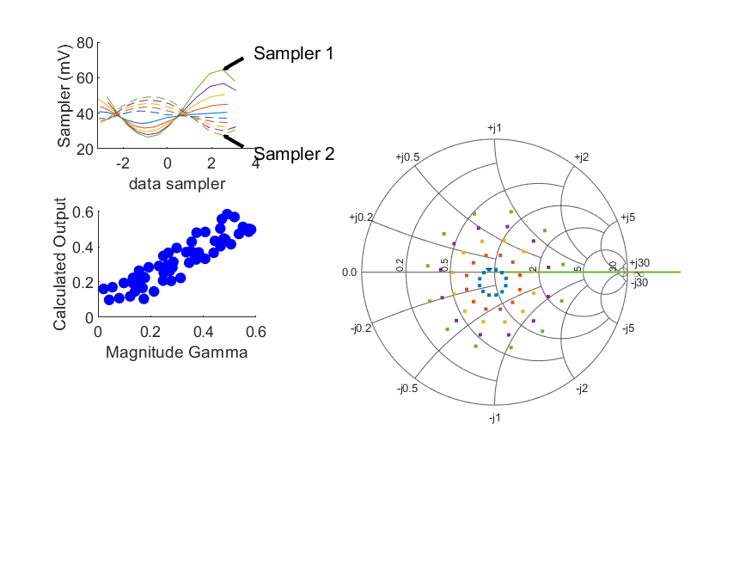
Coupled Line Performance At 10.70 GHz, 16.000000 dBm Output Power 2.00 V mean sampler bias
Sampler Av
  Sampler 1: 28.631
  Sampler 2: 28.631
Sampler Offset (rather than -1)
  -3.0906726834225999
Goodness Of fit
  0.12387708155638658
Sampler 1 Range
  0.037890231099999998
Sampler 2 Range
  0.021460514099999998
DUT output dBm Mean
  16.900318334490752
DUT input dBm Mean
  7.7327795775904882
RMS Error
  0.064963244311455212
Max Error
  0.090442608116755085

Slide 36

Coupled Line Performance At 10.70 GHz, 16.000000 dBm Output Power 2.10 V mean sampler bias
Sampler Av
  Sampler 1: 26.332
  Sampler 2: 26.332
Sampler Offset (rather than -1)
  -2.9724339892078824
Goodness Of fit
  0.17668072228142945
Sampler 1 Range
  0.039862676
Sampler 2 Range
  0.021486266900000002
DUT output dBm Mean
  17.031555067824083
DUT input dBm Mean
  8.7943804109238215
RMS Error
  0.080017249562322423
Max Error
  0.11492263469594788

Slide 37
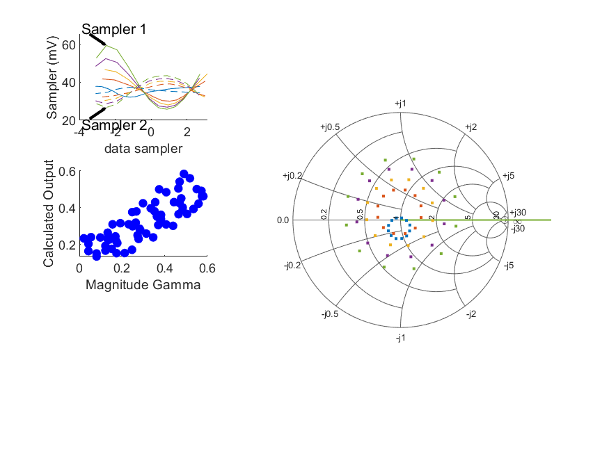
Coupled Line Performance At 10.70 GHz, 16.000000 dBm Output Power 2.20 V mean sampler bias
Sampler Av
  Sampler 1: 29.542
  Sampler 2: 29.542
Sampler Offset (rather than -1)
  -3.1907972232392767
Goodness Of fit
  0.22905701352613902
Sampler 1 Range
  0.033590208699999999
Sampler 2 Range
  0.016774936200000003
DUT output dBm Mean
  15.971648880522496
DUT input dBm Mean
  8.7942745299714389
RMS Error
  0.092102917663722861
Max Error
  0.14122345713485829

