Slide 1
Coupledline Compiled Data

Slide 2
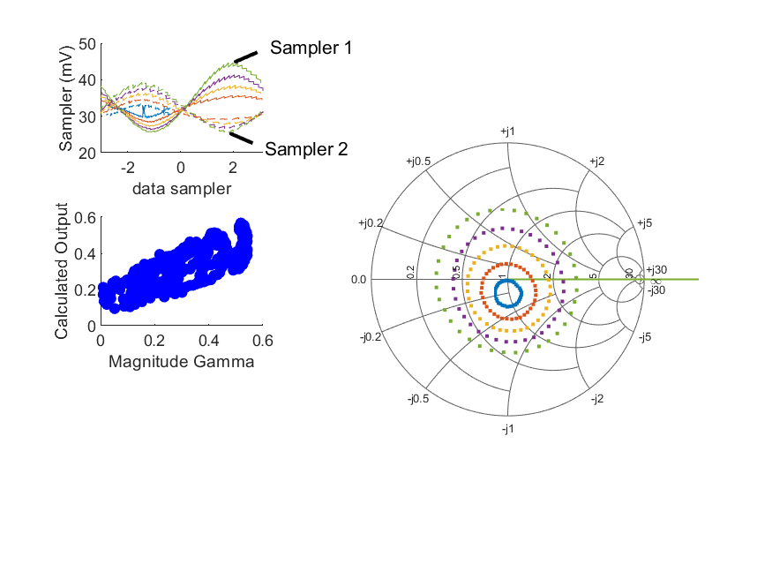
Coupled Line Performance At 9.90 GHz, 14.000000 dBm Output Power 1.72 V mean sampler bias
Sampler Av
  Sampler 1: 30.142
  Sampler 2: 30.142
Sampler Offset (rather than -1)
  -2.3554870652309474
Goodness Of fit
  1.306237090561102
Sampler 1 Range
  0.018960098099999999
Sampler 2 Range
  0.013776120999999999
DUT output dBm Mean
  13.963742945104398
DUT input dBm Mean
  1.7042938988845782
RMS Error
  0.094397936559230428
Max Error
  0.19753163216981412

Slide 3
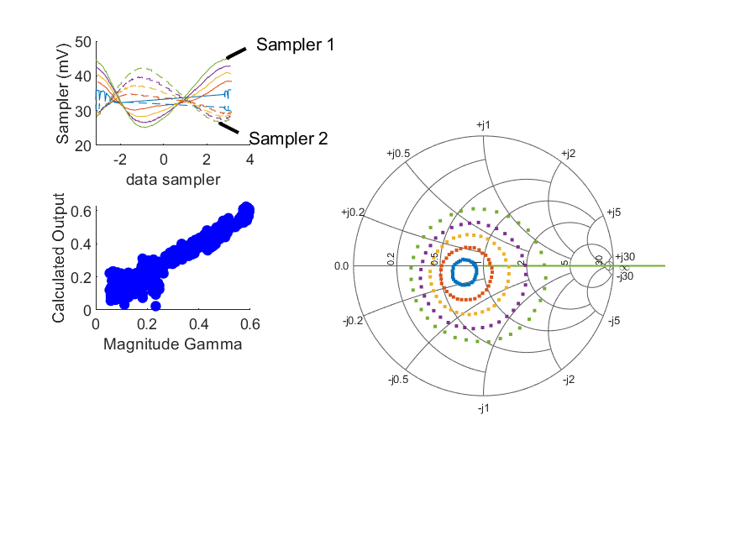
Coupled Line Performance At 10.40 GHz, 14.000000 dBm Output Power 1.72 V mean sampler bias
Sampler Av
  Sampler 1: 46.569
  Sampler 2: 46.569
Sampler Offset (rather than -1)
  -3.4800570308273007
Goodness Of fit
  0.19942792437769691
Sampler 1 Range
  0.019837153999999999
Sampler 2 Range
  0.015636025899999999
DUT output dBm Mean
  14.511226590934211
DUT input dBm Mean
  2.7569573440391424
RMS Error
  0.046110381787679774
Max Error
  0.20978220503614367

Slide 4
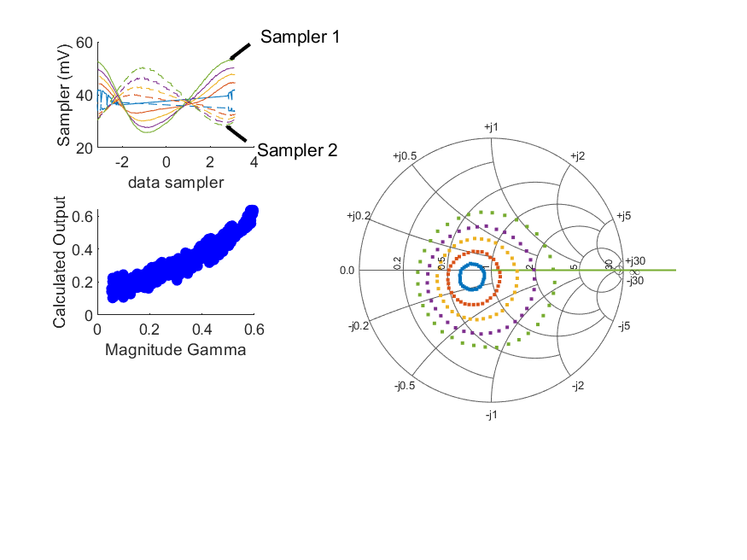
Coupled Line Performance At 10.40 GHz, 16.000000 dBm Output Power 1.72 V mean sampler bias
Sampler Av
  Sampler 1: 35.153
  Sampler 2: 35.153
Sampler Offset (rather than -1)
  -2.9771112026921216
Goodness Of fit
  0.30560928325761411
Sampler 1 Range
  0.027417510100000004
Sampler 2 Range
  0.021996765299999999
DUT output dBm Mean
  16.074192632600877
DUT input dBm Mean
  4.3466717329280309
RMS Error
  0.050482091818752191
Max Error
  0.11006357247718962

Slide 5

Coupled Line Performance At 10.40 GHz, 18.000000 dBm Output Power 1.72 V mean sampler bias
Sampler Av
  Sampler 1: 21.474
  Sampler 2: 21.474
Sampler Offset (rather than -1)
  -2.1435848528580164
Goodness Of fit
  0.59589393349158248
Sampler 1 Range
  0.040203979299999998
Sampler 2 Range
  0.031701477199999994
DUT output dBm Mean
  17.95257508815644
DUT input dBm Mean
  6.2923692607058079
RMS Error
  0.067872605425842669
Max Error
  0.15302234132170761

Slide 6
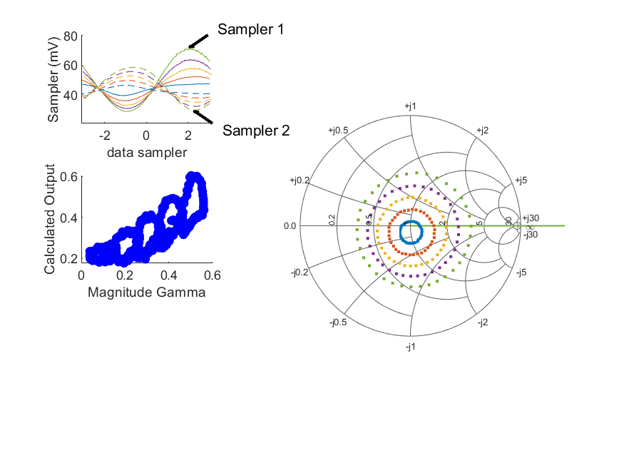
Coupled Line Performance At 10.90 GHz, 18.000000 dBm Output Power 1.72 V mean sampler bias
Sampler Av
  Sampler 1: 17.641
  Sampler 2: 17.641
Sampler Offset (rather than -1)
  -1.9595600396848047
Goodness Of fit
  1.1663671702339498
Sampler 1 Range
  0.0429071512
Sampler 2 Range
  0.029136850300000003
DUT output dBm Mean
  17.868892069180291
DUT input dBm Mean
  6.7491053269790982
RMS Error
  0.089292500358078078
Max Error
  0.15106906297861433

Slide 7
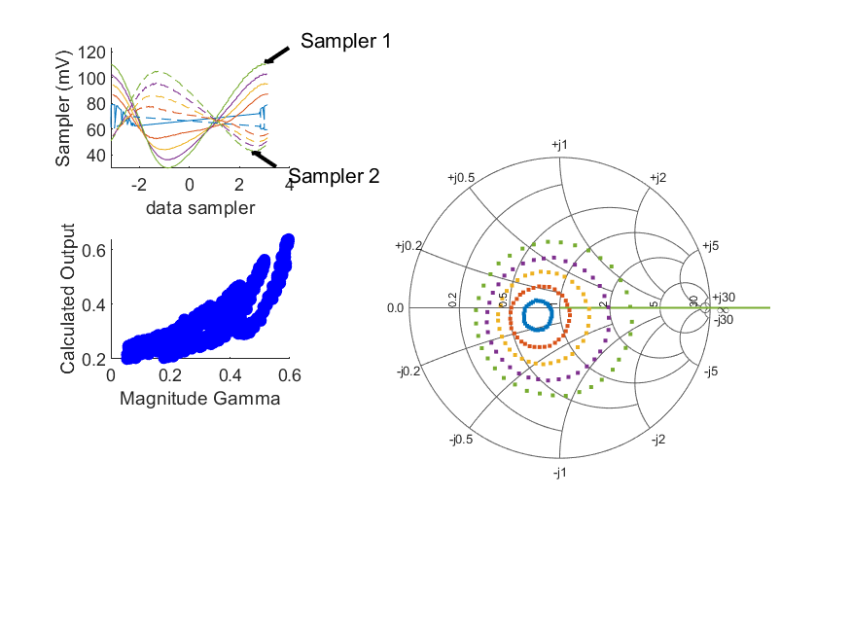
Coupled Line Performance At 10.40 GHz, 22.000000 dBm Output Power 1.72 V mean sampler bias
Sampler Av
  Sampler 1: 8.305
  Sampler 2: 8.305
Sampler Offset (rather than -1)
  -1.2545063353494001
Goodness Of fit
  0.98613298239701819
Sampler 1 Range
  0.081079455599999989
Sampler 2 Range
  0.0619753392
DUT output dBm Mean
  21.679596898173106
DUT input dBm Mean
  10.580755566261367
RMS Error
  0.085645909157735414
Max Error
  0.16941843539644247

Slide 8
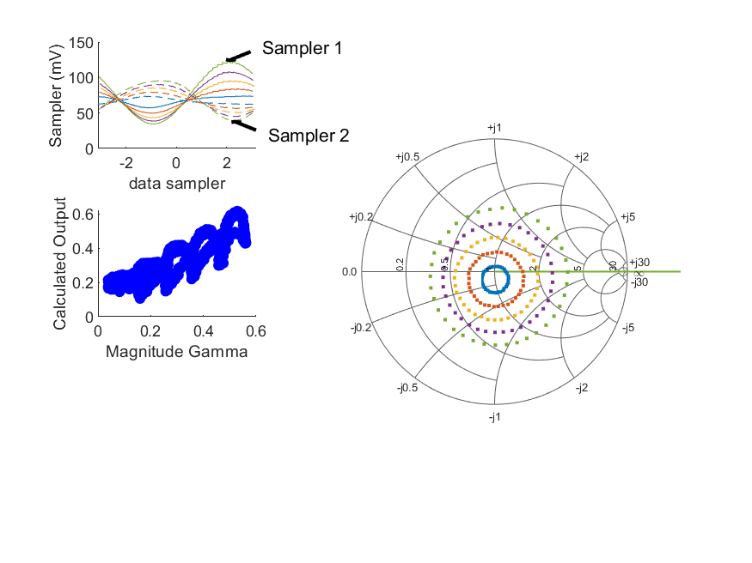
Coupled Line Performance At 10.90 GHz, 22.000000 dBm Output Power 1.72 V mean sampler bias
Sampler Av
  Sampler 1: 9.827
  Sampler 2: 9.827
Sampler Offset (rather than -1)
  -1.7524504813945341
Goodness Of fit
  0.92581325642681156
Sampler 1 Range
  0.088756677000000006
Sampler 2 Range
  0.056674633900000007
DUT output dBm Mean
  21.643125709735848
DUT input dBm Mean
  11.1421265769791
RMS Error
  0.078922730729175009
Max Error
  0.16290982190752851

Slide 9
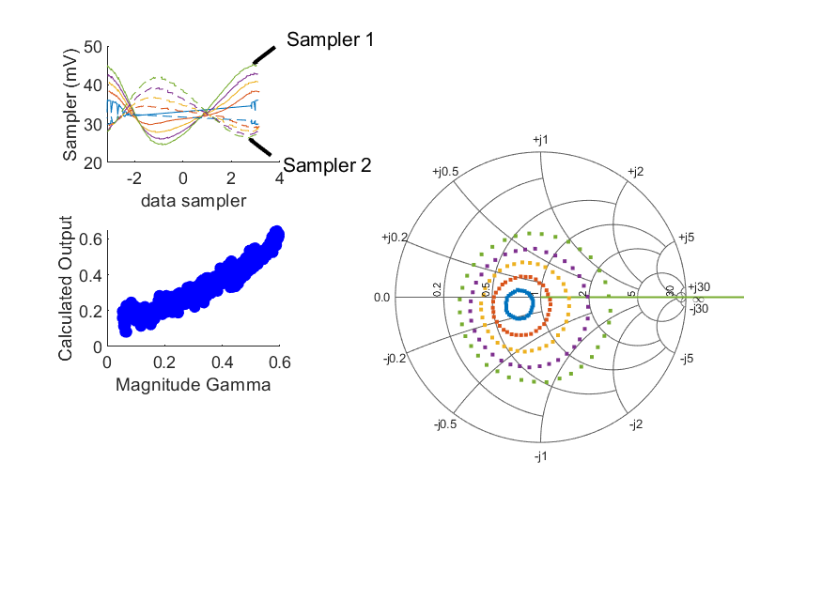
Coupled Line Performance At 10.40 GHz, 14.000000 dBm Output Power 1.82 V mean sampler bias
Sampler Av
  Sampler 1: 42.658
  Sampler 2: 42.658
Sampler Offset (rather than -1)
  -3.2546022197081745
Goodness Of fit
  0.28714784957983069
Sampler 1 Range
  0.020744503600000002
Sampler 2 Range
  0.015751050599999997
DUT output dBm Mean
  14.608196940934212
DUT input dBm Mean
  3.2232213162613652
RMS Error
  0.047198114605617396
Max Error
  0.1105052998758268

Slide 10
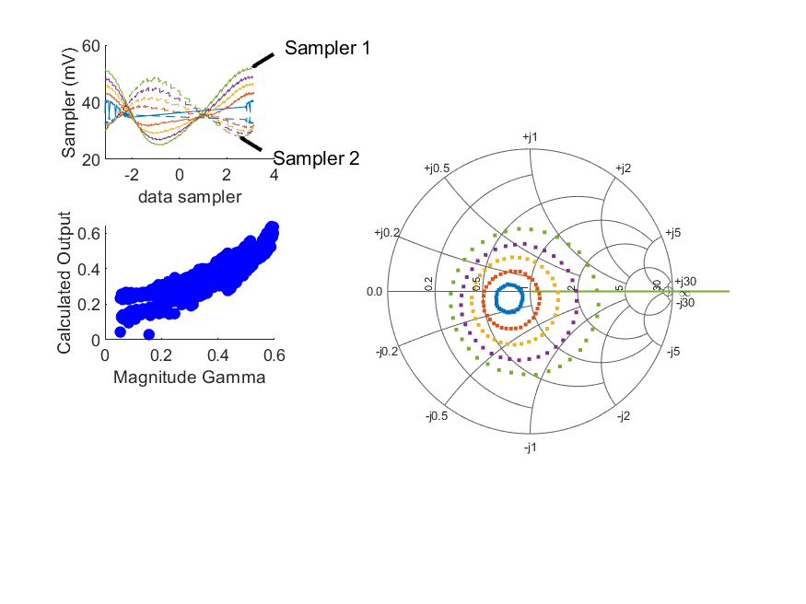
Coupled Line Performance At 10.40 GHz, 16.000000 dBm Output Power 1.82 V mean sampler bias
Sampler Av
  Sampler 1: 28.944
  Sampler 2: 28.944
Sampler Offset (rather than -1)
  -2.4192784562022167
Goodness Of fit
  0.59937199172377276
Sampler 1 Range
  0.0271287653
Sampler 2 Range
  0.020893235699999999
DUT output dBm Mean
  15.858770238156437
DUT input dBm Mean
  4.5720474273724765
RMS Error
  0.069638475277197034
Max Error
  0.15798282296115973

Slide 11
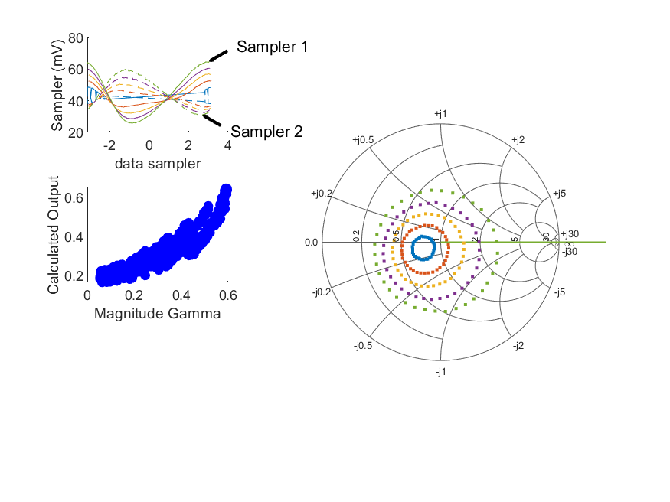
Coupled Line Performance At 10.40 GHz, 18.000000 dBm Output Power 1.82 V mean sampler bias
Sampler Av
  Sampler 1: 20.797
  Sampler 2: 20.797
Sampler Offset (rather than -1)
  -2.0724712982960947
Goodness Of fit
  0.63415120496592681
Sampler 1 Range
  0.039000323800000007
Sampler 2 Range
  0.028895365500000002
DUT output dBm Mean
  17.707395418711986
DUT input dBm Mean
  6.649506982928032
RMS Error
  0.069164464607600951
Max Error
  0.14774468507062494

Slide 12
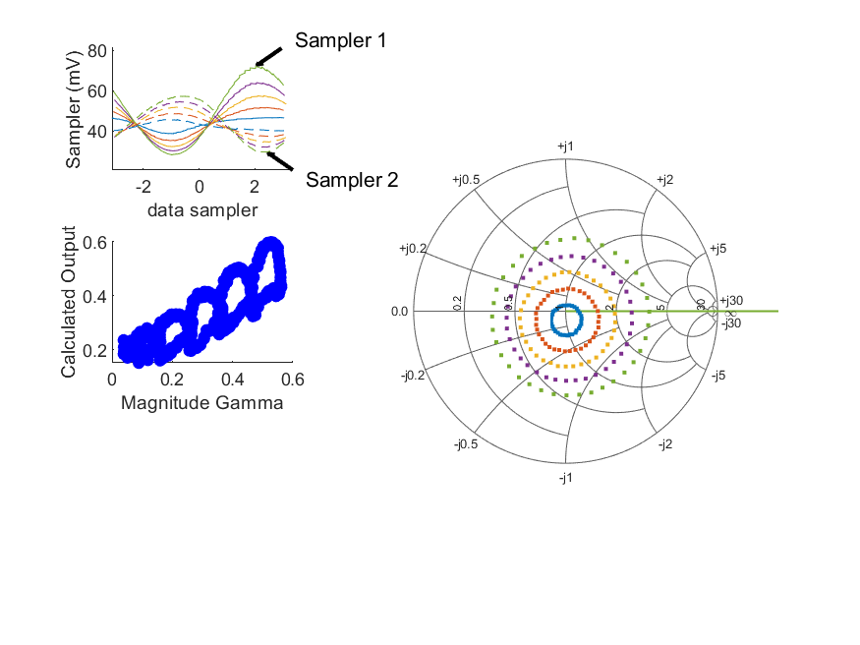
Coupled Line Performance At 10.90 GHz, 18.000000 dBm Output Power 1.82 V mean sampler bias
Sampler Av
  Sampler 1: 17.181
  Sampler 2: 17.181
Sampler Offset (rather than -1)
  -1.962460578418455
Goodness Of fit
  1.1165492697406034
Sampler 1 Range
  0.044137576999999997
Sampler 2 Range
  0.02794468
DUT output dBm Mean
  17.817483099735849
DUT input dBm Mean
  7.359884688090208
RMS Error
  0.085994581789050062
Max Error
  0.14781606093720856

Slide 13
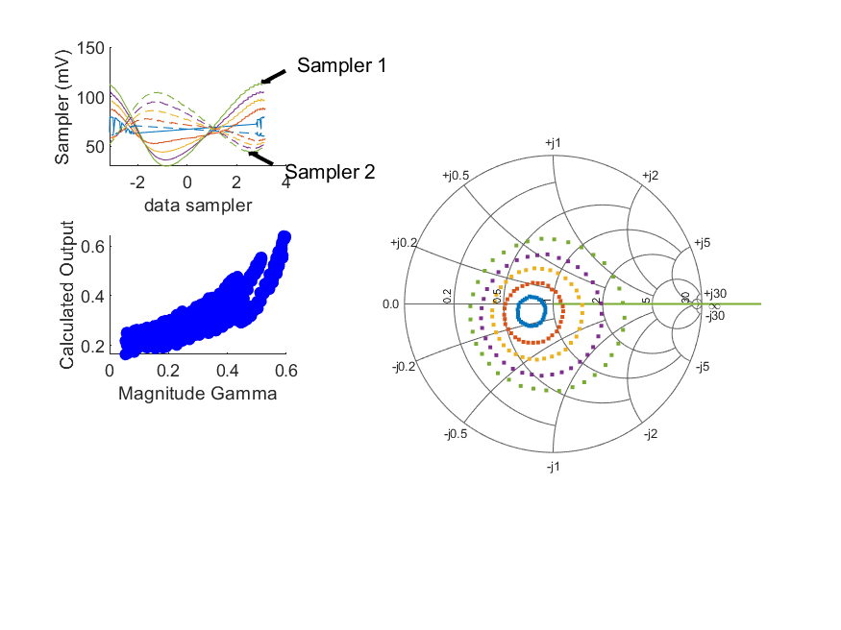
Coupled Line Performance At 10.40 GHz, 22.000000 dBm Output Power 1.82 V mean sampler bias
Sampler Av
  Sampler 1: 8.785
  Sampler 2: 8.785
Sampler Offset (rather than -1)
  -1.3840691675344112
Goodness Of fit
  0.82502050373877189
Sampler 1 Range
  0.08381598609999999
Sampler 2 Range
  0.060503171899999993
DUT output dBm Mean
  21.759147260426154
DUT input dBm Mean
  11.319797732928029
RMS Error
  0.078114427629374247
Max Error
  0.16152297831595219

Slide 14

Coupled Line Performance At 10.90 GHz, 22.000000 dBm Output Power 1.82 V mean sampler bias
Sampler Av
  Sampler 1: 8.424
  Sampler 2: 8.424
Sampler Offset (rather than -1)
  -1.512092881718156
Goodness Of fit
  1.2164967782577985
Sampler 1 Range
  0.090405730500000003
Sampler 2 Range
  0.056585302999999997
DUT output dBm Mean
  21.687895033504738
DUT input dBm Mean
  11.860611826979099
RMS Error
  0.09268095290416356
Max Error
  0.18356082071159474

Slide 15
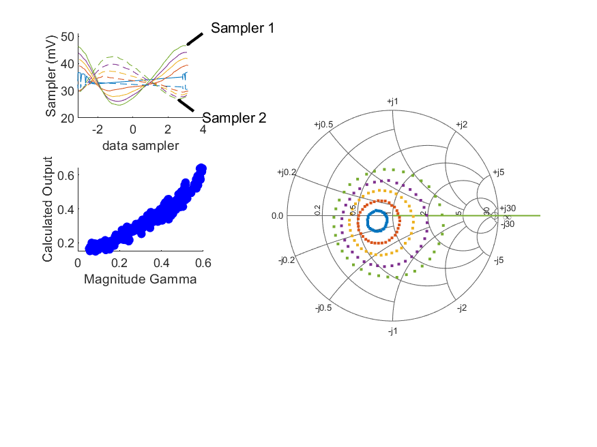
Coupled Line Performance At 10.40 GHz, 14.000000 dBm Output Power 1.90 V mean sampler bias
Sampler Av
  Sampler 1: 35.020
  Sampler 2: 35.020
Sampler Offset (rather than -1)
  -2.8088407254773595
Goodness Of fit
  0.15258487600197293
Sampler 1 Range
  0.021863913499999998
Sampler 2 Range
  0.015776935499999999
DUT output dBm Mean
  14.771196613156434
DUT input dBm Mean
  4.1084757051502541
RMS Error
  0.047644210105674344
Max Error
  0.096051399479838706

Slide 16
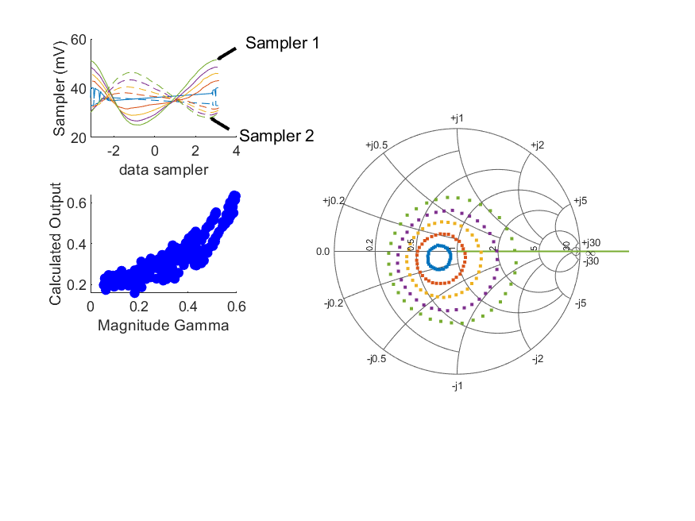
Coupled Line Performance At 10.40 GHz, 16.000000 dBm Output Power 1.90 V mean sampler bias
Sampler Av
  Sampler 1: 30.317
  Sampler 2: 30.317
Sampler Offset (rather than -1)
  -2.6567600644862854
Goodness Of fit
  0.32709940428891016
Sampler 1 Range
  0.026476227300000002
Sampler 2 Range
  0.018385177500000002
DUT output dBm Mean
  15.695813179823103
DUT input dBm Mean
  5.0972915384835868
RMS Error
  0.073374716678015012
Max Error
  0.15053881169998551

Slide 17
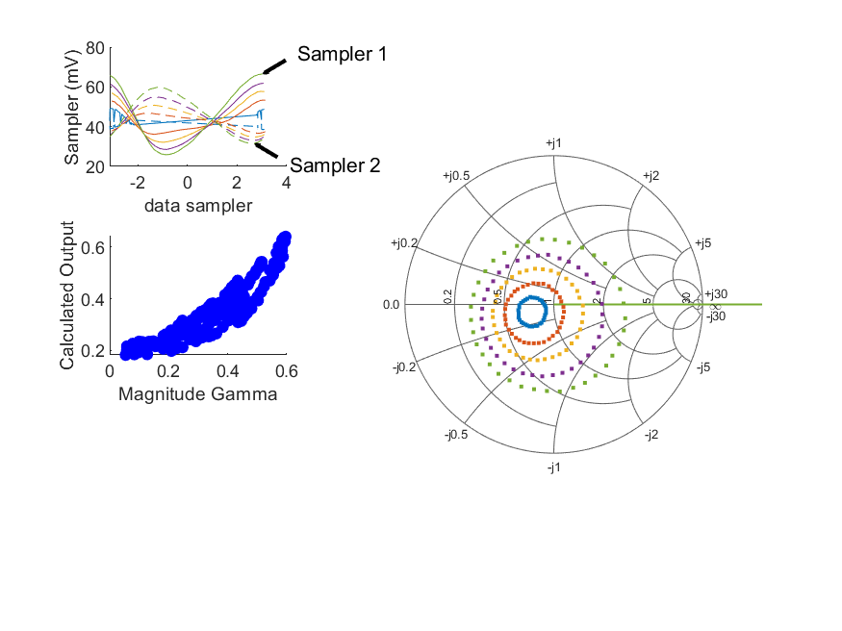
Coupled Line Performance At 10.40 GHz, 18.000000 dBm Output Power 1.90 V mean sampler bias
Sampler Av
  Sampler 1: 19.443
  Sampler 2: 19.443
Sampler Offset (rather than -1)
  -2.0154385983054794
Goodness Of fit
  0.27217757203108855
Sampler 1 Range
  0.040594893199999996
Sampler 2 Range
  0.028321377000000002
DUT output dBm Mean
  17.775126429823104
DUT input dBm Mean
  7.4160910940391433
RMS Error
  0.065130353172453609
Max Error
  0.13165063997261489

Slide 18
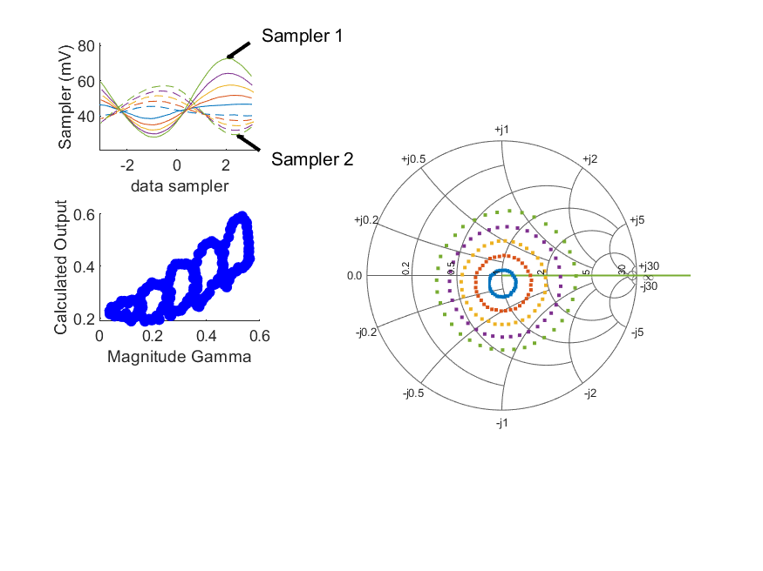
Coupled Line Performance At 10.90 GHz, 18.000000 dBm Output Power 1.90 V mean sampler bias
Sampler Av
  Sampler 1: 15.450
  Sampler 2: 15.450
Sampler Offset (rather than -1)
  -1.8002211423015289
Goodness Of fit
  0.64484695899374
Sampler 1 Range
  0.044446429100000004
Sampler 2 Range
  0.027735474200000002
DUT output dBm Mean
  17.815773608069183
DUT input dBm Mean
  8.0554320769791001
RMS Error
  0.095501734911885572
Max Error
  0.15509306026480379

Slide 19
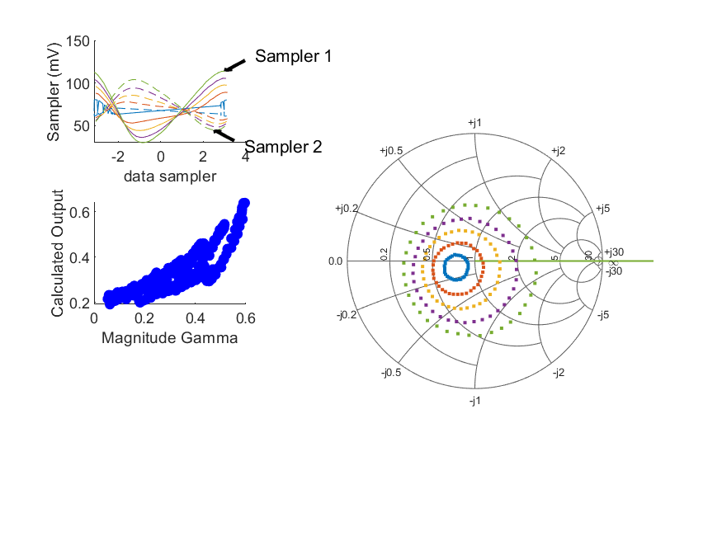
Coupled Line Performance At 10.40 GHz, 22.000000 dBm Output Power 1.90 V mean sampler bias
Sampler Av
  Sampler 1: 9.245
  Sampler 2: 9.245
Sampler Offset (rather than -1)
  -1.5034859266945459
Goodness Of fit
  0.40898924511227996
Sampler 1 Range
  0.084210197799999997
Sampler 2 Range
  0.059378589000000002
DUT output dBm Mean
  21.794909676964103
DUT input dBm Mean
  11.831456094039142
RMS Error
  0.078789603446502932
Max Error
  0.16129261101254977

