Slide 1
Coupledline Compiled Data

Slide 2
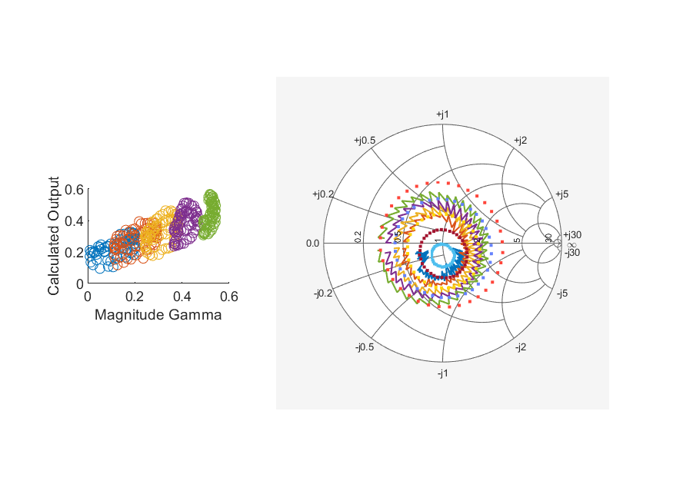
Coupled Line Performance At 9.90 GHz, 14.000000 dBm Output Power 1.72 V mean sampler bias
Sampler Av
  Sampler 1: 0.588
  Sampler 2: 0.383
Kappa
  Sampler 1: 0.0154
  Sampler 2: 0.0192
Goodness Of fit
  1.3062370905611014
Range
  Sampler 1: 0.019
  Sampler 2: 0.0138
dBm Mean
  DUT output 13.9637
  DUT input 1.70429
RMS Error
  0.0943979
Max Error
  0.202343

Slide 3
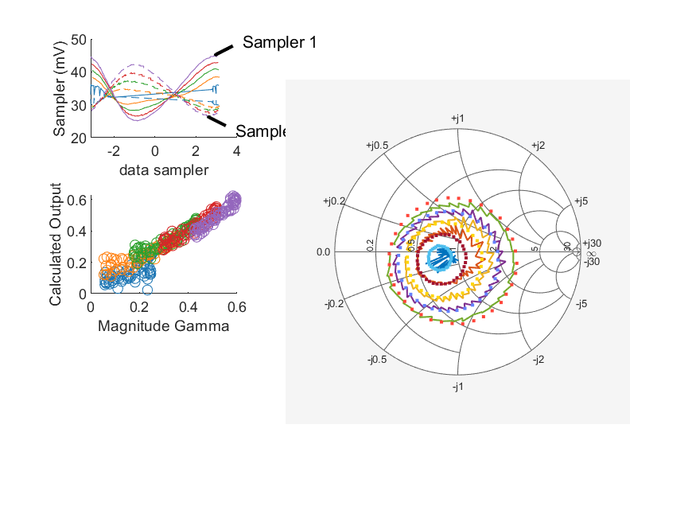
Coupled Line Performance At 10.40 GHz, 14.000000 dBm Output Power 1.72 V mean sampler bias
Sampler Av
  Sampler 1: 0.328
  Sampler 2: 0.251
Kappa
  Sampler 1: 0.023
  Sampler 2: 0.0231
Goodness Of fit
  0.19942792437769705
Range
  Sampler 1: 0.0198
  Sampler 2: 0.0156
dBm Mean
  DUT output 14.5112
  DUT input 2.75696
RMS Error
  0.0461104
Max Error
  0.209782

Slide 4
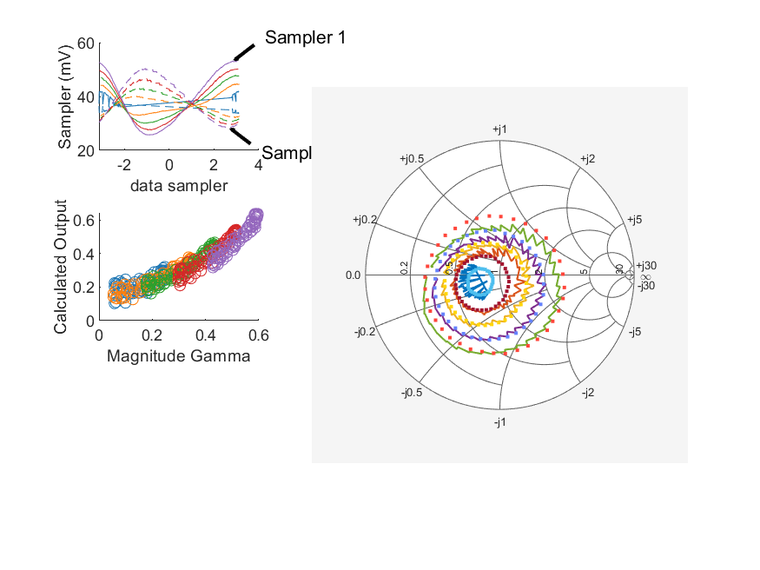
Coupled Line Performance At 10.40 GHz, 16.000000 dBm Output Power 1.72 V mean sampler bias
Sampler Av
  Sampler 1: 0.3
  Sampler 2: 0.226
Kappa
  Sampler 1: 0.0227
  Sampler 2: 0.0253
Goodness Of fit
  0.30560928325761405
Range
  Sampler 1: 0.0274
  Sampler 2: 0.022
dBm Mean
  DUT output 16.0742
  DUT input 4.34667
RMS Error
  0.0504821
Max Error
  0.166366

Slide 5
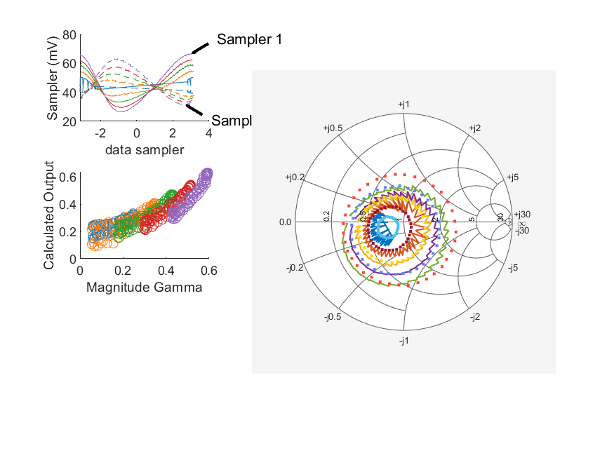
Coupled Line Performance At 10.40 GHz, 18.000000 dBm Output Power 1.72 V mean sampler bias
Sampler Av
  Sampler 1: 0.324
  Sampler 2: 0.24
Kappa
  Sampler 1: 0.0225
  Sampler 2: 0.0228
Goodness Of fit
  0.59589393349158382
Range
  Sampler 1: 0.0402
  Sampler 2: 0.0317
dBm Mean
  DUT output 17.9526
  DUT input 6.29237
RMS Error
  0.0678726
Max Error
  0.184743

Slide 6
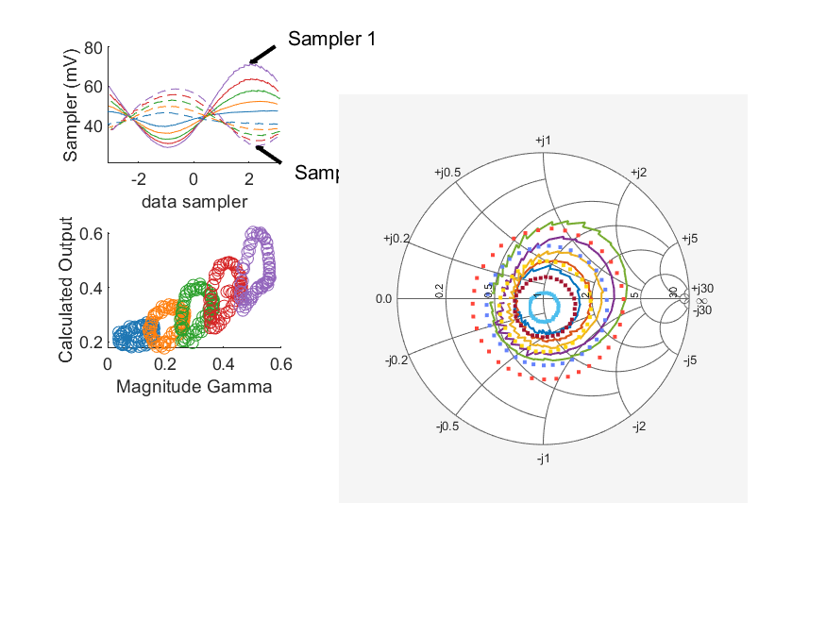
Coupled Line Performance At 10.90 GHz, 18.000000 dBm Output Power 1.72 V mean sampler bias
Sampler Av
  Sampler 1: 0.394
  Sampler 2: 0.243
Kappa
  Sampler 1: 0.0203
  Sampler 2: 0.021
Goodness Of fit
  1.1663671702339471
Range
  Sampler 1: 0.0429
  Sampler 2: 0.0291
dBm Mean
  DUT output 17.8689
  DUT input 6.74911
RMS Error
  0.0892925
Max Error
  0.196363

Slide 7
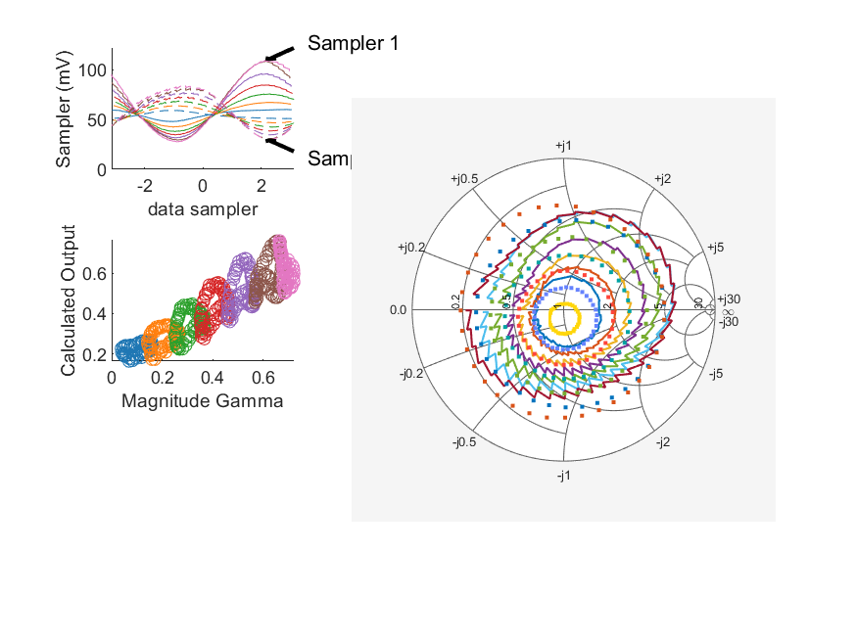
Coupled Line Performance At 10.90 GHz, 20.000000 dBm Output Power 1.72 V mean sampler bias
Sampler Av
  Sampler 1: 0.263
  Sampler 2: 0.158
Kappa
  Sampler 1: 0.028
  Sampler 2: 0.0295
Goodness Of fit
  3.3529418431712621
Range
  Sampler 1: 0.0821
  Sampler 2: 0.0535
dBm Mean
  DUT output 19.9366
  DUT input 9.40941
RMS Error
  0.0912958
Max Error
  0.190861

Slide 8
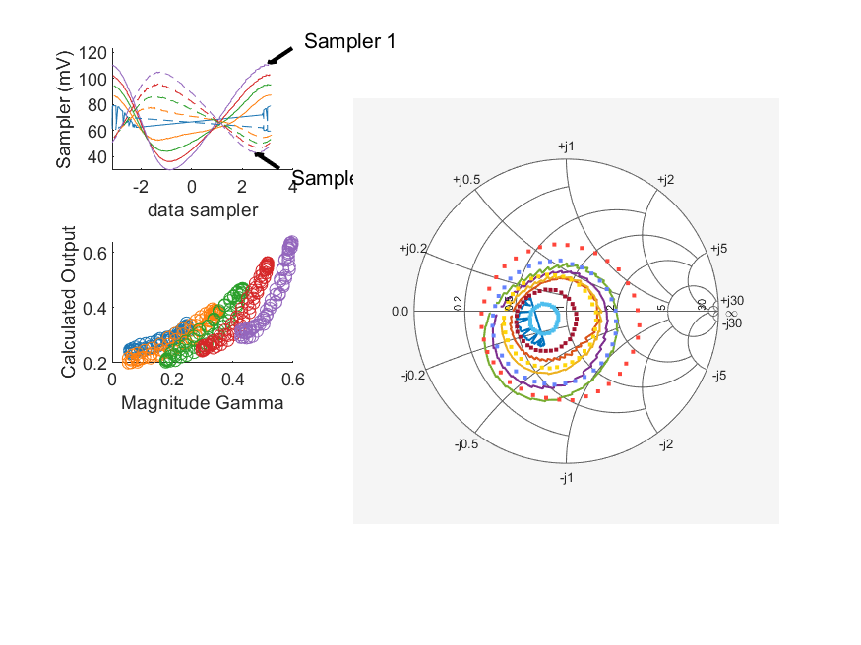
Coupled Line Performance At 10.40 GHz, 22.000000 dBm Output Power 1.72 V mean sampler bias
Sampler Av
  Sampler 1: 0.355
  Sampler 2: 0.255
Kappa
  Sampler 1: 0.0124
  Sampler 2: 0.0131
Goodness Of fit
  0.98613298239701841
Range
  Sampler 1: 0.0811
  Sampler 2: 0.062
dBm Mean
  DUT output 21.6796
  DUT input 10.5808
RMS Error
  0.0856459
Max Error
  0.188356

Slide 9
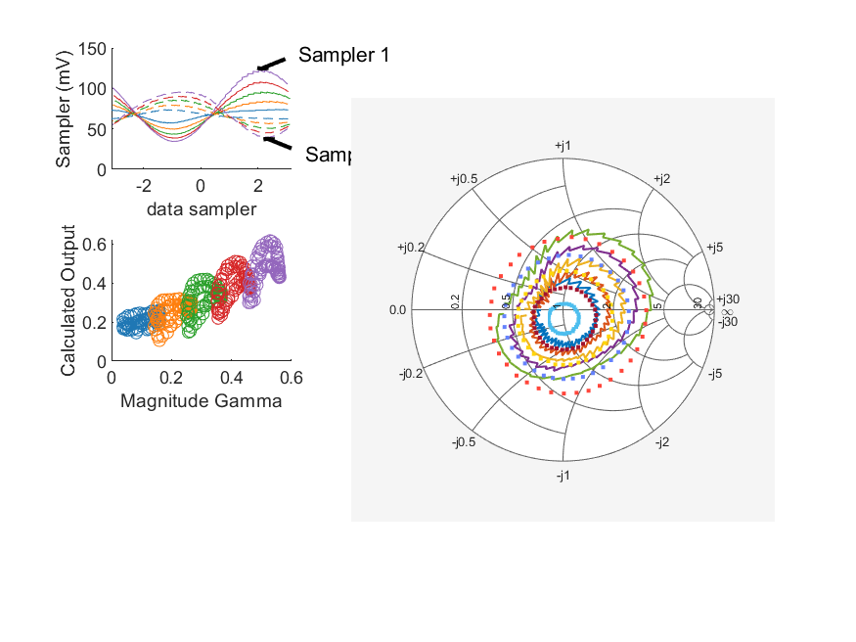
Coupled Line Performance At 10.90 GHz, 22.000000 dBm Output Power 1.72 V mean sampler bias
Sampler Av
  Sampler 1: 0.285
  Sampler 2: 0.165
Kappa
  Sampler 1: 0.0294
  Sampler 2: 0.0274
Goodness Of fit
  0.92581325642681123
Range
  Sampler 1: 0.0888
  Sampler 2: 0.0567
dBm Mean
  DUT output 21.6431
  DUT input 11.1421
RMS Error
  0.0789227
Max Error
  0.177515

Slide 10
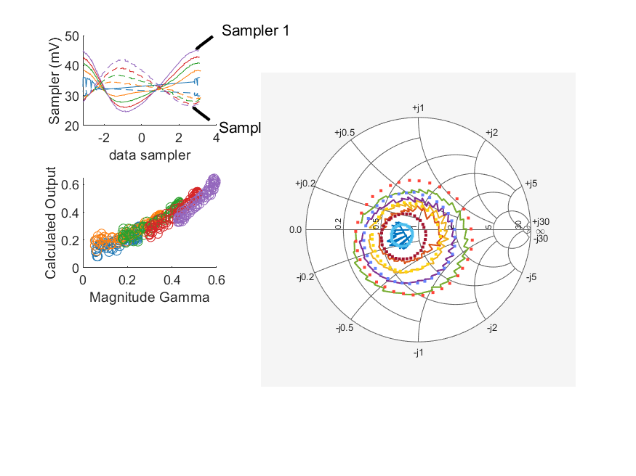
Coupled Line Performance At 10.40 GHz, 14.000000 dBm Output Power 1.82 V mean sampler bias
Sampler Av
  Sampler 1: 0.348
  Sampler 2: 0.251
Kappa
  Sampler 1: 0.0222
  Sampler 2: 0.0222
Goodness Of fit
  0.28714784958015938
Range
  Sampler 1: 0.0207
  Sampler 2: 0.0158
dBm Mean
  DUT output 14.6082
  DUT input 3.22322
RMS Error
  0.0471981
Max Error
  0.162158

Slide 11
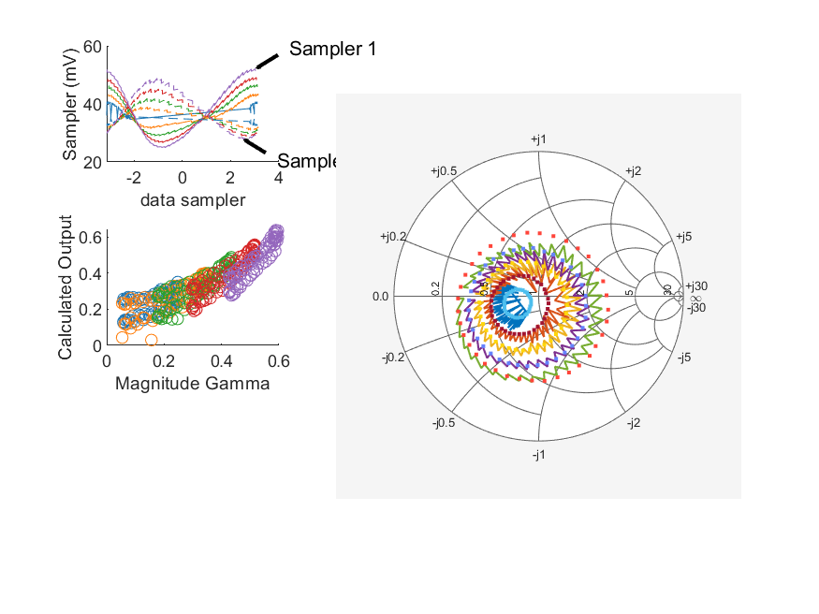
Coupled Line Performance At 10.40 GHz, 16.000000 dBm Output Power 1.82 V mean sampler bias
Sampler Av
  Sampler 1: 0.378
  Sampler 2: 0.271
Kappa
  Sampler 1: 0.0204
  Sampler 2: 0.0205
Goodness Of fit
  0.59937199172377298
Range
  Sampler 1: 0.0271
  Sampler 2: 0.0209
dBm Mean
  DUT output 15.8588
  DUT input 4.57205
RMS Error
  0.0696385
Max Error
  0.198213

Slide 12
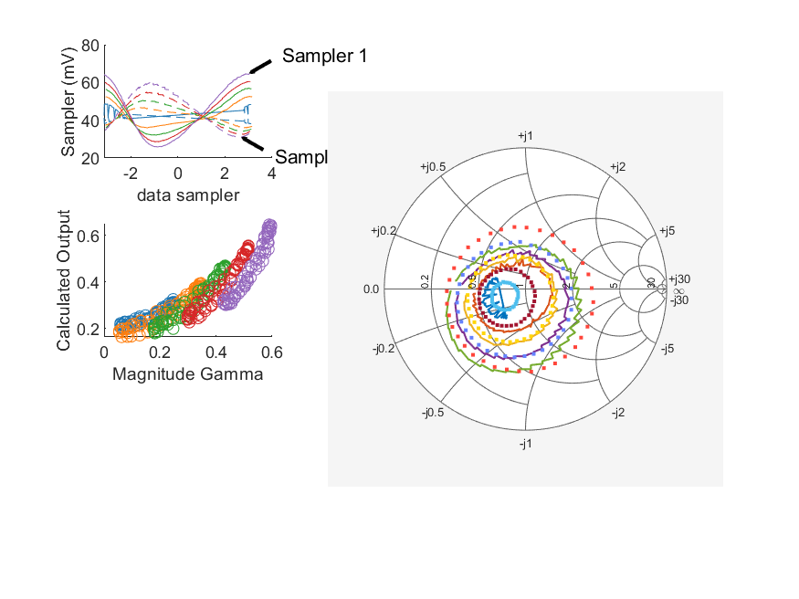
Coupled Line Performance At 10.40 GHz, 18.000000 dBm Output Power 1.82 V mean sampler bias
Sampler Av
  Sampler 1: 0.35
  Sampler 2: 0.244
Kappa
  Sampler 1: 0.0212
  Sampler 2: 0.0212
Goodness Of fit
  0.63415120496592603
Range
  Sampler 1: 0.039
  Sampler 2: 0.0289
dBm Mean
  DUT output 17.7074
  DUT input 6.64951
RMS Error
  0.0691645
Max Error
  0.16331

Slide 13
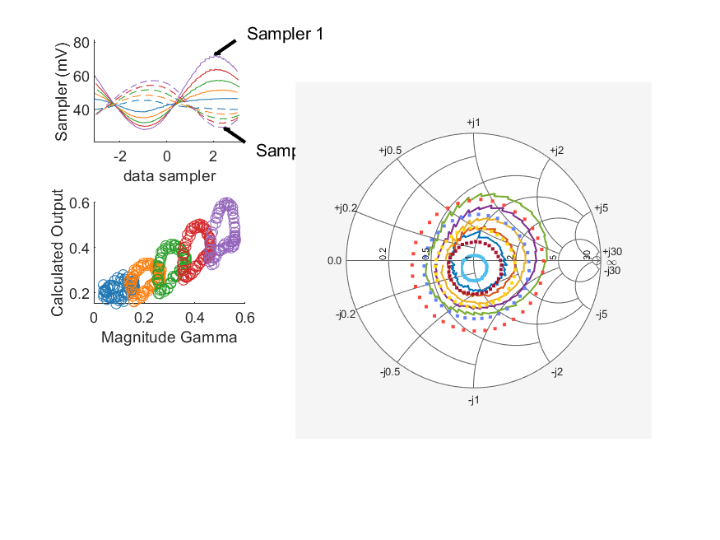
Coupled Line Performance At 10.90 GHz, 18.000000 dBm Output Power 1.82 V mean sampler bias
Sampler Av
  Sampler 1: 0.394
  Sampler 2: 0.227
Kappa
  Sampler 1: 0.019
  Sampler 2: 0.0213
Goodness Of fit
  1.116549269740603
Range
  Sampler 1: 0.0441
  Sampler 2: 0.0279
dBm Mean
  DUT output 17.8175
  DUT input 7.35988
RMS Error
  0.0859946
Max Error
  0.197409

Slide 14
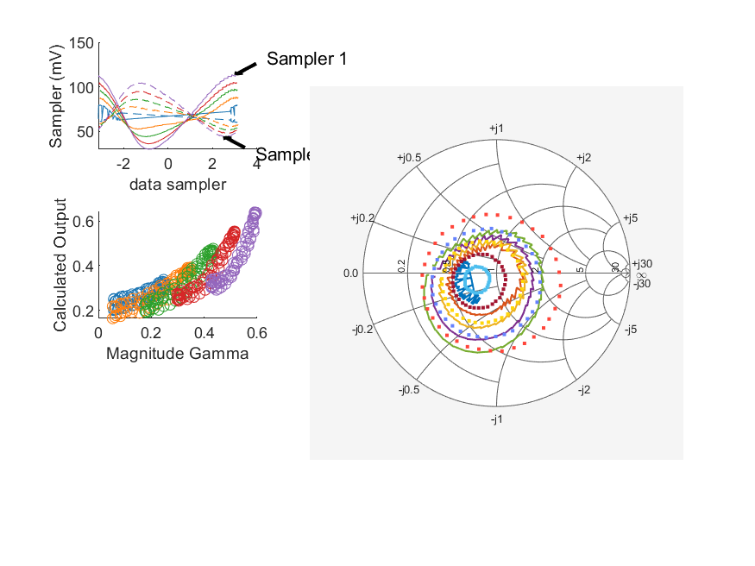
Coupled Line Performance At 10.40 GHz, 22.000000 dBm Output Power 1.82 V mean sampler bias
Sampler Av
  Sampler 1: 0.318
  Sampler 2: 0.218
Kappa
  Sampler 1: 0.0171
  Sampler 2: 0.0182
Goodness Of fit
  0.82502050373877189
Range
  Sampler 1: 0.0838
  Sampler 2: 0.0605
dBm Mean
  DUT output 21.7591
  DUT input 11.3198
RMS Error
  0.0781144
Max Error
  0.192978

Slide 15
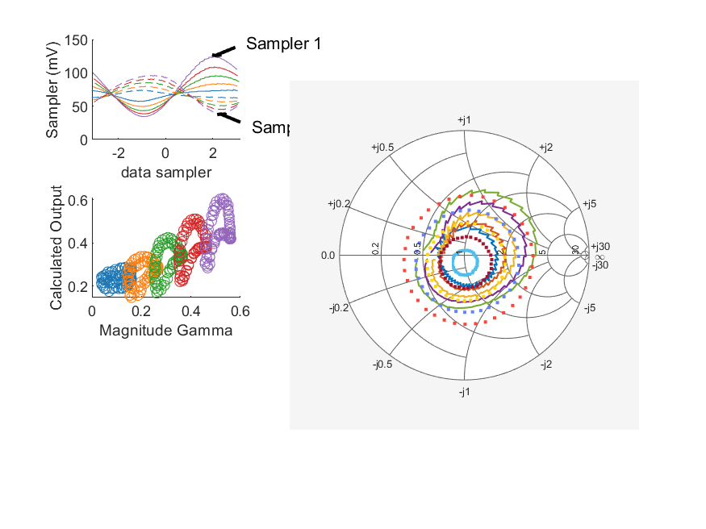
Coupled Line Performance At 10.90 GHz, 22.000000 dBm Output Power 1.82 V mean sampler bias
Sampler Av
  Sampler 1: 0.326
  Sampler 2: 0.184
Kappa
  Sampler 1: 0.0212
  Sampler 2: 0.0224
Goodness Of fit
  1.2164967782577976
Range
  Sampler 1: 0.0904
  Sampler 2: 0.0566
dBm Mean
  DUT output 21.6879
  DUT input 11.8606
RMS Error
  0.092681
Max Error
  0.202751

Slide 16
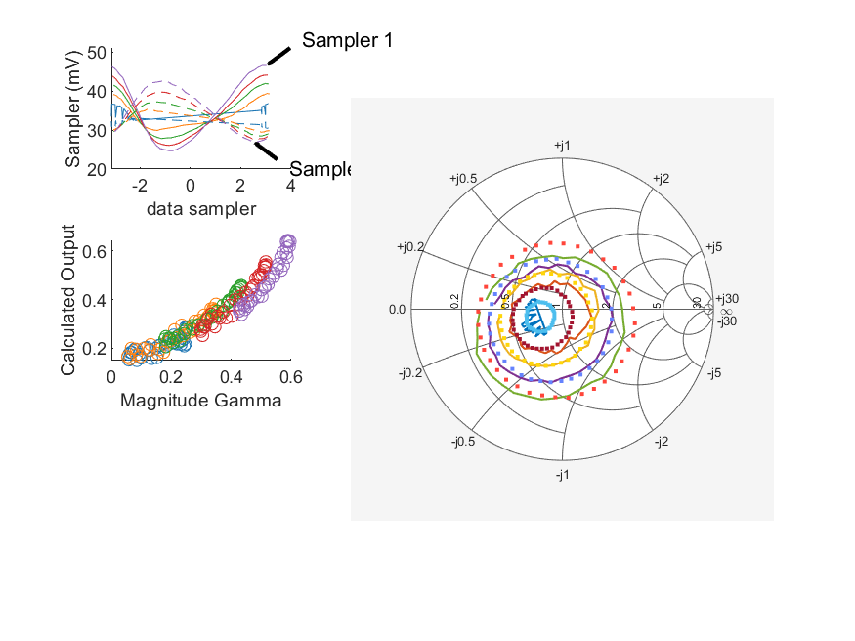
Coupled Line Performance At 10.40 GHz, 14.000000 dBm Output Power 1.90 V mean sampler bias
Sampler Av
  Sampler 1: 0.4
  Sampler 2: 0.271
Kappa
  Sampler 1: 0.0209
  Sampler 2: 0.0208
Goodness Of fit
  0.15258487600197301
Range
  Sampler 1: 0.0219
  Sampler 2: 0.0158
dBm Mean
  DUT output 14.7712
  DUT input 4.10848
RMS Error
  0.0476442
Max Error
  0.132832

Slide 17
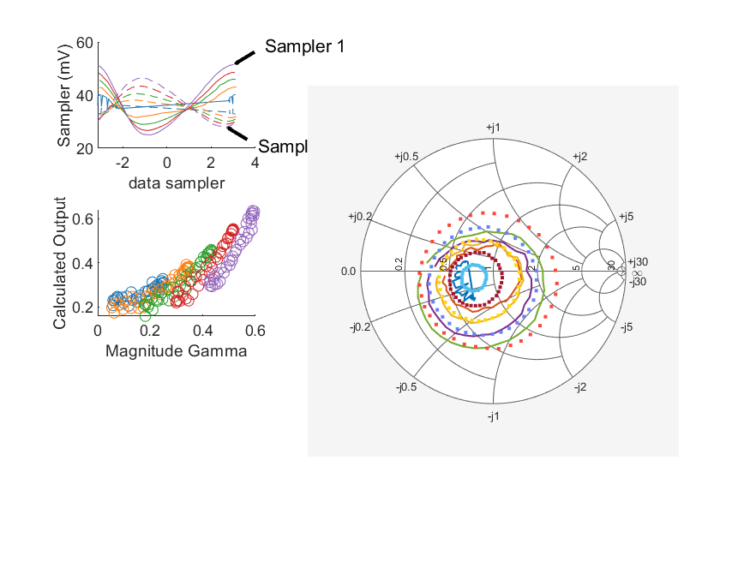
Coupled Line Performance At 10.40 GHz, 16.000000 dBm Output Power 1.90 V mean sampler bias
Sampler Av
  Sampler 1: 0.378
  Sampler 2: 0.248
Kappa
  Sampler 1: 0.0209
  Sampler 2: 0.0222
Goodness Of fit
  0.32709940428891043
Range
  Sampler 1: 0.0265
  Sampler 2: 0.0184
dBm Mean
  DUT output 15.6958
  DUT input 5.09729
RMS Error
  0.0733747
Max Error
  0.172963

Slide 18

Coupled Line Performance At 10.40 GHz, 18.000000 dBm Output Power 1.90 V mean sampler bias
Sampler Av
  Sampler 1: 0.358
  Sampler 2: 0.237
Kappa
  Sampler 1: 0.0207
  Sampler 2: 0.0209
Goodness Of fit
  0.27217757203108861
Range
  Sampler 1: 0.0406
  Sampler 2: 0.0283
dBm Mean
  DUT output 17.7751
  DUT input 7.41609
RMS Error
  0.0651304
Max Error
  0.157413

Slide 19
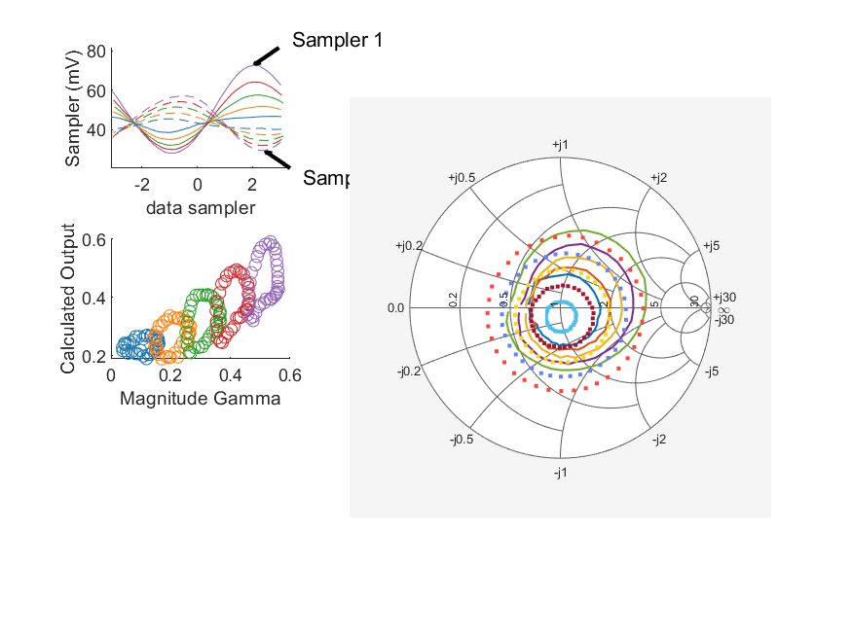
Coupled Line Performance At 10.90 GHz, 18.000000 dBm Output Power 1.90 V mean sampler bias
Sampler Av
  Sampler 1: 0.43
  Sampler 2: 0.238
Kappa
  Sampler 1: 0.0187
  Sampler 2: 0.0184
Goodness Of fit
  0.64484695899373978
Range
  Sampler 1: 0.0444
  Sampler 2: 0.0277
dBm Mean
  DUT output 17.8158
  DUT input 8.05543
RMS Error
  0.0955017
Max Error
  0.197867

Slide 20

Coupled Line Performance At 10.40 GHz, 22.000000 dBm Output Power 1.90 V mean sampler bias
Sampler Av
  Sampler 1: 0.3
  Sampler 2: 0.199
Kappa
  Sampler 1: 0.0236
  Sampler 2: 0.0204
Goodness Of fit
  0.40898924511228008
Range
  Sampler 1: 0.0842
  Sampler 2: 0.0594
dBm Mean
  DUT output 21.7949
  DUT input 11.8315
RMS Error
  0.0787896
Max Error
  0.174256

