Slide 1
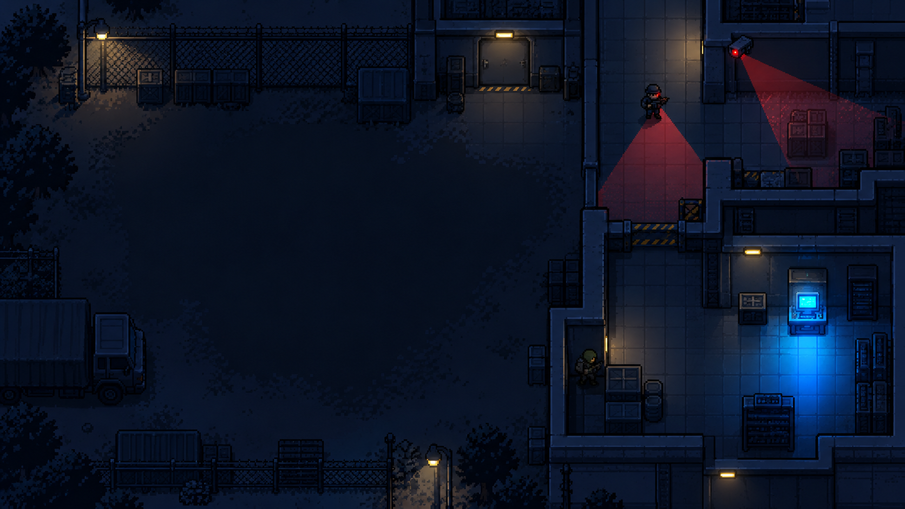
PIXEL REBELLION: SHADOW PROTOCOL
MISSION BRIEFING
MISSION
CONTROLS
You are a rebel operative infiltrating a secure facility. Move through the level, collect the required evidence, avoid guards and cameras, and reach extraction without being detected.
Keep the keys familiar and consistent so players can learn quickly.
WASD
ARROWS
Move
SHIFT
Sprint / Hold
OBJECTIVES
E
Interact / Evidence / Terminal
1
Navigate the facility
R
Restart
2
Collect required evidence
ESC
Pause / Help
3
Avoid detection
MOUSE
Menu Selection
4
Reach the extraction point
!
STAY UNDETECTED
Avoid guard vision
Watch cameras
Use cover
START MISSION ▶
Stay out of red detection cones.
Cameras can detect movement.
Hide behind objects when needed.

