Slide 1
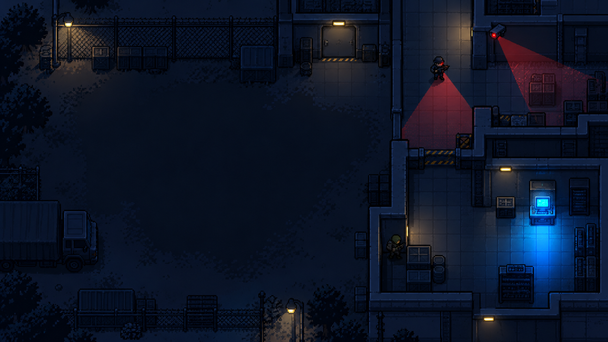
PIXEL REBELLION: SHADOW PROTOCOL
SCORE
LIVES
EVIDENCE
ALERT
STATUS
MODE
ESC: PAUSE/ HELP
0000
♥ ♥ ♥
0 / 4
0%
SAFE
EASY
MISSION TRACKER
Current Objective
Find and collect evidence.
Evidence: 0 / 4
Terminal: Locked
Extraction: Locked
Unlock extraction after required evidence is collected.
WASD / ARROWS
Move
CONTEXT PROMPT
E
Collect Evidence / Use Terminal / Hide
EXTRACTION
SHIFT
Sprint
R
Restart
Only appears when the player is close enough to interact.
LOCKED

