Slide 1

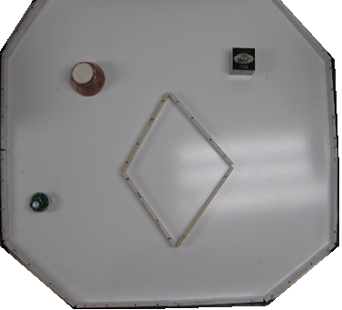
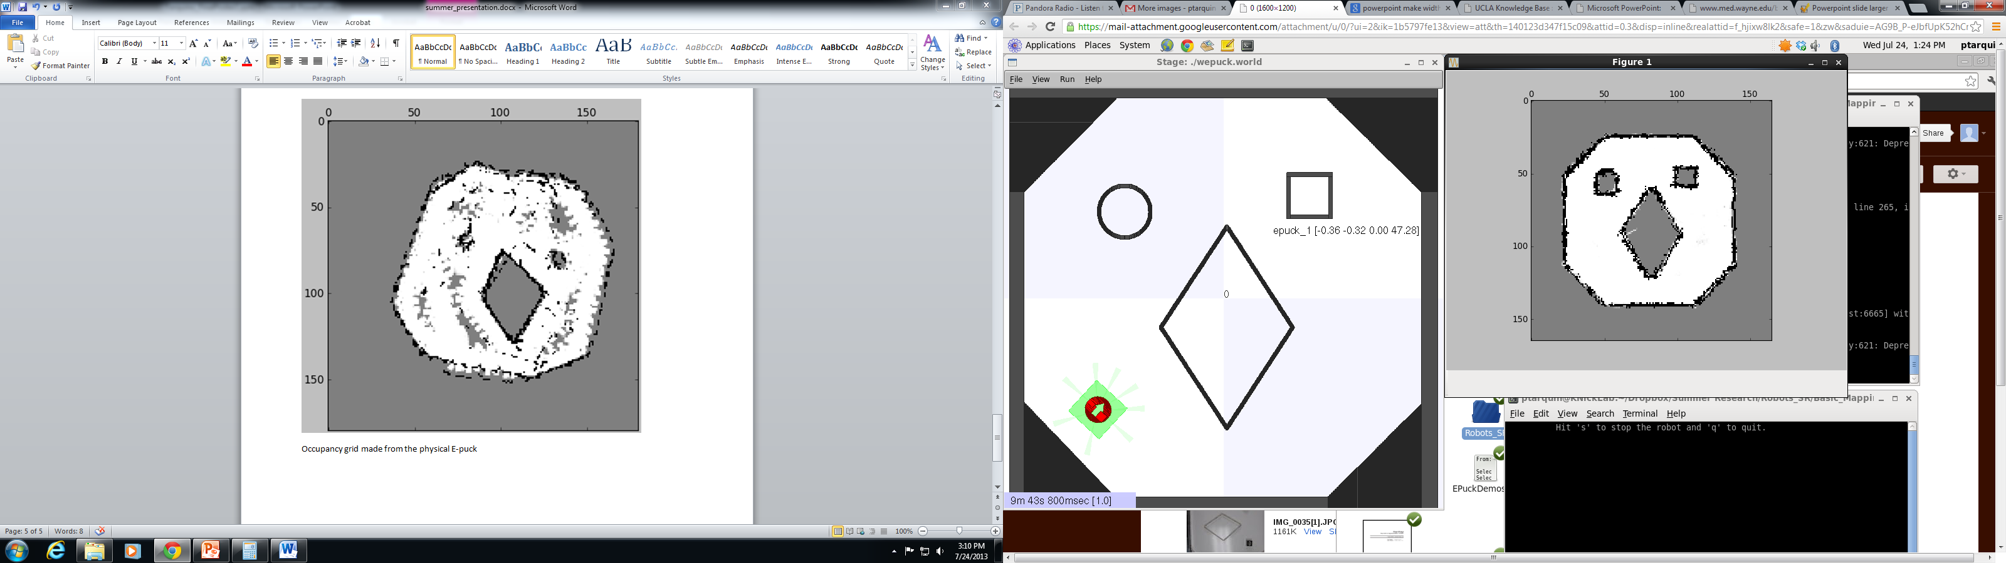
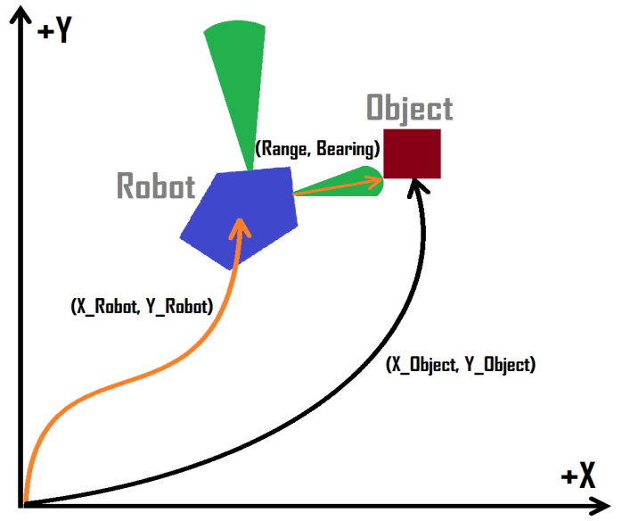
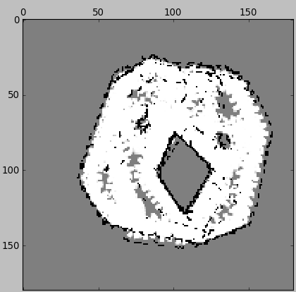
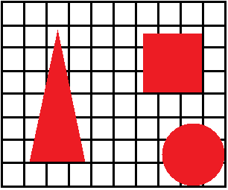
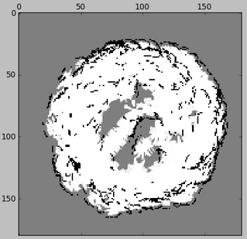
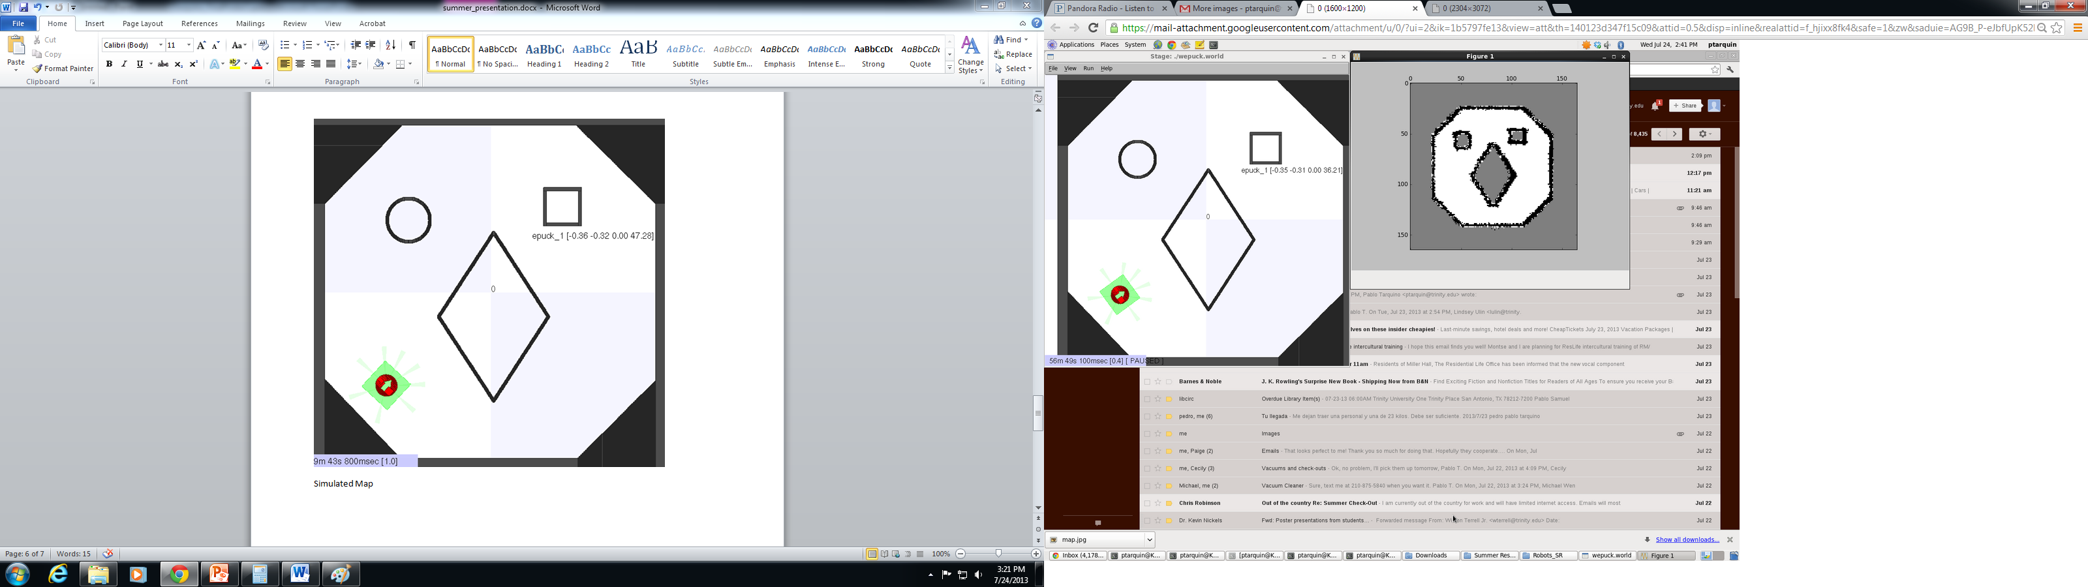
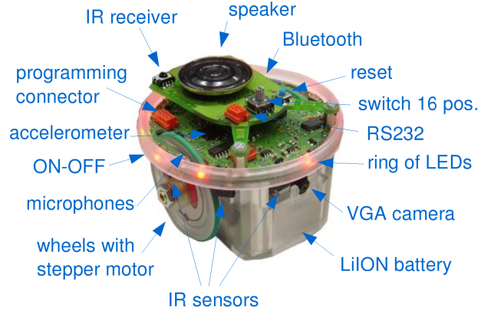
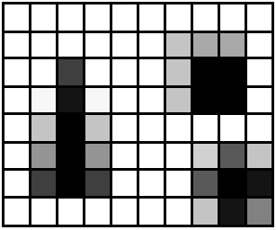

Programming Table-Top Robots to Automatically Construct and Use Maps
Pablo Tarquino Dr. Nickels, Advisor
Abstract
In this project, both a simulated and real E-Puck robot were programmed to map an unknown environment based on odometer readings.
Occupancy Grid
Based on odometer readings, an environment is mapped. This map is shown in a two dimensional grid, where each cell shows the probability that the area is occupied.
Simultaneous Localization and Mapping
SLAM is a probabilistic technique used by robots to construct a map of an unknown environment while at the same time keeping track of their current location within the map.
The heart of SLAM solves what has been described as a “chicken and egg” problem: A robot needs an accurate map to know its location within the environment, yet a precise knowledge of the location within an environment is needed to create an accurate map.
E-Puck
Figure 6: Physical environment with obstacles
Figure 7: Virtual environment with obstacles
Figure 2: Robot detecting an object within a coordinate system. Through odometers, the robot can keep track of its movement. The sensors can return the range and bearing of an object. The project used this information in order to properly map the object.
Figure 8: Probability Occupancy Grid made from the physical E-Puck’s odometer readings.
Figure 9: Probability Occupancy Grid made from the simulated E-Puck’s odometer readings.
Table-top Robot: E-puck
The E-puck robot is an educational robot commercially available that is easy to program. For this project, the following features of the E-puck robot were of particular interest:
Bluetooth communication
Eight infrared proximity and light sensors
Two power wheels with odometers
Autonomy: Two hours moving battery life
Figure 3: A simple environment overlaid with a grid.
0 | 0 | 0 | 0 | 0 | 0 | 0 | 0 | 0 | 0
0 | 0 | 0.42 | 0 | 0 | 0 | 0.27 | 0.34 | 0.34 | 0
0 | 0 | 0.73 | 0 | 0 | 0 | 0.27 | 1 | 1 | 0
0 | 0.05 | 0.98 | 0.05 | 0 | 0 | 0.27 | 1 | 1 | 0
0 | 0.28 | 1 | 0.28 | 0 | 0 | 0 | 0 | 0 | 0
0 | 0.42 | 1 | 0.42 | 0 | 0 | 0 | 0.18 | 0.64 | 0.27
0 | 0.74 | 1 | 0.74 | 0 | 0 | 0 | 0.65 | 1 | 0.94
0 | 0 | 0 | 0 | 0 | 0 | 0 | 0.29 | 0.94 | 0.48
Figure 10: Error seen with the physical E-Puck odometer readings. The error is due to wheel slip.
Figure 11: Basic Occupancy Grid made from the simulated E-Puck’s odometer readings.
Figure 4: Matrix showing the probability that the area corresponding to each cell is occupied.
Figure 1: E-Puck Robot displaying numerous components
Conclusion
This project investigated the mapping aspect of SLAM, allowed the student to program robots, and produced accurate maps of an unknown simulated environment using robots.
Software
The project used the computer language Python and the popular Player/Stage software package.
Programming Language: Python
Useful Python Libraries:
Math: Imports mathematical operations
Numpy and Matplotlib: Imports graphing capabilities
Matrix and LinAlgebra: Imports matrix and linear algebra operations
Player/Stage:
Player: Robot device interface used to communicate with the E-Puck robot
Stage: Simulator used for testing of the code
Further Research
This project managed to successfully implement the mapping aspect of SLAM. This meant that the project considered the odometer readings to be exact. Future projects can account for odometer readings with error, thereby studying the localization aspect of SLAM.
Figure 5: Graphical representation of the map. Darker colors represent a greater probability that the area is occupied.
Results
The simulated and physical E-puck robot was programmed to map an environment. The simulated robot produced very accurate maps while the physical robot had a flawed map due to wheel slip.
Acknowledgements
Many thanks to Dr. Nickels and his guidance throughout the summer, the Murchison Fellowship for their generous support of the research project, and the Biology Department for printing this poster.
References
Owen, Jennifer. "Player/Stage Manual." Jenny Owen's Website. N.p., n.d. Web. 18 July 2013. <http://www-users.cs.york.ac.uk/jowen/playerstage-manual.html>.
Siegwart, Roland, and Illah Reza Nourbakhsh. Introduction to Autonomous Mobile Robots. Cambridge, MA: MIT, 2004. Print.
.
“Stack Overflow." Stack Overflow. N.p., n.d. Web. 24 July 2013. <http://stackoverflow.com/>.
"E-puck Web Site." E-puck Education Robot. École Polytechnique Fédérale De Lausanne, n.d. Web. 18 July 2013. <http://www.e-puck.org/>.
Zelle, John M. Python Programming: An Introduction to Computer Science. Wilsonville, Or.: Franklin, Beedle, 2004. Print.

