Slide 2

Neural networks cancer

Slide 3
Neural networks cancer

Slide 4
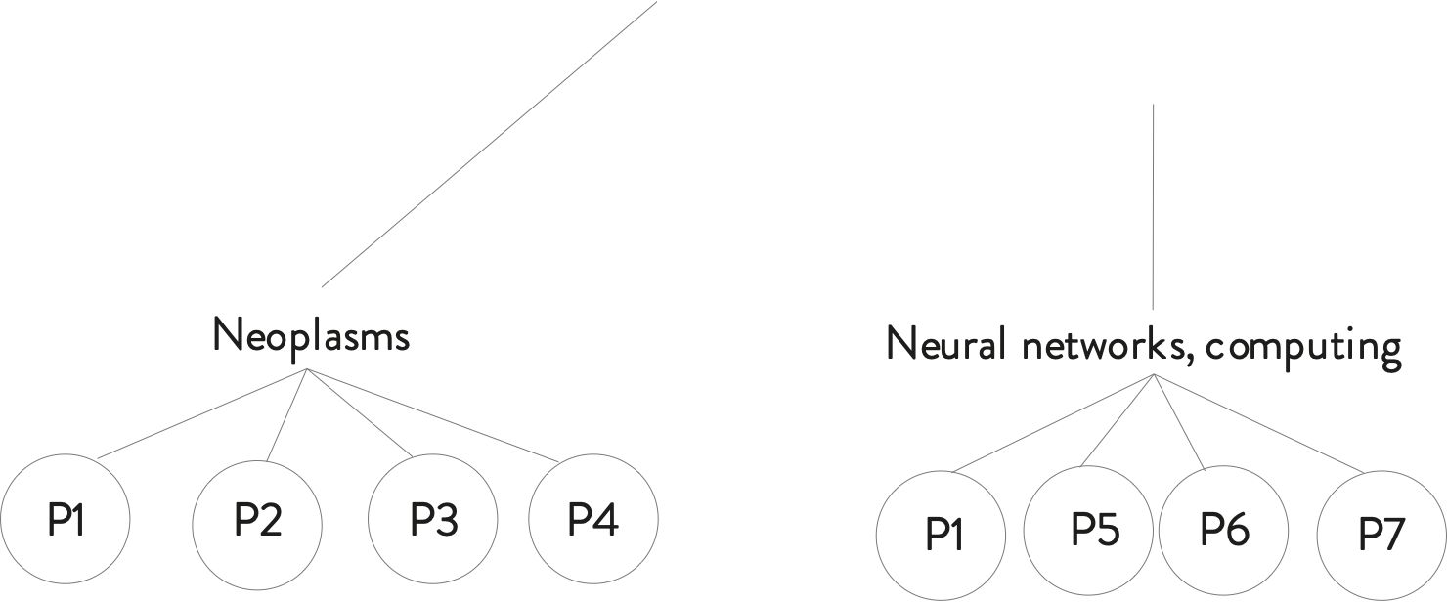

Slide 5
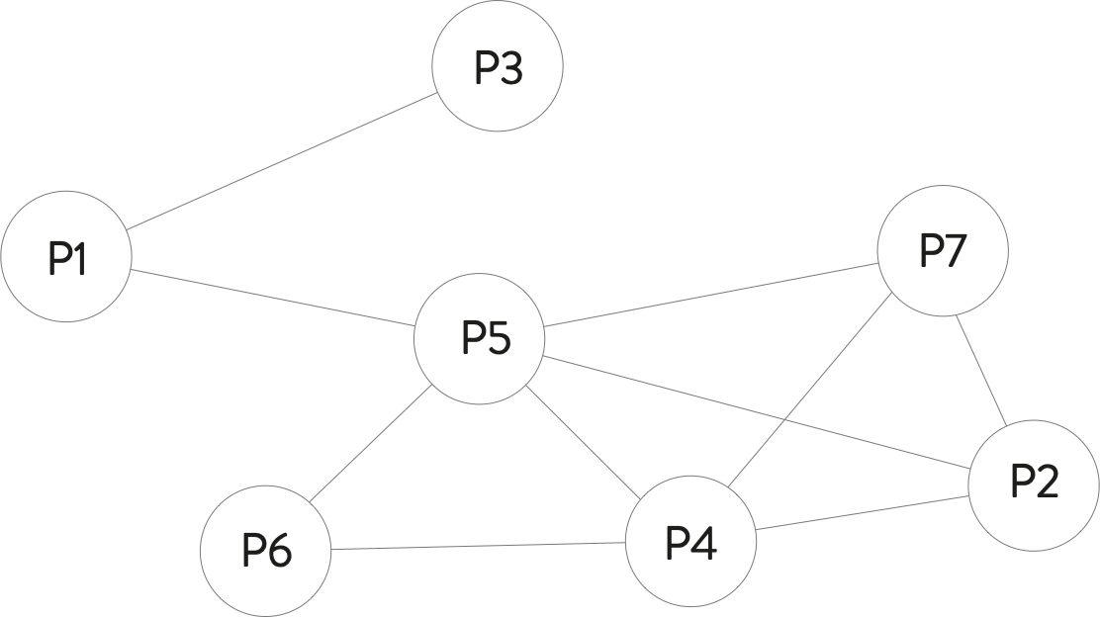
PageRank

Slide 6
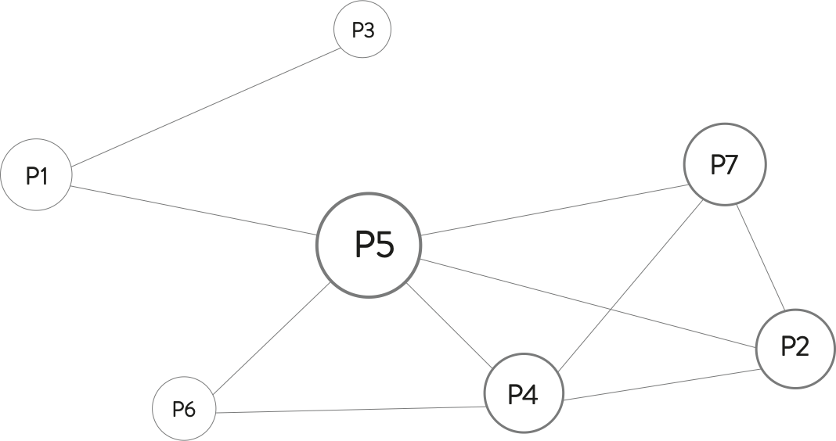

Slide 7
