Slide 1
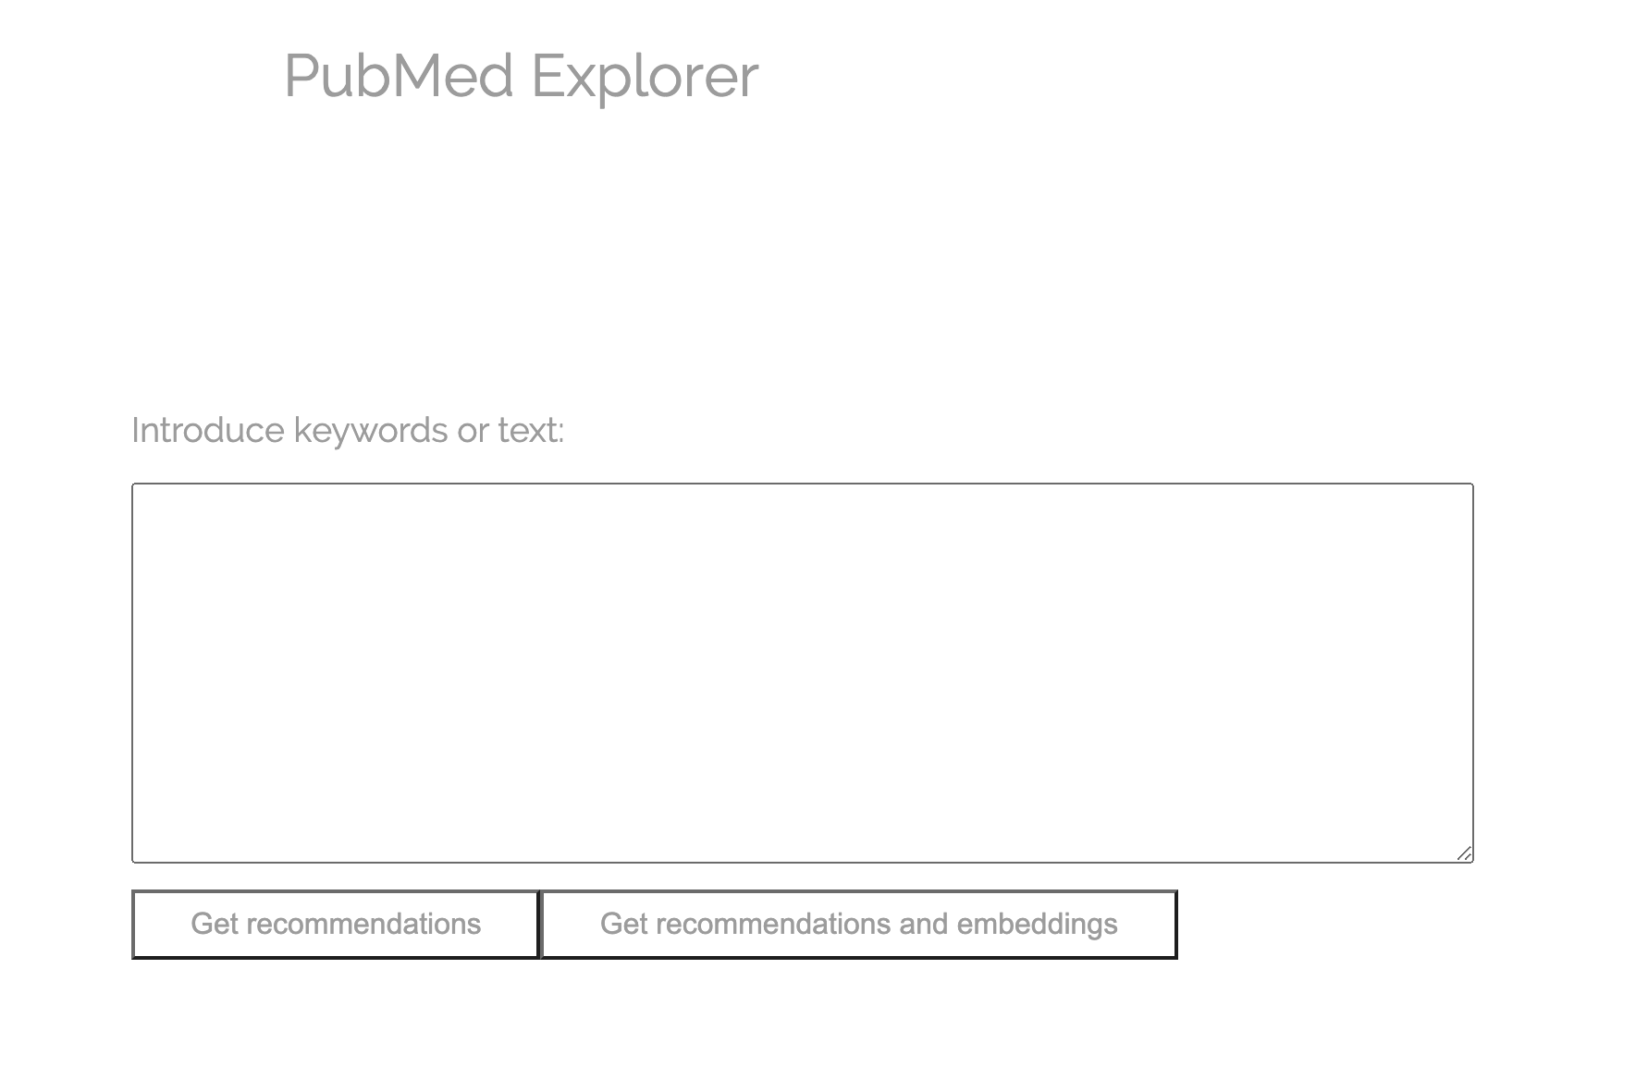
USER INTERFACE

Slide 2
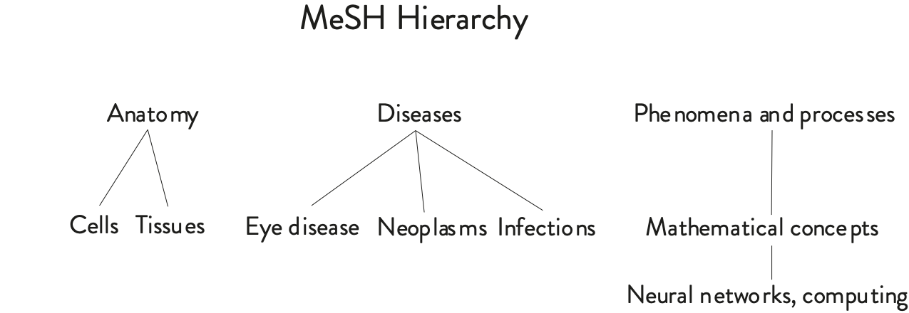
USER INPUT
Neural networks cancer

Slide 3
KEYWORDS ARE MAPPED TO MESH TERMS
Neural networks cancer

Slide 4
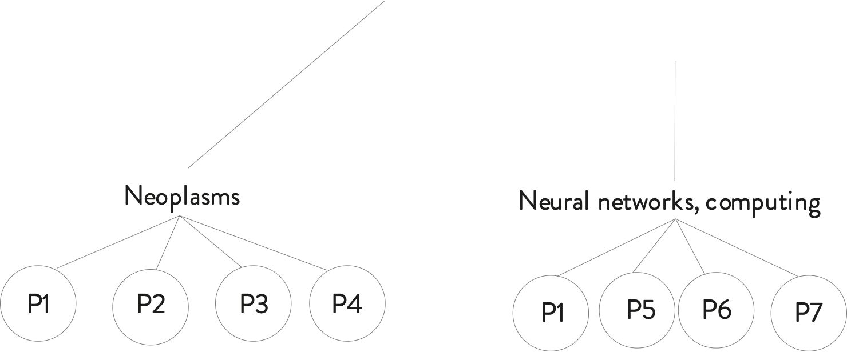
PAPERS ARE RETRIEVED USING MESH TERMS

Slide 5
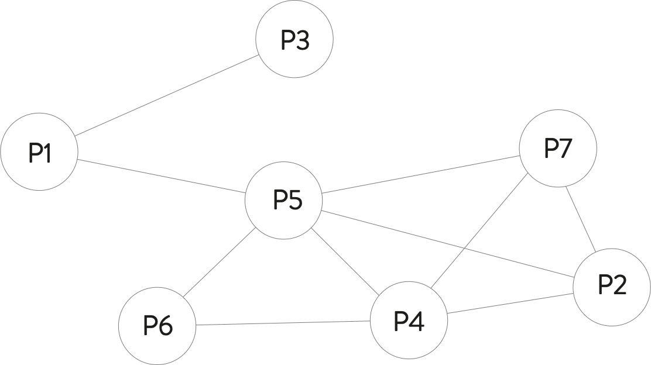
A CITATION GRAPH IS BUILT

Slide 6
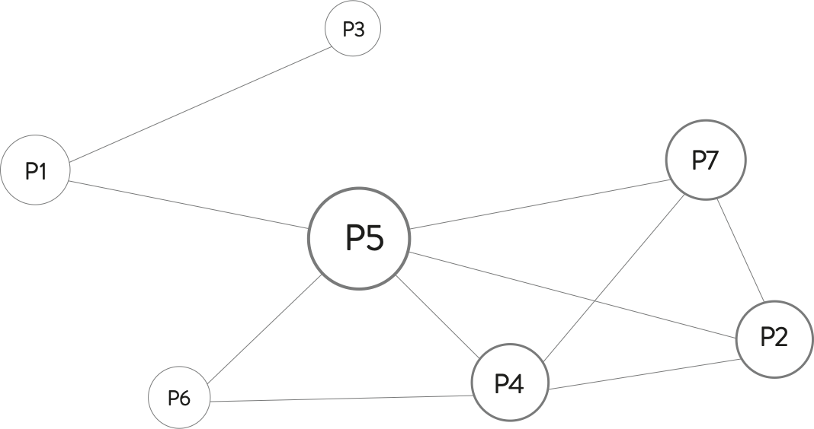
PAGERANK FINDS THE MOST INFLUENTIAL PAPERS
PageRank

Slide 7
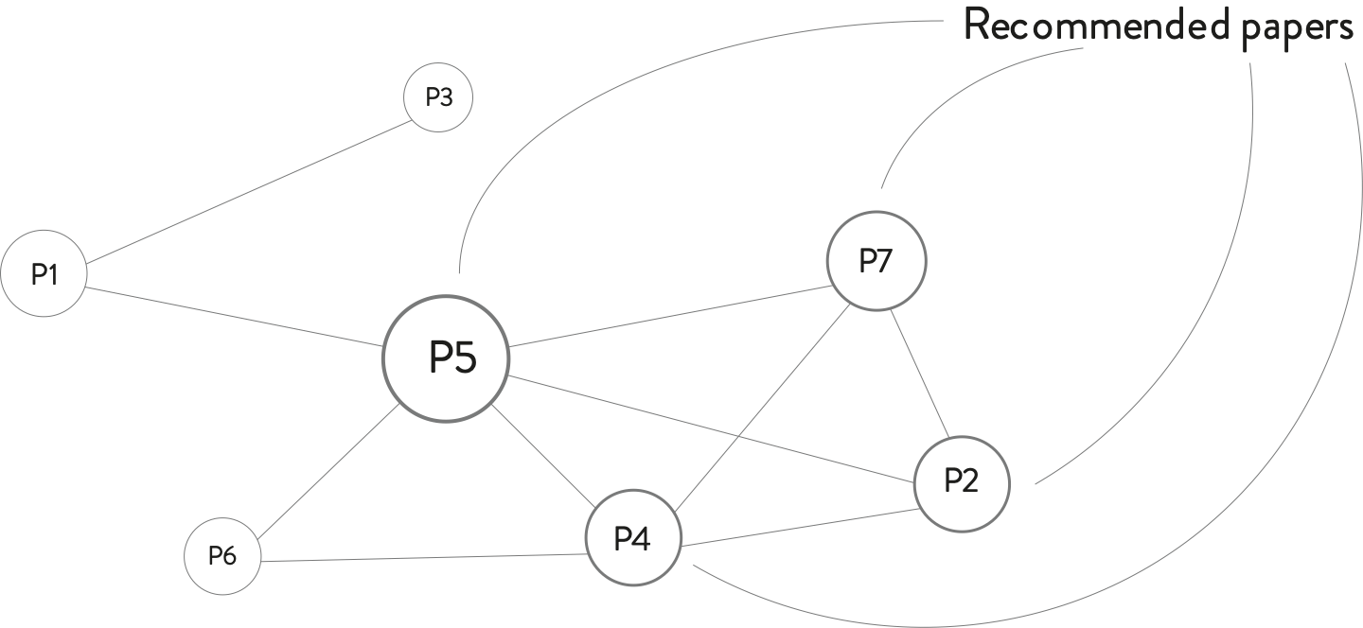
PAGERANK FINDS THE MOST INFLUENTIAL PAPERS

Slide 8
THE MOST INFLUENTIAL AUTHORS ARE RETRIEVED
Recommended authors

Slide 9
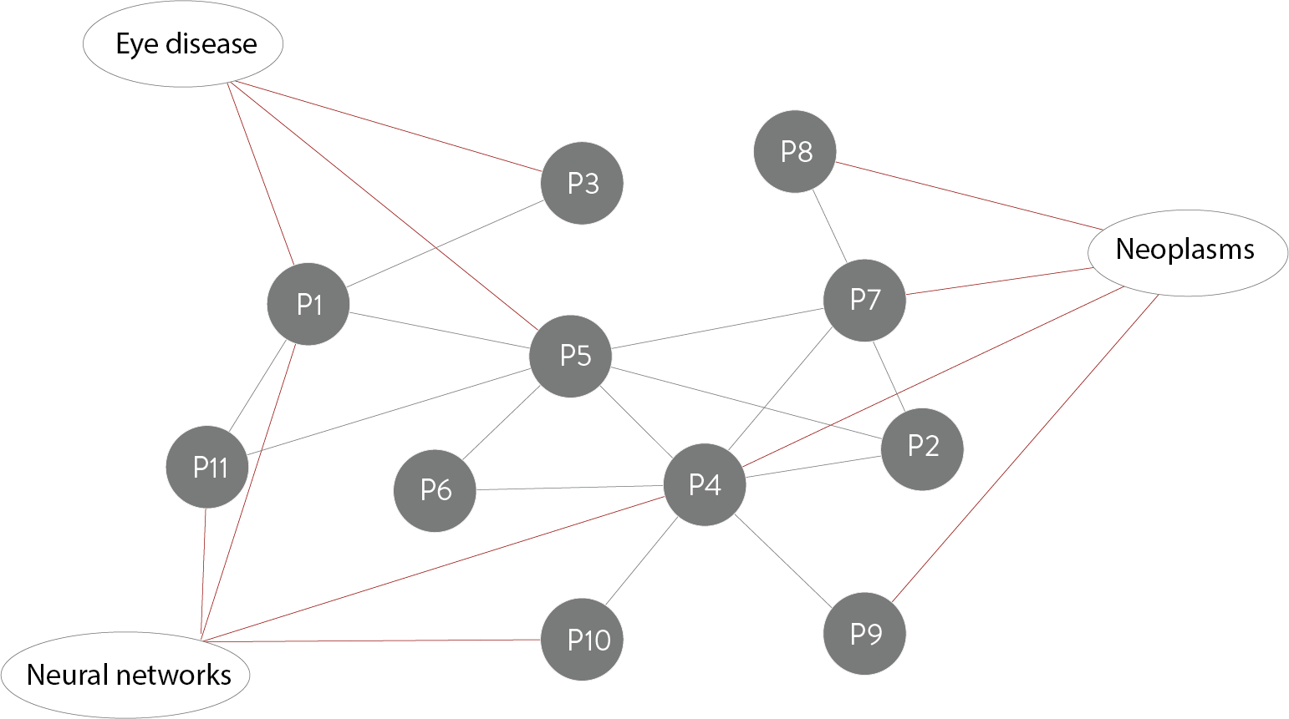
PAPER AND KEYWORD VISUALIZATION
Heterogeneous graph

Slide 10
NODE EMBEDDINGS WITH RGCN
Link prediction task

Slide 11
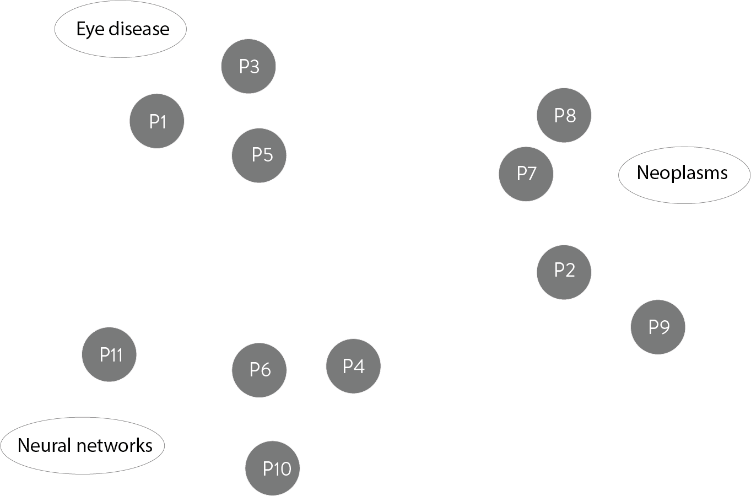
PAPER AND KEYWORD VISUALIZATION

