Slide 1
Treasure Haunt
CSCI 3130
Group 08
Shuwen Ruan
Hongyi Liu

Slide 2
Clients
Dr. Derek Reilly
Daniel Yule

Slide 3
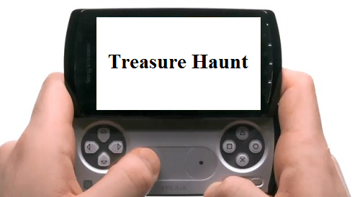
Project Goals
Game for clients to play on an android device.

Slide 4
Requirements
Play around citadel
Multiple player
Join in / Drop off in mid stream
Fun

Slide 5
Game Description
Players collect coins
Coins generated and replenished randomly
Leader board shows high record
Coin collection conflict

Slide 6
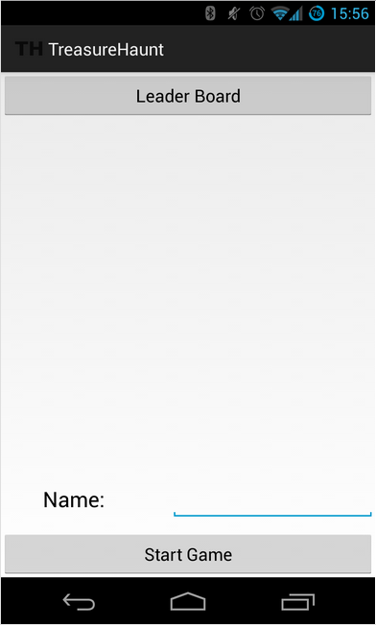
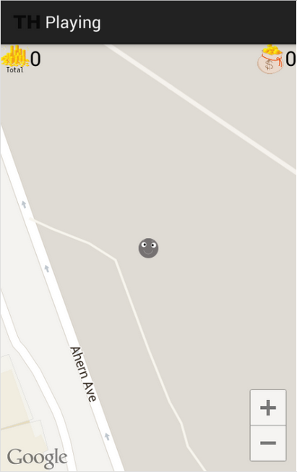
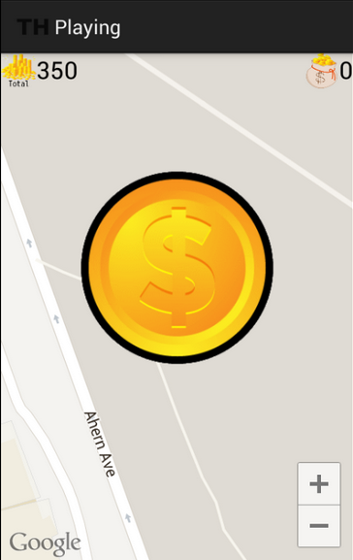
How to play?

Slide 7
Process
User stories
Small tasks
Test case
Build

Slide 8
Tools
Java
Android SDK 4.2
Google maps API for android

Slide 9
Use what we learnt in class
SVN
JUnit
Ant build
Pair programing

Slide 10
Questions?

