Slide 1

ESE 2.19: GRAPHICS AND
STATS FOR GEOSCIENTISTS
SESSION 6
BIVARIATE STATISTICS
AND SCATTER-PLOTS

Slide 2
BIVARIATE STATISTICS
So far have looked at univariate statistics – one variable forming one distribution.
Bivariate statistics looks at two variables:
Total Organic Carbon (TOC) of rock sample AND fossil diversity.
Idea is to look for relationship between variables
Is fossil diversity lower when TOC higher?
If we can show there is a relationship, we can start to look for possible causes!
To study bivariate problems visually we use scatter plots.

Slide 3
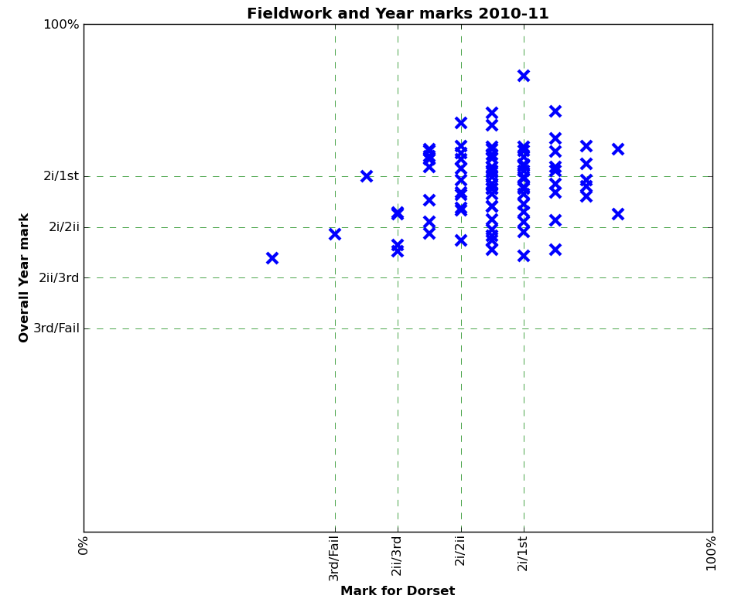
EXAMPLE – STUDENT MARKS
Does Dorset fieldwork mark predict overall year performance?
Scatter plot of two variables.
Shows relationship visually – no strong relationship.
Are these two variables actually independent?

Slide 4
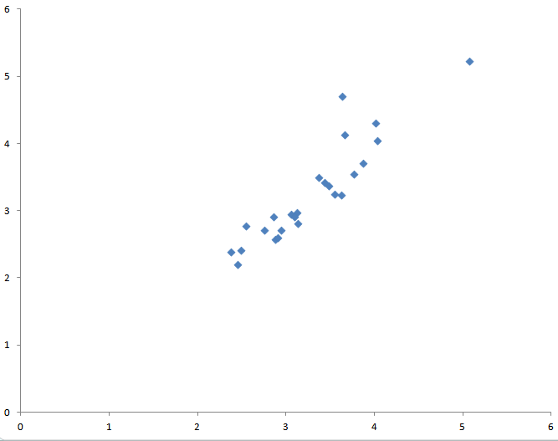
LINEAR REGRESSION
Common thing to do with bivariate data is to model it mathematically – fit a line to it (‘regression’).
Not appropriate if weak relationship.
But a sensible thing to do if variables closely linked
Can use line as a model to predict one variable from the other.
Can also fit complex curves.
Will just look at fitting straight lines – linear regression.

Slide 5
LINEAR REGRESSION
Can just draw a line by eye...
... but better to work it out mathematically
Many mathematical methods exist to find the best fitting line
By far most widely used is ‘least squares’ method
Minimises sum of squares of vertical errors
Compute in Python with scipy.stats.linregress function
Returns slope and intercept – m and c in y = mx + c
[Ignore rest of returns for now]

Slide 6
ESE 2.19: GRAPHICS AND
STATS FOR GEOSCIENTISTS
SESSION 6
DEMONSTRATION –
PLOTTING A SCATTER PLOT IN PYTHON

Slide 7
ESE 2.19: GRAPHICS AND
STATS FOR GEOSCIENTISTS
SESSION 6
PRACTICAL 6a
PLOT BRACHIOPOD BIOMETRIC DATA
ERRATUM
Sample Program, 1st line on handout
Should be%pylab inline NOT %inline pylab

Slide 8
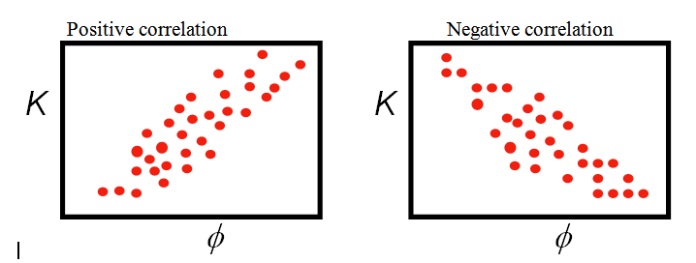
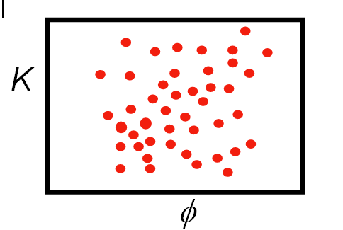
CORRELATION
Plotting a scatter diagram gives a visual feel for how well two variables are related, or correlated
Correlation can also be defined mathematically
Correlation coefficients (r-values) range -1 to 1
+ve correlation
R ~ 0.7
-ve correlation
R ~ -0.7
No correlation
R ~ 0.0

Slide 9
CORRELATION
Two commonly used methods for calculating correlation coefficients
Pearson Product-moment Correlation Coefficient
Spearman’s Rank Correlation Coefficient
To explain them and the differences between them we need to cover a few more basic concepts...
Probability
Normal distributions
Parametric vs non-parametric statistics

Slide 10

MATHEMATICAL PROBABILITY
Probability (p) of an event occurring defined as value 0-1 – 0 = never occurs, 1 = always occurs
Example - dice-throwing
Probability of throwing a 6 in one die throw = 0.167
Probability of all possible outcomes will sum to 1

Slide 11
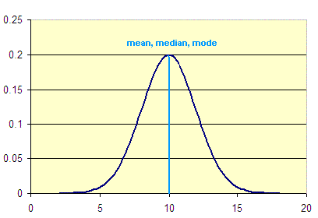
PROBABILITY & DISTRIBUTIONS
When we try to determine whether e.g. two variables are related talk in terms of probability
Possible any apparent relationship is chance
Try to work out how unlikely this is – as a p value
Also used in probability-distribution diagrams
Summary of how some variable is distributed
Y axis ‘probability of sampling’
Can’t talk about probability of getting a particular value (why not?)
But probability of value < x makes sense - given by area to left of x
[Integral of curve = 1 – why?]
x

Slide 12
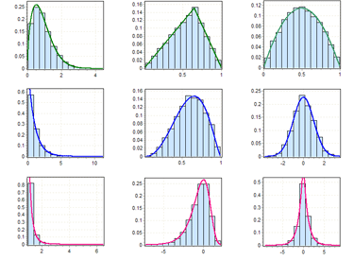
PROBABILITY & DISTRIBUTIONS
Histograms of samples are ways of getting at underlying probability distributions of populations

Slide 13
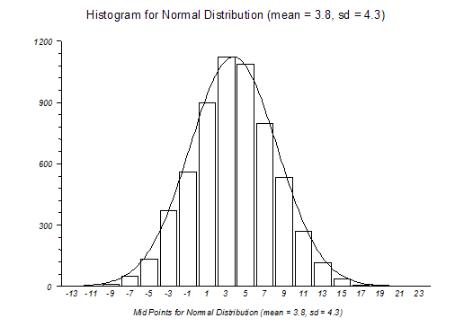
NORMAL DISTRIBUTIONS
Many real-world distributions approximate a ‘bell-shape’
This shape is known as a Normal or Gaussian distribution
Very important in statistics!
x

Slide 14

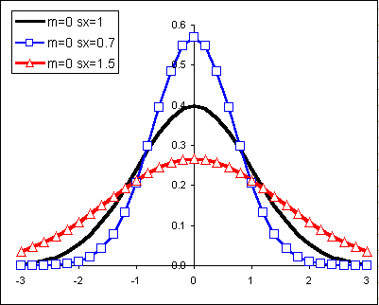
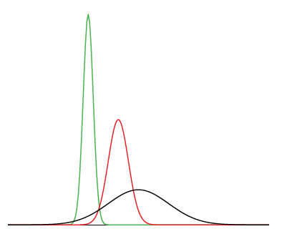
NORMAL DISTRIBUTIONS
Normal distribution defined mathematically as:
σ = standard deviation , μ = mean
You don’t need to know the formula – but do need to know it only depends on mean and standard deviation!
x

Slide 15
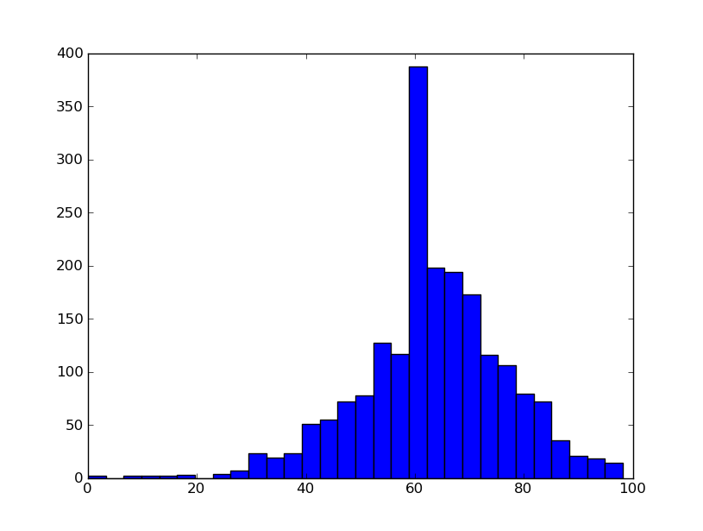
NORMAL DISTRIBUTIONS
Normal distributions are important as a lot of inferential statistical methods assume distributions are normal
No real-world distribution is completely normal
Many people assume deviations from normal are minor – this can be problematic!
Histogram of 2000 overall module marks from ESESIS
Normally distributed?
Sort of – but
- big peak around 60
- skewed – long left tail
x

Slide 16
BACK TO CORRELATION
Pearson Product-moment Correlation Coefficient
The most widely used method to get an r-value for correlation
Won’t go into the maths involved
Main catch – assumes distributions are Normal
Rather unclear how much deviation is allowed!
Can calculate a probability value for a Pearson r-value (scipy.stats.pearsonr does this automatically)
Gives probability of the apparent correlation coming about by chance
Very useful – but assumption of normality remains a problem

Slide 17
NON-PARAMETRIC CORRELATION
Alternative method for correlation is Spearman’s Rank Correlation Coefficient
This is a non-parametric statistic
Does not rely on underlying data being of any particular distribution
Most non-parametric statistics use concept of ranked data – data replaced by order
E.g. Data: [2.3, 4.5, 1.1, 9]
Ranks [2,3,1,4]

Slide 18
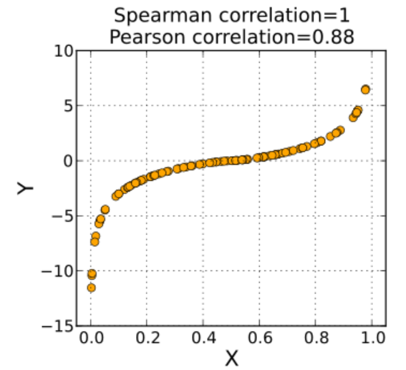
NON-PARAMETRIC CORRELATION
Spearman’s r much better for non-normally distributed data. It also gives equivalent p-value
But...
Misses subtlety in data (e.g [2.3, 4.5, 1.1, 9000] ranked the same as [2.3, 4.5, 1.1, 5] )
Doesn’t quite measure same thing as Pearson’s r
Latter closer to most peoples concept of correlation
Ideally – use Pearson’s if data
Is normally distributed

Slide 19
PRACTICAL 6b
For the first_year_marks.csv dataset:
Calculate r and p values using both Pearson’s and Spearman’s correlation methodologies
Are these data correlated at all? If so is the correlation weak or strong?
Plot histograms of each of the two variables, and overlay normal curves to the histograms – how well do they match?
Method for overlaying normal curves:
Work out mean and standard deviation for each distribution, use numpy linspace (see handout) to generate x values, then norm.pdf (see handout) to generate the y values. To plot this over the histogram just call plot after calling hist. Note that the histogram will need to be ‘normalised’ (have it’s vertical scale turned into probabilities) for overlay of distribution to work properly – use the normed=True kwarg for the hist function – see handout from last session.

