Slide 1

ESE 2.19: GRAPHICS AND
STATS FOR GEOSCIENTISTS
SESSION 8
CHI-SQUARED TESTS
AND SOME MISCELLANIA

Slide 2
MORNING’S PRACTICAL
B1: I have two sets of trilobite fossils from different localities. I think they are from the same species but want some quantitative confirmation – on the basis of their mean length:width ratio (triloshape1.csv, triloshape2.csv) is there evidence that they are different?
H₀: Mean length:width ratios of the two datasets are the same
H₁: Mean length:width ratios of the two datasets are different
2-tailed. Both normally distributed - t-test p=0.038 - accept H₁
B2: I have measured mica percentages in samples of igneous rocks from two different localities (micapercent1.csv, micapercent2.csv). The mean mica percentage is lower in the second locality and I have a geological theory that may explain this, but I first need to rule out the possibility that the lower mica content is just due to chance.
H₀: Mean mica percentage of the two datasets are the same
H₁: Mean mica percentage of locality 2 is lower than that of locality 1.
1-tailed. Neither normally distributed - MW-test p=0.022 - accept H₁

Slide 3
THE CHI-SQUARED TEST
Chi-Squared test used for discrete (categorised) data
Foot length – continuous
Shoe size – discrete
Geological discrete data might be:
Fossil type (species A, species B, …)
Rock classification (sandstone, limestone, mudstone…)
Fault type (normal, thrust, strike-slip …)
Chi-squared test provides a way of assessing how likely it is that counts of discrete data fit some expected pattern.

Slide 4
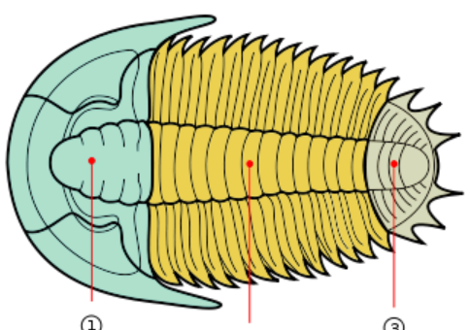
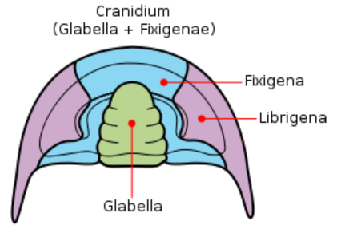
CHI-SQUARED EXAMPLE
We have many trilobite fossils from one deposit
Fossils are moults
Have cranidia, librigena, and pygidia
Should have ratio of 1:2:1
Does our data depart from this? If it does we can infer a taphonomic bias – probably current-sorting.

Slide 5
CHI-SQUARED EXAMPLE
 | Observed
Cranidia | 20
Librigena | 32
Pygidia | 17
 | Observed | Expected
Cranidia | 20 | 17.25
Librigena | 32 | 34.5
Pygidia | 17 | 17.25
TOTAL | 69 | 69
 | Observed
Cranidia | 20
Librigena | 32
Pygidia | 17
TOTAL | 69

Slide 6
CHI-SQUARED EXAMPLE
Chi-squared test requires an observed/expected table of this form
Pass the table to the function
Obs=array([20,32,17])
Exp=array([17.25,34.5,17.25])
s,p=chisquare(Obs,Exp)
p is the probability of this occuring by chance – here 0.73 – actually quite likely.
 | Observed | Expected
Cranidia | 20 | 17.25
Librigena | 32 | 34.5
Pygidia | 17 | 17.25
TOTAL | 69 | 69
NOTE – chisquare function requires numpy arrays!

Slide 7
CHI-SQUARED ASSUMPTIONS
Chi-Squared test quite broadly applicable.
No requirement for anything to be normal!
But
No expected category should be less than 1 (it does not matter what the observed values are)
No more than one-fifth of expected categories should be less than 5.

Slide 8
ESE 2.19: GRAPHICS AND
STATS FOR GEOSCIENTISTS
SESSION 8
PRACTICAL
HYPOTHESIS TESTING
USING CHI-SQUARED

Slide 9
MULTIVARIATE STATISTICS
All tests so far dealt with bivariate statistics
Real situations often involve multiple samples
Many (complex) statistical procedures exist to work with these – multivariate statistics
e.g. ANOVA – Analysis Of Variance
Use to look for differences in means in multiple normally distributed samples
(Kruskal-Wallis test – a non-parametric equivalent)
e.g. Principal Components Analysis
All multivariate stats outside scope of this course!

Slide 10
THE CLASS TEST
Half the mark for this course is already done
Other class test is tomorrow morning
Similar in format to the one we have had
Will be based around exercises similar to practicals in our sessions 5-8
You will be given CSV data, and asked to write a program to:
- read it in
- provide descriptive statistics on it
- generate one or more plots from it
- undertake one or more hypothesis tests

Slide 11
THE CLASS TEST
Will be 3 hours in length - hopefully you will not need all the time.
You can bring in any notes you like.
Full internet access is available, so you can look up help files, download pre-written code, etc.
NOT allowed to use email or any other messaging system to communicate with anyone outside the room - we will be watching carefully.
Demonstrators will be available to help you if you get stuck – they can remove bugs, but this will be noted and (some) marks deducted!

Slide 12
USE THE RIGHT STATISTIC/TEST!
Pearson’s Correlation Coefficient
Tells you whether two paired datasets (i.e. with same number of items) are correlated (linked)
Spearman’s Correlation Coefficient
As Pearson’s, but without assumption that data is normally distributed (i.e. non-parametric)
Student’s T-test
Tells you whether means differ between underlying populations of two samples
Mann-Whitney U-Test
As T-test, but without assumption that data is normally distributed (i.e. non-parametric)

Slide 13
USE THE RIGHT STATISTIC/TEST!
2-sample Kolmogrov-Smirnov Test
Tells you whether the underlying populations of two samples differ in any way (not just means). Non-parametric test, no assumption of normality
Chi-squared Test
Tells you whether counts of discrete (categorised) data fit an expected pattern. No assumption of normality – but a few restrictions
LEARN WHICH TO USE AND WHEN – AND USE THE RIGHT ONE!

