Slide 1

ESE 2.19: GRAPHICS AND
STATS FOR GEOSCIENTISTS
SESSION 7
HYPOTHESIS TESTING

Slide 2
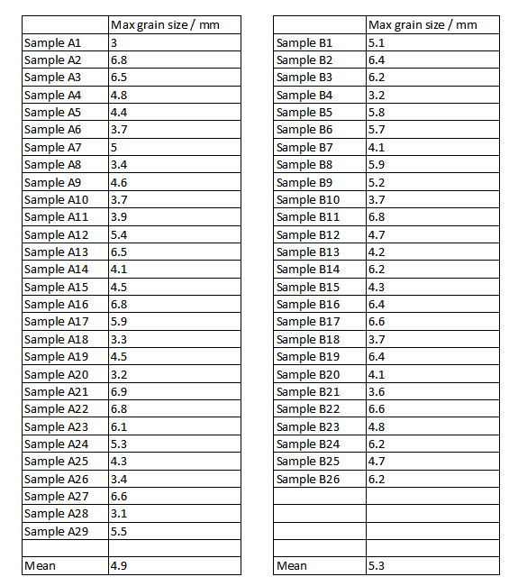
INFERENTIAL STATISTICS
Inferential statistics – ways to answer questions:
e.g. is grain size higher in deposit B than deposit A?
 | Max grain size / mm |  |  | Max grain size / mm
Sample A1 | 3 |  | Sample B1 | 5.1
Sample A2 | 6.8 |  | Sample B2 | 6.4
Sample A3 | 6.5 |  | Sample B3 | 6.2
Sample A4 | 4.8 |  | Sample B4 | 3.2
Sample A5 | 4.4 |  | Sample B5 | 5.8
Sample A6 | 3.7 |  | Sample B6 | 5.7
Sample A7 | 5 |  | Sample B7 | 4.1
Sample A8 | 3.4 |  | Sample B8 | 5.9
Sample A9 | 4.6 |  | Sample B9 | 5.2
Sample A10 | 3.7 |  | Sample B10 | 3.7
Sample A11 | 3.9 |  | Sample B11 | 6.8
Sample A12 | 5.4 |  | Sample B12 | 4.7
Sample A13 | 6.5 |  | Sample B13 | 4.2
Sample A14 | 4.1 |  | Sample B14 | 6.2
Sample A15 | 4.5 |  | Sample B15 | 4.3
Sample A16 | 6.8 |  | Sample B16 | 6.4
Sample A17 | 5.9 |  | Sample B17 | 6.6
Sample A18 | 3.3 |  | Sample B18 | 3.7
Sample A19 | 4.5 |  | Sample B19 | 6.4
Sample A20 | 3.2 |  | Sample B20 | 4.1
Sample A21 | 6.9 |  | Sample B21 | 3.6
Sample A22 | 6.8 |  | Sample B22 | 6.6
Sample A23 | 6.1 |  | Sample B23 | 4.8
Sample A24 | 5.3 |  | Sample B24 | 6.2
Sample A25 | 4.3 |  | Sample B25 | 4.7
Sample A26 | 3.4 |  | Sample B26 | 6.2
Sample A27 | 6.6
Sample A28 | 3.1
Sample A29 | 5.5
Mean | 4.9 |  | Mean | 5.3
Interested in whether energy levels different in A and B - will bear on theories of how they formed.
Sample from B has a higher mean
But is this just chance variation?
To answer this we:
Formulate formal hypotheses
Apply a statistical hypothesis test.

Slide 3
HYPOTHESES
We formulate two hypotheses:
The ‘Null hypothesis’ (H₀)
‘There is no difference in mean maximum grain size for samples obtained from deposits A and B’
...and an ‘Alternative hypothesis’ (H₁)
‘The mean maximum grain size is higher in sample B than it is in sample A’
Only accept H₁ if it is very unlikely that H₀ can explain our observations – otherwise reject H_{1.}
Analogy to criminal trials
‘Not guilty’ is H_{0 ,} ‘Guilty’ is H_{1.}
Not ‘guilty’ (H₀) verdict returned unless ‘Guilty’ (H₁) proven ‘beyond reasonable doubt’.

Slide 4
TESTING HYPOTHESES
Many different types of statistical tests exist:
To test different types of hypothesis.
To handle different types of data.
Student’s T-test – test to assess probability that two samples have same underlying mean.
Function in scipy.stats is ttest_ind
Takes two lists/arrays of values – i.e. two samples.
Returns ‘t-statistic’, describing how different means are.
Returns also a p-value – how likely it is that any difference in means could have occurred by chance.
In example, these are -1.1 and 0.28 respectively
Is a probability of 0.28 enough to reject H₀?

Slide 5
SIGNIFICANCE
Should have defined what level of probability is ‘enough’ before doing calculation!
This is known as the ‘significance level’.
Traditionally set at p=0.05 (5%, 1 in 20), but arbitrary!
Never set higher in practice.
In some cases (when being sure is very important) set lower, at p=0.01 or even p=0.001.
Here result was p=0.28, above 5% significant level.
Result said to be ‘not significant’ – not enough evidence to accept H₁, so reject H₁ as unproven.
STATISTICAL SIGNIFICANCE DOES NOT IMPLY IMPORTANCE OR STRENGTH OF A RESULT!

Slide 6
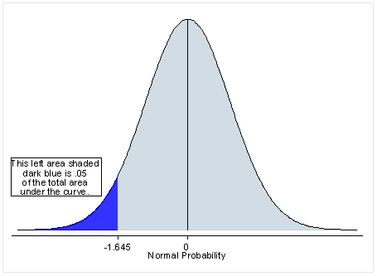
TAILS & SIGNIFICANCE LEVELS
Test in example is a one-tailed test:
H₁ : ‘The mean maximum grain size is higher in sample B than it is in sample A’
Interested in whether mean of B is greater than mean of A, not different to the mean of A
Distribution of all possible t-values.
Significant if value falls into blue region,
(Image is left-sided one-tailed example)

Slide 7
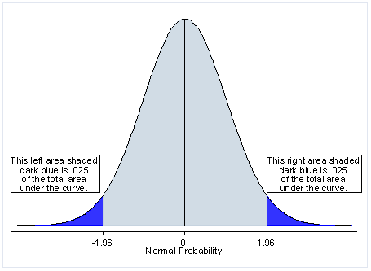
TAILS & SIGNIFICANCE LEVELS
Some tests are two-tailed tests
H₁ : ‘The mean maximum grain size is different in the two samples’
Two possible ways it can be different – higher than OR lower than
Two-tailed test has two ‘significance regions’ – one in each tail – each half size of one-tailed significance region

Slide 8
TAILS & SIGNIFICANCE LEVELS
Tails in practice
1. Decide if your test is one or two-tailed BEFORE doing it!
2. Values returned by scipy.stats functions (e.g. ttest_ind) are for two-tailed tests (mostly!)
If your test is two-tailed, there is no issue
If test is one-tailed, halve the p-value before interpreting it.
In our example p was 0.28 – but this is two-tailed, test was one-tailed.
Actual p value = 0.14 – still not significant (>0.05) – but halving could easily make the difference!

Slide 9
MORE ON THE T-TEST
T-test is the most widely used statistical test...
... but not always appropriate.
Makes several assumptions.
Sensible results need reasonably large sample sizes:
No real agreement on what is sufficient.
This applies to other tests too.
Assumes data in samples is normally distributed:
May or may not really be true.
If not – consider using non-parametric tests.

Slide 10
NON-PARAMETRIC EQUIVALENTS
Most commonly used: the Mann-Whitney U test
Uses ranks of data (like Spearman’s correlation).
Does not require distributions of data to be normal.
Less powerful test (more false negatives) if distributions are normal (as all non-parametric tests).
Also: Kolmorogov-Smirnov (K-S) test
K-S test is for ‘goodness of fit’ – how well a distribution fits a mathematic model.
‘Two-sample’ K-S test variant can be used as a non-parametric alternative to a t-test.
Tests more than just difference in means – tests other aspects of distribution shape.
Use to answer questions like ‘do these two samples seem to come from the same underlying population’?

Slide 11
CORRELATION HYPOTHESIS TESTS
Have already seen that p-values can be obtained for correlations (Pearson or Spearman).
Can test hypotheses of correlation with these.
H₀ : ‘Dorset mark and end-of-year Mark are not related’
H₁ : ‘There is a correlation between Dorset mark and end-of-year Mark’
Two-tailed test, will use a 5% significance level
... Pearson R is 0.27, p=0.014 – significant
... Spearman R is 0.19, p=0.087 – not significant!
i.e. if we can use Pearson we can accept H₁
... but with Spearman we can’t - not enough evidence
Need to do a better job of deciding which to use!

Slide 12
TESTS OF NORMALITY
Rather than guess whether distribution is normal – can we test for it?
Yes – becomes another hypothesis test:
H₀ : ‘Underlying distribution is normal’
H₁ : ‘Underlying distribution is not normal’
Many different tests of normality exist – no agreement on which is best.
A good solution is D’Agostino & Pearson combined test – normaltest function in scipy.stats
Demo: are the marks distributions normal in first year marks example?

Slide 13
ESE 2.19: GRAPHICS AND
STATS FOR GEOSCIENTISTS
SESSION 7
PRACTICAL
HYPOTHESIS TESTING USING PYTHON

