Slide 1
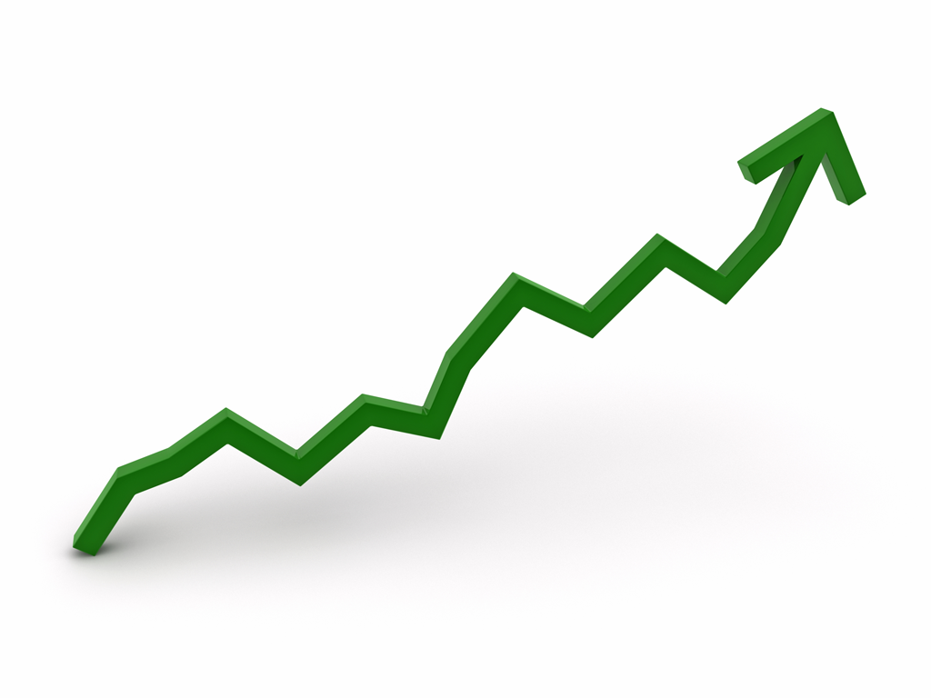
ESE 2.19: GRAPHICS AND
STATS FOR GEOSCIENTISTS
SESSION 5
STATISTICS AND GRAPHS
AN INTRODUCTION

Slide 2
COURSE STYLE
Some of you will have done stats before – most probably not in detail
This section of course will be concerned with
- Teaching you practical applications of stats
- Teaching you how to use Python to undertake statistical analyses of data
- More practise with graphing data in Python
Will largely NOT be concerned with mathematical theory underlying statistics
Goal is for you to pick up practical statistical skills and knowledge
-

Slide 3
STATISTICS - DEFINITIONS
“The study of the collection, organisation, analysis and interpretation of data”
Methods for describing and analysing non-deterministic phenomena
Deterministic phenomena – can be precisely predicted:
Orbits of planets
Chemical reactions
Non-deterministic phenomena – include randomness:
Heights of people in the UK
Measurements of mineral %ages in rock sample
Lengths of a certain fossil from a certain locality

Slide 4
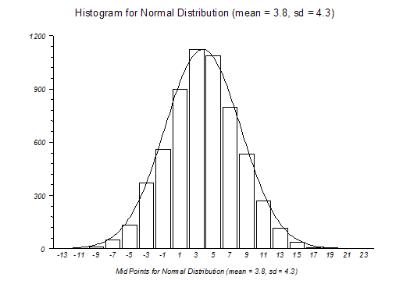
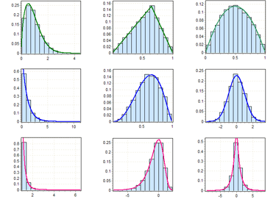
POPULATIONS & DISTRIBUTIONS
Population - whole underlying ‘universe’ of possible values – normally unattainable!
e.g. Full set of all heights of all people in the UK
e.g. Lengths of EVERY fossil specimen from loc.
Distribution – shape of population histogram

Slide 5
SAMPLES
Sample – a subset of the population that we have actually measured
e.g. Heights of all people in this room
e.g. Lengths of fossils in one collector’s collection
Statistics involves using samples to represent populations
Samples must be unbiased for statistics to be of any use!

Slide 6
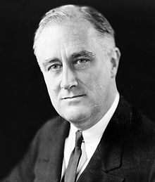
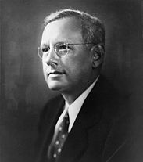
BIASED SAMPLES
Example – 1936 US Presidential Election
Roosevelt
Democrat
Landon
Republican
VS
Literary Digest undertook a massive pre-election poll
Sent out 10 million questionnaires to list of names obtained from phone books and car-registration lists
Predicted Republican landslide...
... actual result was biggest Democratic landslide in C20th
Why?

Slide 7
BIASED SAMPLES
Are our samples from last slide also likely to be biased?
Heights of all people in this room
Lengths of fossils in one collector’s collection
Better ways to sample these populations?
Not going to talk any more in this course about need for non-biased (random) samples
But it IS vitally important

Slide 8
BRANCHES OF STATISTICS
Two branches/classes of statistics
Descriptive statistics
Numbers used to summarise samples (and hence hopefully populations)
e.g. Averages
Inferential statistics
Methods for drawing conclusions from samples or combinations of samples
e.g. ‘On basis of my samples, how likely is it that height and shoe size are related?’
[What do we mean by related here?]
Will stick to descriptive statistics today

Slide 9
AVERAGES
Averages = ‘measures of central tendency’
Several types exist. Most common:
Mean (technically arithmetic mean) – familiar (!)
Median: middle value when numbers ordered
[1,3,5,2,4,7,2,6,8,3,2,3,5] => [1, 2, 2, 2, 3, 3, 3, 4, 5, 5, 6, 7, 8]
13 numbers – median is 7th (index 6 in Python) = 3
[1,3,5,2,4,7,2,6,8,3,3,5] => [1, 2, 2, 3, 3, 3, 4, 5, 5, 6, 7, 8]
12 numbers – median is mean of 6th and 7th = 3.5
Mode: most common value – 3 in [1,3,5,2,4,7,2,6,8,3,3,5]
Advantages of median:
May be better for skewed distributions
Reduces effect of outliers
Don’t need to know values of end-values
Mode much more rarely used

Slide 10
MEASURES OF SPREAD
Much more to a distribution than average
These samples have same mean & median...
[-0.2, -0.1, -0.1, 0.0, 0.0, 0.0 , 0.1 , 0.1 , 0.2]
[-1000, -500, 0, 500, 1000]
... but very different spread
Many descriptive statistics exist for spread
Simplest is range, = maximum – minimum
[-0.2, -0.1, -0.1, 0.0, 0.0, 0.0 , 0.1 , 0.1 , 0.2]
Range = 0.4
[-1000, -500, 0, 50, 1000]
Range = 2000

Slide 11
PERCENTILES & IQ RANGE
Best explained with a distribution:
20th Percentile ~ -2 20% of values are lower than this
75th Percentile ~ 8.5 75% of values are lower than this
Median is 50th percentile – here ~4 50% values lower!
Interquartile (IQ) range = 75th percentile – 25th percentile

Slide 12
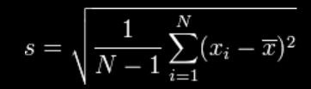
STANDARD DEVIATION (SD)
Most commonly used measure of spread
N = number of samples
x_{i} = individual measurement
x = sample mean
Gives a measure of spread in same units as sample
Technically – this is sample standard deviation
- N-1 is called Bessel’s correction – removes bias
s.d. is mathematically very useful – but less intuitive than other measures
Also come across Variance – square of standard deviation

Slide 13
ESE 3.23: GRAPHICS AND
STATS FOR GEOSCIENTISTS
SESSION 5
DEMONSTRATION –
DESCRIPTIVE STATISTICS IN PYTHON

Slide 14
SET UP FOR IPYTHON
Connect as you did for Gerard’s course
Start Xming
Connect to student.ese.ic.ac.uk using putty
Remember to enable X11 forwarding
Just once – now - to download course materials
git clone https://github.com/marksutton/GraphicsAndStats.git
Then to move into correct directory (do after every login)
cd GraphicsAndStats
… and start iPython
ipython notebook

Slide 15
ESE 3.23: GRAPHICS AND
STATS FOR GEOSCIENTISTS
PRACTICAL 5a
1. Examine ‘qzpercentages.csv’ (use %load iPython command – %load qzpercentages.csv)
2. Write a program to read this in and then calculate the mean, median, range, interquartile range, standard deviation, variance, and mode.
3. If this was too easy… try to write a better mode function; where there is more than one mode (e.g. in [1,2,2,3,3]) it should return all modes (as a list).
git clone https://github.com/marksutton/GraphicsAndStats.git
ERRATUM – 2nd line from bottom of Descriptive Statistics in Python
SHOULD be mode_array=my_mode_tuple[0] not mode_array=mode[0]

Slide 16
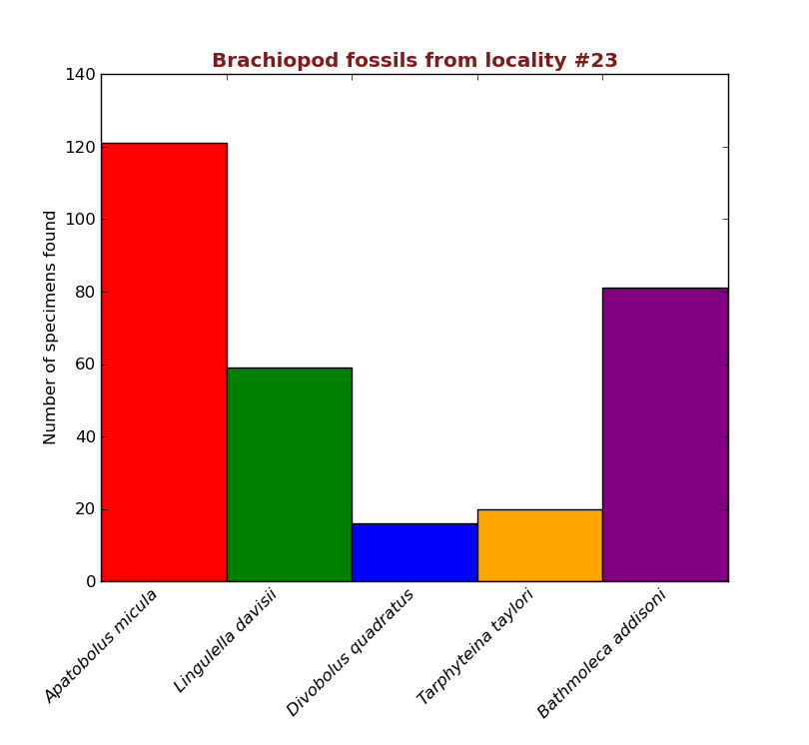
PLOTTING GRAPHS
Part of this module –plotting data using Python
Using ‘Matplotlib’ (via pylab module) for this – as for Gerard’s course
Start your programs with: %pylab inline
Imports pylab/matplotlib (and numpy) functions
Forces graphs to display within iPython notebook
Start with Bar Charts
Common chart type
Used for plotting discrete data
e.g. Shoe-size
e.g. Countries
Example here – fossil species from a certain locality
Not to be confused with histograms
Demo – plotting this in Python

Slide 17
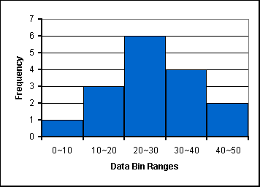
HISTOGRAMS
Histograms are way to summarize distributions
Range of distribution split into categories or ‘bins’
Size of bins is artibtrary – whatever works best
Normal to have equal-sized bins (here 10)
Samples falling into each bin are counted (= frequency)
Plotted as a adjacent rectangles – bar-chart like
Shape approximates probability distribution of population

Slide 18
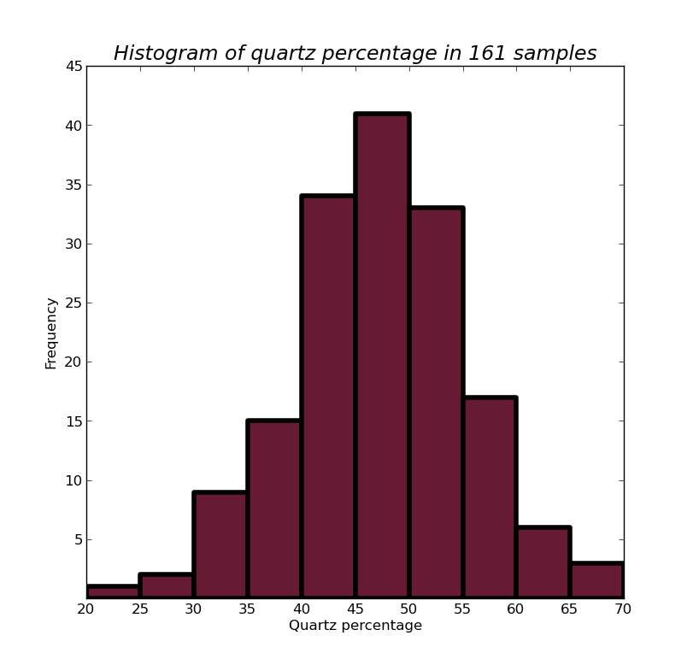
Practical 5b – generate this histogram from qzpercentages.csv
Notes:
Line thickness increased
Colour needs to be specified
Bins need to be specified
Need to add title
Need to add axis titles
Need to fix y-axis ticks to avoid ‘0’ crashing into ’20’
Need to fix x-axis labels to make sure all bins are labelled
Hint - Remember the Python range function!
Then... import into Inkscape and annotate (in any way you like) to show median, mean, 25th and 75th percentile values

