Slide 1

Sector Stock Selection Model
If you want to invest in or get exposure to the energy sector, should you invest in the largest/well known energy stocks or invest in a sector index ETF?
Which one is the best long term investment?
With the help of Python, we can help you make an investment decision.

Slide 2
Overview
Analyzed energy sector to figure out whether it made more sense to invest in IXC or one of the stocks within the ETF(Monthly Performance)
Solved a number of mathematical formulas to measure stock performance over 5 years (Sharpe Ratio, Sortino Ratio, Alpha, Beta, etc)
Created visuals to show findings
Used summary statistics to compare how many times a stock outperformed IXC and which stock performed better than others
Notes:
Yvette

Slide 3
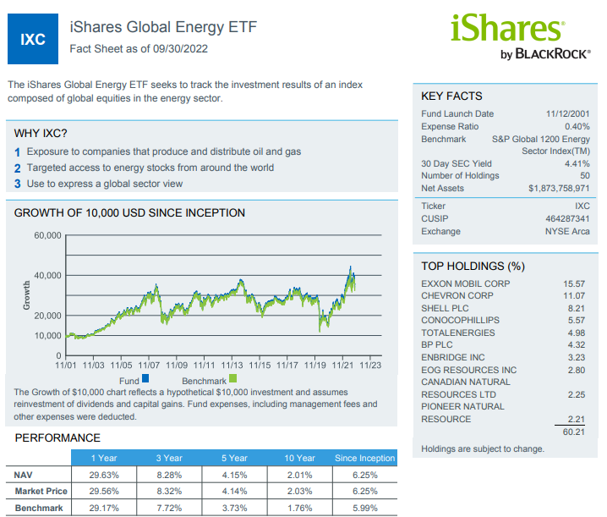
Define the Investing Universe
We are using IXC ETF as it tracks the investment results of the index composed of global equities in the energy sector
It gives a good picture of how the energy sector performed
Top 4 holdings are : XOM, CVX, SHEL, and COP
These 4 stocks comprise over 40% of the ETF’s holdings.
Notes:
Yvette

Slide 4
Performance Criteria
We compared monthly Cumulative Returns and Excess Return (alpha) against the IXC for the past 5 years
We calculated how frequently the 4 stocks outperformed the index ETF over the past 5 years
We used Beta to measure risk of the 4 stocks against the index ETF
We compared the Sharpe Ratios to measure performance of the 4 stocks and the ETF
Given how volatile the energy sector is, we used Sortino Ratio to demonstrate stock performance
We used the data to compute the top performing stock of the 4
Notes:
Yvette

Slide 5
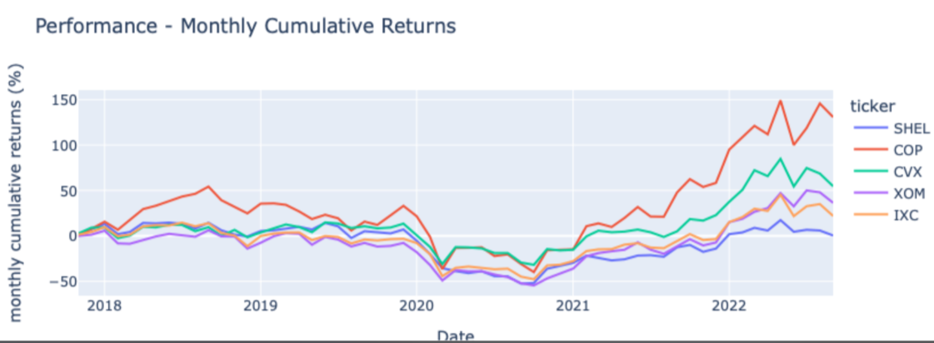
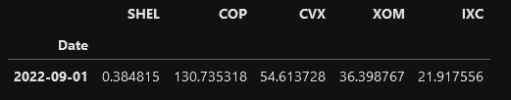
Stock/ETF performance
Cumulative Returns - Total Returns of Each Stock and ETF over the 5 year period
We used Python Code to create a Data Frame of Cumulative Returns for each stock and the ETF and compared their performance
The Data showed that COP, XOM, and CVX outperformed the ETF(IXC)
SHEL underperformed

Slide 6
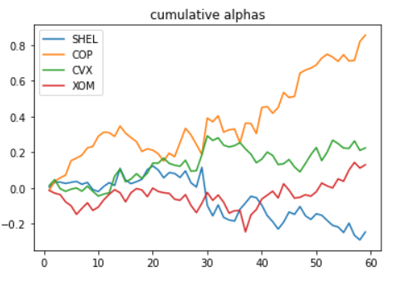
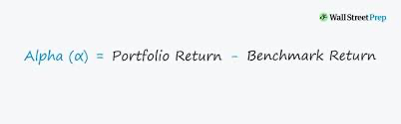
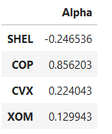
Alpha
Measures the returns of an investment in comparison to the market index or some other benchmark returns
Used IXC ETF returns as our benchmark to evaluate the performance of each stock against it
From our calculations, we determined COP, CVX & XOM had positive alphas which meant that over the last 5 years they outperformed the IXC returns
SHEL had a negative alpha, which means that it was outperformed by the benchmark(IXC).

Slide 7
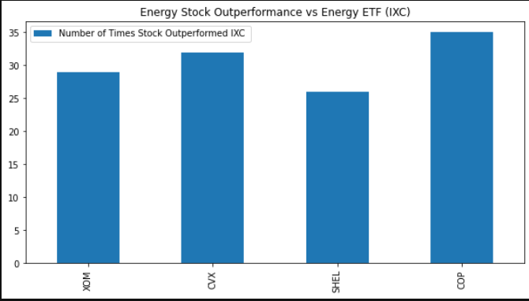
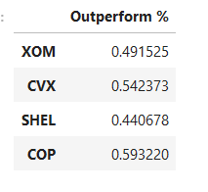
Outperformance Percentage
Calculated the number of times (how many months) that each stock returns were greater than IXC
Divided the number of times each stock outperformed IXC by the number of accountable months to get a performance percentage
COP outperformed IXC 35 times, SHEL 26 times, etc
COP is the most attractive based on this criteria.
29
32
26
35
Notes:
Giselle

Slide 8
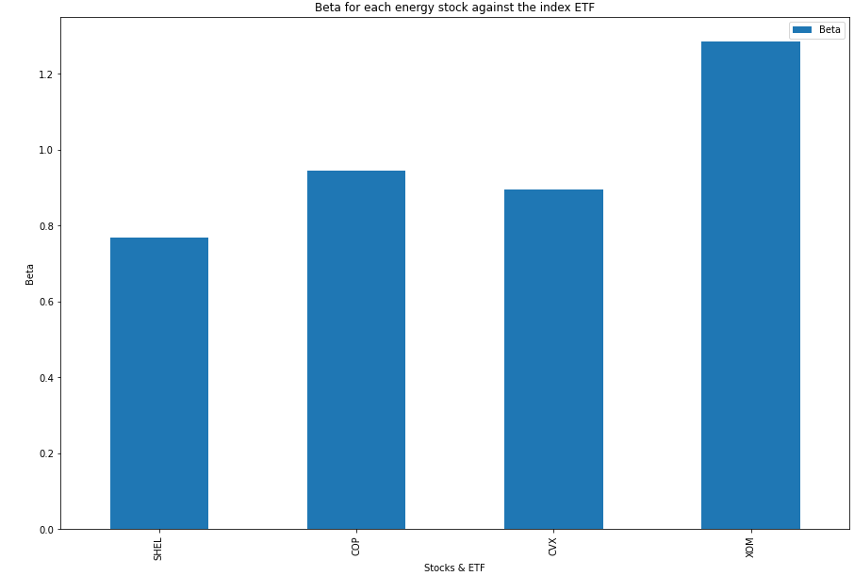
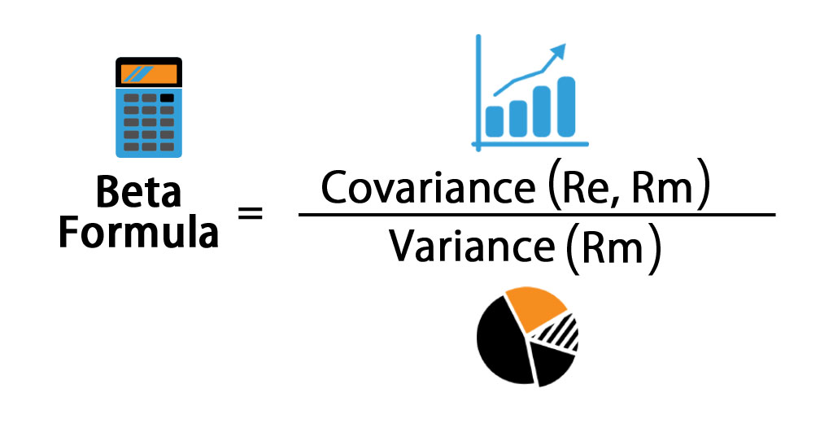
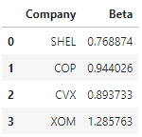
Risk/Volatility -Beta
Beta - measures the volatility of a stock in comparison to a benchmark/index - we used the IXC as the benchmark to enable comparison between stocks.
Calculated Variance of each stock and ETF
Calculated Covariance of each stock against the ETF returns
Calculated Beta of each stock and visualized the results
SHEL has the lowest Beta against IXC with 0.769 %

Slide 9
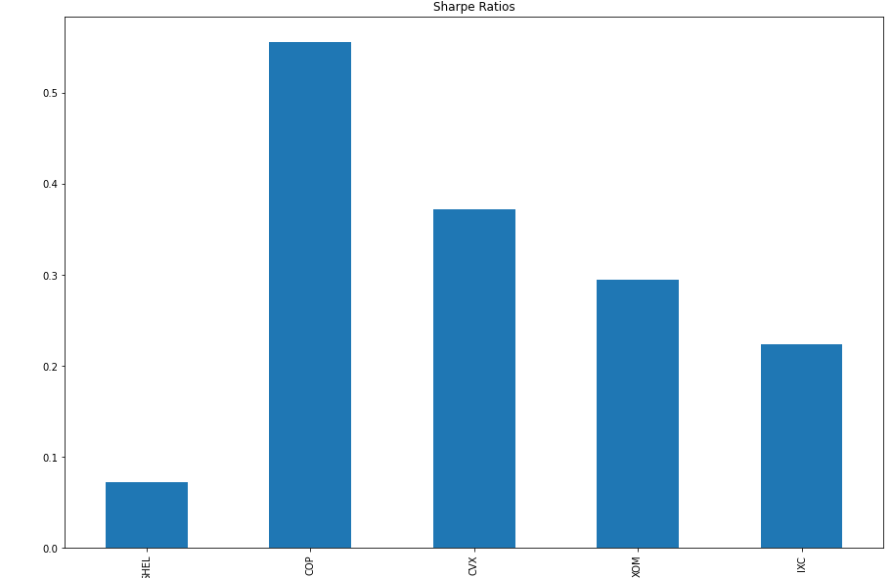
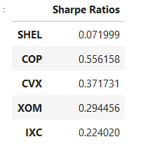
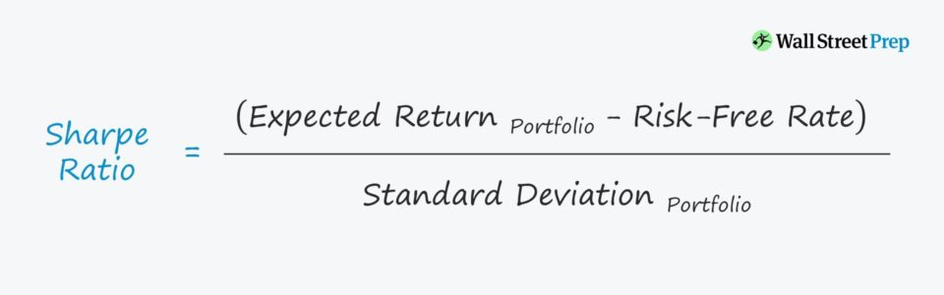
Sharpe Ratio
Sharpe Ratio - Measures excess returns against a risk that someone assumes when investing in the asset. The higher the Sharpe Ratio the more attractive the asset
We used annualized pct returns of each stock and the ETF
For the Risk Free rate we took the average rate of a treasury bill
Divided the difference by the annualized returns’ standard deviation
Based on this measure or criteria, we can see that three stocks are more attractive than the ETF - COP, CVX, XOM
SHEL has a lower Sharpe Ratio than the ETF (IXC), thus it is less attractive than the ETF.
Notes:
German

Slide 10
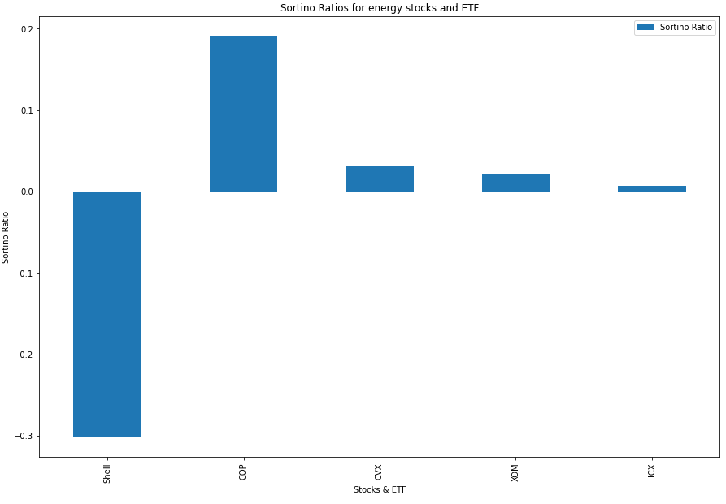
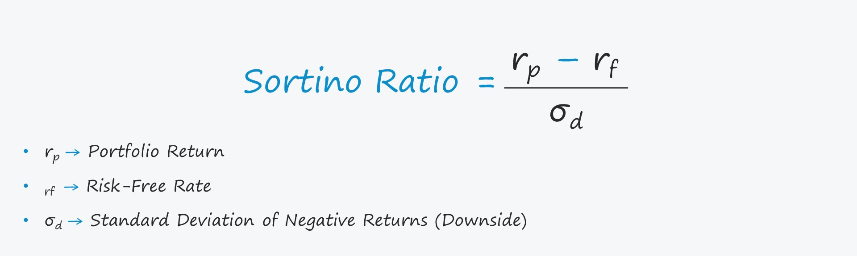
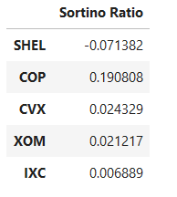
Sortino Ratio
Financial metric that measures harmful volatility or “bad volatility” by using the standard deviation of negative portfolio returns
This is called downside deviation (does not consider overall risk)
Similar to Sharpe Ratio but uses only downside deviation
SHEL has the lowest sortino ratio
COP leading with 0.19 ratio.
Notes:
Azam

Slide 11
Results & Analysis
Combined the 6 criteria into a single DataFrame
Calculated the 3 quartile measurements for each performance criteria (25th, 50th, & 75th percentiles)
Assigned 0, 1, 2, 3 points to each quartile accordingly
Tallied points to the corresponding stock depending on which quartile their data/measurement fell into for the specific criteria
Selected the stock with the most points - COP

Slide 12
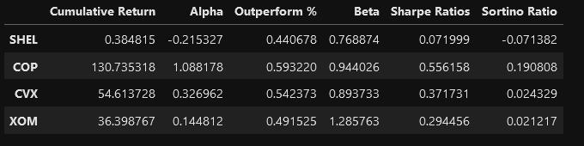
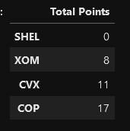
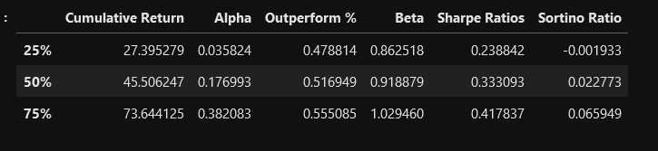
Results and Analysis

Slide 13
Conclusion (Looking Ahead)
This Model can be used for any Sector ETF to help select a specific stock in the sector or the chosen ETF, based on the metrics we used to make educated investment decisions.
Coding Model can be expanded to a Command Line Interface which would be able to analyze any other ETF and its stock holdings
Investment Model that can help a retail investor make portfolio decisions based on financial metrics
A possible framework for a Robo Advisor App

Slide 14
Thank You!

Slide 15


Contributors
Herman
Gorovodskiy
Gisell
Tavarez
Azam
Jiva
Gilberto
Sanchez
Yvette
Liang
Notes:
Tools which will help us staying connected breaking physical barriers.

