Slide 1
Statistical Learning
https://github.com/ggorr/Machine-Learning/tree/master/ISLR

Slide 2
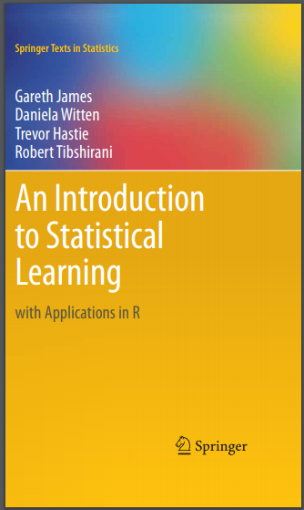
교재
An Introduction to Statistical Learning with Applications in R
G. James, D. Witten, T. Hastie and R. Tibshirani

Slide 3
2 Statistical Learning
2.1 What Is Statistical Learning?
2.2 Assessing Model Accuracy
2.3 Lab: Introduction to R
2.4 Exercises

Slide 4
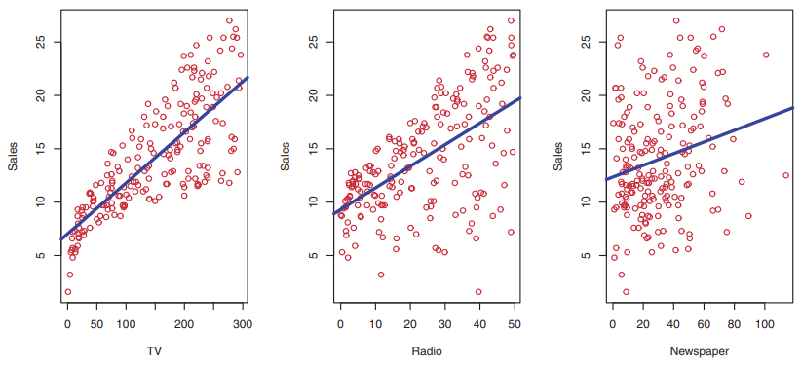
2.1 What Is Statistical Learning?
Advertising data set

Slide 5
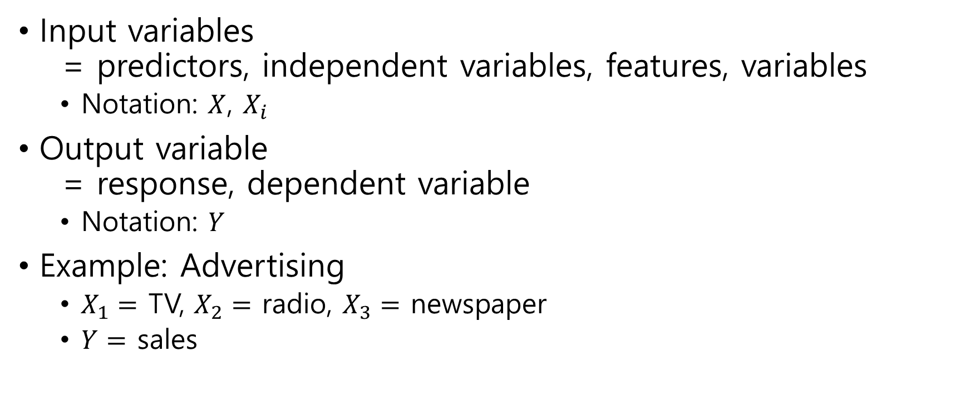
Input variables = predictors, independent variables, features, variables
Notation: $X$, $X_{i}$
Output variable = response, dependent variable
Notation: $Y$
Example: Advertising
$X_{1}=$ TV, $X_{2}=$ radio, $X_{3}=$ newspaper
$Y=$ sales

Slide 6

Relationship between Predictors and Response
We assume that $Y=f\left(X\right)+ε$
$X=(X_{1},X_{2}, …, X_{p})$ - predictors
$ε$ : random error independent of X $E\left[ε\right]=0$, i.e. zero mean

Slide 7
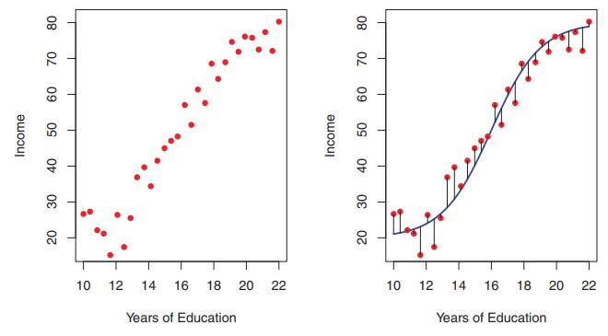
Example

Slide 8

What Is Statistical Learning?
Statistical learning refers to a set of approaches for estimating $f$.

Slide 9
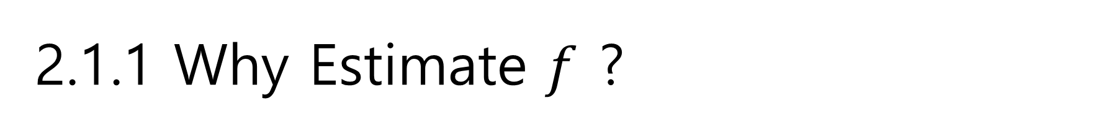
2.1.1 Why Estimate $f$ ?
Reason
Prediction
Inference

Slide 10

Prediction
Prediction
$\hat{Y}=\hat{f}(X)$
$\hat{Y}$ is an estimate of $Y$
$\hat{f}$ is treated as a black box
Not concerned with the exact form
Interested in the accuracy

Slide 11

Example
$X_{1}, …, X_{p}$: characteristics of a blood sample
$Y$: risk for an adverse reaction

Slide 12
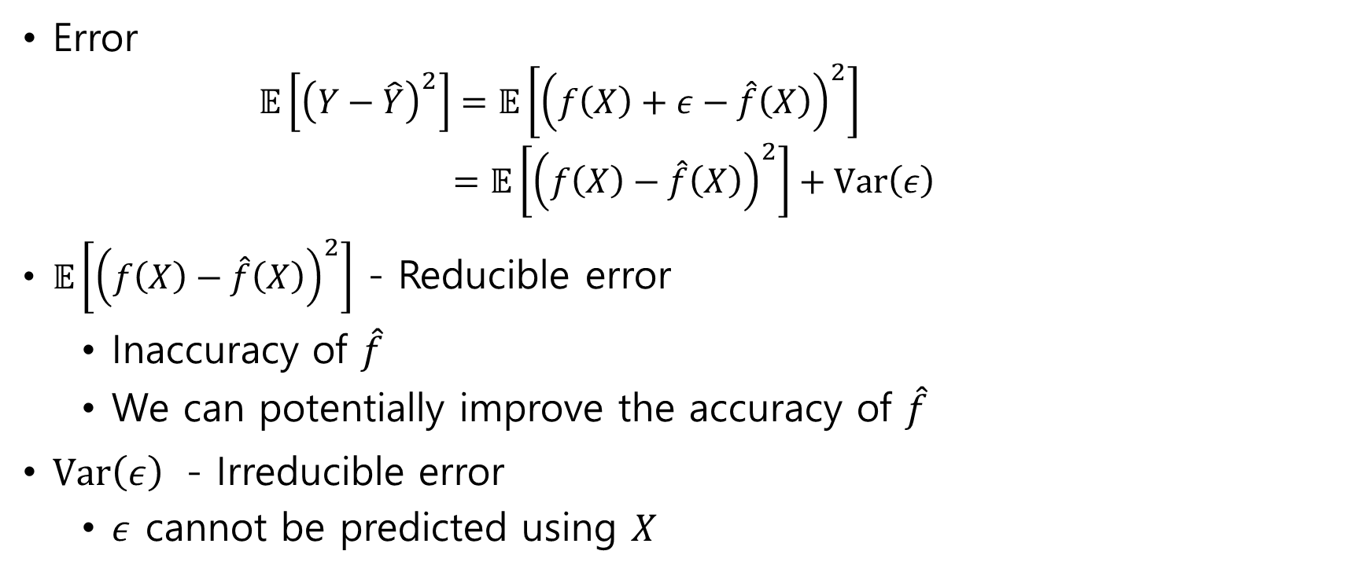
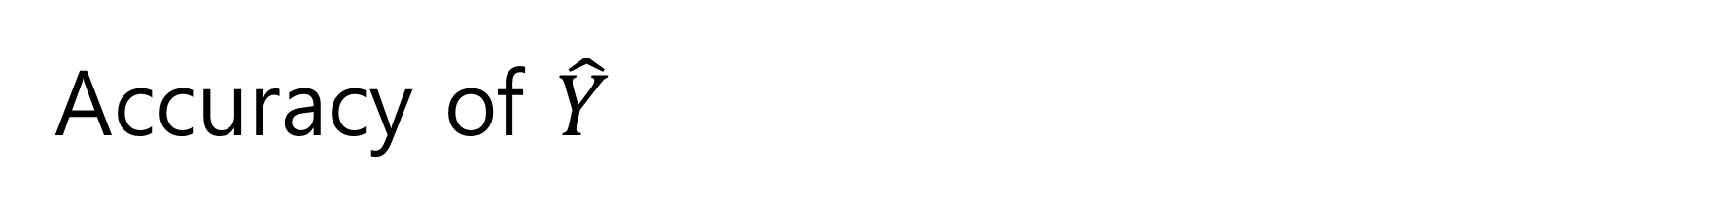
Accuracy of $\hat{Y}$
Error $𝔼\left[{\left(Y−\hat{Y}\right)}^{2}\right]=𝔼\left[{\left(f\left(X\right)+ε−\hat{f}\left(X\right)\right)}^{2}\right]$ $=𝔼\left[{\left(f\left(X\right)−\hat{f}\left(X\right)\right)}^{2}\right]+Var\left(ε\right)$
$𝔼\left[{\left(f\left(X\right)−\hat{f}\left(X\right)\right)}^{2}\right]$ - Reducible error
Inaccuracy of $\hat{f}$
We can potentially improve the accuracy of $\hat{f}$
$Var\left(ε\right)$ - Irreducible error
$ε$ cannot be predicted using $X$

Slide 13

Inference
How $Y$ changes as a function of $X_{1}, …, X_{p}$
Which predictors are associated with the response?
What is the relationship between the response and each predictor?

Slide 14
Example
Advertising data set
Which media contribute to sales?
Which media generate the biggest boost in sales
How much increase in sales is associated with a given increase in TV advertising?

Slide 15

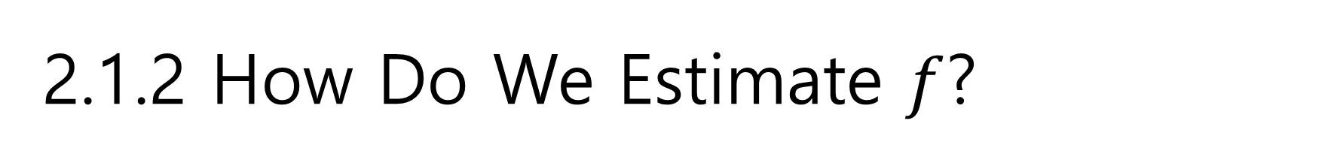
2.1.2 How Do We Estimate $f$?
Training data set: observations
Input variables
$p$ : number of predictors
$n$ : number of data
$x_{ij}$ for $i=1, …, n$ and $j=1, …, p$
$x_{i}=(x_{i1}, …, x_{ip})$
Output variable
$y_{i}$ for $i=1, …, n$

Slide 16
Training
Parametric method
Non-parametric method

Slide 17
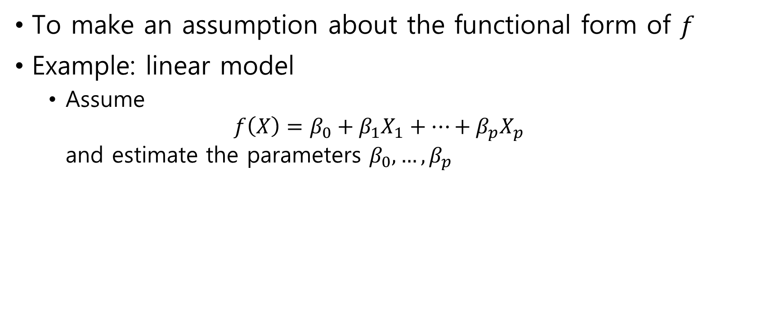
Parametric Method
To make an assumption about the functional form of $f$
Example: linear model
Assume $f\left(X\right)=β_{0}+β_{1}X_{1}+⋯+β_{p}X_{p}$ and estimate the parameters $β_{0}, …, β_{p}$

Slide 18
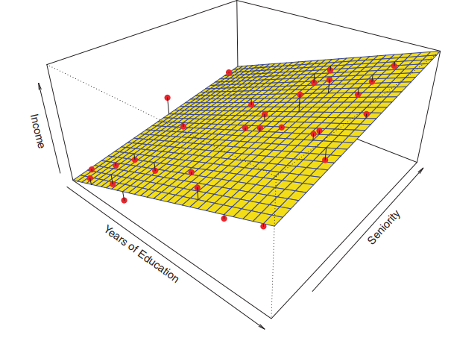

Example
$income≈β_{0}+β_{1}×education{+ β}_{2}×seniority$

Slide 19

Model
A model is a form of $f$
Example: linear model assumes that $f$ is linear $f\left(X\right)=β_{0}+β_{1}X_{1}+⋯+β_{p}X_{p}$

Slide 20
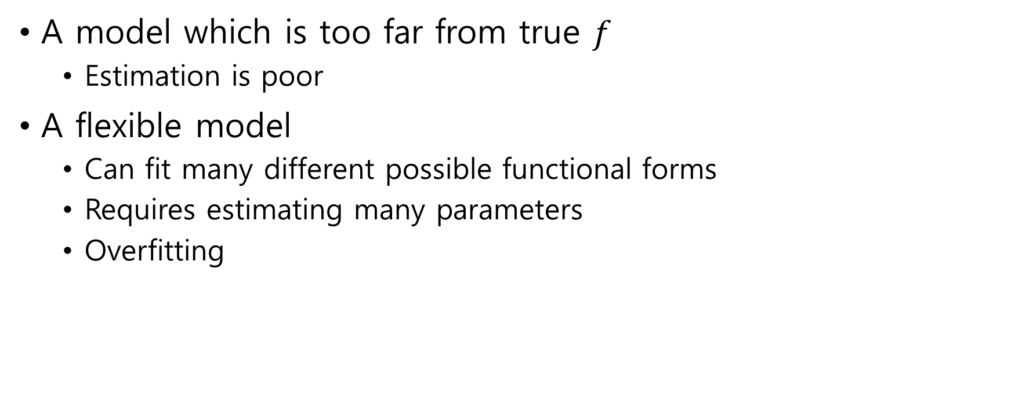
Model selection
A model which is too far from true $f$
Estimation is poor
A flexible model
Can fit many different possible functional forms
Requires estimating many parameters
Overfitting

Slide 21
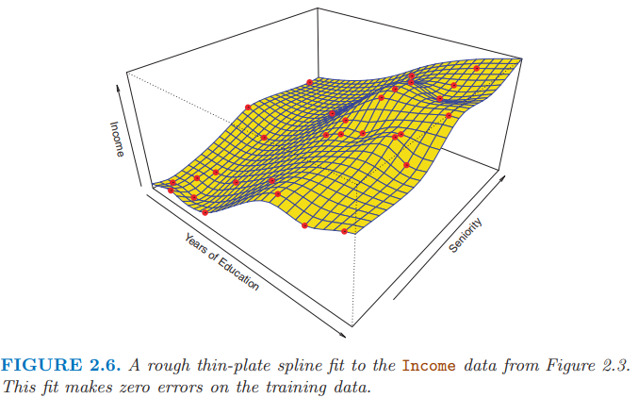

Non-parametric Methods
Do not make explicit assumptions about $f$
A very large number of observations is required
Example: thin-plate spline

Slide 22
2.1.3 The Trade-Off Between Prediction Accuracy and Model Interpretability
Why would we choose a more restrictive method instead of a very flexible approach?
In inference, restrictive models are much more interpretable

Slide 23
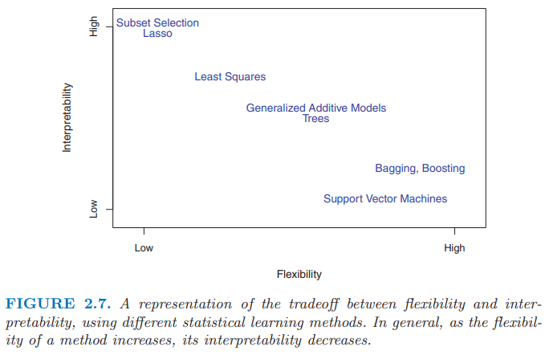

Slide 24
2.1.4 Supervised Versus Unsupervised Learning
Supervised learning
Use responses for training data
unsupervised learning
No response
Example: cluster analysis

Slide 25
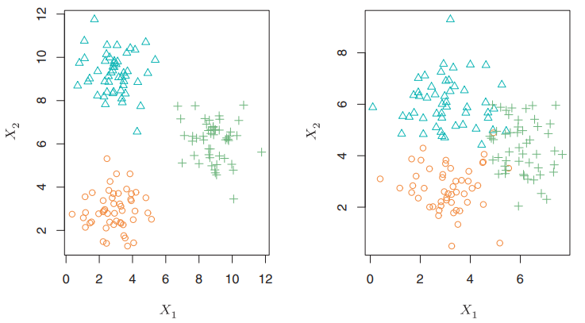
Clustering

Slide 26
2.1.5 Regression Versus Classification Problems
Regression
Quantitative
Example: a person’s age, height, or income, the value of a house, the price of a stock
Classification
Qualitative a.k.a. categorical
Example: a person’s gender (male or female), the brand of product purchased (brand A, B, or C)

Slide 27
2.2 Assessing Model Accuracy
There is no free lunch in statistics
No one method dominates all others over all possible data sets
On a particular data set, one specific method may work best
To decide the best method for given data set

Slide 28

2.2.1 Measuring the Quality of Fit
Mean squared error (MSE) $MSE=\frac{1}{n}\sum_{i=1}^{n}{{\left(y_{i}−\hat{f}\left(x_{i}\right)\right)}^{2}}$

Slide 29
Training and Test
Training MSE
MSE for training data
Test MSE
MSE for test data
Test data = test observations
Unseen data during training process
We are interested in the accuracy of the predictions on previously unseen test data

Slide 30

Training data
$\{\left(x_{1},y_{1}\right), …, \left(x_{n},y_{n}\right)\}$
Test data
$(x_{0},y_{0})$
If we have a large number of test data, we could compute $Ave{\left(\hat{f}\left(x_{0}\right)−y_{0}\right)}^{2}$

Slide 31
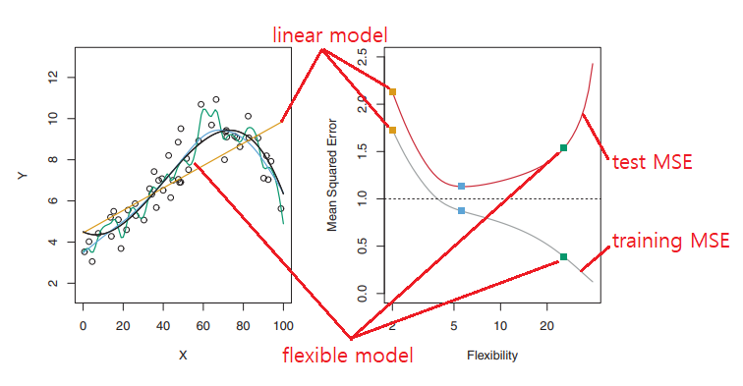

Slide 32
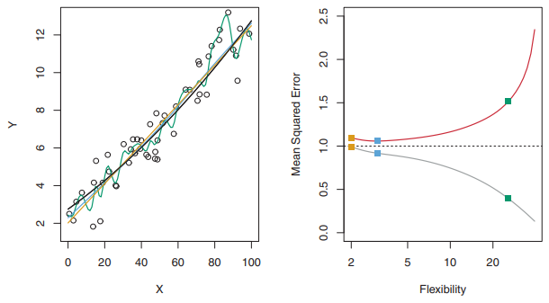
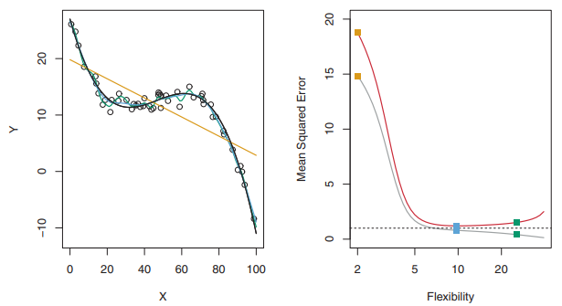

Slide 33
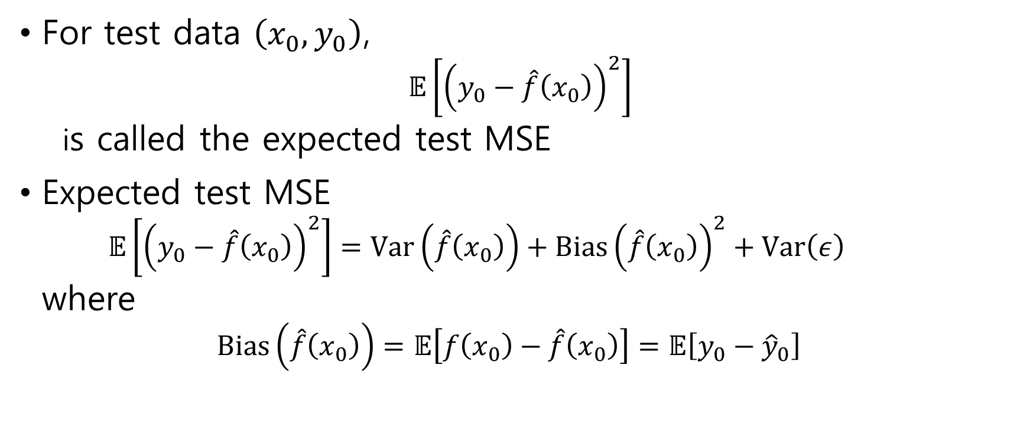
2.2.2 The Bias-Variance Trade-Off
For test data $\left(x_{0}, y_{0}\right)$, $𝔼\left[{\left(y_{0}−\hat{f}\left(x_{0}\right)\right)}^{2}\right]$ is called the expected test MSE
Expected test MSE $𝔼\left[{\left(y_{0}−\hat{f}\left(x_{0}\right)\right)}^{2}\right]=Var\left(\hat{f}\left(x_{0}\right)\right)+Bias{\left(\hat{f}\left(x_{0}\right)\right)}^{2}+Var\left(ε\right)$ where $Bias\left(\hat{f}\left(x_{0}\right)\right)=𝔼\left[f\left(x_{0}\right)−\hat{f}\left(x_{0}\right)\right]=𝔼\left[y_{0}−{\hat{y}}_{0}\right]$

Slide 34
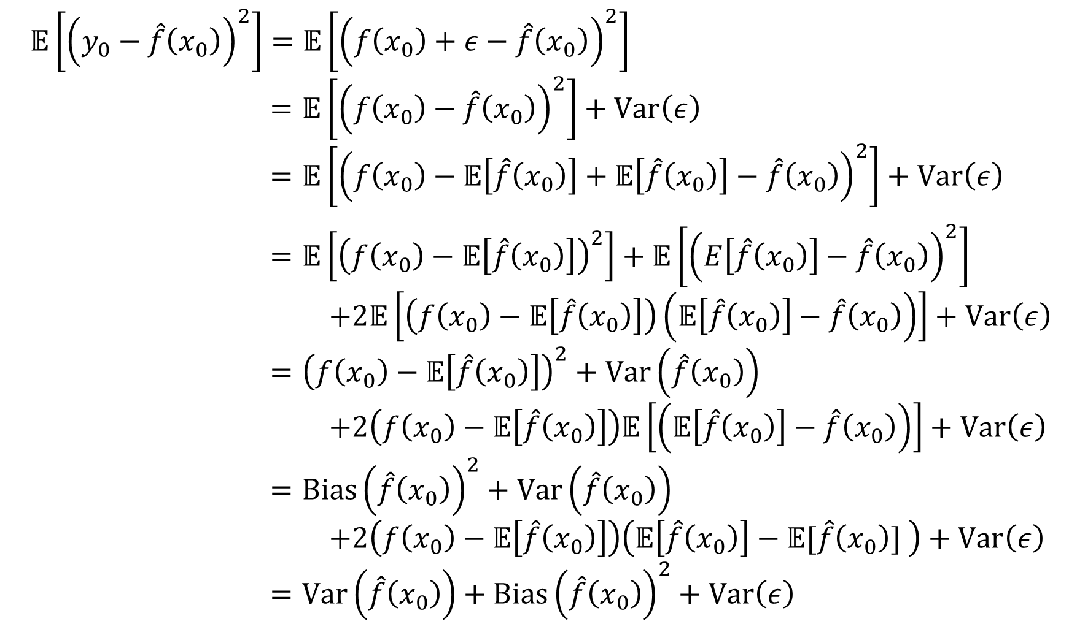
$𝔼\left[{\left(y_{0}−\hat{f}\left(x_{0}\right)\right)}^{2}\right]=𝔼\left[{\left(f\left(x_{0}\right)+ε−\hat{f}\left(x_{0}\right)\right)}^{2}\right]$ $=𝔼\left[{\left(f\left(x_{0}\right)−\hat{f}\left(x_{0}\right)\right)}^{2}\right]+Var\left(ε\right)$ $=𝔼\left[{\left(f\left(x_{0}\right)−𝔼\left[\hat{f}\left(x_{0}\right)\right]+𝔼\left[\hat{f}\left(x_{0}\right)\right]−\hat{f}\left(x_{0}\right)\right)}^{2}\right]+Var\left(ε\right)$
$=𝔼\left[{\left(f\left(x_{0}\right)−𝔼\left[\hat{f}\left(x_{0}\right)\right]\right)}^{2}\right]+𝔼\left[{\left(E\left[\hat{f}\left(x_{0}\right)\right]−\hat{f}\left(x_{0}\right)\right)}^{2}\right]$ $+2𝔼\left[\left(f\left(x_{0}\right)−𝔼\left[\hat{f}\left(x_{0}\right)\right]\right)\left(𝔼\left[\hat{f}\left(x_{0}\right)\right]−\hat{f}\left(x_{0}\right)\right)\right]+Var\left(ε\right)$ $={\left(f\left(x_{0}\right)−𝔼\left[\hat{f}\left(x_{0}\right)\right]\right)}^{2}+Var\left(\hat{f}\left(x_{0}\right)\right)$ $+2\left(f\left(x_{0}\right)−𝔼\left[\hat{f}\left(x_{0}\right)\right]\right)𝔼\left[\left(𝔼\left[\hat{f}\left(x_{0}\right)\right]−\hat{f}\left(x_{0}\right)\right)\right]+Var\left(ε\right)$ $=Bias{\left(\hat{f}\left(x_{0}\right)\right)}^{2}+Var\left(\hat{f}\left(x_{0}\right)\right)$ $+2\left(f\left(x_{0}\right)−𝔼\left[\hat{f}\left(x_{0}\right)\right]\right)\left(𝔼\left[\hat{f}\left(x_{0}\right)\right]−𝔼[\hat{f}\left(x_{0}\right)] \right)+Var\left(ε\right)$ $=Var\left(\hat{f}\left(x_{0}\right)\right)+Bias{\left(\hat{f}\left(x_{0}\right)\right)}^{2}+Var\left(ε\right)$

Slide 35
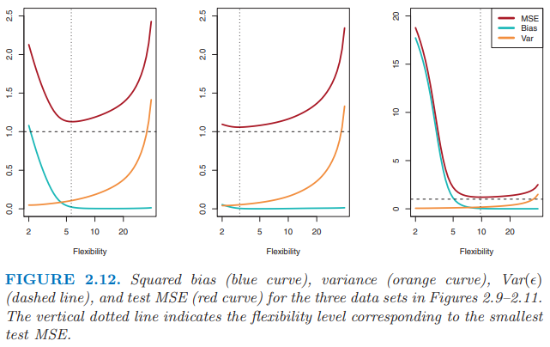

Slide 36
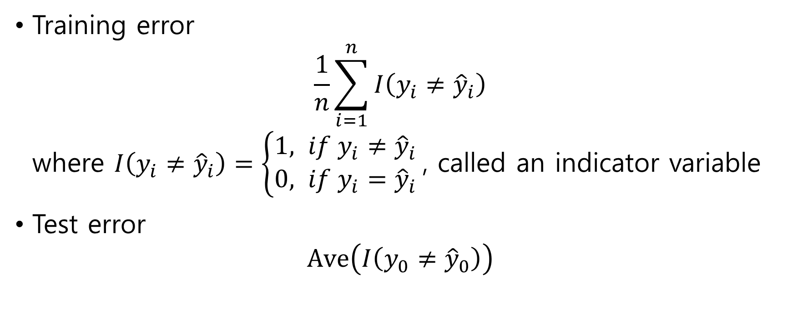
2.2.3 The Classification Setting
Training error $\frac{1}{n}\sum_{i=1}^{n}{I\left(y_{i}≠{\hat{y}}_{i}\right)}$ where $I\left(y_{i}≠{\hat{y}}_{i}\right)=\left\{\begin{aligned}1, if y_{i}≠{\hat{y}}_{i} \\ 0, if y_{i}={\hat{y}}_{i}\end{aligned}\right.$, called an indicator variable
Test error $Ave\left(I\left(y_{0}≠{\hat{y}}_{0}\right)\right)$

Slide 37
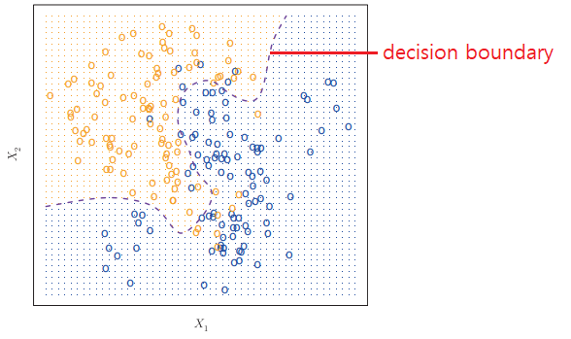
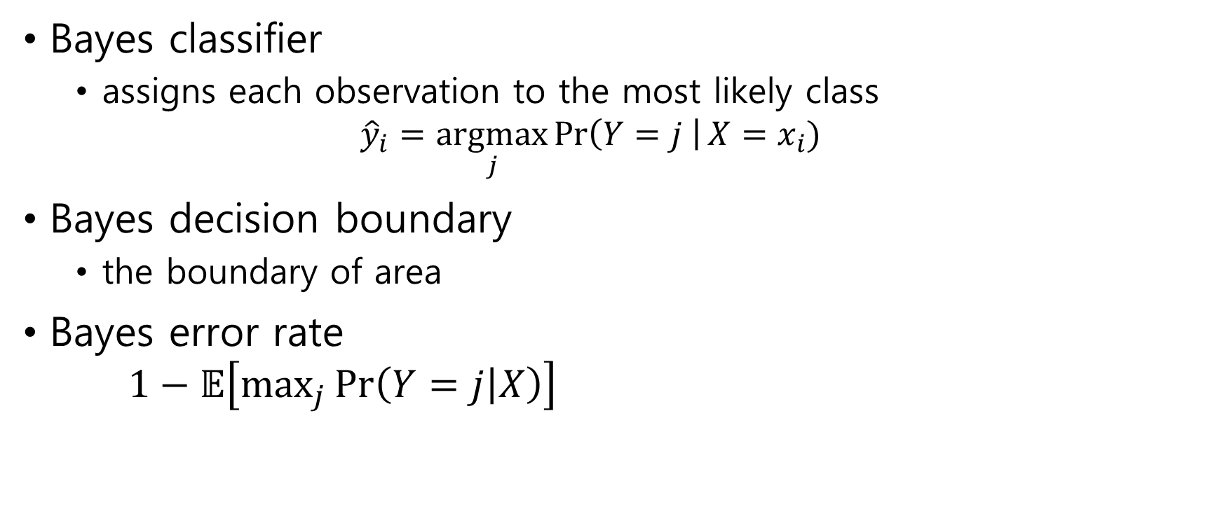
The Bayes Classifier
Bayes classifier
assigns each observation to the most likely class ${\hat{y}}_{i}=\underset{j}{argmax}{\operatorname{Pr}\left(Y=j \right|X=x_{i})}$
Bayes decision boundary
the boundary of area
Bayes error rate $1−𝔼\left[\max_{j}{\operatorname{Pr}\left(Y=j | X\right)}\right]$

Slide 38
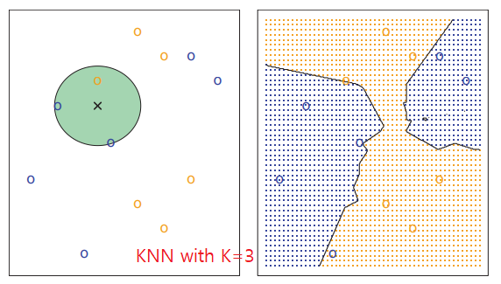

K-Nearest Neighbors
K-Nearest Neighbors(KNN) $\operatorname{Pr}\left(Y=j | X=x_{0}\right)=\frac{1}{K}\sum_{i∈N_{0}}{I\left(y_{i}=j\right)}$

Slide 39
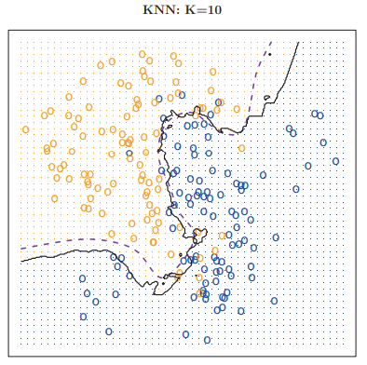
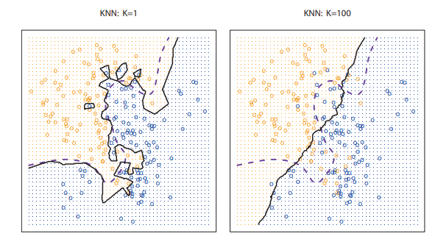
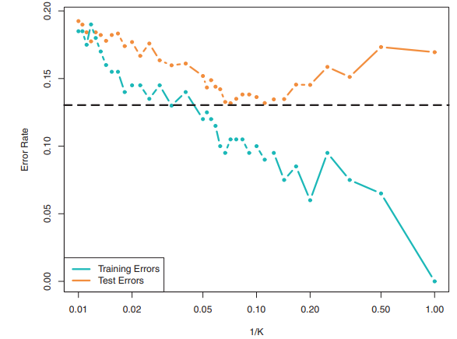

Slide 40
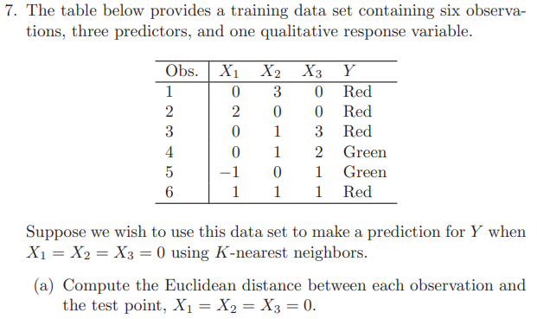
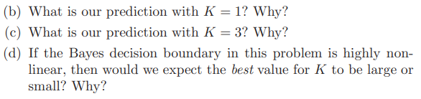
2.4 Exercise
Solve with pen
Solve with Python
Compute training error rate
Compute test error rate

