Slide 1
Statistical Learning
https://github.com/ggorr/Machine-Learning/tree/master/ISLR

Slide 2
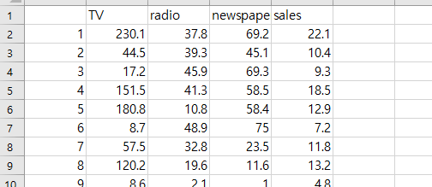

Data
http://faculty.marshall.usc.edu/gareth-james/ISL/data.html
Example: Advertising.csv
import pandas as pd df = pd.read_csv('data/Advertising.csv', sep=',') print(df.keys()) print(df.values.shape) tv = df.TV.values print(tv.shape)

Slide 3
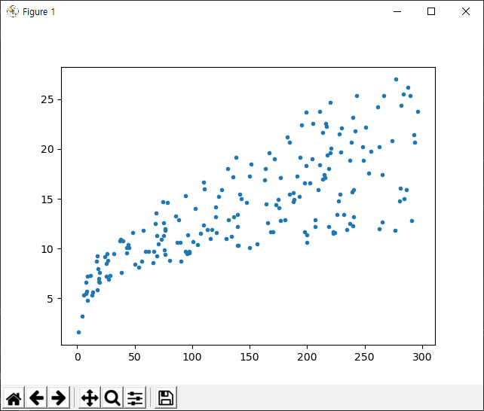
Plot
import pandas as pd import matplotlib.pyplot as plt df = pd.read_csv('data/Advertising.csv', sep=',') tv = df.TV.values sales = df.sales.values plt.plot(tv, sales, '.') plt.show()

Slide 4
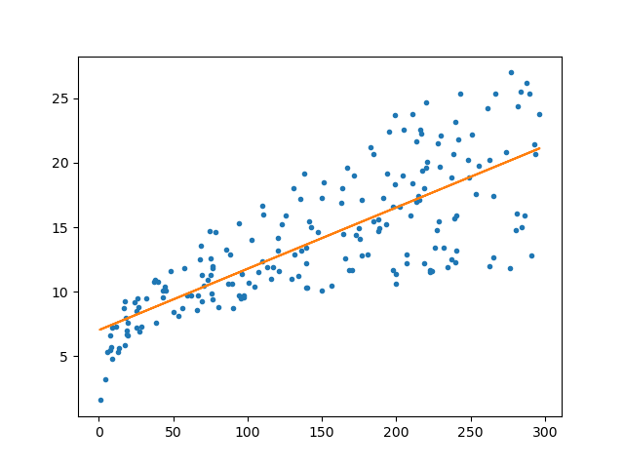
Linear Regression
import pandas as pd import matplotlib.pyplot as plt from sklearn.linear_model import LinearRegression df = pd.read_csv('data/Advertising.csv', sep=',') tv = df.TV.values sales = df.sales.values lr = LinearRegression() lr.fit(tv.reshape(-1, 1), sales) print('beta_0 =', lr.intercept_) print('beta_1 =', lr.coef_[0]) plt.plot(tv, sales, '.') plt.plot(tv, lr.predict(tv.reshape(-1,1))) plt.show() ''' beta_0 = 7.032593549127695 beta_1 = 0.04753664043301975 '''

Slide 5
3 Linear Regression
3.1 Simple Linear Regression
3.2 Multiple Linear Regression
3.3 Other Considerations in the Regression Model
3.4 The Marketing Plan
3.5 Comparison of Linear Regression with K-Nearest Neighbors
Lab: Linear Regression
Exercises

Slide 6
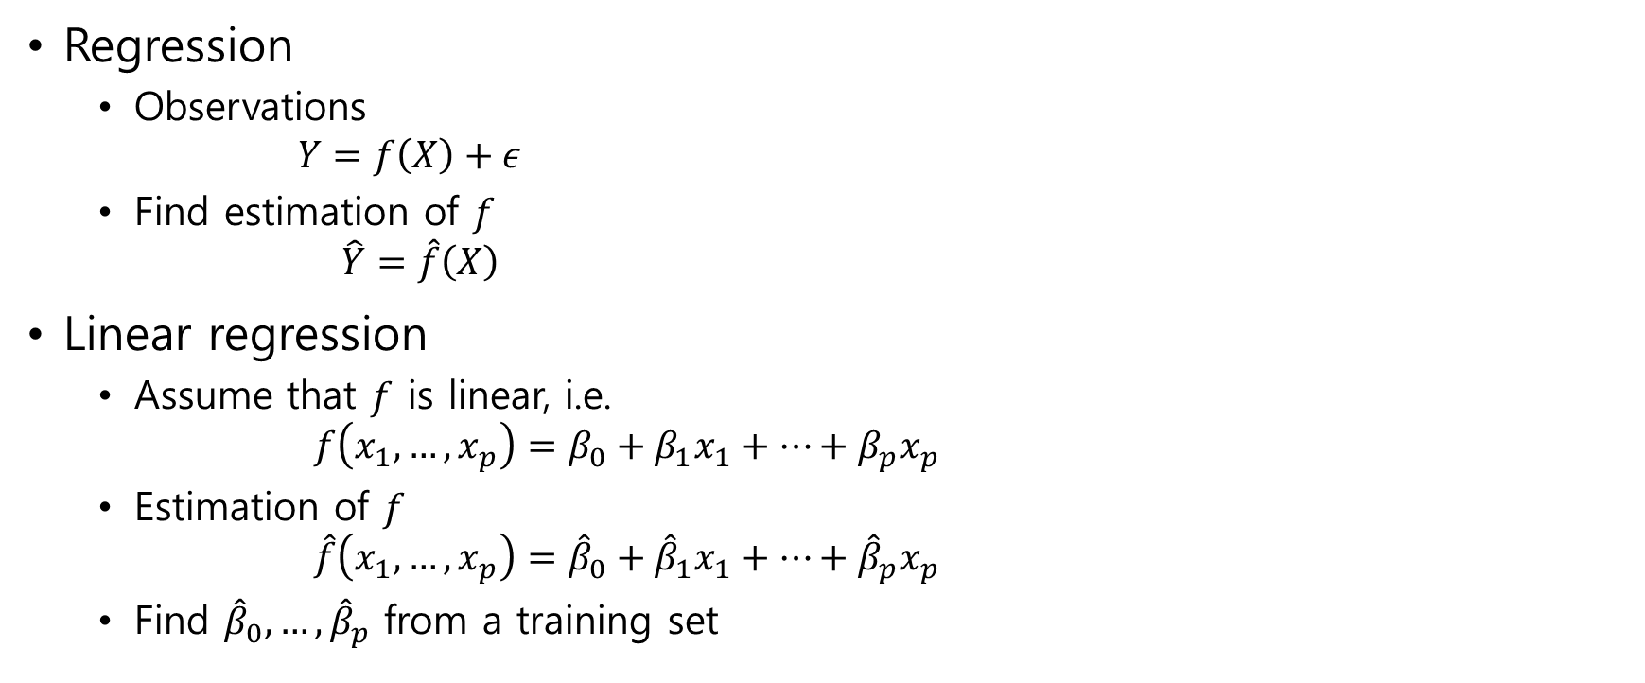
Regression
Regression
Observations $Y=f\left(X\right)+ε$
Find estimation of $f$ $\hat{Y}=\hat{f}\left(X\right)$
Linear regression
Assume that $f$ is linear, i.e. $f\left(x_{1}, …,x_{p}\right)=β_{0}+β_{1}x_{1}+⋯+β_{p}x_{p}$
Estimation of $f$ $\hat{f}\left(x_{1}, …,x_{p}\right)={\hat{β}}_{0}+{\hat{β}}_{1}x_{1}+⋯+{\hat{β}}_{p}x_{p}$
Find ${\hat{β}}_{0},…,{\hat{β}}_{p}$ from a training set

Slide 7
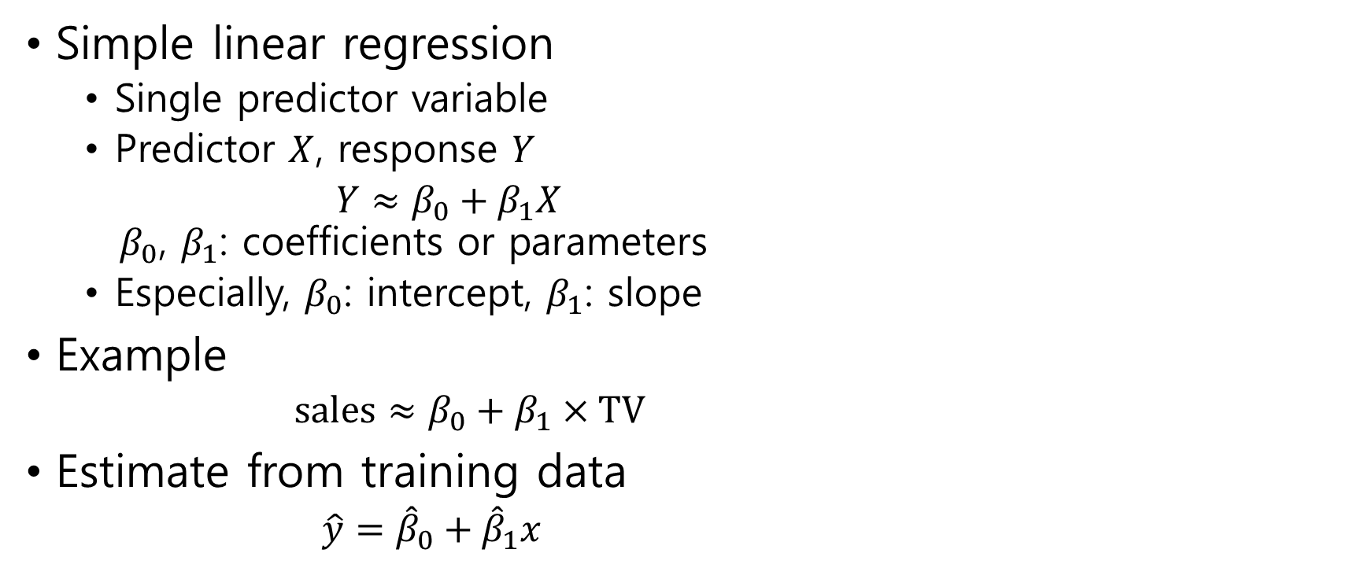
3.1 Simple Linear Regression
Simple linear regression
Single predictor variable
Predictor $X$, response $Y$
$Y≈β_{0}+β_{1}X$ $β_{0}$, $β_{1}$: coefficients or parameters
Especially, $β_{0}$: intercept, $β_{1}$: slope
Example
$sales≈β_{0}+β_{1}×TV$
Estimate from training data
$\hat{y}={\hat{β}}_{0}+{\hat{β}}_{1}x$

Slide 8
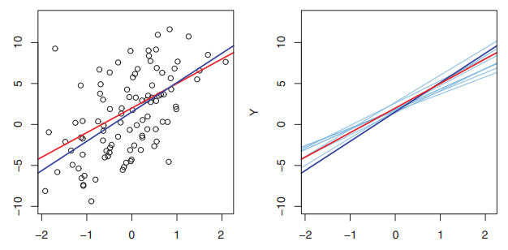
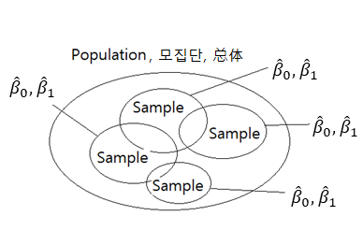
A simulated data

Slide 9
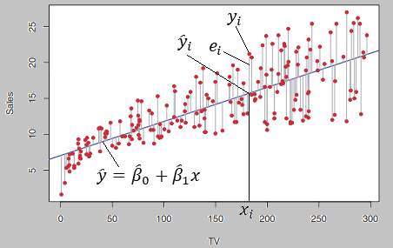
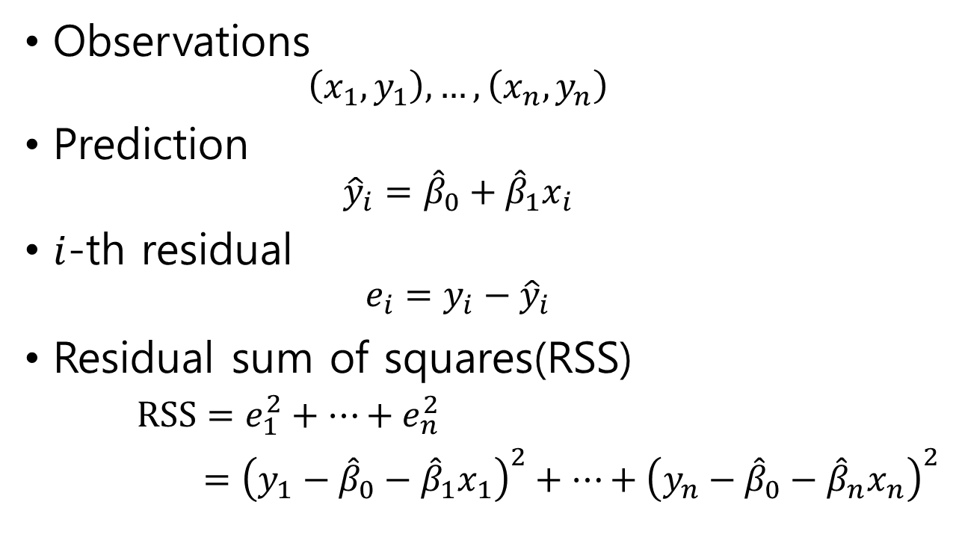
3.1.1 Estimating the Coefficients
Observations
$$\left(x_{1},y_{1}\right), …,\left(x_{n},y_{n}\right)$$
Prediction
$${\hat{y}}_{i}={\hat{β}}_{0}+{\hat{β}}_{1}x_{i}$$
$i$-th residual
$$e_{i}=y_{i}−{\hat{y}}_{i}$$
Residual sum of squares(RSS)
$RSS=e_{1}^{2}+⋯+e_{n}^{2}$
$={\left(y_{1}−{\hat{β}}_{0}−{\hat{β}}_{1}x_{1}\right)}^{2}+⋯+{\left(y_{n}−{\hat{β}}_{0}−{\hat{β}}_{n}x_{n}\right)}^{2}$

Slide 10

Least Square Approach
To minimize the RSS ${\hat{β}}_{1}=\frac{\sum_{i=1}^{n}{\left(x_{i}−\overline{x}\right)\left(y_{i}−\overline{y}\right)}}{\sum_{i=1}^{n}{{\left(x_{i}−\overline{x}\right)}^{2}}}$ ${\hat{β}}_{0}=\overline{y}−{\hat{β}}_{1}\overline{x}$

Slide 11
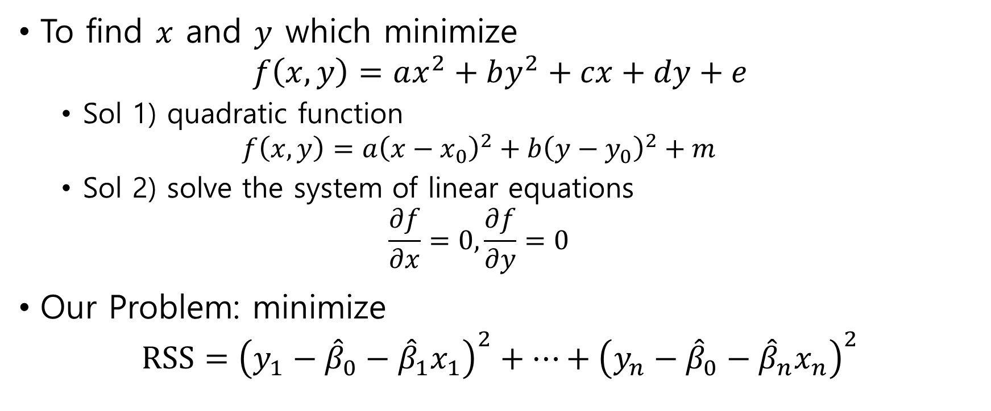
Computation
To find $x$ and $y$ which minimize $f\left(x,y\right)=ax^{2}+by^{2}+cx+dy+e$
Sol 1) quadratic function $f\left(x,y\right)=a{\left(x−x_{0}\right)}^{2}+b{\left(y−y_{0}\right)}^{2}+m$
Sol 2) solve the system of linear equations $\frac{∂f}{∂x}=0, \frac{∂f}{∂y}=0$
Our Problem: minimize $RSS={\left(y_{1}−{\hat{β}}_{0}−{\hat{β}}_{1}x_{1}\right)}^{2}+⋯+{\left(y_{n}−{\hat{β}}_{0}−{\hat{β}}_{n}x_{n}\right)}^{2}$

Slide 12
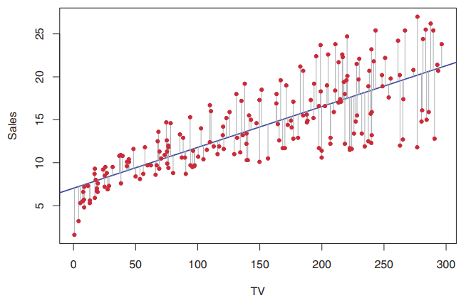
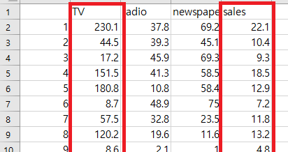

Advertising
TV and sales
${\hat{β}}_{0}=7.0325$
${\hat{β}}_{1}=0.0475$

Slide 13
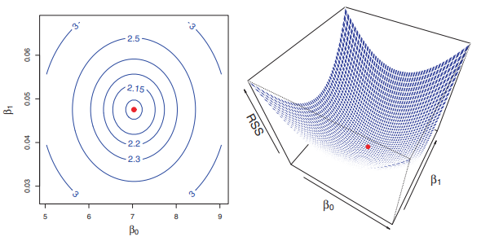
RSS
RSS is a quadratic function

Slide 14
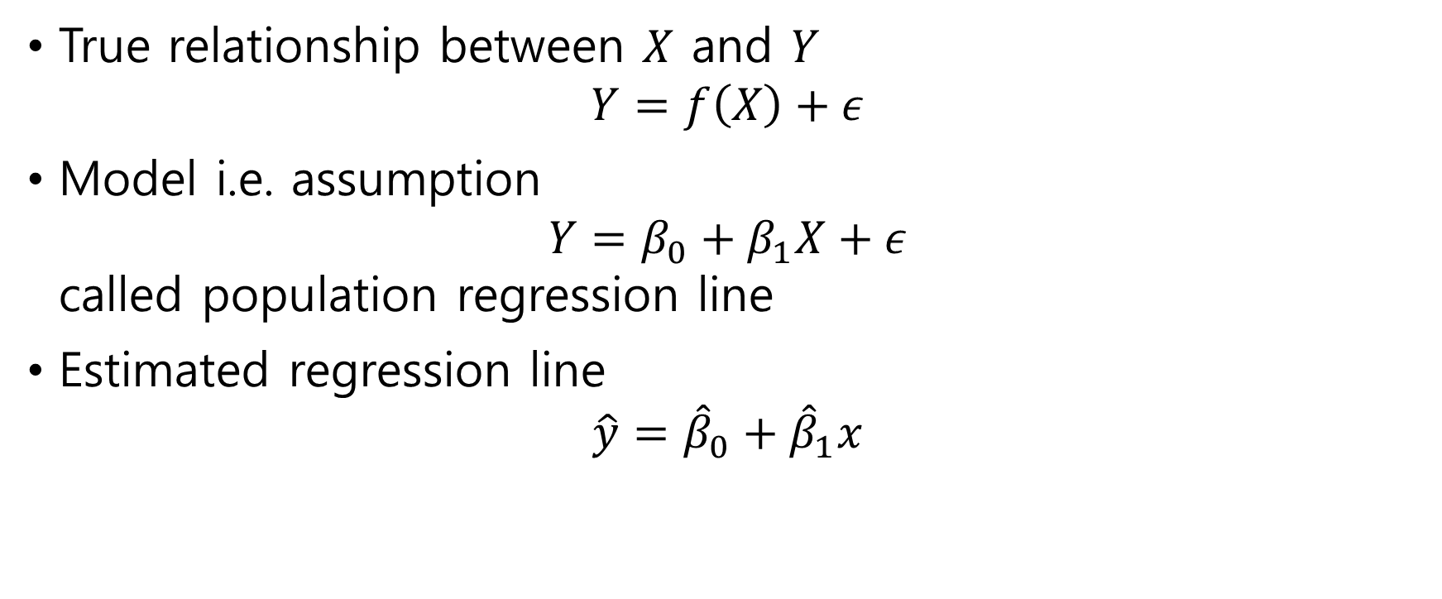
3.1.2 Assessing the Accuracy of the Coefficient Estimates
True relationship between $X$ and $Y$ $Y=f\left(X\right)+ε$
Model i.e. assumption $Y=β_{0}+β_{1}X+ε$ called population regression line
Estimated regression line
$$\hat{y}={\hat{β}}_{0}+{\hat{β}}_{1}x$$

Slide 15
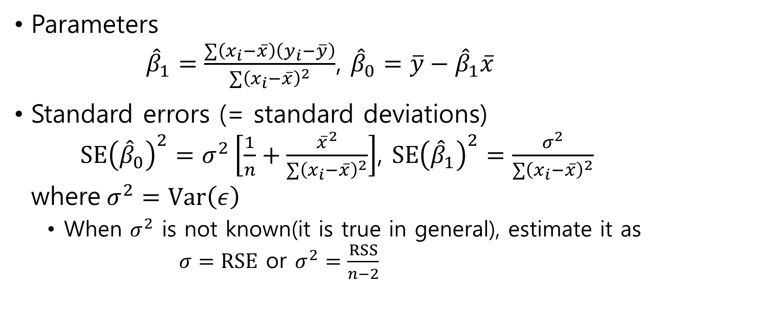
Accuracy of the Coefficient Estimates
Parameters ${\hat{β}}_{1}=\frac{∑\left(x_{i}−\overline{x}\right)\left(y_{i}−\overline{y}\right)}{∑{\left(x_{i}−\overline{x}\right)}^{2}}$, ${\hat{β}}_{0}=\overline{y}−{\hat{β}}_{1}\overline{x}$
Standard errors (= standard deviations) $SE{\left({\hat{β}}_{0}\right)}^{2}=σ^{2}\left[\frac{1}{n}+\frac{{\overline{x}}^{2}}{∑{\left(x_{i}−\overline{x}\right)}^{2}}\right]$, $SE{\left({\hat{β}}_{1}\right)}^{2}=\frac{σ^{2}}{∑{\left(x_{i}−\overline{x}\right)}^{2}}$ where$σ^{2}=Var\left(ε\right)$
When $σ^{2}$ is not known(it is true in general), estimate it as $σ=RSE$ or $σ^{2}=\frac{RSS}{n−2}$

Slide 16

Prove that $SE{\left({\hat{β}}_{0}\right)}^{2}=σ^{2}\left[\frac{1}{n}+\frac{{\overline{x}}^{2}}{\sum_{i=1}^{n}{{\left(x_{i}−\overline{x}\right)}^{2}}}\right]$, $SE{\left({\hat{β}}_{1}\right)}^{2}=\frac{σ^{2}}{\sum_{i=1}^{n}{{\left(x_{i}−\overline{x}\right)}^{2}}}$
see the page “Proofs involving ordinary least squares” in wikipedia

Slide 17

confidence interval
95% confidence interval for $β_{i}$ $[{\hat{β}}_{i}−2⋅SE\left({\hat{β}}_{i}\right), {\hat{β}}_{i}+2⋅SE\left({\hat{β}}_{i}\right)]$

Slide 18
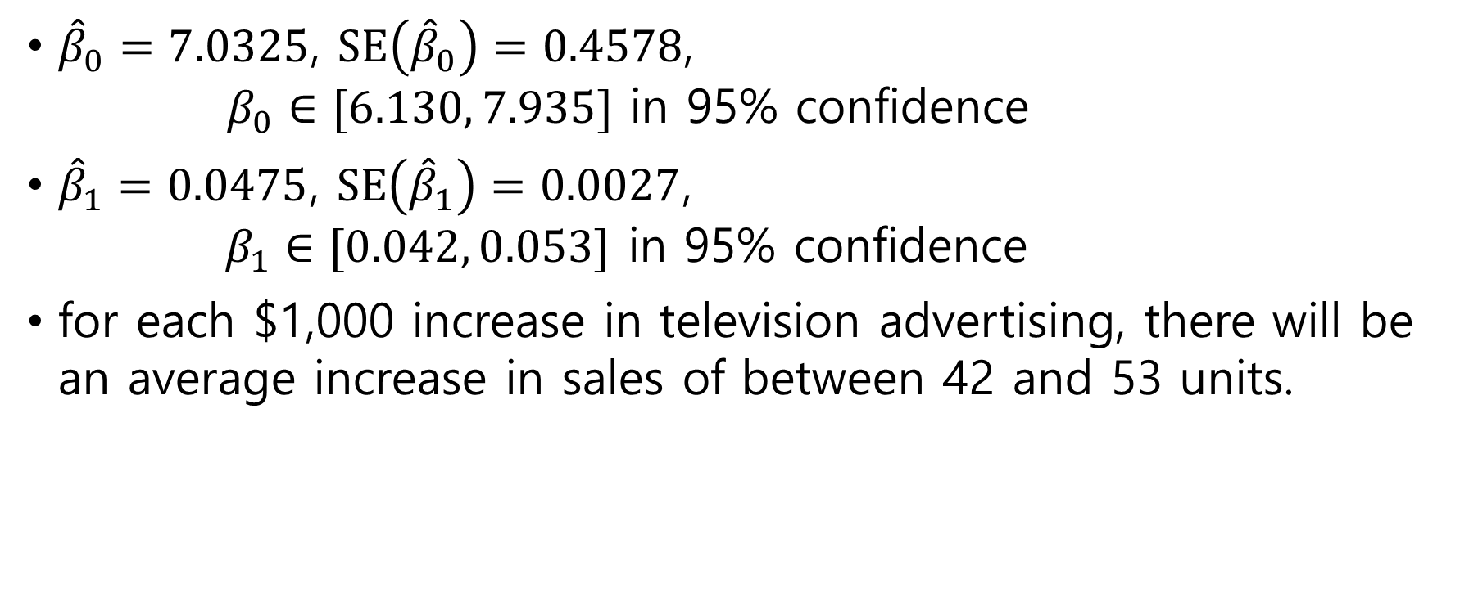
Example: advertising data
${\hat{β}}_{0}=7.0325$, $SE\left({\hat{β}}_{0}\right)=0.4578$, $β_{0}∈[6.130, 7.935]$ in 95% confidence
${\hat{β}}_{1}=0.0475$, $SE\left({\hat{β}}_{1}\right)=0.0027$, $β_{1}∈[0.042, 0.053]$ in 95% confidence
for each $1,000 increase in television advertising, there will be an average increase in sales of between 42 and 53 units.

Slide 19
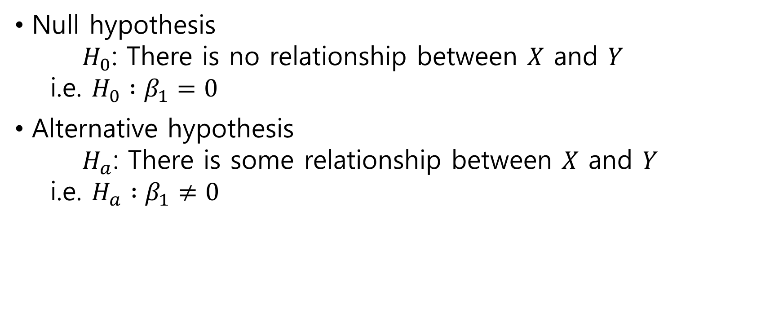
Hypothesis Test
Null hypothesis $H_{0}$: There is no relationship between $X$ and $Y$ i.e. $H_{0} :β_{1}=0$
Alternative hypothesis $H_{a}$: There is some relationship between $X$ and $Y$ i.e. $H_{a} :β_{1}≠0$

Slide 20
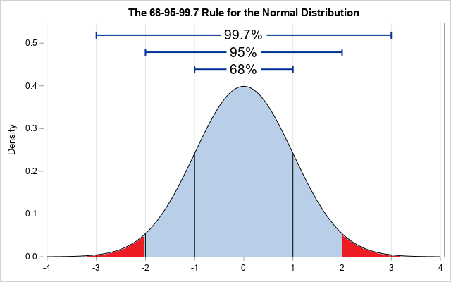
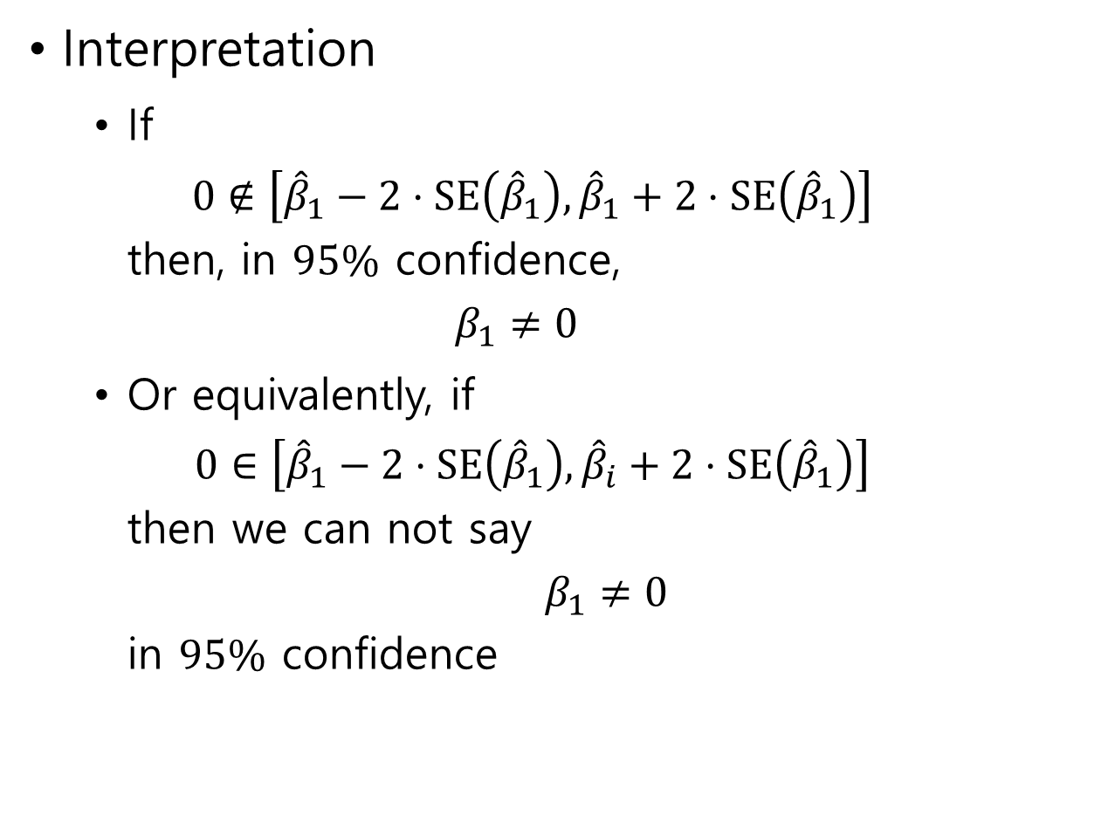
Interpretation
If $0∉\left[{\hat{β}}_{1}−2⋅SE\left({\hat{β}}_{1}\right),{\hat{β}}_{1}+2⋅SE\left({\hat{β}}_{1}\right)\right]$ then, in $95\%$ confidence, $β_{1}≠0$
Or equivalently, if $0∈\left[{\hat{β}}_{1}−2⋅SE\left({\hat{β}}_{1}\right), {\hat{β}}_{i}+2⋅SE\left({\hat{β}}_{1}\right)\right]$ then we can not say $β_{1}≠0$ in $95\%$ confidence

Slide 21
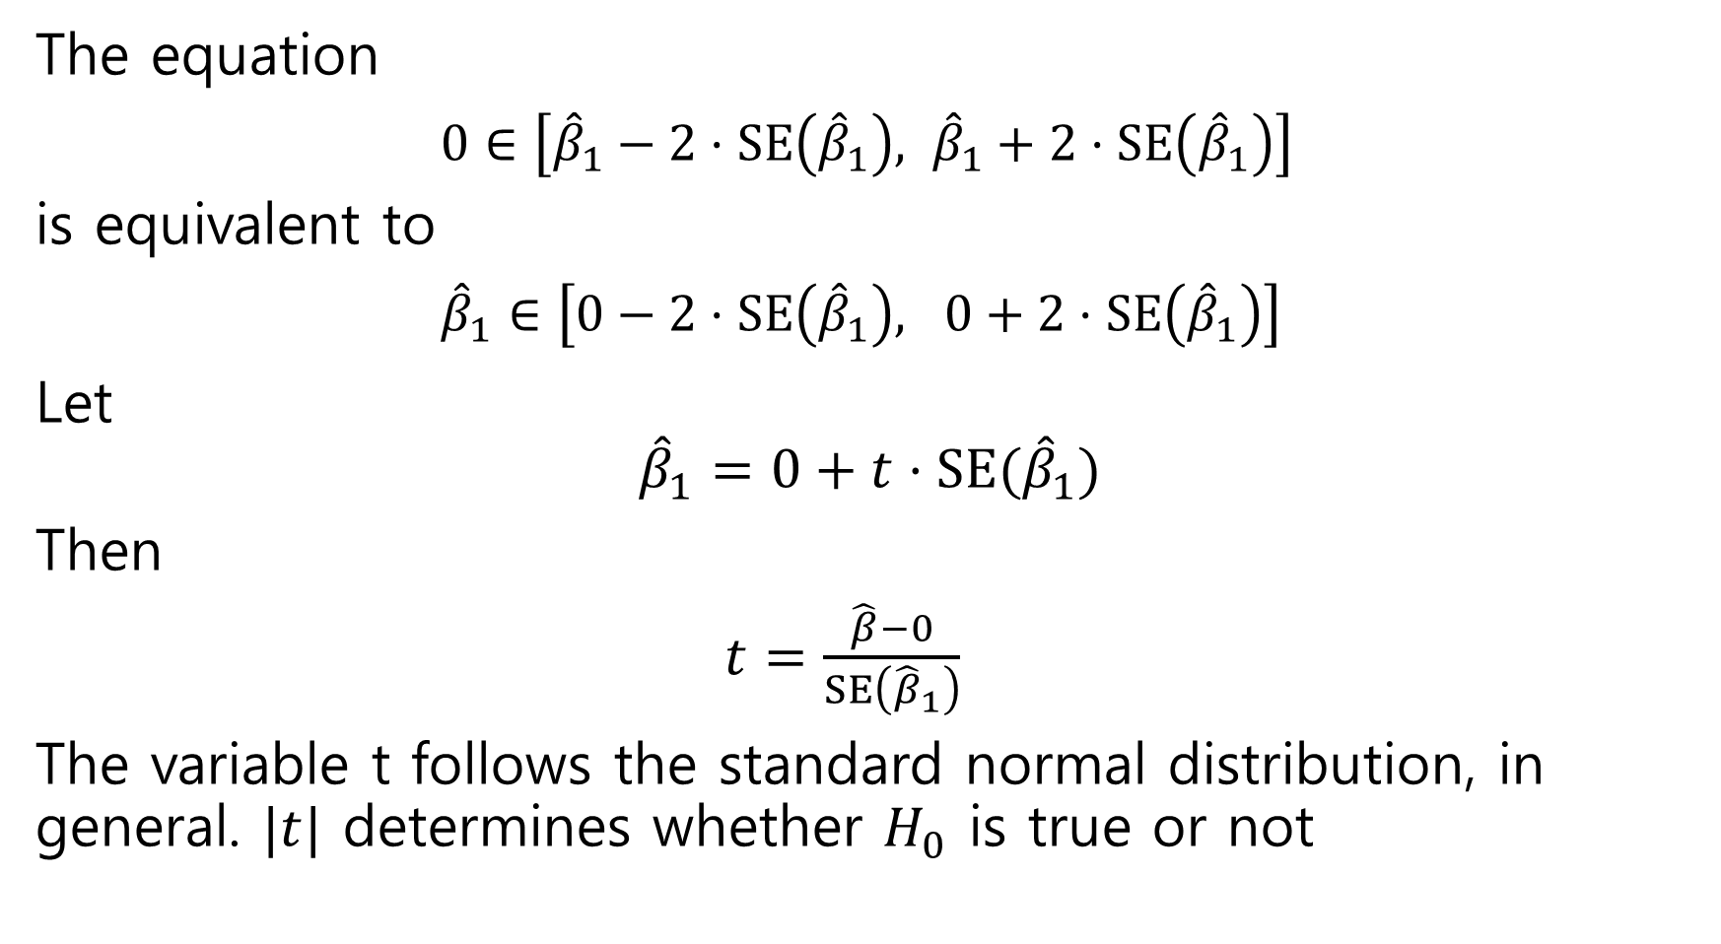
The equation $0∈\left[{\hat{β}}_{1}−2⋅SE\left({\hat{β}}_{1}\right), {\hat{β}}_{1}+2⋅SE\left({\hat{β}}_{1}\right)\right]$ is equivalent to ${\hat{β}}_{1}∈\left[0−2⋅SE\left({\hat{β}}_{1}\right), 0+2⋅SE\left({\hat{β}}_{1}\right)\right]$
Let $${\hat{β}}_{1}=0+t⋅SE({\hat{β}}_{1})$$
Then
$t=\frac{\hat{β}−0}{SE\left({\hat{β}}_{1}\right)}$
The variable t follows the standard normal distribution, in general. $|t|$ determines whether $H_{0}$ is true or not

Slide 22
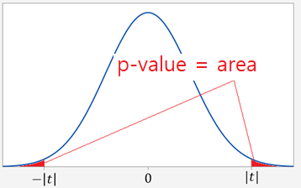
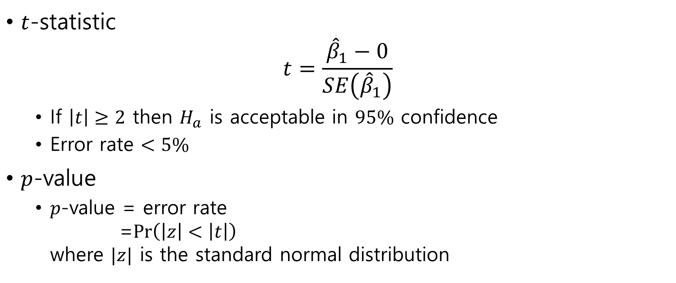
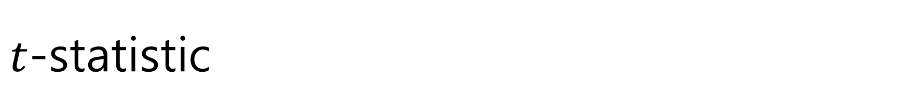
$t$-statistic
$t$-statistic $t=\frac{{\hat{β}}_{1}−0}{SE\left({\hat{β}}_{1}\right)}$
If $\left|t\right|≥2$ then $H_{a}$ is acceptable in $95\%$ confidence
Error rate $<5\%$
$p$-value
$p$-value = error rate =$\operatorname{Pr}\left(\left|z\right|<\left|t\right|\right)$ where $|z|$ is the standard normal distribution

Slide 23

Advertising

Slide 24

3.1.3 Assessing the Accuracy of the Model
The extent to which the model fits the data
Methods:
Residual Standard Error
$R^{2}$ statistic

Slide 25

Residual Standard Error
Residual Standard Error(RSE) $RSE=\sqrt{\frac{1}{n−2}RSS}=\sqrt{\frac{1}{n−2}∑{\left(y_{i}−{\hat{y}}_{i}\right)}^{2}}$
Recall that $RSS=\sum_{i=1}^{n}{{\left(y_{i}−{\hat{y}}_{i}\right)}^{2}}$

Slide 26
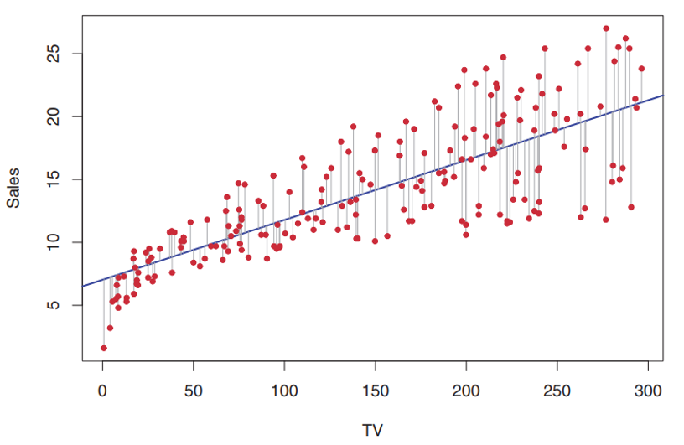
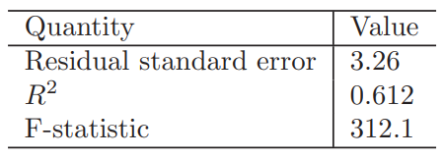
Advertising
Actual sales in each market deviate from the true regression line by approximately 3,260 units, on average

Slide 27
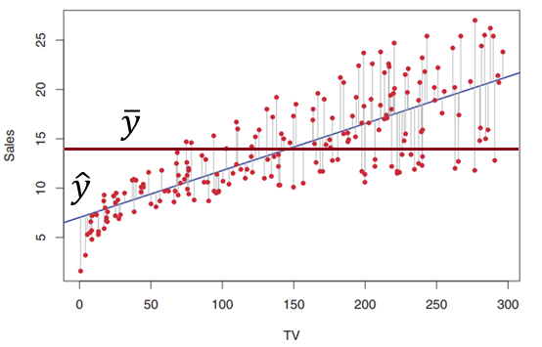
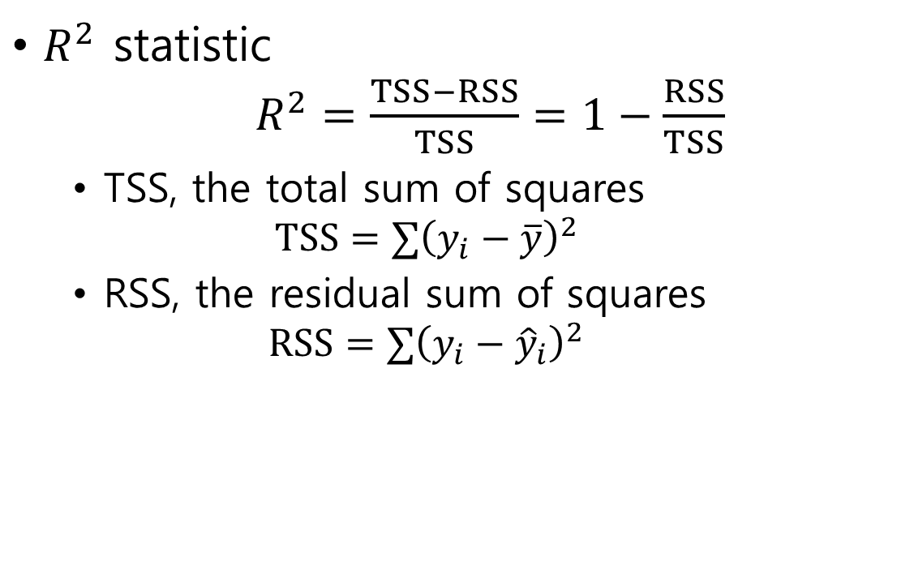
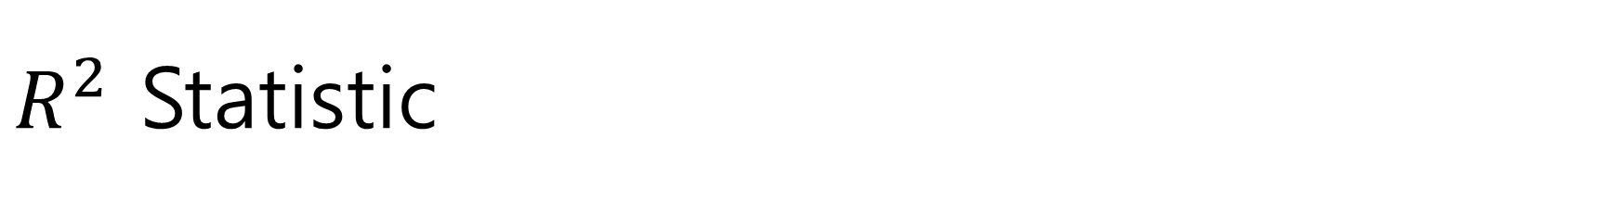
$R^{2}$ Statistic
$R^{2}$ statistic $R^{2}=\frac{TSS−RSS}{TSS}=1−\frac{RSS}{TSS}$
TSS, the total sum of squares $TSS=∑{\left(y_{i}−\overline{y}\right)}^{2}$
RSS, the residual sum of squares $RSS=∑{\left(y_{i}−{\hat{y}}_{i}\right)}^{2}$

Slide 28
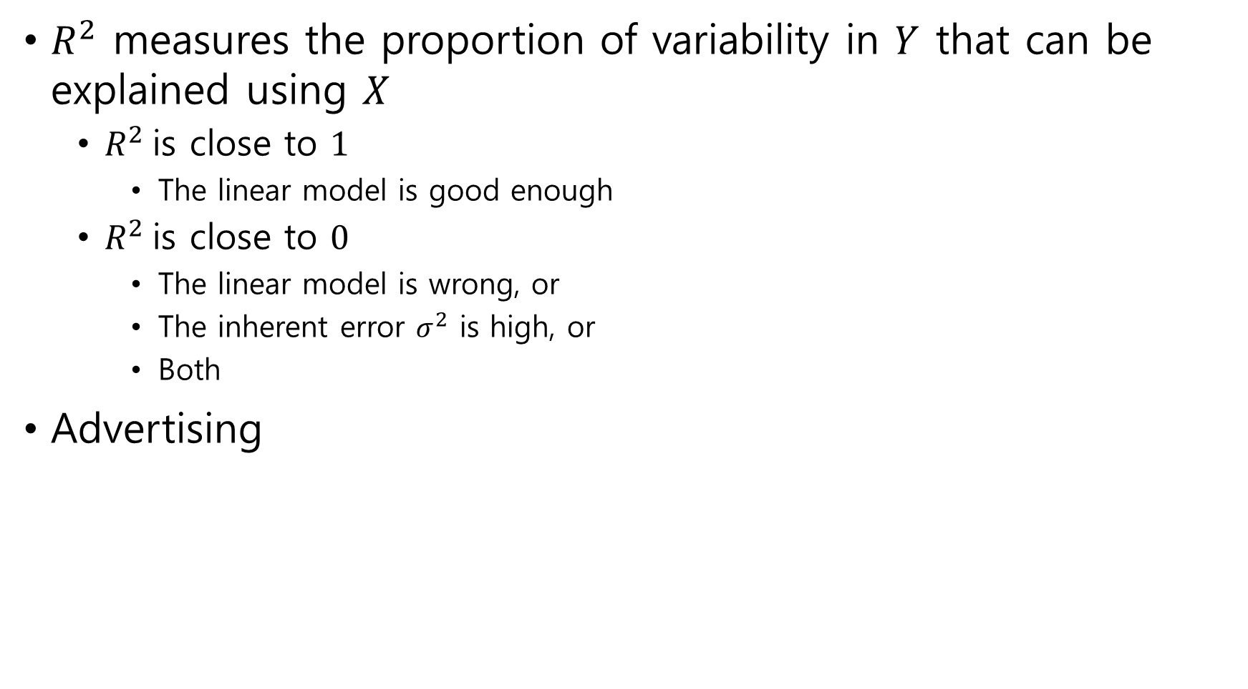
$R^{2}$ measures the proportion of variability in $Y$ that can be explained using $X$
$R^{2}$is close to $1$
The linear model is good enough
$R^{2}$is close to $0$
The linear model is wrong, or
The inherent error $σ^{2}$ is high, or
Both
Advertising

Slide 29

Correlation
Correlation measures the linear relationship between $X$ and $Y$ $Cor\left(X,Y\right)=\frac{∑(x_{i}−\overline{x})(y_{i}−\overline{y})}{\sqrt{∑{\left(x_{i}−\overline{x}\right)}^{2}∑{\left(y_{i}−\overline{y}\right)}^{2}}}$
Cosine similarity
$R^{2}=Cor{\left(X,Y\right)}^{2}$

Slide 30
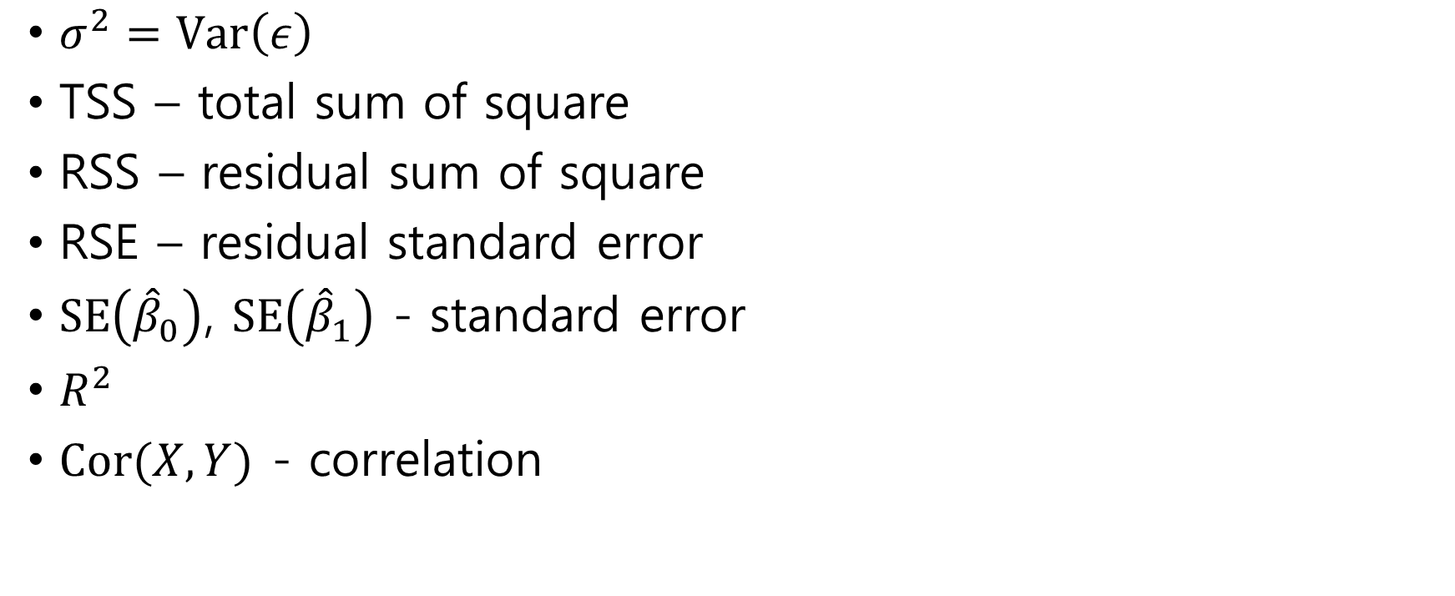
summary
$σ^{2}=Var\left(ε\right)$
TSS – total sum of square
RSS – residual sum of square
RSE – residual standard error
$SE\left({\hat{β}}_{0}\right)$, $SE\left({\hat{β}}_{1}\right)$ - standard error
$R^{2}$
$Cor(X,Y)$ - correlation

Slide 31
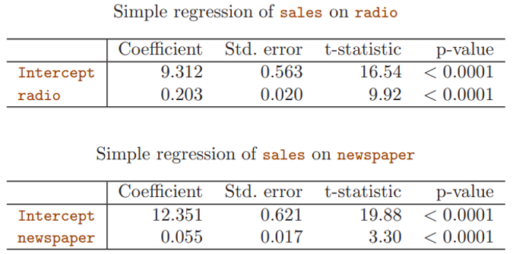
3.2 Multiple Linear Regression
Is it sufficient?

Slide 32

Multiple Linear Regression $Y=β_{0}+β_{1}X_{1}+⋯+β_{p}X_{p}+ε$
Example: advertising $sales=β_{0}+β_{1}×TV+β_{2}×radio+β_{3}×newspaper+ε$

Slide 33

Estimate coefficients
Find ${\hat{β}}_{0},…,{\hat{β}}_{p}$ to minimize $RSS=∑{\left(y_{i}−{\hat{y}}_{i}\right)}^{2}$ $=∑{\left(y_{i}−{\hat{β}}_{0}−{\hat{β}}_{1}x_{i1}−⋯−{\hat{β}}_{p}x_{ip}\right)}^{2}$

Slide 34

matrix form
$X=\left[\begin{matrix}230.1 & 37.8 & 69.2 \\ 44.5 & 39.3 & 45.1 \\ ⋮ & ⋮ & ⋮\end{matrix}\right]$
$y=\left[\begin{matrix}22.1 \\ 10.4 \\ ⋮\end{matrix}\right]$
$β=\left[\begin{matrix}β_{1} \\ β_{2} \\ β_{3}\end{matrix}\right]$
$y=β_{0}+Xβ+ε$

Slide 35

matrix form
$X=\left[\begin{matrix}1 & 230.1 & 37.8 & 69.2 \\ 1 & 44.5 & 39.3 & 45.1 \\ ⋮ & ⋮ & ⋮ & ⋮\end{matrix}\right]$
$y=\left[\begin{matrix}22.1 \\ 10.4 \\ ⋮\end{matrix}\right]$
$β=\left[\begin{matrix}β_{0} \\ β_{1} \\ β_{2} \\ β_{3}\end{matrix}\right]$
$y=Xβ+ε$
RSS$= ∥y−X\hat{β}∥^{2}$

Slide 36
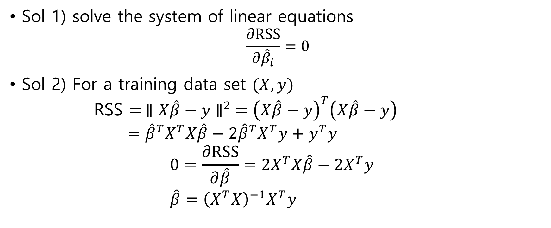
Computation
Sol 1) solve the system of linear equations $\frac{∂RSS}{∂{\hat{β}}_{i}}=0$
Sol 2) For a training data set $(X, y)$ RSS $= ∥X\hat{β}−y∥^{2} ={\left(X\hat{β}−y\right)}^{T}\left(X\hat{β}−y\right)$ $={\hat{β}}^{T}X^{T}X\hat{β}−2{\hat{β}}^{T}X^{T}y+y^{T}y$ $0=\frac{∂RSS}{∂\hat{β}}=2X^{T}X\hat{β}−2X^{T}y$ $\hat{β}={\left(X^{T}X\right)}^{−1}X^{T}y$

Slide 37

Sol 3) equation $X\hat{β}=y$
multiply the Moore-Penrose pseudo inverse ${\left(X^{T}X\right)}^{−1}X^{T}$ in both sides ${\left(X^{T}X\right)}^{−1}X^{T}X\hat{β}={\left(X^{T}X\right)}^{−1}X^{T}y$ $\hat{β}={\left(X^{T}X\right)}^{−1}X^{T}y$
Is $X^{T}X$ invertiable?

Slide 38
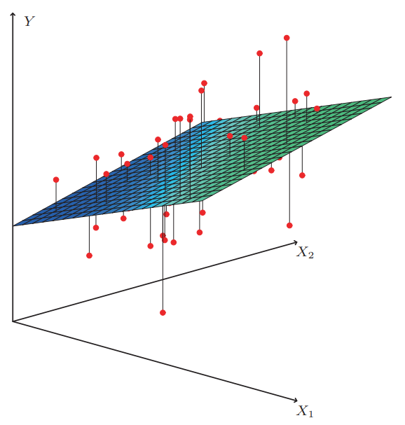

Slide 39
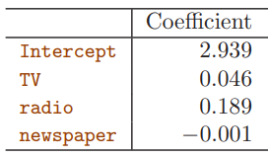
Example
Advertising
There is no relationship between sales and newspaper

Slide 40
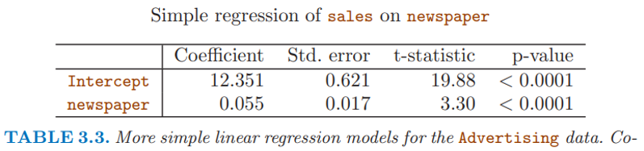
In simple regression, there is relation between sales and newspaper. Why?

Slide 41
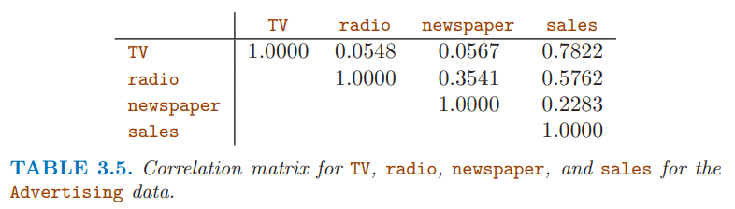
Correlation between radio and newspaper
The correlation reveals a tendency to spend more on newspaper advertising in markets where more is spent on radio advertising
shark attacks versus ice cream sales for data collected at a given beach community

Slide 42
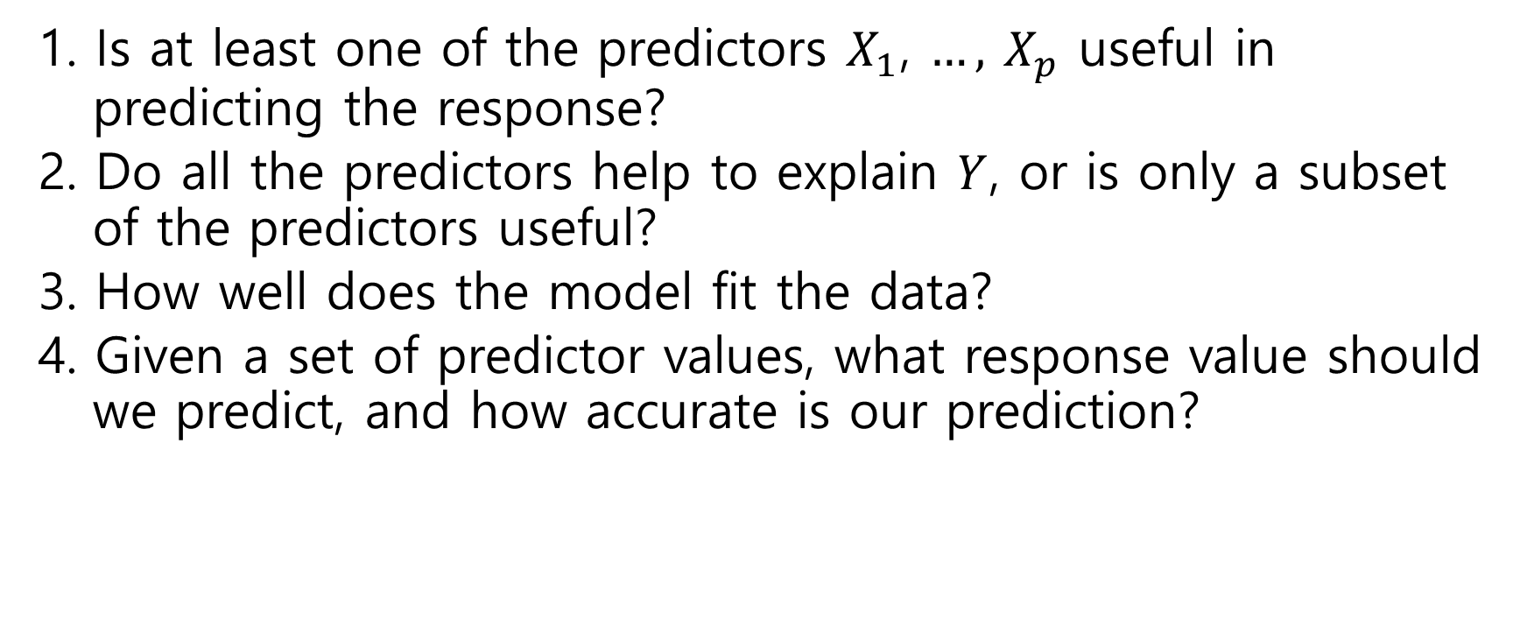
3.2.2 Some Important Questions
1. Is at least one of the predictors $X_{1}$, $…,$ $X_{p}$ useful in predicting the response?
2. Do all the predictors help to explain $Y$, or is only a subset of the predictors useful?
3. How well does the model fit the data?
4. Given a set of predictor values, what response value should we predict, and how accurate is our prediction?

Slide 43

One: Is There a Relationship Between the Response and Predictors?
Null hypothesis $H_{0}:β_{1}=⋯=β_{p}=0$
Alternative hypothesis $H_{a}:$ at least one $β_{j}$ is non-zero

Slide 44

F-statistic
F-statistic $F=\frac{(TSS−RSS)/p}{RSS/(n−p−1)}$
where $TSS=∑{\left(y_{i}−\overline{y}\right)}^{2}$, $RSS=∑{\left(y_{i}−{\hat{y}}_{i}\right)}^{2}$
$𝔼\left[\frac{RSS}{n−p−1}\right]=σ^{2}$ if the population model is linear
$𝔼\left[\frac{TSS−RSS}{p}\right]≥σ^{2}$ In particular, $𝔼\left[\frac{TSS−RSS}{p}\right]=σ^{2}$ if $H_{0}$ is true
$F≥1$

Slide 45

The F-statistic takes on a value close to 1
When there is no relationship between the response and predictors
Or equivalently, $H_{0}$ is true

Slide 46

Advertising

Slide 47

Two: Deciding on Important Variables
Forward selection
Start from null model – no variables
Add variables which has the lowest RSS, one by one
Backward selection
Start from full model
remove variables which has the highest $p$-value, one by one
Mixed selection
Forward selection
Remove variable of which $p$-value exceeds the threshold

Slide 48

Three: Model Fit
Numerical measures of model fit: $R^{2}$ and RSE
$R^{2}$
close to 1 indicates that the model explains a large portion of $Y$
coincides $cor\left(Y, \hat{Y}\right)$
RSE $RSE=\sqrt{\frac{RSS}{n−p−1}}$

Slide 49

Four: Predictions
Incorrectness of prediction
Inaccuracy in the coefficient of estimation
Model bias
Population is not linear
Irreducible error due to $ε$

Slide 50
3.3 Other Considerations in the Regression Model
3.3.1 Qualitative Predictors
3.3.2 Extensions of the Linear Model
3.3.3 Potential Problems

Slide 51
3.3.1 Qualitative Predictors
Variable types
Quantitative
Qualitative

Slide 52
Example: Credit
Response
Balance
Credit card debt
Predictors
age, cards(# of cards), education(years), income, limit(credit limit), rating(credit rating) - quantitative
gender, student(student status), status(marital status), ethnicity(Caucasian, African American, Asian) - qualitative

Slide 53


Slide 54

Predictors with Only Two Levels
Qualitative predictor which has only two levels
Example: credit
Regression
Predictor – gender
Response - balance
$\left(x_{1},y_{1}\right), …, \left(x_{n}, y_{n}\right)$ $x_{i}=\left\{\begin{aligned}1, if female \\ 0, if male \end{aligned}\right.$ $y_{i}=β_{0}+β_{1}x_{i}+ε_{i}$

Slide 55


Linear Regression of balance on gender

Slide 56

Another labels
$x_{i}=\left\{\begin{aligned}1, if female \\ 0, if male \end{aligned}\right.$
$x_{i}=\left\{\begin{aligned}1, if female \\ −1, if male \end{aligned}\right.$

Slide 57

Qualitative Predictors with More than Two Levels
Qualitative predictor which has levels > 2
Example : credit
ethnicity – Caucasian, African American, Asian
regression
data – ethnicity, balance
$\left(x_{11}, x_{12},y_{1}\right), …, \left(x_{n1}, x_{n2}, y_{n}\right)$ $x_{i1}=\left\{\begin{aligned}1, if Asian \\ 0, if not Asian\end{aligned}\right.$ $x_{i2}=\left\{\begin{aligned}1, if Caucasian \\ 0, if not Caucasian\end{aligned}\right.$ $y_{i}=β_{0}+β_{1}x_{i1}+β_{2}x_{i2}+ε_{i}$

Slide 58


Linear regression of balance on ethnicity

Slide 59

3.3.2 Extensions of the Linear Model
Linear Model
Predictors and response are additive and linear $Y=β_{0}+β_{1}X_{1}+⋯+β_{p}X_{p}+ε$

Slide 60


Removing the Additive Assumption
Interaction effect
$X_{1}X_{2}$
Example: advertising
$X_{1}=$ TV, $X_{2}=$ radio
$Y=β_{0}+β_{1}X_{1}+β_{2}X_{2}+β_{3}X_{1}X_{2}+ε$

Slide 61


Result
$R^{2}$ with interaction $0.968$
$R^{2}$ without interaction $0.897$

Slide 62

Non-linear Relationships
polynomial regression $Y=β_{0}+β_{1}X+⋯+β_{p}X^{p}+ε$

Slide 63



Auto
Example - auto
$mpg=β_{0}+β_{1}×horsepower+β_{2}×horsepower^{2}+ε$

Slide 64



Slide 65
3.3.3 Potential Problems
1. Non-linearity of the response-predictor relationships.
2. Correlation of error terms.
3. Non-constant variance of error terms.
4. Outliers.
5. High-leverage points.
6. Collinearity.

Slide 66


1. Non-linearity of the Data
$\log{x}$, $\sqrt{x}$, $x^{2}$

Slide 67

2. Correlation of Error Terms

Slide 68


3. Non-constant Variance of Error Terms
We assume
$ε$ is independent of predictors
$E\left(ε\right)=0$
$Var\left(ε_{i}\right)=$constant
But $Var\left(ε_{i}\right)$ may not be constant

Slide 69


Slide 70

4. Outliers

Slide 71



5. High Leverage Points
high leverage = an unusual value for $x_{i}$

Slide 72

Leverage computation
Simple linear regression
$h_{i}=\frac{1}{n}+\frac{{\left(x_{i}−\overline{x}\right)}^{2}}{\sum_{j=1}^{n}{{\left(x_{j}−\overline{x}\right)}^{2}}}$
$\frac{1}{n}≤h_{i}≤1$
average of $h_{i}=\frac{∑h_{i}}{n}=\frac{p+1}{n}$
large $h_{i}=$ high leverage
General case
$h_{i}=i$-th diagonal entry of hat matrix $X{\left(X^{T}X\right)}^{−1}X^{T}$

Slide 73

6. Collinearity
Credit

Slide 74

variance inflation factor (VIF)
$VIF\left({\hat{β}}_{j}\right)=\frac{1}{1−R_{X_{j}|X_{−j}}^{2}}$
$R_{X_{j}|X_{−j}}^{2}$ is the $R^{2}$ from a regression of $X_{j}$ onto all of the other predictors
If $R_{X_{j}|X_{−j}}^{2}$ is close to one, then collinearity is present, and so the VIF will be large.

Slide 75
3.4 The Marketing Plan
Read the book

Slide 76
3.5 Comparison of Linear Regression with K-Nearest Neighbors
Parametric regression
Linear regression, etc
Non-parametric regression
KNN regression(K-nearest neighbors regression)

Slide 77


KNN
$\hat{f}\left(x_{0}\right)=\frac{1}{K}\sum_{x_{i}∈N_{0}}{y_{i}}$
$N_{0}=K$ training observations that are closest to $x_{0}$

Slide 78


Slide 79


Slide 80


Slide 81

curse of dimensionality

