Slide 1
Statistical Learning
https://github.com/ggorr/Machine-Learning/tree/master/ISLR

Slide 2
4 Classification
4.1 An Overview of Classification
4.2 Why Not Linear Regression?
4.3 Logistic Regression
4.4 Linear Discriminant
4.5 A Comparison of Classification Methods
4.6 Lab: Logistic Regression, LDA, QDA, and KNN
4.7 Exercises

Slide 3

4.1 An Overview of Classification
classification
response $Y$ is qualitive
true/false, yes/no, A/B/C
example - default
predictors : income, valance(credit card debt)
response : default(不付)

Slide 4
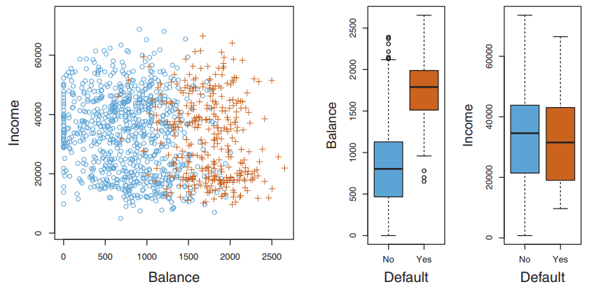
Income, balance, default

Slide 5
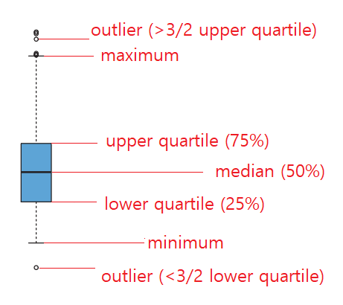
Box plot

Slide 6
4.2 Why Not Linear Regression?
example – emergency room(急诊室)
predictors - symptoms
response – stroke, drug overdose, epileptic seizure
Is there any ordering in responses?

Slide 7
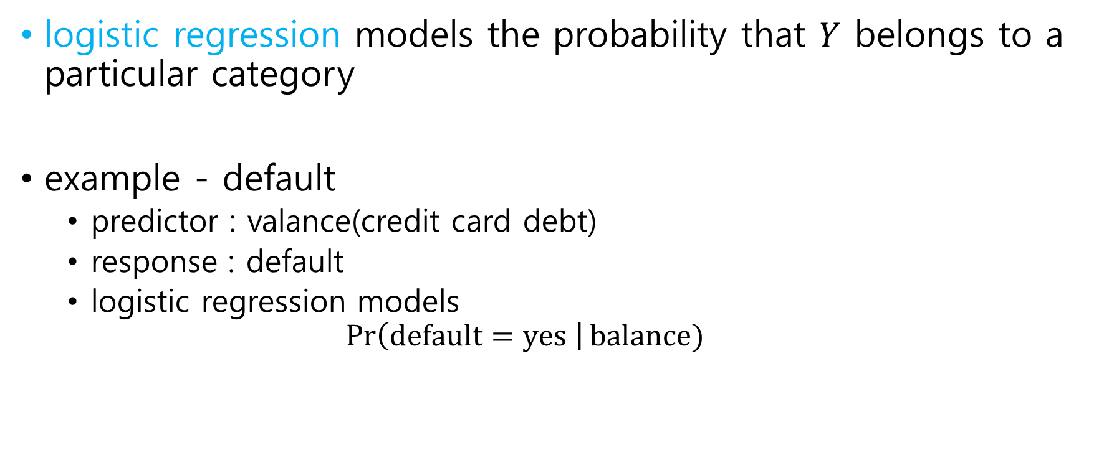
4.3 Logistic Regression
logistic regression models the probability that $Y$ belongs to a particular category
example - default
predictor : valance(credit card debt)
response : default
logistic regression models $\operatorname{Pr}\left(default=yes \right|balance)$

Slide 8
4.3 Logistic Regression
4.3.1 The Logistic Model
4.3.2 Estimating the Regression Coefficients
4.3.3 Making Predictions
4.3.4 Multiple Logistic Regression
4.3.5 Logistic Regression for >2 Response Classes

Slide 9
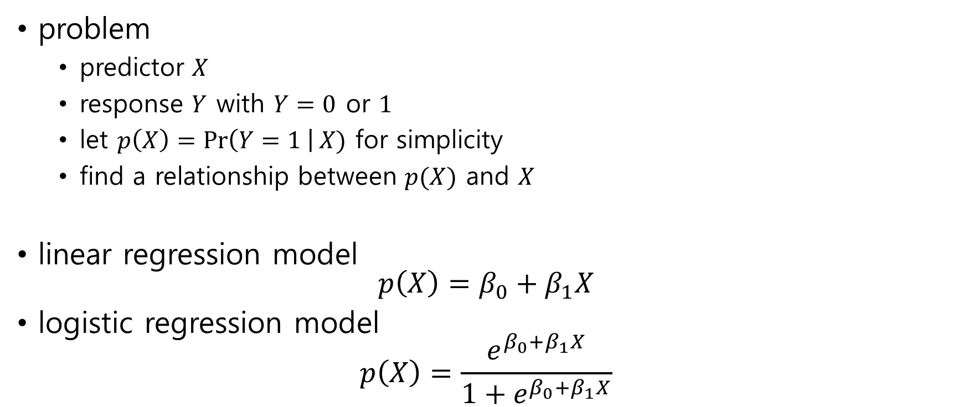
4.3.1 The Logistic Model
problem
predictor $X$
response $Y$ with $Y=0$ or $1$
let $p\left(X\right)=\operatorname{Pr}\left(Y=1 \right|X)$ for simplicity
find a relationship between $p(X)$ and $X$
linear regression model $p\left(X\right)=β_{0}+β_{1}X$
logistic regression model $p\left(X\right)=\frac{e^{β_{0}+β_{1}X}}{1+e^{β_{0}+β_{1}X}}$

Slide 10
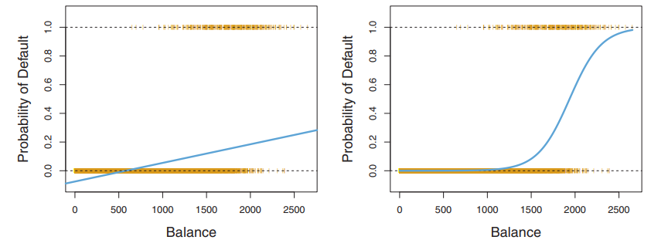

linear model vs logistic model
linear regression model is not suitable for probability, because $0≤p\left(X\right)≤1$

Slide 11

Some calculations
$p\left(X\right)=\frac{e^{β_{0}+β_{1}X}}{1+e^{β_{0}+β_{1}X}}=\frac{1}{1+\frac{1}{e^{β_{0}+β_{1}X}}}$
$e^{β_{0}+β_{1}X}=\frac{p\left(X\right)}{1−p(X)}$
$\frac{p\left(X\right)}{1−p(X)}$ is called odds
$\log{\frac{p\left(X\right)}{1−p(X)}}=β_{0}+β_{1}X$
$\log{\frac{p\left(X\right)}{1−p(X)}}$ is called log-odds or logit

Slide 12
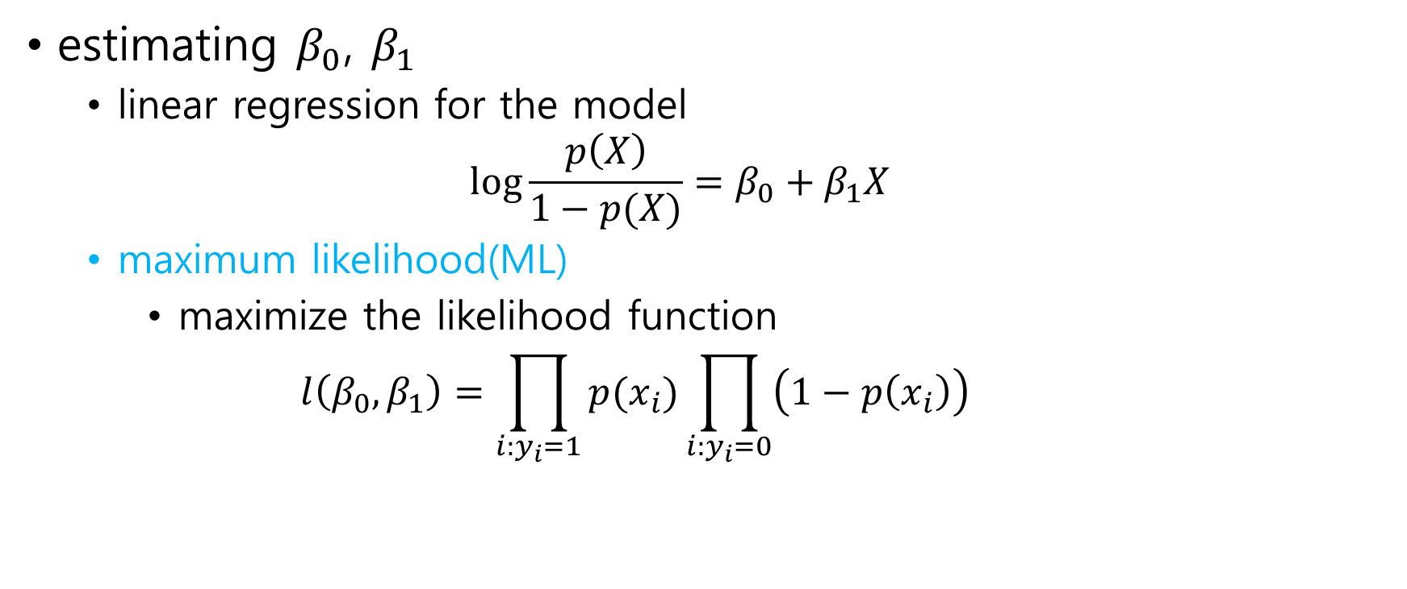
4.3.2 Estimating the Regression Coefficients
estimating $β_{0}$, $β_{1}$
linear regression for the model $\log{\frac{p\left(X\right)}{1−p(X)}}=β_{0}+β_{1}X$
maximum likelihood(ML)
maximize the likelihood function $l\left(β_{0},β_{1}\right)=\prod_{i:y_{i}=1}{p(x_{i})}\prod_{i:y_{i}=0}{\left(1−p\left(x_{i}\right)\right)}$

Slide 13
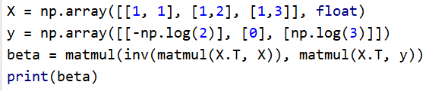



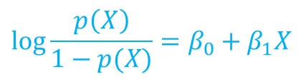

Example: Linear Regression
X | 1 | 1 | 1 | 2 | 2 | 3 | 3 | 3 | 3
Y | 0 | 0 | 1 | 0 | 1 | 0 | 1 | 1 | 1
data
probabilities $p\left(X=1\right)=1/3$, $p\left(X=2\right)=1/2$, $p\left(X=3\right)=3/4$
log-odds $\log{\frac{1/3}{1−1/3}}=−\log{2}$, $\log{\frac{1/2}{1−1/2}=0}$, $\log{\frac{3/4}{1−3/4}}=\log{3}$
regression ${\hat{β}}_{0}=−1.66$, ${\hat{β}}_{1}=0.90$
$$p\left(X\right)=\operatorname{Pr}\left(Y=1 \right|X)$$
$$\log{\frac{p\left(X\right)}{1−p(X)}}$$
$$\log{\frac{p\left(X\right)}{1−p(X)}}=β_{0}+β_{1}X$$

Slide 14
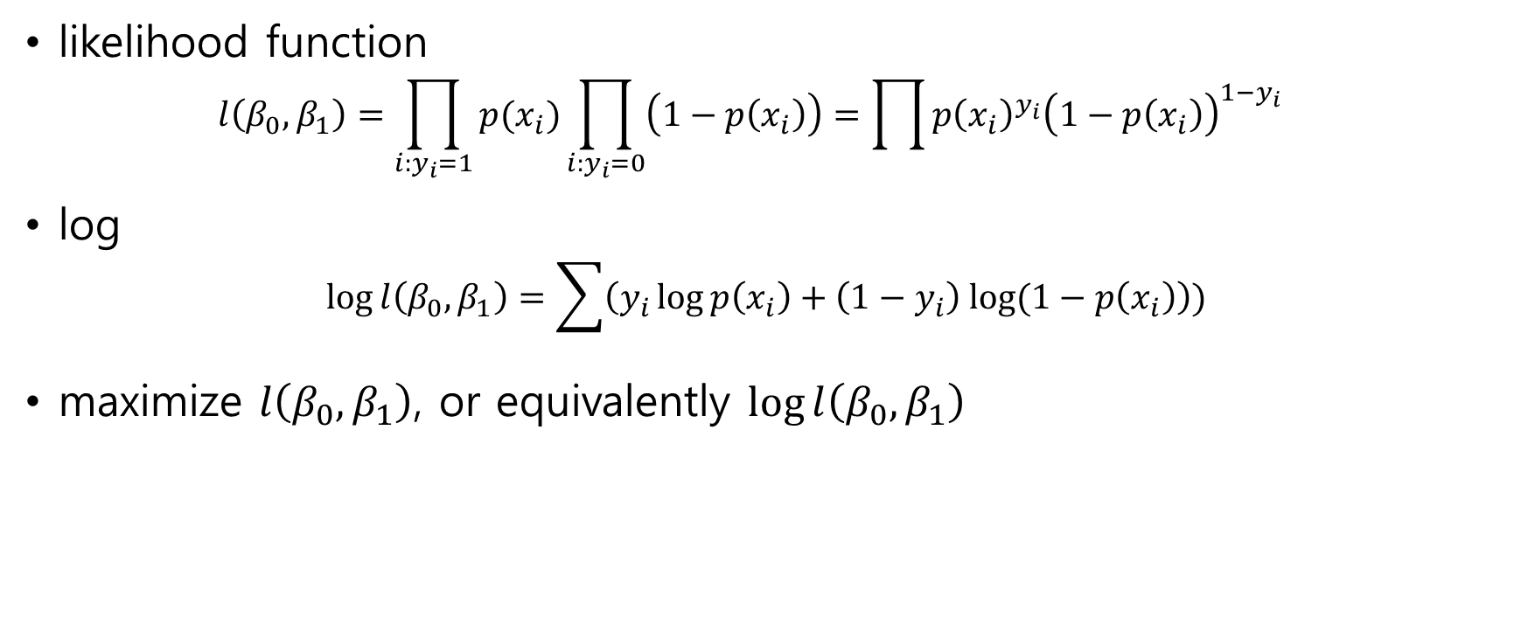
Maximum Likelihood
likelihood function $l\left(β_{0},β_{1}\right)=\prod_{i:y_{i}=1}{p(x_{i})}\prod_{i:y_{i}=0}{\left(1−p\left(x_{i}\right)\right)}=\prod{p{\left(x_{i}\right)}^{y_{i}}{\left(1−p\left(x_{i}\right)\right)}^{1−y_{i}}}$
log $\log{l\left(β_{0},β_{1}\right)}=\sum{\left(y_{i}\log{p\left(x_{i}\right)}+\left(1−y_{i}\right) log{(1−p\left(x_{i}\right)}\right))}$
maximize $l\left(β_{0},β_{1}\right)$, or equivalently $\log{l\left(β_{0},β_{1}\right)}$

Slide 15


Example: Maximum Likelihood
$$\begin{aligned}\frac{∂\log{l\left(β_{0},β_{1}\right)}}{∂β_{0}}=0 \\ \frac{∂\log{l\left(β_{0},β_{1}\right)}}{∂β_{1}}=0\end{aligned}$$
solve
calculation let $σ\left(z\right)=\frac{1}{1+e^{−z}}$ and $z=β_{0}+β_{1}x$ then $p\left(x\right)=σ\left(z\right)=σ\left(β_{0}+β_{1}x\right)$ $σ^{′}\left(z\right)=σ\left(z\right)\left(1−σ\left(z\right)\right)$ $\frac{∂p\left(x\right)}{∂β_{0}}=σ\left(z\right)\left(1−σ\left(z\right)\right)=p\left(x\right)\left(1−p\left(x\right)\right)$ $\frac{∂p\left(x\right)}{∂β_{1}}=σ\left(z\right)\left(1−σ\left(z\right)\right)x=xp\left(x\right)\left(1−p\left(x\right)\right)$

Slide 16
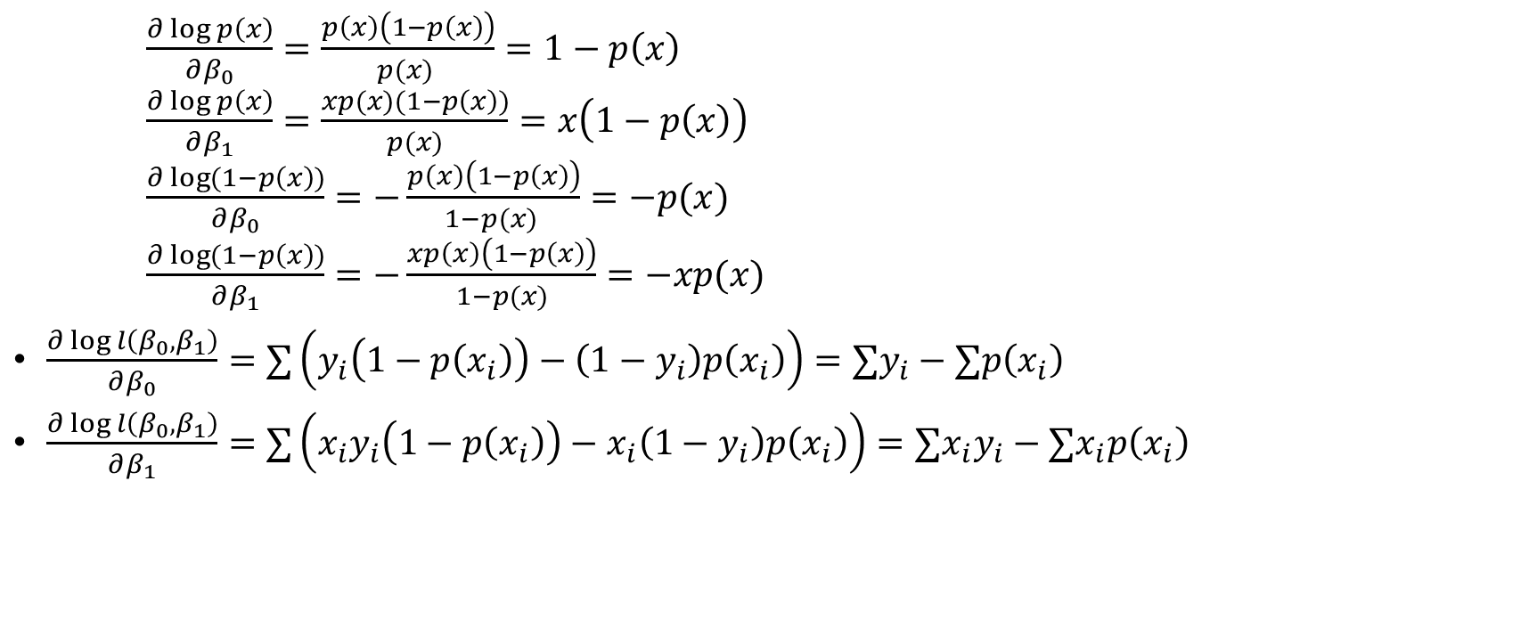
Example: Maximum Likelihood
$\frac{∂\log{p\left(x\right)}}{∂β_{0}}=\frac{p\left(x\right)\left(1−p\left(x\right)\right)}{p(x) }=1−p\left(x\right)$ $\frac{∂\log{p\left(x\right)}}{∂β_{1}}=\frac{xp(x)(1−p\left(x\right))}{p(x)}=x\left(1−p\left(x\right)\right)$ $\frac{∂\log{(1−p\left(x\right))}}{∂β_{0}}=−\frac{p\left(x\right)\left(1−p\left(x\right)\right)}{1−p(x) }=−p(x)$ $\frac{∂\log{(1−p\left(x\right))}}{∂β_{1}}=−\frac{xp\left(x\right)\left(1−p\left(x\right)\right)}{1−p(x)}=−xp(x)$
$\frac{∂\log{l\left(β_{0},β_{1}\right)}}{∂β_{0}}=∑\left(y_{i}\left(1−p\left(x_{i}\right)\right)−\left(1−y_{i}\right)p\left(x_{i}\right)\right)=∑y_{i}−∑p\left(x_{i}\right)$
$\frac{∂\log{l\left(β_{0},β_{1}\right)}}{∂β_{1}}=∑\left(x_{i}y_{i}\left(1−p\left(x_{i}\right)\right)−x_{i}\left(1−y_{i}\right)p\left(x_{i}\right)\right)=∑{x_{i}y}_{i}−∑x_{i}p\left(x_{i}\right)$

Slide 17

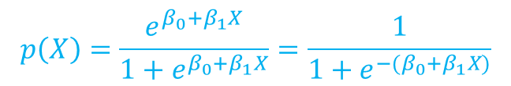

Example: Maximum Likelihood
solve $∑y_{i}=∑p\left(x_{i}\right)$ $∑{x_{i}y}_{i}=∑x_{i}p\left(x_{i}\right)$
solve $5=3p\left(1\right)+2p\left(2\right)+4p\left(3\right)$ $12=3p\left(1\right)+4p\left(2\right)+12p\left(3\right)$
solution
X | 1 | 1 | 1 | 2 | 2 | 3 | 3 | 3 | 3
Y | 0 | 0 | 1 | 0 | 1 | 0 | 1 | 1 | 1
$$p\left(X\right)=\frac{e^{β_{0}+β_{1}X}}{1+e^{β_{0}+β_{1}X}}=\frac{1}{1+e^{{−(β}_{0}+β_{1}X)}}$$

Slide 18
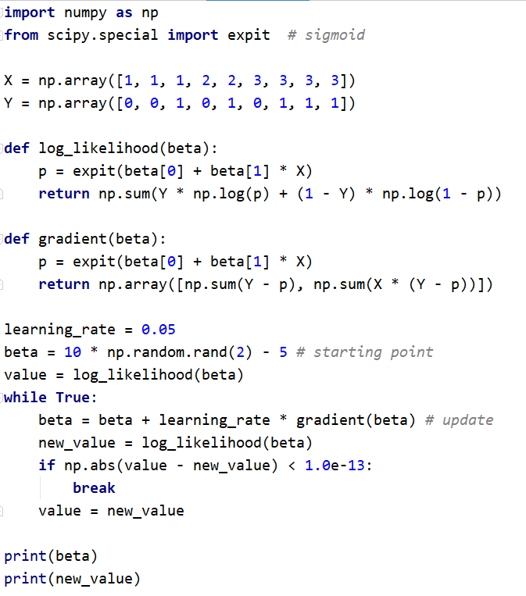

Slide 19
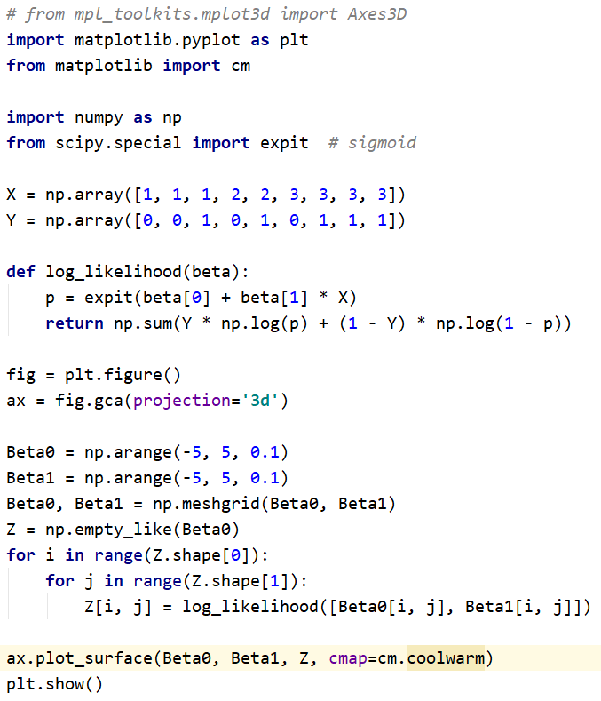

Slide 20
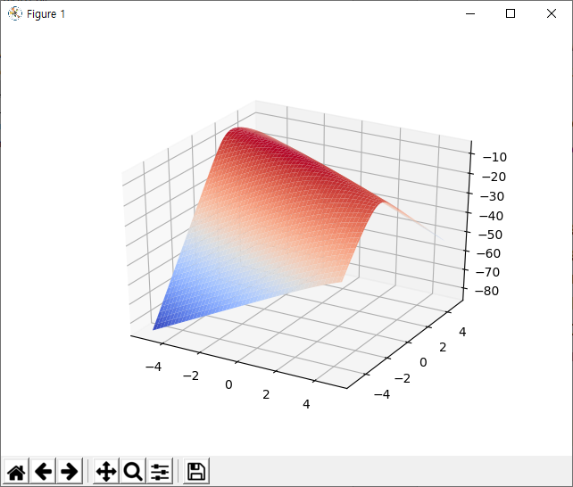
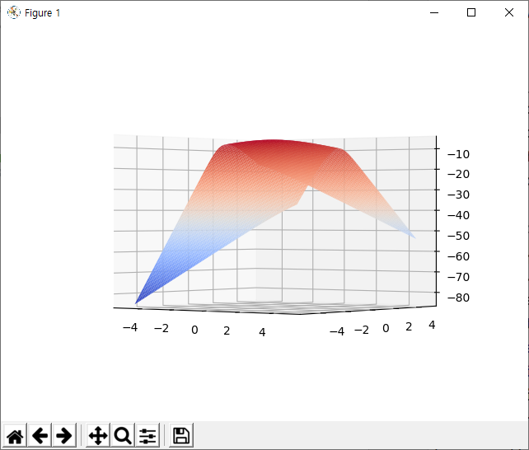

Slide 21

4.3.3 Making Predictions
prediction $\operatorname{Pr}\left(Y=1 \right| X=x)=\frac{1}{1+e^{−(−1.65+0.9x)}}$
$X=1.5$ $\operatorname{Pr}\left(Y=1 \right| X=1.5)=\frac{1}{1+e^{0.3}}=0.43$

Slide 22
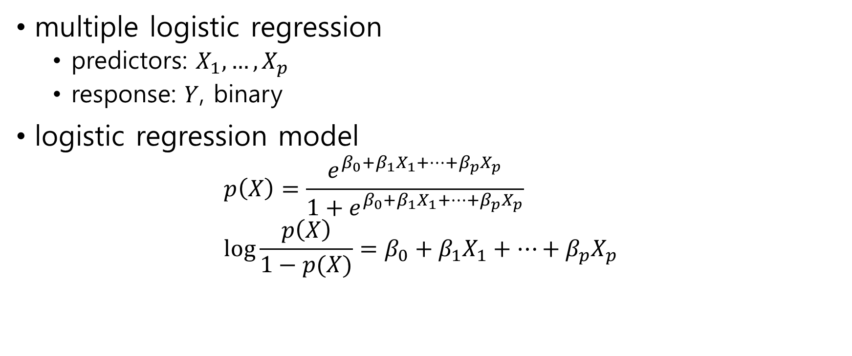
4.3.4 Multiple Logistic Regression
multiple logistic regression
predictors: $X_{1}, …, X_{p}$
response: $Y$, binary
logistic regression model $p\left(X\right)=\frac{e^{β_{0}+β_{1}X_{1}+⋯+β_{p}X_{p}}}{1+e^{β_{0}+β_{1}X_{1}+⋯+β_{p}X_{p}}}$ $\log{\frac{p\left(X\right)}{1−p(X)}}=β_{0}+β_{1}X_{1}+⋯+β_{p}X_{p}$

Slide 23

4.3.5 Logistic Regression for >2 Response Classes
example – emergency room
response - stroke, drug overdose, epileptic seizure. $p\left(X\right)=\operatorname{Pr}\left(Y=stroke \right| X)$ $q\left(X\right)=\operatorname{Pr}\left(Y=drug overdose \right|X)$ $1−p\left(X\right)−q(X)$

Slide 24

4.4 Linear Discriminant Analysis
4.4.1 Using Bayes’ Theorem for Classification
4.4.2 Linear Discriminant Analysis for $p=1$
4.4.3 Linear Discriminant Analysis for $p>1$
4.4.4 Quadratic Discriminant Analysis

Slide 25
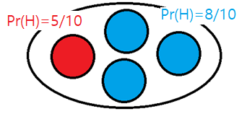

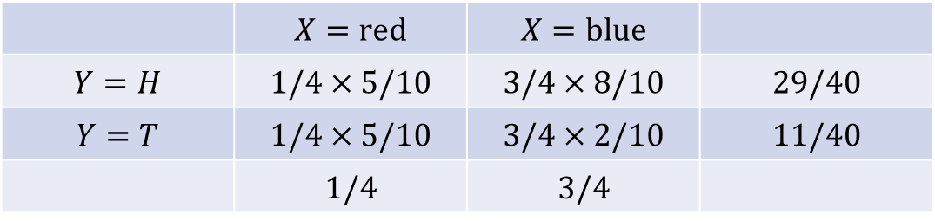
Example - coins
choose and toss
$X∈\left\{red, blue\right\}$
$Y∈\{H, T\}$
$\operatorname{Pr}\left(X=red \right|Y=T)= ?$
 | $$X=red$$ | $$X=blue$$
$$Y=H$$ | $$1/4×5/10$$ | $$3/4×8/10$$ | $$29/40$$
$$Y=T$$ | $$1/4×5/10$$ | $$3/4×2/10$$ | $$11/40$$
 | $$1/4$$ | $$3/4$$

Slide 26
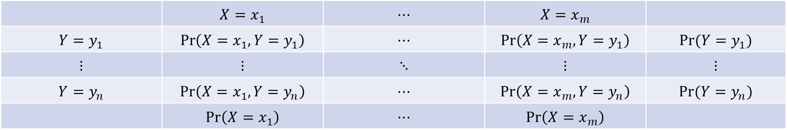

Bayes’ Theorem
joint probability $Pr⁡(X=x_{i}, Y=y_{j})$
conditional probability(Bayes’ Theorem) $\operatorname{Pr}\left(X=x_{i} \right| Y=y_{j})=\frac{\operatorname{Pr}\left(X=x_{i},Y=y_{j}\right)}{\operatorname{Pr}\left(Y=y_{j}\right)}$
marginal probability $\operatorname{Pr}\left(X=x_{i}\right)=\sum_{j}{Pr⁡(X=x_{i},Y=y_{j})}$
 | $$X=x_{1}$$ | $$⋯$$ | $$X=x_{m}$$
$$Y=y_{1}$$ | $$\operatorname{Pr}\left(X=x_{1},Y=y_{1}\right)$$ | $$⋯$$ | $$\operatorname{Pr}\left(X=x_{m},Y=y_{1}\right)$$ | $$Pr⁡(Y=y_{1})$$
$$⋮$$ | $$⋮$$ | $$⋱$$ | $$⋮$$ | $$⋮$$
$$Y=y_{n}$$ | $$\operatorname{Pr}\left(X=x_{1},Y=y_{n}\right)$$ | $$⋯$$ | $$\operatorname{Pr}\left(X=x_{m},Y=y_{n}\right)$$ | $$Pr⁡(Y=y_{n})$$
 | $$\operatorname{Pr}\left(X=x_{1}\right)$$ | $$⋯$$ | $$\operatorname{Pr}\left(X=x_{m}\right)$$

Slide 27
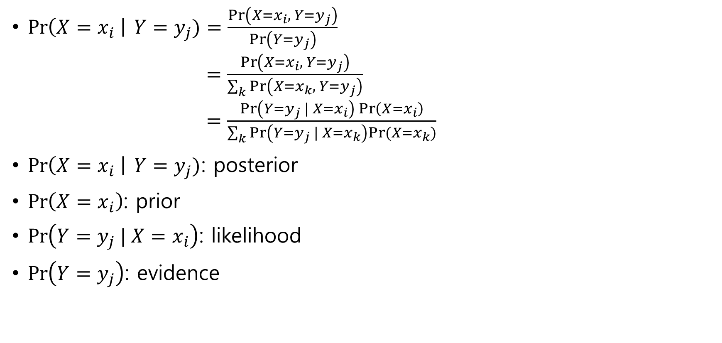
Bayes’ Theorem
$\operatorname{Pr}\left(X=x_{i} \right| Y=y_{j})=\frac{\operatorname{Pr}\left(X=x_{i}, Y=y_{j}\right)}{\operatorname{Pr}\left(Y=y_{j}\right)}$ $=\frac{\operatorname{Pr}\left(X=x_{i}, Y=y_{j}\right)}{\sum_{k}{\operatorname{Pr}\left(X=x_{k}, Y=y_{j}\right)}}$ $=\frac{\operatorname{Pr}\left(Y=y_{j} | X=x_{i}\right)\operatorname{Pr}\left(X=x_{i}\right)}{\sum_{k}{\operatorname{Pr}\left(Y=y_{j} | X=x_{k}\right)Pr⁡(X=x_{k})}}$
$\operatorname{Pr}\left(X=x_{i} \right| Y=y_{j})$: posterior
$\operatorname{Pr}\left(X=x_{i}\right)$: prior
$\operatorname{Pr}\left(Y=y_{j} | X=x_{i}\right)$: likelihood
$\operatorname{Pr}\left(Y=y_{j}\right)$: evidence

Slide 28
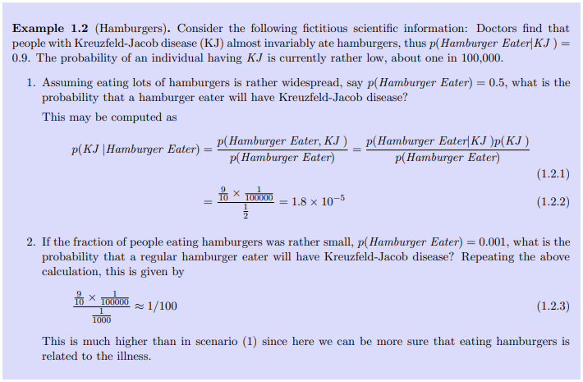

Slide 29
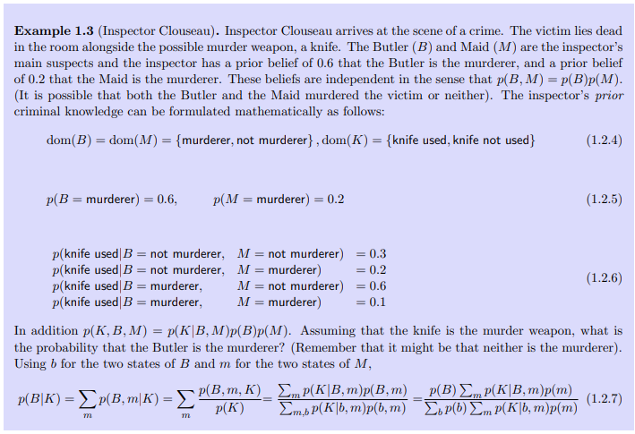
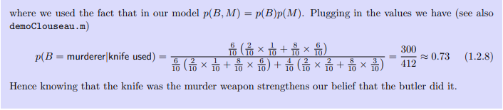

Slide 30
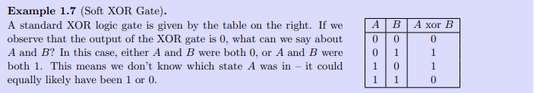
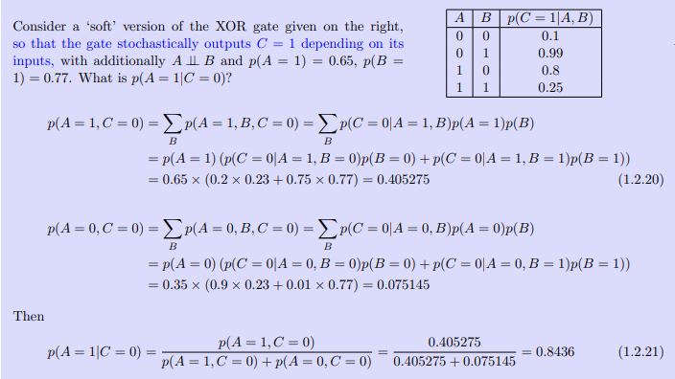

Slide 31
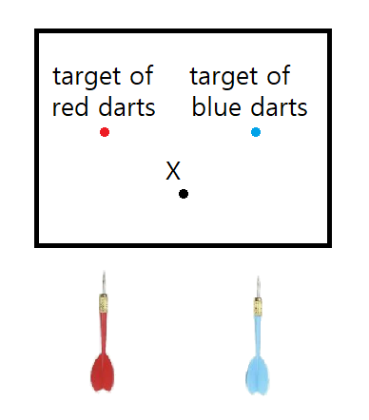
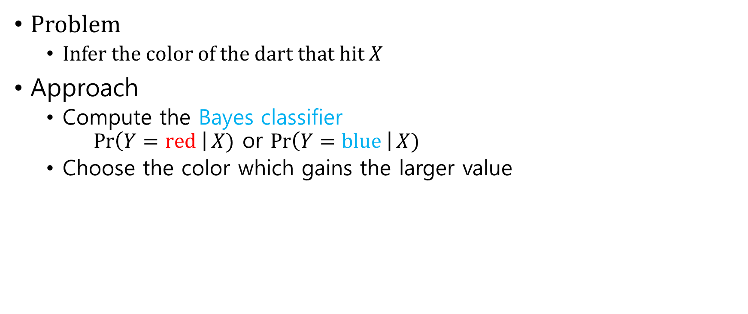
Example: dart
Problem
Infer the color of the dart that hit $X$
Approach
Compute the Bayes classifier $\operatorname{Pr}\left(Y=red \right|X)$ or $\operatorname{Pr}\left(Y=blue \right|X)$
Choose the color which gains the larger value

Slide 32

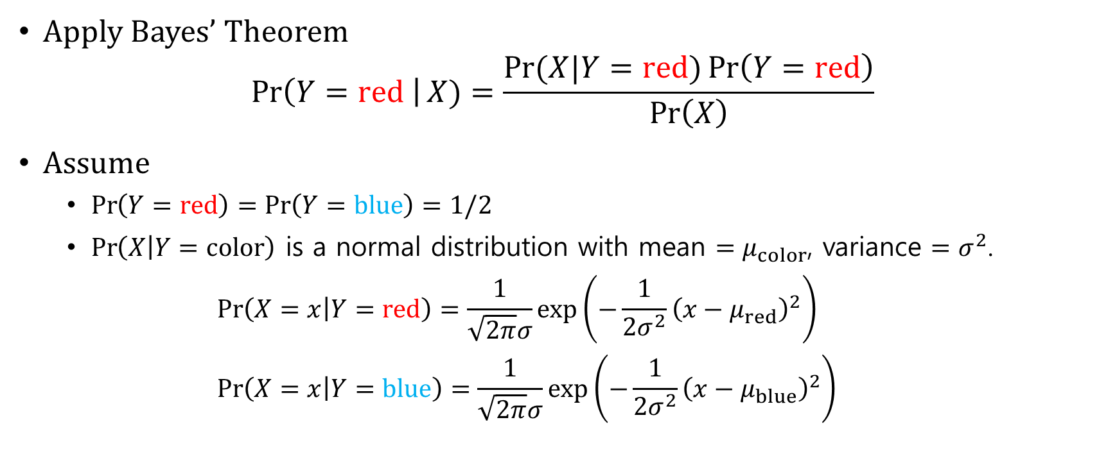
1-dimensional dart
Apply Bayes’ Theorem $\operatorname{Pr}\left(Y=red \right|X)=\frac{Pr(X|Y=red){\operatorname{Pr}\left(Y=red\right)}}{\operatorname{Pr}\left(X\right)}$
Assume
$\operatorname{Pr}\left(Y=red\right)=\operatorname{Pr}\left(Y=blue\right)=1/2$
$\operatorname{Pr}\left(X | Y=color\right)$ is a normal distribution with mean $=μ_{color}$, variance $=σ^{2}$. $\operatorname{Pr}\left(X=x | Y=red\right)=\frac{1}{\sqrt{2π}σ}exp\left(−\frac{1}{2σ^{2}}{\left(x−μ_{red}\right)}^{2}\right)$ $\operatorname{Pr}\left(X=x | Y=blue\right)=\frac{1}{\sqrt{2π}σ}exp\left(−\frac{1}{2σ^{2}}{\left(x−μ_{blue}\right)}^{2}\right)$

Slide 33
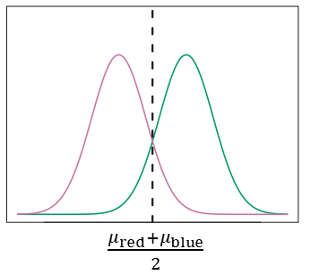

Computation $\log{\operatorname{Pr}\left(Y=red | X=x\right)}=\log{\operatorname{Pr}\left(X=x | Y=red\right)}+\log{\operatorname{Pr}\left(Y=red\right)}−\log{\operatorname{Pr}\left(X=x\right)}$ $=x\frac{μ_{red}}{σ^{2}}−\frac{μ_{red}^{2}}{2σ^{2}}$ + const. $\log{\operatorname{Pr}\left(Y=blue | X=x\right)}=x\frac{μ_{blue}}{σ^{2}}−\frac{μ_{blue}^{2}}{2σ^{2}}$ + const.
Decision boundary $\log{\operatorname{Pr}\left(Y=red | X=x\right)}=\log{\operatorname{Pr}\left(Y=blue | X=x\right)}$ $x=\frac{μ_{red} + μ_{blue}}{2}$

Slide 34
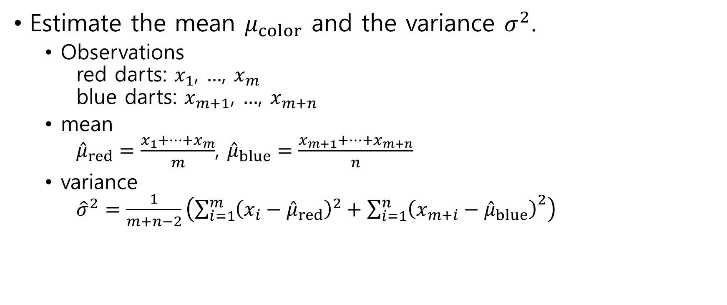
Linear discriminant analysis(LDA)
Estimate the mean $μ_{color}$ and the variance $σ^{2}$.
Observations red darts: $x_{1}$, $…$, $x_{m}$ blue darts: $x_{m+1}$, $…$, $x_{m+n}$
mean ${\hat{μ}}_{red}=\frac{x_{1}+⋯+x_{m}}{m}$, ${\hat{μ}}_{blue}=\frac{x_{m+1}+⋯+x_{m+n}}{n}$
variance ${\hat{σ}}^{2}=\frac{1}{m+n−2}\left(\sum_{i=1}^{m}{{\left(x_{i}−{\hat{μ}}_{red}\right)}^{2}}+{\sum_{i=1}^{n}{\left(x_{m+i}−{\hat{μ}}_{blue}\right)}}^{2}\right)$

Slide 35
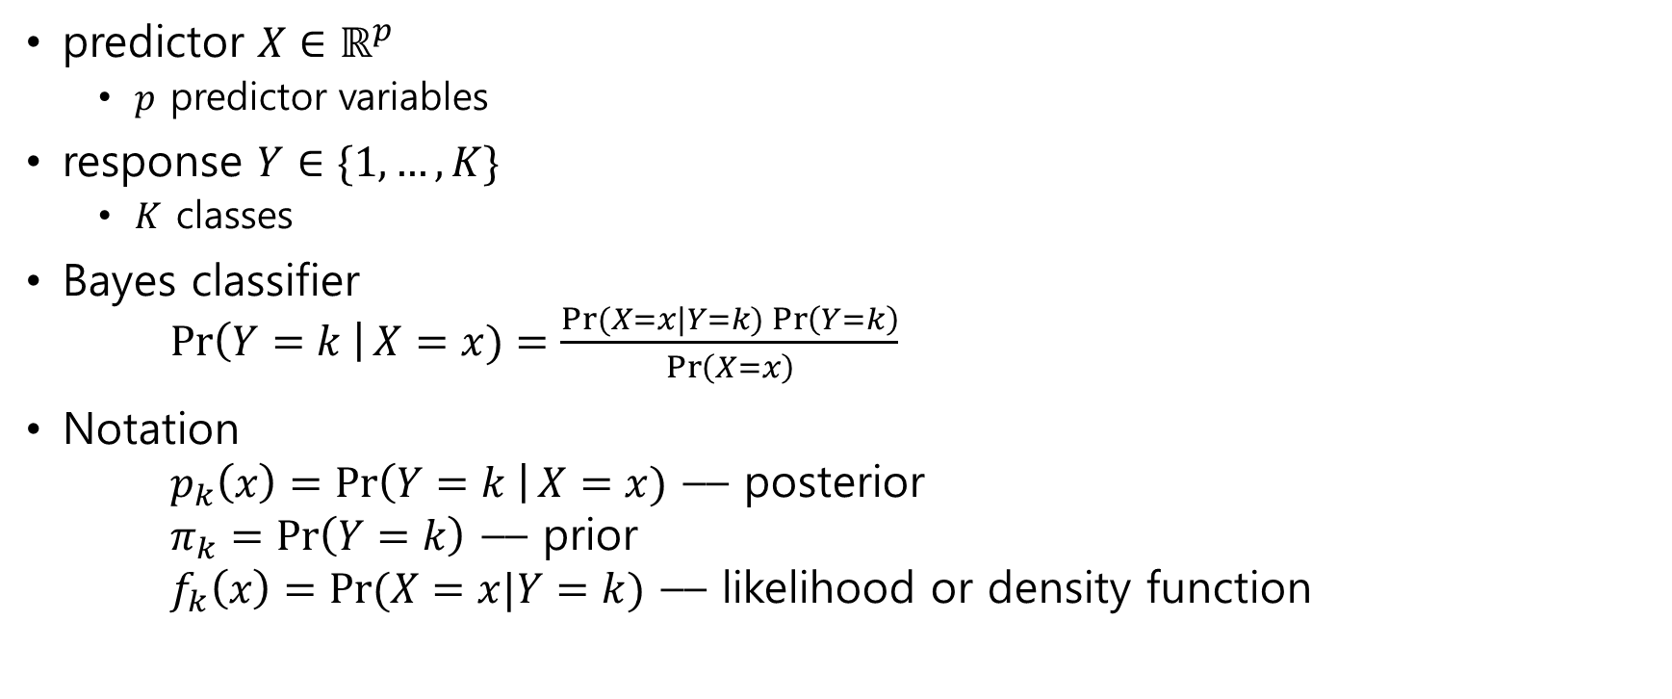
4.4.1 Using Bayes’ Theorem for Classification
predictor $X∈ℝ^{p}$
$p$ predictor variables
response $Y∈\{1,…, K\}$
$K$ classes
Bayes classifier $\operatorname{Pr}\left(Y=k \right|X=x)=\frac{Pr(X=x|Y=k){\operatorname{Pr}\left(Y=k\right)}}{\operatorname{Pr}\left(X=x\right)}$
Notation $p_{k}\left(x\right)=\operatorname{Pr}\left(Y=k \right|X=x)$ –– posterior $π_{k}=\operatorname{Pr}\left(Y=k\right)$ –– prior $f_{k}\left(x\right)=Pr⁡(X=x|Y=k)$ –– likelihood or density function

Slide 36

Bayes classifier $p_{k}\left(x\right)=\frac{π_{k}f_{k}(x)}{\sum_{l=1}^{K}{π_{l}f_{l}\left(x\right)}}$
Note posterior ~ prior $⋅$ likelihood

Slide 37

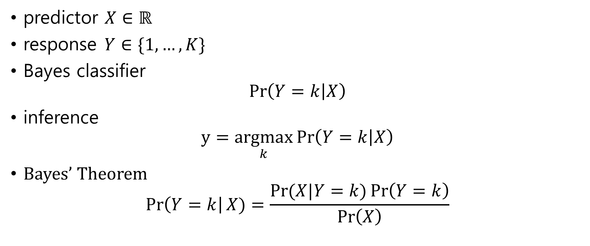

4.4.2 Linear Discriminant Analysis for $p=1$
predictor $X∈ℝ$
response $Y∈\{1, …,K\}$
Bayes classifier $\operatorname{Pr}\left(Y=k | X\right)$
inference $y=\underset{k}{argmax}{\operatorname{Pr}\left(Y=k | X\right)}$
Bayes’ Theorem $\operatorname{Pr}\left(Y=k\right|X)=\frac{Pr(X|Y=k){\operatorname{Pr}\left(Y=k\right)}}{\operatorname{Pr}\left(X\right)}$

Slide 38
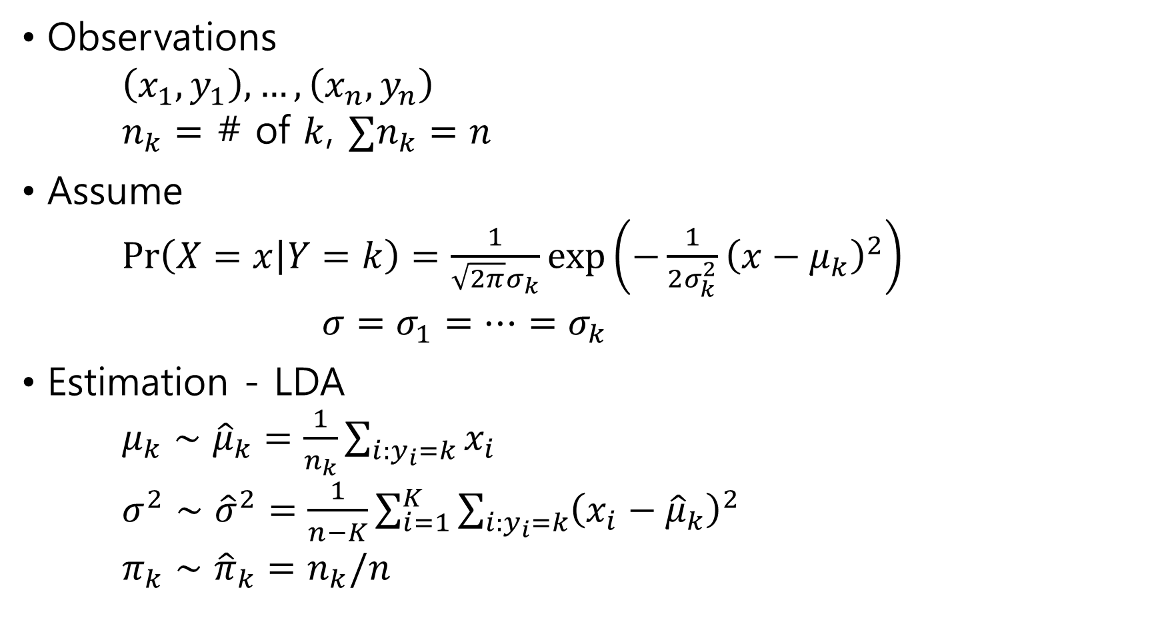
Observations $\left(x_{1},y_{1}\right), …,\left(x_{n},y_{n}\right)$ $n_{k}=$ # of $k$, $∑n_{k}=n$
Assume $\operatorname{Pr}\left(X=x | Y=k\right)=\frac{1}{\sqrt{2π}σ_{k}}exp\left(−\frac{1}{2σ_{k}^{2}}{\left(x−μ_{k}\right)}^{2}\right)$ $σ=σ_{1}=⋯=σ_{k}$
Estimation - LDA $μ_{k}∼{\hat{μ}}_{k}=\frac{1}{n_{k}}\sum_{i:y_{i}=k}{x_{i}}$ ${σ^{2}∼\hat{σ}}^{2}=\frac{1}{n−K}\sum_{i=1}^{K}{\sum_{i:y_{i}=k}{{\left(x_{i}−{\hat{μ}}_{k}\right)}^{2}}}$ $π_{k}∼{\hat{π}}_{k}=n_{k}/n$

Slide 39
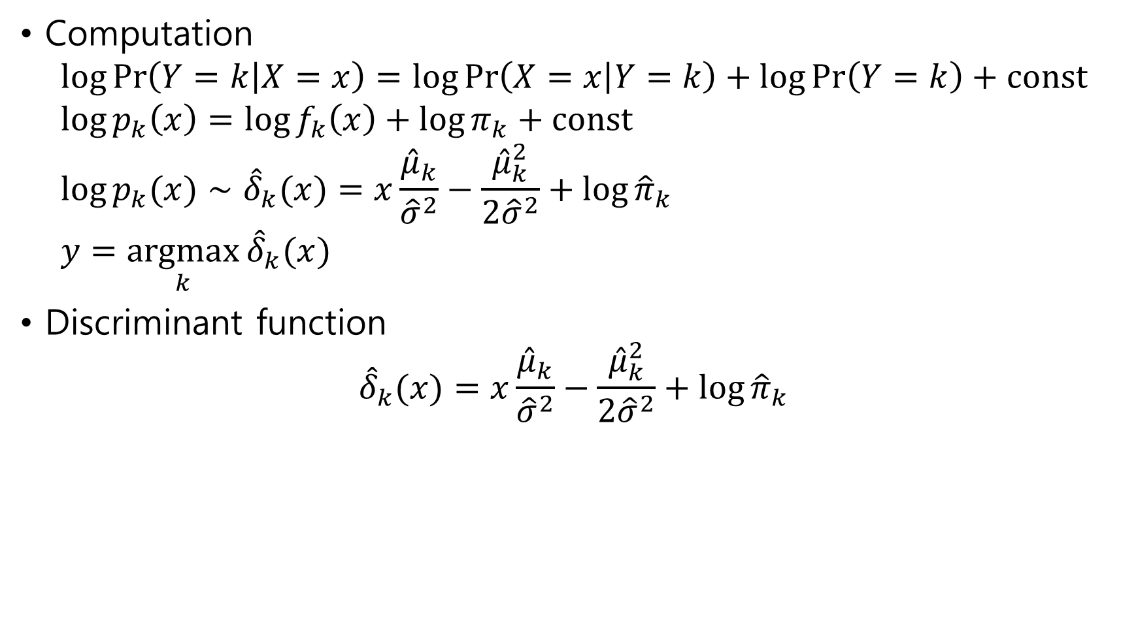
Computation $\log{\operatorname{Pr}\left(Y=k | X=x\right)}=\log{\operatorname{Pr}\left(X=x | Y=k\right)}+\log{\operatorname{Pr}\left(Y=k\right)}+const$ $\log{p_{k}\left(x\right)}=\log{f_{k}\left(x\right)}+\log{π_{k}}+const$ $\log{p_{k}(x)}∼{\hat{δ}}_{k}(x)=x\frac{{\hat{μ}}_{k}}{{\hat{σ}}^{2}}−\frac{{\hat{μ}}_{k}^{2}}{{2\hat{σ}}^{2}}+\log{{\hat{π}}_{k}}$ $y=\underset{k}{argmax}{{\hat{δ}}_{k}(x)}$
Discriminant function ${\hat{δ}}_{k}(x)=x\frac{{\hat{μ}}_{k}}{{\hat{σ}}^{2}}−\frac{{\hat{μ}}_{k}^{2}}{{2\hat{σ}}^{2}}+\log{{\hat{π}}_{k}}$

Slide 40


4.4.3 Linear Discriminant Analysis for $p>1$
$X∈ℝ^{p}$
$Y∈\{1, …,k\}$

Slide 41


Multivariate Gaussian distribution
$X∼N\left(μ,Σ\right)$
$μ=E\left(X\right)$ – mean
$Σ=cov(X)$ – $p×p$ covariance matrix of $X$
density function $f\left(x\right)=\frac{1}{{\left(2π\right)}^{p/2}{\left|Σ\right|}^{1/2}}\exp\left(−\frac{1}{2}{\left(x−μ\right)}^{T}Σ^{−1}\left(x−μ\right)\right)$

Slide 42

Covariance Matrix
$cov\left(X\right)=E\left[\left(X−E\left(X\right)\right){\left(X−E\left(X\right)\right)}^{T}\right]$
$X=\left[\begin{matrix}X_{1} \\ ⋮ \\ X_{p}\end{matrix}\right]$, $E\left[X\right]=\left[\begin{matrix}{E[X}_{1}] \\ ⋮ \\ E[X_{p}]\end{matrix}\right]$
$cov\left(X\right)=E\left[\left(X−E\left[X\right]\right){\left(X−E\left[X\right]\right)}^{T}\right]$ $=\left[\begin{matrix}E\left[\left(X_{1}−E\left[X_{1}\right]\right)\left(X_{1}−E\left[X_{1}\right]\right)\right] & ⋯ & E\left[\left(X_{1}−E\left[X_{1}\right]\right)\left(X_{p}−E\left[X_{p}\right]\right)\right] \\ ⋮ & ⋱ & ⋮ \\ E\left[\left(X_{p}−E\left[X_{p}\right]\right)\left(X_{1}−E\left[X_{1}\right]\right)\right] & ⋯ & E\left[\left(X_{p}−E\left[X_{p}\right]\right)\left(X_{p}−E\left[X_{p}\right]\right)\right]\end{matrix}\right]$

Slide 43

LDA
Assume $f_{k}\left(x\right)=\frac{1}{{\left(2π\right)}^{p/2}{\left|Σ_{k}\right|}^{1/2}}\exp\left(−\frac{1}{2}{\left(x−μ_{k}\right)}^{T}Σ_{k}^{−1}\left(x−μ_{k}\right)\right)$ $Σ=Σ_{1}=⋯=Σ_{K}$
log-posterior $\log{f_{k}(x)}=x^{T}Σ^{−1}μ_{k}−\frac{1}{2}μ_{k}^{T}Σ^{−1}μ_{k}+\log{π_{k}}+const$
Discriminant ${\hat{δ}}_{k}\left(x\right)=x^{T}{\hat{Σ}}^{−1}{\hat{μ}}_{k}−\frac{1}{2}{\hat{μ}}_{k}^{T}{\hat{Σ}}^{−1}{\hat{μ}}_{k}+\log{{\hat{π}}_{k}}$

Slide 44



2-dimensional dart
Observations
red: $\left(−0.5, 0.0\right), \left(−1.0,−1.0\right), \left(1.0, 0.0\right), \left(−1.0, 1.0\right), (0.0, 0.0)$
blue:$\left(0.5, 0.0\right), \left(1.0,−1.0\right), \left(−2.0, 0.0\right), \left(1.0, 1.0\right), (0.5, 0.5)$
Computations
${\hat{μ}}_{1}=(−0.3, 0.0)$, ${\hat{μ}}_{2}=(0.2, 0.1)$
${\hat{Σ}}_{11}=\frac{1}{10−2}\left({0.2}^{2}+{0.7}^{2}+{1.3}^{2}+{0.7}^{2}+{0.3}^{2}+{0.3}^{2}+{0.8}^{2}+{2.2}^{2}+{0.8}^{2}+{0.3}^{2}\right)$
${\hat{Σ}}_{12}=\frac{1}{10−2}(0.0+\left(−0.7\right)⋅\left(−1.0\right)+0.0+\left(−0.7\right)⋅1.0+0.0+0.3⋅\left(−0.1\right)+⋯)$
${\hat{Σ}}_{21}=Σ_{12}$
${\hat{Σ}}_{22}=\frac{1}{10−2}(0.0+{1.0}^{2}+⋯)$
$\hat{Σ}=\left[\begin{matrix}1.1375 & 0.01875 \\ 0.01875 & 0.525\end{matrix}\right]$, ${\hat{Σ}}^{−1}=$

Slide 45


Discriminant
${\hat{δ}}_{1}(x,y)=−0.26x+0.01y−0.04$
${\hat{δ}}_{2}(x,y)=0.17x+0.18y−0.03$
$(0,0)$ is blue
Bayes decision boundary
$0.43x+0.17y+0.01=0$

Slide 46



Generated data
red $\sim N\left(\left(−1,−1\right), 1\right)$
blue $\sim N\left(\left(1,1\right), 1\right)$

Slide 47

4.4.4 Quadratic Discriminant Analysis
Bayes classifier $\operatorname{Pr}\left(Y=k\right|X)=\frac{Pr(X|Y=k){\operatorname{Pr}\left(Y=k\right)}}{\operatorname{Pr}\left(X\right)}$
log $\log{p_{k}\left(x\right)}=\log{f_{k}\left(x\right)}+\log{π_{k}}+const$
QDA
assume $f_{k}\left(x\right)=\frac{1}{{\left(2π\right)}^{p/2}{\left|Σ_{k}\right|}^{1/2}}\exp\left(−\frac{1}{2}{\left(x−μ_{k}\right)}^{T}Σ_{k}^{−1}\left(x−μ_{k}\right)\right)$

Slide 48


discriminant $\log{p_{k}(x)}=−\frac{1}{2}{\left(x−μ_{k}\right)}^{T}Σ_{k}^{−1}\left(x−μ_{k}\right)+\log{π_{k}}−\frac{1}{2}log⁡|Σ_{k}|+const$ $δ_{k}\left(x\right)=−\frac{1}{2}{\left(x−μ_{k}\right)}^{T}Σ_{k}^{−1}\left(x−μ_{k}\right)+\log{π_{k}}−\frac{1}{2}log⁡|Σ_{k}|$ $=−\frac{1}{2}x^{T}Σ_{k}^{−1}x+x^{T}Σ_{k}^{−1}μ_{k}−\frac{1}{2}μ_{k}^{T}Σ_{k}^{−1}μ_{k}+log π_{k}−\frac{1}{2}log⁡|Σ_{k}|$
The discriminant $δ_{k}\left(x\right)$is a quadratic form

Slide 49


Generated data
red $\sim N\left(\left(−1,−1\right), 1\right)$
blue $\sim N\left(\left(1,1\right), 1\right)$

Slide 50
4.5 A Comparison of Classification Methods
Logistic regression
LDA
QDA
KNN

