Slide 1
Statistical Learning
https://github.com/ggorr/Machine-Learning/tree/master/ISLR

Slide 2
5 Resampling Methods
5.1 Cross-Validation
5.2 The Bootstrap

Slide 3
What is resampling method?
Drawing samples from a training set
Fitting a model on each sample

Slide 4
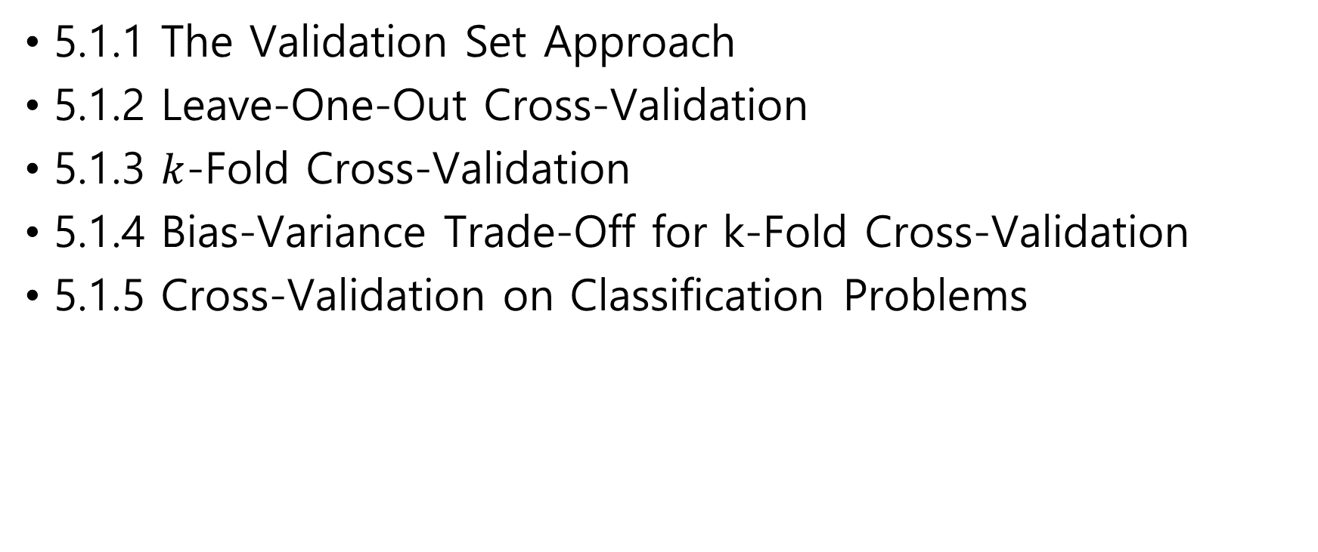
5.1 Cross-Validation
5.1.1 The Validation Set Approach
5.1.2 Leave-One-Out Cross-Validation
5.1.3 $k$-Fold Cross-Validation
5.1.4 Bias-Variance Trade-Off for k-Fold Cross-Validation
5.1.5 Cross-Validation on Classification Problems

Slide 5
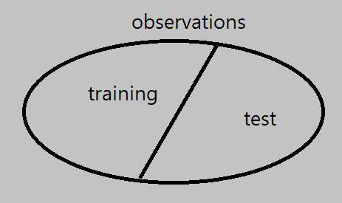
What is cross-validation
Holding out some observations from the fitting process
Computing test error rates from the holding out observations

Slide 6
5.1.1 The Validation Set Approach
Validation set approach
Random splitting
A training set – 50%
A validation set(= hold-out set) – 50%
Training and computing test error rate

Slide 7
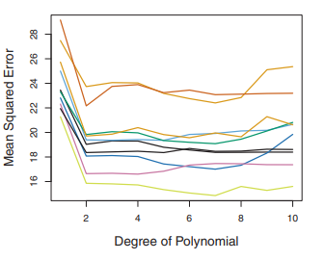
The Validation Set Approach
Test errors are highly variable
high variance
Test errors are overestimated
because training uses the half of data set

Slide 8
5.1.2 Leave-One-Out Cross-Validation
Leave-one-out cross-validation (LOOCV)
Training on observations except one
Computing test error for leave one observation
Averaging test errors

Slide 9
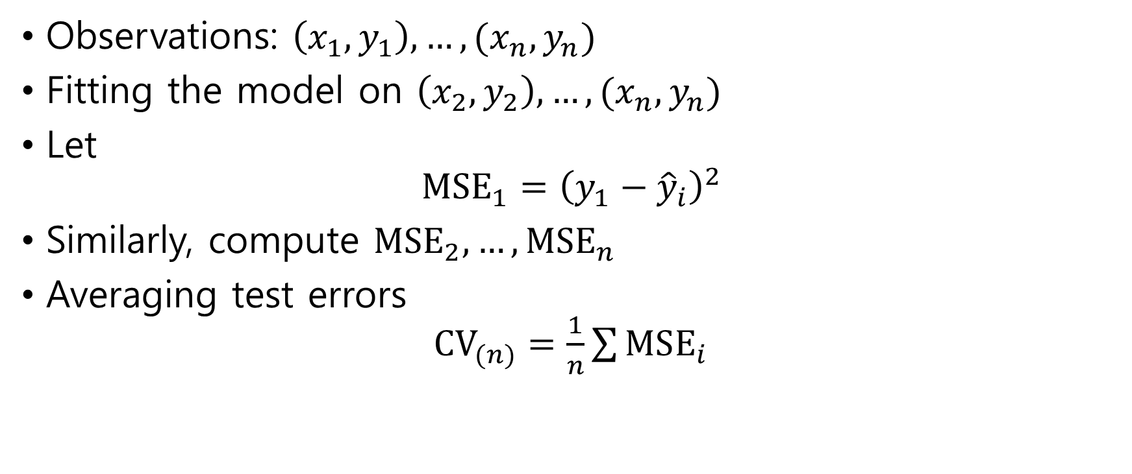
Applying LOOCV
Observations: $\left(x_{1},y_{1}\right), …,(x_{n}, y_{n})$
Fitting the model on $\left(x_{2},y_{2}\right), …,(x_{n}, y_{n})$
Let $MSE_{1}={\left(y_{1}−{\hat{y}}_{i}\right)}^{2}$
Similarly, compute $MSE_{2}, …,MSE_{n}$
Averaging test errors $CV_{(n)}=\frac{1}{n}\sum{MSE_{i}}$

Slide 10

Linear or polynomial regression
Interesting formula $CV_{(n)}=\frac{1}{n}{\sum{\left(\frac{y_{i}−{\hat{y}}_{i}}{1−h_{i}}\right)}}^{2}$ where $h_{i}$ is the leverage, i.e. $h_{i}=i$-th diagonal entry of the hat matrix $X{\left(X^{T}X\right)}^{−1}X^{T}$

Slide 11
LOOCV
Computational cost is high

Slide 12
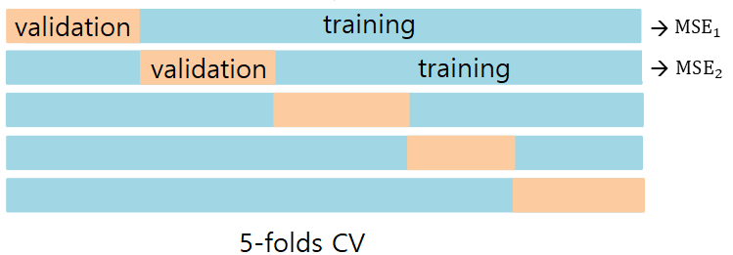
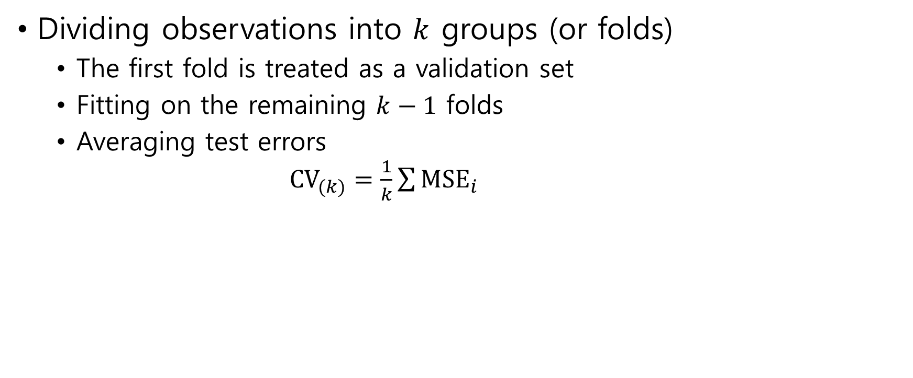
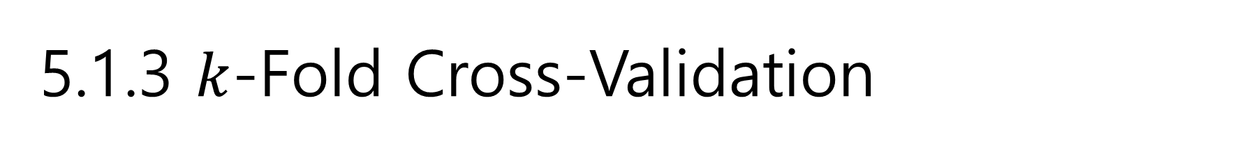
5.1.3 $k$-Fold Cross-Validation
Dividing observations into $k$ groups (or folds)
The first fold is treated as a validation set
Fitting on the remaining $k−1$ folds
Averaging test errors $CV_{(k)}=\frac{1}{k}\sum{MSE_{i}}$

Slide 13
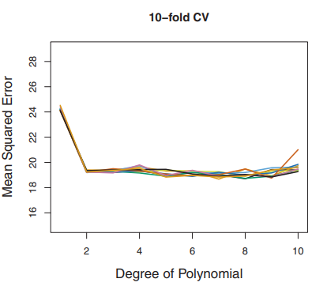
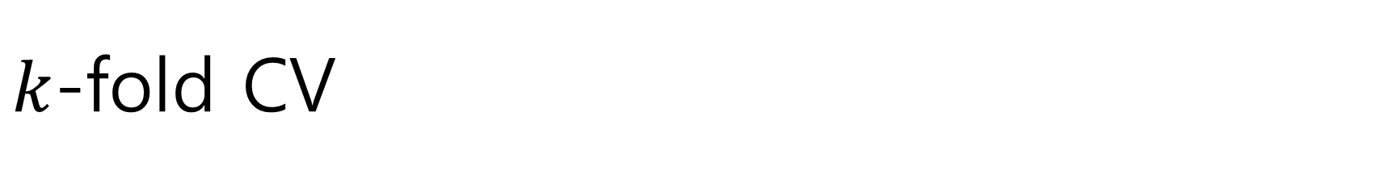
$k$-fold CV
Computational cost is not high
Test errors are not highly variable

Slide 14

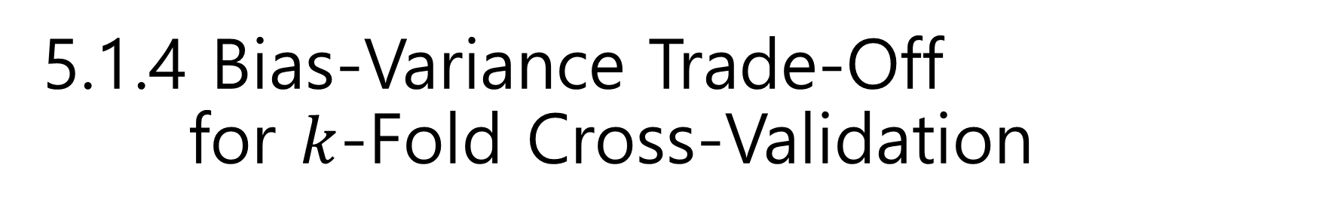
5.1.4 Bias-Variance Trade-Off for $k$-Fold Cross-Validation
Bias of test error Validation set approach $≥$ $k$-Fold CV $≥$ LOOCV
Variance of test error $k$-Fold CV $≤$ LOOCV

Slide 15

5.1.5 Cross-Validation on Classification Problems
LOOCV $CV_{(n)}=\frac{1}{n}\sum{Err_{i}}$ where $Err_{i}=I(y_{i}≠{\hat{y}}_{i})$
$k$-fold CV $CV_{(k)}=\frac{1}{k}\sum{Err_{i}}$ where $Err_{i}=\sum_{j∈Validation_{i}}{I(y_{j}≠{\hat{y}}_{j})}$

Slide 16
5.2 The Bootstrap
Bootstrap
Repeatedly sampling from the original data set with replacement (恢复提取)
Quantifying the uncertainty of an estimator
Example - estimating the standard error of coefficient

Slide 17
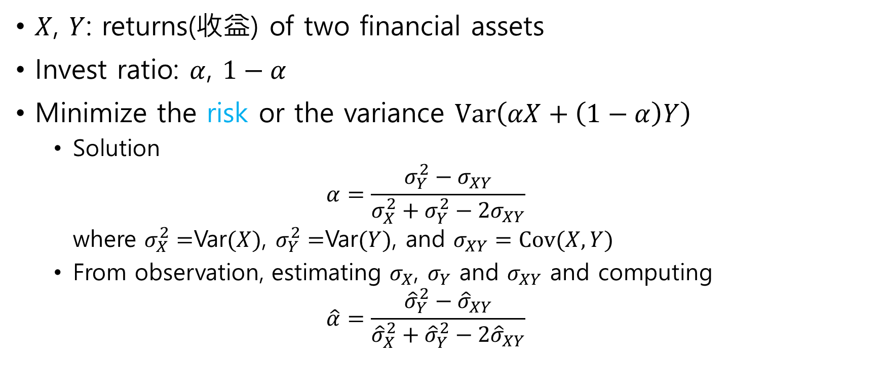
Example: Invest
$X$, $Y$: returns(收益) of two financial assets
Invest ratio: $α$, $1−α$
Minimize the risk or the variance $Var\left(αX+\left(1−α\right)Y\right)$
Solution $α=\frac{σ_{Y}^{2}−σ_{XY}}{σ_{X}^{2}+σ_{Y}^{2}−2σ_{XY}}$ where $σ_{X}^{2}=$Var$(X)$, $σ_{Y}^{2}=$Var$(Y)$, and $σ_{XY}=Cov(X, Y)$
From observation, estimating $σ_{X}$, $σ_{Y}$ and $σ_{XY}$ and computing $\hat{α}=\frac{{\hat{σ}}_{Y}^{2}−{\hat{σ}}_{XY}}{{\hat{σ}}_{X}^{2}+{\hat{σ}}_{Y}^{2}−2{\hat{σ}}_{XY}}$

Slide 18
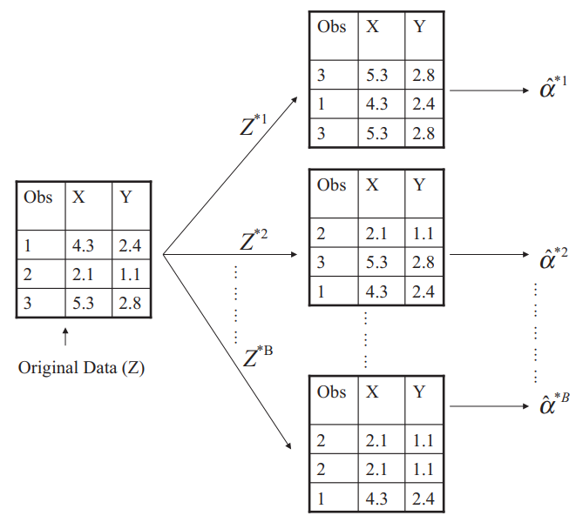

Estimating the variance of $α$
Repeatedly sampling from the original data set with replacement
Computing the variance of $\hat{α}$ $\hat{Ver}\left(\hat{α}\right)=\frac{1}{B−1} \sum_{r=1}^{B}{{\left({\hat{α}}^{∗r}−\frac{1}{B}\sum_{r^{′}=1}^{B}{{\hat{α}}^{∗r^{′}}}\right)}^{2}}$

