Slide 1
Statistical Learning
https://github.com/ggorr/Machine-Learning/tree/master/ISLR

Slide 2
6. Linear Model Selection and Regularization
6.1 Subset Selection
6.2 Shrinkage Methods
6.3 Dimension Reduction Methods
6.4 Considerations in High Dimensions
6.5 Lab 1: Subset Selection Methods
6.6 Lab 2: Ridge Regression and the Lasso
6.7 Lab 3: PCR and PLS Regression
6.8 Exercises

Slide 3
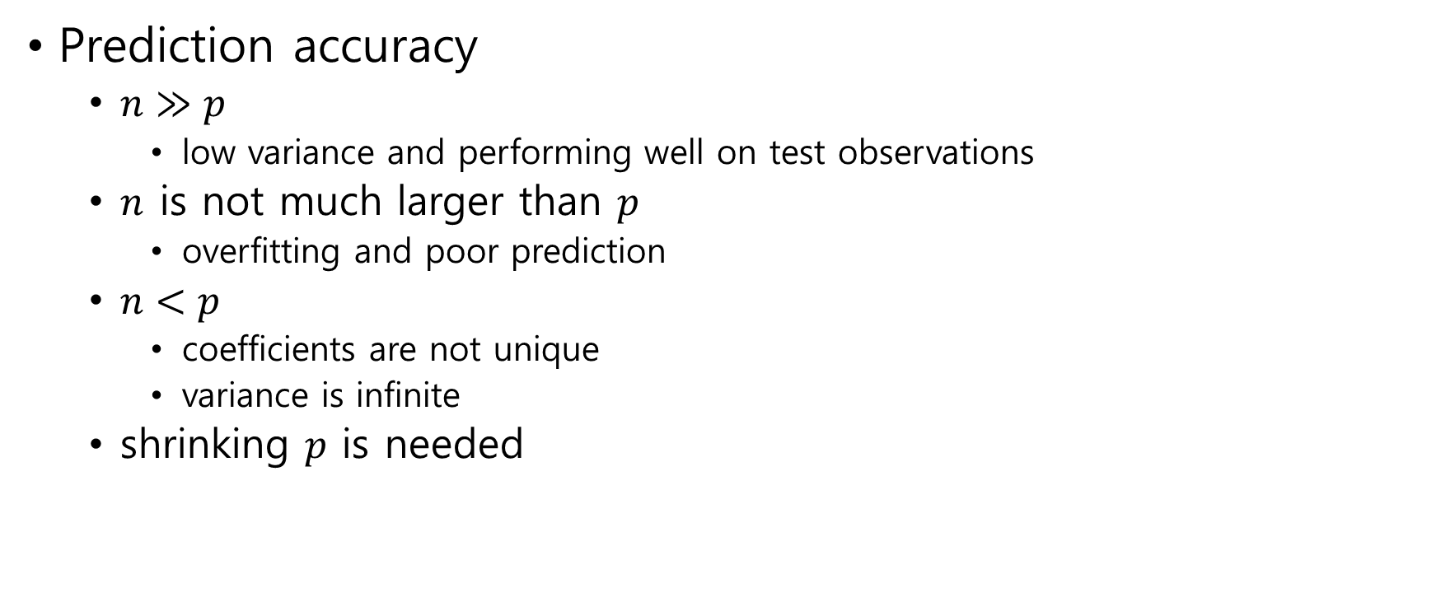
Linear model with least square estimate
Prediction accuracy
$n≫p$
low variance and performing well on test observations
$n$ is not much larger than $p$
overfitting and poor prediction
$n<p$
coefficients are not unique
variance is infinite
shrinking $p$ is needed

Slide 4
Model Interpretability
removing irrelevant variables is needs
feature selection (or variable selection)
Solution
Subset Selection
Shrinkage
Dimension Reduction

Slide 5
6.1 Subset Selection
6.1.1 Best Subset Selection
6.1.2 Stepwise Selection
6.1.3 Choosing the Optimal Model

Slide 6

6.1.1 Best Subset Selection
selecting the best model from among the $2^{p}$ possibilities
select the best subset of $\{X_{1},…,X_{p}\}$

Slide 7
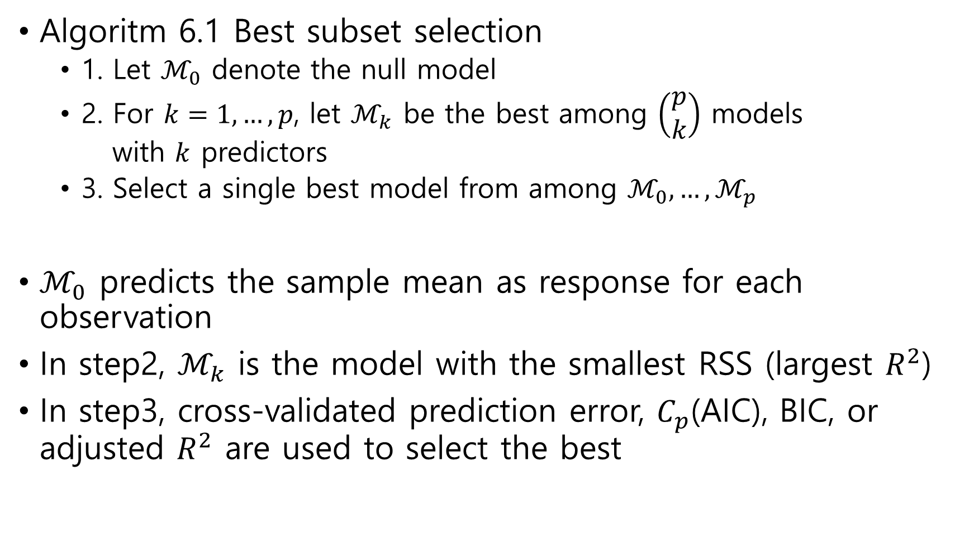
Algoritm 6.1 Best subset selection
1. Let $ℳ_{0}$ denote the null model
2. For $k=1,…, p$, let $ℳ_{k}$ be the best among $\left(\begin{matrix}p \\ k\end{matrix}\right)$ models with $k$ predictors
3. Select a single best model from among $ℳ_{0},…,ℳ_{p}$
$ℳ_{0}$ predicts the sample mean as response for each observation
In step2, $ℳ_{k}$ is the model with the smallest RSS (largest $R^{2}$)
In step3, cross-validated prediction error, $C_{p}$(AIC), BIC, or adjusted $R^{2}$ are used to select the best

Slide 8
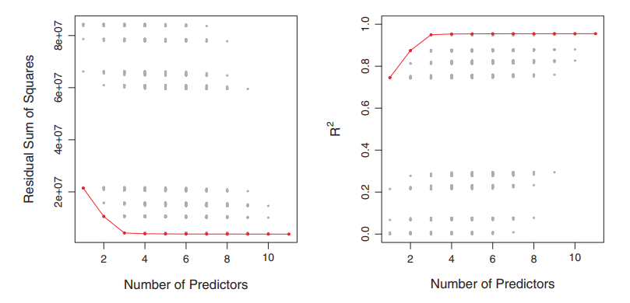

Slide 9

6.1.2 Stepwise Selection
best subset selection cannot be applied with very large $p$
$2^{p}$ possibilities
computationally infeasible for $p≥40$
stepwise selection

Slide 10
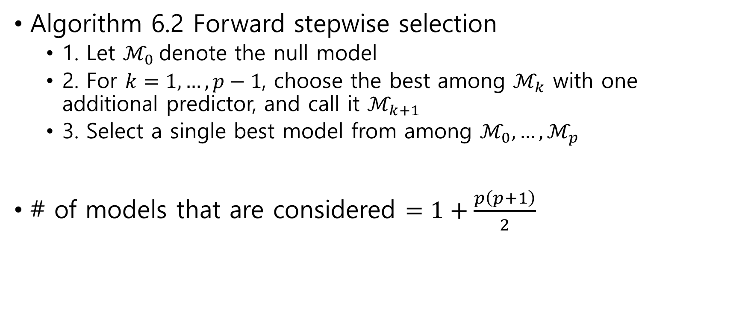
Forward Stepwise Selection
Algorithm 6.2 Forward stepwise selection
1. Let $ℳ_{0}$denote the null model
2. For $k=1,…, p−1$, choose the best among $ℳ_{k}$ with one additional predictor, and call it $ℳ_{k+1}$
3. Select a single best model from among $ℳ_{0},…,ℳ_{p}$
# of models that are considered $=1+\frac{p\left(p+1\right)}{2}$

Slide 11

Backward Stepwise Selection
Algorithm 6.3 Backward stepwise selection
1. Let $ℳ_{p}$denote the full model
2. For $k=p,…,1$, choose the best among models that contain all but one of the predictors in $ℳ_{k}$, and call it $ℳ_{k−1}$
3. Select a single best model from among $ℳ_{0},…,ℳ_{p}$

Slide 12
Hybrid Approaches
hybrid versions of forward and backward stepwise selection
In forward stepwise selection, after adding new variable, remove variables, if any, that no longer provide an improvement

Slide 13

6.1.3 Choosing the Optimal Model
Selecting a single best model from among $ℳ_{0},…,ℳ_{p}$
Comparing RSSs directly is meaningless because RSS of $ℳ_{k}$ decreases (or $R^{2}$ increases) as $k$ increases
one may use cross-validated prediction error, $C_{p}$, AIC, BIC, or Adjusted $R^{2}$

Slide 14
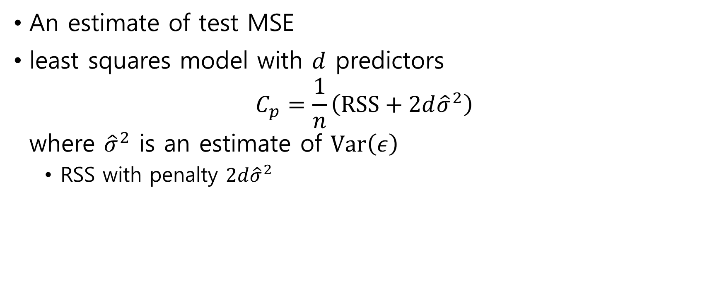
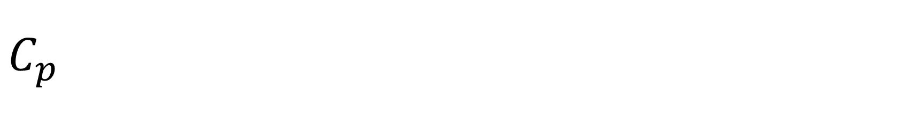
$C_{p}$
An estimate of test MSE
least squares model with $d$ predictors $C_{p}=\frac{1}{n}\left(RSS+2d{\hat{σ}}^{2}\right)$ where ${\hat{σ}}^{2}$ is an estimate of $Var\left(ε\right)$
RSS with penalty $2d{\hat{σ}}^{2}$

Slide 15
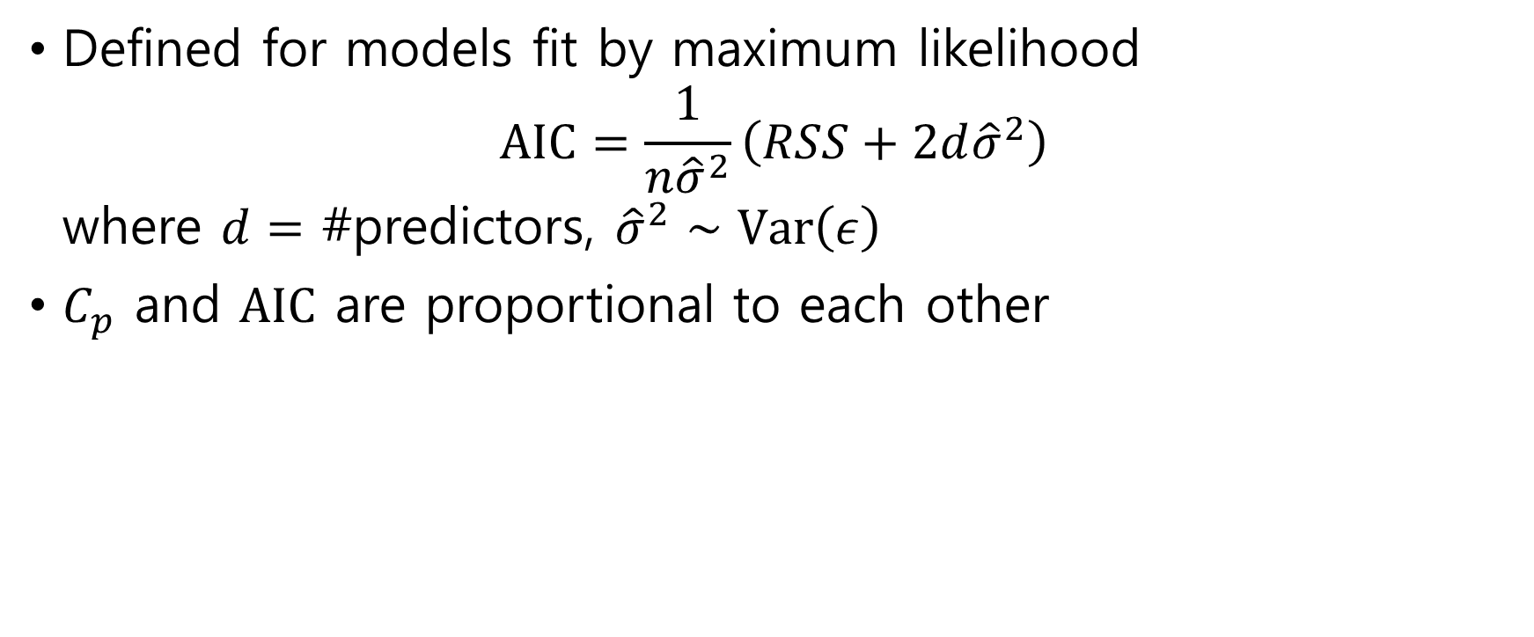
AIC(Akaike information criterion)
Defined for models fit by maximum likelihood $AIC=\frac{1}{n{\hat{σ}}^{2}}\left(RSS+2d{\hat{σ}}^{2}\right)$ where $d=$ #predictors, ${\hat{σ}}^{2}∼Var\left(ε\right)$
$C_{p}$ and $AIC$ are proportional to each other

Slide 16

BIC(Bayesian information criterion)
Derived from a Bayesian point of view $BIC=\frac{1}{n}\left(RSS+\log{n}d{\hat{σ}}^{2}\right)$ where $d=$ #predictors, ${\hat{σ}}^{2}∼Var\left(ε\right)$

Slide 17


Adjusted $R^{2}$
$\text{least} \text{squares} \text{model} \text{with} d \text{predictors}$ $Adjusted R^{2}=1−\frac{RSS/(n−d−1)}{TSS/(n−1)}$
Compare with $R^{2}=1−\frac{RSS}{TSS}$

Slide 18
Validation and Cross-Validation
directly estimate the test error
using the validation set
using cross-validation methods

Slide 19
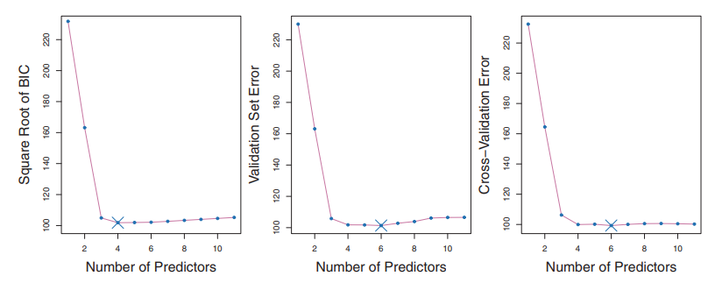

Trends
AIC, BIC, $C_{p}$, and adjusted $R^{2}$ → Validation and CV
computing power

Slide 20
6.2 Shrinkage Methods
Linear model
Least square to fit the model
Regularize the coefficient estimates
shrink the coefficient estimates towards zero
6.2.1 Ridge Regression
6.2.2 The Lasso
6.2.3 Selecting the Tuning Parameter

Slide 21
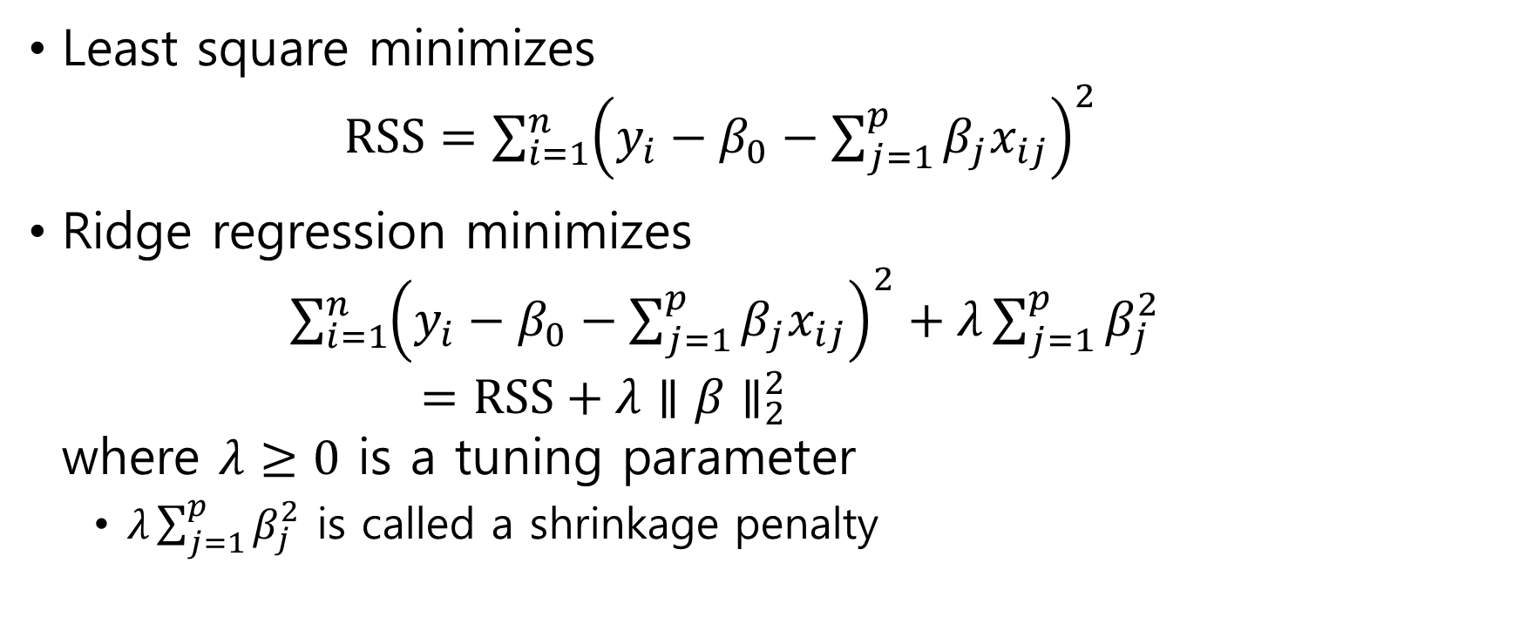
6.2.1 Ridge Regression
Least square minimizes $RSS={\sum_{i=1}^{n}{\left(y_{i}−β_{0}−\sum_{j=1}^{p}{β_{j}x_{ij}}\right)}}^{2}$
Ridge regression minimizes $\sum_{i=1}^{n}{{\left(y_{i}−β_{0}−\sum_{j=1}^{p}{β_{j}x_{ij}}\right)}^{2}}+λ\sum_{j=1}^{p}{β_{j}^{2}}$ $=RSS+λ∥β∥_{2}^{2}$ where $λ≥0$ is a tuning parameter
$λ\sum_{j=1}^{p}{β_{j}^{2}}$ is called a shrinkage penalty

Slide 22
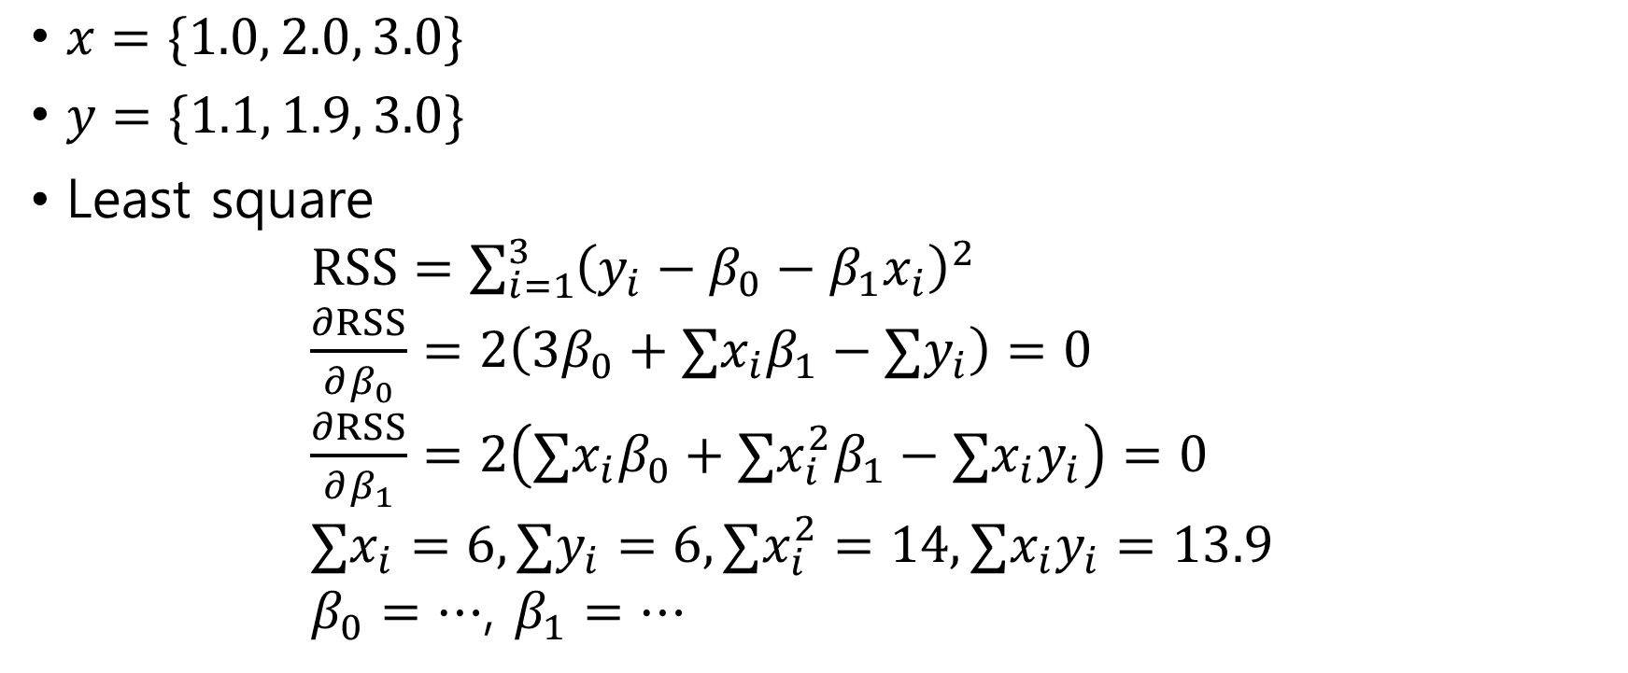
Example
$x=\{1.0, 2.0, 3.0\}$
$y=\{1.1, 1.9, 3.0\}$
Least square $RSS=\sum_{i=1}^{3}{{\left(y_{i}−β_{0}−β_{1}x_{i}\right)}^{2}}$ $\frac{∂RSS}{∂β_{0}}=2\left(3β_{0}+∑x_{i}β_{1}−∑y_{i}\right)=0$ $\frac{∂RSS}{∂β_{1}}=2\left(∑x_{i}β_{0}+∑x_{i}^{2}β_{1}−∑x_{i}y_{i}\right)=0$ $∑x_{i}=6, ∑y_{i}=6, ∑x_{i}^{2}=14,∑x_{i}y_{i}=13.9$ $β_{0}=…$, $β_{1}=…$

Slide 23
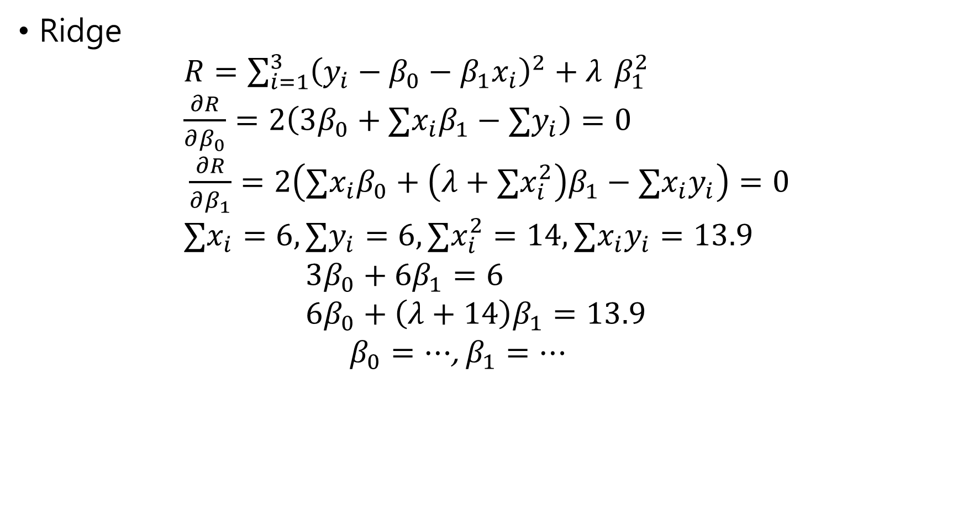
Ridge $R=\sum_{i=1}^{3}{{\left(y_{i}−β_{0}−β_{1}x_{i}\right)}^{2}}+λ$ $β_{1}^{2}$ $\frac{∂R}{∂β_{0}}=2\left(3β_{0}+∑x_{i}β_{1}−∑y_{i}\right)=0$ $\frac{∂R}{∂β_{1}}=2\left(∑x_{i}β_{0}+\left(λ+∑x_{i}^{2}\right)β_{1}−∑x_{i}y_{i}\right)=0$ $∑x_{i}=6, ∑y_{i}=6, ∑x_{i}^{2}=14,∑x_{i}y_{i}=13.9$ $3β_{0}+6β_{1}=6$ $6β_{0}+\left(λ+14\right)β_{1}=13.9$ $β_{0}=⋯$, $β_{1}=⋯$

Slide 24
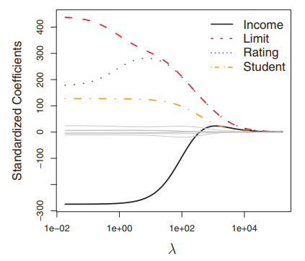

“Standardized” means that the standard deviation of each predictor is 1, using the formula ${\tilde{x}}_{ij}=\frac{x_{ij}}{\sqrt{\frac{1}{n}\sum_{i=1}^{n}{{\left(x_{ij}−{\overline{x}}_{j}\right)}^{2}}}}$

Slide 25

6.2.2 The Lasso
The Lasso minimizes $\sum_{i=1}^{n}{{\left(y_{i}−β_{0}−\sum_{j=1}^{p}{β_{j}x_{ij}}\right)}^{2}}+λ\sum_{j=1}^{p}{\left|β\right|}$ $=RSS+λ∥β∥_{1}$ where $λ≥0$ is a tuning parameter

Slide 26
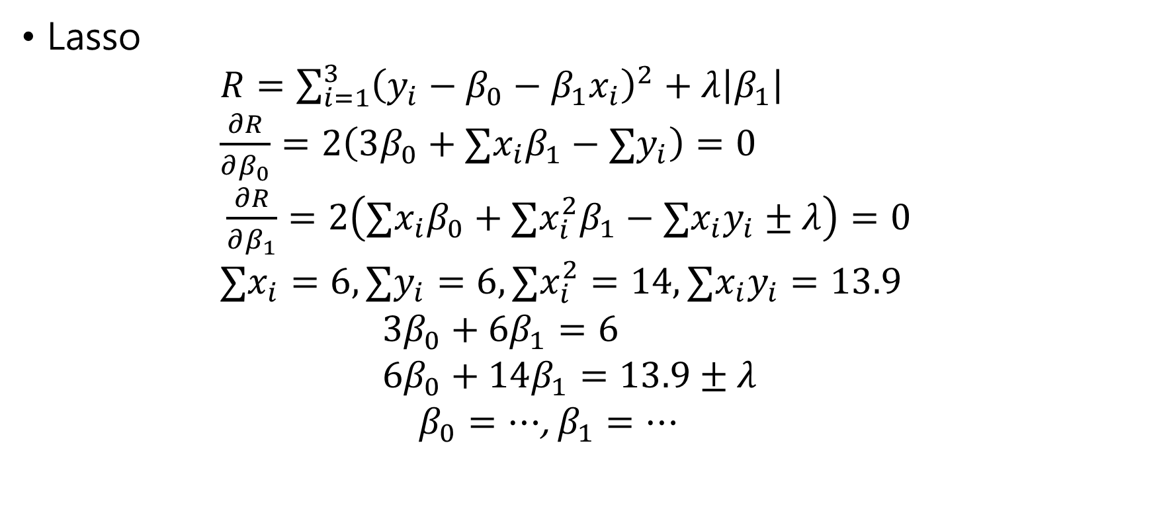
Example
Lasso $R=\sum_{i=1}^{3}{{\left(y_{i}−β_{0}−β_{1}x_{i}\right)}^{2}}+λ\left|β_{1}\right|$ $\frac{∂R}{∂β_{0}}=2\left(3β_{0}+∑x_{i}β_{1}−∑y_{i}\right)=0$ $\frac{∂R}{∂β_{1}}=2\left(∑x_{i}β_{0}+∑x_{i}^{2}β_{1}−∑x_{i}y_{i}±λ\right)=0$ $∑x_{i}=6, ∑y_{i}=6, ∑x_{i}^{2}=14,∑x_{i}y_{i}=13.9$ $3β_{0}+6β_{1}=6$ $6β_{0}+14β_{1}=13.9±λ$ $β_{0}=⋯$, $β_{1}=⋯$

Slide 27
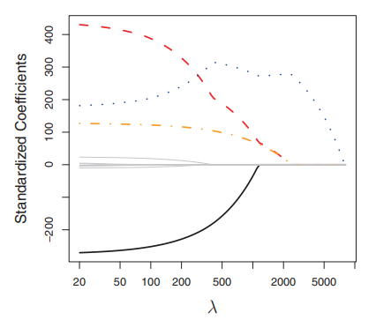

Slide 28
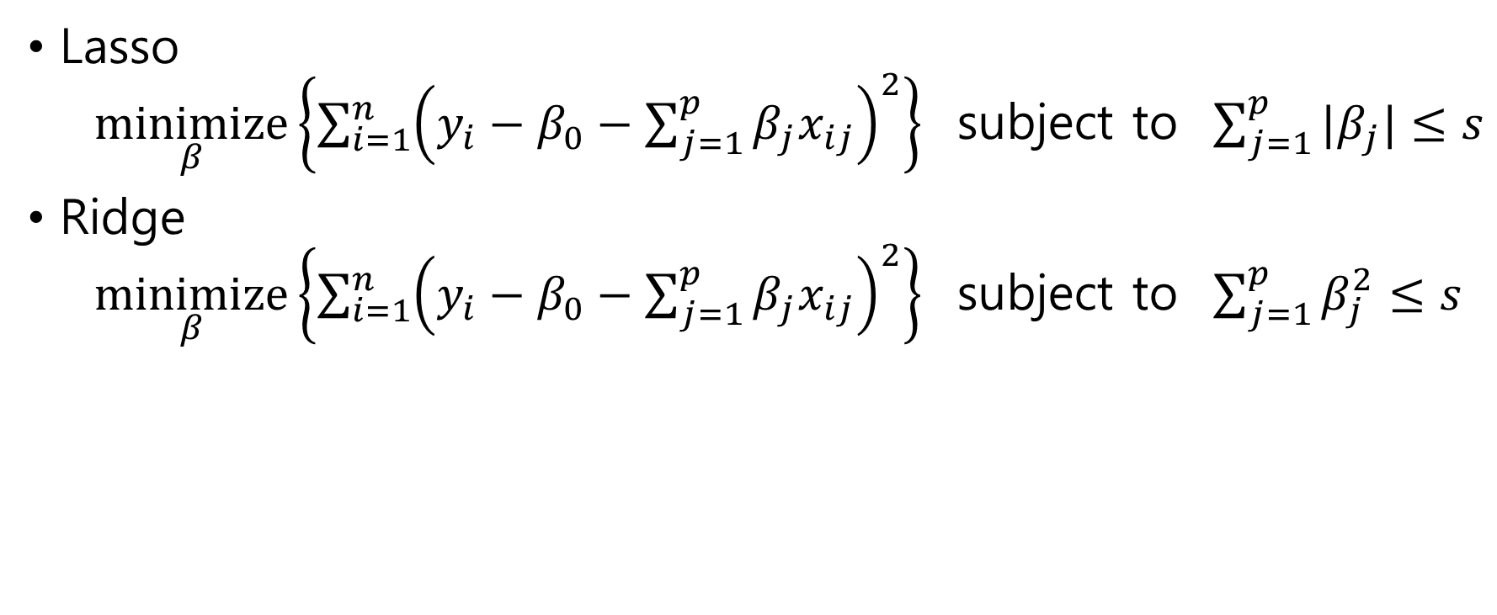
Another formulation
Lasso $\underset{β}{minimize}\left\{\sum_{i=1}^{n}{{\left(y_{i}−β_{0}−\sum_{j=1}^{p}{β_{j}x_{ij}}\right)}^{2}}\right\}$ subject to $\sum_{j=1}^{p}{|β_{j}|}≤s$
Ridge $\underset{β}{minimize}\left\{\sum_{i=1}^{n}{{\left(y_{i}−β_{0}−\sum_{j=1}^{p}{β_{j}x_{ij}}\right)}^{2}}\right\}$ subject to $\sum_{j=1}^{p}{β_{j}^{2}}≤s$

Slide 29
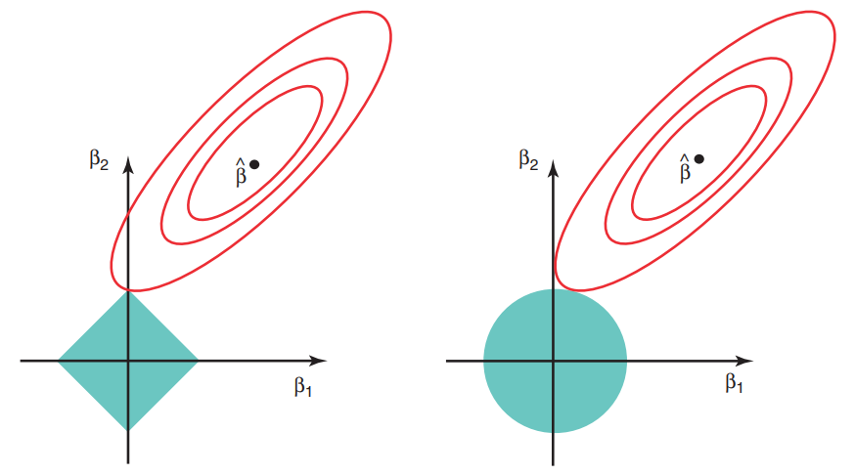

Slide 30
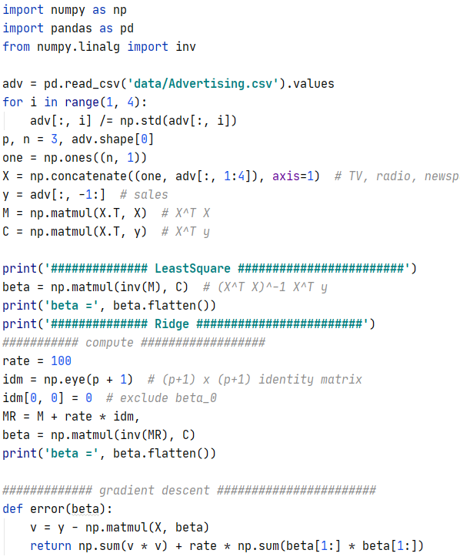
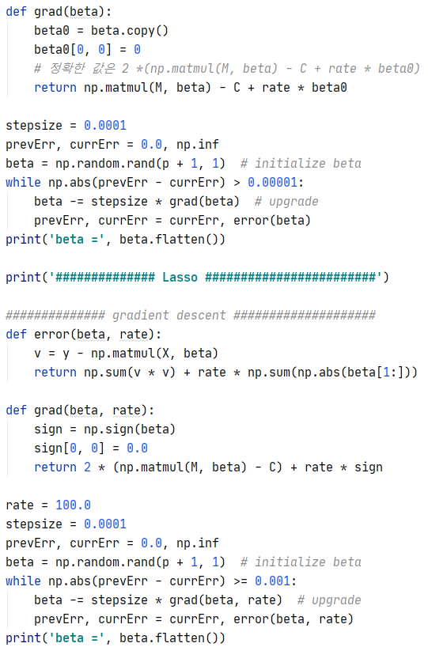
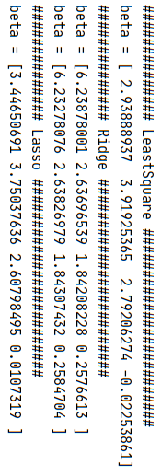

Slide 31

6.2.3 Selecting the Tuning Parameter
Determine the tuning parameter $λ$
Cross-validation

Slide 32
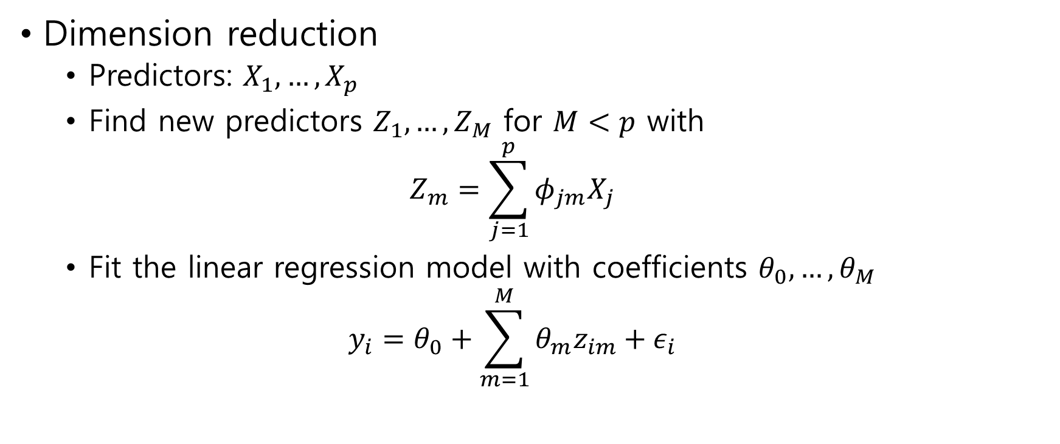
6.3 Dimension Reduction Methods
Dimension reduction
Predictors: $X_{1},…,X_{p}$
Find new predictors $Z_{1},…,Z_{M}$ for $M<p$ with $Z_{m}=\sum_{j=1}^{p}{φ_{jm}X_{j}}$
Fit the linear regression model with coefficients $θ_{0},…,θ_{M}$ $y_{i}=θ_{0}+\sum_{m=1}^{M}{θ_{m}z_{im}}+ε_{i}$

Slide 33
6.3.1 Principal Components Regression
6.3.2 Partial Least Squares

Slide 34
6.3.1 Principal Components Regression
Principal components analysis(PCA)
A technique for reducing the dimension of a data matrix

Slide 35
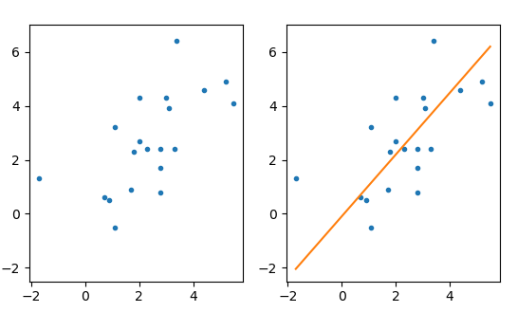

PCA
$$n=20, p=2$$
(-1.7, 1.3)
(1.7, 0.9)
(1.1, -0.5)
(0.7, 0.6)
(0.9, 0.5)
(2.0, 2.7)
(2.8, 0.8)
(1.8, 2.3)
(2.3, 2.4)
(2.8, 1.7)
(1.1, 3.2)
(2.8, 2.4)
(3.3, 2.4)
(3.0, 4.3)
(2.0, 4.3)
(4.4, 4.6)
(3.4, 6.4)
(3.1, 3.9)
(5.5, 4.1)
(5.2, 4.9)
The first principal component
The direction along which observations vary the most

Slide 36
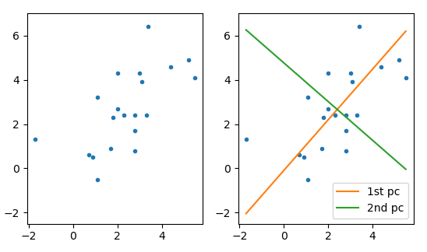
PCA
The second principal component
The direction along which observations vary the second most
The 1st and 2nd principal components are orthogonal
And so on

Slide 37
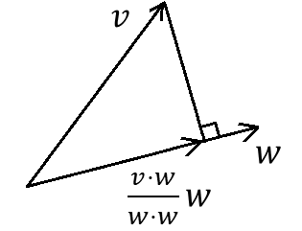

Inner product
The projection of a vector $v$ into the direction $w$ is $\frac{v⋅w}{w⋅w}w$
The norm of the projection is $\left|v⋅w\right|$ if $∥w∥=1$

Slide 38

Computation
Observation
$X_{1}=\left(x_{11},…,x_{1p}\right)$, $…$, $X_{n}=\left(x_{n1},…,x_{np}\right)$
$X=\left[\begin{matrix}x_{11} & ⋯ & x_{1p} \\ ⋮ & ⋱ & ⋮ \\ x_{n1} & ⋯ & x_{np}\end{matrix}\right]$
Centering for simplicity
Assume $\sum_{i=1}^{n}{x_{ij}}=0$ for all $j$
or, let $x_{ij}≔x_{ij}−$ mean of $j$–th column

Slide 39
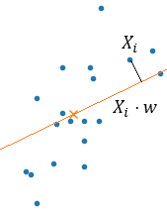
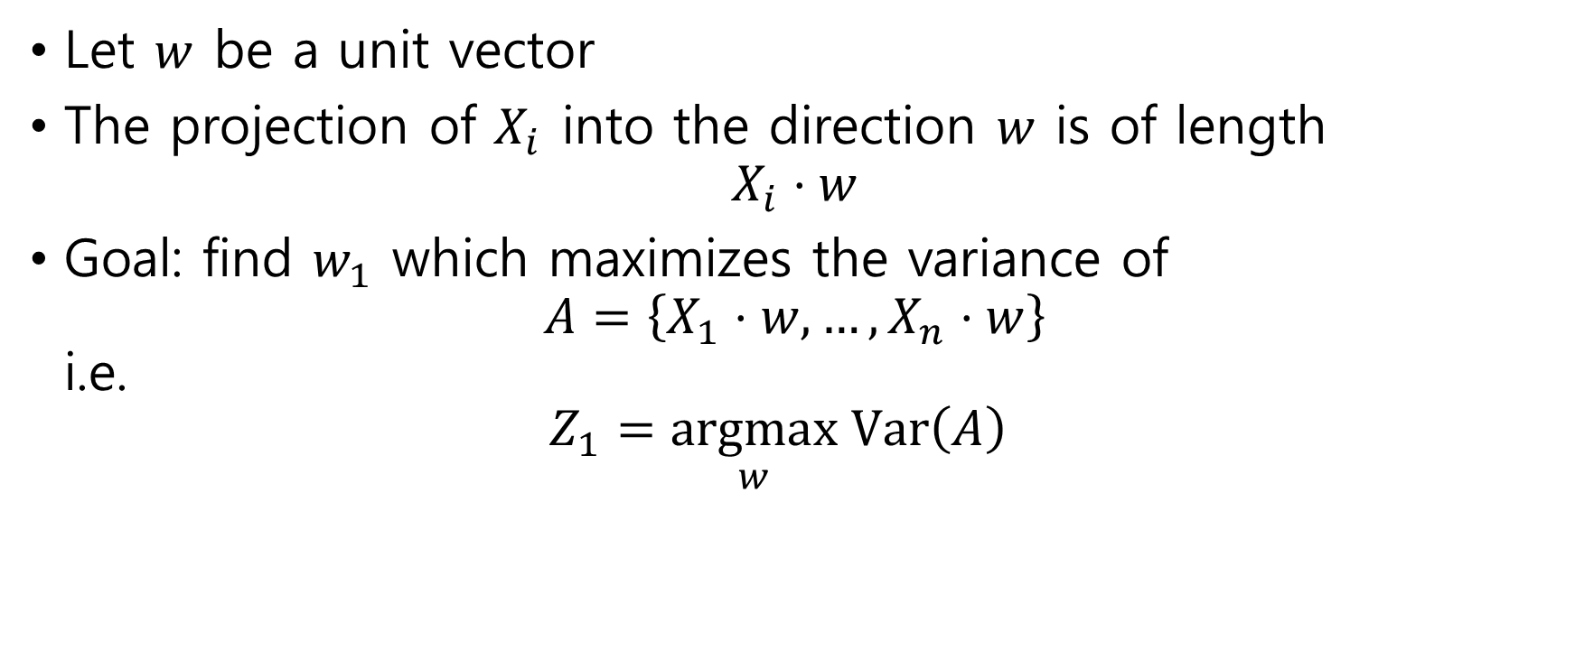
The first principal component
Let $w$ be a unit vector
The projection of $X_{i}$ into the direction $w$ is of length $X_{i}⋅w$
Goal: find $w_{1}$ which maximizes the variance of $A=\left\{X_{1}⋅w,…,X_{n}⋅w\right\}$ i.e. $Z_{1}=\underset{w}{argmax} Var\left(A\right)$

Slide 40
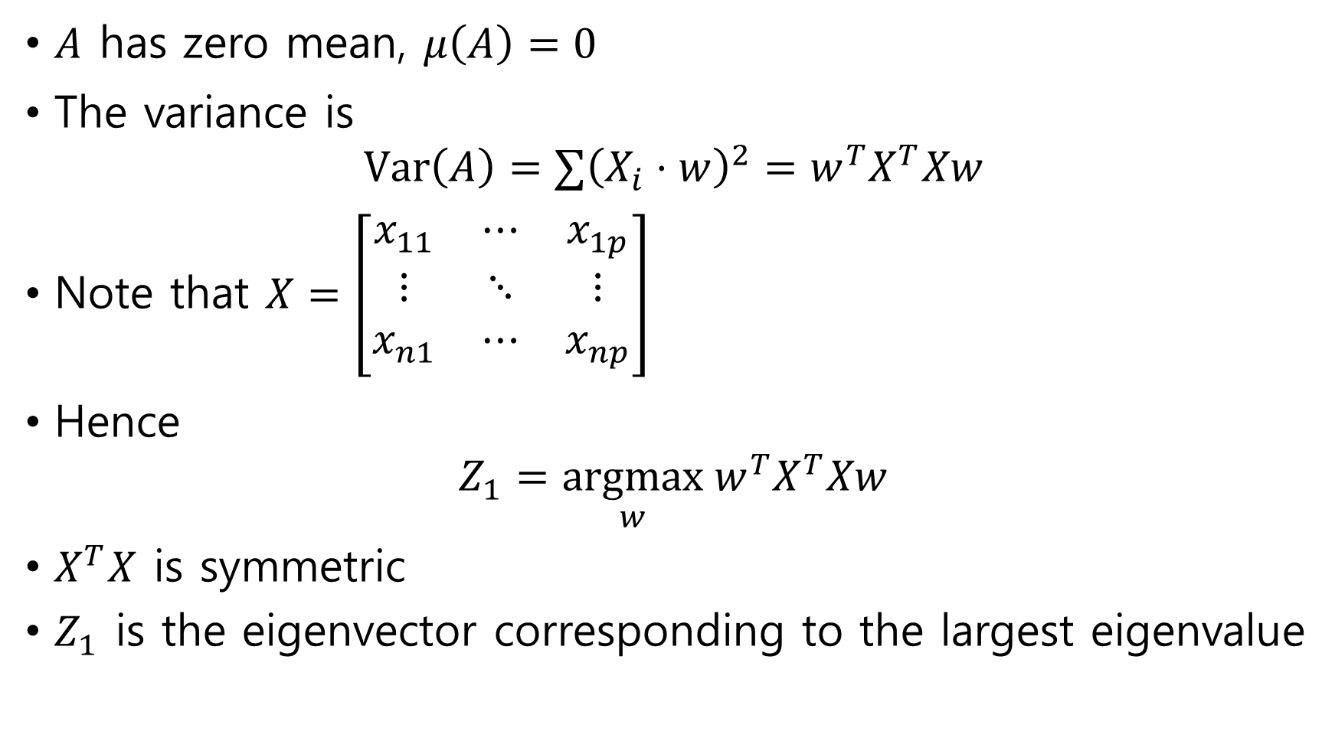
$A$ has zero mean, $μ\left(A\right)=0$
The variance is $Var\left(A\right)=∑{\left(X_{i}⋅w\right)}^{2}=w^{T}X^{T}Xw$
Note that $X=\left[\begin{matrix}x_{11} & ⋯ & x_{1p} \\ ⋮ & ⋱ & ⋮ \\ x_{n1} & ⋯ & x_{np}\end{matrix}\right]$
Hence $Z_{1}=\underset{w}{argmax} w^{T}X^{T}Xw$
$X^{T}X$ is symmetric
$Z_{1}$ is the eigenvector corresponding to the largest eigenvalue

Slide 41

The other principal component
The $k$-th principal component $Z_{k}$ is the eigenvector corresponding to the $k$-th eigenvalue in order

Slide 42
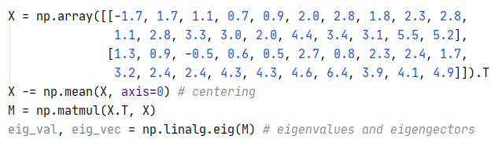



Code
Find eigenvalues and eigenvectors
Sorting
Print

Slide 43
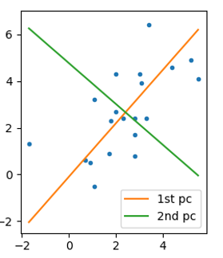
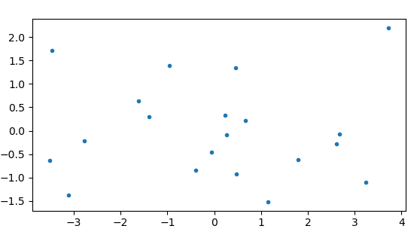
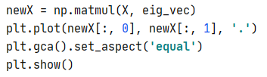
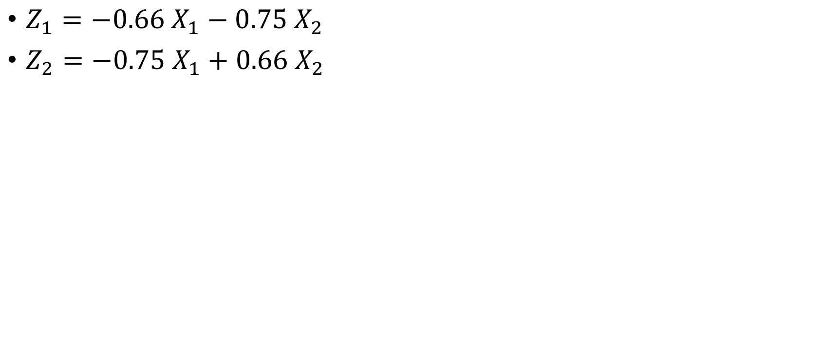
New predictors

Slide 44
Principal Components Regression
Principal components regression(PCR)
Standardization
Variance of each predictor to be 1
New predictor selection
Cross-validation

Slide 45
6.3.2 Partial Least Squares
Partial Least Square(PLS)
find directions that help explain both the response and the predictors

Slide 46
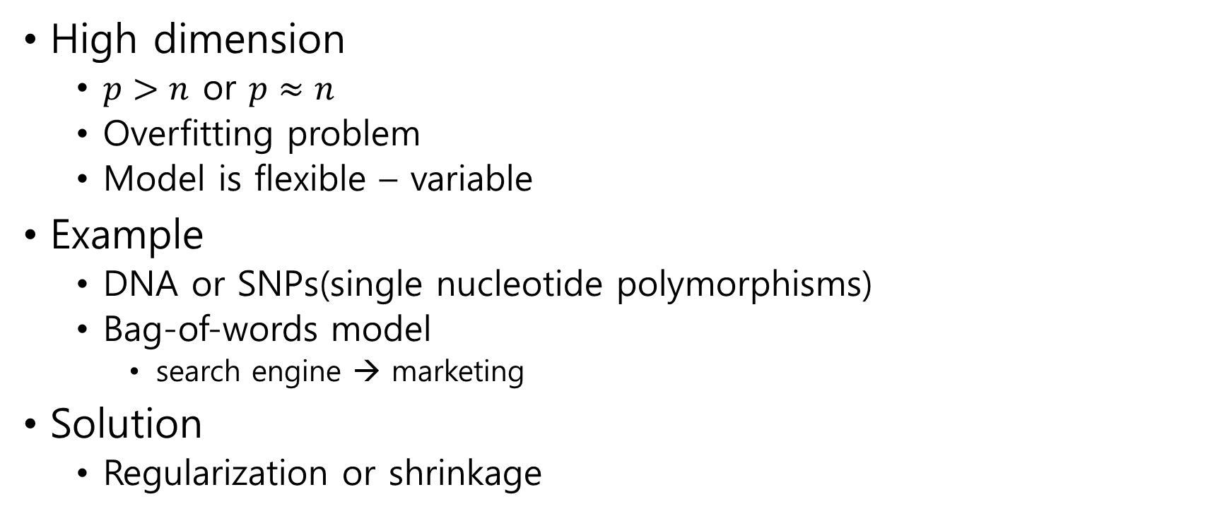
6.4 Considerations in High Dimensions
High dimension
$p>n$ or $p≈n$
Overfitting problem
Model is flexible – variable
Example
DNA or SNPs(single nucleotide polymorphisms)
Bag-of-words model
search engine → marketing
Solution
Regularization or shrinkage

