Slide 1
Statistical Learning
https://github.com/ggorr/Machine-Learning/tree/master/ISLR

Slide 2
7 Moving Beyond Linearity
7.1 Polynomial Regression
7.2 Step Functions
7.3 Basis Functions
7.4 Regression Splines
7.5 Smoothing Splines
7.6 Local Regression
7.7 Generalized Additive Models
7.8 Lab: Non-linear Modeling
7.9 Exercises

Slide 3

7.1 Polynomial Regression
Polynomial regression of degree $d$ $y_{i}=β_{0}+β_{1}x_{i}+⋯+β_{d}x_{i}^{d}+ε$

Slide 4
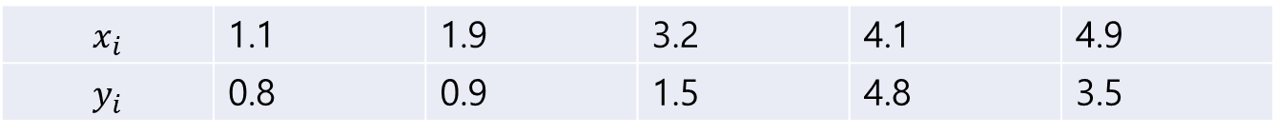

Example
Data
predictors $x$, $x^{2}$, $…\text{, }x^{d}$
solution $β={\left(X^{T}X\right)}^{−1}X^{T}y$ where $X=\left[\begin{matrix}1 & 1.1 & ⋯ & {1.1}^{d} \\ ⋮ & ⋮ & ⋱ & ⋮ \\ 1 & 4.9 & ⋯ & {4.9}^{d}\end{matrix}\right]$, $y=\left[\begin{matrix}0.8 \\ ⋮ \\ 3.5\end{matrix}\right]$
$$x_{i}$$ | 1.1 | 1.9 | 3.2 | 4.1 | 4.9
$$y_{i}$$ | 0.8 | 0.9 | 1.5 | 4.8 | 3.5

Slide 5
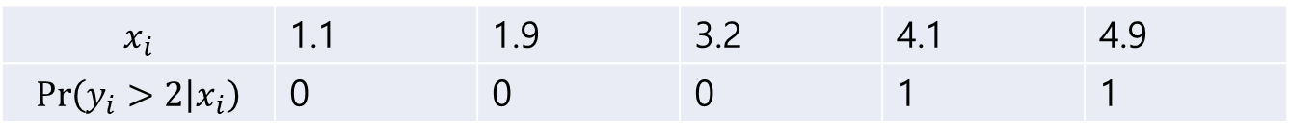
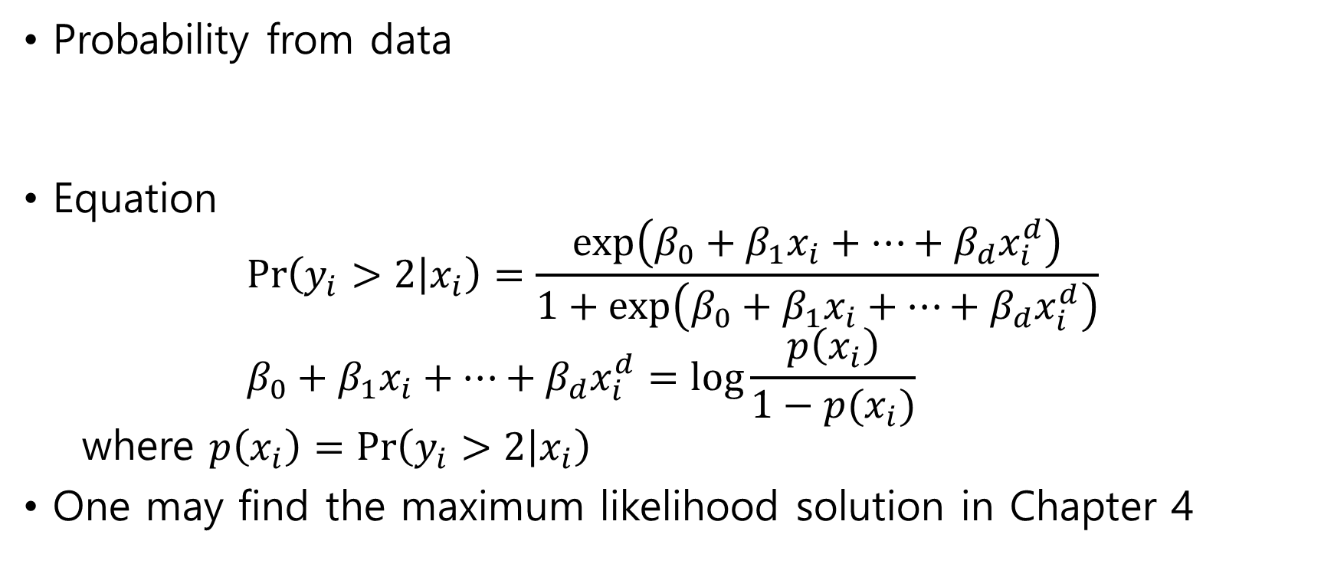
Example
Probability from data
Equation $\operatorname{Pr}\left(y_{i}>2 | x_{i}\right)=\frac{\exp\left(β_{0}+β_{1}x_{i}+⋯+β_{d}x_{i}^{d}\right)}{1+\exp\left(β_{0}+β_{1}x_{i}+⋯+β_{d}x_{i}^{d}\right)}$ $β_{0}+β_{1}x_{i}+⋯+β_{d}x_{i}^{d}=\log{\frac{p\left(x_{i}\right)}{1−p(x_{i})}}$ where $p\left(x_{i}\right)=\operatorname{Pr}\left(y_{i}>2 | x_{i}\right)$
One may find the maximum likelihood solution in Chapter 4
$$x_{i}$$ | 1.1 | 1.9 | 3.2 | 4.1 | 4.9
$$\operatorname{Pr}\left(y_{i}>2 | x_{i}\right)$$ | 0 | 0 | 0 | 1 | 1

Slide 6
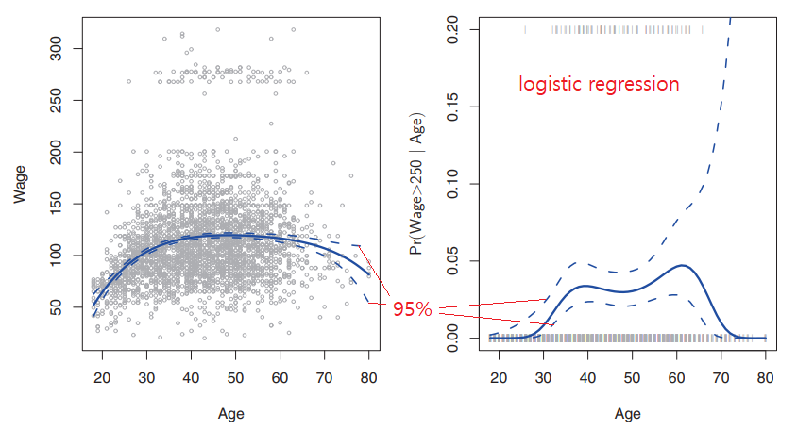

Example
Polynomial regression of degree $4$

Slide 7
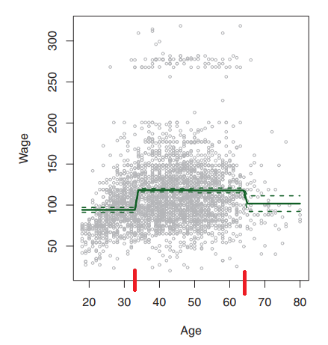
7.2 Step Functions
Divide and average

Slide 8
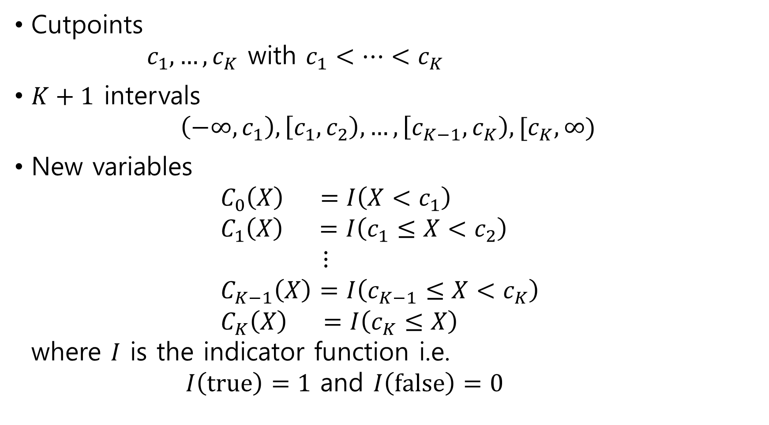
Cutpoints $c_{1},…,c_{K}$ with $c_{1}<⋯<c_{K}$
$K+1$ intervals $\left(−∞,c_{1}\right), \left[c_{1},c_{2}\right), …,\left[c_{K−1},c_{K}\right),[c_{K},∞)$
New variables $C_{0}\left(X\right) =I\left(X<c_{1}\right)$ $C_{1}\left(X\right) =I\left(c_{1}≤X<c_{2}\right)$ $⋮$ $C_{K−1}\left(X\right)=I\left(c_{K−1}≤X<c_{K}\right)$ $C_{K}\left(X\right) =I\left(c_{K}≤X\right)$ where $I$ is the indicator function i.e. $I\left(true\right)=1$ and $I\left(false\right)=0$

Slide 9
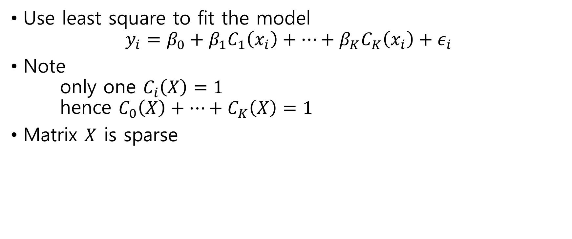
Estimation
Use least square to fit the model $y_{i}=β_{0}+β_{1}C_{1}\left(x_{i}\right)+⋯+β_{K}C_{K}\left(x_{i}\right)+ε_{i}$
Note only one $C_{i}\left(X\right)=1$ hence $C_{0}\left(X\right)+⋯+C_{K}\left(X\right)=1$
Matrix $X$ is sparse

Slide 10

7.3 Basis Functions
New variables $b_{1}\left(X\right),…,b_{K}(X)$
Model $y_{i}=β_{0}+β_{1}b_{1}\left(x_{i}\right)+⋯+β_{K}b_{K}\left(x_{i}\right)+ε_{i}$
Example
Polynomial regression $b_{i}\left(X\right)=X^{i}$

Slide 11
7.4 Regression Splines
7.4.1 Piecewise Polynomials
7.4.2 Constraints and Splines
7.4.3 The Spline Basis Representation
7.4.4 Choosing the Number and Locations of the Knots
7.4.5 Comparison to Polynomial Regression

Slide 12

7.4.1 Piecewise Polynomials
Knots(=cut points) $c_{1},…,c_{K}$ with $c_{1}<⋯<c_{K}$
$K+1$ intervals $\left(−∞,c_{1}\right), \left[c_{1},c_{2}\right), …,\left[c_{K−1},c_{K}\right),[c_{K},∞)$
Polynomial regression on each interval

Slide 13
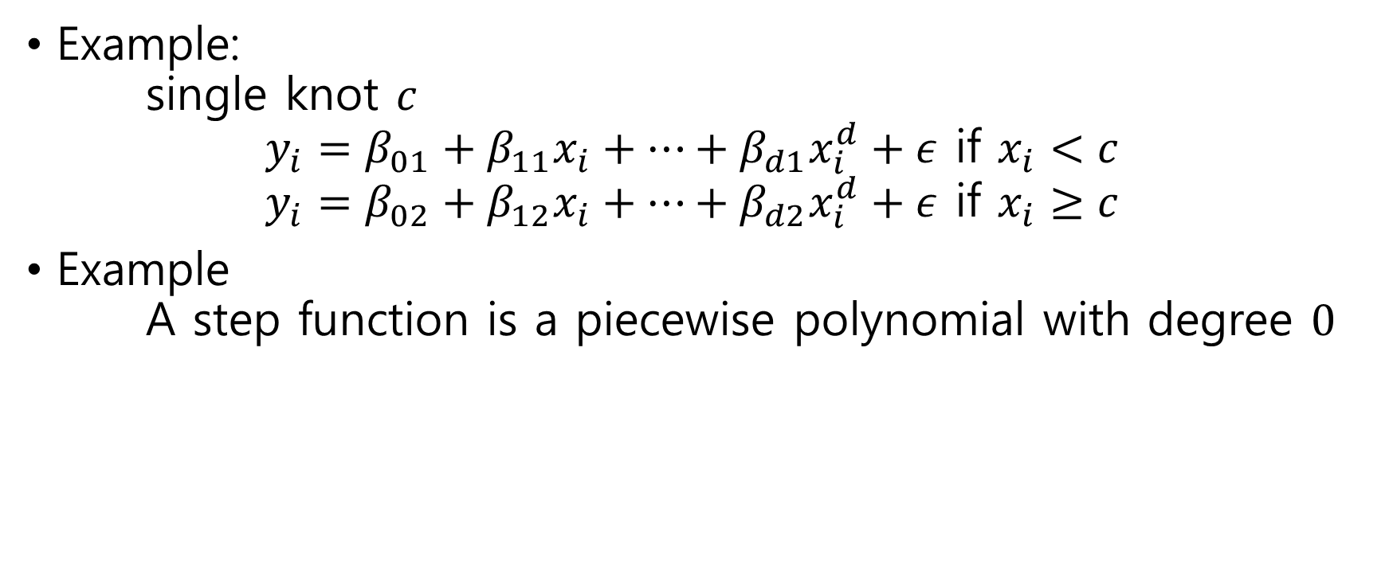
Examples
Example: single knot $c$ $y_{i}=β_{01}+β_{11}x_{i}+⋯+β_{d1}x_{i}^{d}+ε$ if $x_{i}<c$ $y_{i}=β_{02}+β_{12}x_{i}+⋯+β_{d2}x_{i}^{d}+ε$ if $x_{i}≥c$
Example A step function is a piecewise polynomial with degree $0$

Slide 14
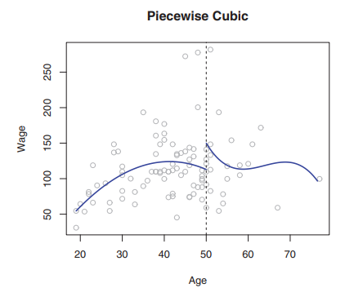

Slide 15
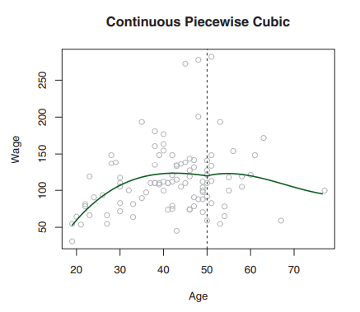
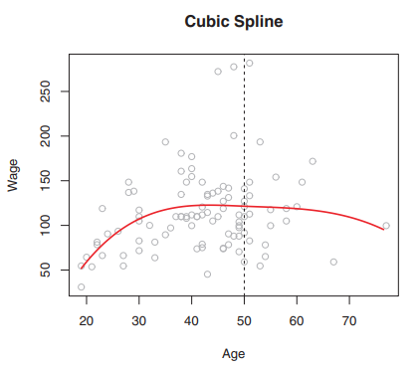
7.4.2 Constraints and Splines

Slide 16
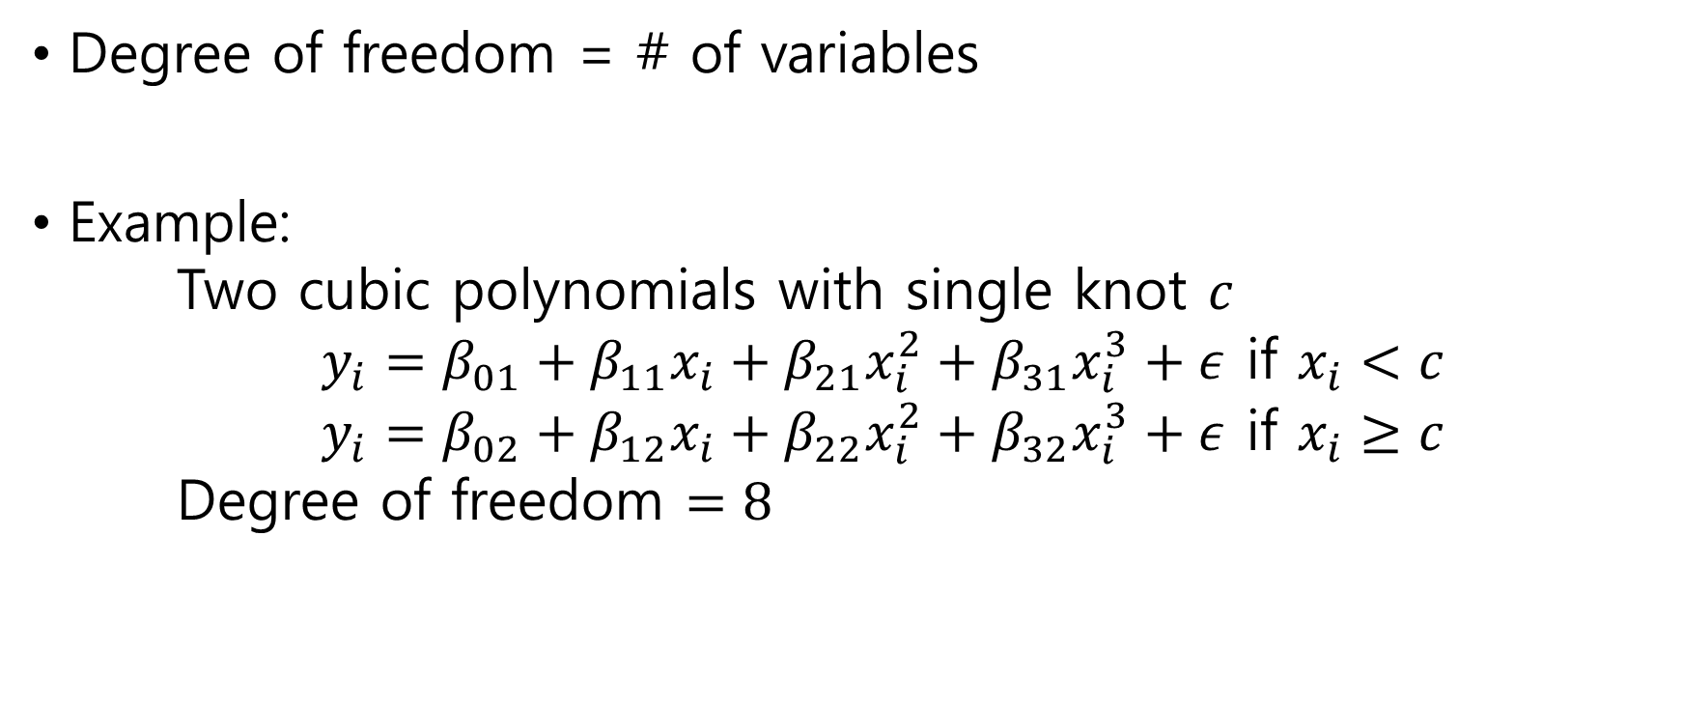
Degree Of Freedom
Degree of freedom = # of variables
Example: Two cubic polynomials with single knot $c$ $y_{i}=β_{01}+β_{11}x_{i}+β_{21}x_{i}^{2}+β_{31}x_{i}^{3}+ε$ if $x_{i}<c$ $y_{i}=β_{02}+β_{12}x_{i}+β_{22}x_{i}^{2}+β_{32}x_{i}^{3}+ε$ if $x_{i}≥c$ Degree of freedom $=8$

Slide 17
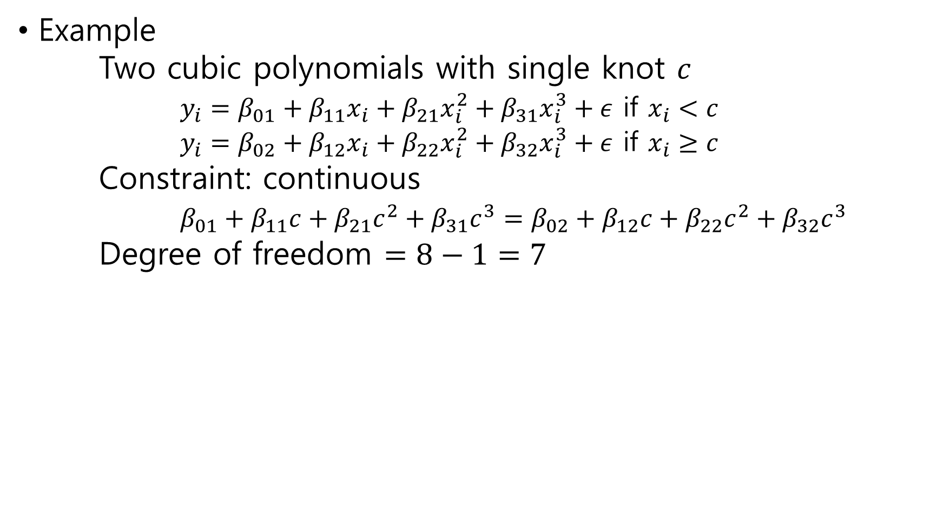
Example Two cubic polynomials with single knot $c$ $y_{i}=β_{01}+β_{11}x_{i}+β_{21}x_{i}^{2}+β_{31}x_{i}^{3}+ε$ if $x_{i}<c$ $y_{i}=β_{02}+β_{12}x_{i}+β_{22}x_{i}^{2}+β_{32}x_{i}^{3}+ε$ if $x_{i}≥c$ Constraint: continuous $β_{01}+β_{11}c+β_{21}c^{2}+β_{31}c^{3}=β_{02}+β_{12}c+β_{22}c^{2}+β_{32}c^{3}$ Degree of freedom $=8−1=7$

Slide 18
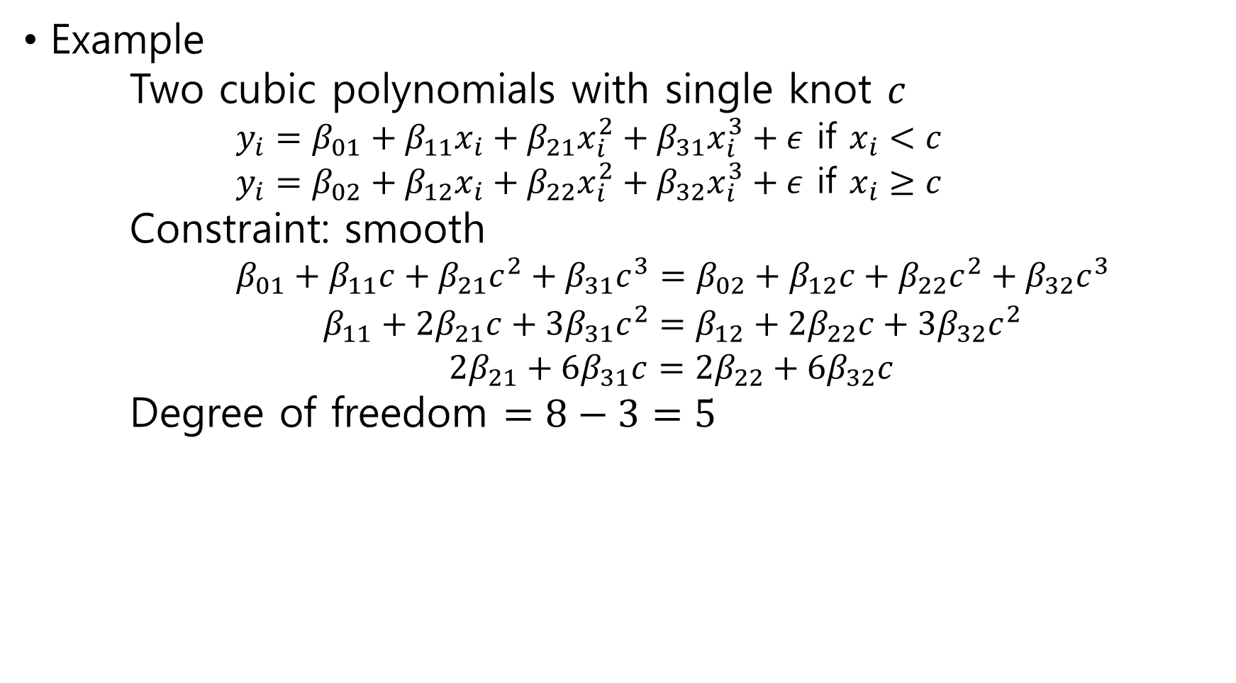
Example Two cubic polynomials with single knot $c$ $y_{i}=β_{01}+β_{11}x_{i}+β_{21}x_{i}^{2}+β_{31}x_{i}^{3}+ε$ if $x_{i}<c$ $y_{i}=β_{02}+β_{12}x_{i}+β_{22}x_{i}^{2}+β_{32}x_{i}^{3}+ε$ if $x_{i}≥c$ Constraint: smooth $β_{01}+β_{11}c+β_{21}c^{2}+β_{31}c^{3}=β_{02}+β_{12}c+β_{22}c^{2}+β_{32}c^{3}$ $β_{11}+2β_{21}c+3β_{31}c^{2}=β_{12}+2β_{22}c+3β_{32}c^{2}$ $2β_{21}+6β_{31}c=2β_{22}+6β_{32}c$ Degree of freedom $=8−3=5$

Slide 19

Cubic Spline
Piecewise cubic polynomials
Continuity
Continuous, 1st derivative is continuous, 2nd derivative is continuous
Degree of freedom $=K+4$

Slide 20
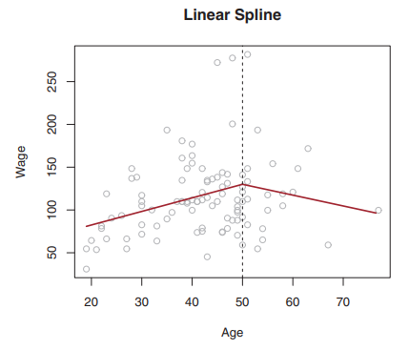

Linear Spline
Piecewise linear
Continuity
Continuous
Degree of freedom $=K+2$

Slide 21

Spline
Piecewise degree-$d$ polynomials
Continuous derivatives up to degree $d−1$
Degree of freedom $=K+d+1$

Slide 22

7.4.3 The Spline Basis Representation
Cubic spline with $K$ knots has degree of freedom $K+4$
Can a cubic spline be modeled as $y_{i}=β_{0}+β_{1}b_{1}\left(x_{i}\right)+⋯+β_{K+3}b_{K+3}\left(x_{i}\right)+ε$ for some basis functions $b_{1},…,b_{K+3}$?

Slide 23

Answer
Truncated power basis function $h\left(x,ξ\right)={\left(x−ξ\right)}_{+}^{3}=\left\{\begin{aligned}{\left(x−ξ\right)}^{3} \\ 0 &\end{aligned}\right.\begin{matrix}if x>ξ \\ otherwise\end{matrix}$
Model $y_{i}=β_{0}+β_{1}x_{i}+β_{2}x_{i}^{2}+β_{3}x_{i}^{3}$ $+β_{4}h(x_{i},c_{1})+⋯+β_{K+3}h\left(x_{i},c_{K}\right)+ε$

Slide 24
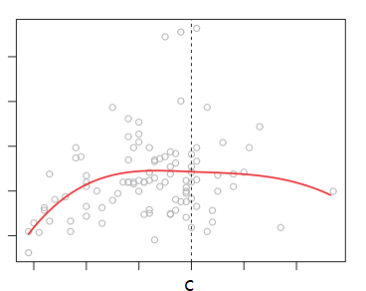
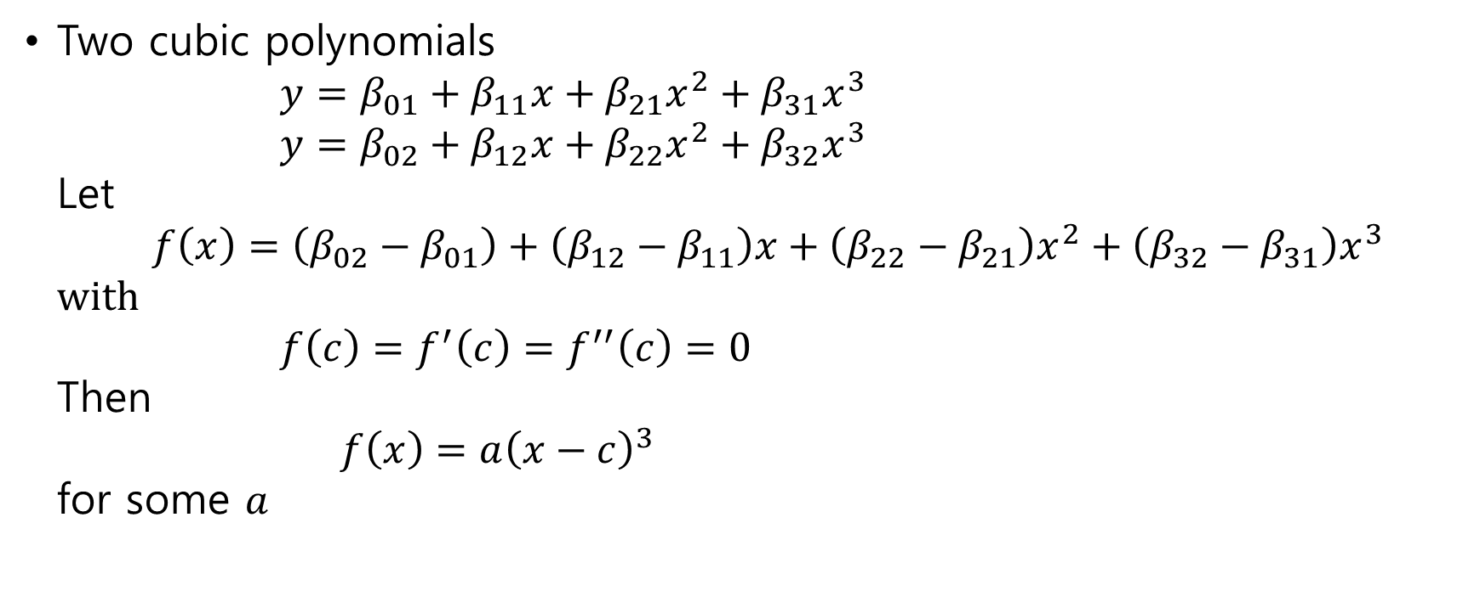
Proof in the case of degree 3
Two cubic polynomials $y=β_{01}+β_{11}x+β_{21}x^{2}+β_{31}x^{3}$ $y=β_{02}+β_{12}x+β_{22}x^{2}+β_{32}x^{3}$ Let $f\left(x\right)=\left(β_{02}−β_{01}\right)+\left(β_{12}−β_{11}\right)x+\left(β_{22}−β_{21}\right)x^{2}+\left(β_{32}−β_{31}\right)x^{3}$ with $f\left(c\right)=f^{′}\left(c\right)=f^{′′}\left(c\right)=0$ Then $f\left(x\right)=a{\left(x−c\right)}^{3}$ for some $a$

Slide 25

Equivalently
$β_{02}+β_{12}x+β_{22}x^{2}+β_{32}x^{3}$ $=β_{01}+β_{11}x+β_{21}x^{2}+β_{31}x^{3}+a{\left(x−c\right)}^{3}$
Thus we have a model of the form
$y_{i}=β_{0}+β_{1}x_{i}+β_{2}x_{i}^{2}+β_{3}x_{i}^{3}+β_{4}h\left(x_{i},c\right)+ε$

Slide 26
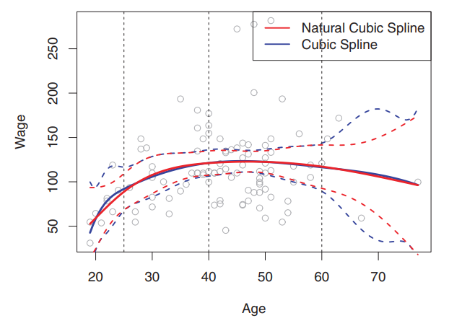

Natural Spline
A regression spline with boundary constraints
linear at the boundary that is, linear if $x≤c_{1}$ or $c_{k}≤x$

Slide 27

Model of Natural Spline
Let $d_{k}\left(x\right)=\frac{{\left(x−c_{k}\right)}_{+}^{3}−{\left(x−c_{K}\right)}_{+}^{3}}{c_{K}−c_{k}}$ $b_{k+1}\left(x\right)=d_{k}\left(x\right)−d_{K−1}(x)$
Model $y=β_{0}+β_{1}X+β_{2}b_{2}\left(X\right)+⋯+β_{K−1}b_{K−1}\left(X\right)+ε$

Slide 28
7.4.4 Choosing the Number and Locations of the Knots

Slide 29
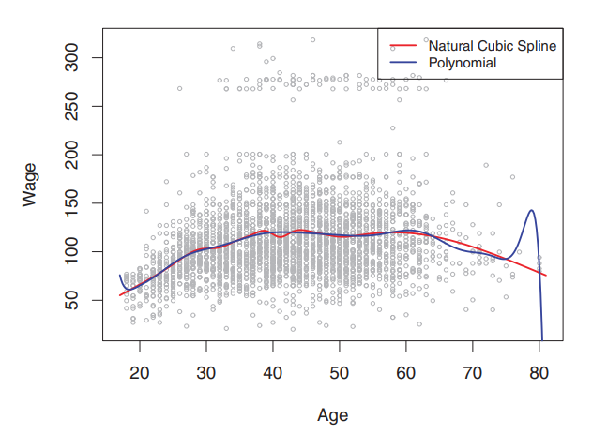
7.4.5 Comparison to Polynomial Regression

Slide 30

7.5 Smoothing Splines
7.5.1 An Overview of Smoothing Splines
7.5.2 Choosing the Smoothing Parameter $λ$

Slide 31

7.5.1 An Overview of Smoothing Splines
Fitting
Find $g(x)$ that minimizes $RSS=\sum_{i=1}^{n}{{\left(y_{i}−g\left(x_{i}\right)\right)}^{2}}$
Smoothing spline
Find g(x) that minimizes “Loss+Penalty” $\sum_{i=1}^{n}{{\left(y_{i}−g\left(x_{i}\right)\right)}^{2}+λ\int{g^{′′}{\left(t\right)}^{2}dt}}$

Slide 32

Avoiding Knot Selection Problem
Using the maximal set of knots with all inputs $x_{1}, …,x_{n}$
Overfitting is controlled by regularization $\int{g^{′′}{\left(t\right)}^{2}dt}$

Slide 33
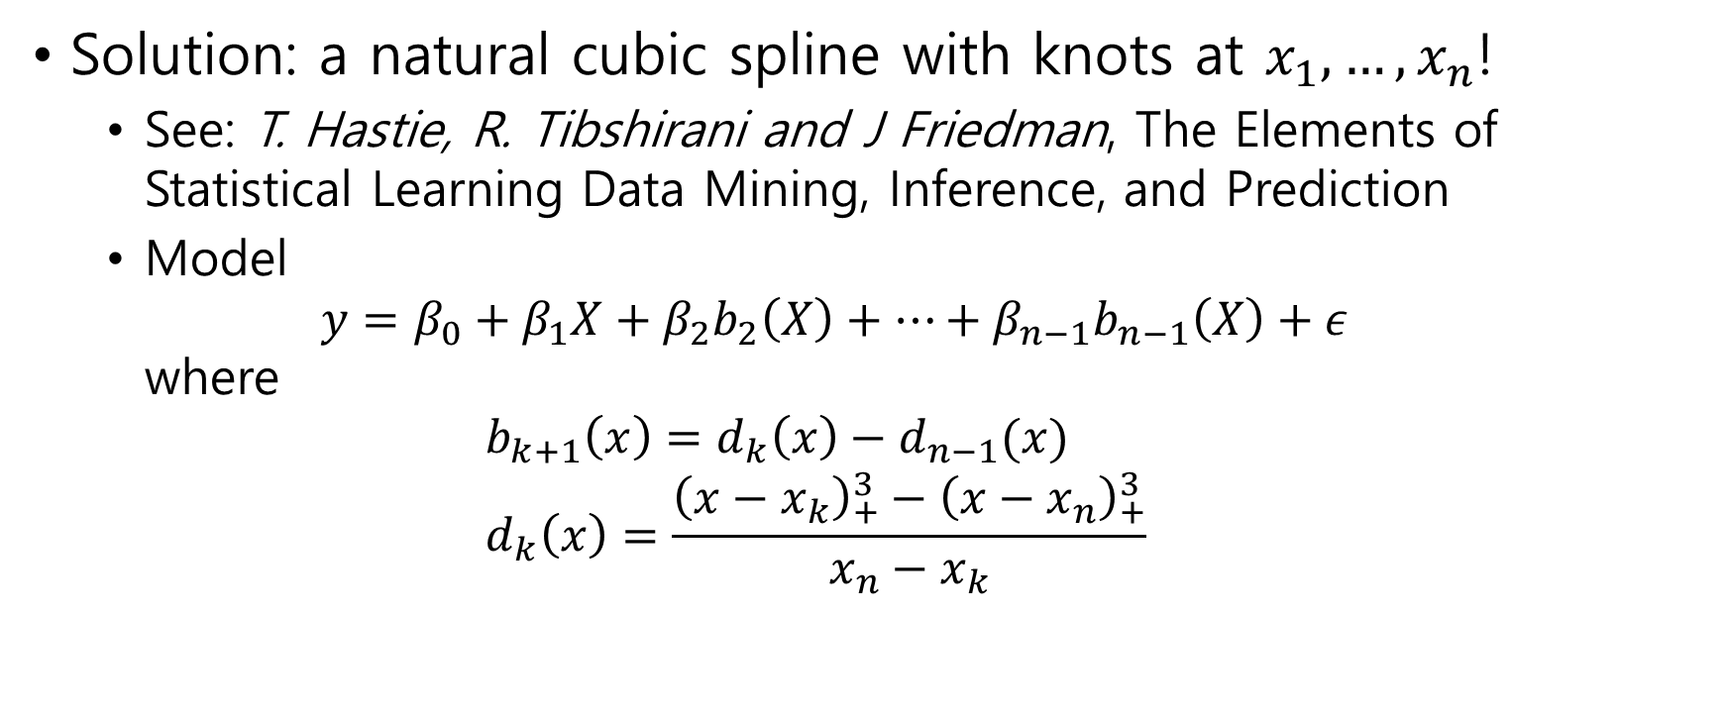
Smoothing spline
Solution: a natural cubic spline with knots at $x_{1},…,x_{n}$!
See: T. Hastie, R. Tibshirani and J Friedman, The Elements of Statistical Learning Data Mining, Inference, and Prediction
Model $y=β_{0}+β_{1}X+β_{2}b_{2}\left(X\right)+⋯+β_{n−1}b_{n−1}\left(X\right)+ε$ where $b_{k+1}\left(x\right)=d_{k}\left(x\right)−d_{n−1}(x)$ $d_{k}\left(x\right)=\frac{{\left(x−x_{k}\right)}_{+}^{3}−{\left(x−x_{n}\right)}_{+}^{3}}{x_{n}−x_{k}}$

Slide 34
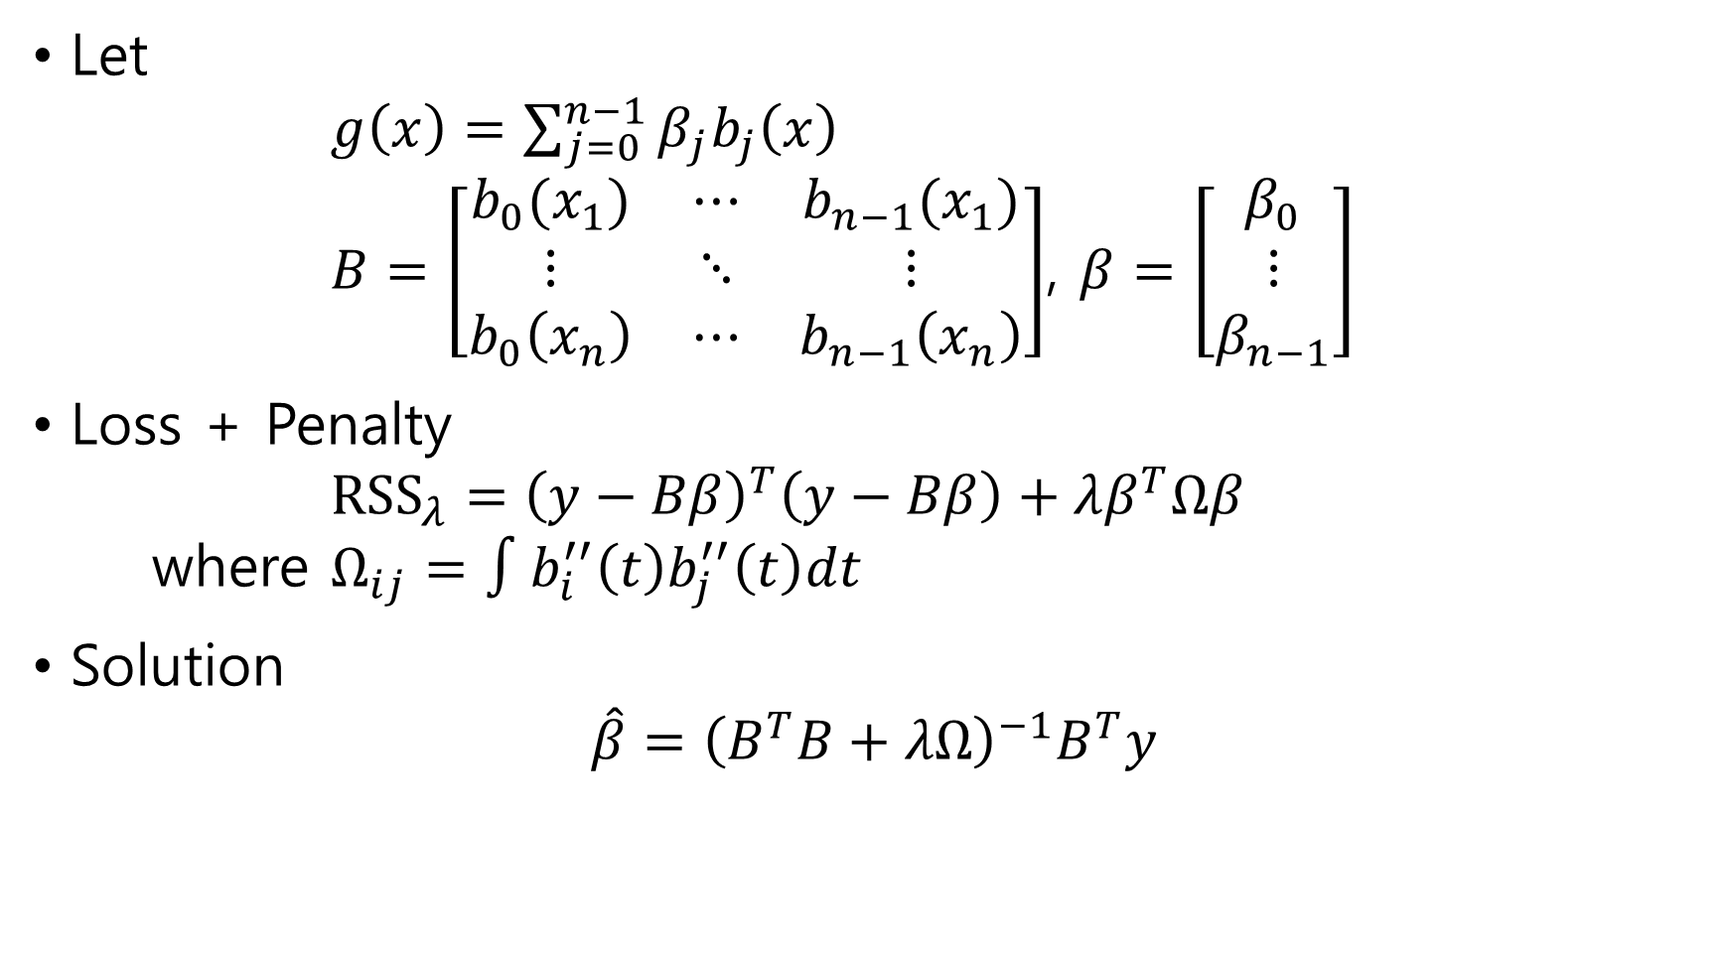
Let $g\left(x\right)=\sum_{j=0}^{n−1}{β_{j}b_{j}\left(x\right)}$ $B=\left[\begin{matrix}b_{0}(x_{1}) & ⋯ & b_{n−1}(x_{1}) \\ ⋮ & ⋱ & ⋮ \\ b_{0}\left(x_{n}\right) & ⋯ & b_{n−1}\left(x_{n}\right)\end{matrix}\right]$, $β=\left[\begin{matrix}β_{0} \\ ⋮ \\ β_{n−1}\end{matrix}\right]$
Loss + Penalty $RSS_{λ}={\left(y−Bβ\right)}^{T}\left(y−Bβ\right)+λβ^{T}Ωβ$ where $Ω_{ij}=∫b_{i}^{′′}\left(t\right)b_{j}^{′′}\left(t\right)dt$
Solution $\hat{β}={\left(B^{T}B+λΩ\right)}^{−1}B^{T}y$

Slide 35
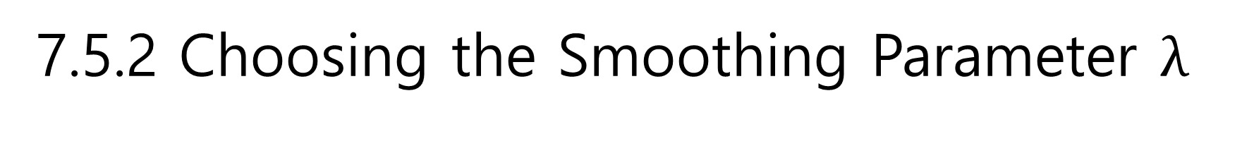
7.5.2 Choosing the Smoothing Parameter $λ$
Cross validation

Slide 36
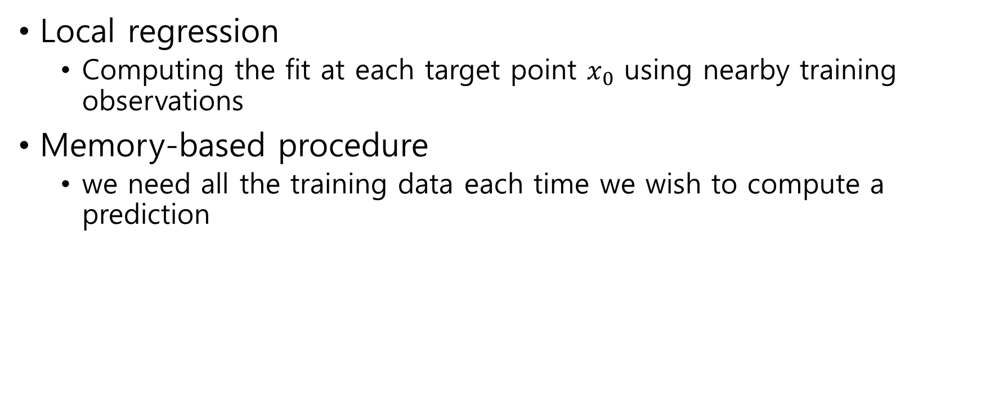
7.6 Local Regression
Local regression
Computing the fit at each target point $x_{0}$ using nearby training observations
Memory-based procedure
we need all the training data each time we wish to compute a prediction

Slide 37
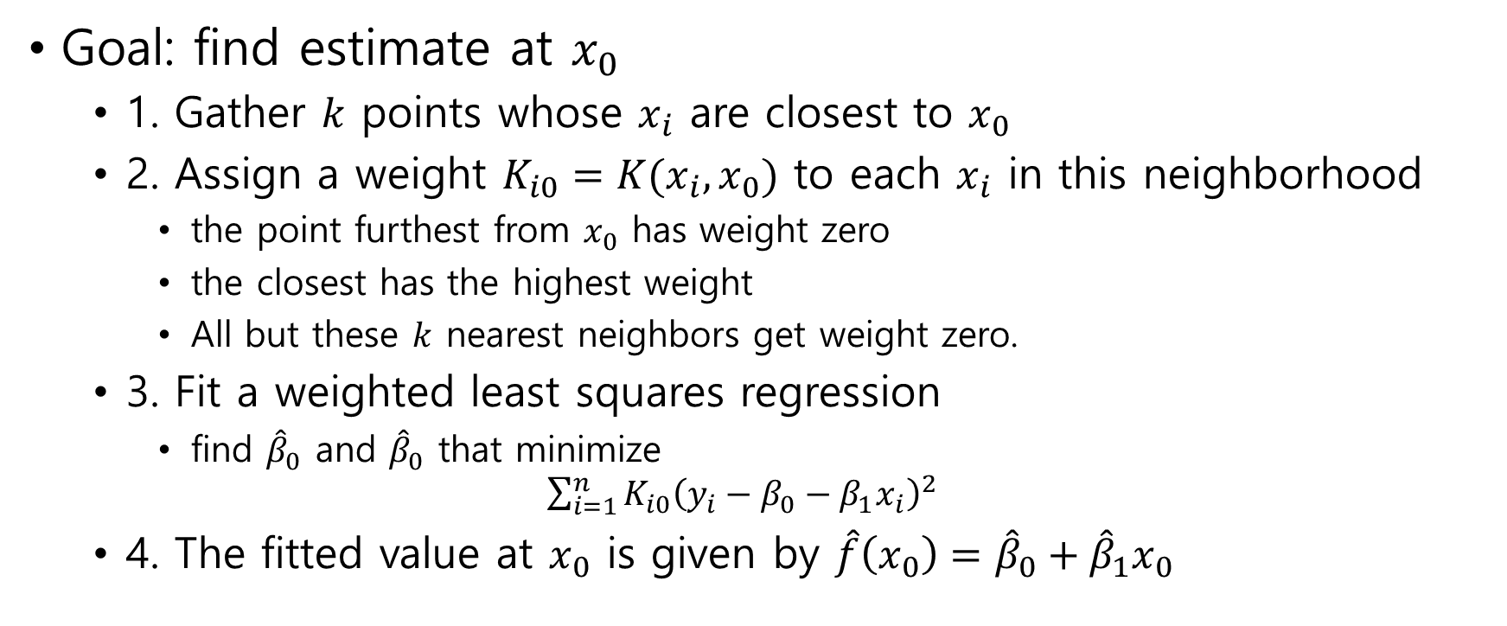
Algorithm
Goal: find estimate at $x_{0}$
1. Gather $k$ points whose $x_{i}$ are closest to $x_{0}$
2. Assign a weight $K_{i0}=K(x_{i},x_{0})$ to each $x_{i}$ in this neighborhood
the point furthest from $x_{0}$ has weight zero
the closest has the highest weight
All but these $k$ nearest neighbors get weight zero.
3. Fit a weighted least squares regression
find ${\hat{β}}_{0}$ and ${\hat{β}}_{0}$ that minimize $\sum_{i=1}^{n}{K_{i0}{\left(y_{i}−β_{0}−β_{1}x_{i}\right)}^{2}}$
4. The fitted value at $x_{0}$ is given by $\hat{f}\left(x_{0}\right)={\hat{β}}_{0}+{\hat{β}}_{1}x_{0}$

Slide 38
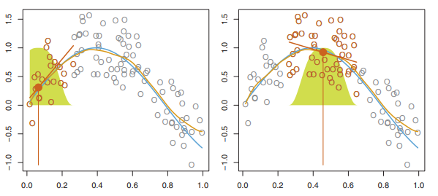

Slide 39
7.7 Generalized Additive Models
Generalized additive models (GAMs)
a general framework for generalized additive model extending a standard linear model

Slide 40

7.7.1 GAMs for Regression Problems
Model $Y=β_{0}+f_{1}\left(X_{1}\right)+⋯+f_{p}\left(X_{p}\right)+ϵ$

Slide 41

7.7.2 GAMs for Classification Problems
Model $\log{\frac{p\left(X\right)}{1−p\left(X\right)}}=β_{0}+f_{1}\left(X_{1}\right)+⋯+f_{p}\left(X_{p}\right)+ε$

