Slide 1
Statistical Learning
https://github.com/ggorr/Machine-Learning/tree/master/ISLR

Slide 2
8 Tree-Based Methods
8.1 The Basics of Decision Trees
8.2 Bagging, Random Forests, Boosting
8.3 Lab: Decision Tree
8.4 Exercises

Slide 3
8.1 The Basics of Decision Trees
8.1.1 Regression Trees
8.1.2 Classification Trees
8.1.3 Trees Versus Linear Models
8.1.4 Advantages and Disadvantages of Trees

Slide 4
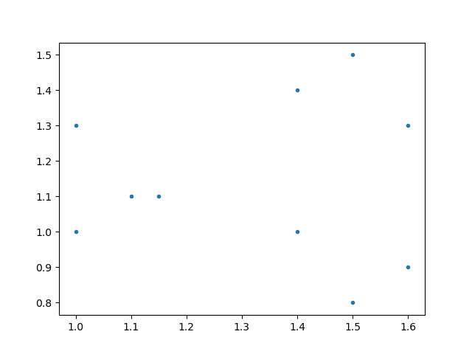
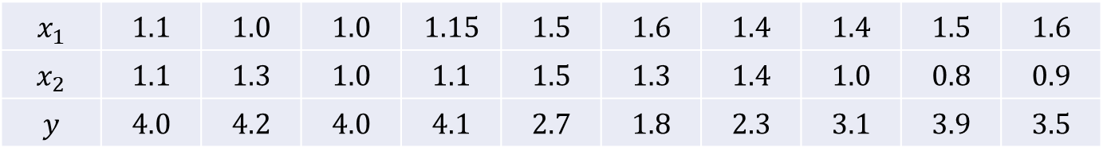
8.1.1 Regression Trees
$$x_{1}$$ | $$1.1$$ | $$1.0$$ | $$1.0$$ | $$1.15$$ | $$1.5$$ | $$1.6$$ | $$1.4$$ | $$1.4$$ | $$1.5$$ | $$1.6$$
$$x_{2}$$ | $$1.1$$ | $$1.3$$ | $$1.0$$ | $$1.1$$ | $$1.5$$ | $$1.3$$ | $$1.4$$ | $$1.0$$ | $$0.8$$ | $$0.9$$
$$y$$ | $$4.0$$ | $$4.2$$ | $$4.0$$ | $$4.1$$ | $$2.7$$ | $$1.8$$ | $$2.3$$ | $$3.1$$ | $$3.9$$ | $$3.5$$

Slide 5
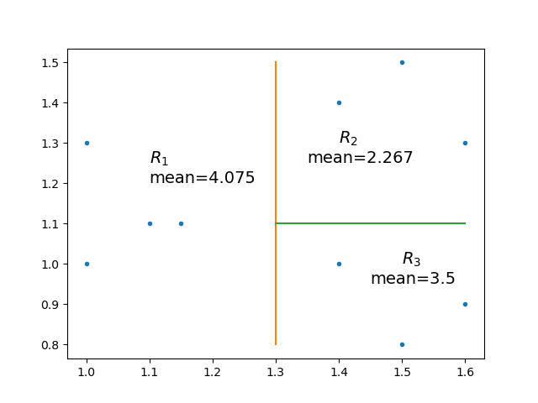

Means: $4.075$, $2.267$, $3.5$

Slide 6
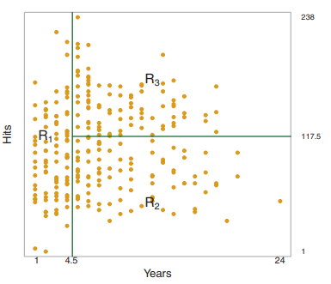

Slide 7
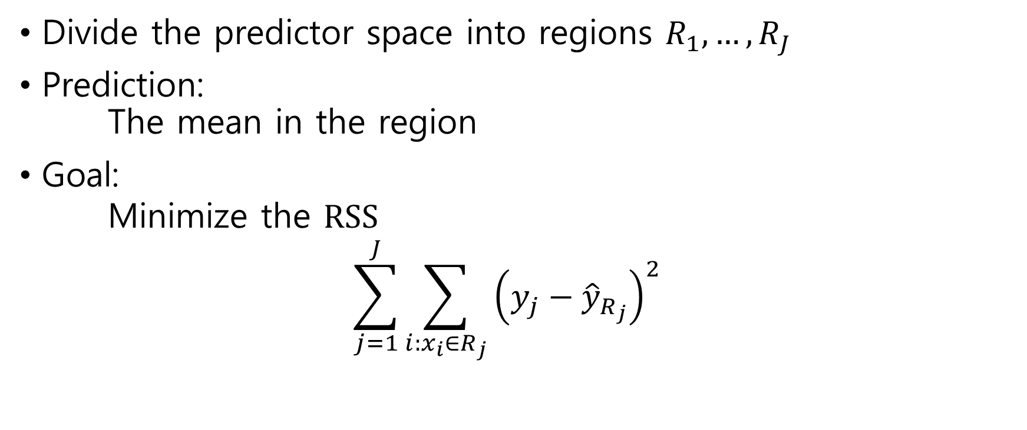
Regression Tree
Divide the predictor space into regions $R_{1}, …, R_{J}$
Prediction: The mean in the region
Goal: Minimize the $RSS$ $\sum_{j=1}^{J}{\sum_{{i:x}_{i}∈R_{j}}{{\left(y_{j}−{\hat{y}}_{R_{j}}\right)}^{2}}}$

Slide 8
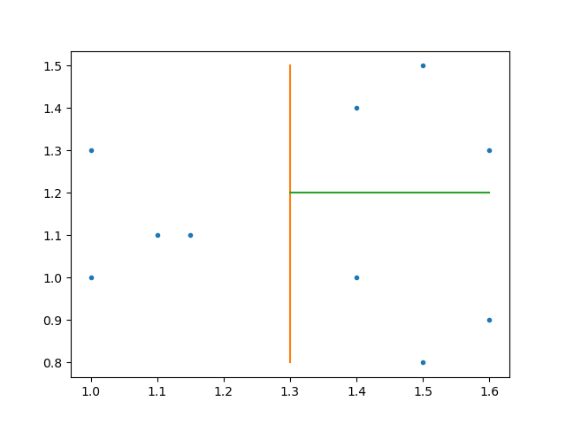
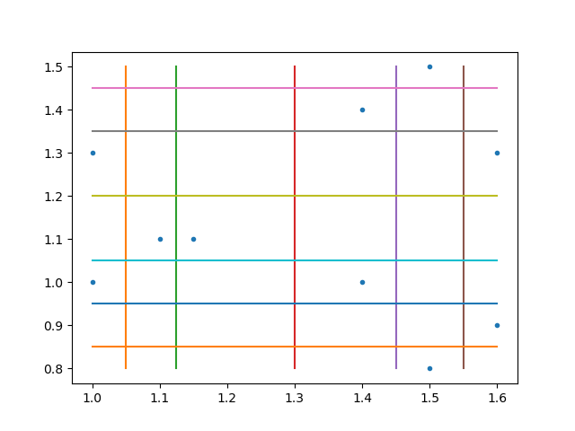
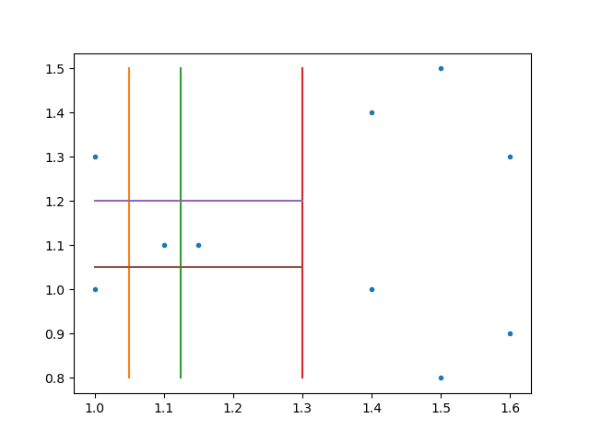
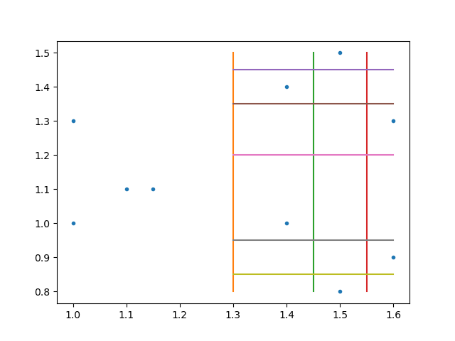
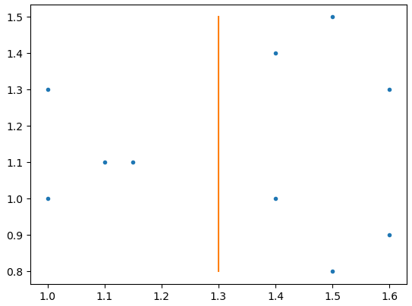

Finding Regions
Let $R_{1}\left(j,s\right)=\left\{X | X_{j}<s\right\}$, $R_{2}\left(j,s\right)=\left\{X | X_{j}≥s\right\}$
Seek $j$ and $s$ that minimize the value $\sum_{i:x_{i}∈R_{1}\left(j,s\right)}{{\left(y_{i}−{\hat{y}}_{R_{1}}\right)}^{2}+}$ $\sum_{{i:x}_{i}∈R_{2}\left(j,s\right)}{{\left(y_{i}−{\hat{y}}_{R_{2}}\right)}^{2}}$
Repeat this process for $R_{1}\left(j,s\right)$ and $R_{2}\left(j,s\right)$

Slide 9
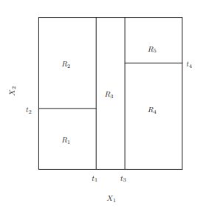
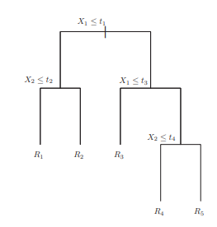

Slide 10
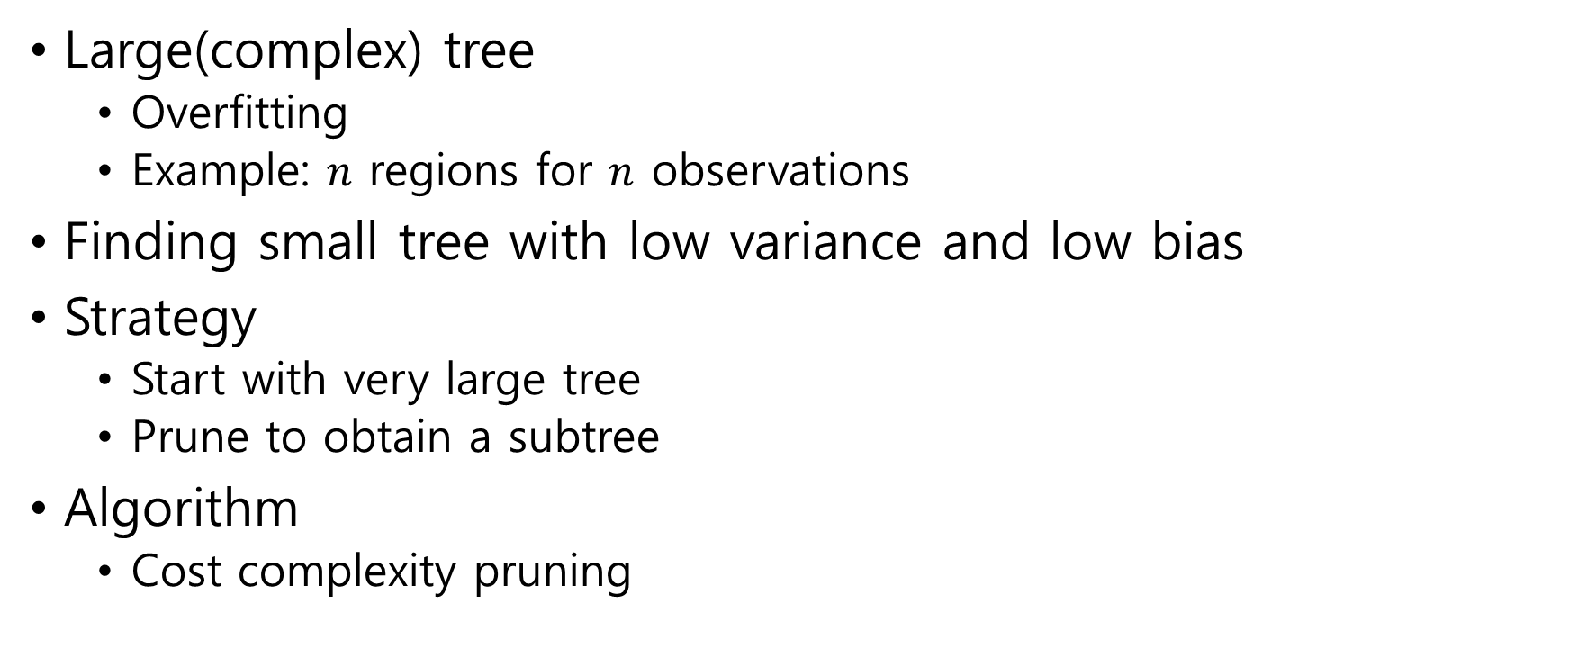
Tree Pruning
Large(complex) tree
Overfitting
Example: $n$ regions for $n$ observations
Finding small tree with low variance and low bias
Strategy
Start with very large tree
Prune to obtain a subtree
Algorithm
Cost complexity pruning

Slide 11
8.1.2 Classification Trees
Classification tree
responses are qualitative
Decision
the most commonly occurring class in each region

Slide 12
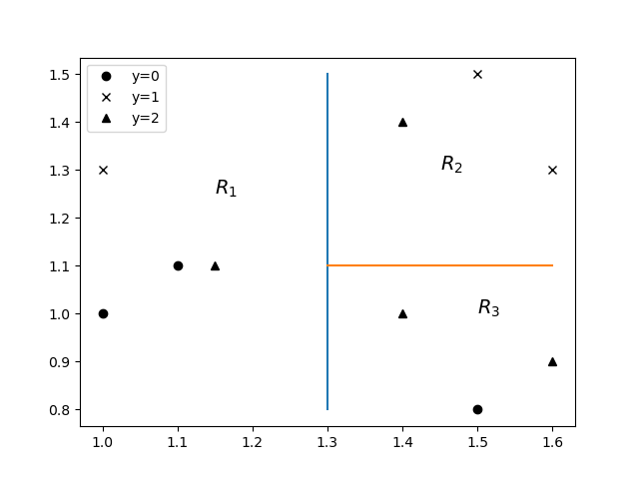
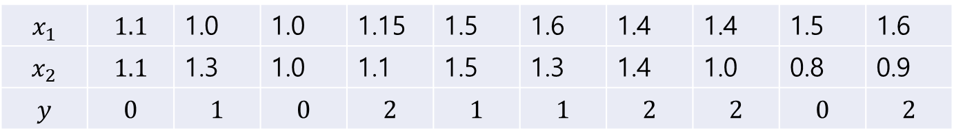
Example
$$x_{1}$$ | $$1.1$$ | 1.0 | 1.0 | 1.15 | 1.5 | 1.6 | 1.4 | 1.4 | 1.5 | 1.6
$$x_{2}$$ | $$1.1$$ | 1.3 | 1.0 | 1.1 | 1.5 | 1.3 | 1.4 | 1.0 | 0.8 | 0.9
$$y$$ | $$0$$ | $$1$$ | $$0$$ | $$2$$ | $$1$$ | $$1$$ | $$2$$ | $$2$$ | $$0$$ | $$2$$

Slide 13
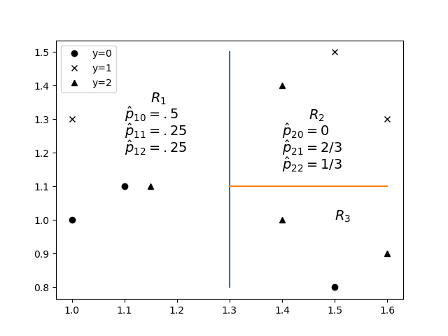
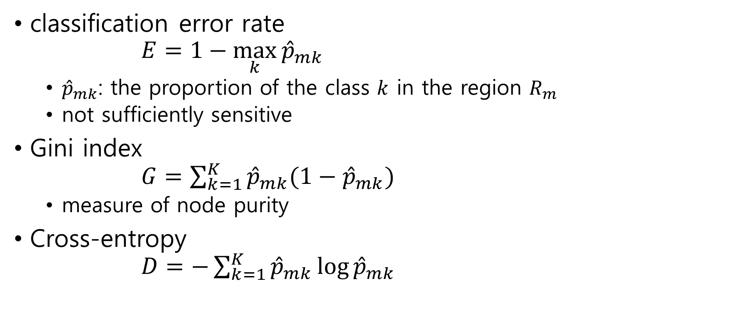
RSS
classification error rate $E=1−\max_{k}{{\hat{p}}_{mk}}$
${\hat{p}}_{mk}$: the proportion of the class $k$ in the region $R_{m}$
not sufficiently sensitive
Gini index $G=\sum_{k=1}^{K}{{\hat{p}}_{mk}(1−{\hat{p}}_{mk})}$
measure of node purity
Cross-entropy $D=−\sum_{k=1}^{K}{{\hat{p}}_{mk}\log{{\hat{p}}_{mk}}}$

Slide 14
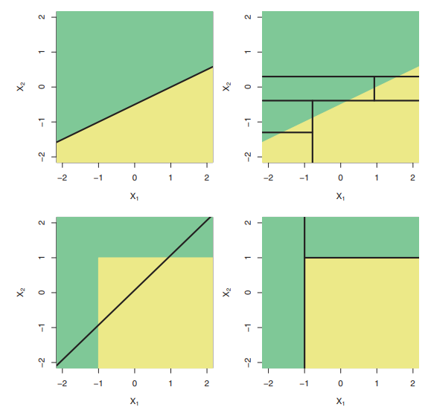
8.1.3 Trees Versus Linear Models
Classification Example
two classes green and yellow

Slide 15
8.1.4 Advantages and Disadvantages of Trees
Trees are
easy to explain
similar to human decision-making
some people believe it!!!
not accurate relative to other regression

Slide 16
8.2 Bagging, Random Forests, Boosting
8.2.1 Bagging
8.2.2 Random Forests
8.2.3 Boosting

Slide 17
8.2.1 Bagging
Bootstrap aggregating = bagging
Motivation
Decision tree suffer from high variance
Averaging a set of observations reduces variance
Approach
Averaging estimates of bootstrapped training data sets
Note
Bootstrap uses repeated samples with replacement

Slide 18

Bagging in Regression
find estimate ${\hat{f}}^{∗b}(x)$ for $b$-th bootstrapped training data set
averaging ${\hat{f}}_{bag}\left(x\right)=\frac{1}{B}\sum_{b=1}^{B}{{\hat{f}}^{∗b}(x)}$ where $B$ is the number of bootstrapped training data sets

Slide 19
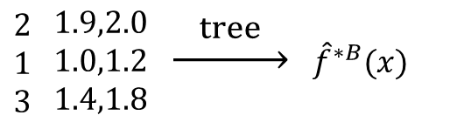
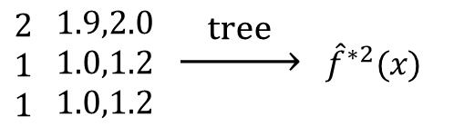
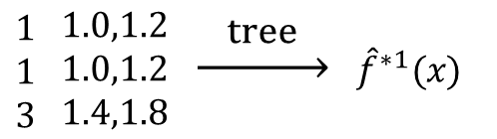

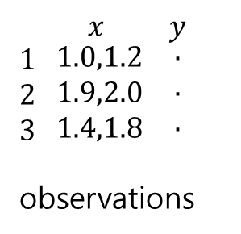
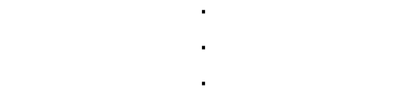
bootstrapped
training data set
$\begin{matrix}1 \\ 1 \\ 3\end{matrix} \begin{matrix}1.0,1.2 \\ 1.0,1.2 \\ 1.4,1.8\end{matrix}$ $\underset{→}{ tree }$ ${\hat{f}}^{∗1}(x)$
$\begin{matrix}2 \\ 1 \\ 1\end{matrix} \begin{matrix}1.9,2.0 \\ 1.0,1.2 \\ 1.0,1.2\end{matrix}$ $\underset{→}{ tree }$ ${\hat{f}}^{∗2}(x)$
$x$ $y$ $\begin{matrix}1 \\ 2 \\ 3\end{matrix} \begin{matrix}1.0,1.2 \\ 1.9,2.0 \\ 1.4,1.8\end{matrix}$ $\begin{matrix}. \\ . \\ .\end{matrix}$
observations
average
${\hat{f}}_{bag}(x)$
$$\begin{matrix}. \\ . \\ .\end{matrix}$$
$\begin{matrix}2 \\ 1 \\ 3\end{matrix} \begin{matrix}1.9,2.0 \\ 1.0,1.2 \\ 1.4,1.8\end{matrix}$ $\underset{→}{ tree }$ ${\hat{f}}^{∗B}(x)$

Slide 20
Bagging with Decision Tree
Complex tree
High variance
Bagging
Averaging without pruning
Reduces variance

Slide 21
Bagging in Classification
Majority vote

Slide 22
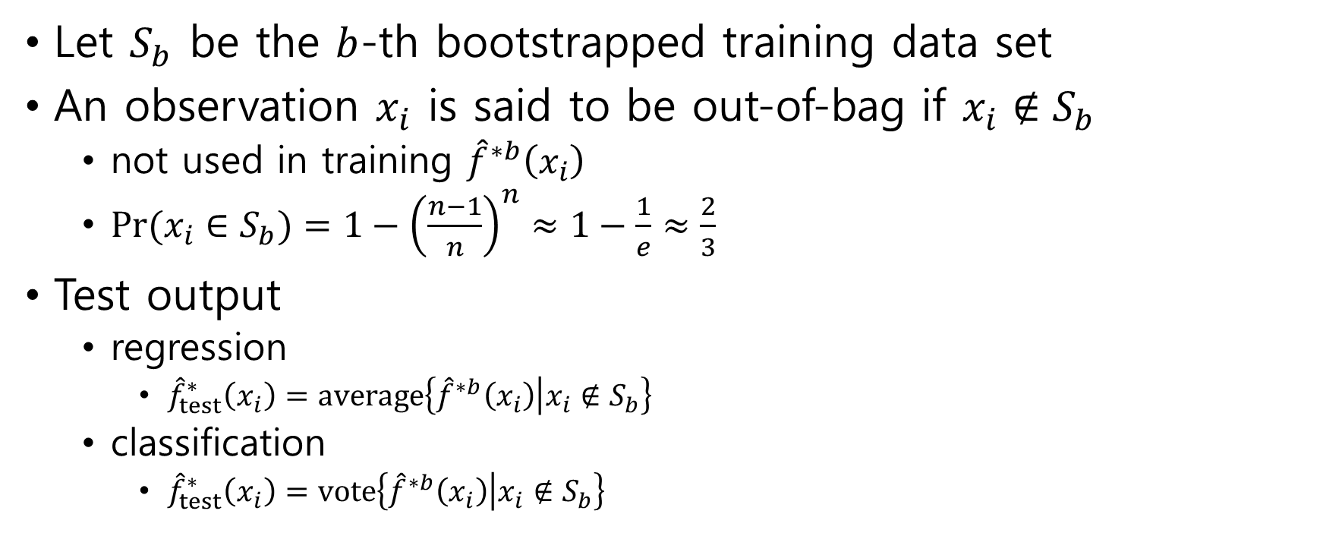
Out-of-bag Error Estimation
Let $S_{b}$ be the $b$-th bootstrapped training data set
An observation $x_{i}$ is said to be out-of-bag if $x_{i}∉S_{b}$
not used in training ${\hat{f}}^{∗b}\left(x_{i}\right)$
$Pr(x_{i}∈S_{b}⁡)=1−{\left(\frac{n−1}{n}\right)}^{n}≈1−\frac{1}{e}≈\frac{2}{3}$
Test output
regression
${\hat{f}}_{test}^{∗}\left(x_{i}\right)=average\left\{{\hat{f}}^{∗b}\left(x_{i}\right) | x_{i}∉S_{b}\right\}$
classification
${\hat{f}}_{test}^{∗}\left(x_{i}\right)=vote\left\{{\hat{f}}^{∗b}\left(x_{i}\right) | x_{i}∉S_{b}\right\}$

Slide 23
Variable Importance Measures
average of Gini indices

Slide 24
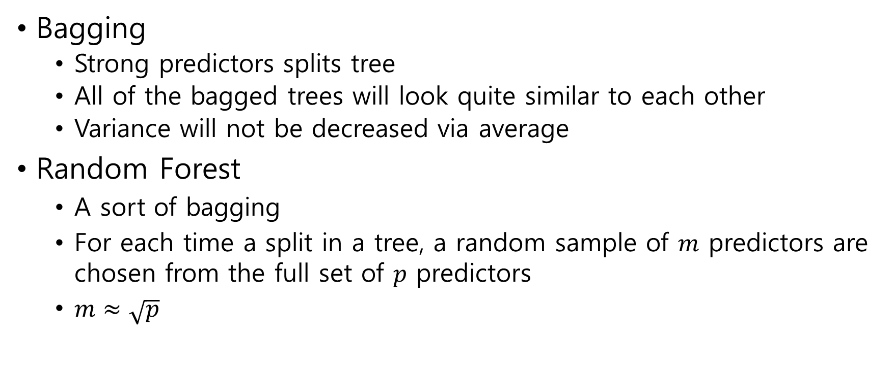
8.2.2 Random Forests
Bagging
Strong predictors splits tree
All of the bagged trees will look quite similar to each other
Variance will not be decreased via average
Random Forest
A sort of bagging
For each time a split in a tree, a random sample of $m$ predictors are chosen from the full set of $p$ predictors
$m≈\sqrt{p}$

Slide 25
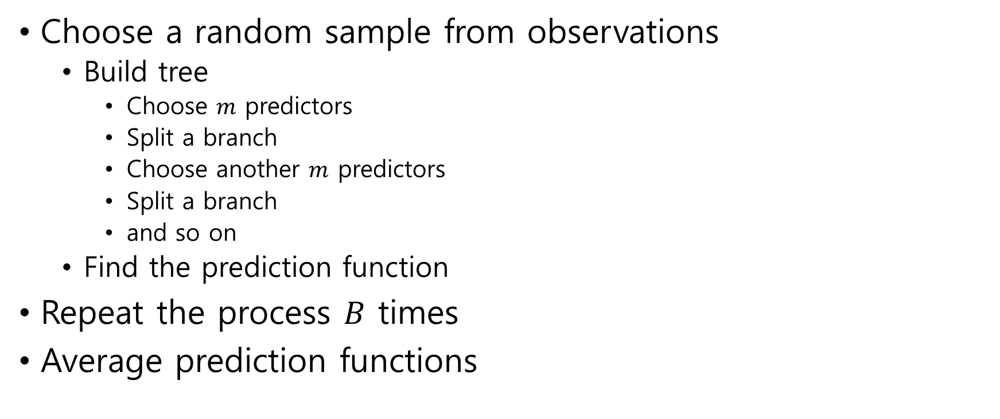
Random Forest Algorithm
Choose a random sample from observations
Build tree
Choose $m$ predictors
Split a branch
Choose another $m$ predictors
Split a branch
and so on
Find the prediction function
Repeat the process $B$ times
Average prediction functions

Slide 26
8.2.3 Boosting
Boosting
A sort of decision tree
the trees are grown sequentially
each tree is grown using information from previously grown trees

Slide 27
