Slide 1
Statistical Learning
https://github.com/ggorr/Machine-Learning/tree/master/ISLR

Slide 2
9 Support Vector Machines
9.1 Maximal Margin Classifier
9.2 Support Vector Classifiers
9.3 Support Vector Machines
9.4 SVMs with More than Two Classes
9.5 Relationship to Logistic Regression
9.6 Lab: Support Vector Machines
9.7 Exercises

Slide 3
9.1 Maximal Margin Classifier
9.1.1 What Is a Hyperplane?
9.1.2 Classification Using a Separating Hyperplane
9.1.3 The Maximal Margin Classifier
9.1.4 Construction of the Maximal Margin Classifier
9.1.5 The Non-separable Case

Slide 4
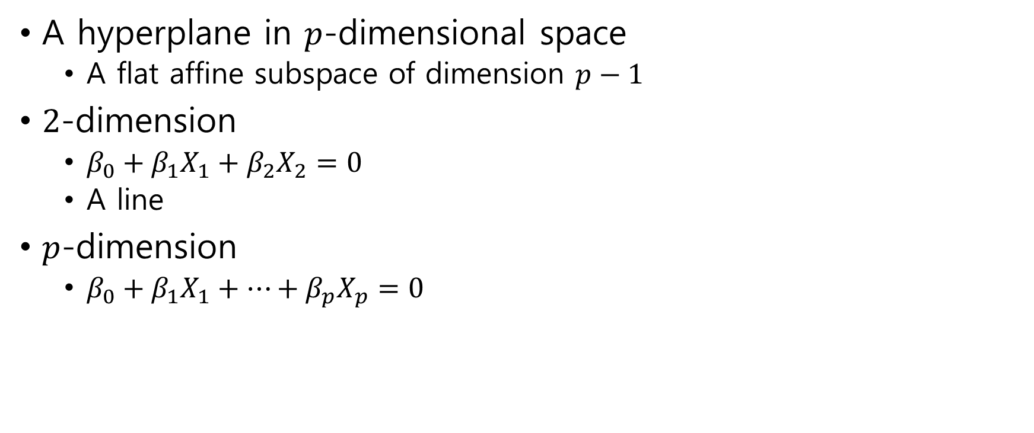
9.1.1 What Is a Hyperplane?
A hyperplane in $p$-dimensional space
A flat affine subspace of dimension $p−1$
$2$-dimension
$β_{0}+β_{1}X_{1}+β_{2}X_{2}=0$
A line
$p$-dimension
$β_{0}+β_{1}X_{1}+⋯+β_{p}X_{p}=0$

Slide 5
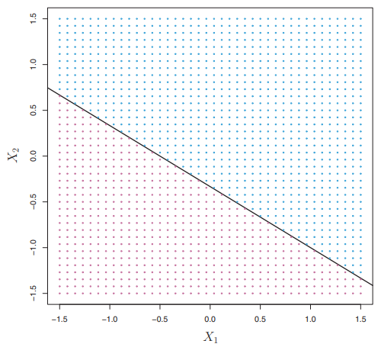

A hyperplane divides $p$-dimensional space into two halves
$β_{0}+β_{1}X_{1}+⋯+β_{p}X_{p}>0$
$β_{0}+β_{1}X_{1}+⋯+β_{p}X_{p}<0$

Slide 6

9.1.2 Classification Using a Separating Hyperplane
Training observations
$x_{1}=\left[\begin{matrix}x_{11} \\ ⋮ \\ x_{1p}\end{matrix}\right], …,x_{n}=\left[\begin{matrix}x_{n1} \\ ⋮ \\ x_{np}\end{matrix}\right]$
$y_{1}, …,y_{n}∈\{−1, 1\}$
Test observation
$x^{∗}=$ $\left[\begin{matrix}x_{1}^{∗} \\ ⋮ \\ x_{p}^{∗}\end{matrix}\right]$
$y^{∗}=?$

Slide 7
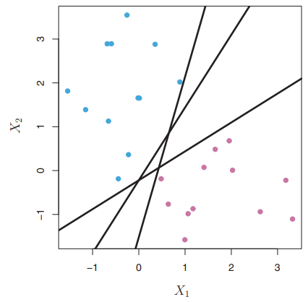
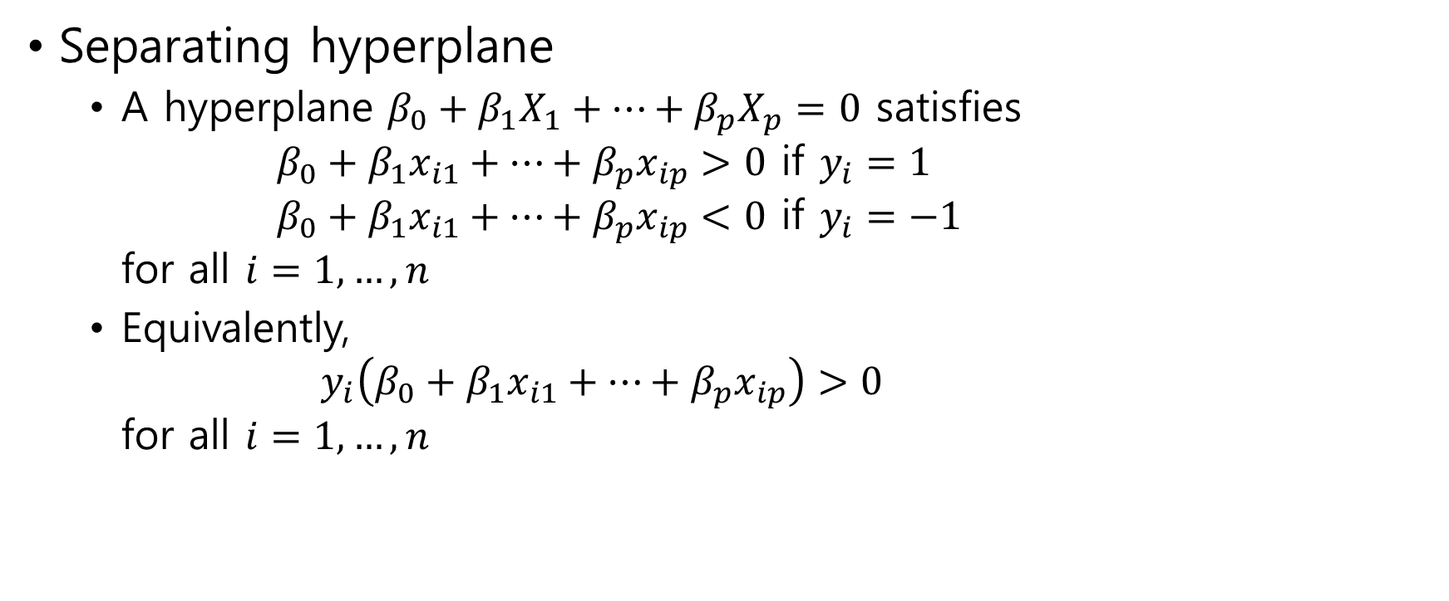
Separating hyperplane
Separating hyperplane
A hyperplane $β_{0}+β_{1}X_{1}+⋯+β_{p}X_{p}=0$ satisfies $β_{0}+β_{1}x_{i1}+⋯+β_{p}x_{ip}>0$ if $y_{i}=1$ $β_{0}+β_{1}x_{i1}+⋯+β_{p}x_{ip}<0$ if $y_{i}=−1$ for all $i=1,…,n$
Equivalently, $y_{i}\left(β_{0}+β_{1}x_{i1}+⋯+β_{p}x_{ip}\right)>0$ for all $i=1,…,n$

Slide 8
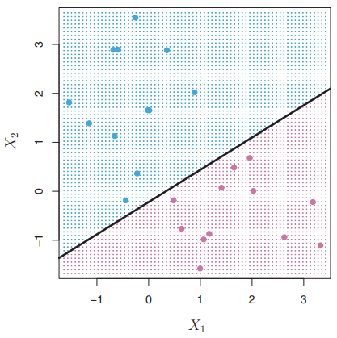

Let $f\left(x^{∗}\right)=β_{0}+β_{1}x_{1}^{∗}+⋯+β_{p}x_{p}^{∗}$
$y^{∗}=\left\{\begin{aligned} 1 if f\left(x^{∗}\right)>0 \\ −1 if f\left(x^{∗}\right)>0\end{aligned}\right.$

Slide 9
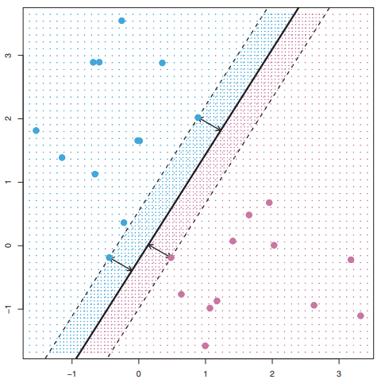
9.1.3 The Maximal Margin Classifier
Margin
The minimal perpendicular distance from the observations to the separating hyperplane
Maximal margin hyperplane (a.k.a. optimal separating hyperplane)
The separating hyperplane that is farthest from the training observations
Maximal margin classifier
To classify test observation using maximal margin hyperplane

Slide 10
Support vector
Support vector
training observations that are equidistant from the maximal margin hyperplane
Hyperplane in the right figure has 3 support vectors

Slide 11

9.1.4 Construction of the Maximal Margin Classifier
Optimization problem: $\underset{β_{0},…,β_{p}}{maximize}{M}$ subject to $\sum_{j=1}^{p}{β_{j}^{2}}=1$ and $y_{i}\left(β_{0}+β_{1}x_{i1}+⋯+β_{p}x_{ip}\right)>M$ for all $i=1,…,n$

Slide 12
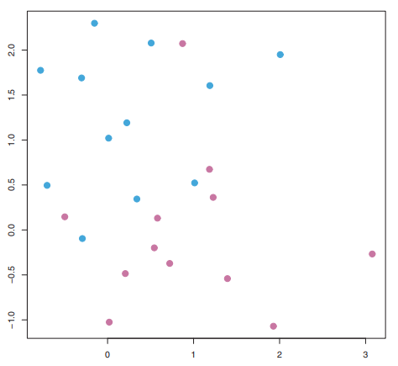
9.1.5 The Non-separable Case
Support vector classifier.
Find a hyperplane that almost separates the classes
Using a soft margin

Slide 13
9.2 Support Vector Classifiers
9.2.1 Overview of the Support Vector Classifier
9.2.2 Details of the Support Vector Classifier

Slide 14
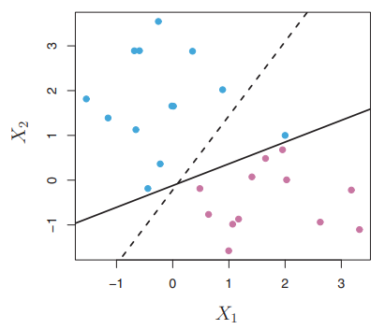
9.2.1 Overview of the Support Vector Classifier
the maximal margin hyperplane
Sometimes, it has only a tiny margin
Extremely sensitive to a change in a single observation
Sensitive to error

Slide 15
support vector classifier
support vector classifier = soft margin classifier
Based on a hyperplane that may not perfectly separate the two classes
Greater robustness to individual observations
Better classification of most of the training observations

Slide 16
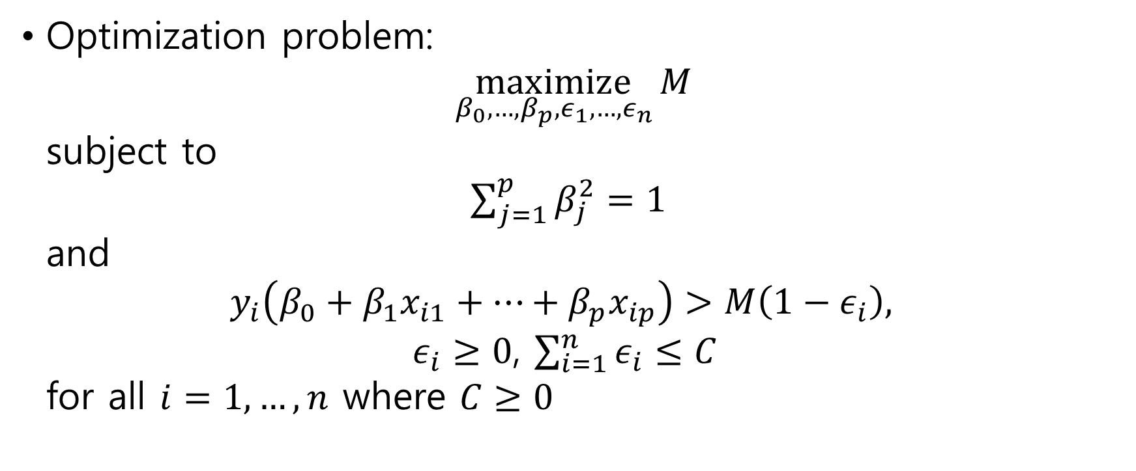
9.2.2 Details of the Support Vector Classifier
Optimization problem: $\underset{β_{0},…,β_{p},ε_{1},…,ε_{n}}{maximize}{M}$ subject to $\sum_{j=1}^{p}{β_{j}^{2}}=1$ and $y_{i}\left(β_{0}+β_{1}x_{i1}+⋯+β_{p}x_{ip}\right)>M\left(1−ε_{i}\right),$ $ε_{i}≥0$, $\sum_{i=1}^{n}{ε_{i}≤C}$ for all $i=1,…,n$ where $C≥0$

