Slide 1
Statistical Learning
https://github.com/ggorr/Machine-Learning/tree/master/ISLR

Slide 2

10 Unsupervised Learning
Unsupervised Learning
Observations
Features $X_{1}$, $…$, $X_{p}$
Without or unknown response
To discover interesting things
PCA
Clustering

Slide 3
10.2 Principal Components Analysis
To find highly variable directions
To find subspaces that are as close as possible to the data cloud

Slide 4
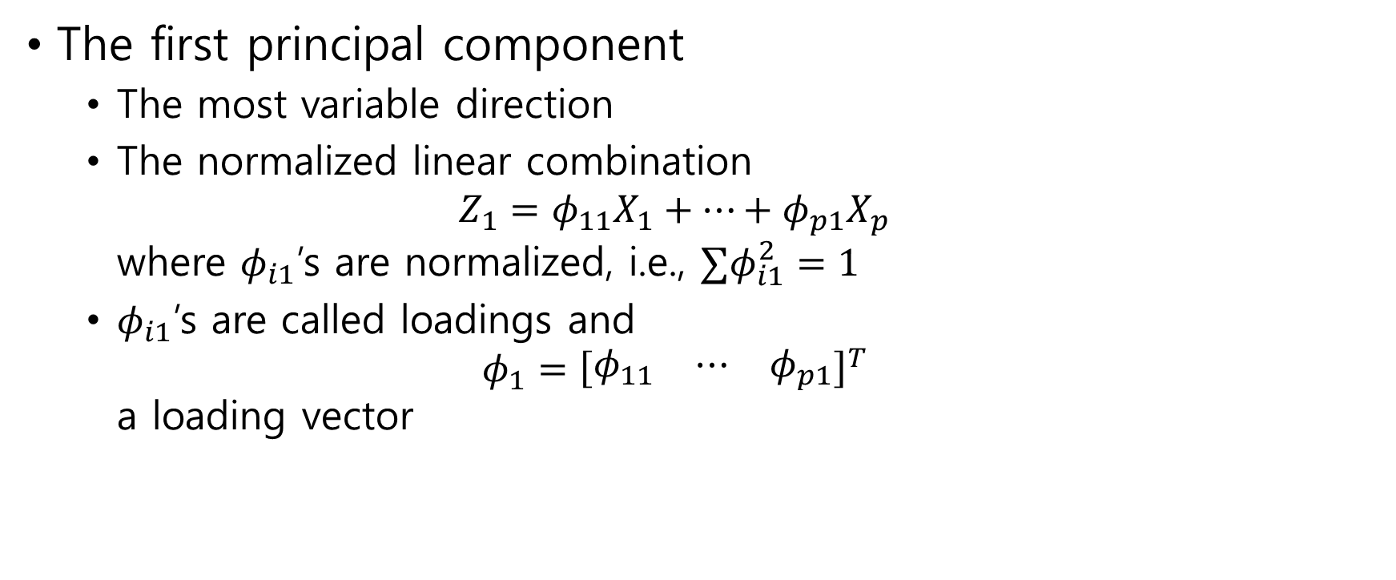
10.2.1 What Are Principal Components?
The first principal component
The most variable direction
The normalized linear combination $Z_{1}=φ_{11}X_{1}+⋯+φ_{p1}X_{p}$ where $φ_{i1}$’s are normalized, i.e., $∑φ_{i1}^{2}=1$
$φ_{i1}$’s are called loadings and $φ_{1}={\left[\begin{matrix}φ_{11} & ⋯ & φ_{p1}\end{matrix}\right]}^{T}$ a loading vector

Slide 5
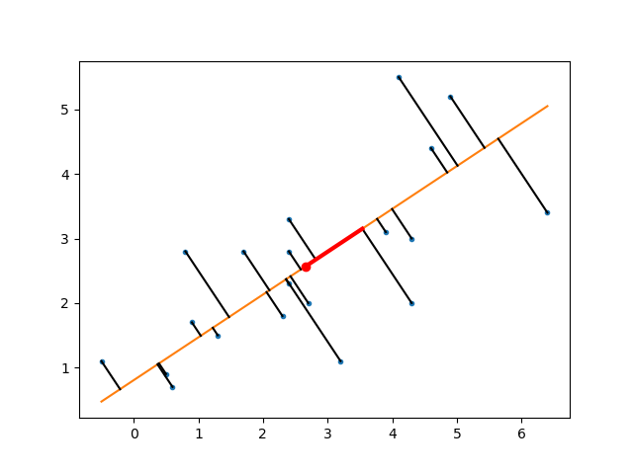


$$z_{i1}={φ_{11}x}_{i1}+⋯+φ_{p1}x_{ip}$$
centroid
$$x_{i}$$

Slide 6
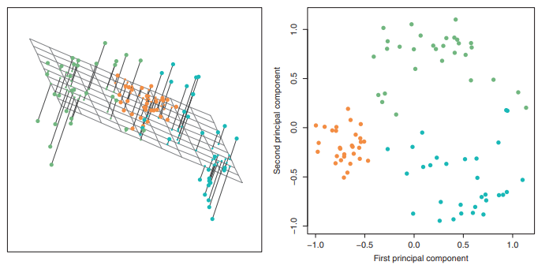

Slide 7
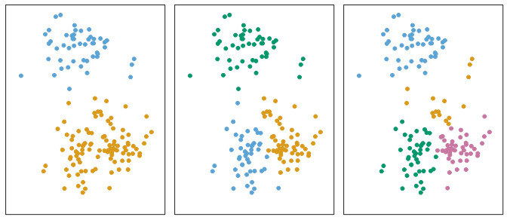
10.3 Clustering Methods
Are observations similar or different?

Slide 8
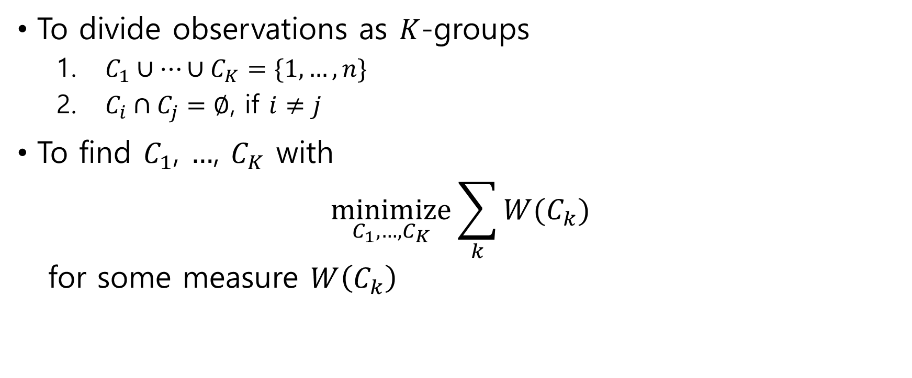

10.3.1 $K$-Means Clustering
To divide observations as $K$-groups
$C_{1}∪⋯∪C_{K}=\{1,…,n\}$
$C_{i}∩C_{j}=∅$, if $i≠j$
To find $C_{1}$, $…$, $C_{K}$ with $\underset{C_{1},…,C_{K}}{minimize}{\sum_{k}{W(C_{k})}}$ for some measure $W\left(C_{k}\right)$

Slide 9

Squared Euclidean distance measure $W\left(C_{k}\right)=\frac{1}{\left|C_{k}\right|}\sum_{i,j∈C_{k}}{∥x_{i}−x_{j}∥^{2}}$
To find $C_{1}$, $…$, $C_{K}$ with $\underset{C_{1},…,C_{K}}{minimize}{\sum_{k}{\frac{1}{\left|C_{k}\right|}\sum_{i,j∈C_{k}}{∥x_{i}−x_{j}∥^{2}}}}$

Slide 10
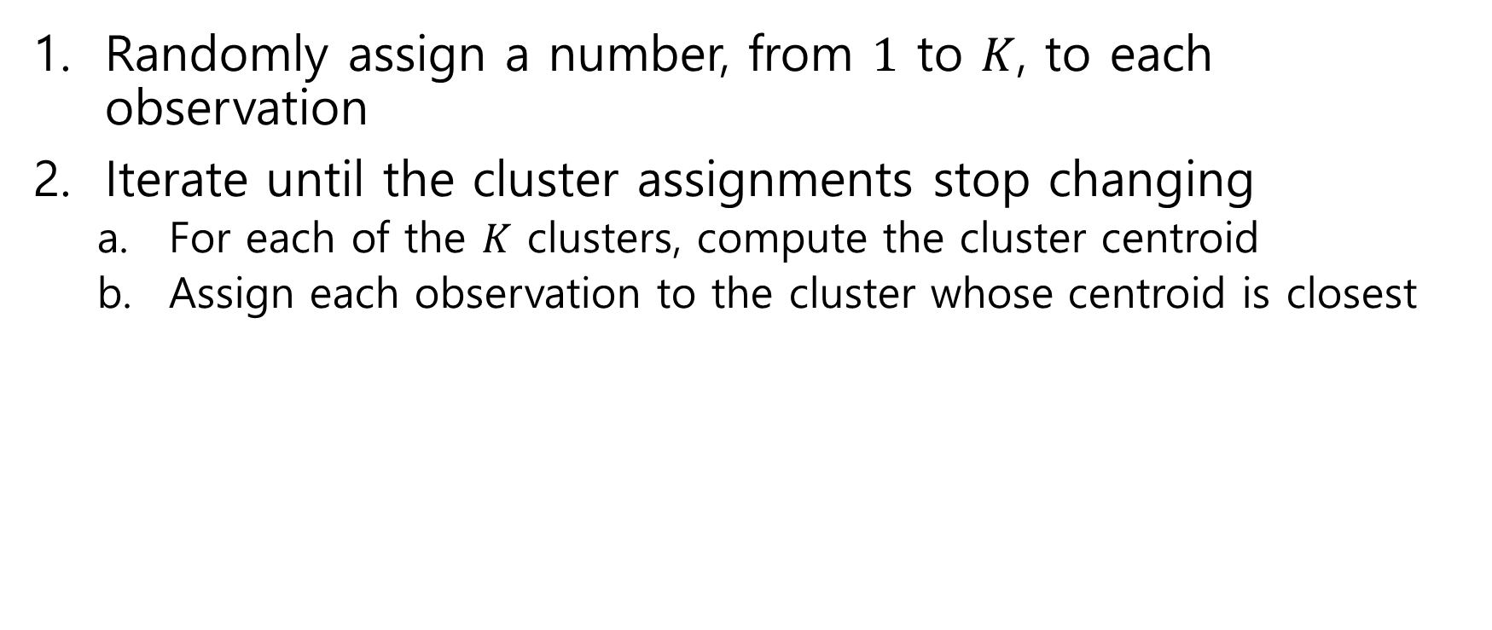

Algorithm 10.1 $K$-Means Clustering
Randomly assign a number, from $1$ to $K$, to each observation
Iterate until the cluster assignments stop changing
For each of the $K$ clusters, compute the cluster centroid
Assign each observation to the cluster whose centroid is closest

Slide 11
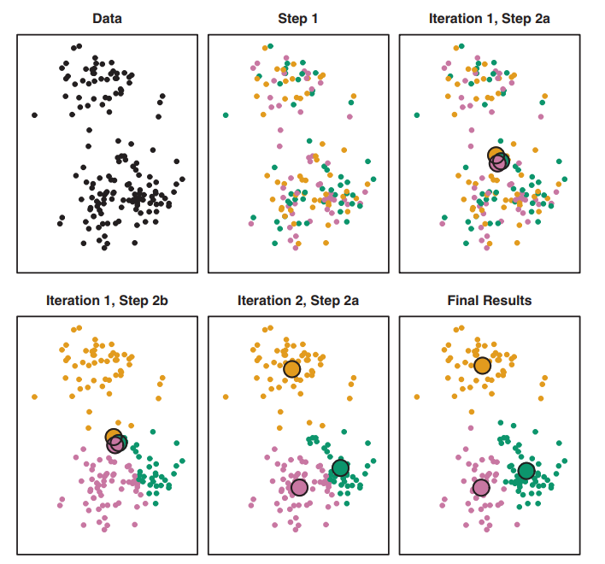

Slide 12
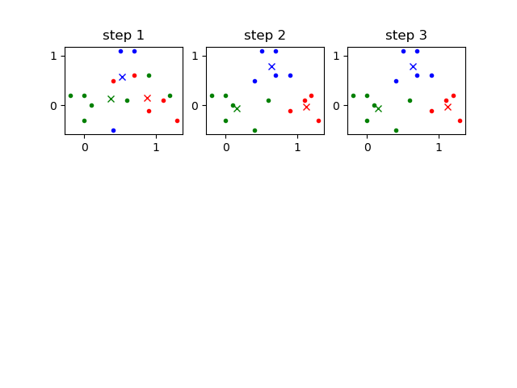
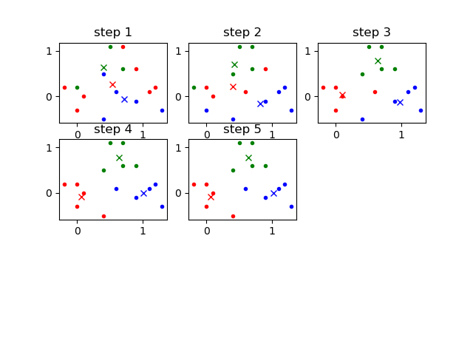

Slide 13
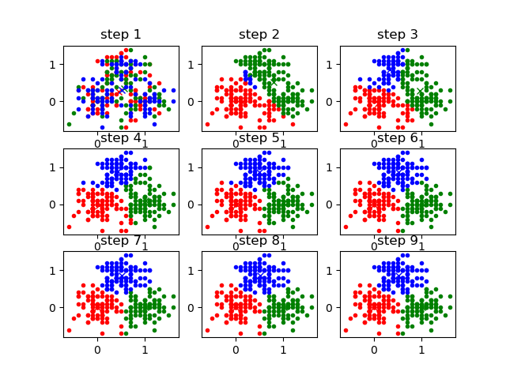

Slide 14
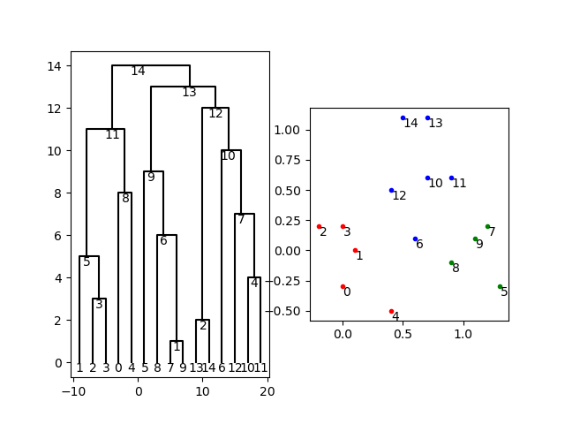
10.3.2 Hierarchical Clustering
Hierarchical clustering
Tree based clustering

Slide 15

Algorithm 10.2 Hierarchical Clustering
Begin with $n$ observations as clusters
Repeat
Fuse two clusters that are least dissimilar(most similar)

Slide 16
Dissimility
Complete linkage
Maximal intercluster dissimilarity
Single linkage
Minimal intercluster dissimilarity
Average linkage
Mean intercluster dissimilarity
Centroid linkage
Dissimilarity between centroids

Slide 17
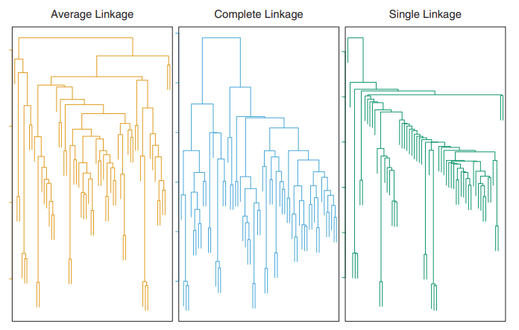

Slide 18
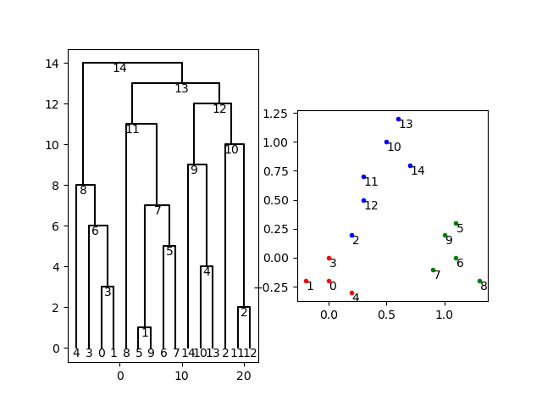

Slide 19
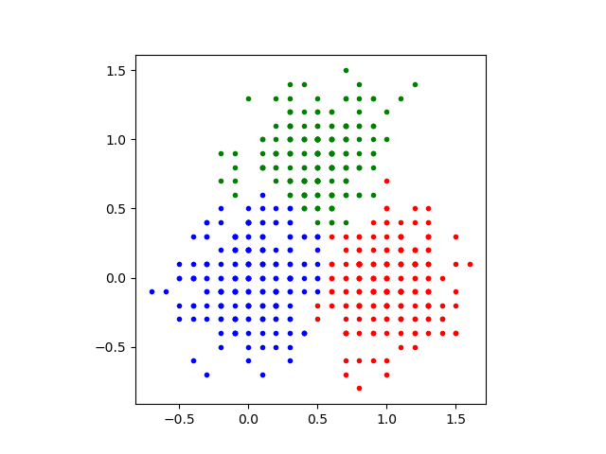
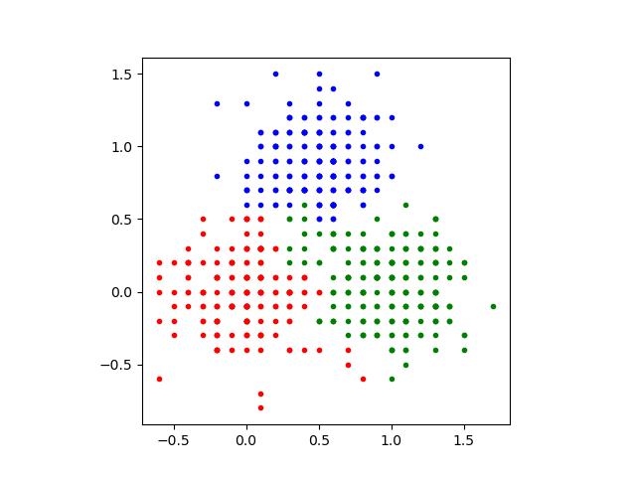
Hierarchical Clustering with average linkage
600 observations

