Slide 1
인공지능프로그래밍
게임콘텐츠학과 박경수
https://github.com/ggorr/Machine-Learning/tree/master/Python

Slide 2
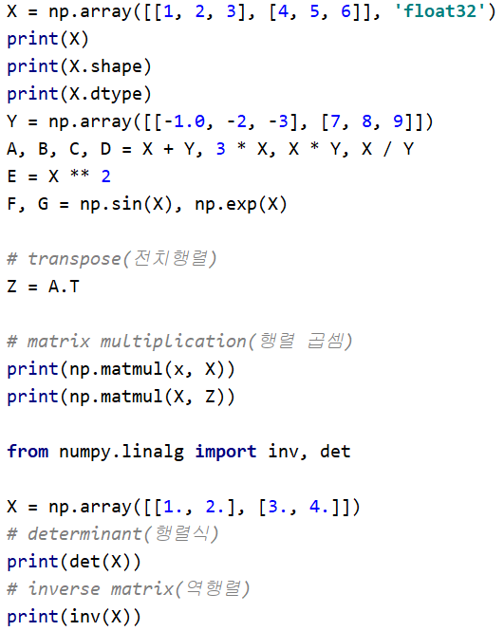
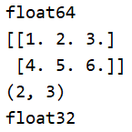
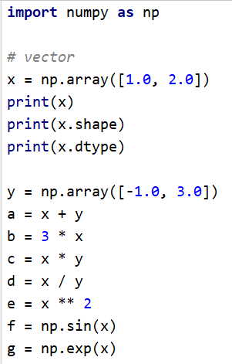



Matrix

Slide 3
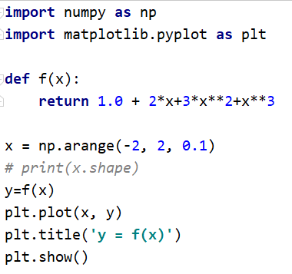
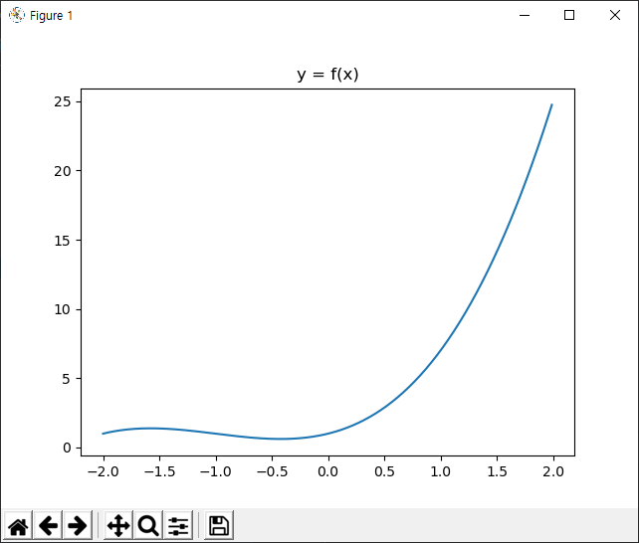
Plot2D

Slide 4
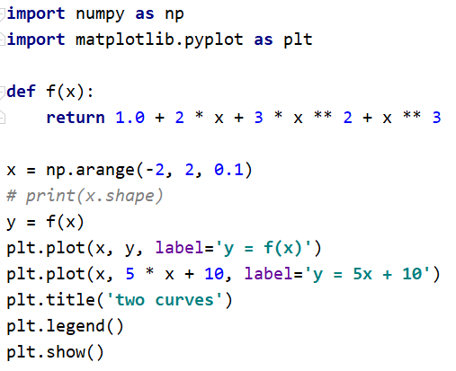
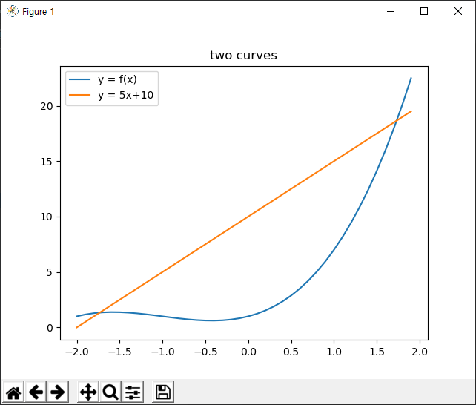
Plot2D

Slide 5
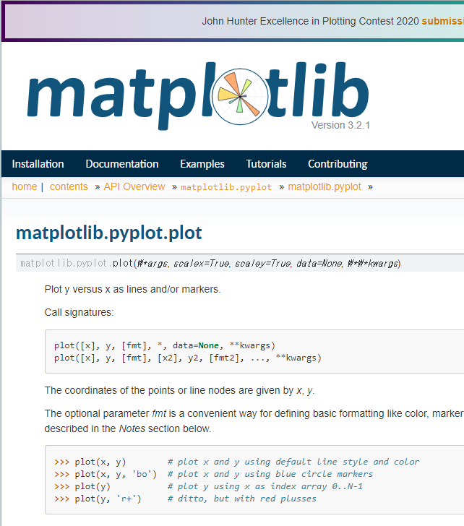
Plot2D
web search “matplotlib.pyplot.plot”

Slide 6
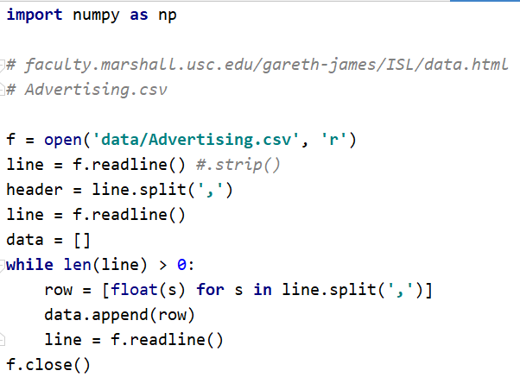
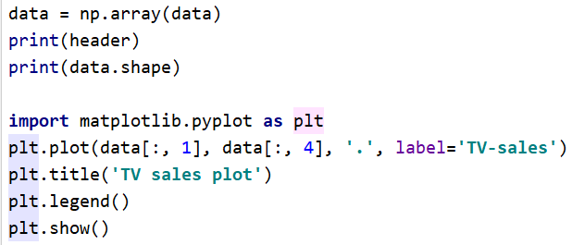
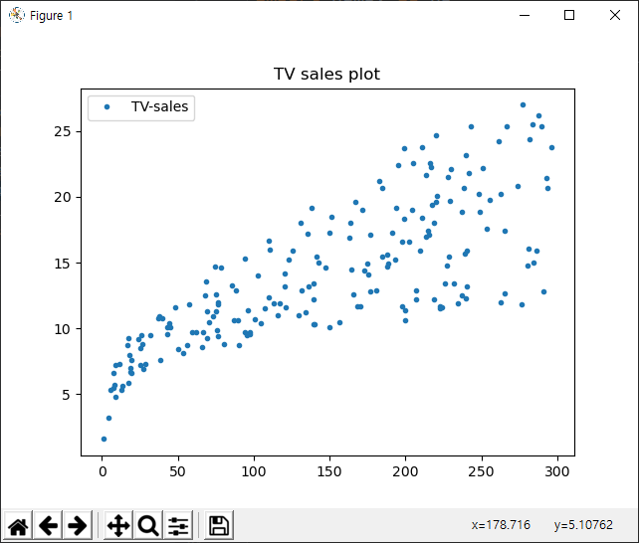

Advertising

Slide 7

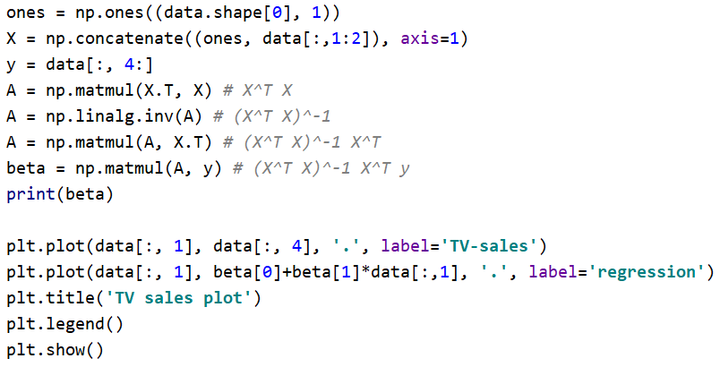
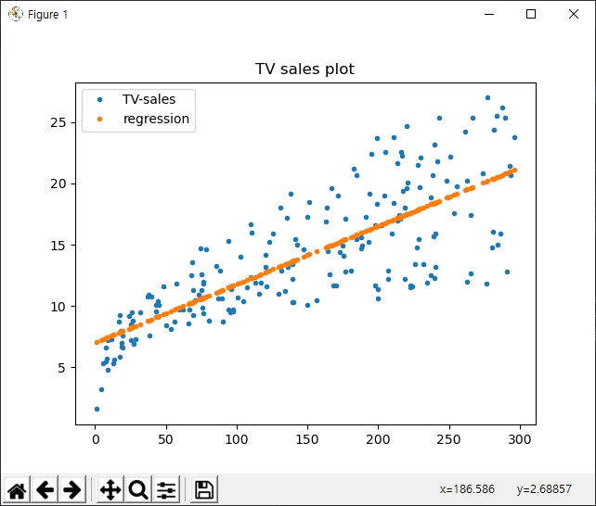
Advertising - Regression
predictor: TV
response: sales

Slide 8

연습문제 1. linear regression predictors: radio response: sales
연습문제 2. linear regression predictors: TV, radio response: sales
연습문제 3. polynomial regression and plot predictors: $TV$, $TV^{2}$ response: sales plot: regression curve

Slide 9
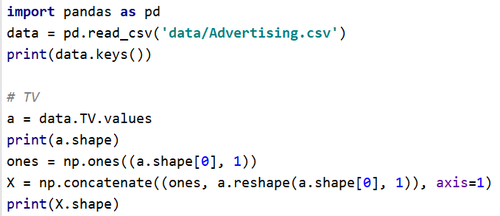
Using pandas

Slide 10
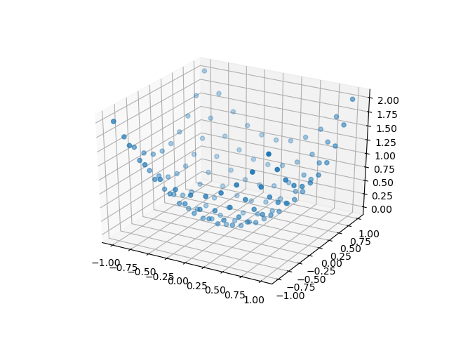
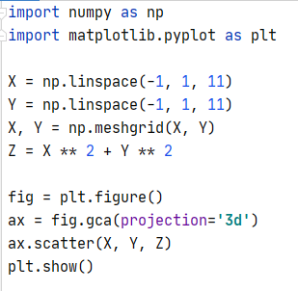
Scatter

Slide 11
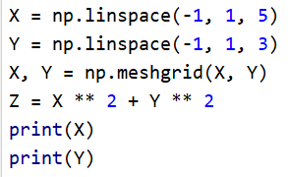
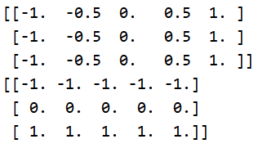
numpy.meshgrid
(-1, -1) | (-0.5, -1) | (0, -1) | (0.5, -1) | (1, -1)
(-1, 0) | (-0.5, 0) | (0, 0) | (0.5, 0) | (1, 0)
(-1, 1) | (-0.5, 1) | (0, 1) | (0.5, 1) | (1, 1)

Slide 12
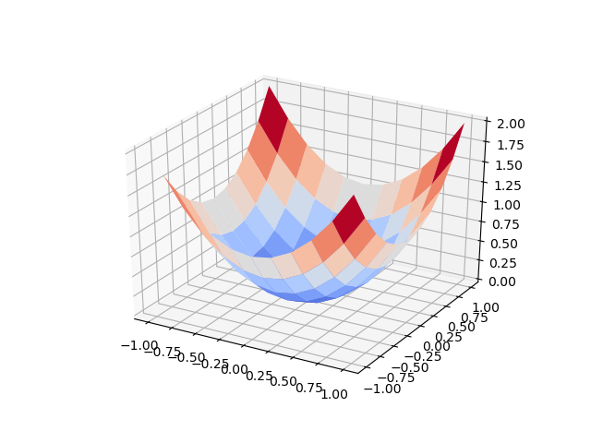
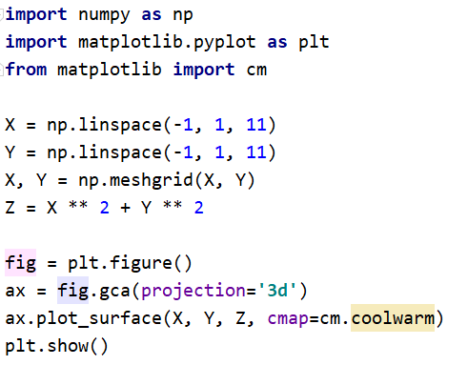
Plot3D

Slide 13
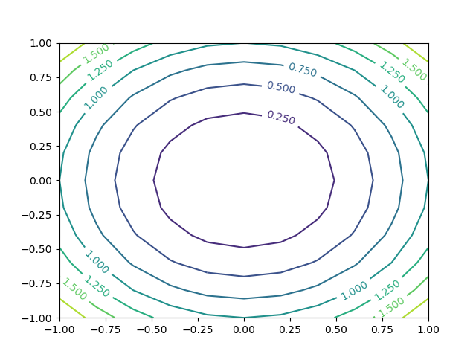
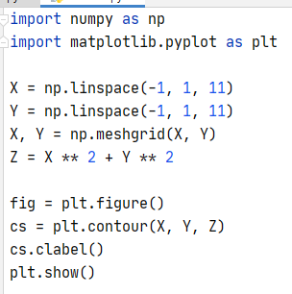
Contour

Slide 14
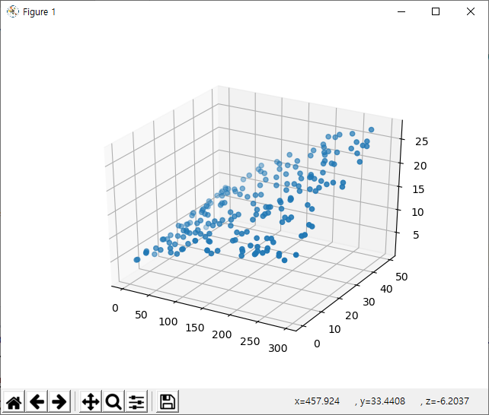
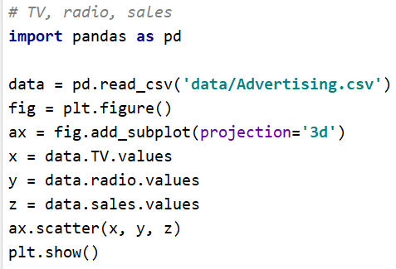
scatter

Slide 15

연습문제 4. plot $z=xy$
연습문제 5. linear regression and 3D plot predictors: TV, radio response: sales plot – surface(plane) and scatter

