Slide 1
인공지능프로그래밍
게임콘텐츠학과 박경수
https://github.com/ggorr/Machine-Learning/tree/master/Python

Slide 2

Function
Surface $z=f(x,y)$
Level curve $f\left(x,y\right)=c$

Slide 3
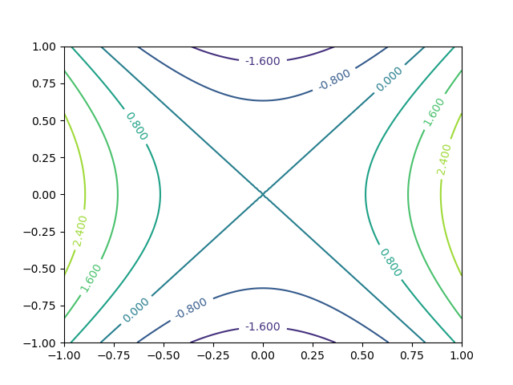

Example
(1) $z=x^{2}+y^{2}$ level curve is a circle $$x^{2}+y^{2}=c$$ (2) $z=3x^{2}+2y^{2}$ level curve is an ellipse $$3x^{2}+{2y}^{2}=c$$
(3) $z=3x^{2}−2y^{2}$ level curve is an hyperbola $$3x^{2}−{2y}^{2}=c$$

Slide 4

Gradient
함수: $z=f(x,y)$
그래디언트(gradient): $∇f\left(x, y\right)=\left(\frac{∂z}{∂x},\frac{∂z}{∂x}\right)=\left(\frac{∂f}{∂x}\left(x,y\right),\frac{∂f}{∂y}\left(x,y\right)\right)$
Example $z=x^{2}+y^{2}$ $∇f\left(x, y\right)=\left(\frac{∂z}{∂x},\frac{∂z}{∂y}\right)=(2x, 2y)$ $∇f\left(−2,3\right)=(−4,6)$

Slide 5

vector or matrix $∇f\left(x, y\right)=\left[\begin{matrix}\frac{∂z}{∂x} \\ \frac{∂z}{∂y}\end{matrix}\right]=\left[\begin{matrix}\frac{∂f}{∂x}(x,y) \\ \frac{∂f}{∂y}(x,y)\end{matrix}\right]$

Slide 6
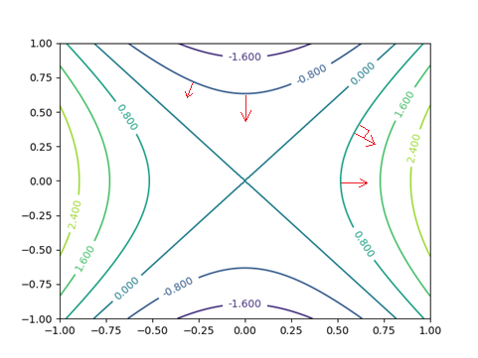
Gradient is the direction in which the function increases fastest (渐变是功能增加最快的方向)
The gradient is perpendicular to the level curve (梯度垂直于水平曲线)

Slide 7

Finding Maximum
maximum of $z=f\left(x,y\right)$
Algorithm
$λ←$ small number
start at any $p←\left(x_{0},y_{0}\right)$
repeat forever
$p←p+λ∇f\left(p\right)$
연습문제 Implement the algorithm for $z=−3x^{2}+6x−2y^{2} −y$

Slide 8

Finding Minimum
$p←p−λ∇f\left(p\right)$

Slide 9

Function composition
Function composition $z=f\left(x,y\right)$ $x=g(s,t)$, $y=h\left(s,t\right)$ $z=f\left(g\left(s,t\right), h(s,t)\right)$
Example $z=x^{2}+y^{2}$ $x=s+2t$, $y=s^{2}−t+1$

Slide 10

Chain rule
$z=f\left(x,y\right)$ $x=g(s,t)$, $y=h\left(s,t\right)$ Then $\frac{∂z}{∂s}=\frac{∂z}{∂x}\frac{∂x}{∂s}+\frac{∂z}{∂y}\frac{∂y}{∂s}$ $\frac{∂z}{∂t}=\frac{∂z}{∂x}\frac{∂x}{∂t}+\frac{∂z}{∂y}\frac{∂y}{∂t}$
Example $z=x^{2}+y^{2}$ $x=s+2t$, $y=s^{2}−t+1$ Then $\frac{∂z}{∂s}=2x⋅1+2y⋅2s=2\left(s+2t\right)+2\left(s^{2}−t+1\right)⋅2s$ $\frac{∂z}{∂t}=2x⋅2+2y⋅\left(−1\right)=2\left(s+2t\right)⋅2+2\left(s^{2}−t+1\right)⋅(−1)$

Slide 11

연습 문제
연습문제 1. $z=xy$, $x=s−t$, $y=s+t$, $\frac{∂z}{∂s}=?$, $\frac{∂z}{∂t}=?$
연습문제 2. $z=xy+2w$, $x=s−t$, $y=s+t$, $w=st$ $\frac{∂z}{∂s}=?$, $\frac{∂z}{∂t}=?$
연습문제 3. $z=xy+w^{2}$, $x=s^{2}$, $y=e^{s}$, $w=s+1$ $\frac{dz}{ds}=?$

Slide 12

General Form
$z=g(y_{1},…,y_{m})$ with $\begin{matrix}y_{1}=f_{1}(x_{1},…,x_{n}) \\ ⋮ \\ y_{m}=f_{m}(x_{1},…,x_{n})\end{matrix}$
$\frac{∂z}{∂x_{i}}=\sum_{j=1}^{m}{\frac{∂z}{∂y_{j}}\frac{∂y_{j}}{∂x_{i}}}$, $i=1, …,n$
matrix form $\left[\begin{matrix}\frac{∂z}{∂x_{1}} \\ ⋮ \\ \frac{∂z}{∂x_{n}}\end{matrix}\right]=\left[\begin{matrix}\frac{∂y_{1}}{∂x_{1}} & ⋯ & \frac{∂y_{m}}{∂x_{1}} \\ ⋮ & ⋱ & ⋮ \\ \frac{∂y_{1}}{∂x_{n}} & ⋯ & \frac{∂y_{m}}{∂x_{n}}\end{matrix}\right]\left[\begin{matrix}\frac{∂z}{∂y_{1}} \\ ⋮ \\ \frac{∂z}{∂y_{m}}\end{matrix}\right]$

Slide 13

Vector Form
$z=g(y_{1},…,y_{m})$ with $\begin{matrix}y_{1}=f_{1}(x_{1},…,x_{n}) \\ ⋮ \\ y_{m}=f_{m}(x_{1},…,x_{n})\end{matrix}$
$x=(x_{1},…,x_{n})$, $y=\left(y_{1},…,y_{m}\right)$, $F=\left(f_{1},…,f_{m}\right)$ $z=g(y)$, $y=F\left(x\right)$ $z=g\left(F\left(x\right)\right)$
Gradient $∇_{y}z=\left[\begin{matrix}\frac{∂z}{∂y_{1}} \\ ⋮ \\ \frac{∂z}{∂y_{m}}\end{matrix}\right]$, $∇_{x}z=\left[\begin{matrix}\frac{∂z}{∂x_{1}} \\ ⋮ \\ \frac{∂z}{∂x_{n}}\end{matrix}\right]$

Slide 14

Jacobian
Jacobian: $m×n$ matrix $\frac{∂y}{∂x}=JF\left(x\right)=\left[\begin{matrix}\frac{∂y_{1}}{∂x_{1}} & ⋯ & \frac{∂y_{1}}{∂x_{n}} \\ ⋮ & ⋱ & ⋮ \\ \frac{∂y_{m}}{∂x_{1}} & ⋯ & \frac{∂y_{m}}{∂x_{n}}\end{matrix}\right]=\left[\begin{matrix}\frac{∂f_{1}}{∂x_{1}}(x) & ⋯ & \frac{∂f_{1}}{∂x_{n}}(x) \\ ⋮ & ⋱ & ⋮ \\ \frac{∂f_{m}}{∂x_{1}}(x) & ⋯ & \frac{∂f_{m}}{∂x_{n}}(x)\end{matrix}\right]$
Chain rule $∇_{x}z=JF{\left(x\right)}^{T}∇_{y}z$

Slide 15

연습문제
연습문제 4. $z=xy$, $\left(x,y\right)=\left(\log{s}−t,s+\log{t}\right)$ $∇_{s,t}z=?$
연습문제 5. $z=xe^{y}+2w$, $\left(x, y, z\right)=\left(s−t, s+t, st\right)$ $∇_{s,t}z=?$
연습문제 6. $z=\cos{x}−\sin{y}+w^{2}$, $\left(x,y,z\right)=\left(s−1, s+1,e^{s}\right)$ $∇_{s}z=?$

