Slide 1
인공지능프로그래밍
게임콘텐츠학과 박경수
https://github.com/ggorr/Machine-Learning/tree/master/Python

Slide 2
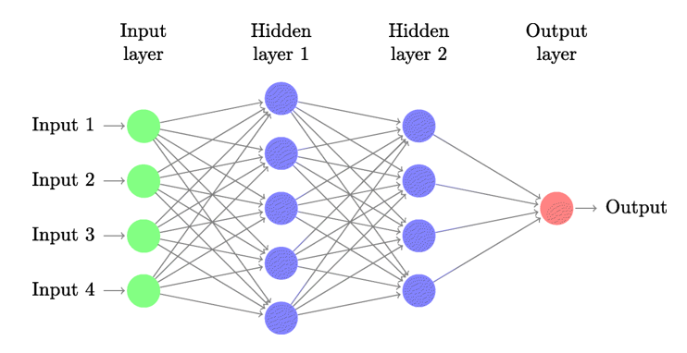
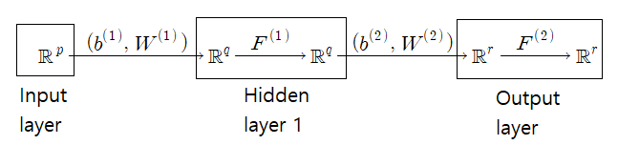
Feedforward Network

Slide 3
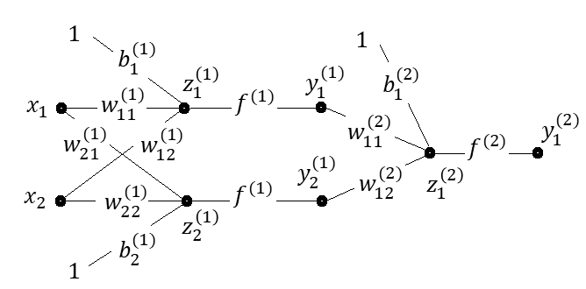
Example

Slide 4

Notation
Input data $X=\left[\begin{matrix}x_{11} & ⋯ & x_{1n} \\ ⋮ & ⋱ & ⋮ \\ x_{p1} & ⋯ & x_{pn}\end{matrix}\right]$, $X_{i}=\left[\begin{matrix}x_{1i} \\ ⋮ \\ x_{pi}\end{matrix}\right]$
Bias and weight $b^{\left(1\right)}=\left[\begin{matrix}b_{1}^{\left(1\right)} \\ ⋮ \\ b_{p}^{\left(1\right)}\end{matrix}\right]$, $W^{\left(1\right)}=\left[\begin{matrix}w_{11}^{\left(1\right)} & ⋯ & w_{1p}^{\left(1\right)} \\ ⋮ & ⋱ & ⋮ \\ w_{q1}^{\left(1\right)} & ⋯ & w_{qp}^{\left(1\right)}\end{matrix}\right]$
Activation $F^{\left(1\right)}=\left[\begin{matrix}f^{\left(1\right)} \\ ⋮ \\ f^{\left(1\right)}\end{matrix}\right]$ where $f^{\left(1\right)}\left(x\right)=σ\left(x\right)=\frac{1}{1+e^{−x}}$ , the sigmoid function

Slide 5

Hidden layer $Z_{i}^{\left(1\right)}=\left[\begin{matrix}z_{1i}^{\left(1\right)} \\ ⋮ \\ z_{qi}^{\left(1\right)}\end{matrix}\right]=b^{\left(1\right)}+W^{\left(1\right)}X_{i}$, i.e. $Z^{\left(1\right)}=b^{\left(1\right)}+W^{\left(1\right)}X$ $Y_{i}^{\left(1\right)}=\left[\begin{matrix}y_{1i}^{\left(1\right)} \\ ⋮ \\ y_{qi}^{\left(1\right)}\end{matrix}\right]=F^{\left(1\right)}\left(Z_{i}^{\left(1\right)}\right)=\left[\begin{matrix}f^{\left(1\right)}\left(z_{1i}^{\left(1\right)}\right) \\ ⋮ \\ f^{\left(1\right)}\left(z_{qi}^{\left(1\right)}\right)\end{matrix}\right]$, i.e. $Y^{\left(1\right)}=F^{\left(1\right)}\left(Z^{\left(1\right)}\right)$

Slide 6

Loss
Input data $X_{1},…,X_{n}$ with $X_{i}=(x_{1i},…,x_{pi})$
Matrix form $X=\left[\begin{matrix}x_{11} & ⋯ & x_{1n} \\ ⋮ & ⋱ & ⋮ \\ x_{p1} & ⋯ & x_{pn}\end{matrix}\right]$
Target $T_{1},…,T_{n}$ with $T_{i}=(t_{1i},…,t_{ri})$
Matrix from $T=\left[\begin{matrix}t_{11} & ⋯ & t_{1n} \\ ⋮ & ⋱ & ⋮ \\ t_{r1} & ⋯ & t_{rn}\end{matrix}\right]$

Slide 7

Output $Y_{1}^{\left(2\right)},…,Y_{n}^{\left(2\right)}$ with $Y_{i}^{\left(2\right)}=\left(y_{1i}^{\left(2\right)},…,y_{ri}^{\left(2\right)}\right)$
Matrix from $Y=Y^{(2)}=\left[\begin{matrix}y_{11}^{\left(2\right)} & ⋯ & y_{1n}^{\left(2\right)} \\ ⋮ & ⋱ & ⋮ \\ y_{r1}^{\left(2\right)} & ⋯ & y_{rn}^{\left(2\right)}\end{matrix}\right]$
MSE(Mean squared error) $E=\sum_{i=1}^{n}{\frac{1}{2}∥Y_{i}^{\left(2\right)}−T_{i}∥^{2}}$

Slide 8

Goal
Find a feedforward network which minimizes the loss $E=\sum_{i=1}^{n}{\frac{1}{2}∥Y_{i}^{\left(2\right)}−T_{i}∥^{2}}$ $=\sum_{i=1}^{n}{\frac{1}{2}\sum_{j=1}^{r}{{\left(y_{ji}^{\left(2\right)}−t_{ji}\right)}^{2}}}$
Approach Find $b^{(j)}$ and $W^{(j)}$ using stochastic gradient descent

Slide 9
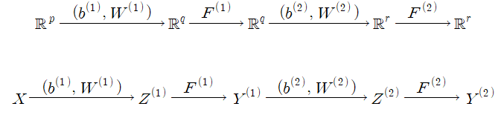

Computation
Goal: to compute gradient of loss with respect to $W^{(i)}$ and $b^{(i)}$
Loss $E=\sum_{i=1}^{n}{\frac{1}{2}∥Y_{i}^{\left(2\right)}−T_{i}∥^{2}}$ $=\sum_{i=1}^{n}{\frac{1}{2}\sum_{j=1}^{r}{{\left(y_{ji}−t_{ji}\right)}^{2}}}$
Gradients $∇_{Y^{(2)}}E=\left[\begin{matrix}\frac{∂E}{∂y_{11}} & ⋯ & \frac{∂E}{∂y_{1n}} \\ ⋮ & ⋱ & ⋮ \\ \frac{∂E}{∂y_{r1}} & ⋯ & \frac{∂E}{∂y_{rn}}\end{matrix}\right]=\left[\begin{matrix}y_{11}−t_{11} & ⋯ & y_{1n}−t_{1n} \\ ⋮ & ⋱ & ⋮ \\ y_{r1}−t_{r1} & ⋯ & y_{rn}−t_{rn}\end{matrix}\right]=Y^{\left(2\right)}−T$

Slide 10

$∇_{Z^{(2)}}E=\left[\begin{matrix}f^{\left(2\right)}′(z_{11})\frac{∂E}{∂y_{11}} & ⋯ & f^{\left(2\right)}′(z_{1n})\frac{∂E}{∂y_{1n}} \\ ⋮ & ⋱ & ⋮ \\ f^{\left(2\right)}′(z_{r1})\frac{∂E}{∂y_{r1}} & ⋯ & f^{\left(2\right)}′(z_{rn})\frac{∂E}{∂y_{rn}}\end{matrix}\right]$ $=JF^{\left(2\right)}\left(Z^{\left(2\right)}\right)∗∇_{Y^{\left(2\right)}}E$ $∇_{W^{(2)}}E=∇_{Z^{(2)}}E∗Y^{\left(1\right)T}$ $∇_{b^{\left(2\right)}}E=\left[\begin{matrix}\sum_{i=1}^{n}{\frac{∂E}{∂Z_{1i}^{\left(2\right)}}} \\ ⋮ \\ \sum_{i=1}^{n}{\frac{∂E}{∂Z_{ri}^{\left(2\right)}}}\end{matrix}\right]$ $∇_{Y^{(1)}}E=W^{\left(2\right)T}∇_{Z^{(2)}}E$ where $∗$ is the Hadamard product

Slide 11

Example: XOR
Input: $\left[\begin{matrix}0 & 0 & 1 & 1 \\ 0 & 1 & 0 & 1\end{matrix}\right]$ Target: $\left[\begin{matrix}0 & 1 & 1 & 0\end{matrix}\right]$ Network:

Slide 12
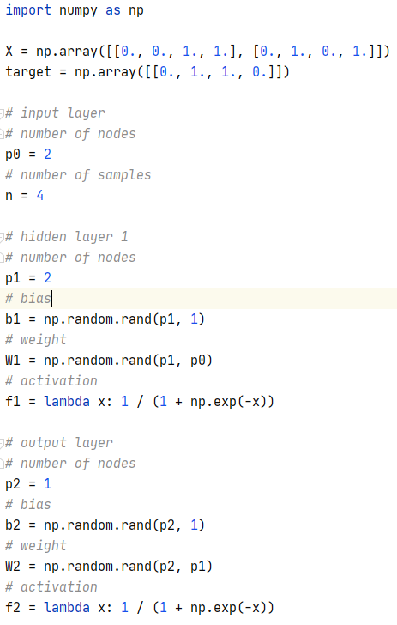
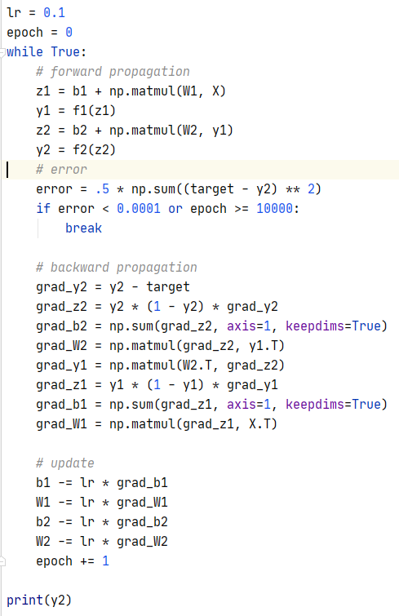

Slide 13
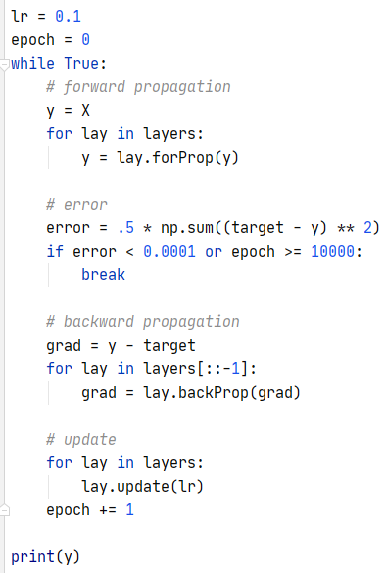
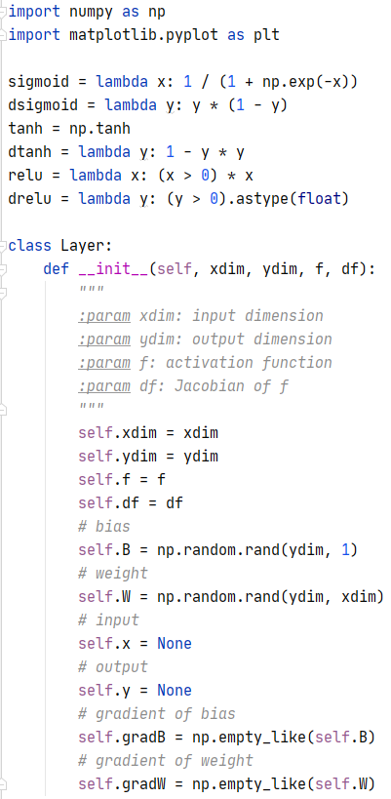
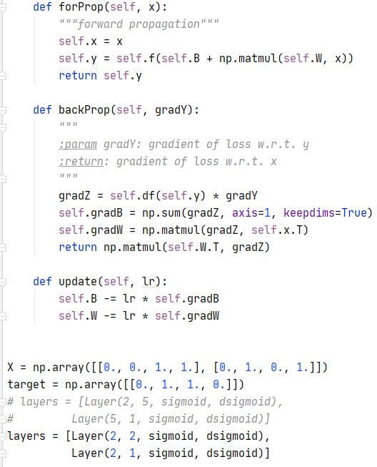
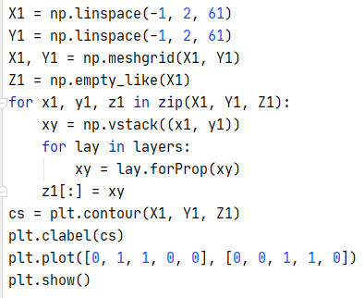
Using class

Slide 14

Activation functions
Sigmoid $σ\left(x\right)=\frac{1}{1+e^{−x}}$, $σ^{′}\left(x\right)=y(1−y)$
ReLU $f\left(x\right)=\left\{\begin{aligned}x if x≥0 \\ 0 otherwise\end{aligned}\right.$, $f′\left(x\right)=\left\{\begin{aligned}1 if x≥0 \\ 0 otherwise\end{aligned}\right.$
Hyper tangent $\tanh{x}=\frac{e^{x}−e^{−x}}{e^{x}+e^{−x}}$, $tanh′{x}=1−y^{2}$
Softmax $F\left(x_{1},…,x_{n}\right)=\left(\frac{e^{x_{1}}}{e^{x_{1}}+⋯+e^{x_{n}}},…,\frac{e^{x_{n}}}{e^{x_{1}}+⋯+e^{x_{n}}}\right)$
Softplus $f\left(x\right)=\log\left(1+e^{x}\right)$

Slide 15

Loss Functions
MSE(Mean squared error) $E=\sum_{i=1}^{n}{\frac{1}{2}∥Y_{i}^{(2)}−T_{i}∥^{2} }$
Binary crossentropy $E=−\sum_{i=1}^{n}{\left(t_{i}\log{y_{i}^{(2)}}+\left(1−t_{i}\right)\log\left(1−y_{i}^{(2)}\right)\right)}$
Output dimension $= 1$, i.e. $r=1$
Activation function = sigmoid
Categorical crossentropy $E =−\sum_{i=1}^{n}{\sum_{j=1}^{r}{t_{ji}\log{y_{ji}^{(2)}}}}$
Output dimension $> 1$, i.e. $r>1$
Activation function = softmax

