Slide 1
Chapter 3 Belief Networks

Slide 2
3.1 The Benefits of Structure
Belief network is a way to depict the independence of variables

Slide 3
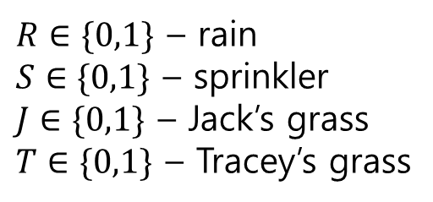
3.1.1 Modelling independencies
One morning Tracey leaves her house and realises that her grass is wet.
Is it due to overnight rain?
Or did she forget to turn off the sprinkler last night?
She notices that the grass of her neighbour, Jack, is also wet.
And she concludes that it has probably been raining.
$R∈\{0,1\}$ – rain
$S∈\{0,1\}$ – sprinkler
$J∈\{0,1\}$ – Jack’s grass
$T∈\{0,1\}$ – Tracey’s grass

Slide 4
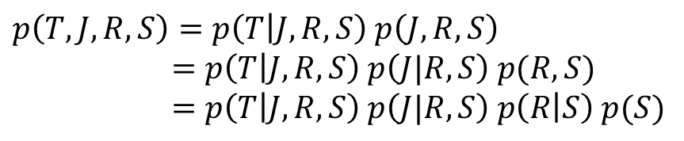
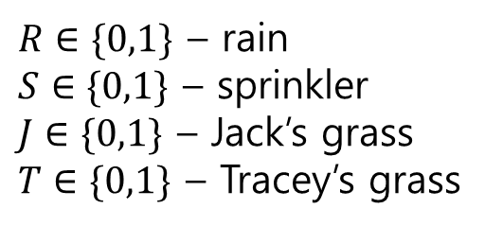
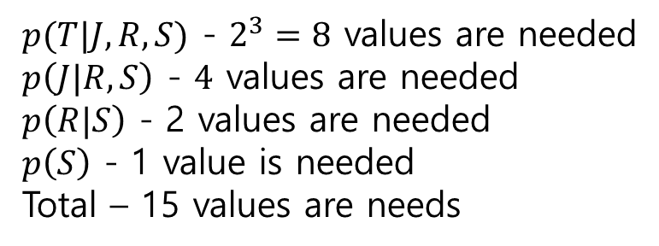
$p\left(T,J,R,S\right)=p\left(T | J,R,S\right) p\left(J,R,S\right)$ $=p\left(T | J,R,S\right) p\left(J|R,S\right) p(R,S)$
$=p\left(T | J,R,S\right) p\left(J|R,S\right) p\left(R | S\right) p(S)$
$R∈\{0,1\}$ – rain
$S∈\{0,1\}$ – sprinkler
$J∈\{0,1\}$ – Jack’s grass
$T∈\{0,1\}$ – Tracey’s grass
$p(T|J,R,S)$ - $2^{3}=8$ values are needed
$p\left(J|R,S\right)$ - $4$ values are needed
$p\left(R|S\right)$ - 2 values are needed
$p\left(S\right)$ - 1 value is needed
Total – 15 values are needs

Slide 5
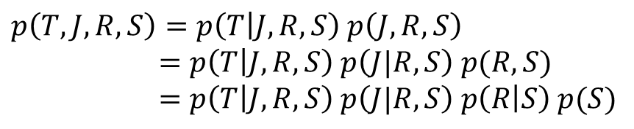
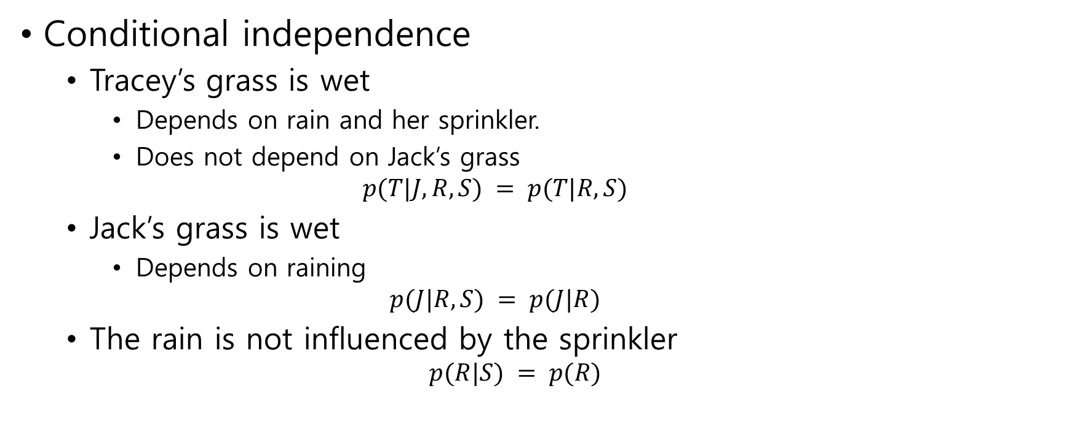

Conditional independence
Tracey’s grass is wet
Depends on rain and her sprinkler.
Does not depend on Jack’s grass $p(T|J, R, S) = p(T|R, S)$
Jack’s grass is wet
Depends on raining $p(J|R, S) = p(J|R)$
The rain is not influenced by the sprinkler $p(R|S) = p(R)$
$p\left(T,J,R,S\right)=p\left(T | J,R,S\right) p\left(J,R,S\right)$ $=p\left(T | J,R,S\right) p\left(J|R,S\right) p(R,S)$
$=p\left(T | J,R,S\right) p\left(J|R,S\right) p\left(R | S\right) p(S)$
$$p(T, J, R, S) = p(T|R, S)p(J|R)p(R)p(S)$$

Slide 6
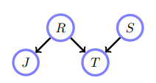


$$p(T, J, R, S) = p(T|R, S)p(J|R)p(R)p(S)$$
$4+2+1+1=8$ values are needed
Belief network structure for the
‘wet grass’ example

Slide 7

conditional probability table(CPT)
$p\left(R = 1\right)= 0.2$
$p(S = 1) = 0.1$
$p\left(J = 1 | R = 1\right)= 1$ $p(J = 1|R = 0) = 0.2$
$p\left(T = 1 | R = 1, S = 0\right)= 1$ $p(T = 1|R = 1, S = 1) = 1$ $p(T = 1|R = 0, S = 1) = 0.9$ $p(T = 1|R = 0, S = 0) = 0$

Slide 8
