Slide 1
Chapter 11 Learning with Hidden Variables

Slide 2
11.1 Hidden Variables and Missing Data
Observational variables
Visible - those for which we actually know the state
Missing – those whose states are missing for a particular datapoint
Hidden(latent) - not all variables in the model are observed

Slide 3
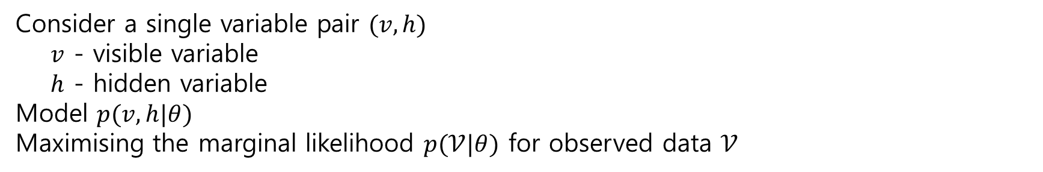
11.2 Expectation Maximisation
11.2.1 Variational EM
individual parameter updates
Consider a single variable pair $(v, h)$
$v$ - visible variable
$h$ - hidden variable
Model $p(v, h|θ)$
Maximising the marginal likelihood $p(𝒱|θ)$ for observed data $𝒱$

Slide 4
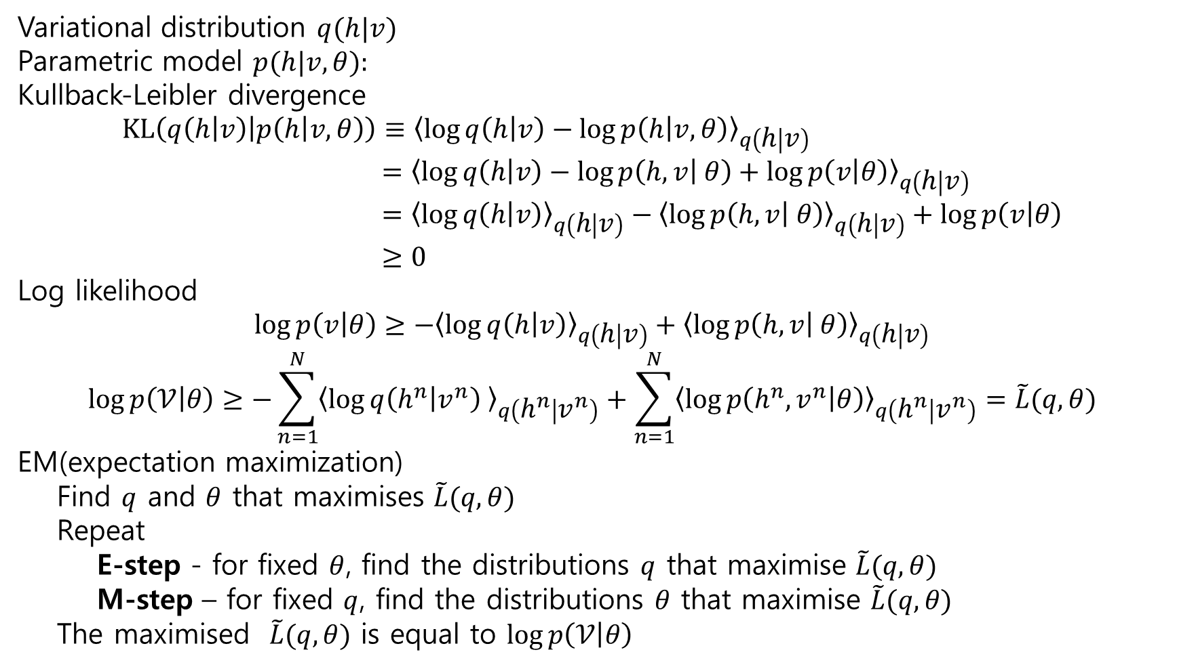
Variational distribution $q(h|v)$
Parametric model $p(h|v, θ):$
Kullback-Leibler divergence
$$KL\left(q\left(h | v\right) | p\left(h | v, θ\right)\right)≡{\left\langle \log{q\left(h | v\right)}−\log{p\left(h | v, θ\right)}\right\rangle }_{q\left(h | v\right)} \\ ={\left\langle \log{q\left(h | v\right)}−\log{p\left(h, v | θ\right)}+\log{p\left(v | θ\right)}\right\rangle }_{q\left(h | v\right)} \\ ={\left\langle \log{q\left(h | v\right)}\right\rangle }_{q\left(h | v\right)}−{\left\langle \log{p\left(h, v | θ\right)}\right\rangle }_{q\left(h | v\right)}+\log{p\left(v | θ\right)} \\ ≥0$$
Log likelihood
$$\log{p\left(v | θ\right)}≥−{\left\langle \log{q\left(h | v\right)}\right\rangle }_{q\left(h | v\right)}+{\left\langle \log{p\left(h, v | θ\right)}\right\rangle }_{q\left(h | v\right)}$$
$$\log{p\left(𝒱 | θ\right)}≥−\sum_{n=1}^{N}{{\left\langle \log{q\left(h^{n} | v^{n}\right) }\right\rangle }_{q\left(h^{n} | v^{n}\right)}}+\sum_{n=1}^{N}{{\left\langle \log{p\left(h^{n},v^{n} | θ\right)}\right\rangle }_{q\left(h^{n} | v^{n}\right)}}=\tilde{L}(q,θ)$$
EM(expectation maximization)
Find $q$ and $θ$ that maximises $\tilde{L}(q,θ)$
Repeat
E-step - for fixed $θ$, find the distributions $q$ that maximise $\tilde{L}(q,θ)$
M-step – for fixed $q$, find the distributions $θ$ that maximise $\tilde{L}(q,θ)$
The maximised $\tilde{L}(q,θ)$ is equal to $\log{p\left(𝒱 | θ\right)}$

Slide 5
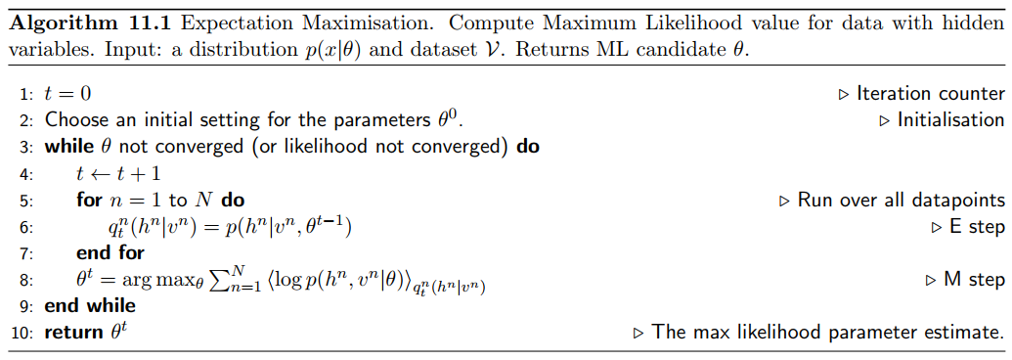

Slide 6
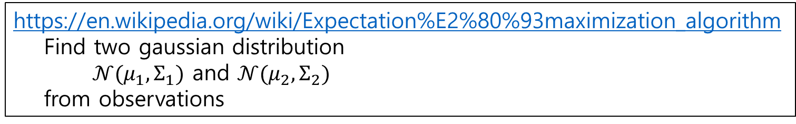
https://en.wikipedia.org/wiki/Expectation%E2%80%93maximization_algorithm
Find two gaussian distribution
$𝒩(μ_{1},Σ_{1})$ and $𝒩(μ_{2},Σ_{2})$
from observations

Slide 7
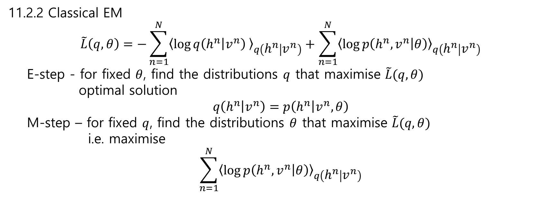
11.2.2 Classical EM
$$\tilde{L}\left(q,θ\right)=−\sum_{n=1}^{N}{{\left\langle \log{q\left(h^{n} | v^{n}\right) }\right\rangle }_{q\left(h^{n} | v^{n}\right)}}+\sum_{n=1}^{N}{{\left\langle \log{p\left(h^{n},v^{n} | θ\right)}\right\rangle }_{q\left(h^{n} | v^{n}\right)}}$$
E-step - for fixed $θ$, find the distributions $q$ that maximise $\tilde{L}(q,θ)$
optimal solution
$$q\left(h^{n} | v^{n}\right)=p\left(h^{n} | v^{n},θ\right)$$
M-step – for fixed $q$, find the distributions $θ$ that maximise $\tilde{L}(q,θ)$
i.e. maximise
$$\sum_{n=1}^{N}{{\left\langle \log{p\left(h^{n},v^{n} | θ\right)}\right\rangle }_{q\left(h^{n} | v^{n}\right)}}$$

Slide 8
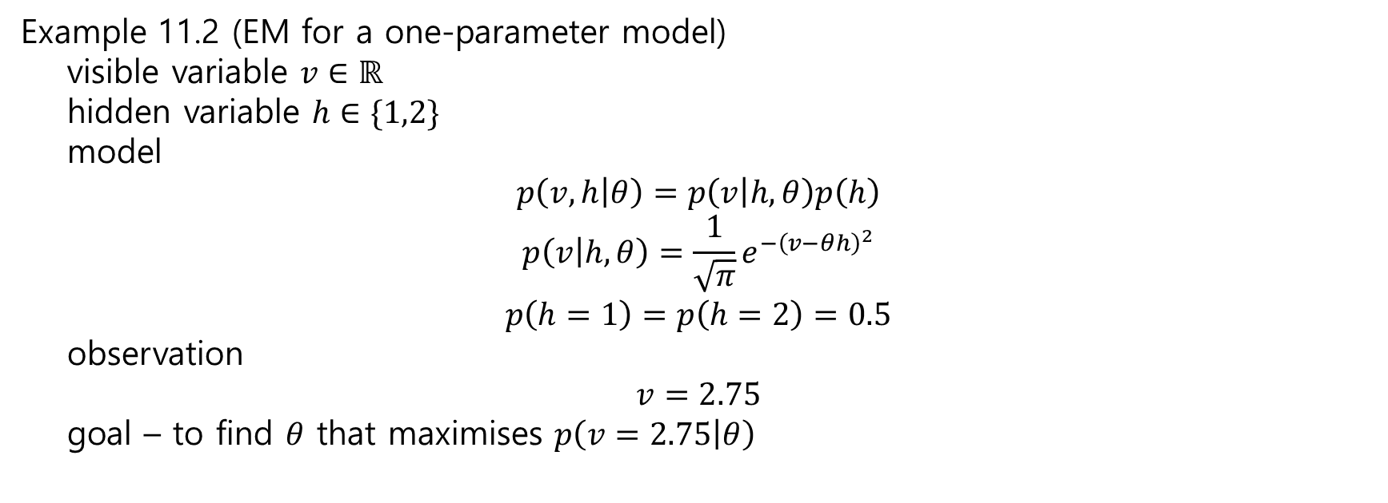
Example 11.2 (EM for a one-parameter model)
visible variable $v∈ℝ$
hidden variable $h∈\{1,2\}$
model
$$p\left(v, h | θ\right)=p\left(v | h, θ\right)p\left(h\right)$$
$$p\left(v | h,θ\right)=\frac{1}{\sqrt{π}}e^{−{\left(v−θh\right)}^{2}}$$
$$p\left(h=1\right)=p\left(h=2\right)=0.5$$
observation
$$v=2.75$$
goal – to find $θ$ that maximises $p\left(v=2.75 | θ\right)$

Slide 9
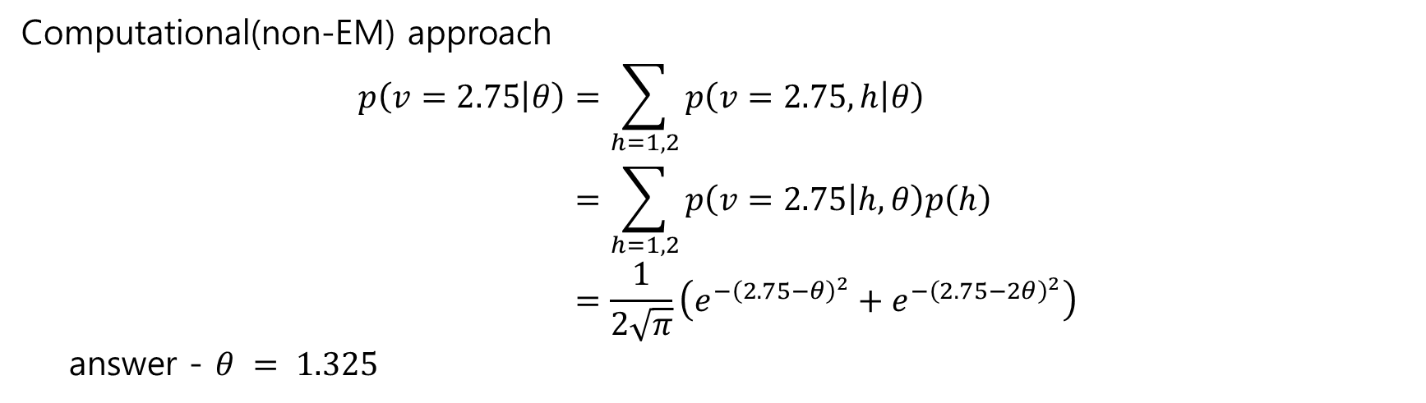
Computational(non-EM) approach
$$p\left(v=2.75 | θ\right)=\sum_{h=1,2}{p\left(v=2.75,h | θ\right)} \\ =\sum_{h=1,2}{p\left(v=2.75 | h,θ\right)p\left(h\right)} \\ =\frac{1}{2\sqrt{π}}\left(e^{−{\left(2.75−θ\right)}^{2}}+e^{−{\left(2.75−2θ\right)}^{2}}\right)$$
answer - $θ = 1.325$

Slide 10
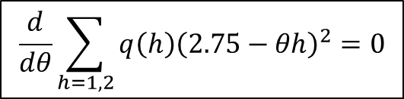
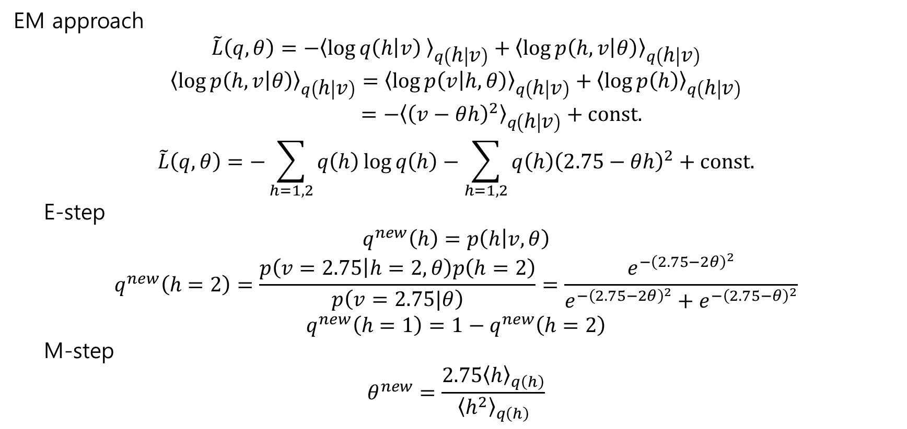
EM approach
$$\tilde{L}\left(q,θ\right)=−{\left\langle \log{q\left(h | v\right) }\right\rangle }_{q\left(h | v\right)}+{\left\langle \log{p\left(h,v | θ\right)}\right\rangle }_{q\left(h | v\right)}$$
$${\left\langle \log{p\left(h,v | θ\right)}\right\rangle }_{q\left(h | v\right)}={\left\langle \log{p\left(v | h,θ\right)}\right\rangle }_{q\left(h | v\right)}+{\left\langle \log{p\left(h\right)}\right\rangle }_{q\left(h | v\right)} \\ =−{\left\langle {\left(v−θh\right)}^{2}\right\rangle }_{q\left(h | v\right)}+const.$$
$$\tilde{L}\left(q,θ\right)=−\sum_{h=1,2}{q\left(h\right)\log{q\left(h\right)}}−\sum_{h=1,2}{q\left(h\right){\left(2.75−θh\right)}^{2}}+const.$$
E-step
$$q^{new}\left(h\right)=p\left(h | v,θ\right)$$
$$q^{new}\left(h=2\right)=\frac{p\left(v=2.75 | h=2,θ\right)p\left(h=2\right)}{p\left(v=2.75|θ\right)}=\frac{e^{−{\left(2.75−2θ\right)}^{2}}}{e^{−{\left(2.75−2θ\right)}^{2}}+e^{−{\left(2.75−θ\right)}^{2}}}$$
$$q^{new}\left(h=1\right)=1−q^{new}\left(h=2\right)$$
M-step
$$θ^{new}=\frac{2.75{\left\langle h\right\rangle }_{q\left(h\right)}}{{\left\langle h^{2}\right\rangle }_{q\left(h\right)}}$$
$$\frac{d}{dθ}\sum_{h=1,2}{q\left(h\right){\left(2.75−θh\right)}^{2}}=0$$

Slide 11
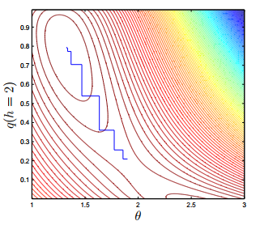

Slide 12
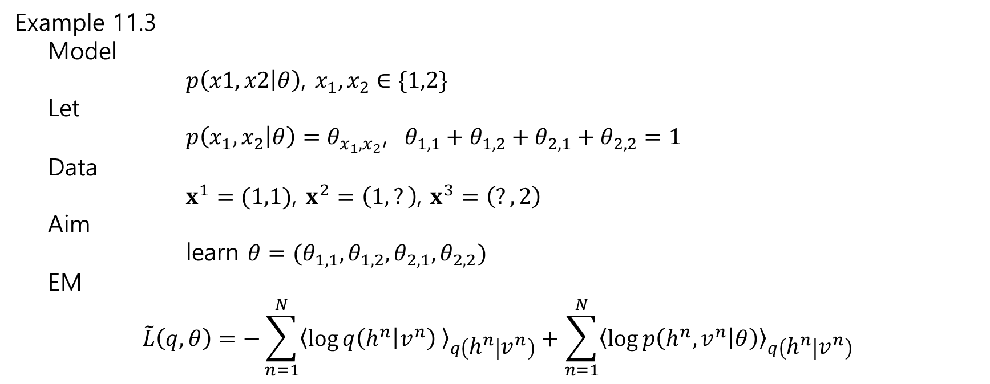
Example 11.3
Model
$p\left(x1, x2 | θ\right)$, $x_{1}, x_{2}∈\{1,2\}$
Let
$p\left(x_{1},x_{2} | θ\right)=θ_{x_{1},x_{2}}$, $θ_{1,1}+θ_{1,2}+θ_{2,1}+θ_{2,2}=1$
Data
$x^{1}=(1,1)$, $x^{2}=\left(1,?\right)$, $x^{3}=\left(?,2\right)$
Aim
learn $θ=(θ_{1,1},θ_{1,2},θ_{2,1}, θ_{2,2})$
EM
$$\tilde{L}\left(q,θ\right)=−\sum_{n=1}^{N}{{\left\langle \log{q\left(h^{n} | v^{n}\right) }\right\rangle }_{q\left(h^{n} | v^{n}\right)}}+\sum_{n=1}^{N}{{\left\langle \log{p\left(h^{n},v^{n} | θ\right)}\right\rangle }_{q\left(h^{n} | v^{n}\right)}}$$
entropy
energy

Slide 13
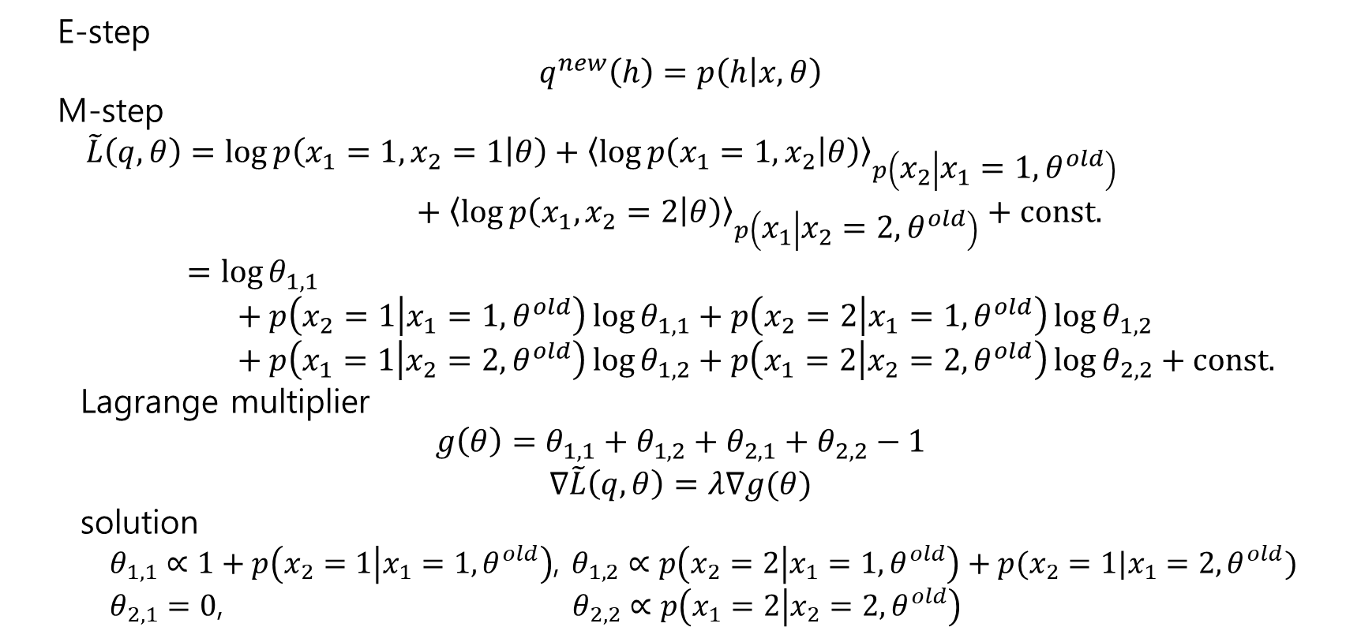
E-step
$$q^{new}\left(h\right)=p\left(h | x,θ\right)$$
M-step
$$\tilde{L}\left(q,θ\right)=\log{p\left(x_{1}=1,x_{2}=1 | θ\right)}+{\left\langle \log{p\left(x_{1}=1,x_{2} | θ\right)}\right\rangle }_{p\left(x_{2} | x_{1}=1,θ^{old}\right)} \\ + {\left\langle \log{p\left(x_{1},x_{2}=2 | θ\right)}\right\rangle }_{p\left(x_{1} | x_{2}=2,θ^{old}\right)}+const. \\ =\log{θ_{1,1}} \\ + p\left(x_{2}=1 | x_{1}=1,θ^{old}\right)\log{θ_{1,1}}+p\left(x_{2}=2 | x_{1}=1,θ^{old}\right)\log{θ_{1,2}} \\ + p\left(x_{1}=1 | x_{2}=2,θ^{old}\right)\log{θ_{1,2}}+p\left(x_{1}=2 | x_{2}=2,θ^{old}\right)\log{θ_{2,2}}+const.$$
Lagrange multiplier
$$g\left(θ\right)=θ_{1,1}+θ_{1,2}+θ_{2,1}+θ_{2,2}−1$$
$$∇\tilde{L}\left(q,θ\right)=λ∇g(θ)$$
solution
$θ_{1,1}∝1+p\left(x_{2}=1 | x_{1}=1,θ^{old}\right)$, $θ_{1,2}∝p\left(x_{2}=2 | x_{1}=1,θ^{old}\right)+p(x_{2}=1|x_{1}=2,θ^{old})$
$θ_{2,1}=0$, $θ_{2,2}∝p\left(x_{1}=2 | x_{2}=2,θ^{old}\right)$

