Slide 1
Chapter 10 Naïve Bayes

Slide 2
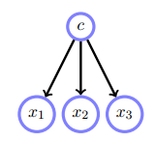
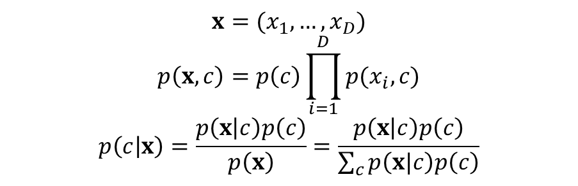
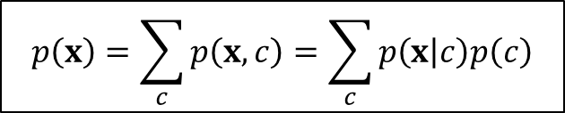
10.1 Naive Bayes and Conditional Independence
$$x=(x_{1},…,x_{D})$$
$$p\left(x,c\right)=p\left(c\right)\prod_{i=1}^{D}{p(x_{i},c)}$$
$$p\left(c | x\right)=\frac{p\left(x | c\right)p\left(c\right)}{p\left(x\right)}=\frac{p\left(x | c\right)p\left(c\right)}{\sum_{c}{p\left(x|c\right)p\left(c\right)}}$$
$$p\left(x\right)=\sum_{c}{p\left(x,c\right)}=\sum_{c}{p\left(x | c\right)p\left(c\right)}$$

Slide 3
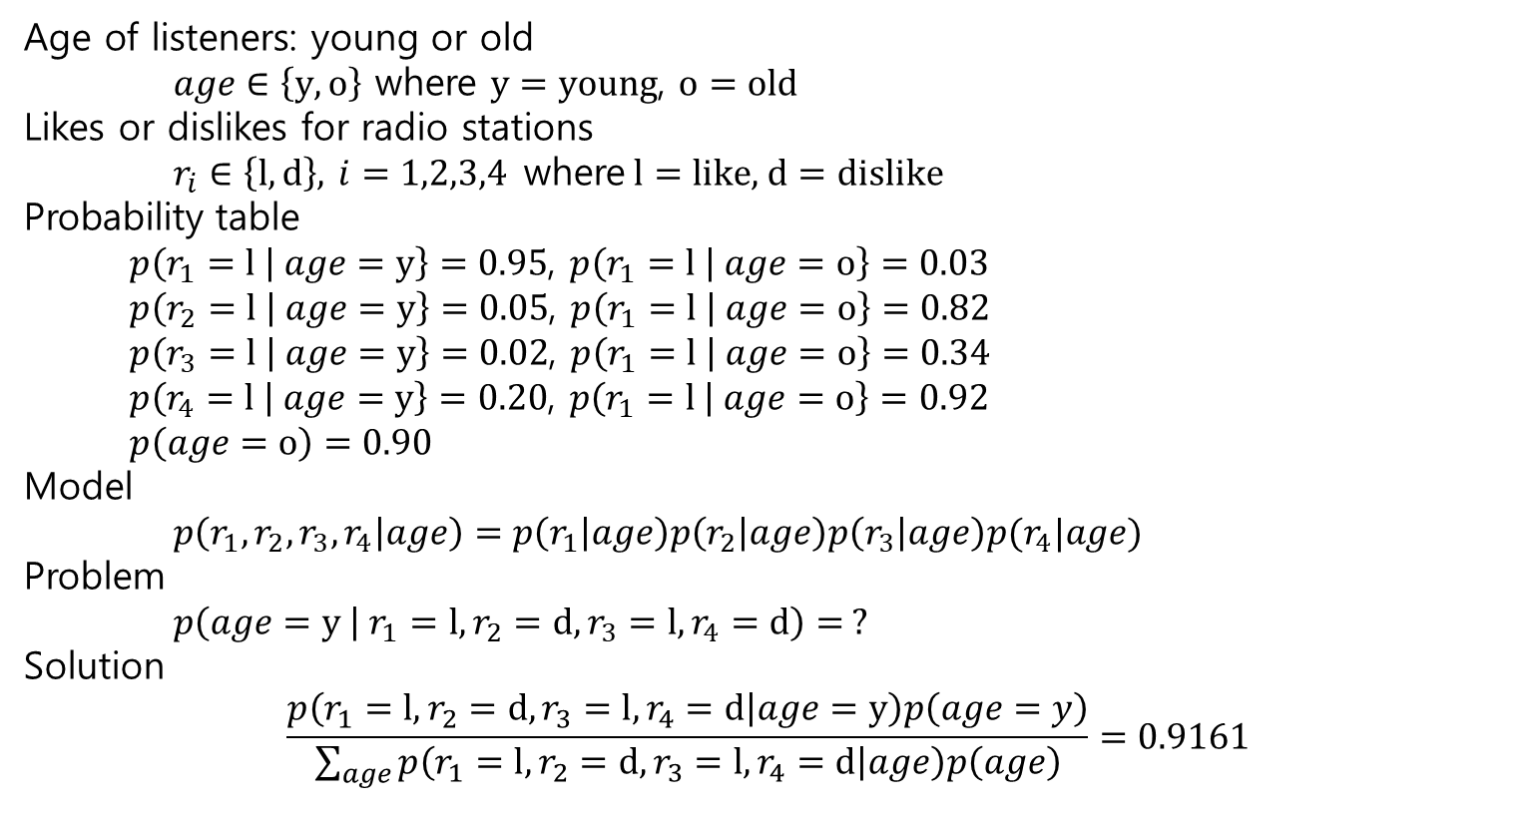
Example 10.1. Ezsurvey.org partitions radio station listeners into two groups – the ‘young’ and ‘old’.
Age of listeners: young or old
$age∈\left\{y, o\right\}$ where $y=young$, $o=old$
Likes or dislikes for radio stations
$r_{i}∈\left\{l,d\right\}$, $i=1,2,3,4$ where $l=like$, $d=dislike$
Probability table
$p\left(r_{1}=l | age=y\right\}=0.95$, $p\left(r_{1}=l | age=o\right\}=0.03$
$p\left(r_{2}=l | age=y\right\}=0.05$, $p\left(r_{1}=l | age=o\right\}=0.82$
$p\left(r_{3}=l | age=y\right\}=0.02$, $p\left(r_{1}=l | age=o\right\}=0.34$
$p\left(r_{4}=l | age=y\right\}=0.20$, $p\left(r_{1}=l | age=o\right\}=0.92$
$p\left(age=o\right)=0.90$
Model
$p\left(r_{1},r_{2},r_{3},r_{4} | age\right)=p\left(r_{1} | age\right)p\left(r_{2} | age\right)p\left(r_{3} | age\right)p(r_{4}|age)$
Problem
$p\left(age=y | r_{1}=l, r_{2}=d, r_{3}=l, r_{4}=d\right)= ?$
Solution
$$\frac{p\left(r_{1}=l, r_{2}=d, r_{3}=l, r_{4}=d | age=y\right)p\left(age=y\right)}{\sum_{age}{p\left(r_{1}=l, r_{2}=d, r_{3}=l, r_{4}=d | age\right)p\left(age\right)}}=0.9161$$

Slide 4
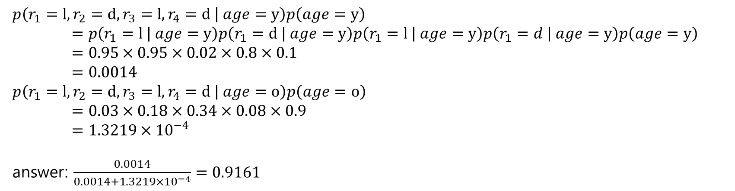
$p\left(r_{1}=l, r_{2}=d, r_{3}=l, r_{4}=d | age=y\right)p\left(age=y\right)$ $=p\left(r_{1}=l | age=y\right)p\left(r_{1}=d | age=y\right)p\left(r_{1}=l | age=y\right)p\left(r_{1}=d | age=y\right)p\left(age=y\right)$
$=0.95×0.95×0.02×0.8×0.1$
$=0.0014$
$p\left(r_{1}=l, r_{2}=d, r_{3}=l, r_{4}=d | age=o\right)p\left(age=o\right)$
$=0.03×0.18×0.34×0.08×0.9$
$=1.3219×{10}^{−4}$
answer: $\frac{0.0014}{0.0014+1.3219×{10}^{−4}}=0.9161$

Slide 5
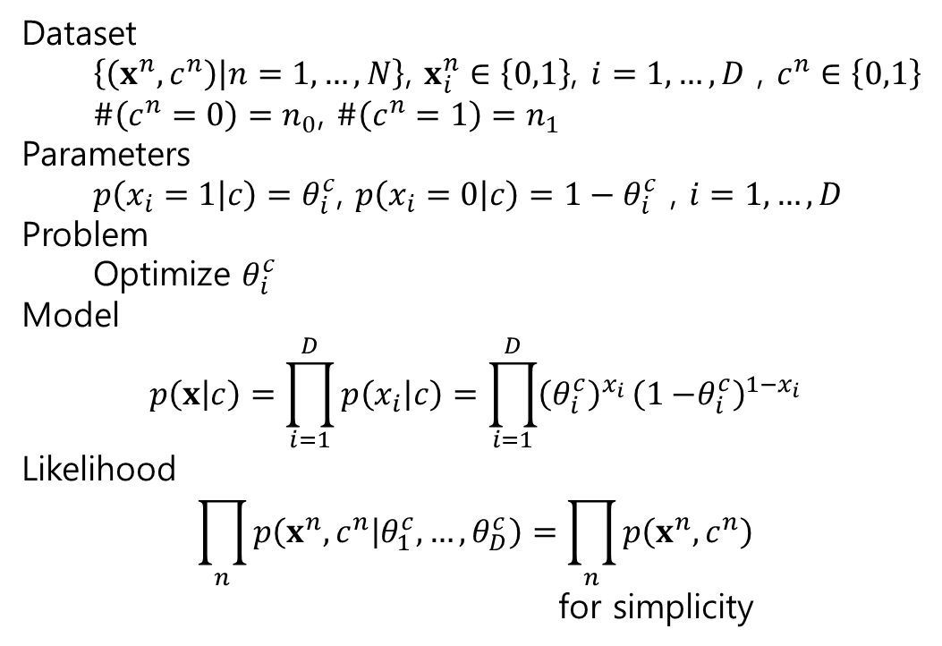
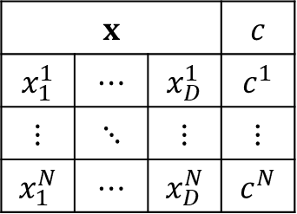
10.2 Estimation using Maximum Likelihood
10.2.1 Binary attributes
Dataset
$\left\{\left(x^{n},c^{n}\right) | n=1,…,N\right\}$, $x_{i}^{n}∈\left\{0,1\right\}$, $i=1,…,D$ , $c^{n}∈\left\{0,1\right\}$
$\#\left(c^{n}=0\right)=n_{0}$, $\#\left(c^{n}=1\right)=n_{1}$
Parameters
$p\left(x_{i}=1 | c\right)=θ_{i}^{c}$, $p\left(x_{i}=0 | c\right)=1−θ_{i}^{c}$ , $i=1,…,D$
Problem
Optimize $θ_{i}^{c}$
Model
$$p\left(x | c\right)=\prod_{i=1}^{D}{p\left(x_{i} | c\right)=\prod_{i=1}^{D}{{\left(θ_{i}^{c}\right)}^{x_{i}}}}{\left(1{−θ}_{i}^{c}\right)}^{1−x_{i}}$$
Likelihood
$$\prod_{n}{p\left(x^{n},c^{n} | θ_{1}^{c},…,θ_{D}^{c}\right)}=\prod_{n}{p\left(x^{n},c^{n}\right)}$$
for simplicity
$$x$$ |  |  | $$c$$
$$x_{1}^{1}$$ | $$⋯$$ | $$x_{D}^{1}$$ | $$c^{1}$$
$$⋮$$ | $$⋱$$ | $$⋮$$ | $$⋮$$
$$x_{1}^{N}$$ | $$⋯$$ | $$x_{D}^{N}$$ | $$c^{N}$$

Slide 6
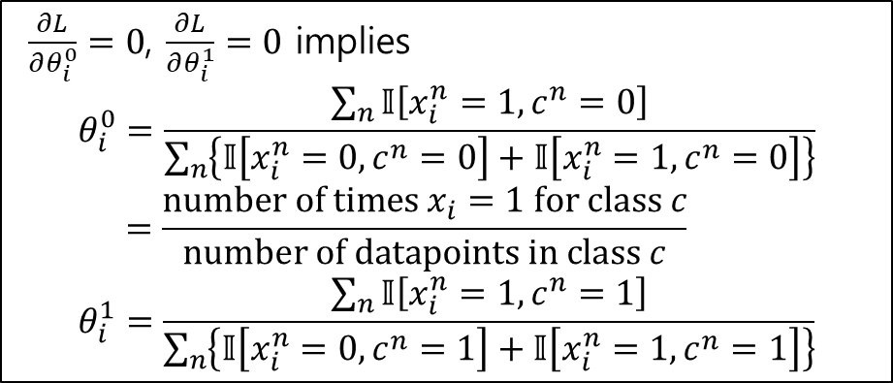
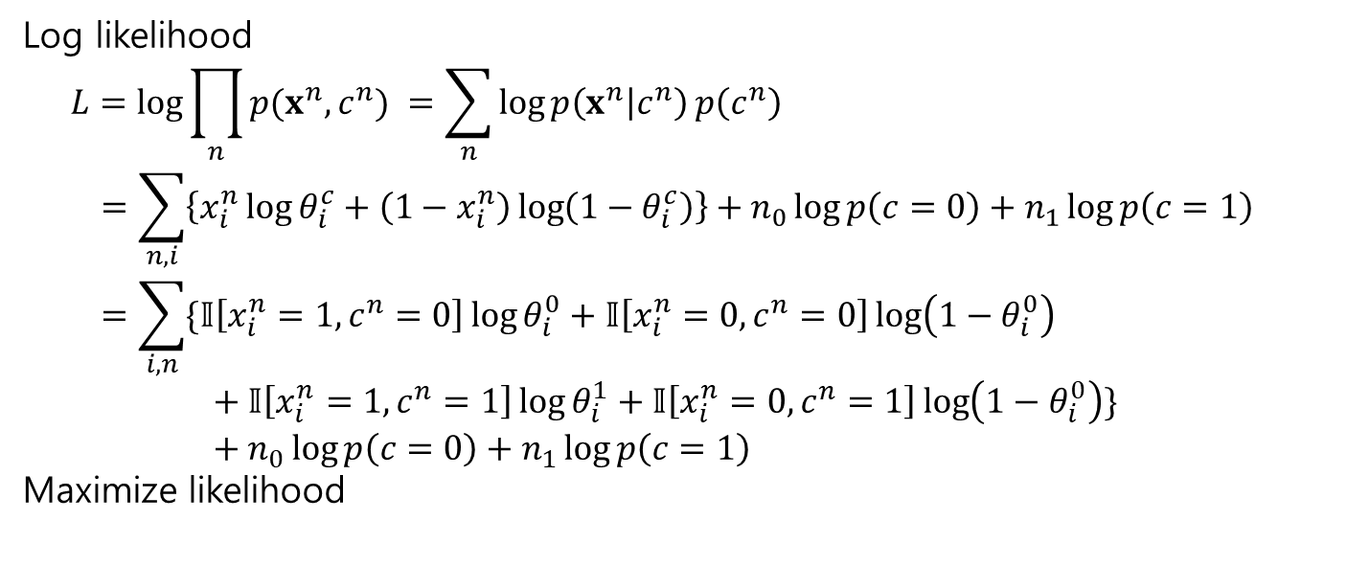
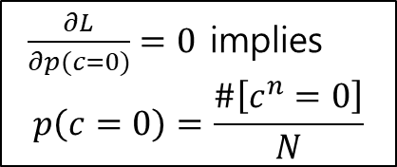
Log likelihood
$$L=\log{\prod_{n}{p(x^{n},c^{n}) }}=\sum_{n}{\log{p\left(x^{n} | c^{n}\right)}p\left(c^{n}\right)}$$
$$=\sum_{n,i}{\left\{x_{i}^{n}\log{θ_{i}^{c}}+\left(1−x_{i}^{n}\right)\log\left(1−θ_{i}^{c}\right)\right\}}+n_{0}\log{p\left(c=0\right)}+n_{1}\log{p\left(c=1\right)} \\ =\sum_{i,n}{\{𝕀\left[x_{i}^{n}=1, c^{n}=0\right]\log{θ_{i}^{0}}+𝕀\left[x_{i}^{n}=0,c^{n}=0\right]\log\left(1−θ_{i}^{0}\right)} \\ + 𝕀\left[x_{i}^{n}=1,c^{n}=1\right]\log{θ_{i}^{1}}+𝕀\left[x_{i}^{n}=0,c^{n}=1\right]\log\left(1−θ_{i}^{0}\right)\}$$
$$+ n_{0}\log{p\left(c=0\right)}+n_{1}\log{p\left(c=1\right)}$$
Maximize likelihood
$\frac{∂L}{∂θ_{i}^{0}}=0$, $\frac{∂L}{∂θ_{i}^{1}}=0$ implies
$$θ_{i}^{0}=\frac{\sum_{n}{𝕀\left[x_{i}^{n}=1,c^{n}=0\right]}}{\sum_{n}{\left\{𝕀\left[x_{i}^{n}=0,c^{n}=0\right]+𝕀\left[x_{i}^{n}=1,c^{n}=0\right]\right\}}}$$
$$=\frac{number of times x_{i}=1 for class c}{number of datapoints in class c}$$
$$θ_{i}^{1}=\frac{\sum_{n}{𝕀\left[x_{i}^{n}=1,c^{n}=1\right]}}{\sum_{n}{\left\{𝕀\left[x_{i}^{n}=0,c^{n}=1\right]+𝕀\left[x_{i}^{n}=1,c^{n}=1\right]\right\}}}$$
$\frac{∂L}{∂p(c=0)}=0$ implies
$$p\left(c=0\right)=\frac{\#\left[c^{n}=0\right]}{N}$$

Slide 7

Classification boundary
We classify a novel input $x^{∗}=\left(x_{1}^{∗},…,x_{D}^{∗}\right)$ as class 1 if
$p\left(c=1 | x^{∗}\right)>p\left(c=0 | x^{∗}\right)$
Using Bayes’ rule and log
$\log{p(x^{∗}}\left|c=1\right)+\log{p\left(c=1\right)}−\log{p\left(x^{∗}\right)}>\log{p(x^{∗}}\left|c=0\right)+\log{p\left(c=0\right)}−\log{p\left(x^{∗}\right)}$
$$\sum_{i}{\log{p\left(x_{i}^{∗} | c=1\right)}}+\log{p\left(c=1\right)}>\sum_{i}{\log{p\left(x_{i}^{∗} | c=0\right)}}+\log{p\left(c=0\right)}$$
$$\sum_{i}{\left(x_{i}^{∗}θ_{i}^{1}+\left(1−x_{i}^{∗}\right)\left(1−θ_{i}^{1}\right)\right)}+\log{p\left(c=1\right)}$$
$$>\sum_{i}{\left(x_{i}^{∗}θ_{i}^{0}+\left(1−x_{i}^{∗}\right)\left(1−θ_{i}^{0}\right)\right)}+\log{p\left(c=0\right)}$$
classify $x^{∗}$ as class 1 if
$$\sum_{i}{w_{i}x_{i}^{∗}+a}>0$$

Slide 8
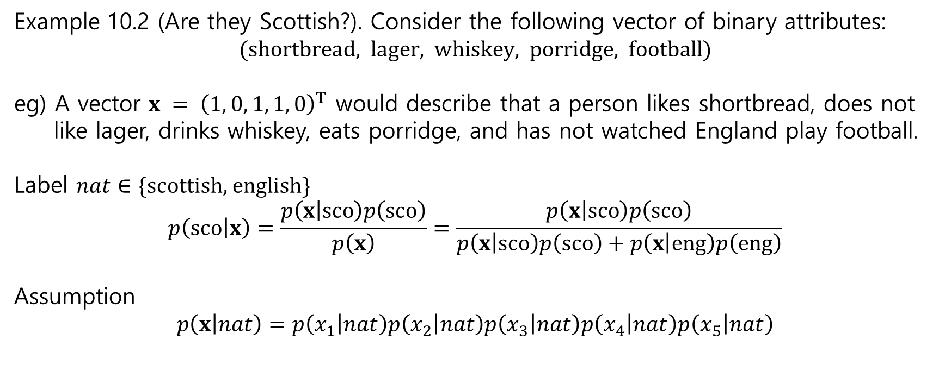
Example 10.2 (Are they Scottish?). Consider the following vector of binary attributes:
$$\text{(}\text{shortbread}\text{, }\text{lager}\text{, }\text{whiskey}\text{, }\text{porridge}\text{, }\text{football}\text{)}$$
eg) A vector $x = {\left(1, 0, 1, 1, 0\right)}^{T}$ would describe that a person likes shortbread, does not
like lager, drinks whiskey, eats porridge, and has not watched England play football.
Label $nat∈\{\text{scottish}\text{, }\text{english}\}$
$$p\left(sco | x\right)=\frac{p\left(x | sco\right)p\left(sco\right)}{p\left(x\right)}=\frac{p\left(x | sco\right)p\left(sco\right)}{p\left(x | sco\right)p\left(sco\right)+p\left(x | eng\right)p\left(eng\right)}$$
Assumption
$$p\left(x | nat\right)=p\left(x_{1} | nat\right)p\left(x_{2} | nat\right)p\left(x_{3} | nat\right)p\left(x_{4} | nat\right)p\left(x_{5} | nat\right)$$

Slide 9
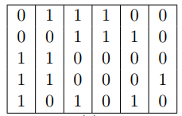
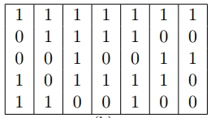
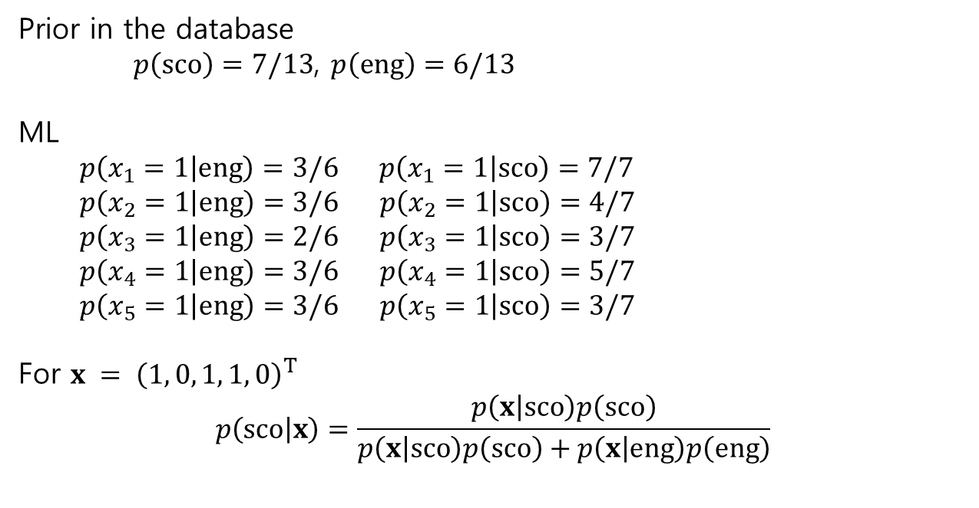
Prior in the database
$p\left(sco\right)=7/13$, $p\left(eng\right)=6/13$
ML
$p\left(x_{1}=1 | eng\right)=3/6$ $p\left(x_{1}=1 | sco\right)=7/7$
$p\left(x_{2}=1 | eng\right)=3/6$ $p\left(x_{2}=1 | sco\right)=4/7$
$p\left(x_{3}=1 | eng\right)=2/6$ $p\left(x_{3}=1 | sco\right)=3/7$
$p\left(x_{4}=1 | eng\right)=3/6$ $p\left(x_{4}=1 | sco\right)=5/7$
$p\left(x_{5}=1 | eng\right)=3/6$ $p\left(x_{5}=1 | sco\right)=3/7$
For $x = {\left(1, 0, 1, 1, 0\right)}^{T}$
$$p\left(sco | x\right)=\frac{p\left(x | sco\right)p\left(sco\right)}{p\left(x | sco\right)p\left(sco\right)+p\left(x | eng\right)p\left(eng\right)}$$
English 6 people
Scottish 7 people

Slide 10

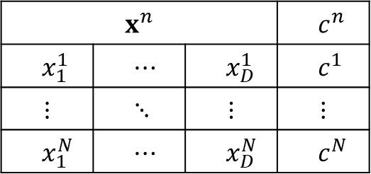
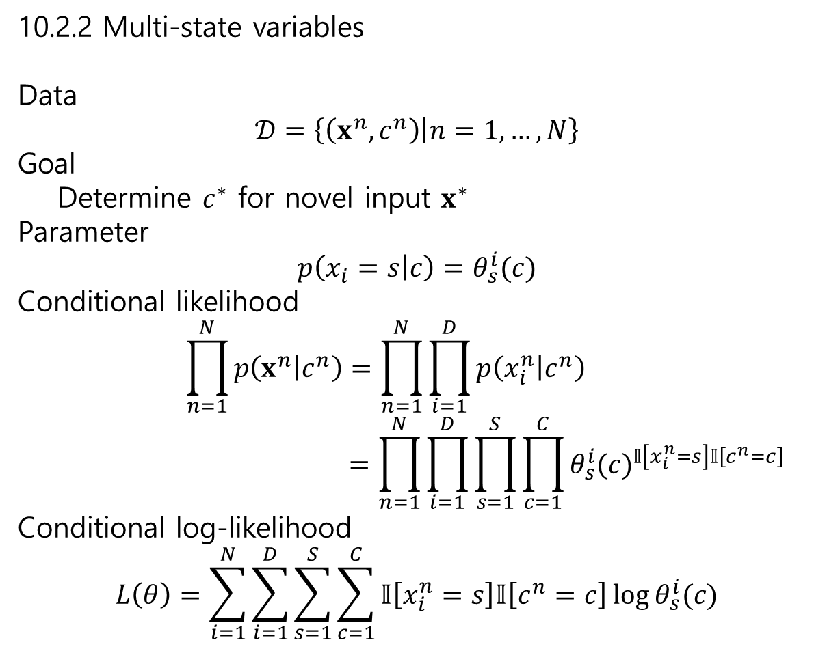
10.2.2 Multi-state variables
Data
$$𝒟=\left\{\left(x^{n},c^{n}\right) | n=1,…,N\right\}$$
Goal
Determine $c^{∗}$ for novel input $x^{∗}$
Parameter
$$p\left(x_{i}=s | c\right)=θ_{s}^{i}(c)$$
Conditional likelihood
$$\prod_{n=1}^{N}{p\left(x^{n} | c^{n}\right)}=\prod_{n=1}^{N}{\prod_{i=1}^{D}{p\left(x_{i}^{n} | c^{n}\right)}}$$
$$=\prod_{n=1}^{N}{\prod_{i=1}^{D}{\prod_{s=1}^{S}{\prod_{c=1}^{C}{{θ_{s}^{i}(c)}^{𝕀\left[x_{i}^{n}=s\right]𝕀\left[c^{n}=c\right]}}}}}$$
Conditional log-likelihood
$$L\left(θ\right)=\sum_{i=1}^{N}{\sum_{i=1}^{D}{\sum_{s=1}^{S}{\sum_{c=1}^{C}{𝕀\left[x_{i}^{n}=s\right]𝕀\left[c^{n}=c\right]\log{θ_{s}^{i}(c)}}}}}$$
$$x^{n}$$ |  |  | $$c^{n}$$
$$x_{1}^{1}$$ | $$⋯$$ | $$x_{D}^{1}$$ | $$c^{1}$$
$$⋮$$ | $$⋱$$ | $$⋮$$ | $$⋮$$
$$x_{1}^{N}$$ | $$⋯$$ | $$x_{D}^{N}$$ | $$c^{N}$$
$x_{i}^{n}∈\{1,…,S\}$, $c^{n}∈\{1,…,C\}$

Slide 11
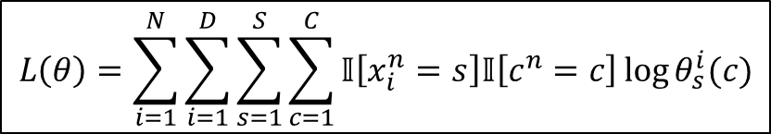
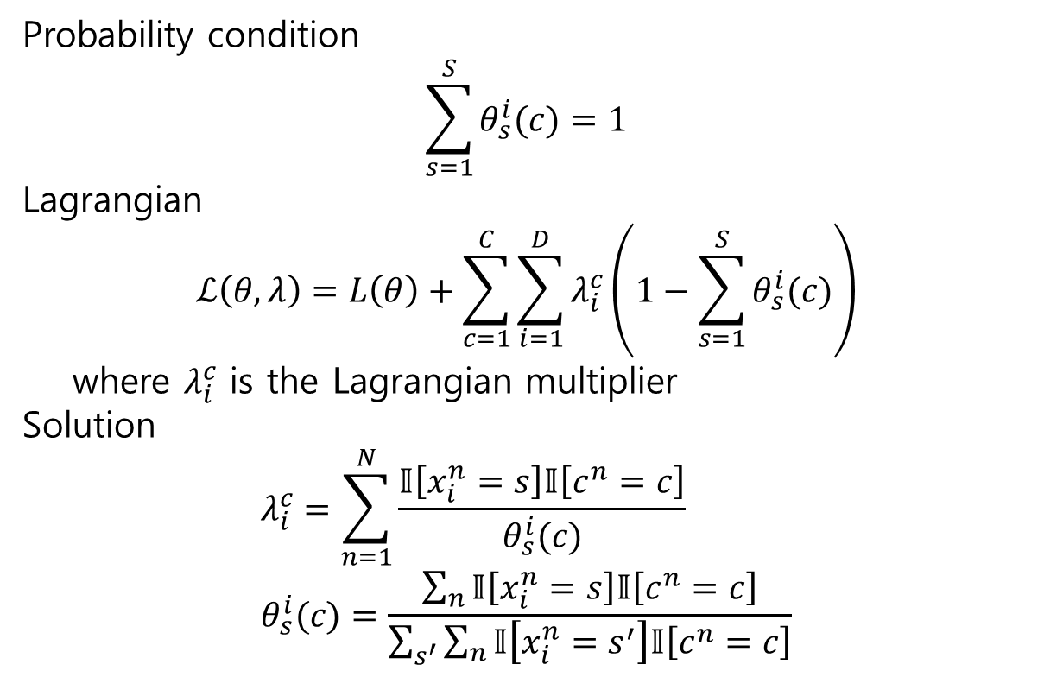
Probability condition
$$\sum_{s=1}^{S}{θ_{s}^{i}(c)=1}$$
Lagrangian
$$ℒ\left(θ,λ\right)=L\left(θ\right)+\sum_{c=1}^{C}{\sum_{i=1}^{D}{λ_{i}^{c}\left(1−\sum_{s=1}^{S}{θ_{s}^{i}(c)}\right)}}$$
where $λ_{i}^{c}$ is the Lagrangian multiplier
Solution
$$λ_{i}^{c}=\sum_{n=1}^{N}{\frac{𝕀\left[x_{i}^{n}=s\right]𝕀\left[c^{n}=c\right]}{θ_{s}^{i}(c)}} \\ θ_{s}^{i}(c)=\frac{\sum_{n}{𝕀\left[x_{i}^{n}=s\right]𝕀\left[c^{n}=c\right]}}{\sum_{s^{′}}{\sum_{n}{𝕀\left[x_{i}^{n}=s^{′}\right]𝕀\left[c^{n}=c\right]}}}$$
$$L\left(θ\right)=\sum_{i=1}^{N}{\sum_{i=1}^{D}{\sum_{s=1}^{S}{\sum_{c=1}^{C}{𝕀\left[x_{i}^{n}=s\right]𝕀\left[c^{n}=c\right]\log{θ_{s}^{i}(c)}}}}}$$

Slide 12
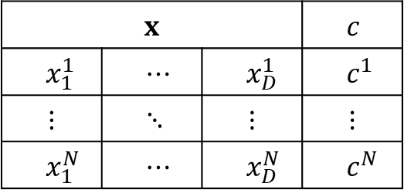
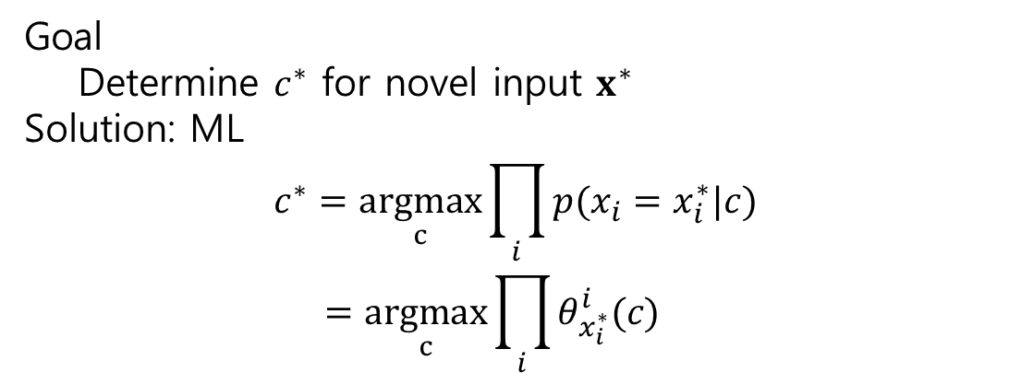

$$x$$ |  |  | $$c$$
$$x_{1}^{1}$$ | $$⋯$$ | $$x_{D}^{1}$$ | $$c^{1}$$
$$⋮$$ | $$⋱$$ | $$⋮$$ | $$⋮$$
$$x_{1}^{N}$$ | $$⋯$$ | $$x_{D}^{N}$$ | $$c^{N}$$
Goal
Determine $c^{∗}$ for novel input $x^{∗}$
Solution: ML
$$c^{∗}=\underset{c}{argmax}{\prod_{i}{p(x_{i}=x_{i}^{∗}|c)}} \\ =\underset{c}{argmax}{\prod_{i}{θ_{x_{i}^{∗}}^{i}(c)}}$$
$x_{i}^{n}∈\{1,…,S\}$, $c^{n}∈\{1,…,C\}$

Slide 13
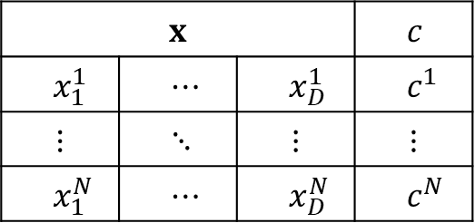
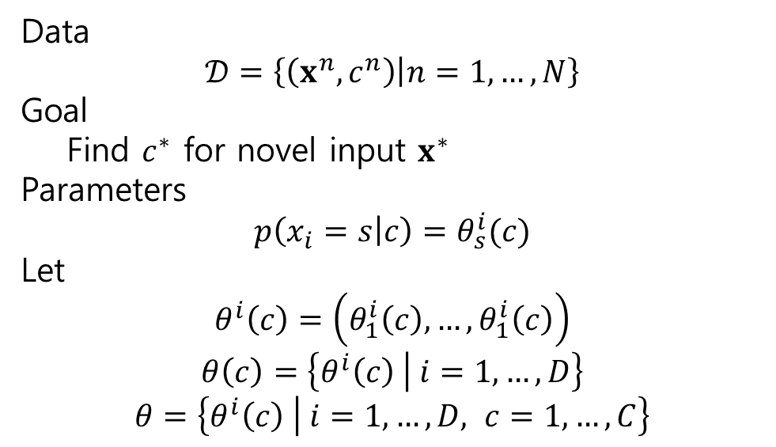

10.3 Bayesian Naive Bayes
Data
$$𝒟=\left\{\left(x^{n},c^{n}\right) | n=1,…,N\right\}$$
Goal
Find $c^{∗}$ for novel input $x^{∗}$
Parameters
$$p\left(x_{i}=s | c\right)=θ_{s}^{i}(c)$$
Let
$$θ^{i}\left(c\right)=\left(θ_{1}^{i}\left(c\right),…,θ_{1}^{i}\left(c\right)\right)$$
$$θ\left(c\right)=\left\{θ^{i}\left(c\right) | i=1,…,D\right\}$$
$$θ=\left\{θ^{i}\left(c\right) | i=1,…,D, c=1,…,C\right\}$$
$$x$$ |  |  | $$c$$
$$x_{1}^{1}$$ | $$⋯$$ | $$x_{D}^{1}$$ | $$c^{1}$$
$$⋮$$ | $$⋱$$ | $$⋮$$ | $$⋮$$
$$x_{1}^{N}$$ | $$⋯$$ | $$x_{D}^{N}$$ | $$c^{N}$$
$x_{i}^{n}∈\{1,…,S\}$, $c^{n}∈\{1,…,C\}$

Slide 14
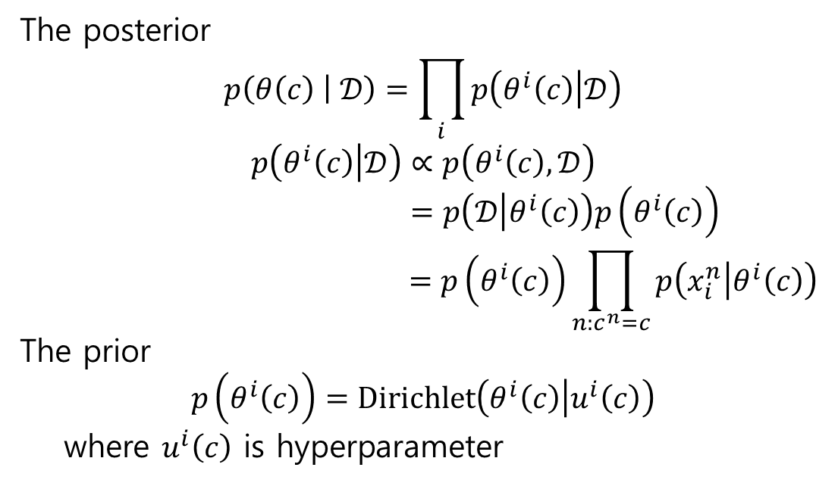
$$x$$ |  |  | $$c$$
$$x_{1}^{1}$$ | $$⋯$$ | $$x_{D}^{1}$$ | $$c^{1}$$
$$⋮$$ | $$⋱$$ | $$⋮$$ | $$⋮$$
$$x_{1}^{N}$$ | $$⋯$$ | $$x_{D}^{N}$$ | $$c^{N}$$
The posterior
$$p\left(θ\left(c\right) | 𝒟\right)=\prod_{i}{p\left(θ^{i}\left(c\right) | 𝒟\right)}$$
$$p\left(θ^{i}\left(c\right) | 𝒟\right)∝p\left(θ^{i}\left(c\right),𝒟\right)$$
$$=p\left(𝒟 | θ^{i}\left(c\right)\right)p\left(θ^{i}\left(c\right)\right)$$
$$=p\left(θ^{i}\left(c\right)\right)\prod_{n:c^{n}=c}{p\left(x_{i}^{n} | θ^{i}\left(c\right)\right)}$$
The prior
$$p\left(θ^{i}\left(c\right)\right)=\text{Dirichlet}\left(θ^{i}\left(c\right) | u^{i}\left(c\right)\right)$$
where $u^{i}\left(c\right)$ is hyperparameter
$x_{i}^{n}∈\{1,…,S\}$, $c^{n}∈\{1,…,C\}$

Slide 15
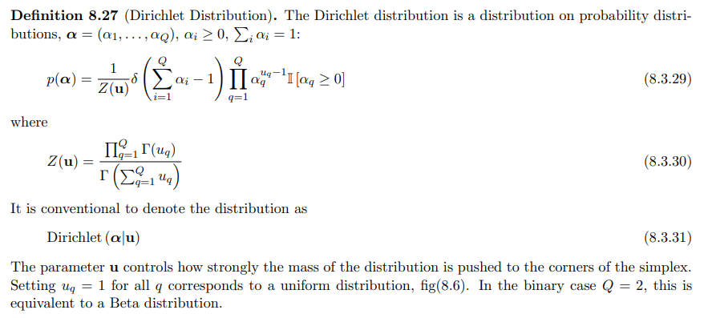

Slide 16
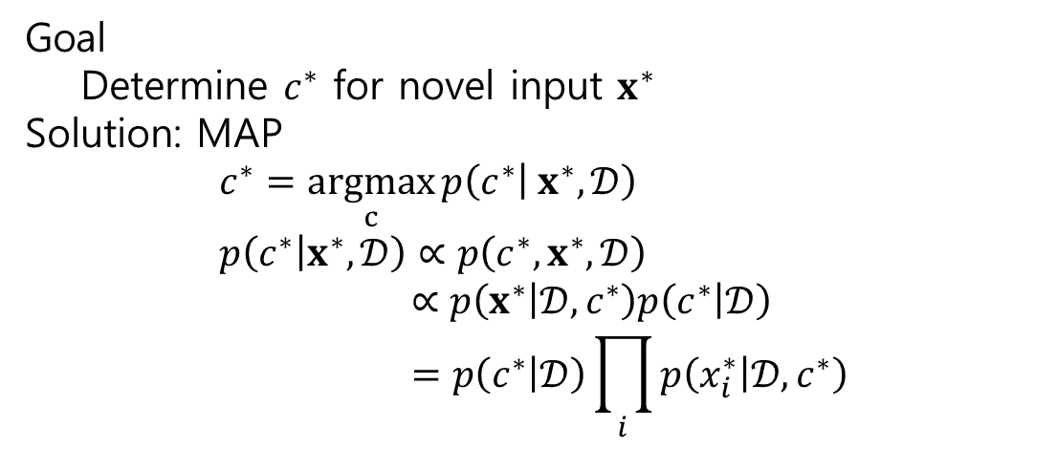
$$x$$ |  |  | $$c$$
$$x_{1}^{1}$$ | $$⋯$$ | $$x_{D}^{1}$$ | $$c^{1}$$
$$⋮$$ | $$⋱$$ | $$⋮$$ | $$⋮$$
$$x_{1}^{N}$$ | $$⋯$$ | $$x_{D}^{N}$$ | $$c^{N}$$
Goal
Determine $c^{∗}$ for novel input $x^{∗}$
Solution: MAP
$$c^{∗}=\underset{c}{argmax}{p\left(c^{∗} | x^{∗},𝒟\right)} \\ p\left(c^{∗} | x^{∗},𝒟\right)∝p\left(c^{∗},x^{∗},𝒟\right) \\ ∝p\left(x^{∗} | 𝒟,c^{∗}\right)p\left(c^{∗} | 𝒟\right) \\ =p\left(c^{∗} | 𝒟\right)\prod_{i}{p\left(x_{i}^{∗} | 𝒟,c^{∗}\right)}$$
$x_{i}^{n}∈\{1,…,S\}$, $c^{n}∈\{1,…,C\}$

