Slide 1
Chapter 3 Finite Markov Decision Processes

Slide 2
MDP
a classical formalization of sequential decision making
actions influence not just immediate rewards, but also subsequent situations, or states, and through those future rewards.

Slide 3
3.1 The Agent–Environment Interface
Agent
The learner and decision maker
Environment
The thing it interacts with, comprising everything outside the agent

Slide 4
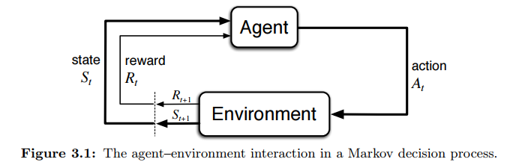

Time step
$t=0, 1, 2, …$
States
$𝒮:$ set of all states
$S_{t}∈𝒮$
Actions
$𝒜(s)$: set of all actions for state $s$
$A_{t}∈𝒜(s)$
Rewards
$ℛ$: set of all rewards
$R_{t+1}∈ℛ$
Trajectory
$S_{0}, A_{0}, R_{1}, S_{1}, A_{1}, R_{2}, …$

Slide 5
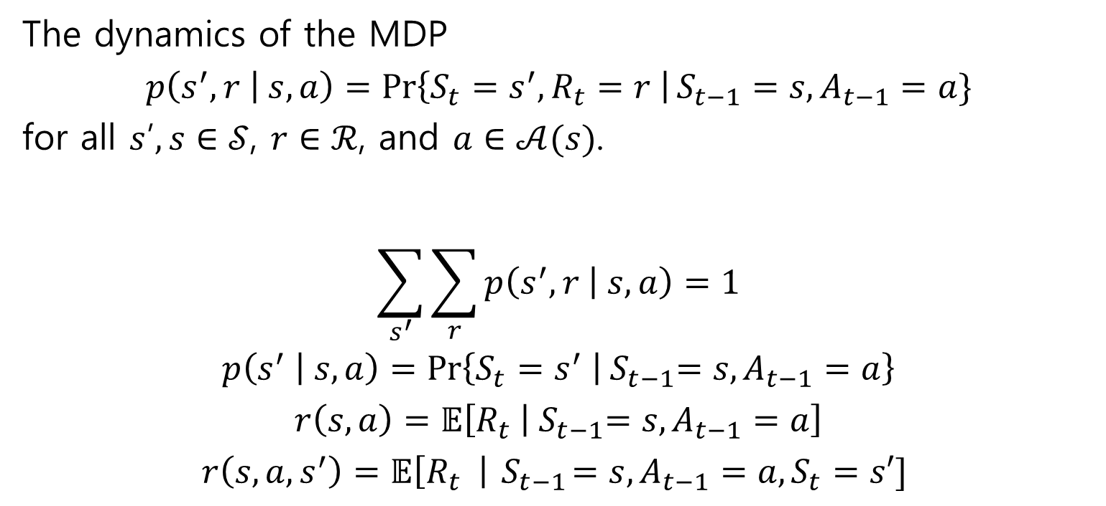
The dynamics of the MDP
$$p\left(s^{′}, r | s, a\right)=\operatorname{Pr}\left\{S_{t}=s^{′}, R_{t}=r \right|S_{t−1}=s, A_{t−1}=a\}$$
for all $s$’$, s∈𝒮$, $r∈ℛ$, and $a∈𝒜(s)$.
$$\sum_{s^{′}}{\sum_{r}{p\left(s^{′},r | s,a\right)}}=1$$
$$p\left(s^{′} | s,a\right)=\operatorname{Pr}\left\{S_{t}=s^{′} | { S}_{t−1}=s,A_{t−1}=a\right\}$$
$$r\left(s,a\right)=𝔼\left[R_{t} | { S}_{t−1}=s,A_{t−1}=a\right]$$
$$r\left(s, a, s^{′}\right)=𝔼\left[R_{t} \right|{ S}_{t−1}=s, A_{t−1}=a, S_{t}=s′]$$

Slide 6
3.2 Goals and Rewards
Goal
To maximize the total amount of reward

Slide 7
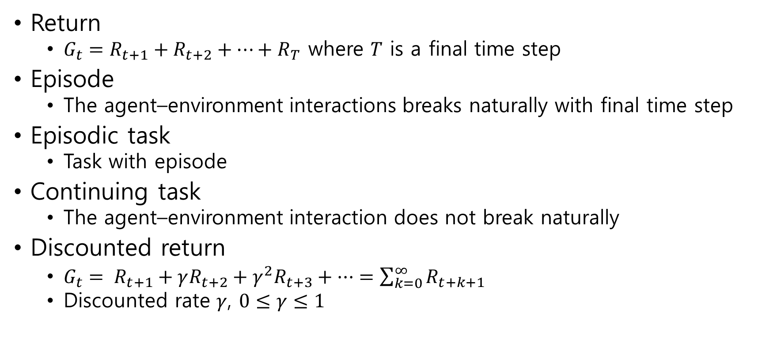
3.3 Returns and Episodes
Return
$G_{t}=R_{t+1}+R_{t+2}+⋯+R_{T}$ where $T$ is a final time step
Episode
The agent–environment interactions breaks naturally with final time step
Episodic task
Task with episode
Continuing task
The agent–environment interaction does not break naturally
Discounted return
$G_{t}= R_{t+1}+γR_{t+2}+γ^{2}R_{t+3}+ ··· =\sum_{k=0}^{∞}{R_{t+k+1}}$
Discounted rate $γ$, $0≤γ≤1$

Slide 8
3.4 Unified Notation for Episodic and Continuing Tasks

Slide 9

3.5 Policies and Value Functions
Policy $π$
Probabilities of selecting an action
$π\left(a | s\right)=\operatorname{Pr}\left\{A_{t}=a | S_{t}=s\right\}$

Slide 10
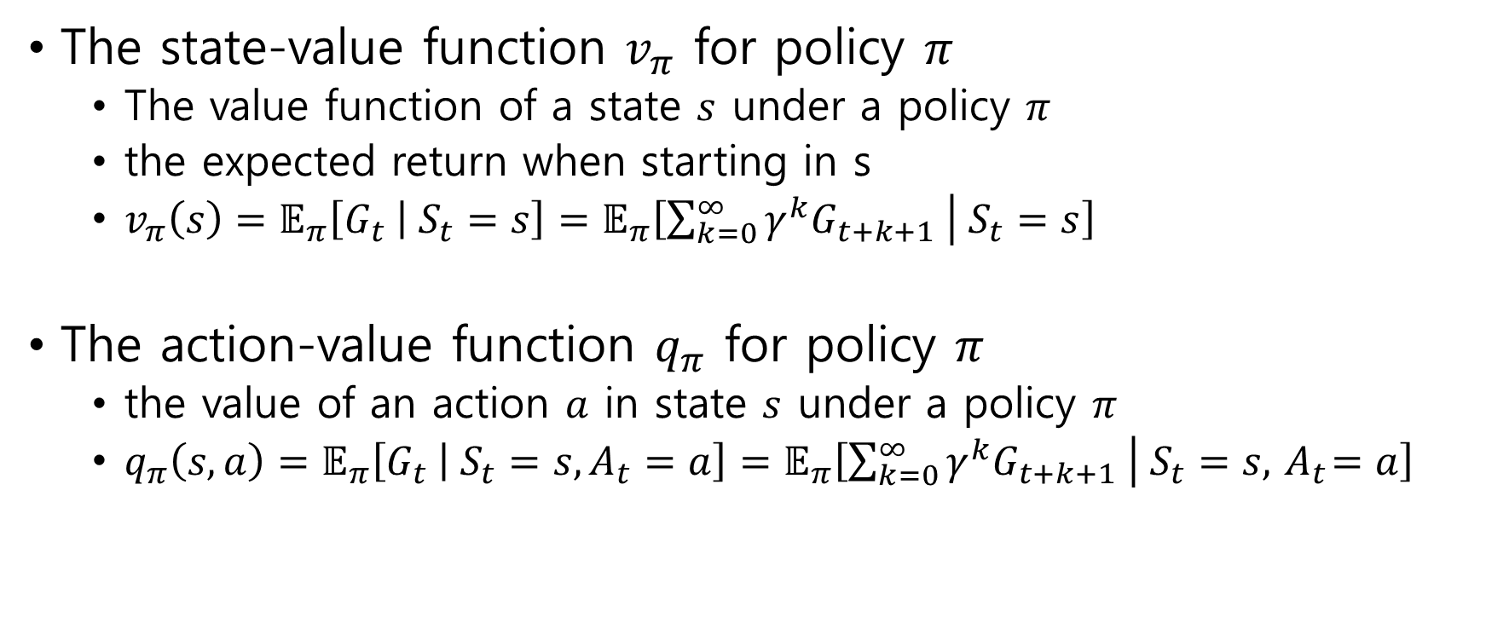
3.5 Policies and Value Functions
The state-value function $v_{π}$ for policy $π$
The value function of a state $s$ under a policy $π$
the expected return when starting in s
$v_{π}\left(s\right)=𝔼_{π}\left[G_{t} | S_{t}=s\right]=𝔼_{π}\left[\sum_{k=0}^{∞}{γ^{k}G_{t+k+1}} | S_{t}=s\right]$
The action-value function $q_{π}$ for policy $π$
the value of an action $a$ in state $s$ under a policy $π$
$q_{π}\left(s,a\right)=𝔼_{π}\left[G_{t} | S_{t}=s, A_{t}=a\right]=𝔼_{π}\left[\sum_{k=0}^{∞}{γ^{k}G_{t+k+1}} | S_{t}=s, { A}_{t}=a\right]$

Slide 11
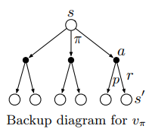
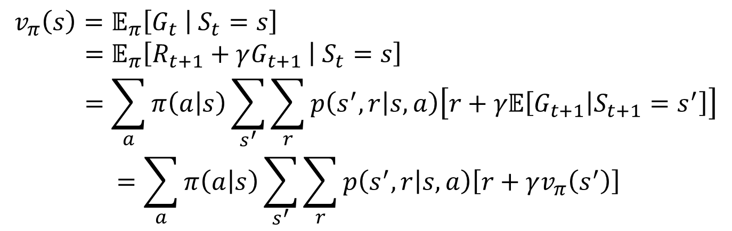

Bellman equation for $v_{π}$
$$v_{π}\left(s\right)=𝔼_{π}\left[G_{t} | S_{t}=s\right] \\ =𝔼_{π}\left[R_{t+1}+γG_{t+1} | S_{t}=s\right] \\ =\sum_{a}{π\left(a | s\right)\sum_{s^{′}}{\sum_{r}{p\left(s^{′},r | s,a\right)\left[r+γ𝔼\left[G_{t+1} | S_{t+1}=s^{′}\right]\right]}}}$$
$$=\sum_{a}{π\left(a | s\right)\sum_{s^{′}}{\sum_{r}{p\left(s^{′},r | s,a\right)\left[r+γv_{π}\left(s^{′}\right)\right]}}}$$

Slide 12
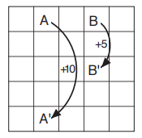

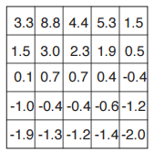
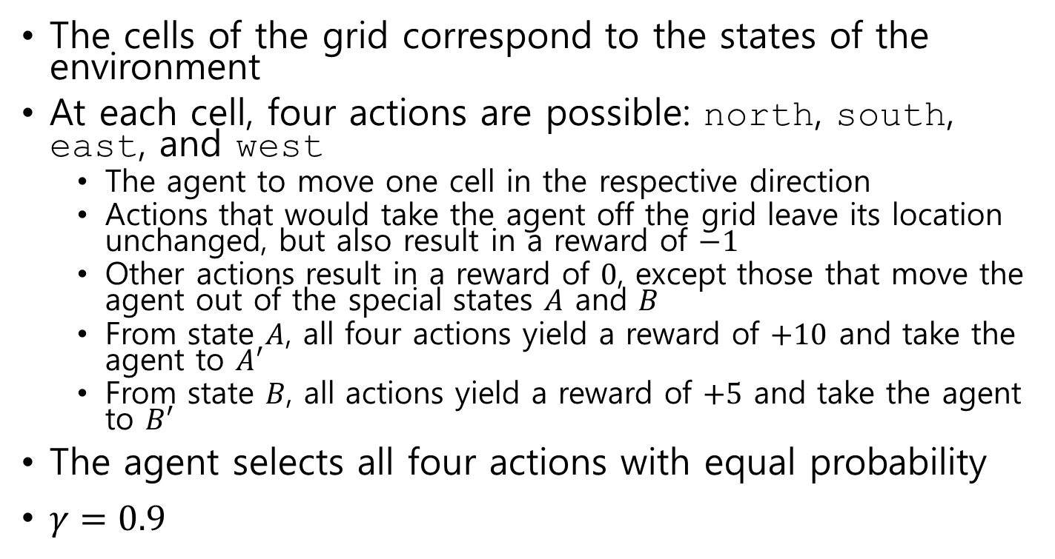
Example 3.5: Gridworld
The cells of the grid correspond to the states of the environment
At each cell, four actions are possible: north, south, east, and west
The agent to move one cell in the respective direction
Actions that would take the agent off the grid leave its location unchanged, but also result in a reward of $−1$
Other actions result in a reward of $0$, except those that move the agent out of the special states $A$ and $B$
From state $A$, all four actions yield a reward of $+10$ and take the agent to $A′$
From state $B$, all actions yield a reward of $+5$ and take the agent to $B′$
The agent selects all four actions with equal probability
$γ=0.9$

Slide 13
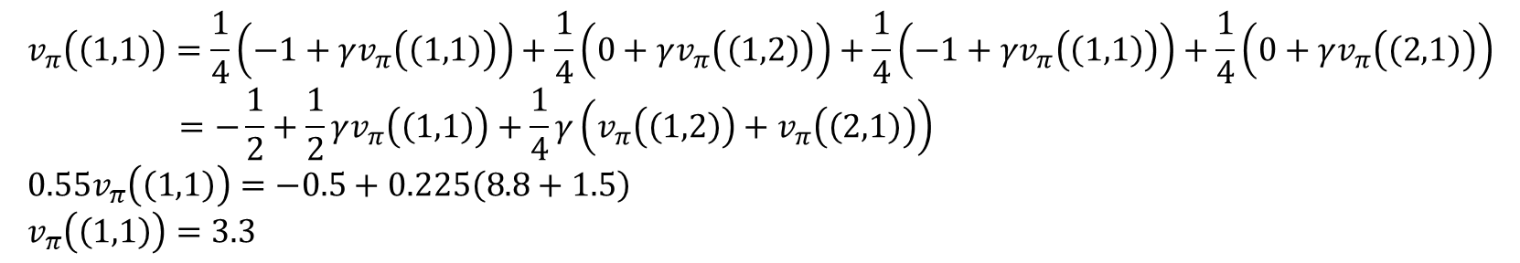
$$v_{π}\left(\left(1,1\right)\right)=\frac{1}{4}\left(−1+γv_{π}\left(\left(1,1\right)\right)\right)+\frac{1}{4}\left(0+γv_{π}\left(\left(1,2\right)\right)\right)+\frac{1}{4}\left(−1+γv_{π}\left(\left(1,1\right)\right)\right)+\frac{1}{4}\left(0+γv_{π}\left(\left(2,1\right)\right)\right) \\ =−\frac{1}{2}+\frac{1}{2}γv_{π}\left(\left(1,1\right)\right)+\frac{1}{4}γ\left(v_{π}\left(\left(1,2\right)\right)+v_{π}\left(\left(2,1\right)\right)\right) \\ 0.55v_{π}\left(\left(1,1\right)\right)=−0.5+0.225\left(8.8+1.5\right) \\ v_{π}\left(\left(1,1\right)\right)=3.3$$

Slide 14
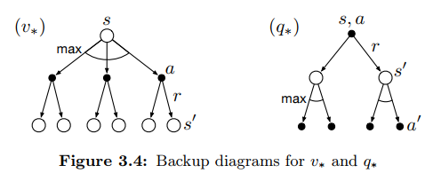

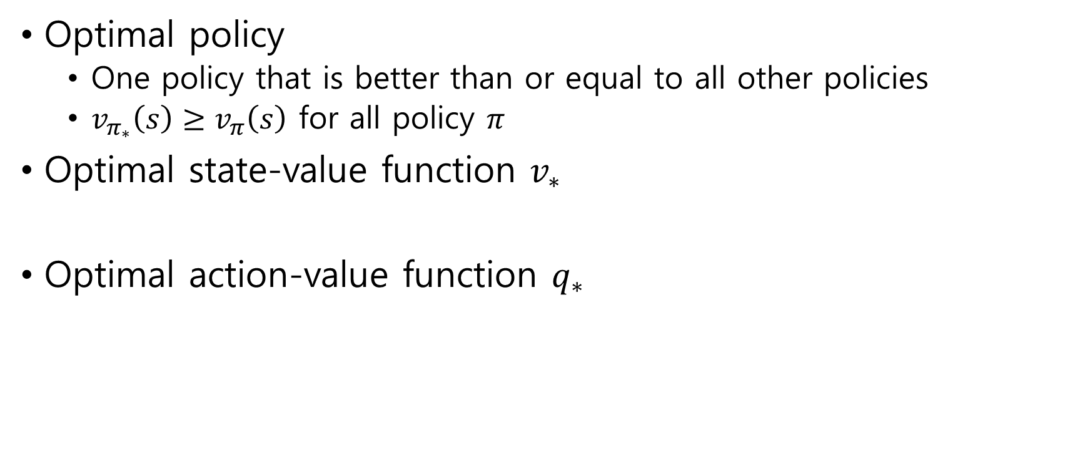

3.6 Optimal Policies and Optimal Value Functions
Optimal policy
One policy that is better than or equal to all other policies
$v_{π_{∗}}\left(s\right)≥v_{π}\left(s\right)$ for all policy $π$
Optimal state-value function $v_{∗}$
Optimal action-value function $q_{∗}$
$$v_{∗}\left(s\right)=\max_{π}{v_{π}\left(s\right)}$$
$$q_{∗}\left(s,a\right)=\max_{π}{q_{π}\left(s,a\right)}$$

Slide 15
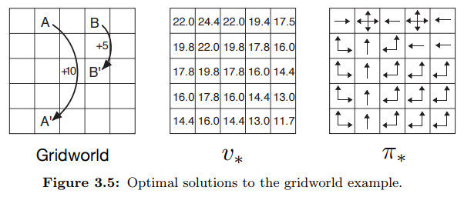
Example 3.8: Solving the Gridworld

Slide 16
3.7 Optimality and Approximation
Optimal policies can be generated only with extreme computational cost
It is an ideal that agents can only approximate

