Slide 1
Chapter 9 Learning as Inference

Slide 2
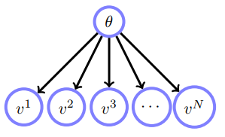
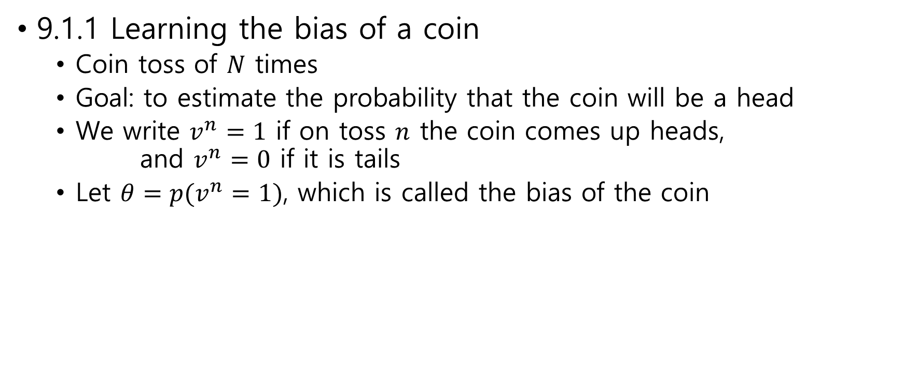
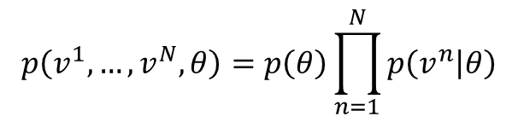
9.1 Learning as Inference
9.1.1 Learning the bias of a coin
Coin toss of $N$ times
Goal: to estimate the probability that the coin will be a head
We write $v^{n}=1$ if on toss $n$ the coin comes up heads, and $v^{n}=0$ if it is tails
Let $θ=p(v^{n}=1)$, which is called the bias of the coin
$$p\left(v^{1},…,v^{N},θ\right)=p\left(θ\right)\prod_{n=1}^{N}{p\left(v^{n} | θ\right)}$$
belief network

Slide 3
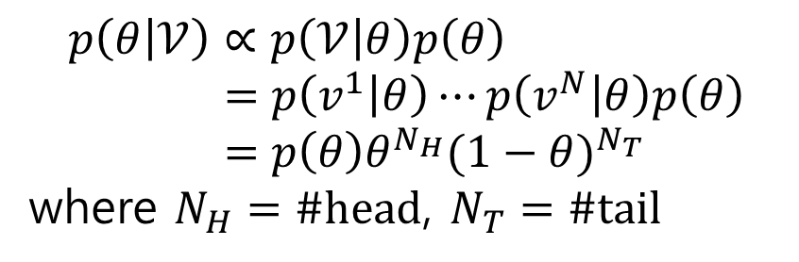


Learning refers to using the observations $v^{1},…,v^{N}$to infer $θ$
For simplicity, let $𝒱=(v^{1},…,v^{N})$
Posterior $p\left(θ | 𝒱\right)=\frac{p\left(𝒱,θ\right)}{p\left(𝒱\right)}=\frac{p\left(𝒱 | θ\right)p\left(θ\right)}{p\left(𝒱\right)}$
MAP $\underset{θ}{argmax}{p\left(θ | 𝒱\right)}$
$$p\left(θ | 𝒱\right)∝p\left(𝒱 | θ\right)p\left(θ\right) \\ =p\left(v^{1} | θ\right)⋯p\left(v^{N} | θ\right)p\left(θ\right) \\ =p\left(θ\right)θ^{N_{H}}{(1−θ)}^{N_{T}}$$
where $N_{H}=\#head$, $N_{T}=\#tail$
$$N_{H}=\sum_{n=1}^{N}{𝕀[v^{n}=1]}$$

Slide 4


For simplicity we assume that $θ∈\{0.1, 0.5, 0.8\}$ and $p(θ=0.1)=0.15$, $p(θ=0.5)=0.8$, $p(θ=0.8)=0.05$
This prior expresses that we have
$80\%$ belief that the coin is ‘fair’
$5\%$ belief the coin is biased to land heads (with $θ=0.8$)
$15\%$ belief the coin is biased to land tails (with $θ=0.1$)
Experiments
$N_{H}=2$, $N_{T}=8$
$p\left(θ=0.1 | 𝒱\right)=k×0.15×{0.1}^{2}×{0.9}^{8}=k×6.46×{10}^{−4}$
$p\left(θ=0.5 | 𝒱\right)=k×0.8×{0.5}^{2}×{0.5}^{8}=k×7.81×{10}^{−4}$
$p\left(θ=0.8 | 𝒱\right)=k×0.05×{0.8}^{2}×{0.2}^{8}=k×8.19×{10}^{−8}$
$k×6.46×{10}^{−4}$+ $k×7.81×{10}^{−4}$+ $k×8.19×{10}^{−8}=1$
$$k=1/0.0014$$
$p\left(θ=0.1 | 𝒱\right)≈0.4525$, $p\left(θ=0.5 | 𝒱\right)≈0.5475$, $p\left(θ=0.8 | 𝒱\right)≈0.0001$

Slide 5
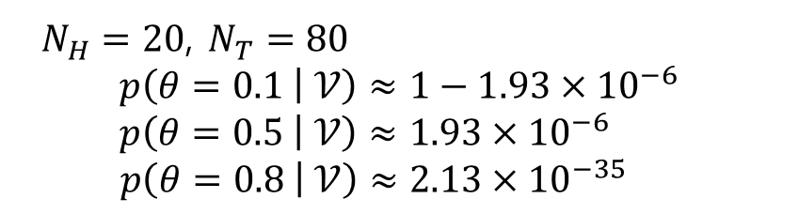
$N_{H}=20$, $N_{T}=80$
$$p\left(θ=0.1 | 𝒱\right)≈1−1.93×{10}^{−6}$$
$$p\left(θ=0.5 | 𝒱\right)≈1.93×{10}^{−6}$$
$$p\left(θ=0.8 | 𝒱\right)≈2.13×{10}^{−35}$$

Slide 6
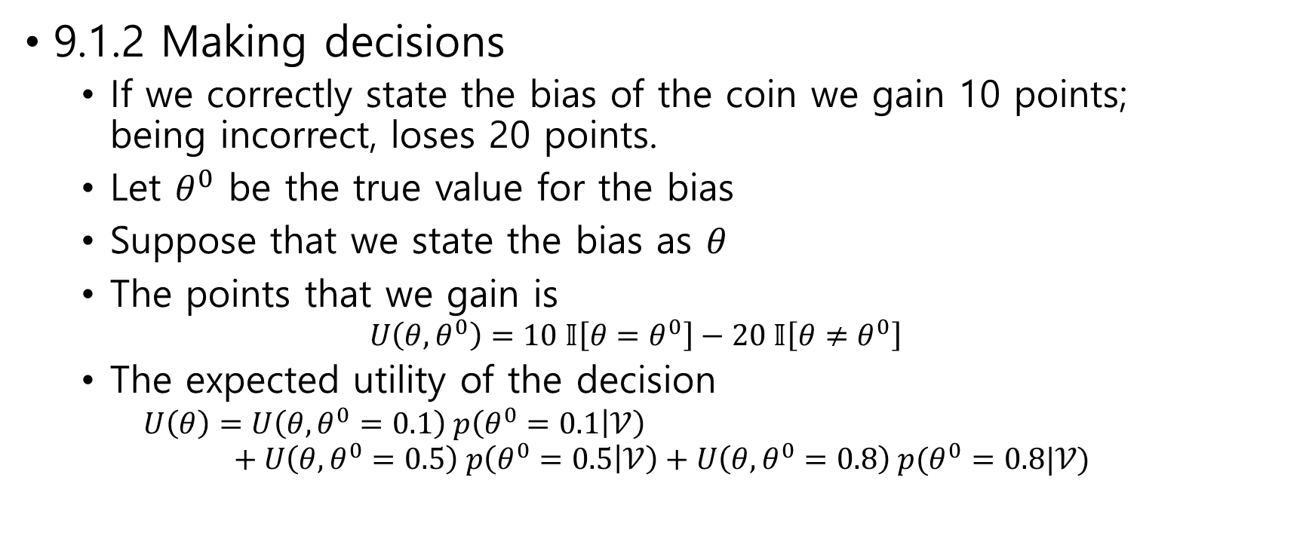
9.1.2 Making decisions
If we correctly state the bias of the coin we gain 10 points; being incorrect, loses 20 points.
Let $θ^{0}$ be the true value for the bias
Suppose that we state the bias as $θ$
The points that we gain is $U\left(θ,θ^{0}\right)=10 𝕀\left[θ=θ^{0}\right]−20 𝕀\left[θ≠θ^{0}\right]$
The expected utility of the decision $U\left(θ\right)=U\left(θ,θ^{0}=0.1\right) p\left(θ^{0}=0.1 | 𝒱\right)$ $+ U\left(θ,θ^{0}=0.5\right) p\left(θ^{0}=0.5 | 𝒱\right)+U\left(θ,θ^{0}=0.8\right) p(θ^{0}=0.8|𝒱)$

Slide 7
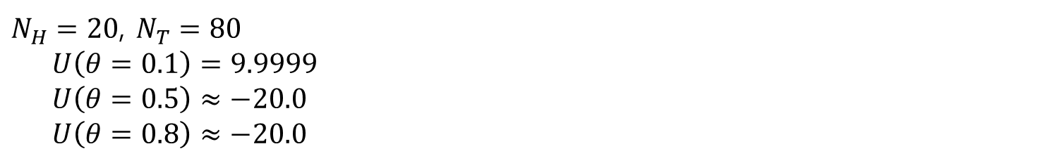
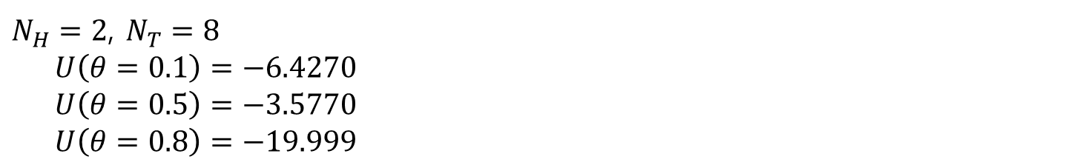
$N_{H}=2$, $N_{T}=8$
$U\left(θ=0.1\right)=−6.4270$
$U\left(θ=0.5\right)=−3.5770$
$U\left(θ=0.8\right)=−19.999$
$N_{H}=20$, $N_{T}=80$
$U\left(θ=0.1\right)=9.9999$
$U\left(θ=0.5\right)≈−20.0$
$U\left(θ=0.8\right)≈−20.0$

Slide 8

9.1.3 A continuum of parameters
Equation $p\left(θ | 𝒱\right)∝p\left(θ\right)θ^{N_{H}}{\left(1−θ\right)}^{N_{T}}$
$θ$ is a continuous variable
The prior $p\left(θ\right)=$ ?

Slide 9
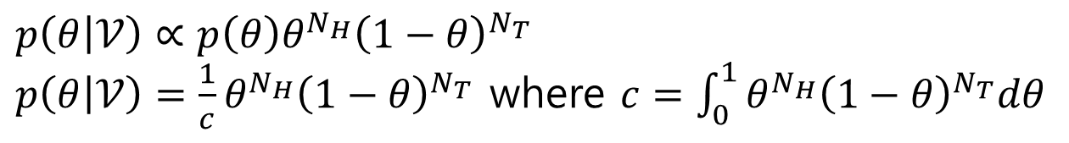
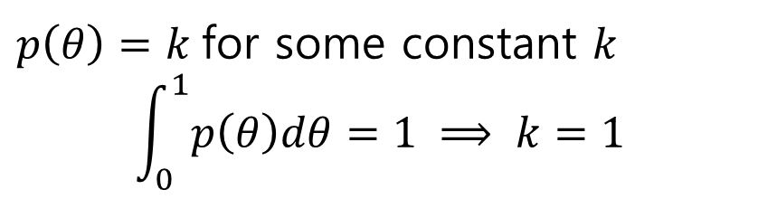
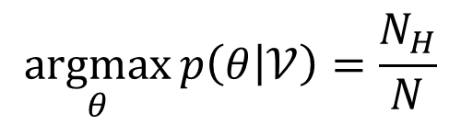
Using a flat prior
$p\left(θ\right)=k$ for some constant $k$
$$\int_{0}^{1}{p\left(θ\right)dθ}=1 ⟹ k=1$$
$p\left(θ | 𝒱\right)∝p\left(θ\right)θ^{N_{H}}{\left(1−θ\right)}^{N_{T}}$
$p\left(θ | 𝒱\right)=\frac{1}{c}θ^{N_{H}}{\left(1−θ\right)}^{N_{T}}$ where $c=\int_{0}^{1}{θ^{N_{H}}{\left(1−θ\right)}^{N_{T}}dθ}$
$$\underset{θ}{argmax}{p\left(θ | 𝒱\right)}=\frac{N_{H}}{N}$$

Slide 10


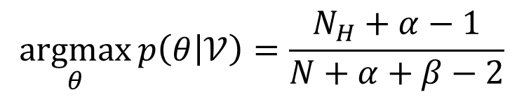
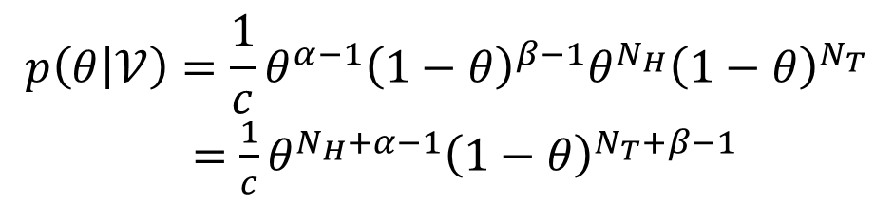
Using a conjugate prior
$$p\left(θ | 𝒱\right)∝p\left(θ\right)θ^{N_{H}}{\left(1−θ\right)}^{N_{T}}$$
The conjugate of $θ^{N_{H}}{\left(1−θ\right)}^{N_{T}}$ is a Beta distribution
$$p\left(θ\right)=\frac{1}{k}θ^{α−1}{\left(1−θ\right)}^{β−1}$$
$$p\left(θ | 𝒱\right)=\frac{1}{c}θ^{α−1}{\left(1−θ\right)}^{β−1}θ^{N_{H}}{\left(1−θ\right)}^{N_{T}}$$ $=\frac{1}{c}θ^{N_{H}+α−1}{\left(1−θ\right)}^{N_{T}+β−1}$
$$\underset{θ}{argmax}{p\left(θ | 𝒱\right)}=\frac{N_{H}+α−1}{N+α+β−2}$$

Slide 11
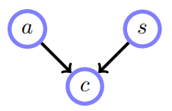
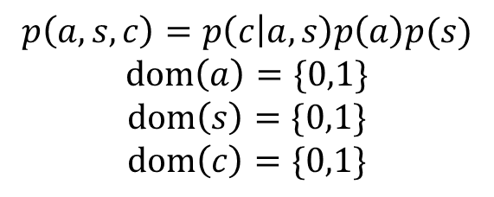
9.3 Maximum Likelihood Training of Belief Networks
Lung cancer
Relationship between
Exposure to asbestos (a)
Being a smoker (s)
The incidence of lung cancer (c)
$$p\left(a,s,c\right)=p\left(c | a,s\right)p\left(a\right)p(s)$$
$$dom\left(a\right)=\{0,1\}$$
$$dom\left(s\right)=\{0,1\}$$
$$dom\left(c\right)=\{0,1\}$$

Slide 12
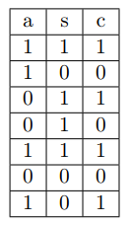
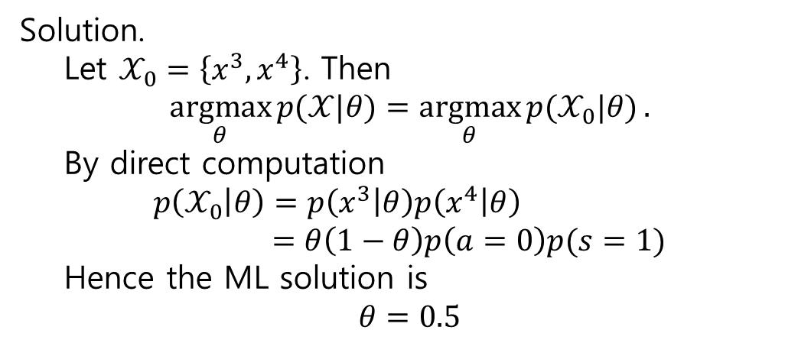
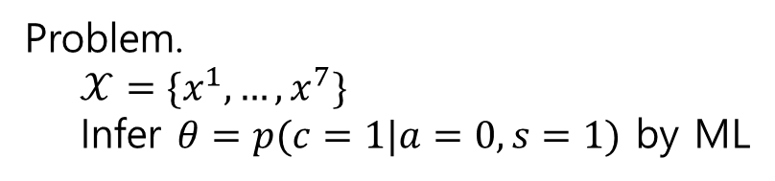
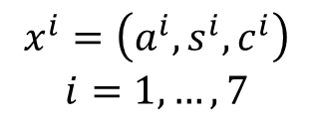
Problem.
$𝒳=\{x^{1},…,x^{7}\}$
Infer $θ=p(c=1|a=0,s=1)$ by ML
Solution.
Let $𝒳_{0}=\left\{x^{3},x^{4}\right\}$. Then
$$\underset{θ}{argmax}{p(𝒳|θ)}=\underset{θ}{argmax}{p(𝒳_{0}|θ)}.$$
By direct computation
$$p\left(𝒳_{0} | θ\right)=p\left(x^{3} | θ\right)p\left(x^{4} | θ\right) \\ =θ\left(1−θ\right)p\left(a=0\right)p(s=1)$$
Hence the ML solution is
$$θ=0.5$$
$$x^{i}=\left(a^{i},s^{i},c^{i}\right)$$
$$i=1,…,7$$

Slide 13

Problem.
Infer $p(c|a,s)$ by ML
$$p\left(c=1 | a=0,s=0\right)$$
$$p\left(c=1 | a=0,s=1\right)$$
$$p\left(c=1 | a=1,s=0\right)$$
$$p\left(c=1 | a=1,s=1\right)$$
Systematic solution?

Slide 14
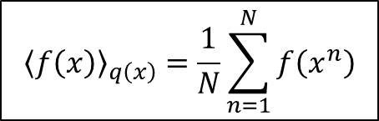
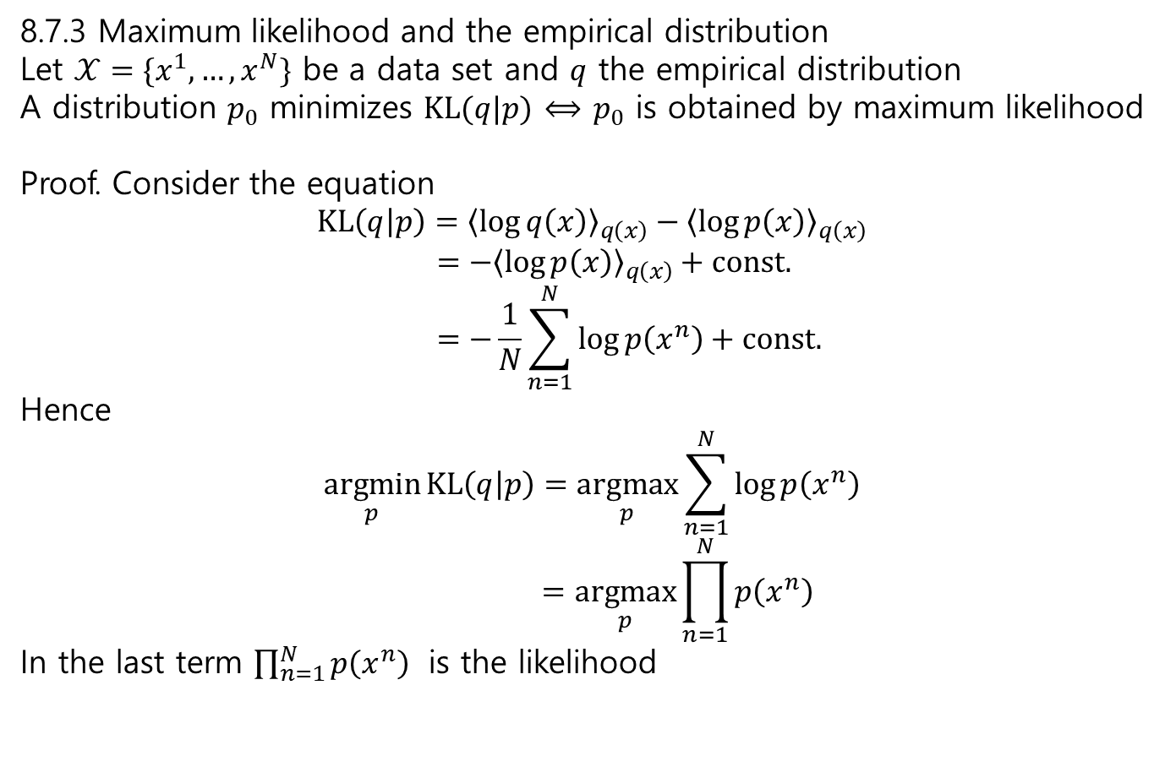
8.7.3 Maximum likelihood and the empirical distribution
Let $𝒳=\{x^{1},…,x^{N}\}$ be a data set and $q$ the empirical distribution
A distribution $p_{0}$ minimizes $KL(q|p)$ $⟺$ $p_{0}$ is obtained by maximum likelihood
Proof. Consider the equation
$$KL\left(q | p\right)={\left\langle \log{q\left(x\right)}\right\rangle }_{q\left(x\right)}−{\left\langle \log{p\left(x\right)}\right\rangle }_{q\left(x\right)} \\ =−{\left\langle \log{p\left(x\right)}\right\rangle }_{q\left(x\right)}+const. \\ =−\frac{1}{N}\sum_{n=1}^{N}{\log{p\left(x^{n}\right)}}+const.$$
Hence
$$\underset{p}{argmin}{KL\left(q | p\right)}=\underset{p}{argmax}{\sum_{n=1}^{N}{\log{p\left(x^{n}\right)}}} \\ =\underset{p}{argmax}{\prod_{n=1}^{N}{p\left(x^{n}\right)}}$$
In the last term $\prod_{n=1}^{N}{p\left(x^{n}\right)}$ is the likelihood
$${\left\langle f\left(x\right)\right\rangle }_{q\left(x\right)}=\frac{1}{N}\sum_{n=1}^{N}{f\left(x^{n}\right)}$$

Slide 15

Maximum likelihood corresponds to counting
For a BN we have
$$p\left(x\right)=\prod_{i=1}^{K}{p\left(x_{i} | pa\left(x_{i}\right)\right)}$$
We want to find the distribution $p(x)$ that minimizes the KL divergence $KL\left(q | p\right)$ for the empirical distribution $q\left(x\right)$
$$KL\left(q | p\right)=−{\left\langle \sum_{i=1}^{K}{\log{p\left(x_{i}|pa\left(x_{i}\right)\right)}}\right\rangle }_{q\left(x\right)}+const. \\ =−\sum_{i=1}^{K}{{\left\langle \log{p\left(x_{i}|pa\left(x_{i}\right)\right)}\right\rangle }_{q\left(x_{i},pa\left(x_{i}\right)\right)}}+const.$$

Slide 16
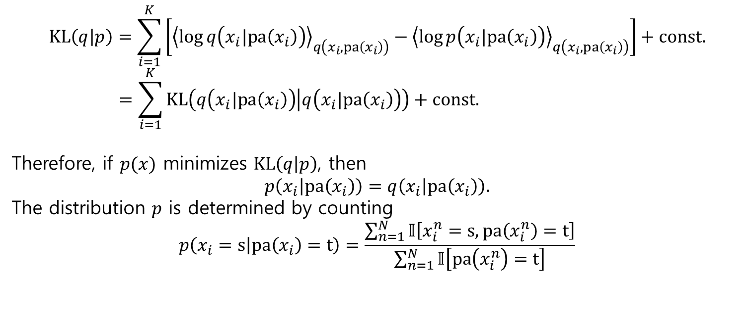
$$KL\left(q | p\right)=\sum_{i=1}^{K}{\left[{\left\langle \log{q\left(x_{i}|pa\left(x_{i}\right)\right)}\right\rangle }_{q\left(x_{i},pa\left(x_{i}\right)\right)}−{\left\langle \log{p\left(x_{i}|pa\left(x_{i}\right)\right)}\right\rangle }_{q\left(x_{i},pa\left(x_{i}\right)\right)}\right]}+const. \\ =\sum_{i=1}^{K}{KL\left(q\left(x_{i}|pa\left(x_{i}\right)\right) | q\left(x_{i}|pa\left(x_{i}\right)\right)\right)}+const.$$
Therefore, if $p(x)$ minimizes $KL\left(q | p\right)$, then $$p\left(x_{i} | pa\left(x_{i}\right)\right)=q\left(x_{i} | pa\left(x_{i}\right)\right).$$
The distribution $p$ is determined by counting
$$p\left(x_{i}=s | pa\left(x_{i}\right)=t\right)=\frac{\sum_{n=1}^{N}{𝕀\left[x_{i}^{n}=s,pa\left(x_{i}^{n}\right)=t\right]}}{\sum_{n=1}^{N}{𝕀\left[pa\left(x_{i}^{n}\right)=t\right]}}$$

Slide 17
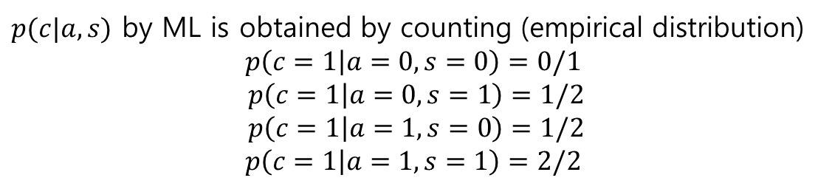
$p(c|a,s)$ by ML is obtained by counting (empirical distribution)
$$p\left(c=1 | a=0,s=0\right)=0/1$$
$$p\left(c=1 | a=0,s=1\right)=1/2$$
$$p\left(c=1 | a=1,s=0\right)=1/2$$
$$p\left(c=1 | a=1,s=1\right)=2/2$$

Slide 18
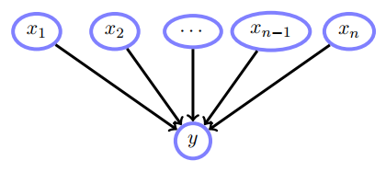

Conditional probability functions
Binary variable $y$ with $n$ binary parental variables $x_{1},…,x_{n}$
Find $p\left(y | x\right)$
There are $2^{n}$ entries in the CPT of $p\left(y | x\right)$
For very large $2^{n}$, we assume that $p$ is a function $f$
$$p\left(y=1 | x,w\right)=f(x,w)$$
where $w=\left(w_{1},…,w_{n}\right)∈ℝ^{n}$
For example
$$f\left(x,w\right)=\frac{1}{1+e^{−w^{T}x}}$$

Slide 19
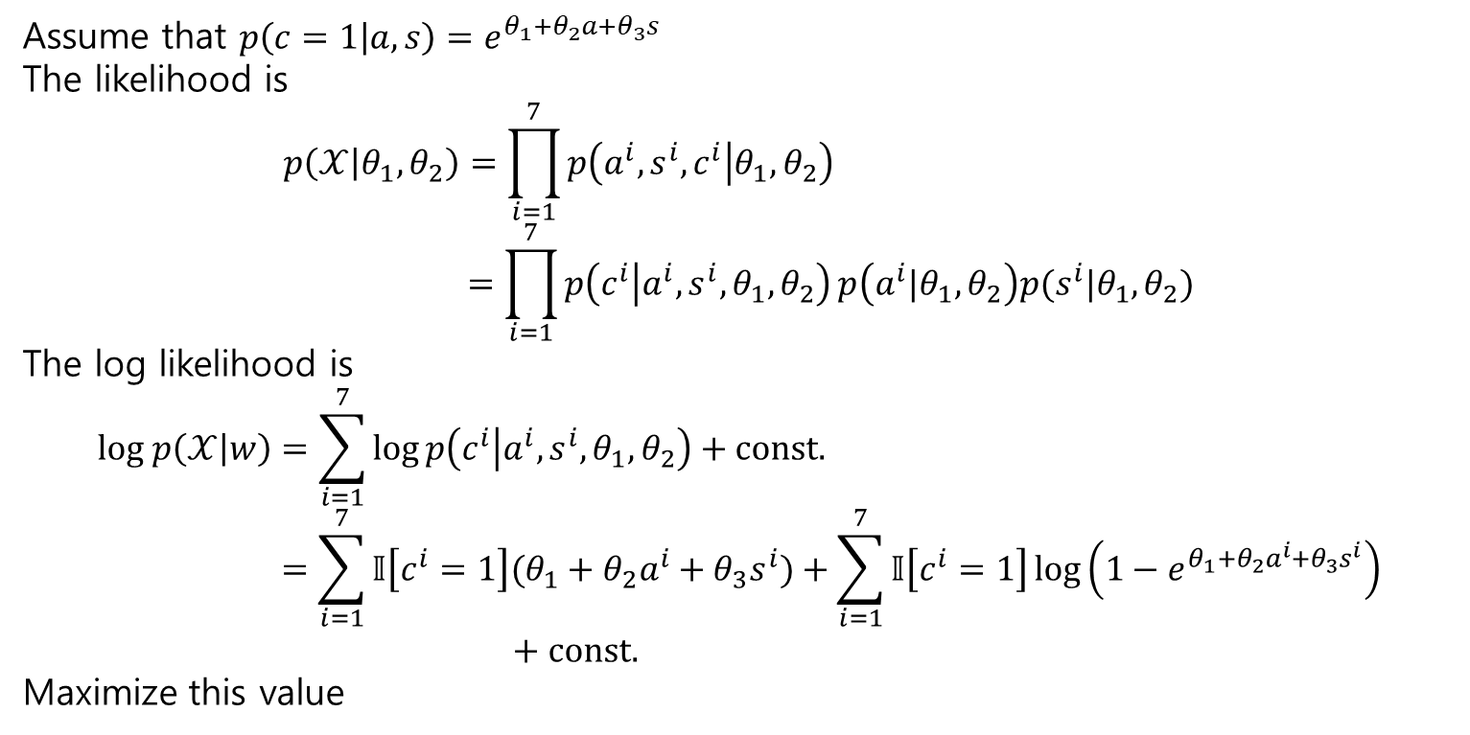
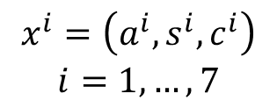
Assume that $p\left(c=1 | a,s\right)=e^{θ_{1}+θ_{2}a+θ_{3}s}$
The likelihood is
$$p\left(𝒳 | θ_{1},θ_{2}\right)=\prod_{i=1}^{7}{p\left(a^{i},s^{i},c^{i} | θ_{1},θ_{2}\right)} \\ =\prod_{i=1}^{7}{p\left(c^{i} | {a^{i},s^{i},θ}_{1},θ_{2}\right)}p\left(a^{i}|θ_{1},θ_{2}\right)p(s^{i}|θ_{1},θ_{2})$$
The log likelihood is
$$log p\left(𝒳 | w\right)=\sum_{i=1}^{7}{\log{p\left(c^{i} | {a^{i},s^{i},θ}_{1},θ_{2}\right)}}+const. \\ =\sum_{i=1}^{7}{𝕀\left[c^{i}=1\right](θ_{1}+θ_{2}a^{i}+θ_{3}s^{i})}+\sum_{i=1}^{7}{𝕀\left[c^{i}=1\right]\log\left(1−e^{θ_{1}+θ_{2}a^{i}+θ_{3}s^{i}}\right)} \\ + const.$$
Maximize this value
$$x^{i}=\left(a^{i},s^{i},c^{i}\right)$$
$$i=1,…,7$$

Slide 20
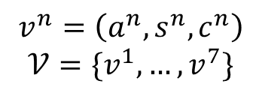
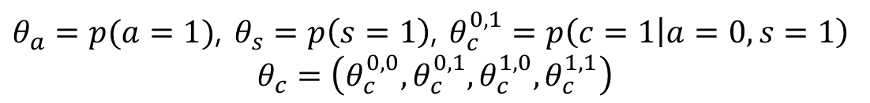
9.4 Bayesian Belief Network Training
$θ_{a}=p(a=1)$, $θ_{s}=p\left(s=1\right)$, $θ_{c}^{0,1}=p\left(c=1 | a=0,s=1\right)$
$$θ_{c}=\left(θ_{c}^{0,0},θ_{c}^{0,1},θ_{c}^{1,0},θ_{c}^{1,1}\right)$$
$$v^{n}=\left(a^{n},s^{n},c^{n}\right)$$
$$𝒱=\{v^{1},…,v^{7}\}$$

