Slide 1
Chapter 9 Learning as Inference

Slide 2
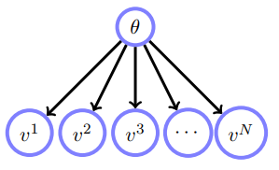
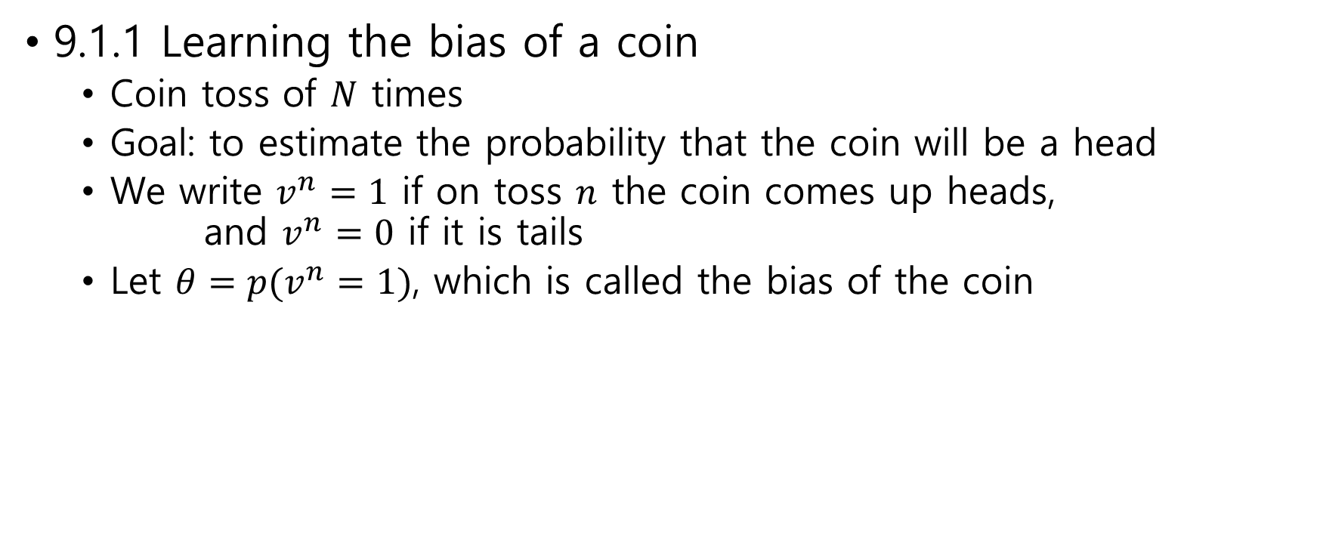
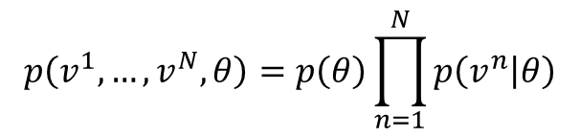
9.1 Learning as Inference
9.1.1 Learning the bias of a coin
Coin toss of $N$ times
Goal: to estimate the probability that the coin will be a head
We write $v^{n}=1$ if on toss $n$ the coin comes up heads, and $v^{n}=0$ if it is tails
Let $θ=p(v^{n}=1)$, which is called the bias of the coin
$$p\left(v^{1},…,v^{N},θ\right)=p\left(θ\right)\prod_{n=1}^{N}{p\left(v^{n} | θ\right)}$$
belief network

Slide 3
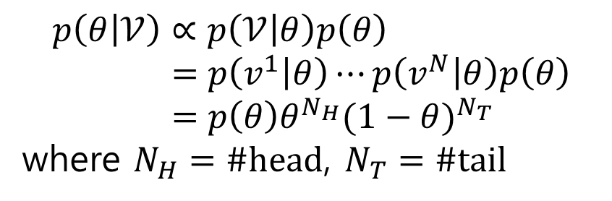


Learning refers to using the observations $v^{1},…,v^{N}$to infer $θ$
For simplicity, let $𝒱=(v^{1},…,v^{N})$
Posterior $p\left(θ | 𝒱\right)=\frac{p\left(𝒱,θ\right)}{p\left(𝒱\right)}=\frac{p\left(𝒱 | θ\right)p\left(θ\right)}{p\left(𝒱\right)}$
MAP $\underset{θ}{argmax}{p\left(θ | 𝒱\right)}$
$$p\left(θ | 𝒱\right)∝p\left(𝒱 | θ\right)p\left(θ\right) \\ =p\left(v^{1} | θ\right)⋯p\left(v^{N} | θ\right)p\left(θ\right) \\ =p\left(θ\right)θ^{N_{H}}{(1−θ)}^{N_{T}}$$
where $N_{H}=\#head$, $N_{T}=\#tail$
$$N_{H}=\sum_{n=1}^{N}{𝕀[v^{n}=1]}$$

Slide 4


For simplicity we assume that $θ∈\{0.1, 0.5, 0.8\}$ and $p(θ=0.1)=0.15$, $p(θ=0.5)=0.8$, $p(θ=0.8)=0.05$
This prior expresses that we have
$80\%$ belief that the coin is ‘fair’
$5\%$ belief the coin is biased to land heads (with $θ=0.8$)
$15\%$ belief the coin is biased to land tails (with $θ=0.1$)
Experiments
$N_{H}=2$, $N_{T}=8$
$p\left(θ=0.1 | 𝒱\right)=k×0.15×{0.1}^{2}×{0.9}^{8}=k×6.46×{10}^{−4}$
$p\left(θ=0.5 | 𝒱\right)=k×0.8×{0.5}^{2}×{0.5}^{8}=k×7.81×{10}^{−4}$
$p\left(θ=0.8 | 𝒱\right)=k×0.05×{0.8}^{2}×{0.2}^{8}=k×8.19×{10}^{−8}$
$k×6.46×{10}^{−4}$+ $k×7.81×{10}^{−4}$+ $k×8.19×{10}^{−8}=1$
$$k=1/0.0014$$
$p\left(θ=0.1 | 𝒱\right)≈0.4525$, $p\left(θ=0.5 | 𝒱\right)≈0.5475$, $p\left(θ=0.8 | 𝒱\right)≈0.0001$

Slide 5
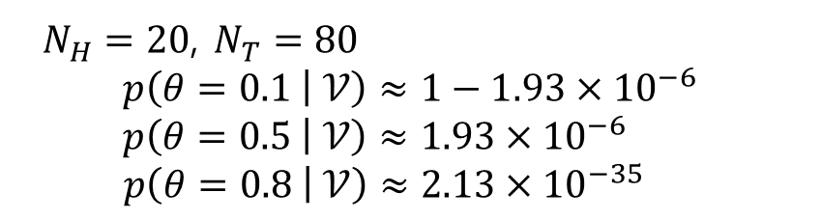
$N_{H}=20$, $N_{T}=80$
$$p\left(θ=0.1 | 𝒱\right)≈1−1.93×{10}^{−6}$$
$$p\left(θ=0.5 | 𝒱\right)≈1.93×{10}^{−6}$$
$$p\left(θ=0.8 | 𝒱\right)≈2.13×{10}^{−35}$$

Slide 6
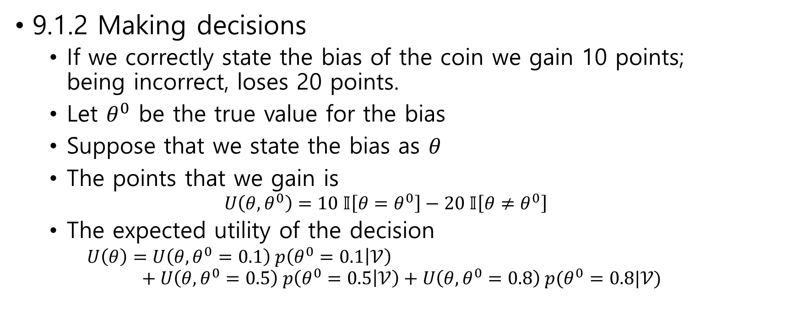
9.1.2 Making decisions
If we correctly state the bias of the coin we gain 10 points; being incorrect, loses 20 points.
Let $θ^{0}$ be the true value for the bias
Suppose that we state the bias as $θ$
The points that we gain is $U\left(θ,θ^{0}\right)=10 𝕀\left[θ=θ^{0}\right]−20 𝕀\left[θ≠θ^{0}\right]$
The expected utility of the decision $U\left(θ\right)=U\left(θ,θ^{0}=0.1\right) p\left(θ^{0}=0.1 | 𝒱\right)$ $+ U\left(θ,θ^{0}=0.5\right) p\left(θ^{0}=0.5 | 𝒱\right)+U\left(θ,θ^{0}=0.8\right) p(θ^{0}=0.8|𝒱)$

Slide 7
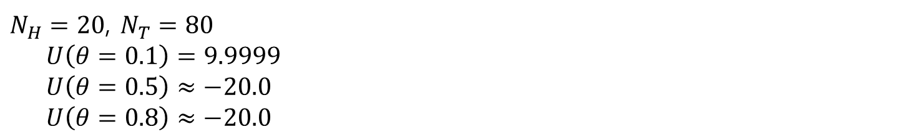
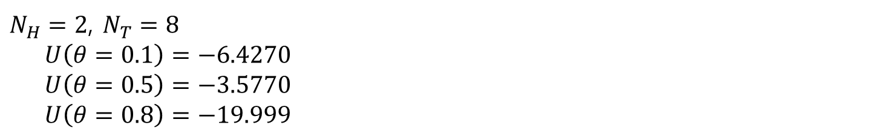
$N_{H}=2$, $N_{T}=8$
$U\left(θ=0.1\right)=−6.4270$
$U\left(θ=0.5\right)=−3.5770$
$U\left(θ=0.8\right)=−19.999$
$N_{H}=20$, $N_{T}=80$
$U\left(θ=0.1\right)=9.9999$
$U\left(θ=0.5\right)≈−20.0$
$U\left(θ=0.8\right)≈−20.0$

Slide 8

9.1.3 A continuum of parameters
Equation $p\left(θ | 𝒱\right)∝p\left(θ\right)θ^{N_{H}}{\left(1−θ\right)}^{N_{T}}$
$θ$ is a continuous variable
The prior $p\left(θ\right)=$ ?

Slide 9
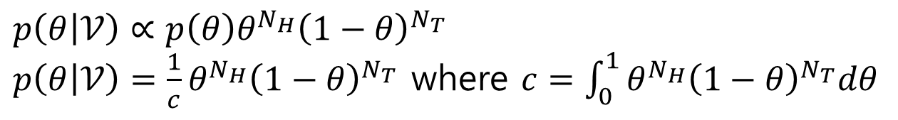
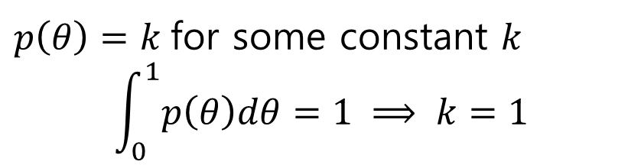
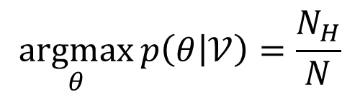
Using a flat prior
$p\left(θ\right)=k$ for some constant $k$
$$\int_{0}^{1}{p\left(θ\right)dθ}=1 ⟹ k=1$$
$p\left(θ | 𝒱\right)∝p\left(θ\right)θ^{N_{H}}{\left(1−θ\right)}^{N_{T}}$
$p\left(θ | 𝒱\right)=\frac{1}{c}θ^{N_{H}}{\left(1−θ\right)}^{N_{T}}$ where $c=\int_{0}^{1}{θ^{N_{H}}{\left(1−θ\right)}^{N_{T}}dθ}$
$$\underset{θ}{argmax}{p\left(θ | 𝒱\right)}=\frac{N_{H}}{N}$$

Slide 10


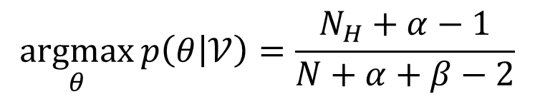
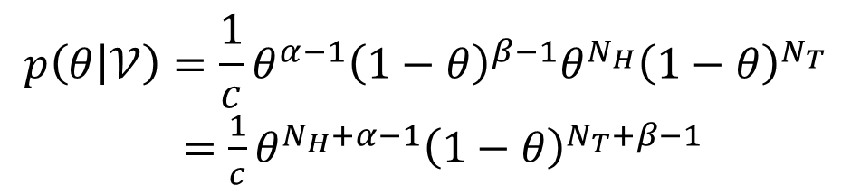
Using a conjugate prior
$$p\left(θ | 𝒱\right)∝p\left(θ\right)θ^{N_{H}}{\left(1−θ\right)}^{N_{T}}$$
The conjugate of $θ^{N_{H}}{\left(1−θ\right)}^{N_{T}}$ is a Beta distribution
$$p\left(θ\right)=\frac{1}{k}θ^{α−1}{\left(1−θ\right)}^{β−1}$$
$$p\left(θ | 𝒱\right)=\frac{1}{c}θ^{α−1}{\left(1−θ\right)}^{β−1}θ^{N_{H}}{\left(1−θ\right)}^{N_{T}}$$ $=\frac{1}{c}θ^{N_{H}+α−1}{\left(1−θ\right)}^{N_{T}+β−1}$
$$\underset{θ}{argmax}{p\left(θ | 𝒱\right)}=\frac{N_{H}+α−1}{N+α+β−2}$$

