Slide 1
Chapter 5 Monte Carlo Methods

Slide 2
Monte Carlo method
Learning from experience
Actual experience
Simulated experience
Learning from sample episodes
Sequences of states, actions, and rewards from experience

Slide 3
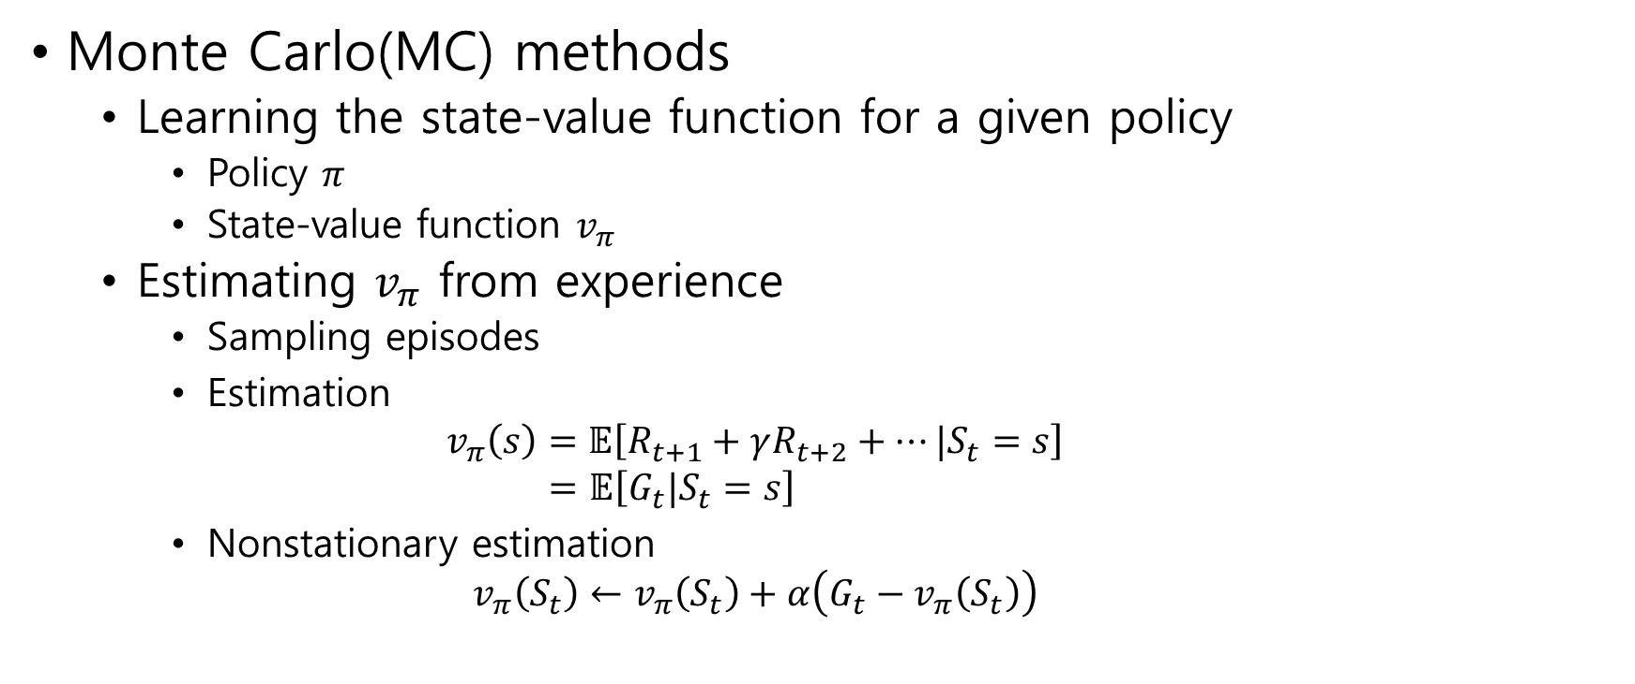
5.1 Monte Carlo Prediction
Monte Carlo(MC) methods
Learning the state-value function for a given policy
Policy $π$
State-value function $v_{π}$
Estimating $v_{π}$ from experience
Sampling episodes
Estimation $v_{π}\left(s\right)=𝔼\left[R_{t+1}+γR_{t+2}+⋯|S_{t}=s\right]$ $=𝔼\left[G_{t}|S_{t}=s\right]$
Nonstationary estimation $v_{π}\left(S_{t}\right)←v_{π}\left(S_{t}\right)+α\left(G_{t}−v_{π}\left(S_{t}\right)\right)$

Slide 4

The first-visit MC method
$v_{π}(s)$ is estimated as the average of the returns following first visits to $s$
The every-visit MC method
$v_{π}(s)$ is estimated as the average of the returns following all visits to $s$

Slide 5
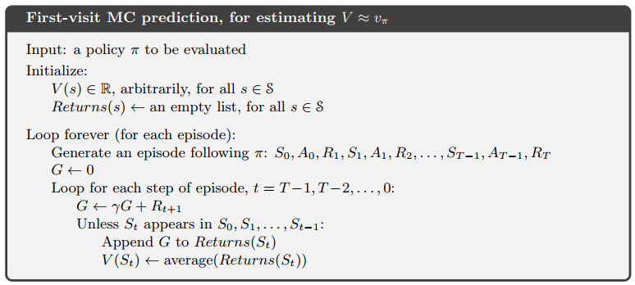

Slide 6
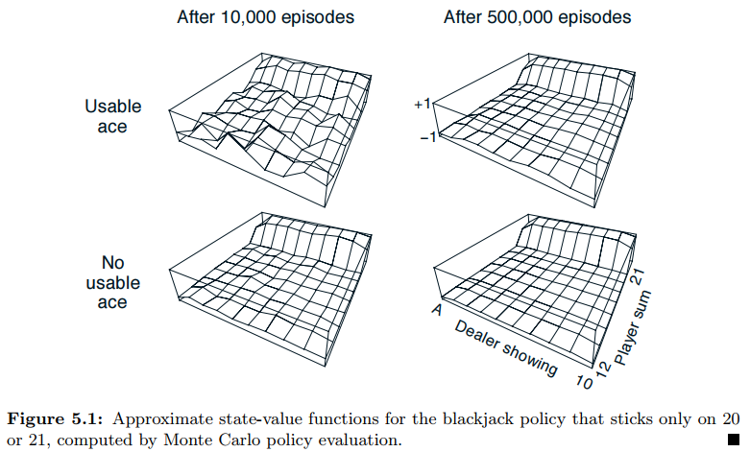

Example 5.1: Blackjack
Usable ace: ace that can be counted as 11
State: player sum and
dealer showing
Action: hit(one more card),
stick(stop)
Reward: $+1$ for winning
$−1$ for losing
$0$ for drawing
$γ=1$

Slide 7
5.2 Monte Carlo Estimation of Action Values
If a model(of environment) is not available
One cannot determine the next state
Example) Alpha-go, black jack
One may estimate action values rather than state values

Slide 8
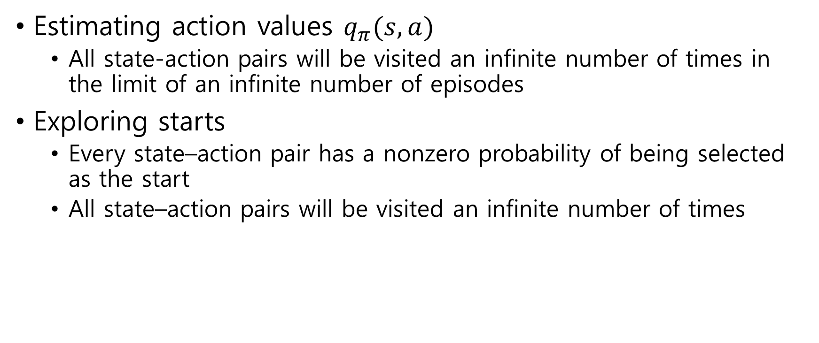
Estimating action values $q_{π}(s,a)$
All state-action pairs will be visited an infinite number of times in the limit of an infinite number of episodes
Exploring starts
Every state–action pair has a nonzero probability of being selected as the start
All state–action pairs will be visited an infinite number of times

Slide 9
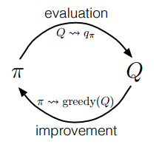
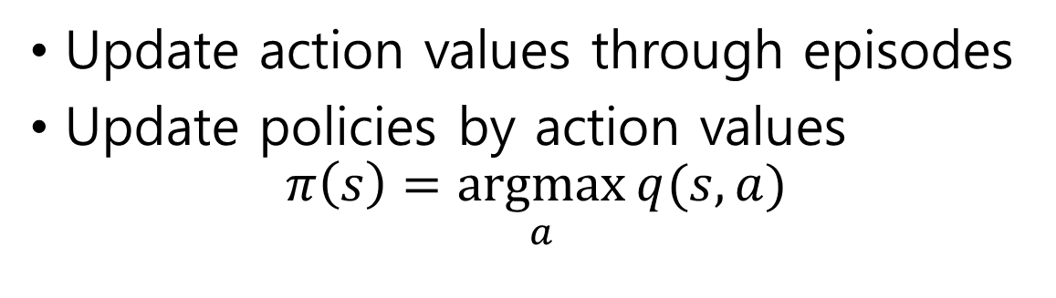
5.3 Monte Carlo Control
Update action values through episodes
Update policies by action values $π\left(s\right)=\underset{a}{argmax}{q(s,a)}$
Control: finding optimal policy

Slide 10
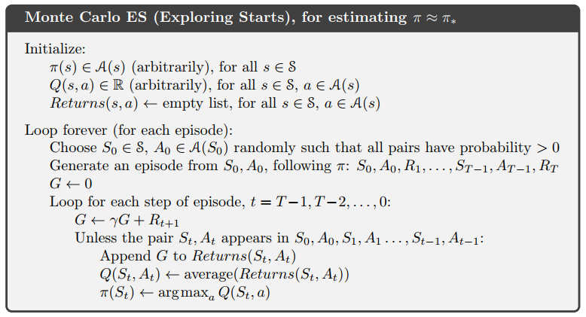

Slide 11
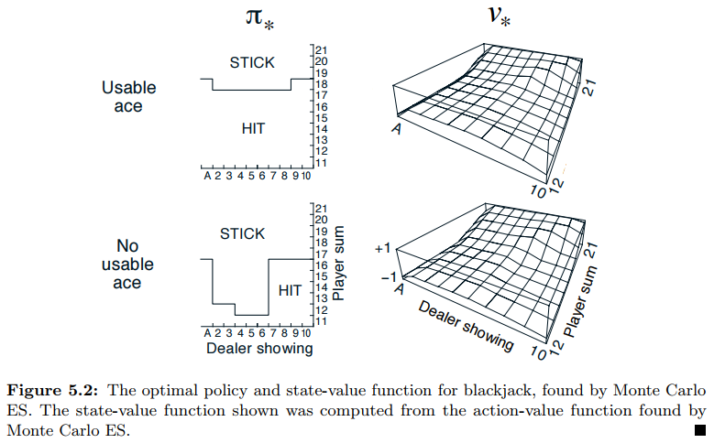
Example 5.3: Solving Blackjack

Slide 12
5.4 Monte Carlo Control without Exploring Starts
On-policy methods
To improve a policy, action values are evaluated using the policy
Off-policy methods
To improve a policy, action values are evaluated using the other policy
MC Method
MC with ES
MC without ES
On-policy
Off-policy

Slide 13
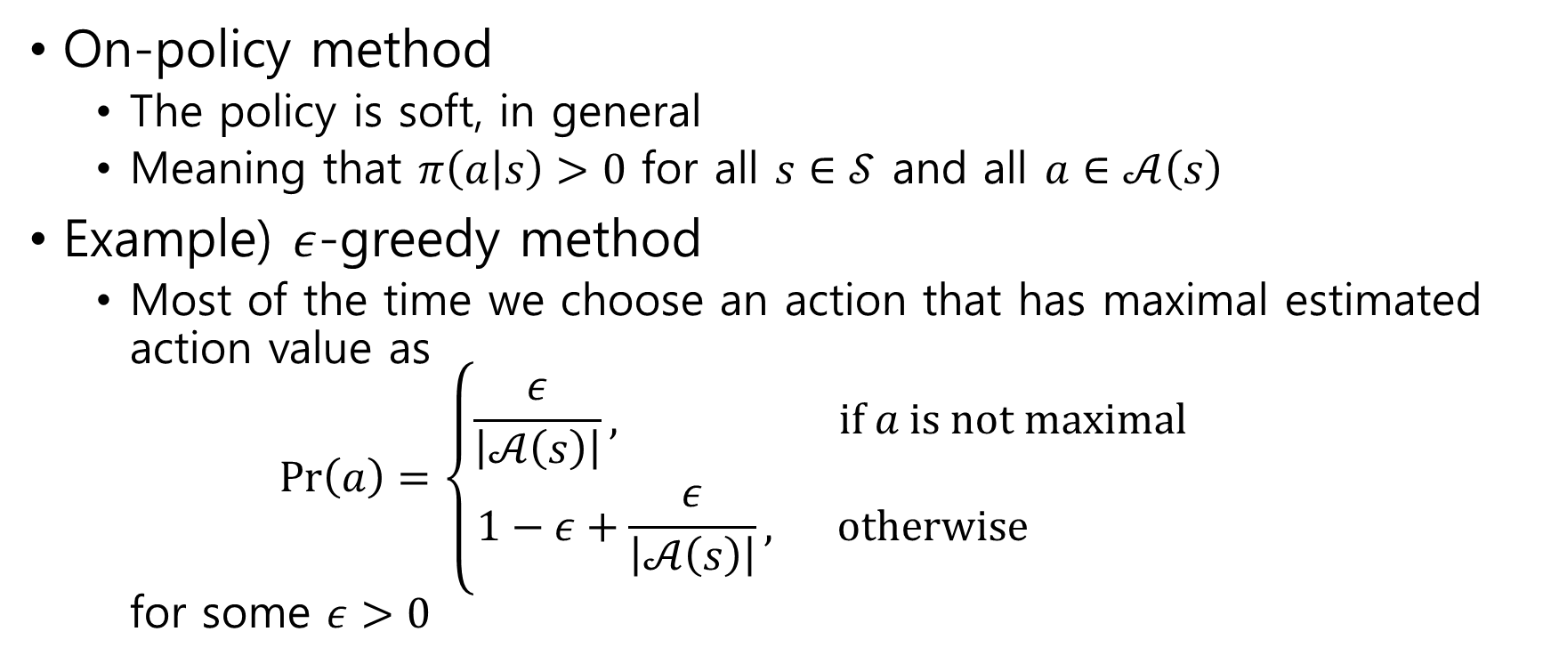
On-policy method
The policy is soft, in general
Meaning that $π\left(a | s\right)>0$ for all $s∈𝒮$ and all $a∈𝒜\left(s\right)$
Example) $ε$-greedy method
Most of the time we choose an action that has maximal estimated action value as $\operatorname{Pr}\left(a\right)=\left\{\begin{aligned}\begin{matrix}\frac{ε}{\left|𝒜\left(s\right)\right|}, & if a is not maximal\end{matrix} \\ \begin{matrix}1−ε+\frac{ε}{\left|𝒜\left(s\right)\right|}, & otherwise \end{matrix}\end{aligned}\right.$ for some $ε>0$

Slide 14
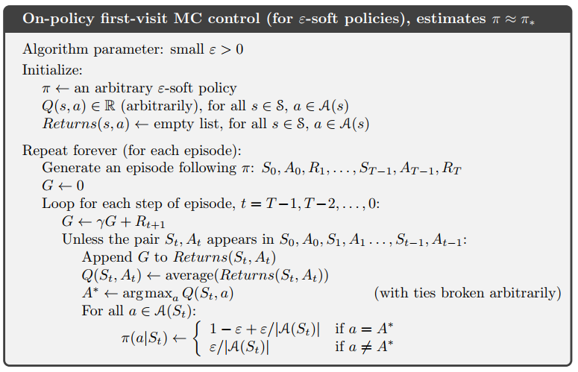

Slide 15
5.5 Off-policy Prediction via Importance Sampling
Dilemma
To calculate an accurate action value, we trace maximal action values
To find a maximal action, we explorer all actions
Off-policy learning
Introducing another policy for explorering
Example
To use two policies, the target policy and the behavior policy
The target policy is learned about, and that becomes the optimal policy
The behavior policy is more exploratory, and is used to generate behavior

Slide 16
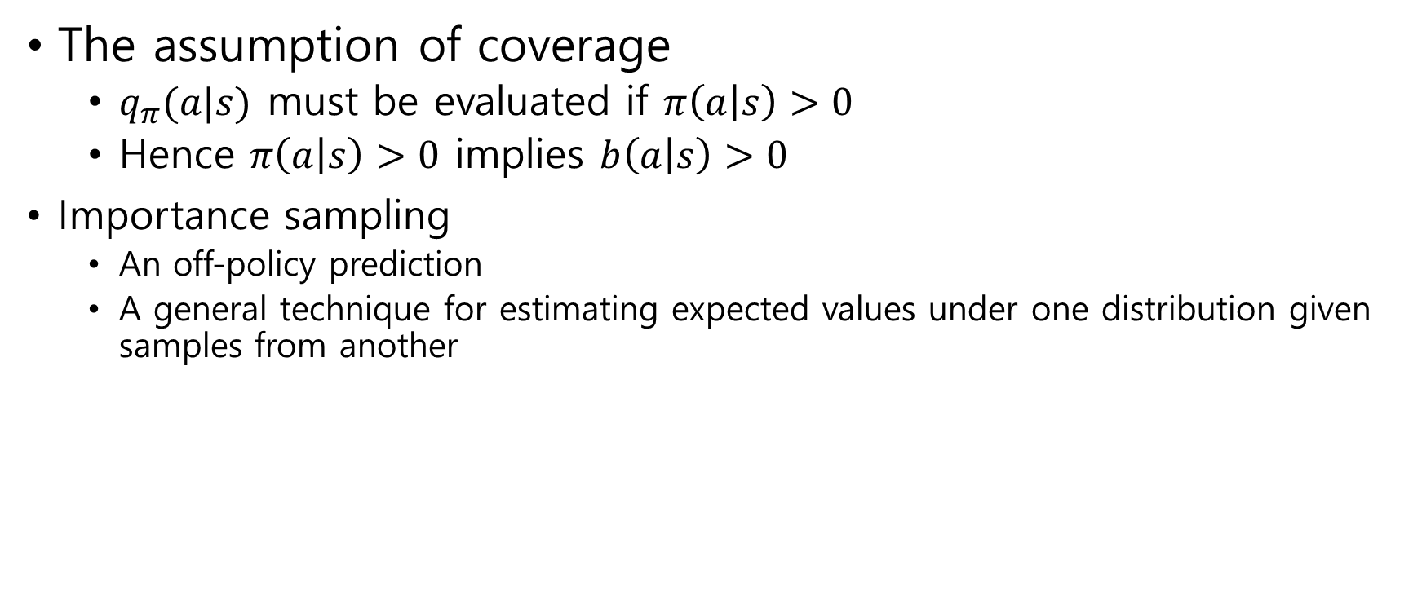
The assumption of coverage
$q_{π}(a|s)$ must be evaluated if $π\left(a | s\right)>0$
Hence $π\left(a | s\right)>0$ implies $b\left(a | s\right)>0$
Importance sampling
An off-policy prediction
A general technique for estimating expected values under one distribution given samples from another

Slide 17
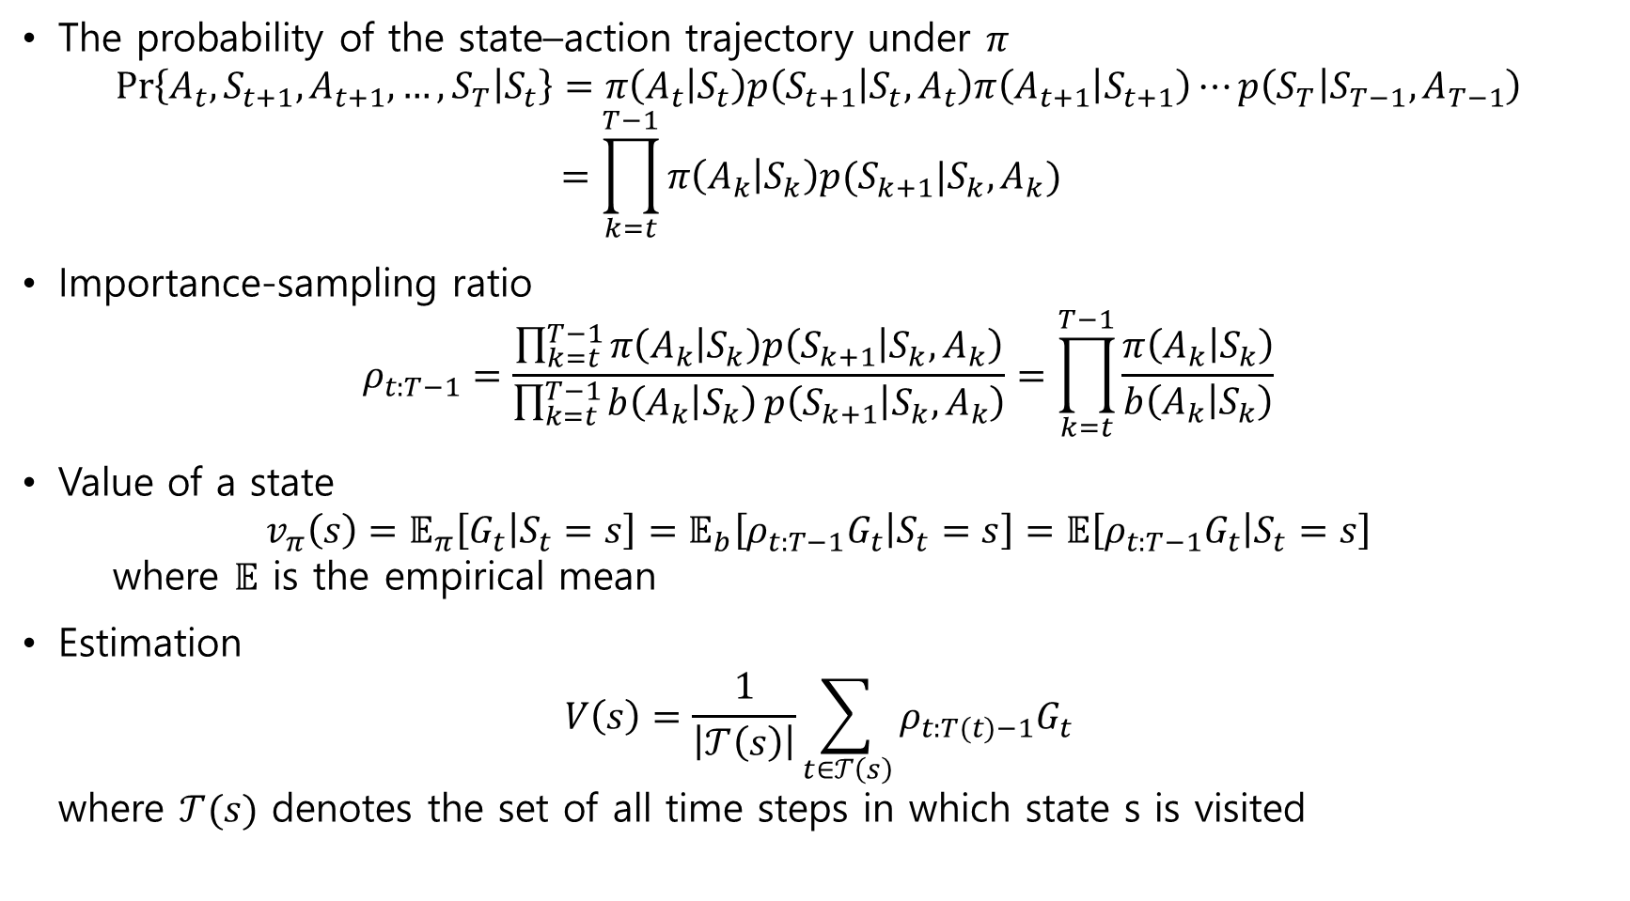
The probability of the state–action trajectory under $π$ $\operatorname{Pr}\left\{A_{t},S_{t+1},A_{t+1},…,S_{T} | S_{t}\right\}=π\left(A_{t} | S_{t}\right)p\left(S_{t+1} | S_{t},A_{t}\right)π\left(A_{t+1} | S_{t+1}\right)⋯p\left(S_{T} | S_{T−1},A_{T−1}\right)$ $=\prod_{k=t}^{T−1}{π\left(A_{k} | S_{k}\right)p(S_{k+1}|S_{k},A_{k})}$
Importance-sampling ratio $ρ_{t:T−1}=\frac{\prod_{k=t}^{T−1}{π\left(A_{k} | S_{k}\right)p\left(S_{k+1} | S_{k},A_{k}\right)}}{\prod_{k=t}^{T−1}{b\left(A_{k} | S_{k}\right)}p\left(S_{k+1} | S_{k},A_{k}\right)}=\prod_{k=t}^{T−1}{\frac{π\left(A_{k} | S_{k}\right)}{b\left(A_{k} | S_{k}\right)}}$
Value of a state $v_{π}\left(s\right)=𝔼_{π}\left[G_{t} | S_{t}=s\right]=𝔼_{b}\left[ρ_{t:T−1}G_{t} | S_{t}=s\right]=𝔼\left[ρ_{t:T−1}G_{t} | S_{t}=s\right]$ where $𝔼$ is the empirical mean
Estimation $V\left(s\right)=\frac{1}{\left|𝒯\left(s\right)\right|}\sum_{t∈𝒯\left(s\right)}{ρ_{t:T(t)−1}G_{t}}$ where $𝒯(s)$ denotes the set of all time steps in which state s is visited

Slide 18

$𝒯(s)$ denotes the set of all time steps in which state s is visited
Ordinary importance sampling $V\left(s\right)=\frac{1}{\left|𝒯\left(s\right)\right|}\sum_{t∈𝒯\left(s\right)}{ρ_{t:T(t)−1}G_{t}}$
Weighted importance sampling $V\left(s\right)=\frac{\sum_{t∈𝒯\left(s\right)}{ρ_{t:T(t)−1}G_{t}}}{\sum_{t∈𝒯\left(s\right)}{ρ_{t:T(t)−1}}}$

Slide 19
5.5 Off-policy Prediction via Importance Sampling
Dilemma
Off-policy learning
Example
To use two policies, the target policy and the behavior policy
The target policy is learned about and becomes the optimal policy
The behavior policy is more exploratory and is used to generate behavior

