Slide 1
Chapter 2 Tensorflow

Slide 2
2.1 Tensorflow Preliminaries
import os
os.environ['TF_CPP_MIN_LOG_LEVEL'] = '2'
import tensorflow.compat.v1 as tf
x = tf.constant("Hello World")
sess = tf.Session()
print(sess.run(x))
Python 3.7
Tensorflow 1.15

Slide 3
x = 2.0
def sillyAdd(z):
return z+x
print(sillyAdd(3)) # Prints out 5.0
print(sillyAdd(16)) # Prints out 18.0
x = tf.constant(2.0)
z = tf.placeholder(tf.float32)
sess = tf.Session()
comp = tf.add(x,z)
print(sess.run(comp,feed_dict={z:3.0})) # Prints out 5.0
print(sess.run(comp,feed_dict={z:16.0})) # Prints out 18.0
print(sess.run(x)) # Prints out 2.0
print(sess.run(comp)) # Prints out a very long error message
print(sess.run(comp,feed_dict={z:3.0})) → tf.add(x,3.0)

Slide 4
bt = tf.random_normal([10], stddev=.1)
b = tf.Variable(bt)
W = tf.Variable(tf.random_normal([784,10], stddev=.1))
sess = tf.Session()
sess.run(tf.global_variables_initializer())
print(sess.run(b))
[-0.05206999 0.08943175 -0.09178174 -0.13757218 0.15039739
0.05112269 -0.02723283 -0.02022207 0.12535755 -0.12932496]
sess.run(tf.global_variables_initializer()) → initializes b and W

Slide 5
2.2 A TF Program
import os
os.environ['TF_CPP_MIN_LOG_LEVEL'] = '2'
import tensorflow.compat.v1 as tf
old_v = tf.logging.get_verbosity()
tf.logging.set_verbosity(tf.logging.ERROR)
from tensorflow.examples.tutorials.mnist import input_data
mnist = input_data.read_data_sets("MNIST_data/", one_hot=True)
tf.logging.set_verbosity(old_v)

Slide 6
batchSz = 100
W = tf.Variable(tf.random_normal([784, 10], stddev=.1))
b = tf.Variable(tf.random_normal([10], stddev=.1))
img = tf.placeholder(tf.float32, [batchSz, 784])
ans = tf.placeholder(tf.float32, [batchSz, 10])
prbs = tf.nn.softmax(tf.matmul(img, W) + b)
xEnt = tf.reduce_mean(-tf.reduce_sum(ans * tf.log(prbs), reduction_indices=[1]))
train = tf.train.GradientDescentOptimizer(0.5).minimize(xEnt)
numCorrect = tf.equal(tf.argmax(prbs, 1), tf.argmax(ans, 1))
accuracy = tf.reduce_mean(tf.cast(numCorrect, tf.float32))
sess = tf.Session()
sess.run(tf.global_variables_initializer())

Slide 7
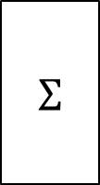
# ------------------------------------------------------------------------------
for i in range(1000):
imgs, anss = mnist.train.next_batch(batchSz)
sess.run(train, feed_dict={img: imgs, ans: anss})
sumAcc = 0
for i in range(1000):
imgs, anss = mnist.test.next_batch(batchSz)
sumAcc += sess.run(accuracy, feed_dict={img: imgs, ans: anss})
print("Test Accuracy: %r" % (sumAcc / 1000))
W, b
softmax
$$Σ$$
prbs
ans
img
xEnt
tf.matmul(img, W) + b

Slide 8


2.3 Multilayered NNs
relu
softmax
$$Σ$$
$$Σ$$
layer
layer

Slide 9
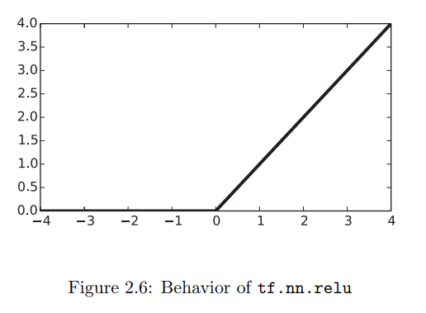
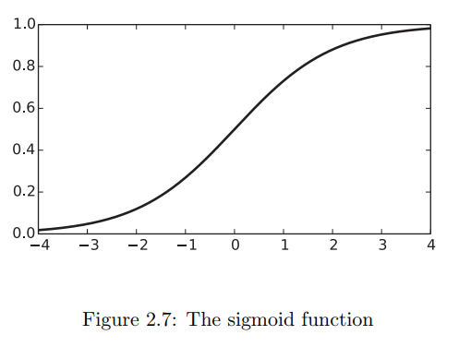
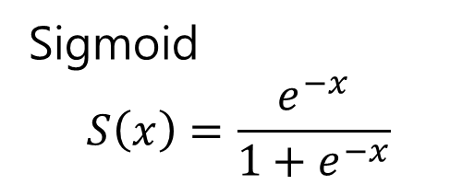
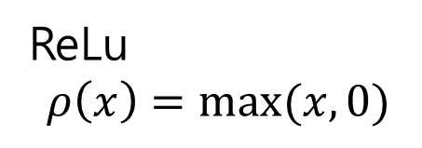
Sigmoid
$$S\left(x\right)=\frac{e^{−x}}{1+e^{−x}}$$
ReLu
$$ρ\left(x\right)=max(x,0)$$

Slide 10
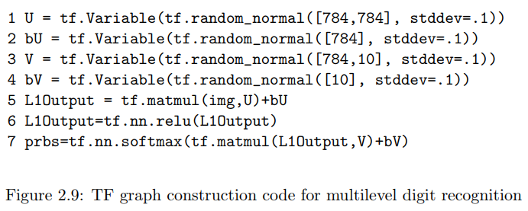



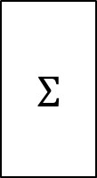


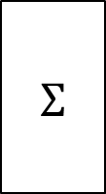

$$U, b_{u}$$
$$Σ$$
$$ρ$$
$$V, b_{v}$$
$$Σ$$
$$σ$$
$$x$$
$$\operatorname{Pr}\left(A\left(x\right)\right)=σ(ρ\left(xU+b_{u}\right)V+b_{v})$$

Slide 11
batchSz = 100
U = tf.Variable(tf.random_normal([784, 784], stddev=.1))
bU = tf.Variable(tf.random_normal([784], stddev=.1))
V = tf.Variable(tf.random_normal([784, 10], stddev=.1))
bV = tf.Variable(tf.random_normal([10], stddev=.1))
img = tf.placeholder(tf.float32, [batchSz, 784])
ans = tf.placeholder(tf.float32, [batchSz, 10])
L1Output = tf.matmul(img, U) + bU
L1Output = tf.nn.relu(L1Output)
prbs = tf.nn.softmax(tf.matmul(L1Output, V) + bV)
xEnt = tf.reduce_mean(-tf.reduce_sum(ans * tf.log(prbs), reduction_indices=[1]))
train = tf.train.GradientDescentOptimizer(0.05).minimize(xEnt)

Slide 12
2.4 Other Pieces
2.4.1 Checkpointing
Before initializing variables (calling global variable initialize)
Save
Restore
saveOb= tf.train.Saver()
saveOb.save(sess, "mylatest.ckpt")
saveOb.restore(sess, "mylatest.ckpt")

Slide 13
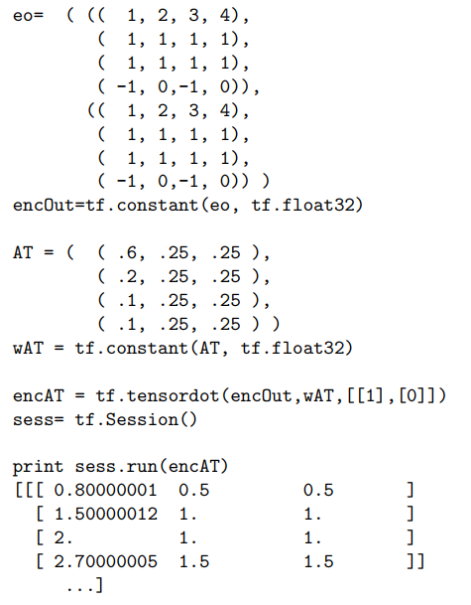
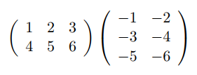
2.4.2 tensordot
Maxtrix multiplication
tensordot
tf.matmul(A, B)
tf.tensordot(A, B, [[ 1 ], [ 0 ]])

Slide 14

2.4.3 Initialization of TF Variables
Xavier initialization
$$σ=\sqrt{\frac{2}{n_{i}+n_{o}}}$$

Slide 15
2.4.4 Simplifying TF Graph Creation
# W = tf.Variable(tf.random_normal([784, 10], stddev=.1))
# b = tf.Variable(tf.random_normal([10], stddev=.1))
img = tf.placeholder(tf.float32, [batchSz, 784])
ans = tf.placeholder(tf.float32, [batchSz, 10])
# prbs = tf.nn.softmax(tf.matmul(img, W) + b)
import tensorflow.contrib.layers as layers
prbs = layers.fully_connected(img, 10, tf.nn.softmax)
xEnt = tf.reduce_mean(-tf.reduce_sum(ans * tf.log(prbs), reduction_indices=[1]))

