Slide 1
Chapter 3 Belief Networks

Slide 2
3.1 The Benefits of Structure
Belief network is a way to depict the independence of variables

Slide 3
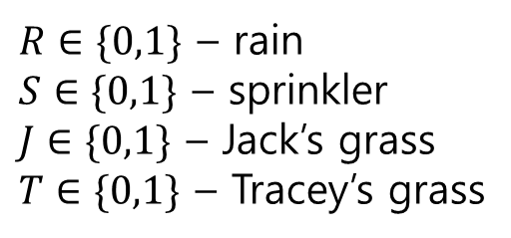
3.1.1 Modelling independencies
One morning Tracey leaves her house and realises that her grass is wet.
Is it due to overnight rain?
Or did she forget to turn off the sprinkler last night?
She notices that the grass of her neighbour, Jack, is also wet.
And she concludes that it has probably been raining.
$R∈\{0,1\}$ – rain
$S∈\{0,1\}$ – sprinkler
$J∈\{0,1\}$ – Jack’s grass
$T∈\{0,1\}$ – Tracey’s grass

Slide 4
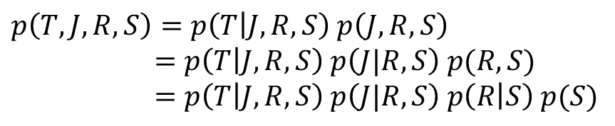
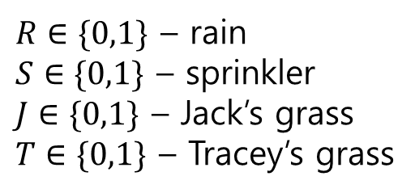
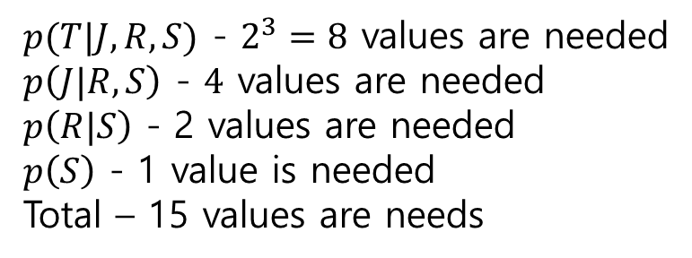
$p\left(T,J,R,S\right)=p\left(T | J,R,S\right) p\left(J,R,S\right)$ $=p\left(T | J,R,S\right) p\left(J|R,S\right) p(R,S)$
$=p\left(T | J,R,S\right) p\left(J|R,S\right) p\left(R | S\right) p(S)$
$R∈\{0,1\}$ – rain
$S∈\{0,1\}$ – sprinkler
$J∈\{0,1\}$ – Jack’s grass
$T∈\{0,1\}$ – Tracey’s grass
$p(T|J,R,S)$ - $2^{3}=8$ values are needed
$p\left(J|R,S\right)$ - $4$ values are needed
$p\left(R|S\right)$ - 2 values are needed
$p\left(S\right)$ - 1 value is needed
Total – 15 values are needs

Slide 5
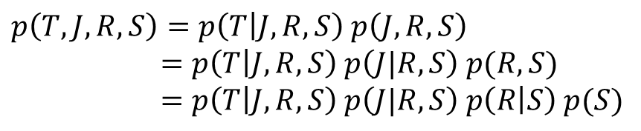
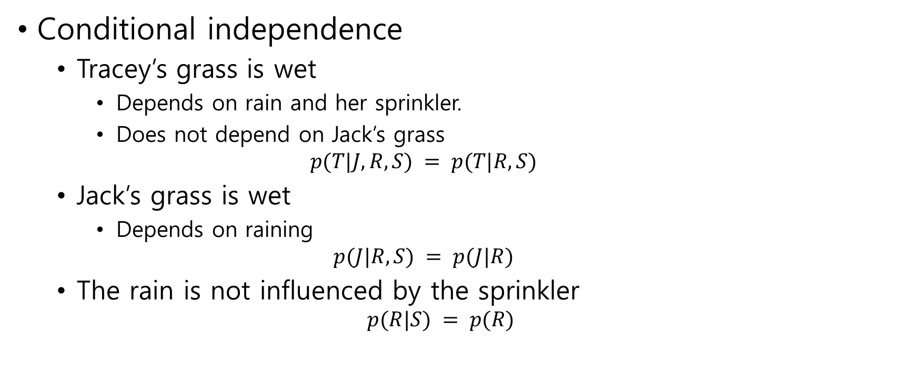

Conditional independence
Tracey’s grass is wet
Depends on rain and her sprinkler.
Does not depend on Jack’s grass $p(T|J, R, S) = p(T|R, S)$
Jack’s grass is wet
Depends on raining $p(J|R, S) = p(J|R)$
The rain is not influenced by the sprinkler $p(R|S) = p(R)$
$p\left(T,J,R,S\right)=p\left(T | J,R,S\right) p\left(J,R,S\right)$ $=p\left(T | J,R,S\right) p\left(J|R,S\right) p(R,S)$
$=p\left(T | J,R,S\right) p\left(J|R,S\right) p\left(R | S\right) p(S)$
$$p(T, J, R, S) = p(T|R, S)p(J|R)p(R)p(S)$$

Slide 6
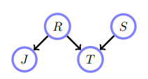


$$p(T, J, R, S) = p(T|R, S)p(J|R)p(R)p(S)$$
$4+2+1+1=8$ values are needed
Belief network structure for the
‘wet grass’ example

Slide 7

conditional probability table(CPT)
$p\left(R = 1\right)= 0.2$
$p(S = 1) = 0.1$
$p\left(J = 1 | R = 1\right)= 1$ $p(J = 1|R = 0) = 0.2$
$p\left(T = 1 | R = 1, S = 0\right)= 1$ $p(T = 1|R = 1, S = 1) = 1$ $p(T = 1|R = 0, S = 1) = 0.9$ $p(T = 1|R = 0, S = 0) = 0$

Slide 8
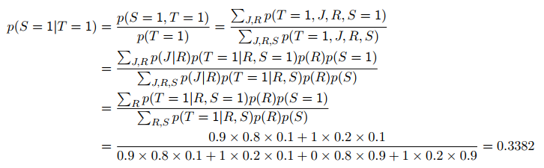
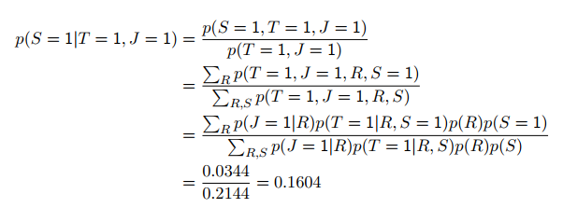

Slide 9
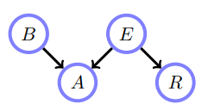
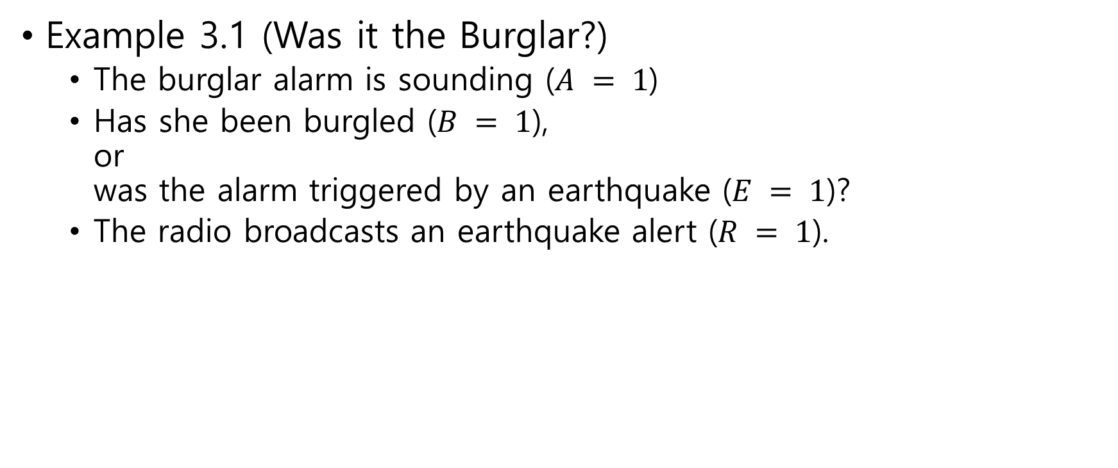
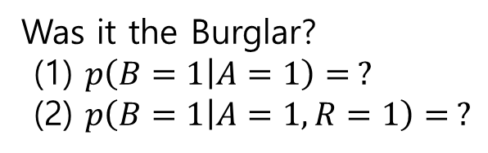
Example 3.1 (Was it the Burglar?)
The burglar alarm is sounding ($A = 1$)
Has she been burgled ($B = 1$), or was the alarm triggered by an earthquake ($E = 1$)?
The radio broadcasts an earthquake alert ($R = 1$).
Was it the Burglar?
(1) $p\left(B=1 | A=1\right)= ?$
(2) $p\left(B=1 | A=1, R=1\right)= ?$

Slide 10
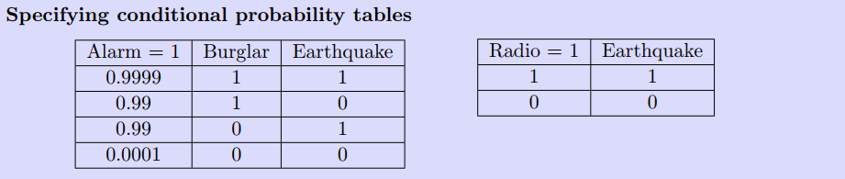
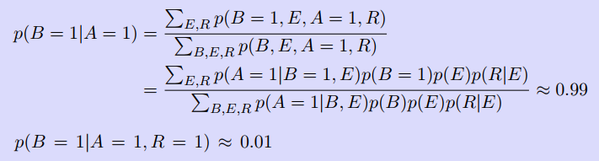
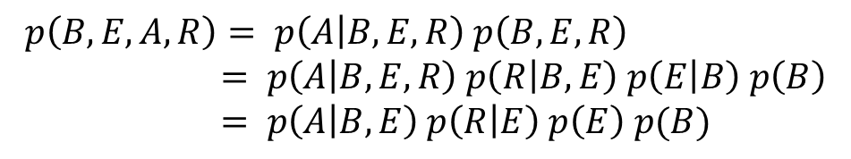
$$p\left(B, E, A, R\right)= p\left(A | B, E, R\right) p\left(B, E, R\right) \\ = p\left(A | B, E, R\right) p\left(R | B, E\right) p\left(E | B\right) p\left(B\right) \\ = p\left(A | B, E\right) p\left(R | E\right) p\left(E\right) p(B)$$

Slide 11
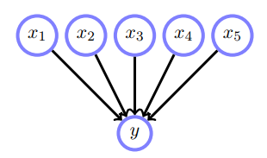
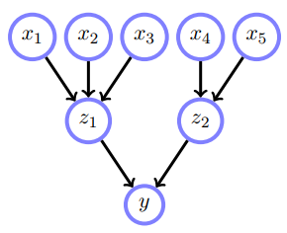

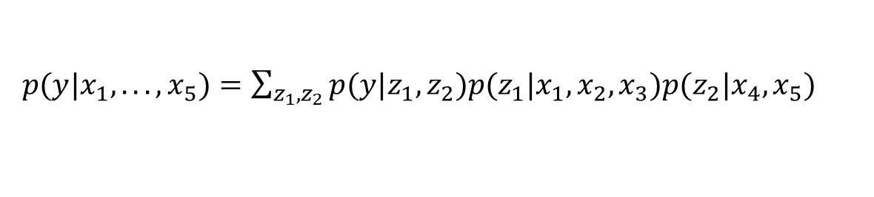

3.1.2 Reducing the burden of specification
Assume that all variables are binary
$2^{5}=32$ states
$2^{3}+2^{2}+2^{2}=16$ states
$p(y|x_{1}, . . . , x_{5})=\sum_{z_{1},z_{2}}{p(y|z_{1}, z_{2})p(z_{1}|x_{1}, x_{2}, x_{3})p(z_{2}|x_{4}, x_{5}) }$

Slide 12
3.2 Uncertain and Unreliable Evidence
3.2.1 Uncertain evidence
Soft or uncertain evidence
The strength of our belief
Example) Sally heard the burglar alarm. But we are 70% sure that the burglar alarm went off.
Hard evidence
We are certain that a variable is in a particular state.
100% or 0%

Slide 13
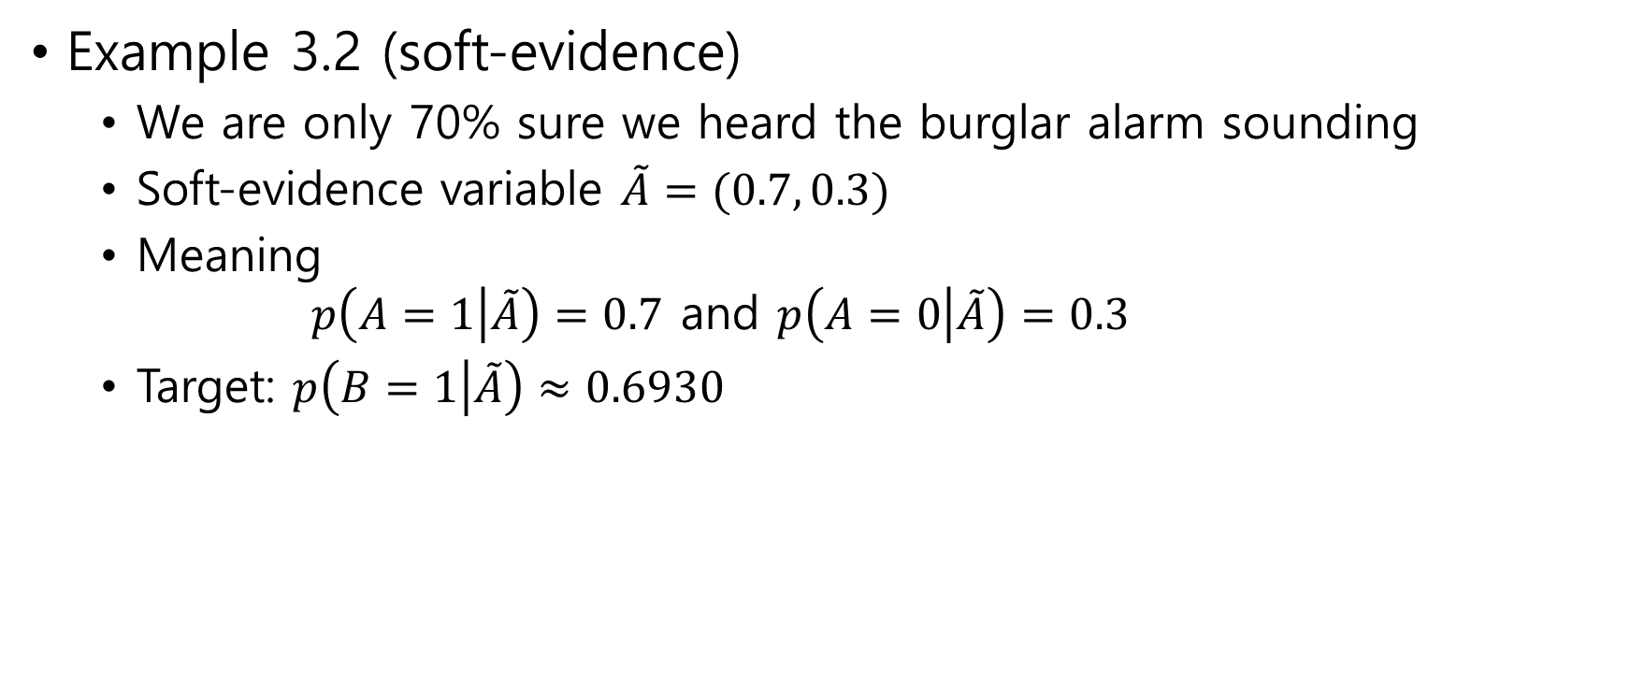
Example 3.2 (soft-evidence)
We are only 70% sure we heard the burglar alarm sounding
Soft-evidence variable $\tilde{A}=(0.7, 0.3)$
Meaning $p\left(A=1 | \tilde{A}\right)=0.7$ and $p\left(A=0 | \tilde{A}\right)=0.3$
Target: $p\left(B=1 | \tilde{A}\right)≈0.6930$

Slide 14
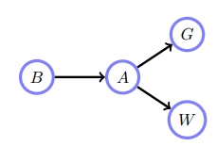
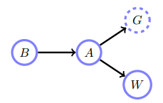
Holmes, Watson and Mrs Gibbon
Watson and Mrs Gibbon are neighbors of Holms
Watson heard the alarm is sounding
Mrs Gibbon heard the alarm
She is a little deaf and cannot be sure herself
80% sure
Was Holmes’ house burgled?
hard evidence
soft evidence

Slide 15
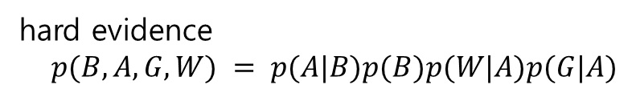
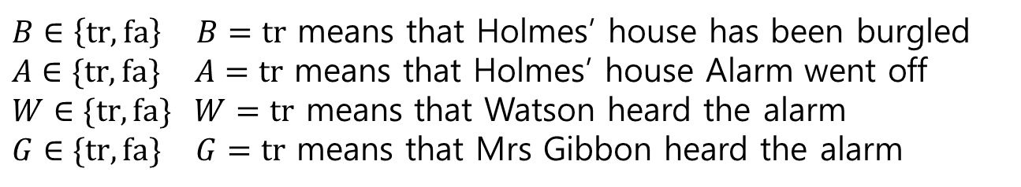

Holmes, Watson and Mrs Gibbon
$B∈\left\{tr, fa\right\}$ $B=tr$ means that Holmes’ house has been burgled
$A∈\{tr, fa\}$ $A=tr$ means that Holmes’ house Alarm went off
$W∈\{tr, fa\}$ $W=tr$ means that Watson heard the alarm
$G∈\{tr, fa\}$ $G=tr$ means that Mrs Gibbon heard the alarm
hard evidence
$p(B, A, G, W) = p(A|B)p(B)p(W|A)p(G|A)$
soft evidence
$$p\left(B=tr | W=tr, \tilde{G}\right)=p\left(B=tr | W=tr, G=tr\right) p\left(G=tr | \tilde{G}\right)+p\left(B=tr | W=tr, G=fa\right) p(G=fa|\tilde{G})$$
$p\left(G=tr | \tilde{G}\right)=0.8$, $p\left(G=fa | \tilde{G}\right)=0.2$

Slide 16
3.2.2 Unreliable evidence

Slide 17
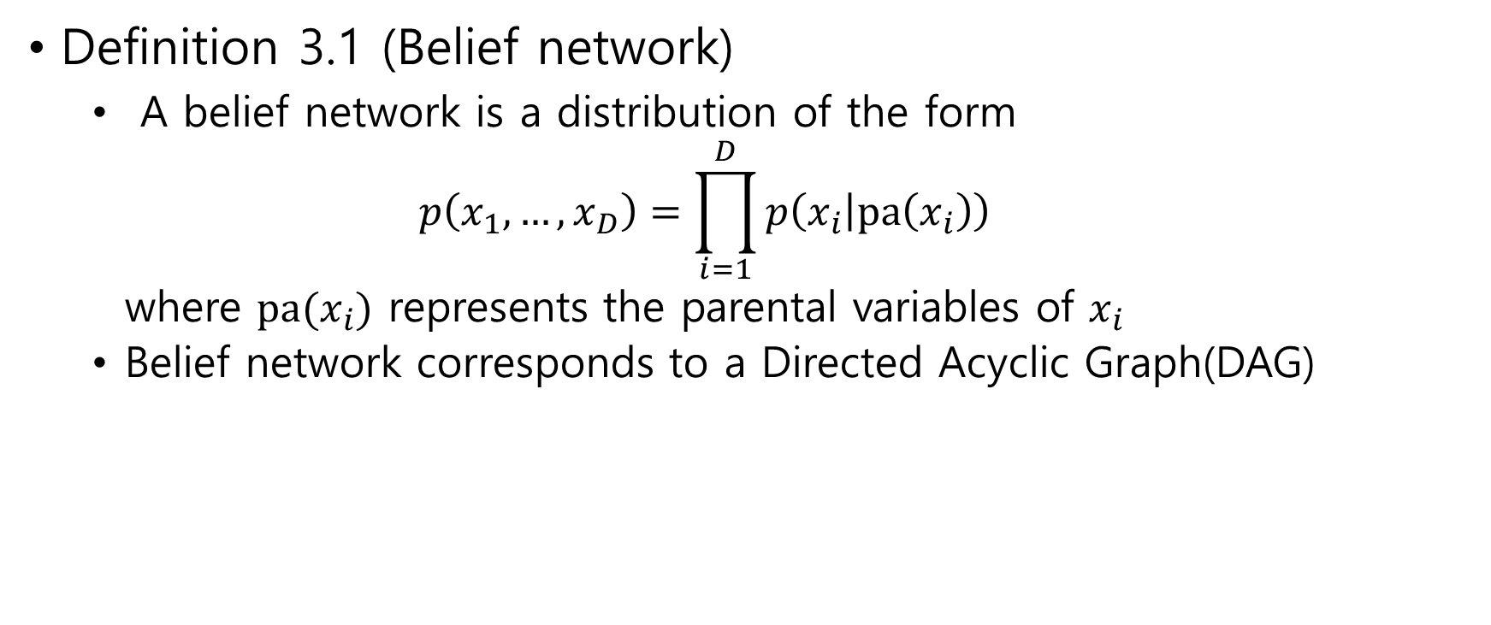
3.3 Belief Networks
Definition 3.1 (Belief network)
A belief network is a distribution of the form $p\left(x_{1},…,x_{D}\right)=\prod_{i=1}^{D}{p\left(x_{i} | pa\left(x_{i}\right)\right)}$ where $pa(x_{i})$ represents the parental variables of $x_{i}$
Belief network corresponds to a Directed Acyclic Graph(DAG)

Slide 18
Wet grass
Burglar
$$P\left(J,R,T,S\right)=p\left(J | R\right) p\left(R\right) p\left(T | R,S\right) p\left(S\right)$$
$$P\left(B,A,E,R\right)=p(B) p\left(A|B,E\right) p(E) p\left(R|E\right)$$

Slide 19
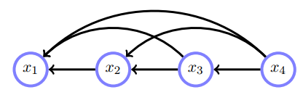
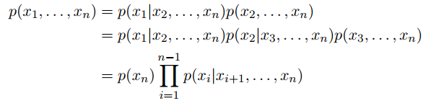

DAG may be written in the cascade form
$x_{1}=J$, $x_{2}=T$, $x_{3}=R$, $x_{4}=S$

Slide 20
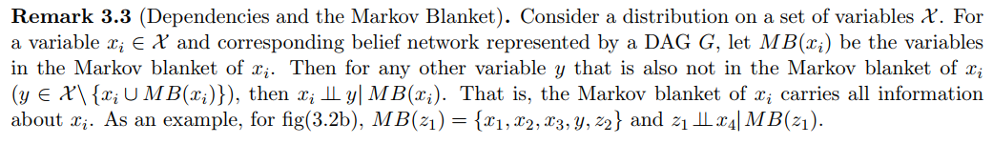
$p\left(z_{1},x_{4}|x_{1},x_{2},x_{3},y,z_{2}\right)=p\left(z_{1}|x_{1},x_{2},x_{3},y,z_{2}\right)$ $p\left(x_{4}|x_{1},x_{2},x_{3},y,z_{2}\right)$ ?

Slide 21
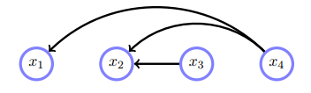
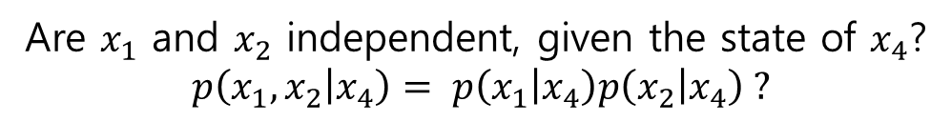
3.3.1 Conditional independence
Are $x_{1}$ and $x_{2}$ independent, given the state of $x_{4}$?
$$p\left(x_{1}, x_{2} | x_{4}\right)= p\left(x_{1} | x_{4}\right)p\left(x_{2} | x_{4}\right) ?$$

Slide 22
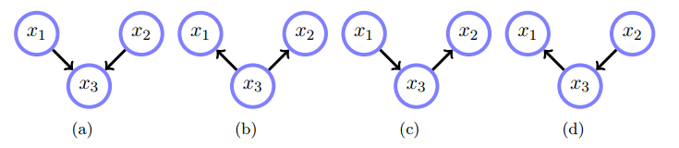
Are any of these graphs equivalent, in the sense that they represent the same distribution?
Answer: $x_{1}∐x_{2}|x_{3}$

Slide 23
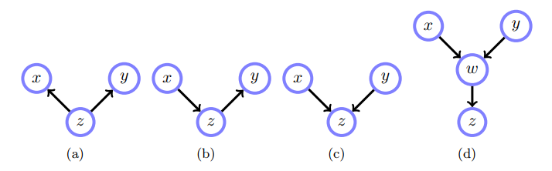

3.3.2 The impact of collisions
Definition 3.2. Given a path $𝒫$, a collider is a node $c$ on $𝒫$ with neighbours $a$ and $b$ on $𝒫$ such that $a→c←b$.

Slide 24
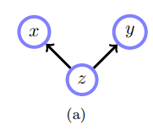
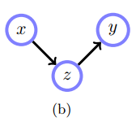

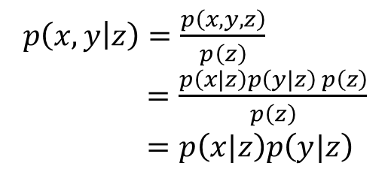

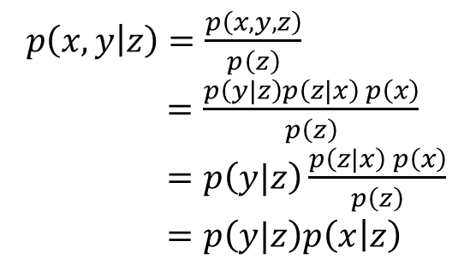
How can we check if $x∐y| z$?
$p\left(x,y | z\right)=\frac{p\left(x,y,z\right)}{p\left(z\right)}$
$=\frac{p\left(x|z\right)p\left(y|z\right) p\left(z\right)}{p\left(z\right)}$
$=p\left(x|z\right)p\left(y|z\right)$
$p\left(x,y | z\right)=\frac{p\left(x,y,z\right)}{p\left(z\right)}$
$=\frac{p\left(y|z\right)p\left(z|x\right) p\left(x\right)}{p\left(z\right)}$
$=p\left(y|z\right)\frac{p\left(z|x\right) p\left(x\right)}{p\left(z\right)}$
$=p\left(y|z\right)p\left(x | z\right)$
Independent conditioned on $z$
Independent conditioned on $z$

Slide 25
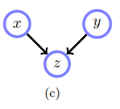
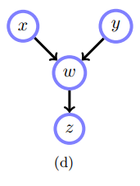


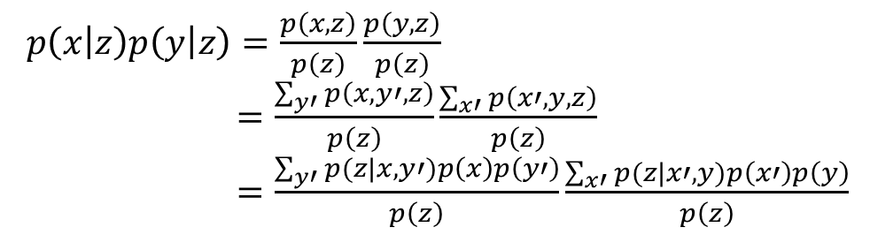
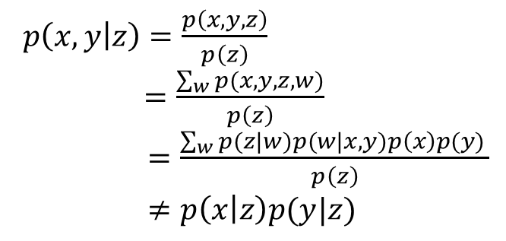
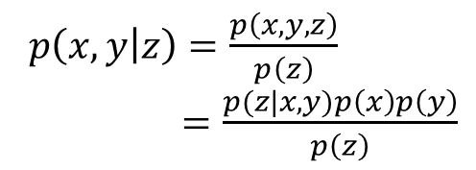
$p\left(x,y | z\right)=\frac{p\left(x,y,z\right)}{p\left(z\right)}$
$=\frac{p(z|x,y)p\left(x\right)p\left(y\right)}{p\left(z\right)}$
$p\left(x,y | z\right)=\frac{p\left(x,y,z\right)}{p\left(z\right)}$
$=\frac{\sum_{w}{p(x,y,z,w)}}{p\left(z\right)}$
$=\frac{\sum_{w}{p(z|w)p(w|x,y)p\left(x\right)p(y) }}{p\left(z\right)}$
$≠p\left(x | z\right)p(y|z)$
$p\left(x | z\right)p\left(y | z\right)=\frac{p\left(x,z\right)}{p\left(z\right)}\frac{p\left(y,z\right)}{p\left(z\right)}$
$=\frac{\sum_{y′}{p\left(x,y′,z\right)}}{p\left(z\right)}\frac{\sum_{x′}{p\left(x′,y,z\right)}}{p\left(z\right)}$
$=\frac{\sum_{y′}{p(z|x,y′)p\left(x\right)p\left(y′\right)}}{p\left(z\right)}\frac{\sum_{x′}{p(z|x′,y)p\left(x′\right)p\left(y\right)}}{p\left(z\right)}$
Graphically dependent conditioned on $z$
i.e. may not be independent
Graphically dependent conditioned on $z$
i.e. may not be independent

Slide 26
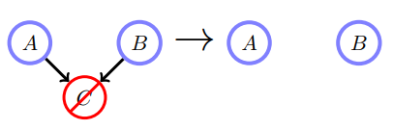
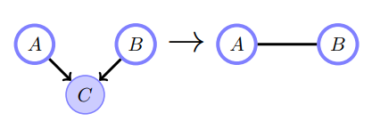


Marginalising over $C$ makes $A$ and $B$ independent.
$A$ and $B$ are independent: $p(A,B)=p(A)p(B)$
Conditioning on $C$ makes $A$ and $B$ (graphically) dependent,
in general $p\left(A, B | C\right)≠p\left(A | C\right) p\left(B | C\right)$

Slide 27
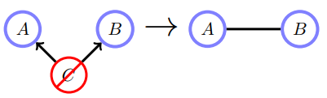
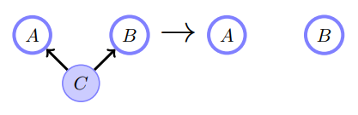


Marginalising over $C$ makes $A$ and $B$ dependent.
in general $p\left(A,B\right)≠p(A)p(B)$
Conditioning on $C$ makes $A$ and $B$ independent:
$$p(A, B|C)=p(A|C)p(B|C)$$

Slide 28
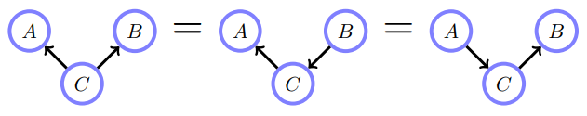
These graphs all express the same
conditional independence assumptions

Slide 29
3.3.3 Graphical path manipulations for independence

Slide 30
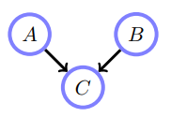
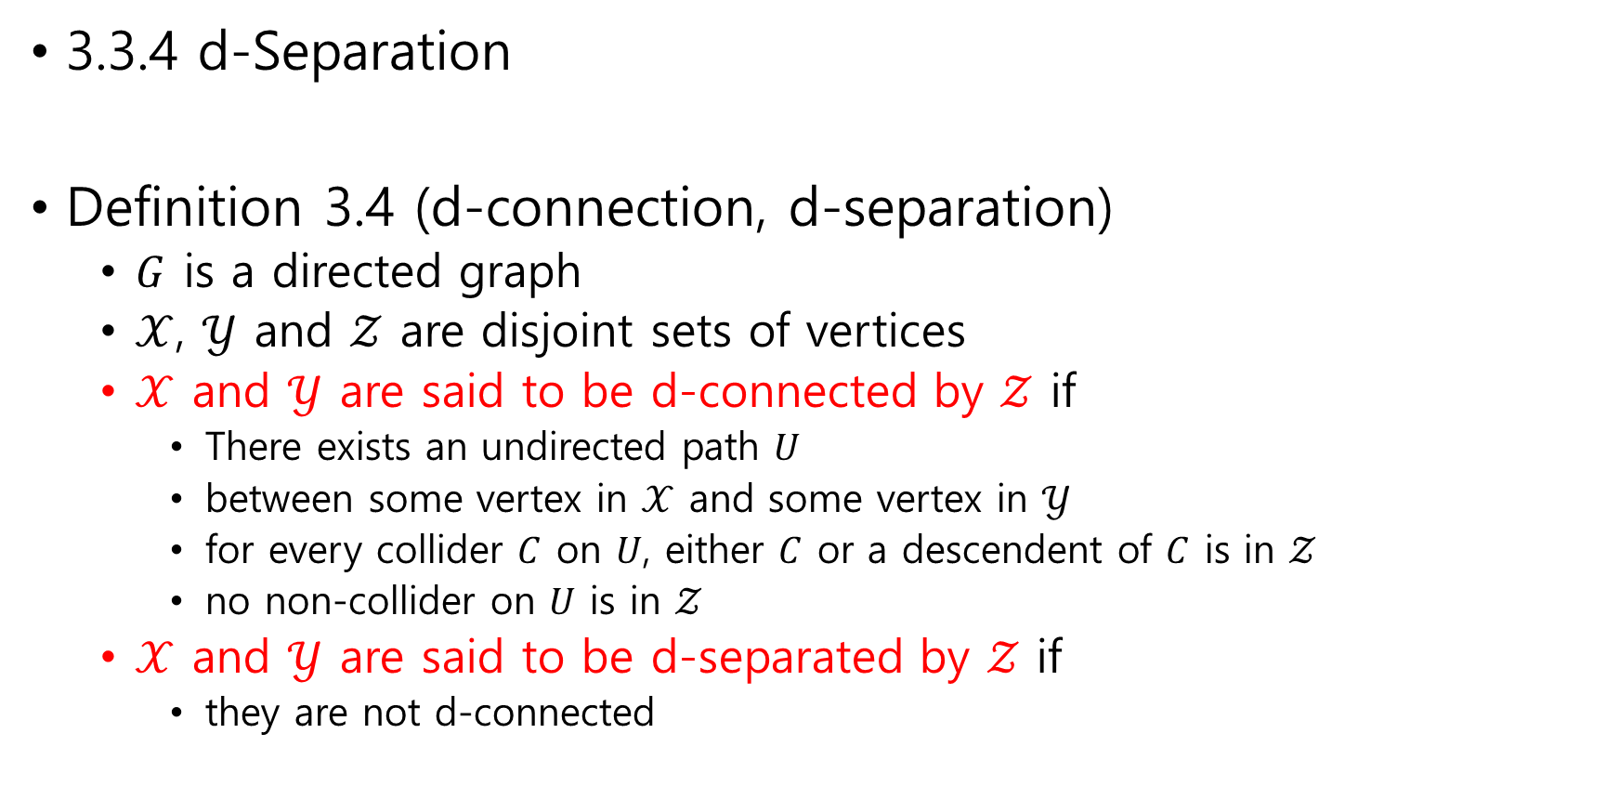
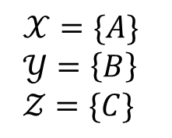
3.3.4 d-Separation
Definition 3.4 (d-connection, d-separation)
$G$ is a directed graph
$𝒳$, $𝒴$ and $𝒵$ are disjoint sets of vertices
$𝒳$ and $𝒴$ are said to be d-connected by $𝒵$ if
There exists an undirected path $U$
between some vertex in $𝒳$ and some vertex in $𝒴$
for every collider $C$ on $U$, either $C$ or a descendent of $C$ is in $𝒵$
no non-collider on $U$ is in $𝒵$
$𝒳$ and $𝒴$ are said to be d-separated by $𝒵$ if
they are not d-connected
$𝒳=\{A\}$
$𝒴=\left\{B\right\}$
$𝒵=\{C\}$

Slide 31







$𝒳$ and $𝒴$ are d-separated by $𝒵$ ⇒ $𝒳\coprod{𝒴}| 𝒵$
$𝒳=\{A\}$, $𝒴=\left\{B\right\}$, $𝒵=\left\{C\right\}$
Are $𝒳$ and $𝒴$ d-connected by $𝒵$?
$t$ and $f$ are
d-connected by $g$
$b$ and $f$ are
d-separated by $u$

Slide 32

3.3.5 Graphical and distributional in/dependence
Graphical independence $⇒$ distributional independence
Graphical dependence $⇒$ distributional dependence ?
Example $a→c←b ⇒ a\coprod{b}$, $a∏c$ and $b∏c$ graphically, not distributionally $dom\left(a\right)=dom\left(b\right)=dom\left(c\right)=\{0,1\}$ (1) $p_{1}\left(c=1 | a,b\right)={\left(a−b\right)}^{2}$, $p_{1}\left(a=1\right)=0.3$, $p_{1}\left(b=1\right)=0.4$ $⇒ a\coprod{b}$, $a∏c$, $b∏c$ (2) $p_{2}\left(c=1 | a,b\right)=0.5$, $p_{2}\left(a=1\right)=0.3$, $p_{2}\left(b=1\right)=0.4$ $⇒ a\coprod{b}$, $a\coprod{c}$, $b\coprod{c}$

Slide 33

Example 3.3
$t∐f|∅$ ? $t$ and $f$ are d-separated (by $∅$)
$t∐f|g$ ? $t$ and $f$ are d-connected by $g$

Slide 34

Example 3.4
$\{b,f\}∐u|∅$ ? $\left\{b,f\right\}$ and $u$ are d-separated (by $∅$)

Slide 35

3.3.6 Markov equivalence in belief networks
Possible independence statements
$x_{1}∐x_{2}$, $x_{1}∐x_{2}|x_{3}$
$x_{1}∐x_{3}$, $x_{1}∐x_{3}|x_{2}$
$x_{2}∐x_{3}$, $x_{2}∐x_{3}|x_{2}$
$$\left\{x_{1},x_{2}\right\}{∐x}_{3}$$
$$\left\{x_{1},x_{3}\right\}{∐x}_{2}$$
$$\left\{x_{2},x_{3}\right\}{∐x}_{1}$$
Definition 3.5 (Markov equivalence).
Two graphs are Markov equivalent if
they represent the same set of conditional independence statements.

Slide 36
Procedure 3.1 (Markov equivalence)
Three nodes, A, B, C are immoral if
C is a child of both A and B
A and B not directly connected
skeleton of a graph
removing the directions on the arrows
Two DAGs represent the same set of independence assumptions if and only if they have the same skeleton and the same set of immoralities

Slide 37




3.4 Causality
3.4.1 Simpson’s paradox
A model of Gender, Drug and Recovery
$$p(G, D, R) = p(R|G, D)p(D|G)p(G)$$
$$p\left(R | D=tr\right)=0.5$$
$$p\left(R | D=fa\right)=0.4$$
Modified model
$$p(G, D, R) = p(R|G, D)p(D|G)p(G)$$
$$p\left(D | G\right)=0.5$$

Slide 38


Modified model
$$p(G, D, R) = p(R|G, D)p(D|G)p(G)$$
$$p\left(D | G\right)=0.5$$
$P\left(R=tr | D=tr\right)=\frac{p\left(D=tr,R=tr\right)}{p\left(D=tr\right)}$
$=\frac{\sum_{G}{p\left(G,R=tr, D=tr\right)}}{\sum_{G,R}{p\left(G,R, D=tr\right)}}$ $=\frac{\sum_{G}{p(R=tr|G,D=tr)p(D=tr|G)p\left(G\right)}}{\sum_{G,R}{p(R|G,D=tr)p(D=tr|G)p\left(G\right)}}$ $=\frac{p\left(R=tr \right|G=ma,D=tr) p\left(D=tr\right|G=ma) p\left(G=ma\right)+p(R=tr|G=fe,D=tr) p(D=tr|G=fe) p(G=fe)}{\sum_{G}{p(D=tr|G) p(G)}}$ $=\frac{0.6 ×0.5×0.5+0.2×0.5×0.5}{0.5×0.5+0.5×0.5 }$ $=0.4$
$P\left(R=tr | D=fa\right)=0.5$

Slide 39



Summary
$$p\left(x_{1},…,x_{D}\right)=\prod_{i=1}^{D}{p\left(x_{i} | pa\left(x_{i}\right)\right)}$$
Belief network
Collider
$𝒳$ and $𝒴$ are d-separated by $𝒵$ ⇒ $𝒳\coprod{𝒴}| 𝒵$
Markov equivalence: Two DAGs represent the same set of independence assumptions if and only if they have the same skeleton and the same set of immoralities
$$p\left(A, B | C\right)≠p\left(A | C\right) p\left(B | C\right)$$

Slide 40



3.7 Exercises
$p\left(P=tr | A=tr, H=tr\right)=$ ?

Slide 41


Exercise 3.3
State if the following conditional independence relationships are true or false
1. $t ∐ s | d$
2. $l ∐ b | s$
3. $a ∐ s | l$
4. $a ∐ s | \{l,d\}$

